Slide 1

Welcome To Titanium!
CodeFab– Apr 30, 2011
Ben Bahrenburg
Appcelerator Titan
E-Mail: ben.bahrenburg@gmail.com
Twitter: @benCoding

Slide 2
Agenda
Titanium Overview
Getting Started
Demos
Q&A

Slide 3

Titanium enables web developers to create native mobile, desktop, and tablet applications using open web technologies (JavaScript, HTML, and CSS)
Key Facts:
Open Source (Apache 2.0)
Pro Services, Training, Analytics and SLA Support available from Appcelerator
Mobile Platforms: iOS, Android, and BlackBerry (beta)
Desktop Platforms: Windows, OS X, and Linux

Slide 4
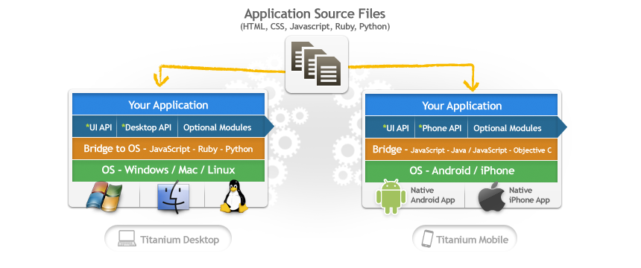
Titanium from 10,000 Feet
Desktop:
HTML 5/ CSS 3 for UI (Webkit)
JavaScript, Ruby, PHP or Python for scripting
Mobile:
JavaScript APIs for UI (Native)
JavaScript for scripting
WebView available, but not required

Slide 5








Platform Features
Native User Experience
Native performance + Native UI
(tables, animations, gestures…etc.)
Multimedia
Camera, video camera,
streaming/device audio/video
Location-based services
Augmented reality, geo-location, compass, native maps
Analytics
Custom analytics baked into every application, track usage patterns and adoption
Social sharing
Authenticated access to Facebook, Twitter, Yahoo YQL.
Native email/address book
Titanium+Plus
Encrypted database, ecommerce, ads, barcode scanners, custom analytics, in-app purchase
Data
Local SQLite data store, web services, lightweight key/value store
Development tools
Create, test, and publish your app using the same tools across platforms

Slide 6
Under the Covers
JavaScript is statically analyzed, native project stub generated
JavaScript precompiled to bytecode (Android) or inlined in a generated C file (iOS)
JavaScript and native code bindings are shipped along with JavaScriptCore (iOS) or Rhino (Android) to interpret JS code at runtime

Slide 7
Getting Started
Zero-to-App

Slide 8
Getting Setup
1
Install your favorite mobile SDK
- iOS, Android or both
2
Read getting started guide
- Available on developer.appcelerator.com
3
Download & install the Titanium Tools
- Available on developer.appcelerator.com
4
Download Kitchen Sink Sample App
- Available on github, links on developer.appcelerator.com

Slide 9

Getting Help
developer.appcelerator.com
Documentation, Video Tutorials, Q&A, and more
support.appcelerator.com
Pro & Enterprise paid support
Community
Extremely active Twitter, IRC, and blogging community
Books
- Two books coming out this fall
bit.ly/CodeFabAppcelerator for more

Slide 10
Demos

Slide 11
Tweetanium
A “real” application

Slide 12
Q&A

Slide 13
Contact
Ben Bahrenburg
Appcelerator Titan
ben.bahrenburg@gmail.com
@benCoding

