Slide 1
ARM Assembly Programming
Computer Organization and Assembly Languages
Yung-Yu Chuang
2007/12/1
with slides by Peng-Sheng Chen

Slide 2
GNU compiler and binutils
HAM uses GNU compiler and binutils
  gcc: GNU C compiler
  as: GNU assembler
  ld: GNU linker
  gdb: GNU project debugger
  insight: a (Tcl/Tk) graphic interface to gdb

Slide 3
Pipeline
COFF (common object file format)
ELF (extended linker format)
Segments in the object file
  Text: code
  Data: initialized global variables
  BSS: uninitialized global variables
gcc
as
Simulator
Debugger
…
.c
.s
.coff
ld
.elf
C source
asm source
object file
executable

Slide 4
GAS program format
.file “test.s”
.text
.global main
.type main, %function
main:
MOV R0, #100
ADD R0, R0, R0
SWI #11
.end

Slide 5
GAS program format
.file “test.s”
.text
.global main
.type main, %function
main:
MOV R0, #100
ADD R0, R0, R0
SWI #11
.end
export variable
set the type of a
symbol to be
either a function
or an object
signals the end
of the program
call interrupt to
end the program

Slide 6
ARM assembly program
label
operation
operand
comments
main:
LDR R1, value @ load value
STR R1, result
SWI #11
value: .word 0x0000C123
result: .word 0

Slide 7
Control structures
Program is to implement algorithms to solve problems. Program decomposition and flow of control are important concepts to express algorithms.
Flow of control:
  Sequence.
  Decision: if-then-else, switch
  Iteration: repeat-until, do-while, for
Decomposition: split a problem into several smaller and manageable ones and solve them independently. (subroutines/functions/procedures)

Slide 8
Decision
If-then-else
switch

Slide 9
If statements
if then else
BNE else
B endif
else:
endif:
C
T
E
// find maximum
if (R0>R1) then R2:=R0
else R2:=R1
C
T
E

Slide 10
If statements
if then else
BNE else
B endif
else:
endif:
C
T
E
// find maximum
if (R0>R1) then R2:=R0
else R2:=R1
C
CMP R0, R1
BLE else
MOV R2, R0
B endif
else: MOV R2, R1
endif:
T
E

Slide 11
If statements
// find maximum
if (R0>R1) then R2:=R0
else R2:=R1
Two other options:
CMP R0, R1
MOVGT R2, R0
MOVLE R2, R1
MOV R2, R0
CMP R0, R1
MOVLE R2, R1
CMP R0, R1
BLE else
MOV R2, R0
B endif
else: MOV R2, R1
endif:

Slide 12
If statements
if (R1==1 || R1==5 || R1==12) R0=1;
TEQ R1, #1 ...
TEQNE R1, #5 ...
TEQNE R1, #12 ...
MOVEQ R0, #1 BNE fail

Slide 13
If statements
if (R1==0) zero
else if (R1>0) plus
else if (R1<0) neg
TEQ R1, #0
BMI neg
BEQ zero
BPL plus
neg: ...
B exit
Zero: ...
B exit
...

Slide 14
If statements
R0=abs(R0)
TEQ R0, #0
RSBMI R0, R0, #0

Slide 15
Multi-way branches
CMP R0, #`0’
BCC other @ less than ‘0’
CMP R0, #`9’
BLS digit @ between ‘0’ and ‘9’
CMP R0, #`A’
BCC other
CMP R0, #`Z’
BLS letter @ between ‘A’ and ‘Z’
CMP R0, #`a’
BCC other
CMP R0, #`z’
BHI other @ not between ‘a’ and ‘z’
letter: ...

Slide 16
Switch statements
switch (exp) {
case c1: S1; break;
case c2: S2; break;
...
case cN: SN; break;
default: SD;
}
e=exp;
if (e==c1) {S1}
else
if (e==c2) {S2}
else
...

Slide 17
Switch statements
switch (R0) {
case 0: S0; break;
case 1: S1; break;
case 2: S2; break;
case 3: S3; break;
default: err;
}
CMP R0, #0
BEQ S0
CMP R0, #1
BEQ S1
CMP R0, #2
BEQ S2
CMP R0, #3
BEQ S3
err: ...
B exit
S0: ...
B exit
The range is between 0 and N
Slow if N is large

Slide 18
Switch statements
ADR R1, JMPTBL
CMP R0, #3
LDRLS PC, [R1, R0, LSL #2]
err:...
B exit
S0: ...
JMPTBL:
.word S0
.word S1
.word S2
.word S3
What if the range is between
M and N?
For larger N and sparse values,
we could use a hash function.
R1
JMPTBL
S0
R0
S1
S2
S3

Slide 19
Iteration
repeat-until
do-while
for

Slide 20
repeat loops
do { } while ( )
loop:
BEQ loop
endw:
S
C
S
C

Slide 21
while loops
while ( ) { }
loop:
BNE endw
B loop
endw:
B test
loop:
test:
BEQ loop
endw:
C
S
C
S
S
C

Slide 22
while loops
while ( ) { }
B test
loop:
test:
BEQ loop
endw:
BNE endw
loop:
test:
BEQ loop
endw:
C
S
C
S
S
C
C

Slide 23
GCD
int gcd (int i, int j)
{
while (i!=j)
{
if (i>j)
i -= j;
else
j -= i;
}
}

Slide 24
GCD
Loop: CMP R1, R2
SUBGT R1, R1, R2
SUBLT R2, R2, R1
BNE loop

Slide 25
for loops
for ( ; ; ) { }
loop:
BNE endfor
B loop
endfor:
for (i=0; i<10; i++)
{ a[i]:=0; }
I
C
A
S
I
C
S
A

Slide 26
for loops
for ( ; ; ) { }
loop:
BNE endfor
B loop
endfor:
for (i=0; i<10; i++)
{ a[i]:=0; }
I
C
A
S
I
C
MOV R0, #0
ADR R2, A
MOV R1, #0
loop: CMP R1, #10
BGE endfor
STR R0,[R2,R1,LSL #2]
ADD R1, R1, #1
B loop
endfor:
S
A

Slide 27
for loops
for (i=0; i<10; i++)
{ do something; }
Execute a loop for a
constant of times.
MOV R1, #0
loop: CMP R1, #10
BGE endfor
@ do something
ADD R1, R1, #1
B loop
endfor:
MOV R1, #10
loop:
@ do something
SUBS R1, R1, #1
BNE loop
endfor:

Slide 28
Procedures
Arguments: expressions passed into a function
Parameters: values received by the function
Caller and callee
void func(int a, int b)
{
...
}
int main(void)
{
func(100,200);
...
}
callee
parameters
caller
arguments

Slide 29
Procedures
main:
...
BL func
...
.end
func:
...
...
.end
How to pass arguments? By registers? By stack? By memory? In what order?

Slide 30
Procedures
main:
@ use R5
BL func
@ use R5
...
...
.end
caller
func:
...
@ use R5
...
...
.end
callee
How to pass arguments? By registers? By stack? By memory? In what order?
Who should save R5? Caller? Callee?

Slide 31
Procedures (caller save)
main:
@ use R5
@ save R5
BL func
@ restore R5
@ use R5
.end
caller
func:
...
@ use R5
.end
callee
How to pass arguments? By registers? By stack? By memory? In what order?
Who should save R5? Caller? Callee?

Slide 32
Procedures (callee save)
main:
@ use R5
BL func
@ use R5
.end
caller
func: @ save R5
...
@ use R5
@restore R5
.end
callee
How to pass arguments? By registers? By stack? By memory? In what order?
Who should save R5? Caller? Callee?

Slide 33
Procedures
main:
@ use R5
BL func
@ use R5
...
...
.end
caller
func:
...
@ use R5
...
...
.end
callee
How to pass arguments? By registers? By stack? By memory? In what order?
Who should save R5? Caller? Callee?
We need a protocol for these.

Slide 34
ARM Procedure Call Standard (APCS)
ARM Ltd. defines a set of rules for procedure entry and exit so that
  Object codes generated by different compilers can be linked together
  Procedures can be called between high-level languages and assembly
APCS defines
  Use of registers
  Use of stack
  Format of stack-based data structure
  Mechanism for argument passing

Slide 35
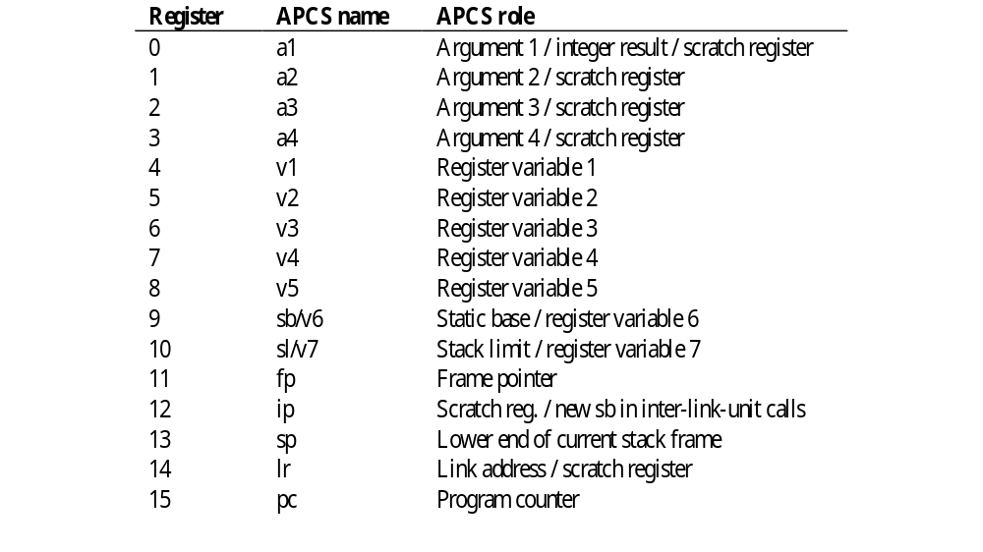
APCS register usage convention

Slide 36
APCS register usage convention
Used to pass the first 4 parameters
Caller-saved if necessary

Slide 37
APCS register usage convention
Register variables, must return unchanged
Callee-saved

Slide 38
APCS register usage convention
Registers for special purposes
Could be used as temporary variables if saved properly.

Slide 39
Argument passing
The first four word arguments are passed through R0 to R3.
Remaining parameters are pushed into stack in the reverse order.
Procedures with less than four parameters are more effective.

Slide 40
Return value
One word value in R0
A value of length 2~4 words (R0-R1, R0-R2, R0-R3)

Slide 41
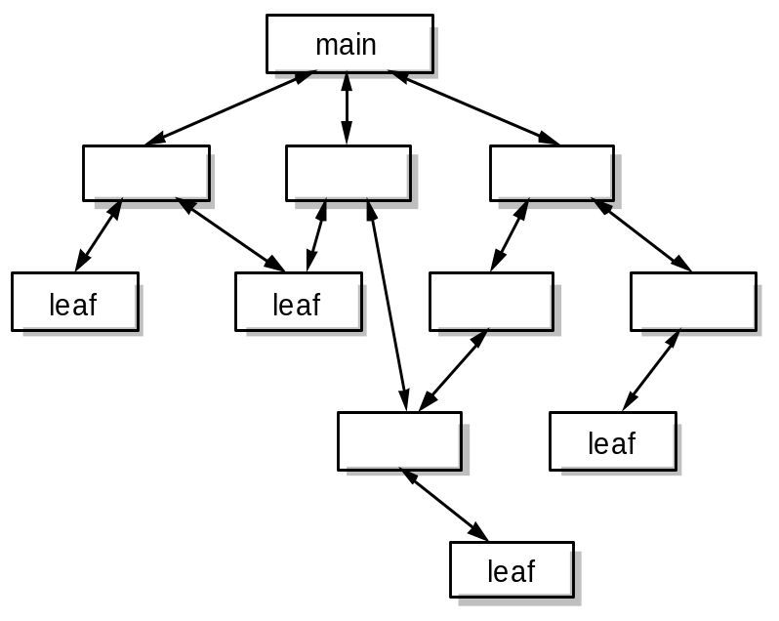
Function entry/exit
A simple leaf function with less than four parameters has the minimal overhead. 50% of calls are to leaf functions
BL leaf1
...
leaf1: ...
...
MOV PC, LR @ return

Slide 42
Function entry/exit
Save a minimal set of temporary variables
BL leaf2
...
leaf2: STMFD sp!, {regs, lr} @ save
...
LDMFD sp!, {regs, pc} @ restore and
@ return

Slide 43
Standard ARM C program address space
application
load address
code
application image
top of application
static data
heap
top of heap
stack limit (sl)
stack pointer (sp)
stack
top of memory

Slide 44
Accessing operands
A procedure often accesses operands in the following ways
  An argument passed on a register: no further work
  An argument passed on the stack: use stack pointer (R13) relative addressing with an immediate offset known at compiling time
  A constant: PC-relative addressing, offset known at compiling time
  A local variable: allocate on the stack and access through stack pointer relative addressing
  A global variable: allocated in the static area and can be accessed by the static base relative (R9) addressing

Slide 45
Procedure
low
main:
LDR R0, #0
...
BL func
...
high
stack

Slide 46
Procedure
low
func: STMFD SP!, {R4-R6, LR}
SUB SP, SP, #0xC
...
STR R0, [SP, #0] @ v1=a1
...
ADD SP, SP, #0xC
LDMFD SP!, {R4-R6, PC}
v1
v2
v3
R4
R5
R6
LR
high
stack

