Slide 1
WEB DEVELOPMENT & DESIGN FOUNDATIONS WITH HTML5
Chapter 14
Key Concepts
Copyright © Terry Felke-Morris

Slide 2
WHAT IS JAVASCRIPT?
Object-based scripting language
Works with the objects associated with a Web page document
  the window
  the document
  the elements
    such as forms, images, hyperlinks, etc

Slide 3
WHAT IS JAVASCRIPT?
Originally developed by Netscape
  Named LiveScript
Netscape & Sun Microsystems Collaboration
  LiveScript renamed JavaScript
JavaScript is NOT Java

Slide 4
COMMON USES OF JAVASCRIPT
Display a message box
Select list navigation
Edit and validate form information
Create a new window with a specified size and screen position
Image Rollovers
Status Messages
Display Current Date
Calculations

Slide 5
CODING JAVASCRIPT
JavaScript statements can be coded on a web page using two different techniques:
  Place JavaScript code between <script> tags
  Place JavaScript code as part of an event attached to an HTML element

Slide 6
JAVASCRIPT: USING THE SCRIPT ELEMENT
The script element
  A container tag
  May be placed in either the head or the body section of a web page
<script type="text/javascript">
<!- -
alert("Welcome to Our Site");
// - ->
</script>

Slide 7
HANDS-ON PRACTICE 14.1
Page 548
chapter14/alert.html

Slide 8
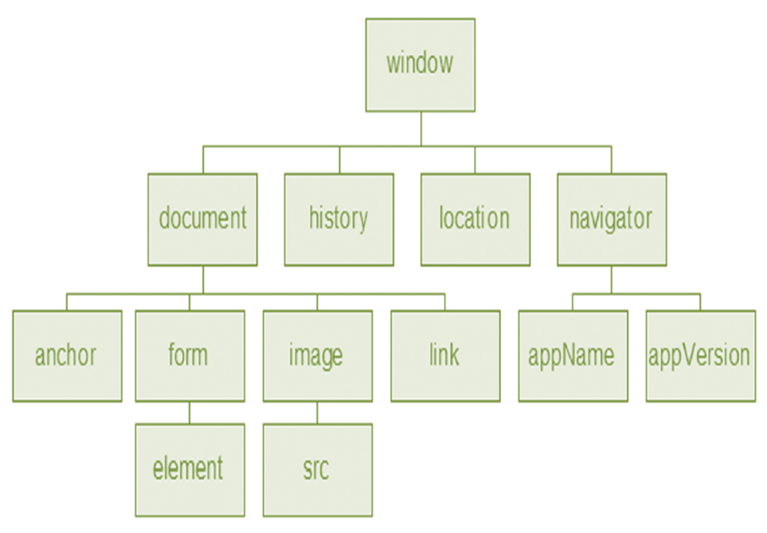
DOCUMENT OBJECT MODEL (DOM)
A portion of the DOM is shown at the left.
Defines every object and element on a web page
Hierarchical structure
Accesses page elements and apply styles to page elements

Slide 9
OBJECT
An object is a thing or entity.
  Browser window
  Submit button
  Web page document

Slide 10
PROPERTY
A property is a characteristic or attribute of an object.
  The background color of a web page document
  document.bgcolor
  The date the web page file was last modified
  document.lastmodified
  The src file of an image object
  image1.src

Slide 11
METHOD
A method is an action (a verb)
  Writing text to a web page document
    document.write()
  Submitting a form
  form1.submit()

Slide 12
HANDS-ON PRACTICE 14.2
Page 551
chapter14/documentwrite.html

Slide 13
JAVASCRIPT AND EVENTS
Events:
actions taken by the web page visitor
  clicking (onclick),
  placing the mouse on an element (onmouseover),
  removing the mouse from an element (onmouseout),
  loading the page (onload),
  unloading the page (onunload), etc.

Slide 14
EVENTS
Event | Event Handler
click | onclick
load | onload
mouseover | onmouseover
mouseout | onmouseout
submit | onsubmit
unload | onunload

Slide 15
HANDS-ON PRACTICE 14.3
Page 553
chapter14/mouseovertest.html

Slide 16
JAVASCRIPT AND EVENTS
JavaScript can be configured to perform actions when events occur.
  The event name is coded as an attribute of an HTML tag
  The value of the event attribute contains the JavaScript code
Example:
Display an alert box when the mouse is placed over a hyperlink.
<a href="home.htm" onmouseover="alert('Click to go home')">Home</a>

Slide 17
JAVASCRIPT DEBUGGING(1)
Check the syntax of the statements
  Pay very close attention to upper and lower case letters, spaces, and quotations
Verify that you have saved the page with your most recent changes
Verify that you are testing the most recent version of the page (refresh or reload the page)
If you get an error message, use the error messages that are displayed by the browser
  In Firefox: Select Tools > Error Console

Slide 18
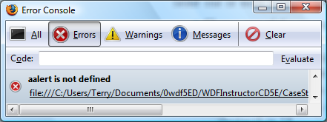
JAVASCRIPT DEBUGGING(2)
Use the Firefox browser:
  Select Tools > Error Console from the Menu
    The Error Console will indicate an issue and the line number
    This may not be exactly where the problem is
    Sometimes the error is a one or two lines above the indicated line number.

Slide 19
VARIABLE
A variable is a placeholder for information.
The variable is stored in the computer’s memory (RAM).
var userName;
userName = "Karen";
document.write(userName);

Slide 20
HANDS-ON PRACTICE 14.4
Page 556
chapter14/variablewrite.html
Page 557
chapter14/variablewrite2.html

Slide 21
PROMPTS
prompt() method
  Displays a message and accepts a value from the user
  myName = prompt(“prompt message”);
  The value typed by the user is stored in the variable myName

Slide 22
HANDS-ON PRACTICE 14.5
Page 558
chapter14/variablewrite3.html
chapter14/changebackground.html

