Slide 1
WEB DEVELOPMENT & DESIGN FOUNDATIONS WITH HTML5
Chapter 2
Key Concepts
Copyright © Terry Felke-Morris

Slide 2
WHAT IS HTML?
HTML:
The set of markup symbols or codes placed in a file intended for display on a Web browser page.
The World Wide Web Consortium (http://w3c.org) sets the standards for HTML and its related languages.

Slide 3
HTML ELEMENTS
Each markup code represents an HTML element .
Each element has a purpose.
Most elements are coded as a pair of tags:
an opening tag and a closing tag.
Tags are enclosed in angle brackets, "<" and ">" symbols.

Slide 4
WHAT IS XHTML?
The most recent standard version of HTML
eXtensible HyperText Markup Language.
XHTML uses:
  the elements and attributes of HTML
  the syntax of XML (eXtensible Markup Language).

Slide 5
XML SYNTAX
An XML document must be well-formed.
  Use lowercase
  Use opening and closing tags
  <body> </body>
  Close stand-alone tag with special syntax
  <hr />

Slide 6

WHAT IS HTML5 ?
Newest draft version of HTML/XHTML
Supported by modern browsers
  Safari, Google Chrome, Firefox, Internet Explorer 9
Intended to be backwards compatible
Adds new elements
Adds new functionality
  Edit form data
  Native video and audio
  And more!

Slide 7
DOCUMENT TYPE DEFINITION
Document Type Definition (DTD)
  doctype statement
  identifies the version of HTML contained in your document.
  placed at the top of a web page document

Slide 8
DTD EXAMPLES
XHTML 1.0 Transitional DTD
<!DOCTYPE html PUBLIC "-//W3C//DTD XHTML 1.0 Transitional//EN"
http://www.w3.org/TR/xhtml1/DTD/xhtml1-transitional.dtd>
HTML5 DTD
<!DOCTYPE html>

Slide 9
EXAMPLE XHTML WEB PAGE
<!DOCTYPE html PUBLIC "-//W3C//DTD XHTML 1.0 Transitional//EN"
"http://www.w3.org/TR/xhtml1/DTD/xhtml1-transitional.dtd">
<html xmlns="http://www.w3.org/1999/xhtml" lang="en" xml:lang="en">
<head>
<title>Page Title Goes Here</title>
<meta http-equiv="Content-Type" content="text/html; charset=utf-8" />
</head>
<body>
... body text and more XHTML tags go here ...
</body>
</html>

Slide 10
EXAMPLE HTML5 WEB PAGE
<!DOCTYPE html>
<html lang="en">
<head>
<title>Page Title Goes Here</title>
<meta charset="utf-8">
</head>
<body>
... body text and more HTML5 tags go here ...
</body>
</html>

Slide 11
HEAD & BODY SECTIONS
Head Section
Contains information that describes the Web page document
  <head>
  …head section info goes here
  </head>
Body Section
Contains text and elements that display in the Web page document
<body>
  …body section info goes here
  </body>

Slide 12
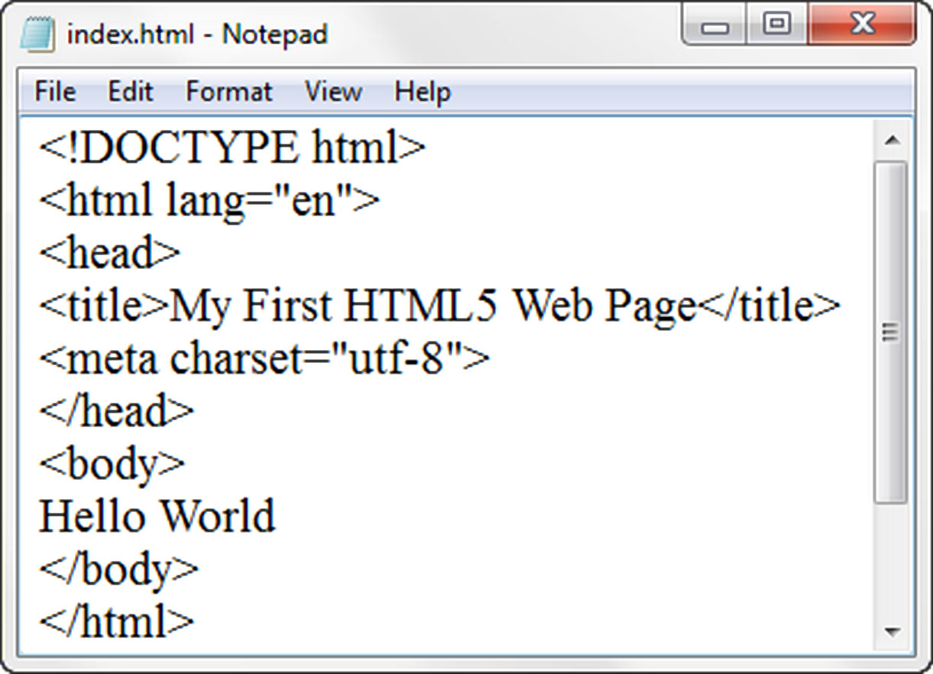
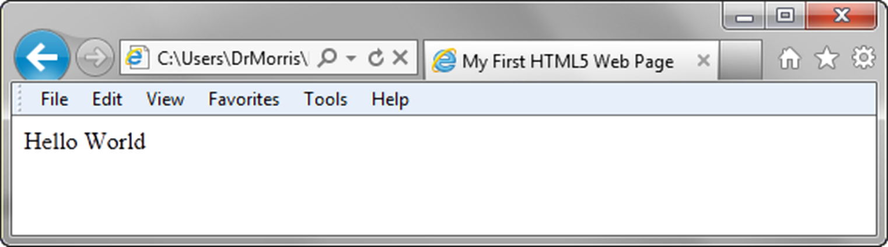
TITLE ELEMENT
META ELEMENT

