Slide 1
WEB DEVELOPMENT & DESIGN FOUNDATIONS WITH HTML5
Chapter 2
Key Concepts
Copyright © Terry Felke-Morris

Slide 2
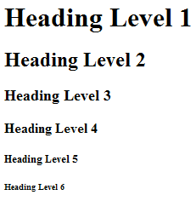
THE HEADING ELEMENT
<h1>Heading Level 1</h1>
<h2>Heading Level 2</h2>
<h3>Heading Level 3</h3>
<h4>Heading Level 4</h4>
<h5>Heading Level 5</h5>
<h6>Heading Level 6</h6>

Slide 3
HANDS-ON PRACTICE 2.2
heading.html

Slide 4
PARAGRAPH ELEMENT
Paragraph element
<p> …paragraph goes here… </p>
  Groups sentences and sections of text together.
  Configures a blank line above and below the paragraph

Slide 5
HANDS-ON PRACTICE 2.3
paragraph.html

Slide 6
LINE BREAK ELEMENT
Line Break element
  Stand-alone, or void tag
    XHTML syntax: <br />
    HTML syntax: <br>
  …text goes here <br>
  This starts on a new line….
  Causes the next element or text to display on a new line

Slide 7
HANDS-ON PRACTICE 2.4
linebreakxhtml.html

Slide 8
BLOCKQUOTE ELEMENT
Blockquote element
  Indents a block of text for special emphasis
  <blockquote>
  …text goes here…
  </blockquote>

Slide 9
HANDS-ON PRACTICE 2.5
blockquote.html

Slide 10
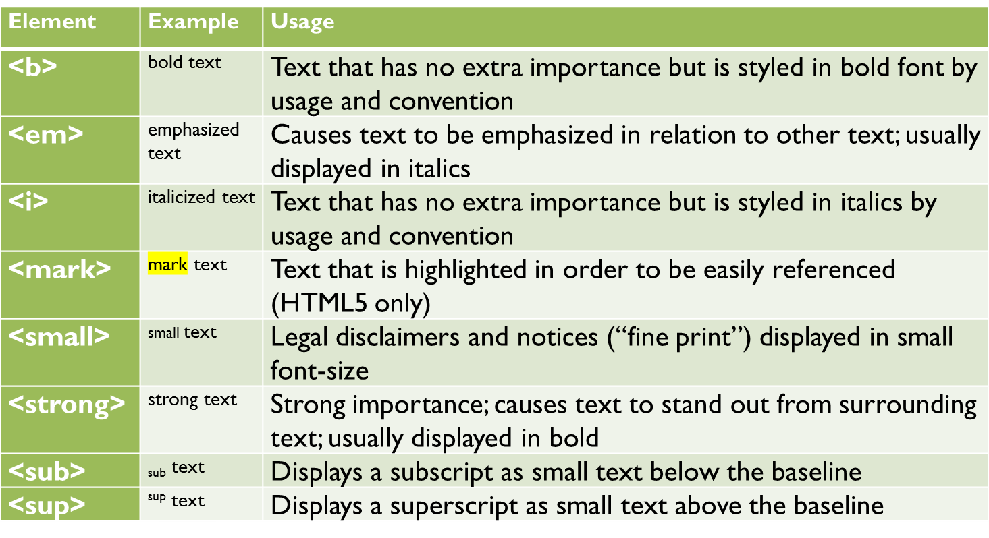
PHRASE ELEMENTS
Indicate the context and meaning of the text

Slide 11
HTML LISTS
Unordered List
Ordered List
Description List
formerly called a definition list

Slide 12
UNORDERED LIST
Displays a bullet, or list marker, before each entry in the list.
<ul>
Contains the unordered list
  type attribute determines the type of bullet point
  default type is disc (but depends on the browser)
<li>
Contains an item in the list

Slide 13
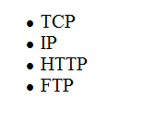
UNORDERED LIST EXAMPLE
<ul>
<li>TCP</li>
<li>IP</li>
<li>HTTP</li>
<li>FTP</li>
</ul>

Slide 14
HANDS-ON PRACTICE 2.6
ulsquare.html

Slide 15
ORDERED LIST
Displays a numbering or lettering system to itemize the information contained in the list
<ol>
Contains the ordered list
  type attribute determines numbering scheme of list, default is numerals
<li>
Contains an item in the list

Slide 16
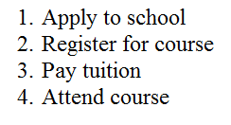
ORDERED LIST EXAMPLE
<ol>
<li>Apply to school</li>
<li>Register for course</li>
<li>Pay tuition</li>
<li>Attend course</li>
</ol>

Slide 17
HANDS-ON PRACTICE 2.7
ol.html

Slide 18
DESCRIPTION LIST
Useful to display a list of terms and descriptions or a list of FAQ and answers
  <dl>
  Contains the description list
  <dt>
  Contains a term/phrase/sentence
  Configures empty space above and below the text
  <dd>
  Contains a description of the term/phrase/sentence
    Indents the text
    Configures empty space above and below the text

Slide 19
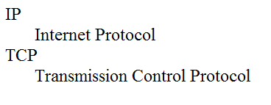
DESCRIPTION LIST EXAMPLE
<dl>
<dt>IP</dt>
<dd>Internet Protocol</dd>
<dt>TCP</dt>
<dd>Transmission Control Protocol</dd>
</dl>

Slide 20
HANDS-ON PRACTICE 2.8
description.html

