Slide 1
WEB DEVELOPMENT & DESIGN FOUNDATIONS WITH HTML5
Chapter 2
Key Concepts
Copyright © Terry Felke-Morris

Slide 2
SPECIAL CHARACTERS
Display special characters such as quotes, copyright symbol, etc.
Character Code
© &copy;
< &lt;
> &gt;
& &amp;
&nbsp;

Slide 3
DIV ELEMENT
Configures a structural block area or “division” on a web page with empty space above and below.
Can contain other block display elements, including other div elements
<div>Home Services Contact</div>

Slide 4
HANDS-ON PRACTICE 2.10
div.html

Slide 5
ANCHOR ELEMENT
Specifies a hyperlink reference (href) to a file
Text between the <a> and </a> is displayed on the web page.
<a href="contact.html">Contact Us</a>
href Attribute
  Indicates the file name or URL

Slide 6
HANDS-ON PRACTICE 2.11
anchor.html

Slide 7
ABSOLUTE & RELATIVE HYPERLINKS
Absolute link
  Link to other websites
<a href="http://yahoo.com">Yahoo</a>
Relative link
  Link to pages on your own site
<a href="index.htm">Home</a>

Slide 8
HANDS-ON PRACTICE 2.12
practice/index.html
practice/background.html
practice/favorites.html

Slide 9
E-MAIL HYPERLINK
Automatically launch the default mail program configured for the browser
If no browser default is configured, a message is displayed
<a href=“mailto:me@hotmail.com”>me@hotmail.com</a>

Slide 10
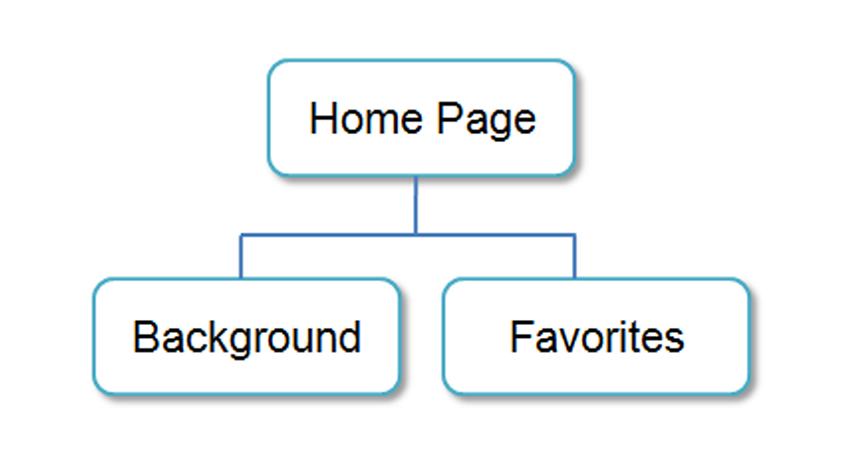
HYPERLINKS
Hands-On Practice

Slide 11
HANDS-ON PRACTICE 2.13
practice2/index.html

Slide 12
WRITING VALID XHTML
Check your code for syntax errors
  Benefit:
    Valid code →
    more consistent browser display
W3C XHTML Validation Tool
  http://validator.w3.org

Slide 13
HANDS-ON PRACTICE 2.14
design.html
design2.html

