Slide 1
WEB DEVELOPMENT & DESIGN FOUNDATIONS WITH HTML5
Chapter 3
Key Concepts
Copyright © Terry Felke-Morris

Slide 2
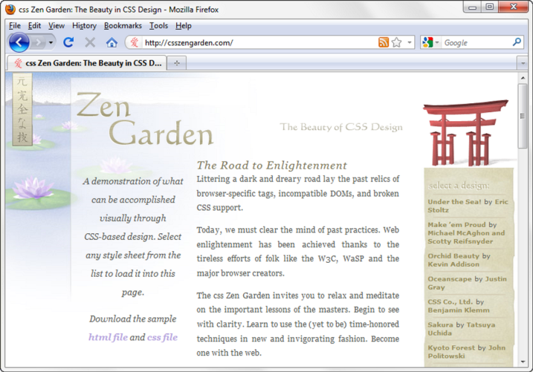
OVERVIEW OF
CASCADING STYLE SHEETS (CSS)
See what is possible with CSS:
  Visit http://www.csszengarden.com
Style Sheets
  used for years in Desktop Publishing
  apply typographical styles and spacing to printed media
CSS
  provides the functionality of style sheets (and much more) for web developers
  a flexible, cross-platform, standards-based language developed by the W3C.

Slide 3
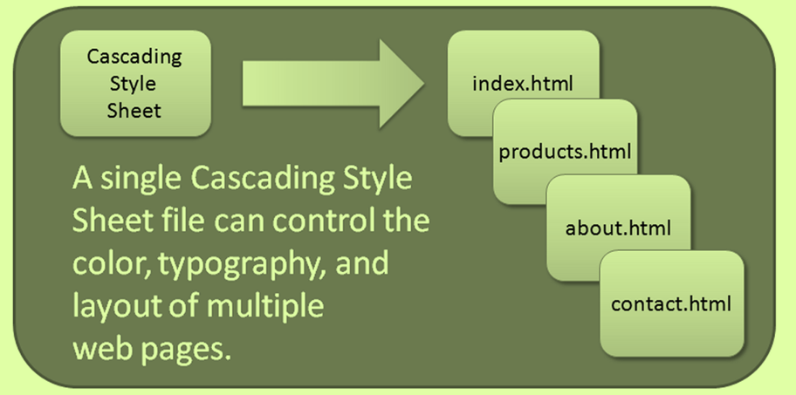
CSS
ADVANTAGES
Greater typography and page layout control
Style is separate from structure
Styles can be stored in a separate document
and associated with the web page
Potentially smaller documents
Easier site maintenance

Slide 4
TYPES OF CASCADING STYLE SHEETS (1)
Inline Styles
Embedded Styles
External Styles
Imported Styles

Slide 5
CASCADING STYLE SHEETS
Inline Styles
  body section
  HTML style attribute
  apply only to the specific element
Embedded Styles
  head section
  HTML style element
  apply to the entire web page document
External Styles
  Separate text file with .css file extension
  Associate with a HTML link element in the head section of a web page
Imported Styles
  Similar to External Styles
  We’ll concentrate on the other three types of styles.

Slide 6

CSS SYNTAX
Style sheets are composed of "Rules" that describe the styling to be applied.
Each Rule contains a Selector and a Declaration

Slide 7

CSS SYNTAX SAMPLE
Configure a web page to display blue text and yellow background.
body { color: blue;
background-color: yellow; }
This could also be written using hexadecimal color values as shown below.
body { color: #0000FF;
background-color: #FFFF00; }

Slide 8
COMMON FORMATTING
CSS PROPERTIES
See Table 3.1 Common CSS Properties, including:
  background-color
  color
  font-family
  font-size
  font-style
  font-weight
  line-height
  margin
  text-align
  text-decoration
  width

Slide 9
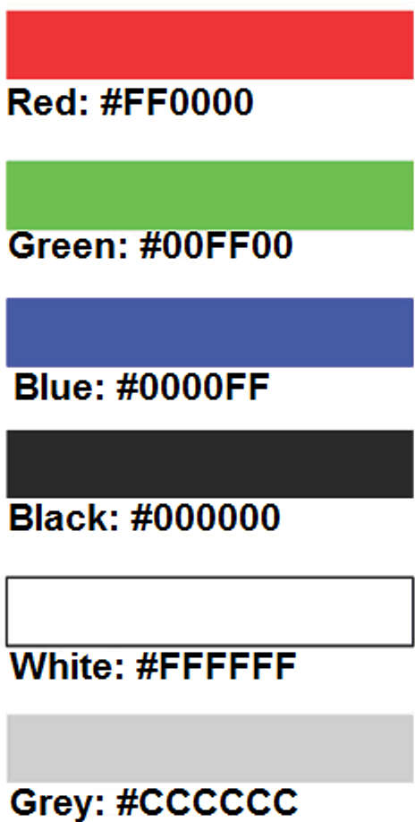
USING COLOR ON WEB PAGES
Computer monitors display color as intensities of red, green, and blue light
RGB Color
The values of red, green, and blue vary from 0 to 255.
Hexadecimal numbers (base 16) represent these color values.

Slide 10
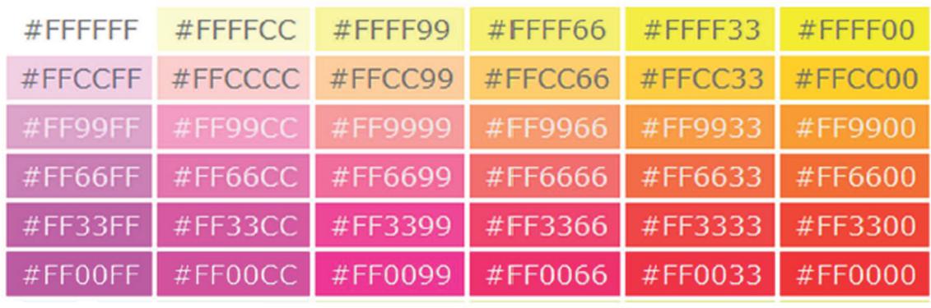
HEXADECIMAL
COLOR VALUES
# is used to indicate a hexadecimal value
Hex value pairs range from 00 to FF
Three hex value pairs describe an RGB color
  #000000 black #FFFFFF white
  #FF0000 red #00FF00 green
  #0000FF blue #CCCCCC grey

Slide 11
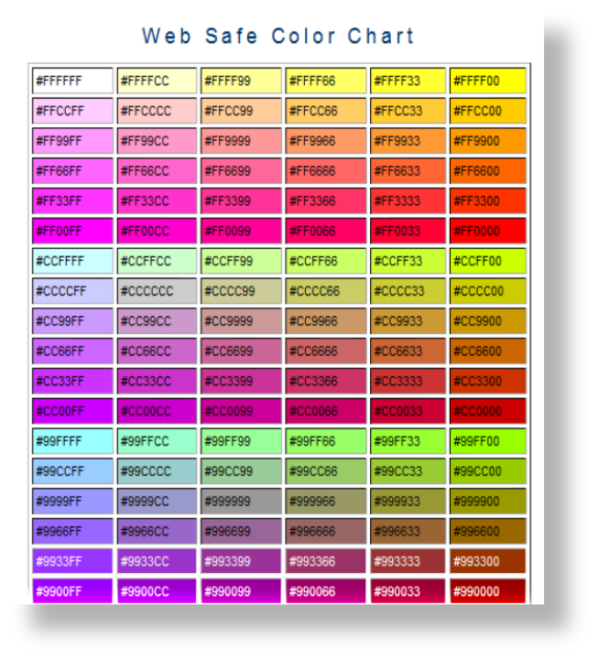
WEB COLOR PALETTE
A collection of 216 colors
Display the most
similar
on the Mac and PC
platforms
Hex values:
00, 33, 66, 99, CC, FF
Color Chart
http://webdevfoundations.net/color

Slide 12
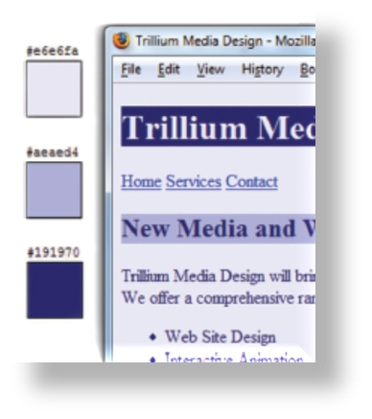
MAKING COLOR CHOICES
How to choose a color scheme?
  Monochromatic
    http://meyerweb.com/eric/tools/color-blend
  Choose from a photograph or other image
    http://www.colr.org
  Begin with a favorite color
    Use one of the sites below to choose other colors
      http://colorsontheweb.com/colorwizard.asp
      http://kuler.Adobe.com
      http://colorschemedesigner.com/

Slide 13
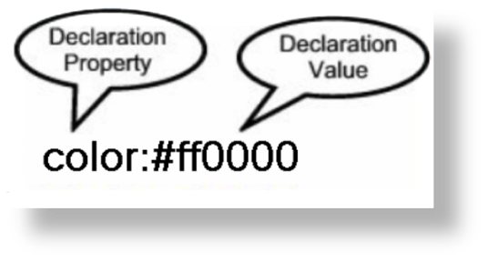

CONFIGURING COLOR WITH INLINE CSS
Inline CSS
  Configured in the body of the web page
  Use the style attribute of an HTML tag
  Apply only to the specific element
The Style Attribute
  Value: one or more style declaration property and value pairs
Example: configure red color text in an <h1> element:
<h1 style="color:#ff0000">Heading text is red</h1>

Slide 14

CONFIGURING COLOR WITH INLINE CSS
Example 2: configure the red text in the heading
configure a gray background in the heading
Separate style rule declarations with ;
<h1 style="color:#FF0000;background-color:#cccccc">This is displayed as a red heading with gray background</h1>

Slide 15
HANDS-ON PRACTICE 3.1
chapter3/inlinep.html

Slide 16

CSS EMBEDDED STYLES
Configured in the header section of a web page.
Use the HTML <style> element
Apply to the entire web page document
Style declarations are contained between the opening and closing <style> tags
Example: Configure a web page with white text on a black background
<style>
body { background-color: #000000;
color: #FFFFFF;
}
</style>

Slide 17

CSS EMBEDDED STYLES
The body selector sets the global style rules for the entire page.
These global rules are overridden for <h1> and <h2> elements by the h1 and h2 style rules.
<style>
body { background-color: #E6E6FA;
color: #191970;}
h1 { background-color: #191970;
color: #E6E6FA;}
h2 { background-color: #AEAED4;
color: #191970;}
</style>

Slide 18
HANDS-ON PRACTICE 3.2
chapter3/starter.html
chapter3/embedded.html

