Slide 1
WEB DEVELOPMENT & DESIGN FOUNDATIONS WITH HTML5
Chapter 3
Key Concepts
Copyright © Terry Felke-Morris

Slide 2
CONFIGURING TEXT WITH CSS
CSS properties for configuring text:
  font-weight
    Configures the boldness of text
  font-style
    Configures text to an italic style
  font-size
    Configures the size of the text
  font-family
    Configures the font typeface of the text

Slide 3
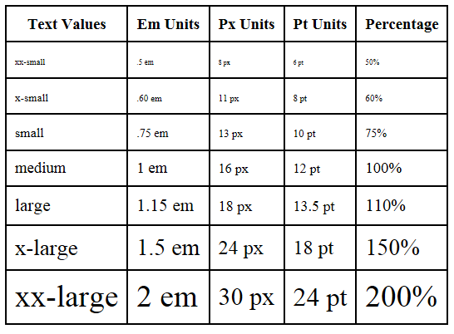
THE FONT-SIZE PROPERTY
Accessibility Recommendation: Use em or percentage font sizes – these can be easily enlarged in all browsers by users

Slide 4
WHAT IS EM UNIT?
See page 90.
chapter3/fonts.html

Slide 5
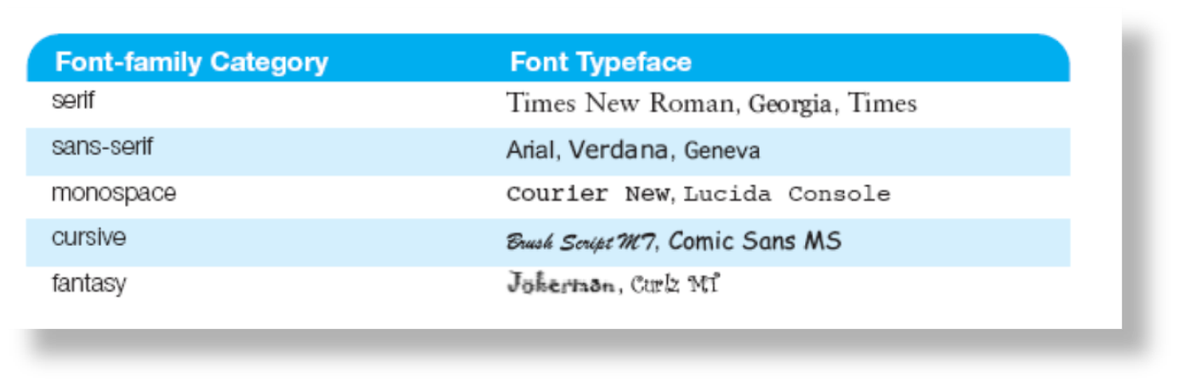
THE FONT-FAMILY PROPERTY
Not everyone has the same fonts installed in their computer
Configure a list of fonts and include a generic family name
p {font-family: Arial, Verdana, sans-serif;}

Slide 6

EMBEDDED STYLES EXAMPLE
<style>
body { background-color: #E6E6FA;
color: #191970;
font-family: Arial, Verdana, sans-serif; }
h1 { background-color: #191970;
color: #E6E6FA;
line-height: 200%;
font-family: Georgia, "Times New Roman", serif; }
h2 { background-color: #AEAED4;
color: #191970; text-align: center;
font-family: Georgia, "Times New Roman", serif; }
p {font-size: .90em; text-indent: 3em; }
ul {font-weight: bold; }
</style>

Slide 7
HANDS-ON PRACTICE 3.3
chapter3/embedded.html
chapter3/embedded2.html

Slide 8
PRIME PROPERTIES CASE STUDY
Pages 124-125
In financing.html
Task 1
Task 2
  Step 1
  Step 2
  Step 3
  Step 4

