Slide 1
WEB DEVELOPMENT & DESIGN FOUNDATIONS WITH HTML5
Chapter 3
Key Concepts
Copyright © Terry Felke-Morris

Slide 2
CSS SELECTORS
CSS style rules can be
configured for an:
  HTML element selector
  class selector
  id selector

Slide 3
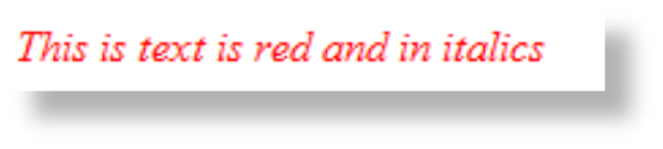
USING CSS WITH “CLASS”
class Selector
  Apply a CSS
  rule to a certain "class" of
  elements on a web page
  Does not associate the
  style to a specific HTML element
Configure with .classname
  code CSS to create a class called “new” with red italic text.
Apply the class:
<p class=“new”>This is text is red and in italics</p>
<style>
.new { color: #FF0000;
font-style: italic;
}
</style>

Slide 4
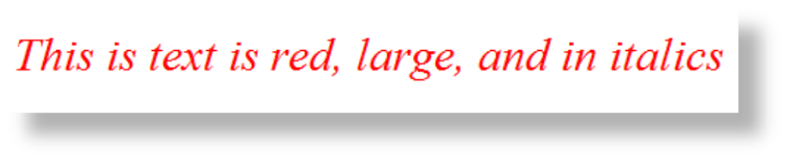
USING CSS WITH “ID”
id Selector
  Apply a CSS
  rule to ONE element
  on a web page.
Configure with #idname
  Code CSS to create an id called “new”
  with red, large, italic text.
Apply the id:
<p id=“new”>This is text is red, large, and in italics</p>
<style>
#new { color: #FF0000;
font-size:2em;
font-style: italic;
}
</style>

Slide 5
CSS CONTEXTUAL SELECTOR
Specify an element within the context of its container (parent) element.
AKA descendent selector
The example configures a
green text color only for
anchor tags located within the footer id
Advantage of contextual selectors:
Reduce the number of classes and ids you need to apply in the HTML
<style>
#footer a {
color: #00ff00; }
</style>

Slide 6
HANDS-ON PRACTICE 3.4
chapter3/embedded2.html
chapter3/embedded3.html

Slide 7
SPAN ELEMENT
Purpose:
  configure a specially formatted area displayed in-line with other elements, such as within a paragraph.
There is no additional empty space above or below a span – it is inline display.

Slide 8
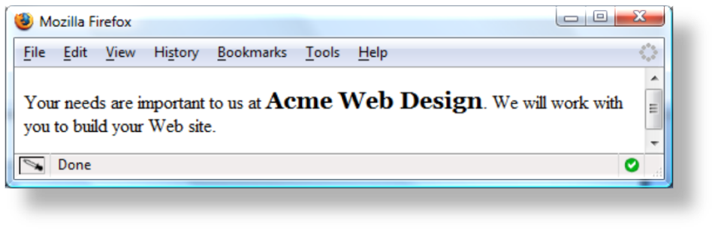
SPAN ELEMENT EXAMPLE
Embedded CSS:
<style>
.companyname { font-weight: bold;
font-family: Georgia, "Times New Roman", serif;
font-size: 1.25em;
}
</style>
HTML:
<p>Your needs are important to us at <span class=“companyname">Acme Web Design</span>.
We will work with you to build your Web site.</p>

Slide 9
HANDS-ON PRACTICE 3.5
chapter3/embedded3.html
chapter3/embedded4.html

Slide 10
EXTERNAL STYLE SHEETS - 1
CSS style rules are contained in a text file separate from the HTML documents.
The External Style Sheet text file:
  extension ".css"
  contains only style rules
  does not contain any HTML tags

Slide 11
EXTERNAL STYLE SHEETS - 2
  Multiple web pages can associate with the same external style sheet file.
site.css
index.html
body {background-color:#E6E6FA;
color:#000000;
font-family:Arial, sans-serif;
font-size:90%; }
h2 { color: #003366; }
.nav { font-size: 16px;
font-weight: bold; }
clients.html
about.html
Etc…

Slide 12
LINK ELEMENT
A self-contained tag
Placed in the header section
Purpose: associates the external style sheet file with the web page.
Example:
<link rel="stylesheet" href="color.css">

Slide 13
USING ANEXTERNAL STYLE SHEET
External Style Sheet color.css
body { background-color: #0000FF;
color: #FFFFFF;
}
To link to the external style sheet called color.css, the HTML code placed in the head section is:
<link rel="stylesheet" href="color.css">

Slide 14
HANDS-ON PRACTICE 3.6
chapter2/template.html
chapter3/color.css
chapter3/external.html

Slide 15
HANDS-ON PRACTICE 3.7
chapter3/embedded4.html
chapter3/3.7/index.html
chapter3/3.7/services.html
chapter3/3.7/trillium.css

