Slide 1
WEB DEVELOPMENT & DESIGN FOUNDATIONS WITH HTML5
Chapter 3
Key Concepts
Copyright © Terry Felke-Morris

Slide 2
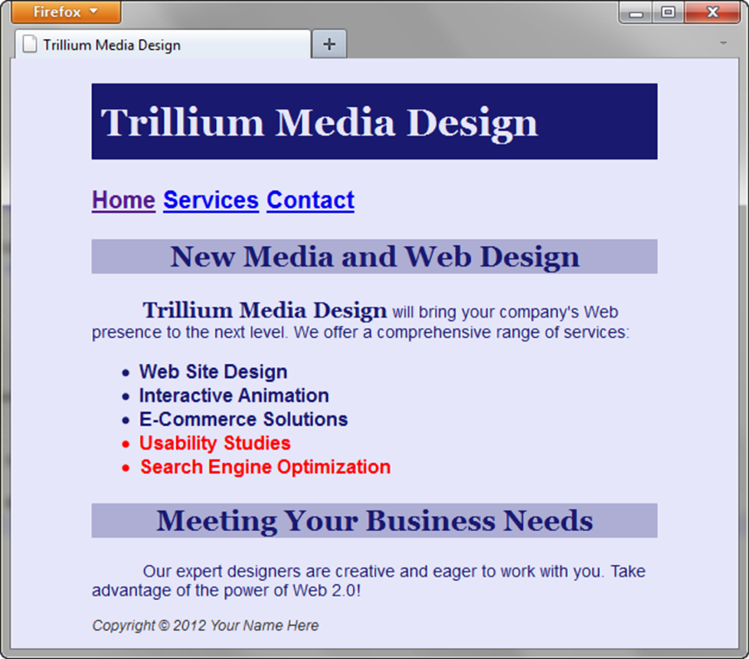
CENTERING PAGE CONTENT
WITH CSS
#container { margin-left: auto;
margin-right: auto;
width:80%; }

Slide 3
HANDS-ON PRACTICE 3.9
chapter3/3.7
chapter3/3.8

Slide 4
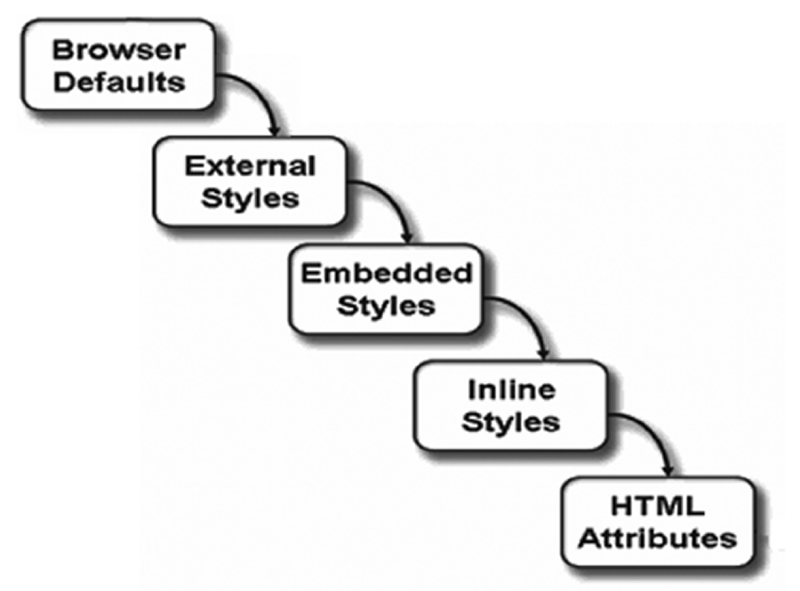
THE “CASCADE”

Slide 5
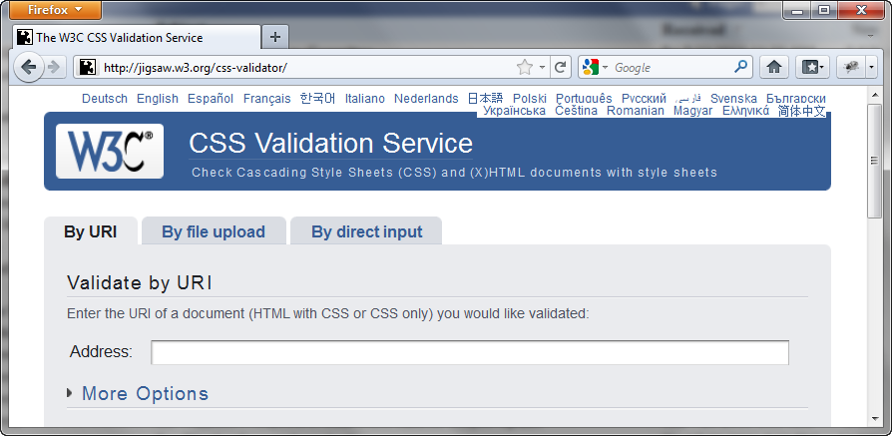
W3C CSS VALIDATION
http://jigsaw.w3.org/css-validator/

Slide 6
PRIME PROPERTIES
Pages 124-127

