Slide 1
WEB DEVELOPMENT & DESIGN FOUNDATIONS WITH HTML5
Chapter 4
Key Concepts
Copyright © Terry Felke-Morris

Slide 2
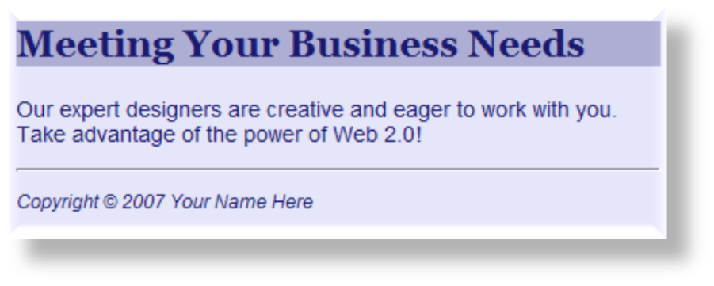
HORIZONTAL RULE ELEMENT
Configures a horizontal line
  XHTML Syntax:
<hr />
  HTML5 Syntax:
  <hr>

Slide 3
HANDS-ON PRACTICE 4.1
chapter4/starter1.html
chapter4/hr.html

Slide 4

CSS BORDER PROPERTY
Configures a border on the top, right, bottom, and left sides of an element
Consists of
  border-width
  border-style
  border-color
h2 { border: 2px solid #ff0000 }

Slide 5
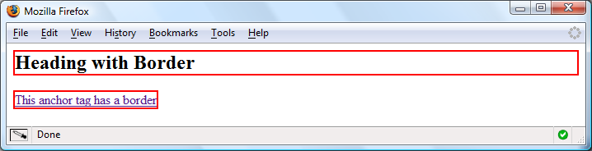
CSS BORDERS:
BLOCK / INLINE ELEMENTS
Block display element
  default width of element content extends to browser margin (or specified width)
Inline display element
  Border closely outlines the element content
  h2 { border: 2px solid #ff0000; }
  a { border: 2px solid #ff0000; }

Slide 6
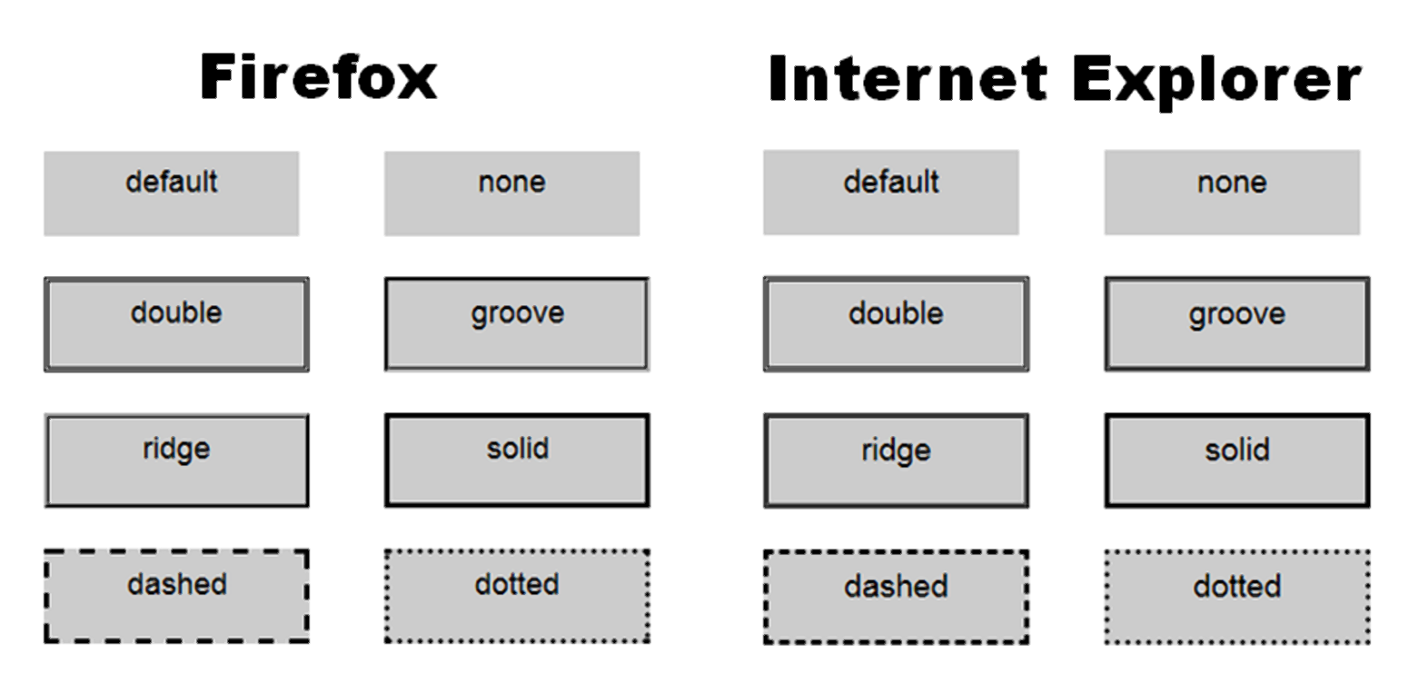
BROWSER DISPLAY CAN VARY

Slide 7

CONFIGURING SPECIFIC
SIDES OF A BORDER
Use CSS to configure a line on one or more sides of an element
  border-bottom
  border-left
  border-right
  border-top
h2 { border-bottom: 2px solid #ff0000 }

Slide 8


CSS PADDING PROPERTY
Configures empty space between the content of the HTML element and the border
Set to 0px by default
h2 { border: 2px solid #ff0000;
padding: 5px; }
No padding property configured:

Slide 9
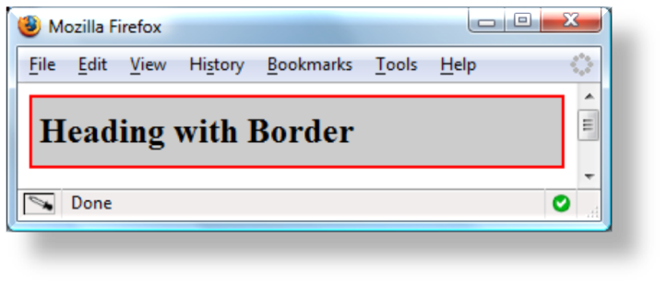
CONFIGURE PADDING ON
SPECIFIC SIDES OF AN ELEMENT
Use CSS to configure padding on one or more sides of an element
  padding-bottom
  padding-left
  padding-right
  padding-top
h2 { border: 2px solid #ff0000;
background-color: #cccccc;
padding-left: 5px;
padding-bottom: 10px;
padding-top: 10px; }

Slide 10
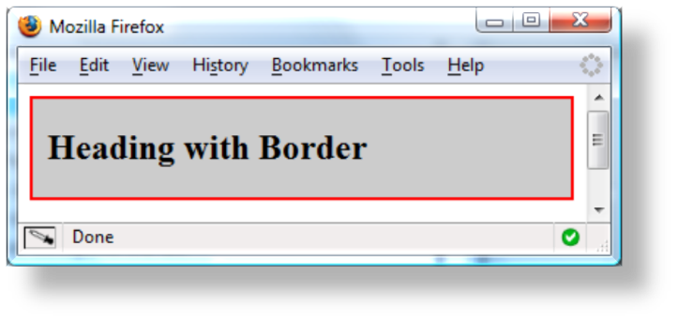
CSS PADDING PROPERTY SHORTHAND: TWO VALUES
Two numeric values or percentages
  first value configures top and bottom padding
  the second value configures left and right padding
    h2 { border: 2px solid #ff0000;
    background-color: #cccccc;
    padding: 20px 10px;
    }

Slide 11
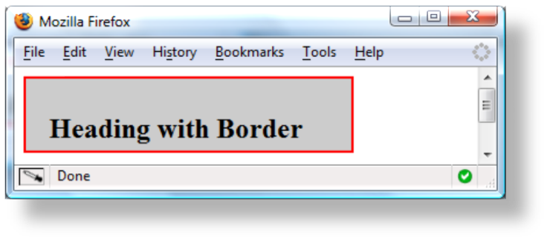
CSS PADDING PROPERTY SHORTHAND: FOUR VALUES
Four numeric values or percentages
  Configure top, right, bottom, and left padding
    h2 { border: 2px solid #ff0000;
    width: 250px;
    background-color: #cccccc;
    padding: 30px 10px 5px 20px;
    }

Slide 12
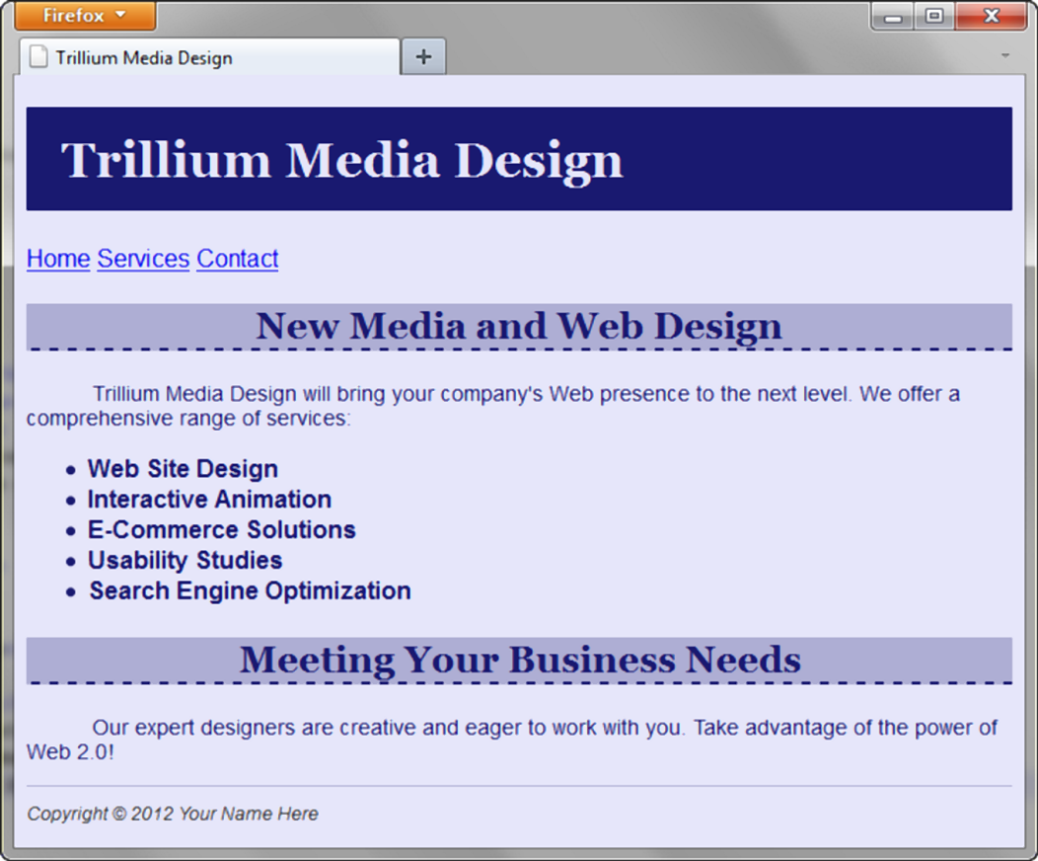
HANDS-ON PRACTICE
h1 { background-color:#191970;
color:#E6E6FA;
padding: 15px;
font-family: Georgia, "Times New Roman", serif; }
h2 { background-color:#AEAED4;
color:#191970;
font-family: Georgia, "Times New Roman", serif;
border-bottom: 2px dashed #191970; }

Slide 13
HANDS-ON PRACTICE 4.2
chapter4/starter1.html
chapter4/border.html

Slide 14
TYPES OF
GRAPHICS
Graphic types commonly used on web pages:
  GIF
  JPG
  PNG

Slide 15
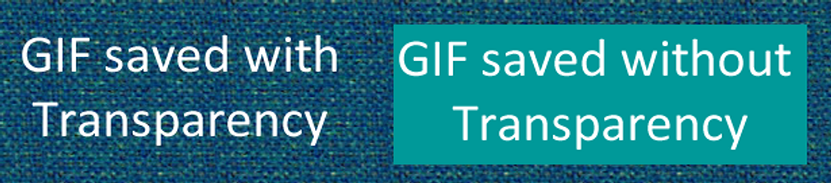
GIF
Background color configured to be transparent
Background color – no transparency
Graphics Interchange Format
Best used for line art and logos
Maximum of 256 colors
One color can be configured as transparent
Can be animated
Uses lossless compression
Can be interlaced

Slide 16

JPEG
Joint Photographic Experts Group
Best used for photographs
Up to 16.7 million colors
Use lossy compression
Cannot be animated
Cannot be made
transparent
Progressive JPEG – similar to interlaced display

Slide 17
PNG
Portable Network Graphic
Support millions of colors
Support multiple levels of transparency
(but browsers do not --
so limit to one transparent color for Web display)
Support interlacing
Use lossless compression
Combines the best of GIF & JPEG
Browser support is growing

Slide 18
HTML IMAGE ELEMENT
Configures graphics on a web page
src Attribute
  File name of the graphic
alt Attribute
  Configures alternate text content (description)
height Attribute
  Height of the graphic in pixels
width Attribute
  Width of the graphic in pixels
<img src=“cake.gif” alt=“birthday cake” height=“100” width=“100”>

Slide 19
ACCESSIBILITY & IMAGES
Required:
  Configure the alt attribute
    Alternate text content to convey the meaning/intent of the image
    NOT the file name of the image
    Use alt="“ for purely decorative images
Recommended:
  If your site navigation uses image links for the main navigation, provide simple text links at the bottom of the page.

Slide 20
HANDS-ON PRACTICE 4.3
chapter4/starter2.html
chapter4/starters
chapter4/4.3/index.html

