Slide 1
WEB DEVELOPMENT & DESIGN FOUNDATIONS WITH HTML5
Chapter 6
Key Concepts
Copyright © Terry Felke-Morris

Slide 2
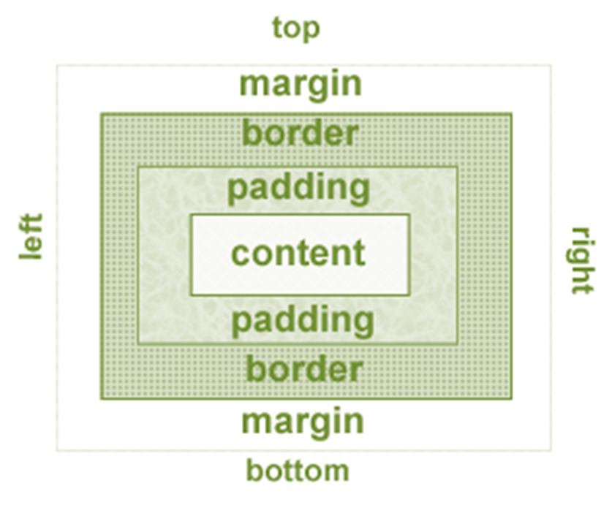
THE BOX MODEL
Content
  Text & web page elements in the container
Padding
  Area between the content and the border
Border
  Between the padding
  and the margin
Margin
  Determines the empty space between the element and adjacent elements

Slide 3
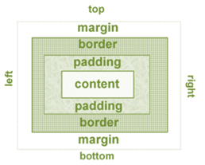
CONFIGURE MARGIN WITH CSS
  The margin property
  Related properties:
    margin-top, margin-right, margin-left, margin-bottom
  Configures empty space between the element and adjacent elements
  Syntax examples
    h1 { margin: 0; }
    h1 { margin: 20px 10px; }
    h1 { margin: 10px 30px 20px; }
    h1 { margin: 20px 30px 0 30px; }

Slide 4
CONFIGURE PADDING WITH CSS
  The padding property
  Related properties:
    padding-top, padding-right, padding-left,
    padding-bottom
  Configures empty space between the content of the HTML element (such as text) and the border
  Syntax examples
    h1 { padding: 0; }
    h1 { padding : 20px 10px; }
    h1 { padding : 10px 30px 20px; }
    h1 { padding : 20px 30px 0 30px; }

Slide 5
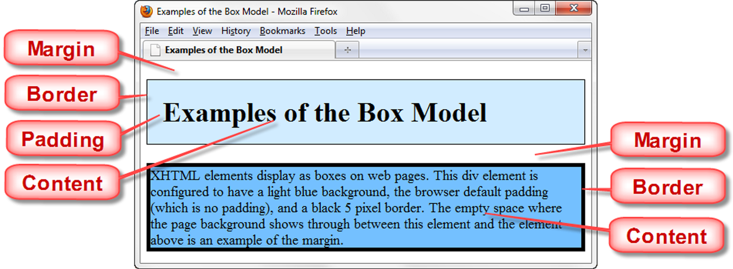
BOX MODEL IN ACTION

Slide 6
BOX MODEL IN ACTION
file:///J:/INF286/chapter6/box.html

Slide 7
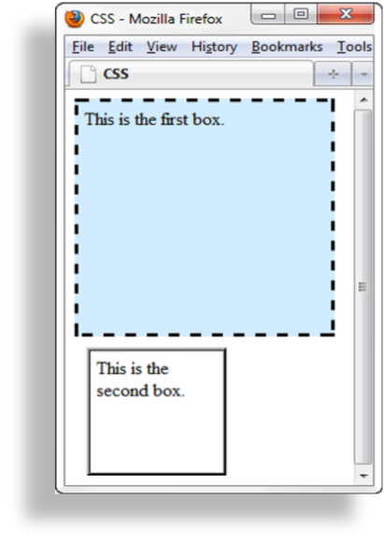
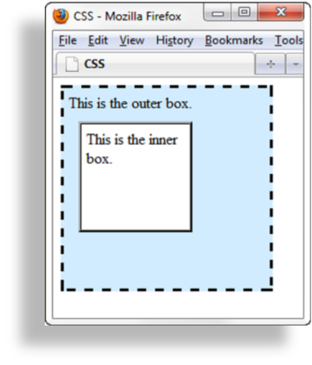
NORMAL FLOW
Browser display of elements in the order they are coded in the Web page document

Slide 8
HANDS-ON PRACTICE 6.1
file:///J:/INF286/chapter6/box1.html
file:///J:/INF286/chapter6/box2.html

Slide 9
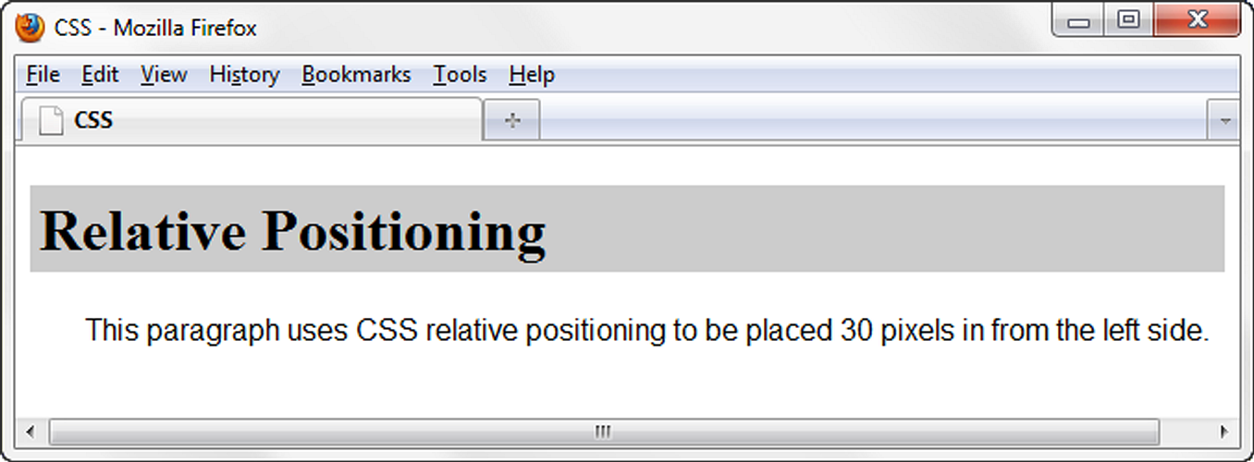
RELATIVE POSITIONING
h1 { background-color:#cccccc;
padding: 5px;
color: #000000; }
#myContent { position: relative;
left: 30px;
font-family: Arial,sans-serif; }
Changes the location of an element in relation to where it would otherwise appear

Slide 10
RELATIVE POSITIONING
file:///J:/INF286/chapter6/relative.html

Slide 11
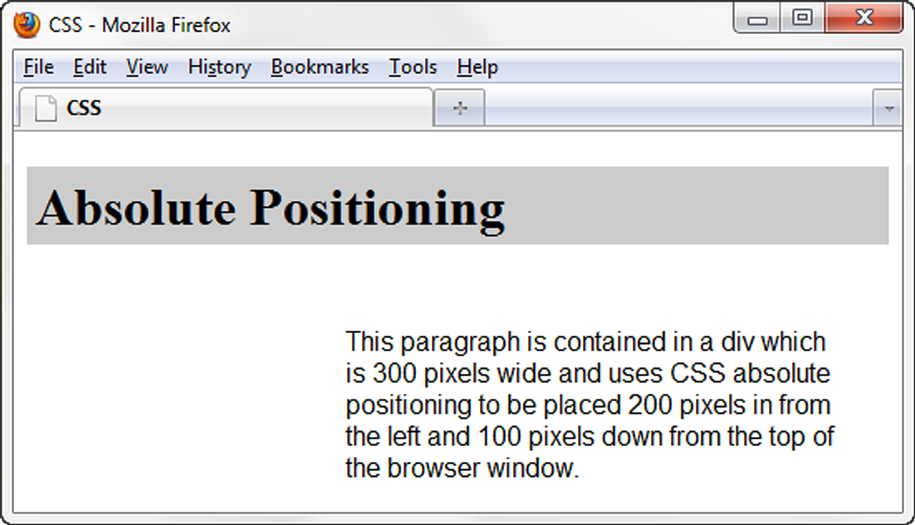
ABSOLUTE POSITIONING
Precisely specifies the location of an element in the browser window
h1 { background-color: #cccccc;
padding: 5px;
color: #000000; }
#content {position: absolute;
left: 200;
top: 100;
font-family: Arial,sans-serif;
width: 300; }

Slide 12
ABSOLUTE POSITIONING
file:///J:/INF286/chapter6/absolute.html

Slide 13
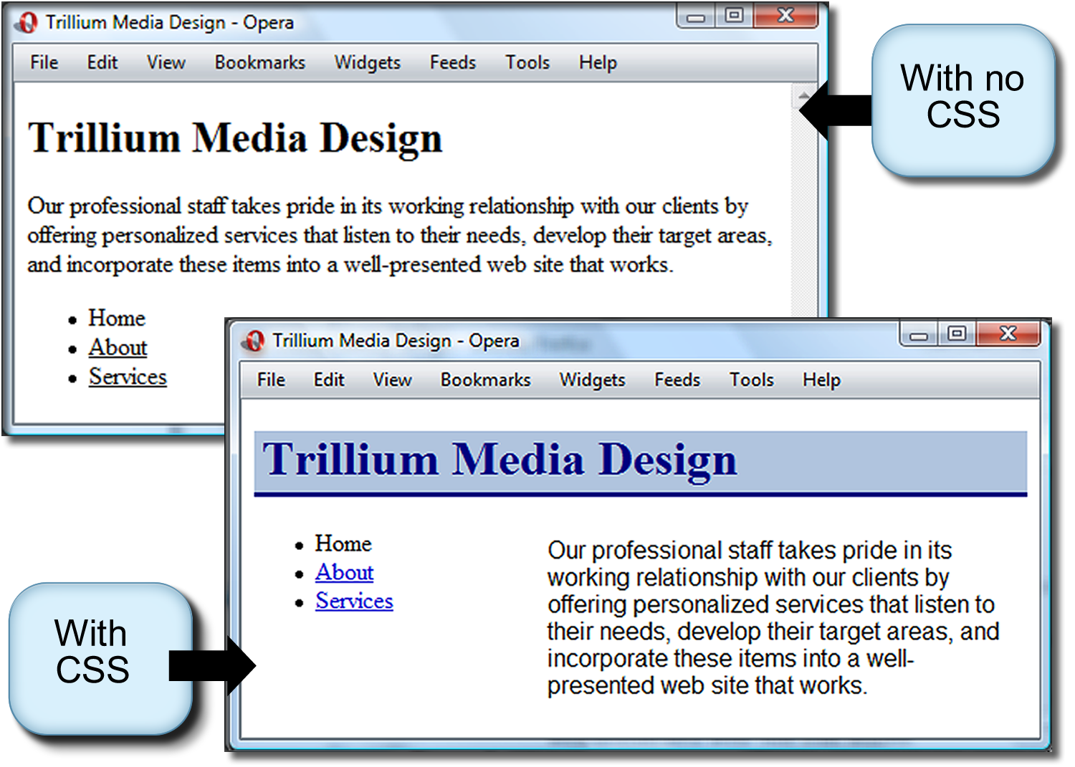
ABSOLUTE POSITIONING EXAMPLE

Slide 14
HANDS-ON PRACTICE 6.1
file:///J:/INF286/chapter6/starter2.html
file:///J:/INF286/chapter6/trillium.html

