Slide 1
WEB DEVELOPMENT & DESIGN FOUNDATIONS WITH HTML5
Chapter 6
Key Concepts
Copyright © Terry Felke-Morris

Slide 2
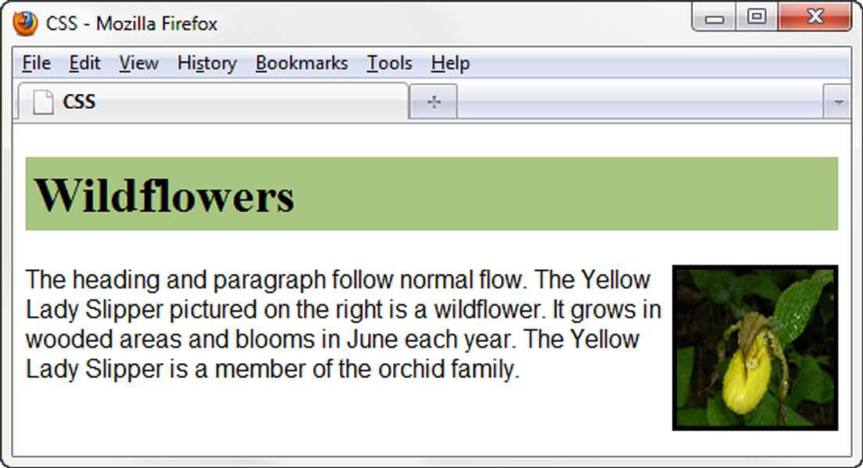
FLOAT PROPERTY
h1 { background-color:#cccccc;
padding:5px;
color: #000000;
}
p { font-family:Arial,sans-serif;
}
#yls {float:right;
margin: 0 0 5px 5px;
border: solid;
}
Elements that seem to “float" on the right or left side of either the browser window or another element are often configured using the float property.

Slide 3
FLOAT PROPERTY
file:///J:/INF286/chapter6/float.html

Slide 4
HANDS-ON PRACTICE 6.3
file:///J:/INF286/chapter6/floatyls.html

Slide 5
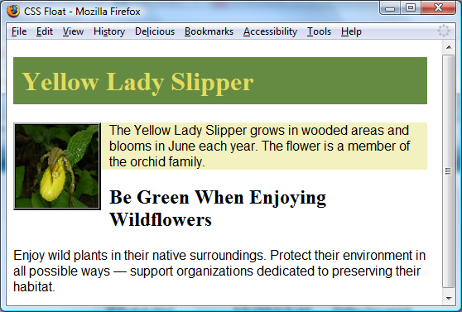
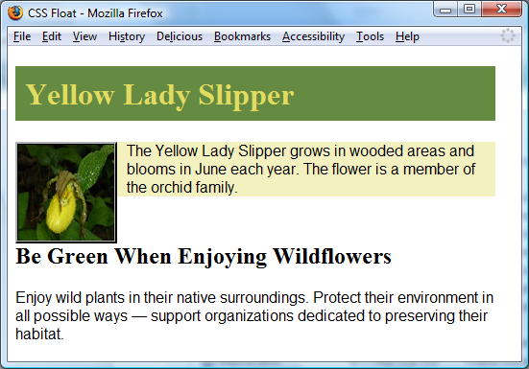
CLEAR PROPERTY
The h2 text is displayed in normal flow.
Useful to “clear” or terminate a float
Values are left, right, and both
clear: left; was applied to the h2. Now the h2 text displays AFTER the floated image.

Slide 6
CLEAR PROPERTY
file:///J:/INF286/chapter6/floatylsclear1.html
file:///J:/INF286/chapter6/floatylsclear2.html

Slide 7
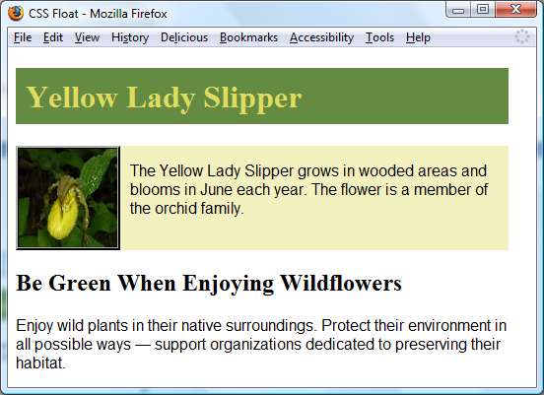
OVERFLOW PROPERTY
The background does not extend as far as you’d expect.
Intended to configure the display of elements on a Web page.
However, it is useful to “clear” or terminate a float before the end of a container element
Values are auto, hidden, and scroll
overflow: auto; was applied to the div that contains the image and paragraph. Now the background extends and the h2 text displays AFTER the floated image.

Slide 8
OVERFLOW PROPERTY
file:///J:/INF286/chapter6/floatylsoverflow.html
file:///J:/INF286/chapter6/floatylsscroll.html

Slide 9
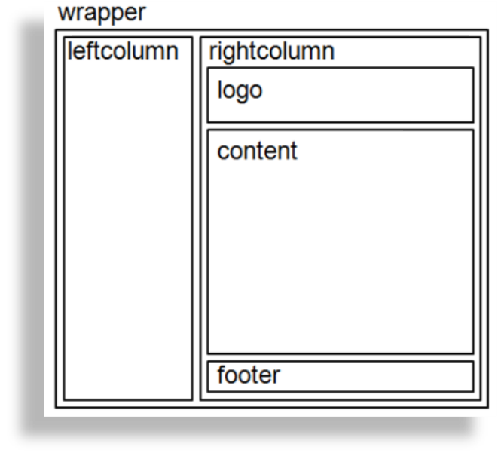
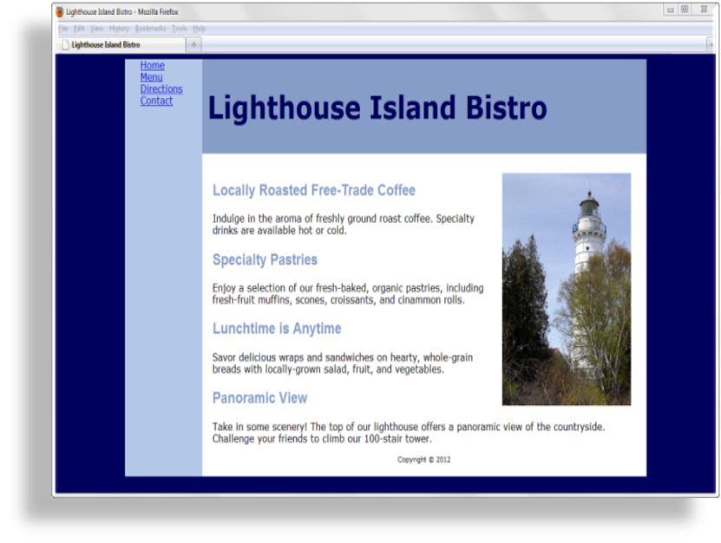
CSS PAGE LAYOUT
TWO COLUMNS (LEFT NAV)

Slide 10
CSS PAGE LAYOUT
TWO COLUMNS (LEFT NAV)
file:///J:/INF286/chapter6/twocolumn1.html

Slide 11
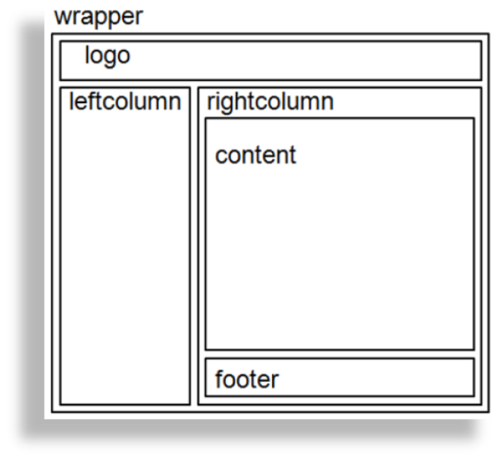
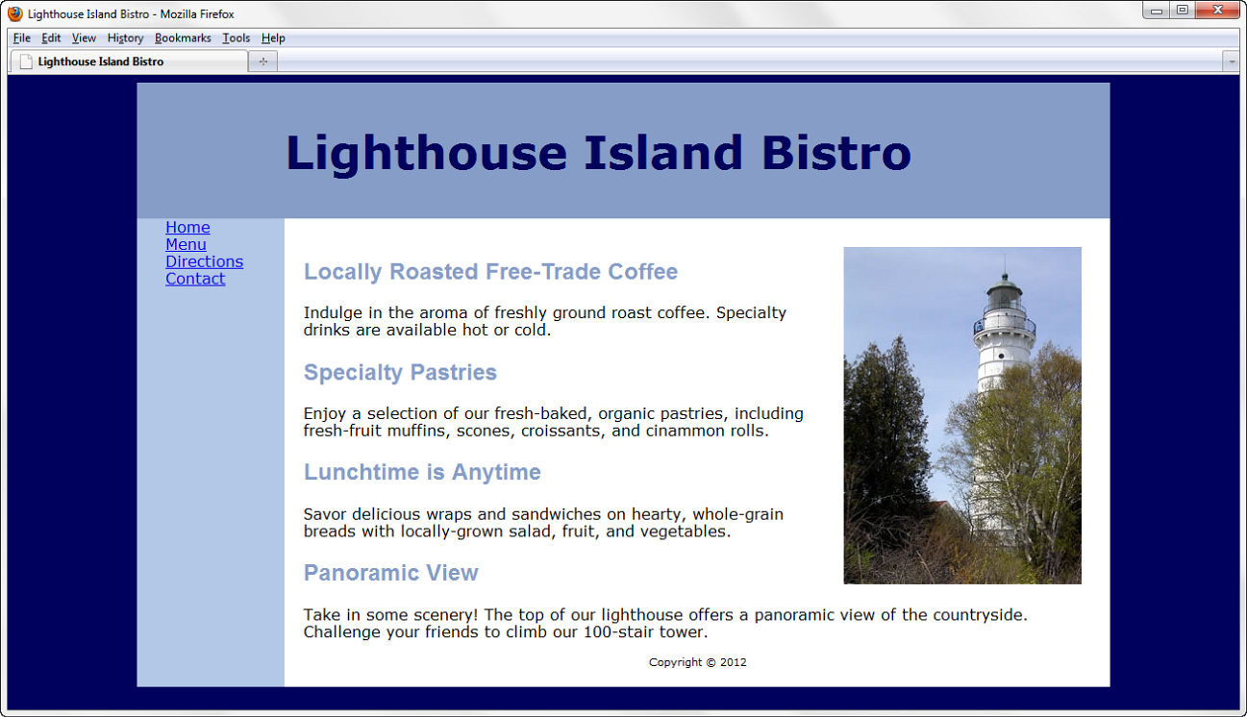
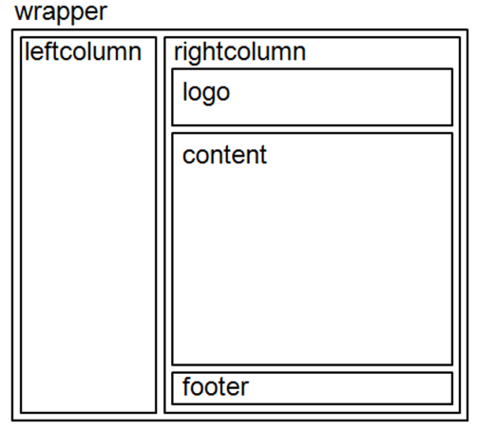
CSS PAGE LAYOUT
TWO COLUMNS (TOP LOGO, LEFT NAV)

Slide 12
CSS PAGE LAYOUT
TWO COLUMNS (TOP LOGO, LEFT NAV)
file:///J:/INF286/chapter6/twocolumn2.html

Slide 13
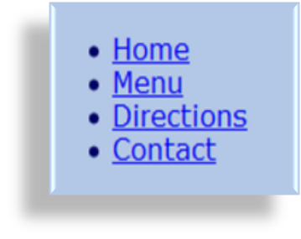
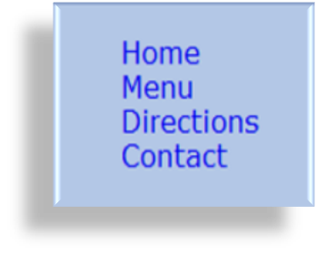
CONFIGURE
HYPERLINKS IN
AN UNORDERED LIST
Vertical Navigation
<div id="leftcolumn">
<ul>
<li><a href="index.html">Home</a></li>
<li><a href="menu.html">Menu</a></li>
<li><a href="directions.html">Directions</a></li>
<li><a href="contact.html">Contact</a></li>
</ul>
</div>
CSS removes the list marker and underline:
  #leftcolumn ul { list-style-type: none; }
  #leftcolumn a { text-decoration: none; }

Slide 14
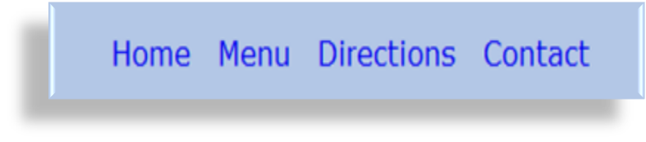
CONFIGURE
HYPERLINKS IN
AN UNORDERED LIST
Horizontal Navigation
HTML:
<div id="nav">
<ul>
<li><a href="index.html">Home</a></li>
<li><a href="menu.html">Menu</a></li>
<li><a href="directions.html">Directions</a></li>
<li><a href="contact.html">Contact</a></li>
</ul>
</div>
CSS removes the list marker, removes the underline, adds padding, and configures the list items for inline display.
    #nav ul { list-style-type: none;}
    #nav a { text-decoration: none;
    padding-right: 10px; }
    #nav li { display: inline; }

Slide 15
CSS PSEUDO-CLASSES
Pseudo-classes and the anchor element
  link – default state
  for a hyperlink
  visited –a hyperlink that
  has been visited
  focus – triggered when
  the hyperlink has focus
  hover – triggered when
  the mouse moves over the hyperlink
  active – triggered when the hyperlink is being clicked
a:link {color:#000066;}
a:visited {color:#003366;}
a:focus {color:#FF0000;}
a:hover {color:#0099CC;}
a:active {color:#FF0000;}

Slide 16
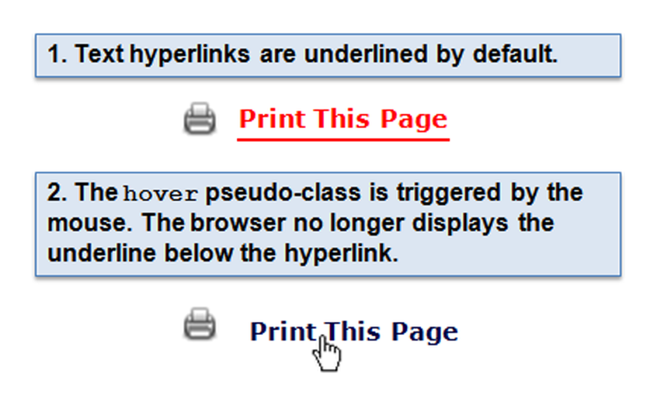
CSS
PSEUDO-CLASSES
a:link { color: #ff0000; }
a:hover { text-decoration: none;
color: #000066; }

Slide 17
HANDS-ON PRACTICE 6.4
file:///J:/INF286/chapter6/starter3.html
file:///J:/INF286/chapter6/hover/index.html

