Slide 1
WEB DEVELOPMENT & DESIGN FOUNDATIONS WITH HTML5
Chapter 6
Key Concepts
Copyright © Terry Felke-Morris

Slide 2
DISPLAY PROPERTY
Configures how and if an element is displayed
  display: none;
    The element will not be displayed.
  display: block;
    The element is rendered as a block element – even if it is actually an inline element, such as a hyperlink.
  display: inline;
    The element will be rendered as an inline element – even if it is actually a block element – such as a <li>.
  You’ll work with the display property later in the chapter.

Slide 3
DECIDING TO CONFIGURE A CLASS OR ID
Configure a class:
  If the style may apply to more than one element on a page
  Use the . (dot) notation in the style sheet.
  Use the class attribute in the HTML.
Configure an id:
  If the style is specific to only one element on a page
  Use the # notation in the style sheet.
  Use the id attribute in the HTML.

Slide 4
CHOOSING A NAME FOR A CLASS OR AN ID
A class or id name should be descriptive of the purpose:
  such as nav, news, footer, etc.
  Bad choice for a name: redText, bolded, blueborder, etc.
The the 10 most commonly used class names are:
footer, menu, title, small, text, content,
header, nav, copyright, and button
Source: http://code.google.com/webstats

Slide 5
CSS DEBUGGING TIPS
Manually check syntax errors
Use W3C CSS Validator to check syntax errors
  http://jigsaw.w3.org/css-validator/
Configure temporary background colors
Configure temporary borders
Use CSS comments to find the unexpected
  /* the browser ignores this code */
Don’t expect your pages to look exactly the same in all browsers!
Be patient!

Slide 6
HANDS-ON PRACTICE 6.5
file:///J:/INF286/chapter6/starter4.html
file:///J:/INF286/chapter6/practice/index.html

Slide 7
HTML5 STRUCTURAL ELEMENTS
Header Element
  contains the headings of either a web page document or an area in the document such as a section or article.
Hgroup Element
  contains two or more heading elements (h1, h2, and so on)

Slide 8
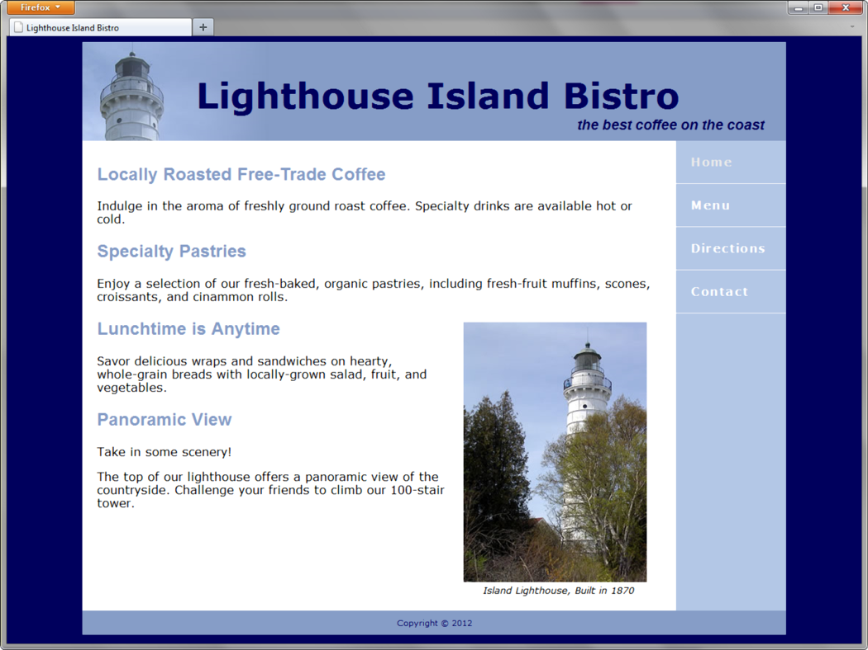
HTML5 STRUCTURAL ELEMENTS
Header Element
Hgroup Element
Example:
<header>
<hgroup>
<h1>Lighthouse&nbsp;Island&nbsp;Bistro</h1>
<h2>the best coffee on the coast</h2>
</hgroup>
</header>

Slide 9
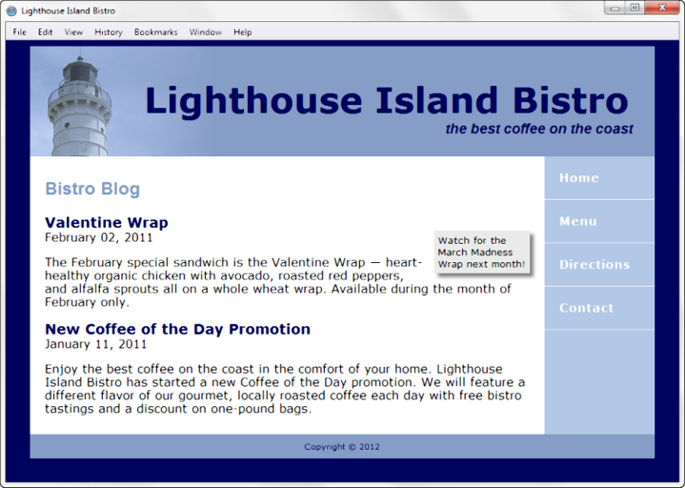
MORE HTML5 ELEMENTS
Nav Element
  contains a section of navigation hyperlinks
  block display
Footer Element
  contains the footer content of a web page or specific area (such as a section or article) on a web page
  block display
Aside Element
  contains a sidebar, a note, or other tangential content
  block display

Slide 10
HANDS-ON PRACTICE 6.6
file:///J:/INF286/chapter6/structure/index.html

Slide 11
MORE HTML5 ELEMENTS
Section Element
  contains a “section” of a document, such as a chapter or topic
  block display
Article Element
  contains an independent entry, such as a blog posting, comment, or e-zine article that could stand on its own
  block display
Time Element
  represents a date or a time
  could be useful to date articles or blog posts
  inline display

Slide 12
HANDS-ON PRACTICE 6.7
file:///J:/INF286/chapter6/blog/index.html

Slide 13
PRIME PROPERTIES
file:///J:/INF286/Prime/Chapter6/index.html
file:///J:/INF286/Prime/Chapter6HTML5/index.html

