Slide 1
WEB DEVELOPMENT & DESIGN FOUNDATIONS WITH HTML5
Chapter 8
Key Concepts
Copyright © Terry Felke-Morris

Slide 2
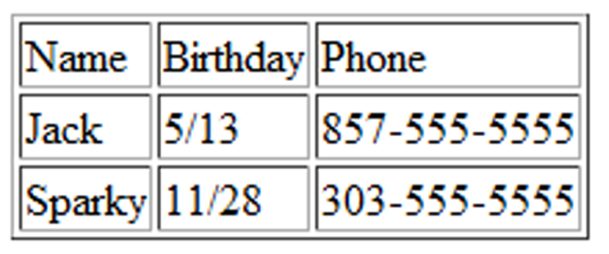
HTML TABLE
Tables are used on web pages
to organize tabular information
Composed of rows and columns – similar to a spreadsheet.
Each individual table cell is at the intersection of a specific row and column.
Configured with table, tr, and td elements

Slide 3
EXAMPLE
file:///J:/INF286/chapter8/table1.html

Slide 4
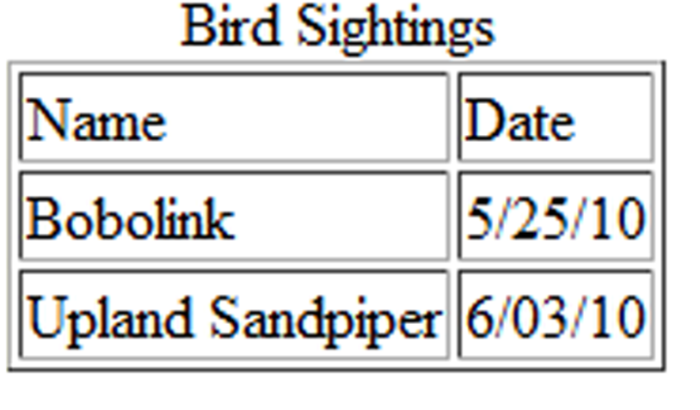
HTML TABLE ELEMENTS
<table>
Contains the table
<tr>
Contains a table row
<td>
Contains a table cell
<caption>
Configures a description of the table

Slide 5
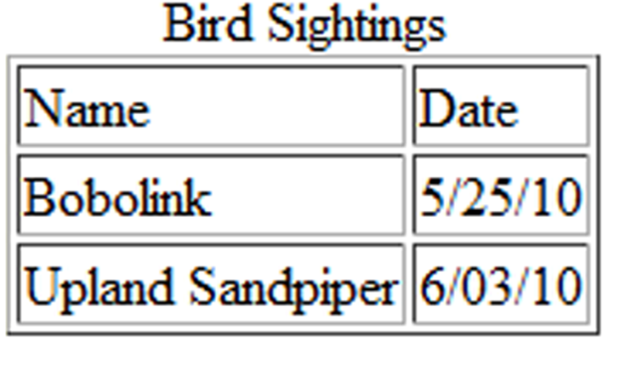
HTML
TABLE EXAMPLE
<table border="1">
<caption>Bird Sightings</caption>
<tr>
<td>Name</td>
<td>Date</td>
</tr>
<tr>
<td>Bobolink</td>
<td>5/25/10</td>
</tr>
<tr>
<td>Upland Sandpiper</td>
<td>6/03/10</td>
</tr>
</table>

Slide 6
EXAMPLE
file:///J:/INF286/chapter8/table2.html

Slide 7
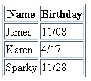
HTML
TABLE EXAMPLE 2
<table border="1">
<tr>
<th>Name</th>
<th>Birthday</th>
</tr>
<tr>
<td>James</td>
<td>11/08</td>
</tr>
<tr>
<td>Karen</td>
<td>4/17</td>
</tr>
<tr>
<td>Sparky</td>
<td>11/28</td>
</tr>
</table>
Using the <th> Element

Slide 8
EXAMPLE
file:///J:/INF286/chapter8/table3.html

Slide 9
HTML COMMON TABLE ATTRIBUTES
align (obsolete)
bgcolor (obsolete)
border (obsolete)
cellpadding (obsolete)
cellspacing (obsolete)
summary (obsolete but may be reinstated)
width (obsolete)
Use CSS to configure table characteristics instead of HTML attributes

Slide 10
HANDS-ON-PRACTICE 8.1
file:///J:/INF286/chapter8/table4.html

Slide 11
HTML COMMON TABLE CELL ATTRIBUTES
align (obsolete)
bgcolor (obsolete)
colspan
rowspan
valign
height (deprecated)
width (deprecated)
Use CSS to configure most table cell characteristics instead of HTML attributes

Slide 12

HTML COLSPAN ATTRIBUTE
<table border="1">
<tr>
<td colspan=“2”>
Birthday List</td>
</tr>
<tr>
<td>James</td>
<td>11/08</td>
</tr>
<tr>
<td>Karen</td>
<td>4/17</td>
</tr>
</table>

Slide 13
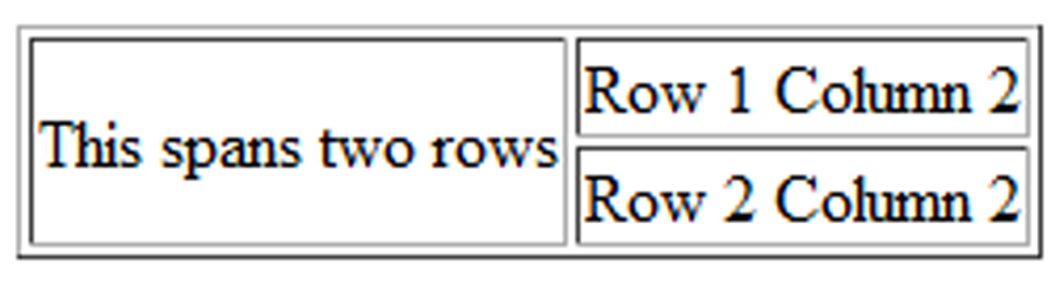
HTML ROWSPAN ATTRIBUTE
<table border="1">
<tr>
<td rowspan="2">This spans two rows</td>
<td>Row 1 Column 2</td>
</tr>
<tr>
<td>Row 2 Column 2</td>
</tr>
</table>

Slide 14
EXAMPLE
file:///J:/INF286/chapter8/table5.html

Slide 15
HANDS-ON-PRACTICE 8.2
file:///J:/INF286/chapter8/table6.html

Slide 16
ACCESSIBILITY AND TABLES
Use table header elements (<th> tags) to indicate column or row headings.
Use the caption element to provide a text title or caption for the table.
Complex tables:
Associate table cell values with their corresponding headers
  <th> tag id attribute
  <td> tag headers attribute

Slide 17
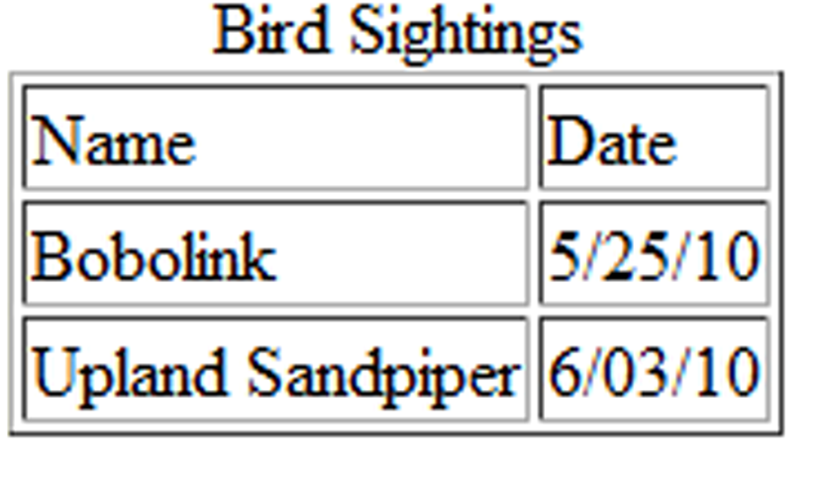
<table border="1">
<caption>Bird Sightings</caption>
<tr>
<th id="name">Name</th>
<th id="date">Date</th>
</tr>
<tr>
<td headers="name">Bobolink</td>
<td headers="date">5/25/10</td>
</tr>
<tr>
<td headers="name">Upland Sandpiper</td>
<td headers="date">6/03/10</td>
</tr>
</table>

Slide 18
EXAMPLE
file:///J:/INF286/chapter8/table8.html

Slide 19
USING CSS TO STYLE A TABLE
HTML Attribute | CSS Property
align | Align a table: table { width: 75%; margin: auto; } Align within a table cell: text-align
bgcolor | background-color
cellpadding | padding
cellspacing | border-spacing or border-collapse
height | height
valign | vertical-align
width | width
border | border, border-style, or border-spacing
-- | background-image

Slide 20
HANDS-ON-PRACTICE 8.3
file:///J:/INF286/chapter8/starter.html
file:///J:/INF286/chapter8/menu.html

Slide 21
CSS STRUCTURAL PSEUDO-CLASSES
Pseudo-class | Purpose
:first-of-type | Applies to the first element of the specified type
:first-child | Applies to the first child of an element (CSS2 selector)
:last-of-type | Applies to the last element of the specified type
:last-child | Applies to the last child of an element
:nth-of-type(n) | Applies to the “nth” element of the specified type Values: a number, odd, or even
Zebra Stripe a Table
tr:nth-of-type(even) { background-color: #eaeaea; }

Slide 22
HANDS-ON-PRACTICE 8.4
file:///J:/INF286/chapter8/menu.html
file:///J:/INF286/chapter8/menucss3.html

Slide 23
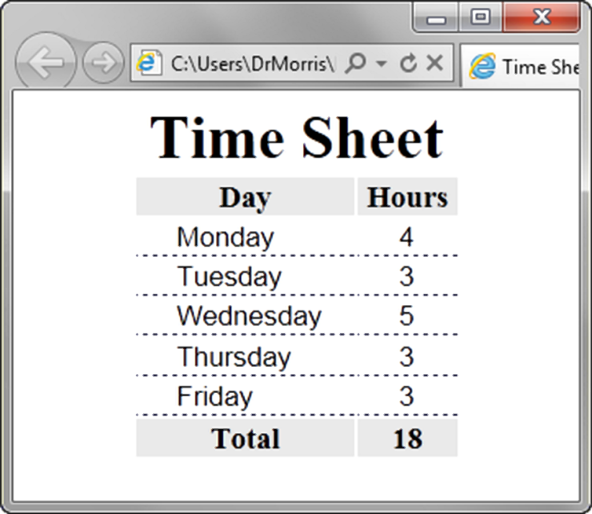
TABLE ROW
GROUPS
<table> <caption>Time Sheet</caption>
<thead>
<tr>
<th id="day">Day</th>
<th id="hours">Hours</th>
</tr>
</thead>
<tbody>
<tr>
<td headers="day">Monday</td>
<td headers="hours">4</td>
</tr>
…
<tr>
<td headers="day">Friday</td>
<td headers="hours">3</td>
</tr>
</tbody>
<tfoot>
<tr>
<td headers="day">Total</td>
<td headers="hours">18</td>
</tr>
</tfoot> </table>
<thead>
table head rows
<tbody >
table body rows
<tfoot>
table footer rows

Slide 24
HANDS-ON-PRACTICE 8.5
file:///J:/INF286/chapter8/tfoot.html

