Slide 1
WEB DEVELOPMENT & DESIGN FOUNDATIONS WITH HTML5
Chapter 9
Key Concepts
Copyright © Terry Felke-Morris

Slide 2

OVERVIEW OF FORMS
Forms are used all over the Web to
  Accept information
  Provide interactivity
Types of forms:
  Search form, Order form, Newsletter sign-up form, Survey form, Add to Cart form, and so on…

Slide 3
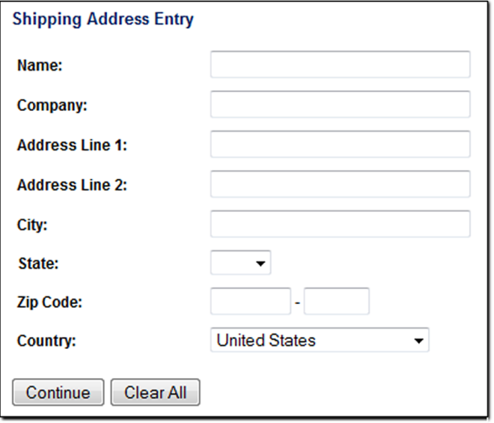
OVERVIEW OF FORMS (2)
Form
  An HTML element that
  contains and organizes
  form controls such as
  text boxes,
  check boxes,
  and buttons
  that can accept information from website visitors.

Slide 4
TWO COMPONENTS OF USING FORMS
1. The HTML form (INF286)
  -- the web page user interface
and
2. The server-side processing (CSC301)
  Server-side processing works with the form data and sends e-mail, writes to a text file, updates a database, or performs some other type of processing on the server.

Slide 5
HTML USING FORMS
<form>
  Contains the form elements on a web page
  Container tag
<input>
  Configures a variety of form elements including text boxes, radio buttons, check boxes, and buttons
  Stand alone tag
<textarea>
  Configures a scrolling text box
  Container tag
<select>
  Configures a select box (drop down list)
  Container tag
<option>
  Configures an option in the select box
  Container tag

Slide 6
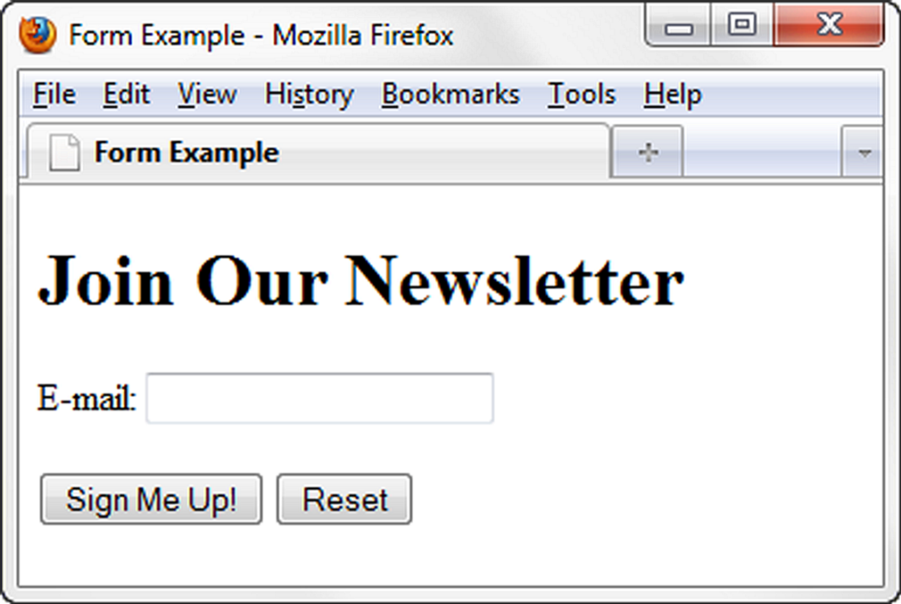
SAMPLE FORM HTML
<form>
E-mail: <input type="text" name ="email" id="email"><br>
<input type="submit">
<input type=“reset">
</form>

Slide 7
HTML FORM ELEMENT
The form element attributes:
  action
    Specifies the server-side program or script that will process your form data
  method
    get – default value,
    form data passed in URL
    post – more secure,
    form data passed in HTTP Entity Body
  name
    Identifies the form
  id
    Identifies the form

Slide 8
HANDS-ON PRACTICE 9.1
Chapter9/form1.html

Slide 9
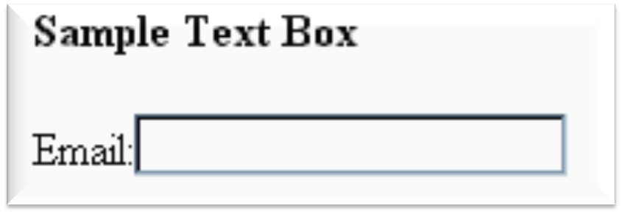
INPUT TEXT BOX
<input>
Accepts text information
Attributes:
  type=“text”
  name
  id
  size
  maxlength
  value

Slide 10
HANDS-ON PRACTICE 9.1
Chapter9/form1.html

Slide 11
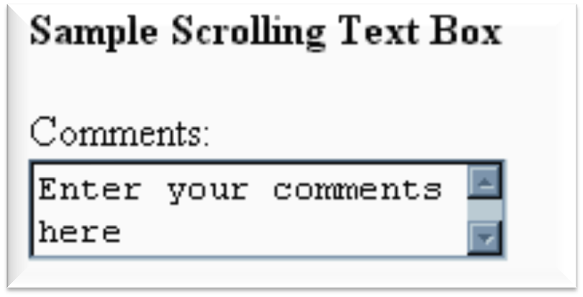
TEXTAREA SCROLLING TEXT BOX
<textarea> </textarea>
Configures a scrolling text box
Attributes:
  name
  id
  cols
  rows

Slide 12
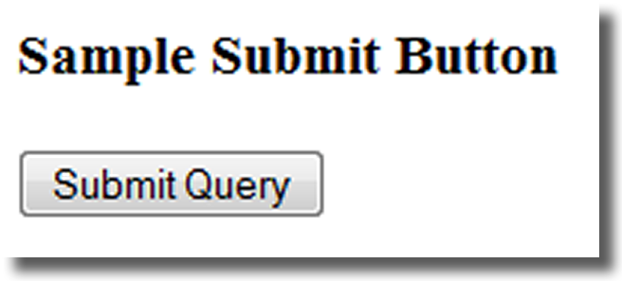
INPUT SUBMIT BUTTON
<input>
Submits the form information
When clicked:
  Triggers the action method on the <form> tag
  Sends the form data (the name=value pair for each form element) to the web server.
Attributes:
  type=“submit”
  name
  id
  value

Slide 13
HANDS-ON PRACTICE 9.2
Chapter9/form2.html

Slide 14
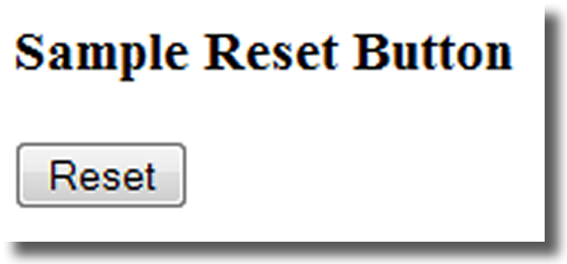
INPUT RESET BUTTON
<input>
Resets the form fields to their initial values
Attributes:
  type=“reset”
  name
  id
  value

Slide 15
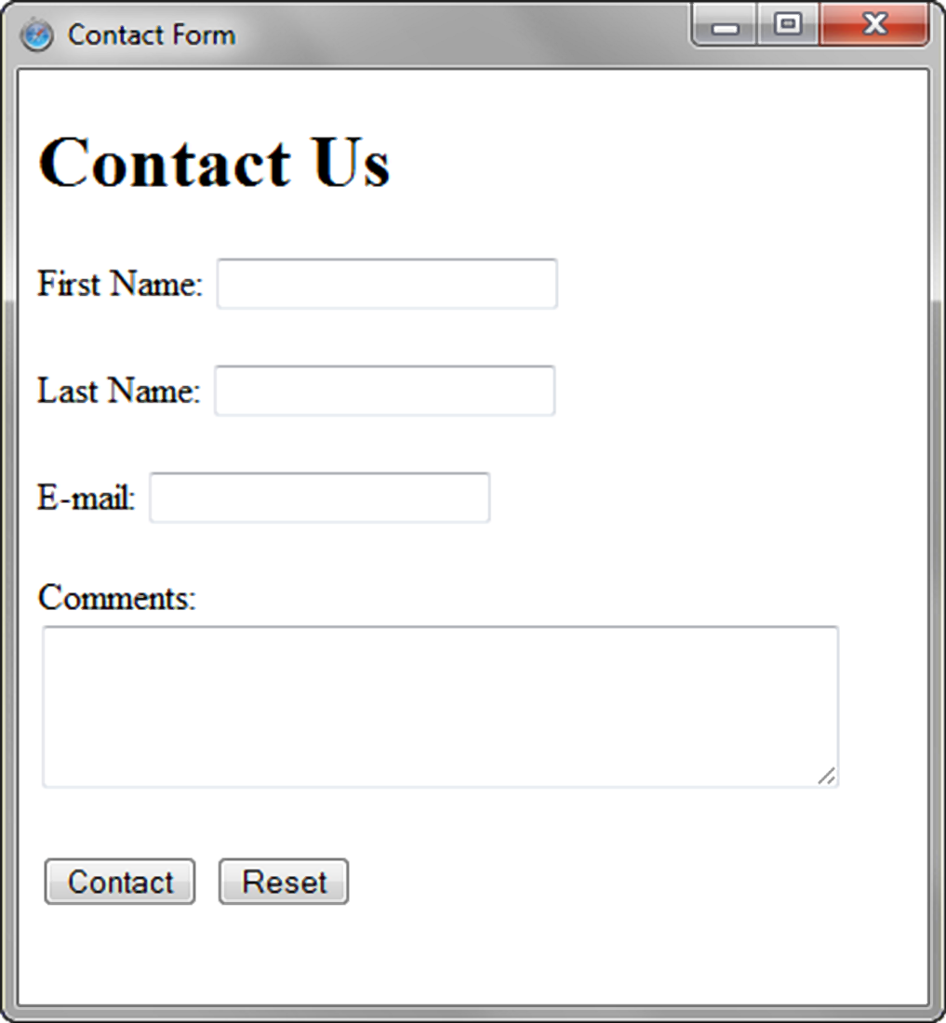
HANDS-ON PRACTICE

Slide 16
HANDS-ON PRACTICE 9.2
Chapter9/form2.html

Slide 17
PRIME PROPERTIES CONTACT
Prime/Chapter9/contact.html

Slide 18
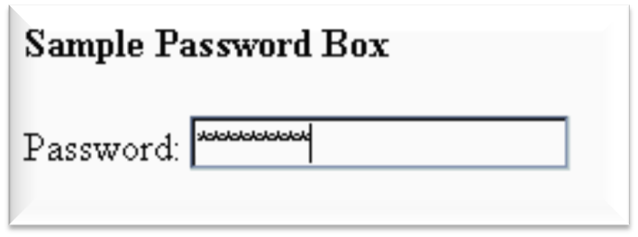
INPUT PASSWORD BOX
<input>
Accepts text information that needs to be hidden as it is entered
Attributes:
  type=“password”
  name
  id
  size
  maxlength
  value

Slide 19
EXAMPLE
Chapter9/login.html

Slide 20
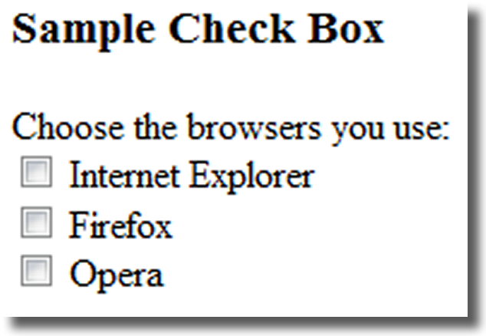
INPUT CHECK BOX
<input>
Allows the user to select one or more of a group of predetermined items
Attributes:
  type=“checkbox”
  name
  id
  checked
  value
1

Slide 21
EXAMPLE
Chapter9/info.html

Slide 22
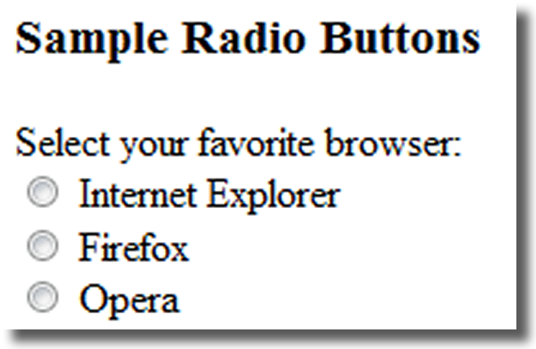
INPUT RADIO BUTTON
<input>
Allows the user to select exactly one from a group of predetermined items
Each radio button in a group is given the same name and a unique value
Attributes:
  type=“radio”
  name
  id
  checked
  value

Slide 23
EXAMPLE
Chapter9/info.html

Slide 24
INPUT HIDDEN FORM DATA
<input>
This form control is not displayed on the web page.
Hidden form fields
  Can be accessed by both client-side and server-side scripting
  Sometimes used to contain information needed as the visitor moves from page to page.
Attributes:
  type=“hidden”
  name
  id
  value

Slide 25
EXAMPLE
Chapter9/login2.html

Slide 26
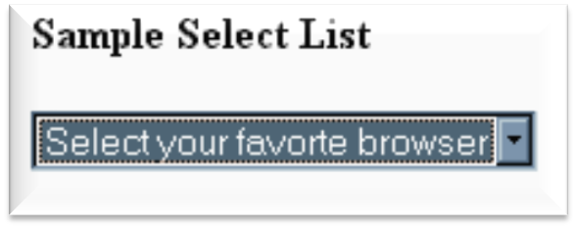
SELECT LIST
<select></select>
Configures a select list (along with option elements)
Also known as: Select Box, Drop-Down List, Drop-Down Box, and Option Box.
Allows the user to select one or more items from a list of predetermined choices.
Attributes:
  name
  id
  size
  multiple

Slide 27
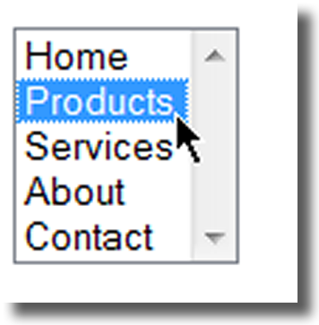
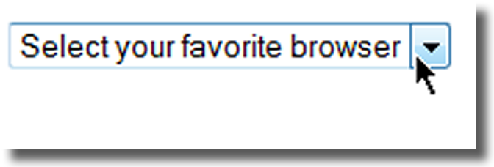
OPTIONS IN A SELECT LIST
<option></option>
Configures the options in a Select List
Attributes:
  value
  selected

Slide 28
EXAMPLE
Chapter9/state.html

