Slide 1
WEB DEVELOPMENT & DESIGN FOUNDATIONS WITH HTML5
Chapter 9
Key Concepts
Copyright © Terry Felke-Morris

Slide 2
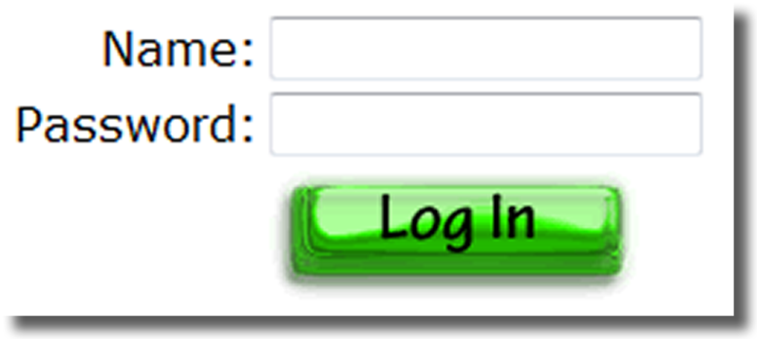
INPUT IMAGE BUTTON
<input>
Submits the form
When clicked:
  Triggers the action method on the form tag
  Sends the form data (the name=value pair for each form element) to the web server.
Attributes:
  type=“image”
  name
  id
  src

Slide 3
INPUT IMAGE BUTTON
<input type=“image” src=“login.gif”>

Slide 4
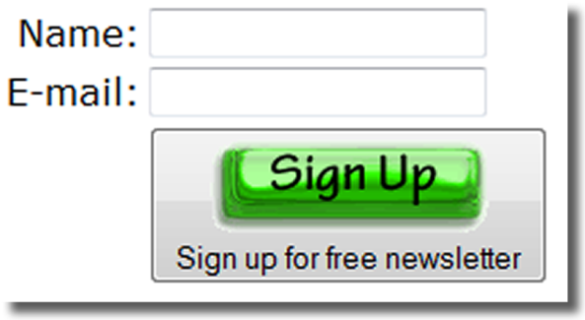
BUTTON ELEMENT
<button></button>
A container tag
When clicked, its function depends on the value of the type attribute.
Can contain a combination of text, images, and media
Attributes:
  type=“submit”, type=“reset”, type=“button”
  name
  id
  alt
  value

Slide 5
BUTTON ELEMENT
<button type=“submit”>
<img src=“signup.gif” width=“80” height=“28”>
</button>

Slide 6
ACCESSIBILITY & FORMS
Label Element
Fieldset Element
Legend Element
Tabindex Attribute
Accesskey Attribute

Slide 7
LABEL ELEMENT
<label></label>
Associates a text label with a form control
Two Different Formats:
<label>Email: <input type="text" name=“email" id ="email"></label>
  Or
  <label for="email">Email: </label>
  <input type="text" name="CustEmail" id= "email">

Slide 8
HANDS-ON PRACTICE 9.3
chapter9/form3.html
For screen readers

Slide 9
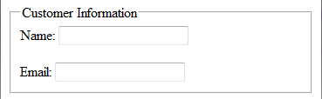
FIELDSET AND LEGEND ELEMENTS
The Fieldset Element
  Container tag
  Creates a visual group of
  form elements on a web page
The Legend Element
  Container tag
  Creates a text label within the fieldset
  <fieldset><legend>Customer Information</legend>
  <label>Name:
  <input type="text" name="Name" id="Name“></label>
  <br><br>
  <label>Email:
  <input type="text" name="Email" id="Email"></label>
  </fieldset>

Slide 10
HANDS-ON PRACTICE 9.4
chapter9/form4.html
chapter9/form4a.html

Slide 11
TABINDEX ATTRIBUTE
Attribute that can be used on form controls and anchor tags
Modifies the default tab order
Assign a numeric value
<input type="text" name="CustEmail" id="CustEmail" tabindex="1">

Slide 12
ACCESSKEY ATTRIBUTE
Attribute that can be used on form controls and anchor tags
Create a “hot-key” combination to place the focus on the component
Assign a value of a keyboard letter
On Windows use the CTRL and the “hot-key” to move the cursor
<input type="text" name="CustEmail" id="CustEmail" accesskey="E">

Slide 13
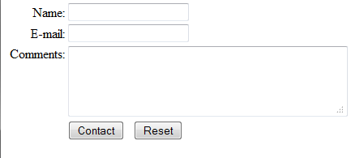
FORMAT A FORM
WITH A TABLE
<form method="get">
<table border="0">
<tr>
<td align="right">Name:</td>
<td><input type="text" name="fmail" id="fmail"></td>
</tr>
<tr>
<td align="right">E-mail:</td>
<td><input type="text" name="email" id="email"></td>
</tr>
<tr>
<td align="right" valign="top">Comments:</td>
<td><textarea name="comments" id="comments" rows="4" cols="40"></textarea></td>
</tr>
<tr>
<td>&nbsp;</td>
<td><input type="submit" value="Contact">
&nbsp; <input type="reset"></td>
</tr>
</table>
</form>

Slide 14
EXAMPLE
chapter9/formtable.html

Slide 15
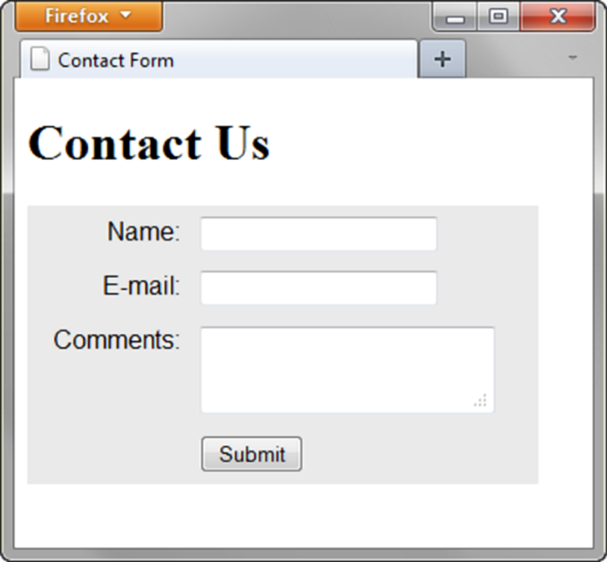
USING CSS TO STYLE A FORM
Transitional Approach
  Use a table to format the form but configure styles instead of HTML table attributes.
table { background-color: #eaeaea;
border-style: none;
width: 20em;
font-family: Arial, sans-serif; }
th { font-weight: normal;
text-align: right;
vertical-align: top; }
td, th {padding: 5px; }

Slide 16
EXAMPLE
chapter9/formtable2.html

Slide 17
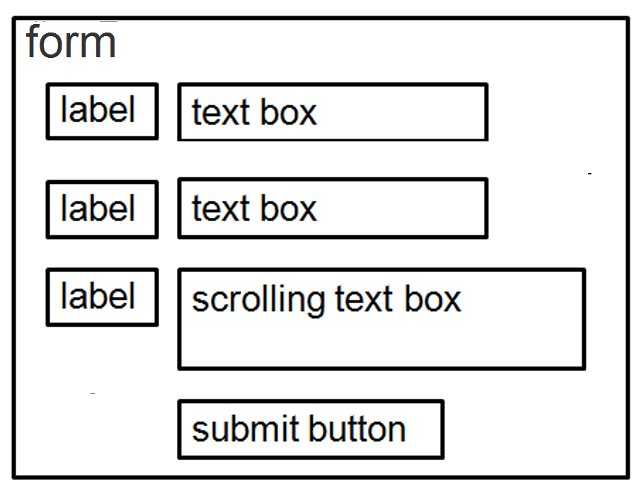
USING CSS TO
STYLE A FORM
“Pure" CSS Approach
  Do not use a table to format the form.
  Use CSS float and display: block
form { background-color:#eaeaea; width: 350px;
font-family: Arial, sans-serif; padding: 10px; }
label { float: left; width: 100px; display: block;
clear: left; text-align: right; padding-right: 10px;
margin-top: 10px; }
input, textarea { margin-top: 10px; display: block; }
#mySubmit { margin-left: 110px; }

Slide 18
EXAMPLE
chapter9/formcss.html

