Slide 1
WEB DEVELOPMENT & DESIGN FOUNDATIONS WITH HTML5
Chapter 9
Key Concepts
Copyright © Terry Felke-Morris

Slide 2
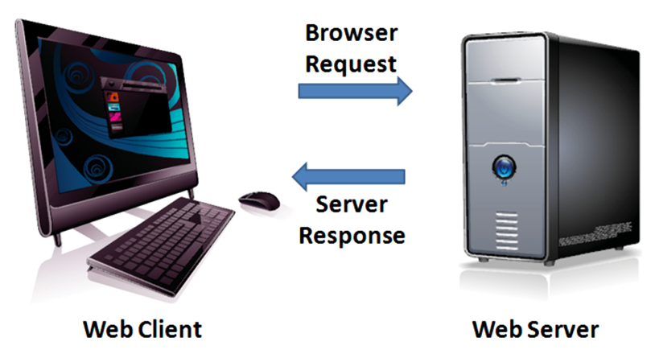
SERVER-SIDE
PROCESSING
Your web browser requests web pages and their related files from a web server.
The web server locates the files and sends them to your web browser.
The web browser then renders the returned files and displays the requested web pages for you to use.

Slide 3
CGI
COMMON GATEWAY INTERFACE
A protocol for a web server to pass a web page user's request to an application program and accept information to send to the user.

Slide 4
SERVER-SIDE SCRIPTING
One of many technologies in which a server-side script is embedded within a Web page document saved with a file extension such as:
  .php (PHP)
  .asp (Active Server Pages)
  .cfm (Adobe ColdFusion)
  .jsp (Sun JavaServer Pages)
  .aspx (ASP.Net).
Uses direct execution — the script is run either by the web server itself or by an extension module to the web server.

Slide 5

STEPS IN UTILIZING SERVER-SIDE PROCESSING
Web page invokes server-side processing by a form or hyperlink.
Web server executes a server-side script.
Server-side script accesses requested database, file, or process.
Web server returns web page with requested information or confirmation of action.

Slide 6
COMMON USES OF
SERVER-SIDE SCRIPTING
Search a database
Place an order at an online store
Send a web page to a friend
Subscribe to a newsletter

Slide 7
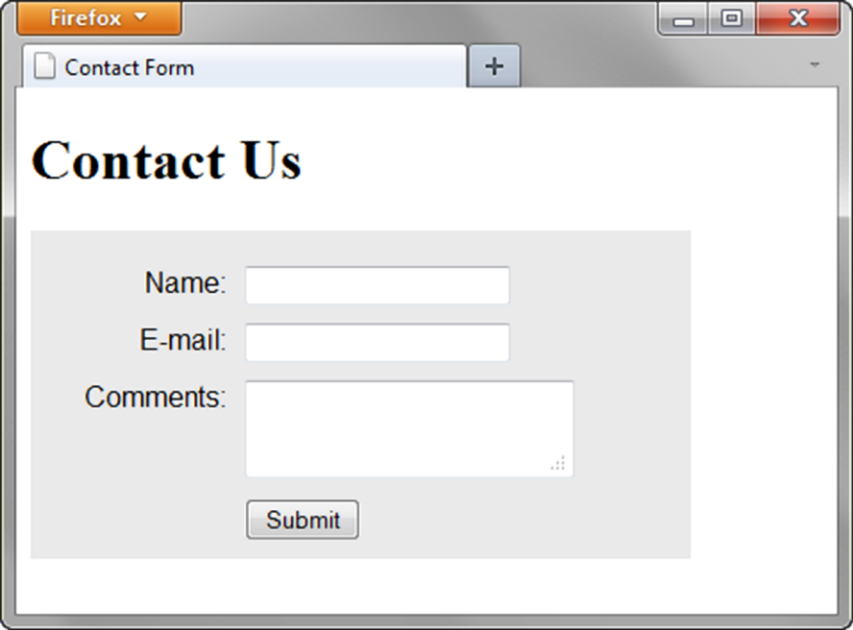
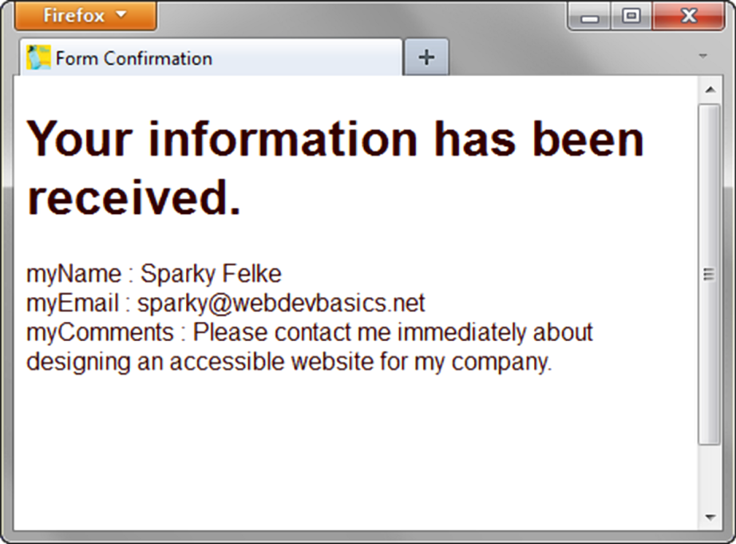
SENDING INFORMATION TO
A SERVER-SIDE SCRIPT
<form method="post" action="http://webdevbasics.net/scripts/demo.php ">

Slide 8
HANDS-ON PRACTICE 9.5
chapter9/contact.html

Slide 9
SOURCES OF FREE
SERVER-SIDE PROCESSING
Many web host providers offer free scripts for their clients. Contact their support area or FAQ to learn more about their services.
Some web sites that offer FREE remotely hosted scripts (in return for displaying an ad).
  http://formbuddy.com
  http://response-o-matic.com
  http://master.com
  http://www.formmail.com
  http://wufoo.com
  http://icebrrg.com
  http://formassembly.com

Slide 10
SERVER-SIDE SCRIPTING TECHNOLOGIES
JavaServer Pages
http://java.sun.com/products/jsp
Active Server Pages
Visit http://msdn.microsoft.com and search for “Active Server Pages”
ColdFusion
http://www.adobe.com/products/coldfusion
PHP
http://www.php.net
Ruby on Rails
http://www.rubyonrails.org or http://tryruby.hobix.com
Microsoft’s .NET Framework
http://www.microsoft.com/net

Slide 11
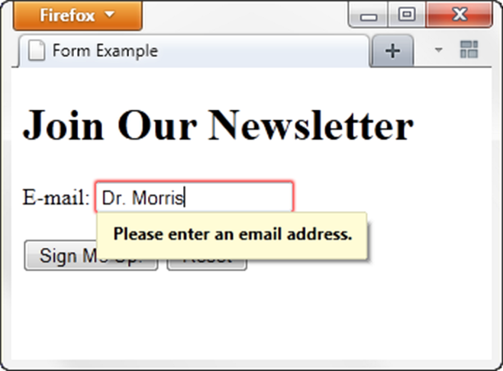
HTML5: EMAIL TEXT BOX
<input>
Accepts text information in e-mail address format
Common Attributes:
  type=“email”
  name
  id
  size
  maxlength
  value
  placeholder
  required

Slide 12
EXAMPLE
chapter9/email.html

Slide 13
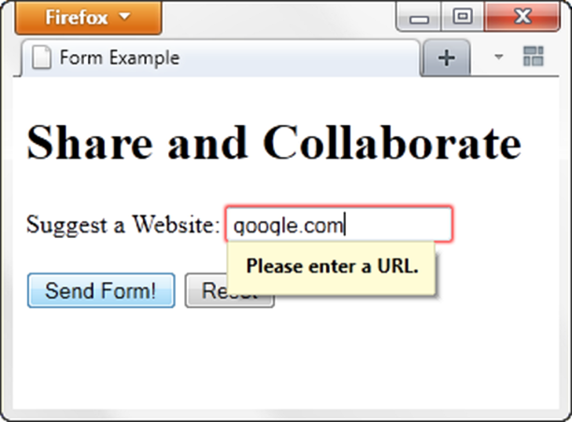
HTML5: URL TEXT BOX
<input>
Accepts text information in URL format
Common Attributes:
  type=“url”
  name
  id
  size
  maxlength
  value
  placeholder
  required

Slide 14
EXAMPLE
chapter9/url.html

Slide 15
HTML5: TELEPHONE NUMBER TEXT BOX
<input>
Accepts text information in telephone number format
Common Attributes:
  type=“tel”
  name
  id
  size
  maxlength
  value
  placeholder
  required

Slide 16
EXAMPLE
chapter9/tel.html

Slide 17
HTML5: SEARCH TEXT BOX
<input>
Accepts search terms
Common Attributes:
  type=“search”
  name
  id
  size
  maxlength
  value
  placeholder
  required

Slide 18
EXAMPLE
chapter9/search.html

Slide 19
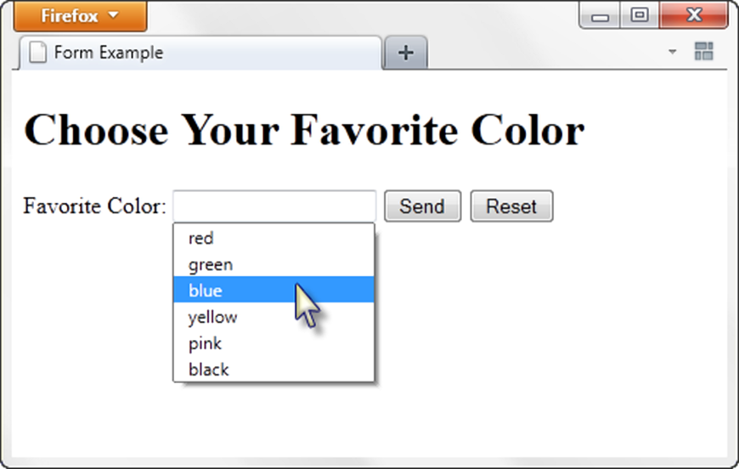
HTML5: DATALIST CONTROL
<label for="color">Favorite Color:</label>
<input type="text" name="color" id="color" list="colors" >
<datalist id="colors">
<option value="red">
<option value="green">
<option value="blue">
<option value="yellow">
<option value="pink">
<option value="black">
</datalist>

Slide 20
EXAMPLE
chapter9/list.html

Slide 21
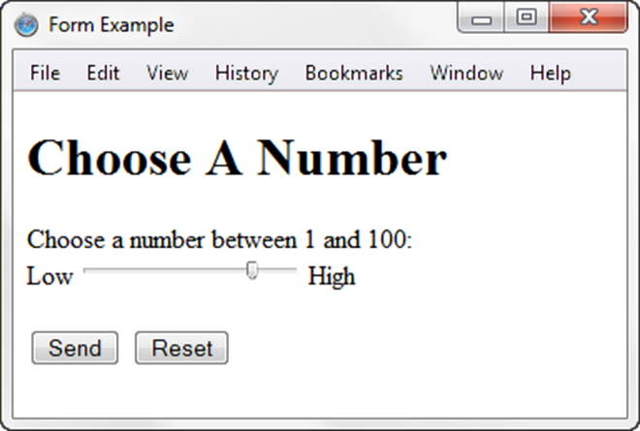
HTML5: SLIDER CONTROL
<label for="myChoice">
Choose a number between 1 and 100:</label><br>
Low <input type="range" name="myChoice" id="myChoice"> High

Slide 22
EXAMPLE
chapter9/range.html

Slide 23
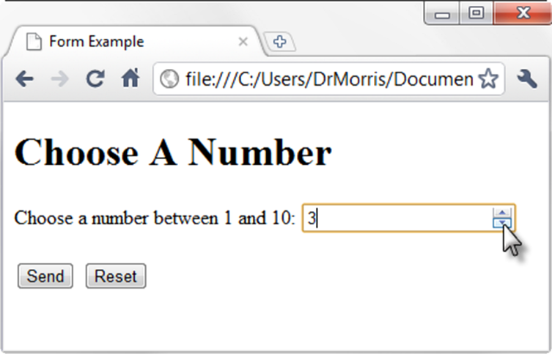
HTML5: SPINNER CONTROL
<label for="myChoice">Choose a number between 1 and 10:</label>
<input type="number" name="myChoice" id="myChoice"
min="1" max="10">

Slide 24
EXAMPLE
chapter9/spinner.html

Slide 25
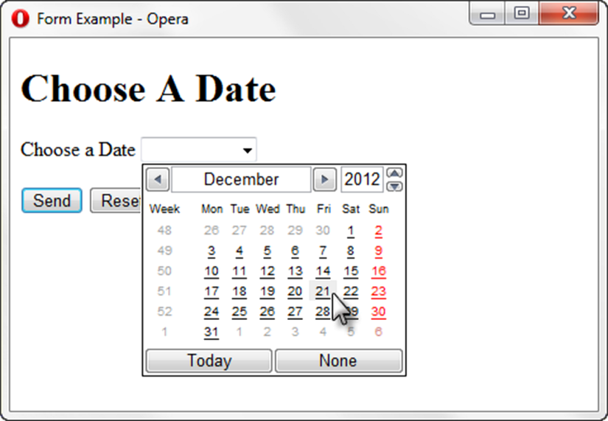
HTML5: CALENDAR CONTROL
<label for="myDate">Choose a Date</label>
<input type="date" name="myDate" id="myDate">

Slide 26
EXAMPLES
chapter9/date.html
Only works with the Opera browser
Choose a color
chapter9/color.html

Slide 27
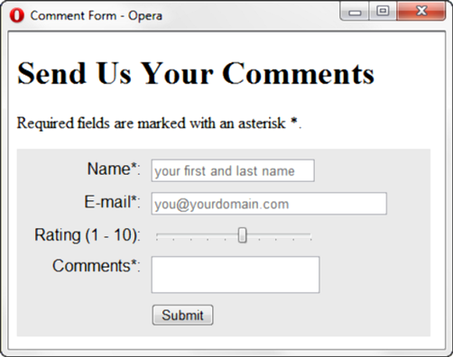
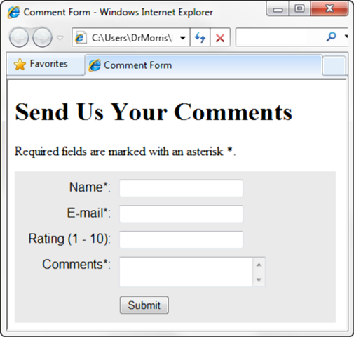
PRACTICE WITH AN HTML5 FORM
The form display and functioning varies with browser support.

Slide 28
HANDS-ON PRACTICE 9.6
<input type="text" name="myName" id="myName" required="required" placeholder="your first and last name">
chapter9/form5.html

