Slide 1
Git/GitHub workshop
October 2, 2024

Slide 2
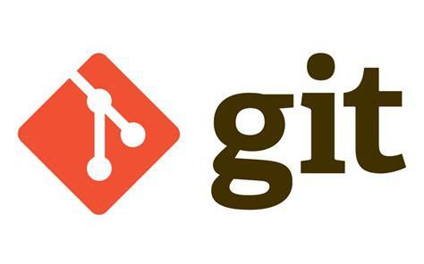
What is Git?
A distributed version control system

Slide 3
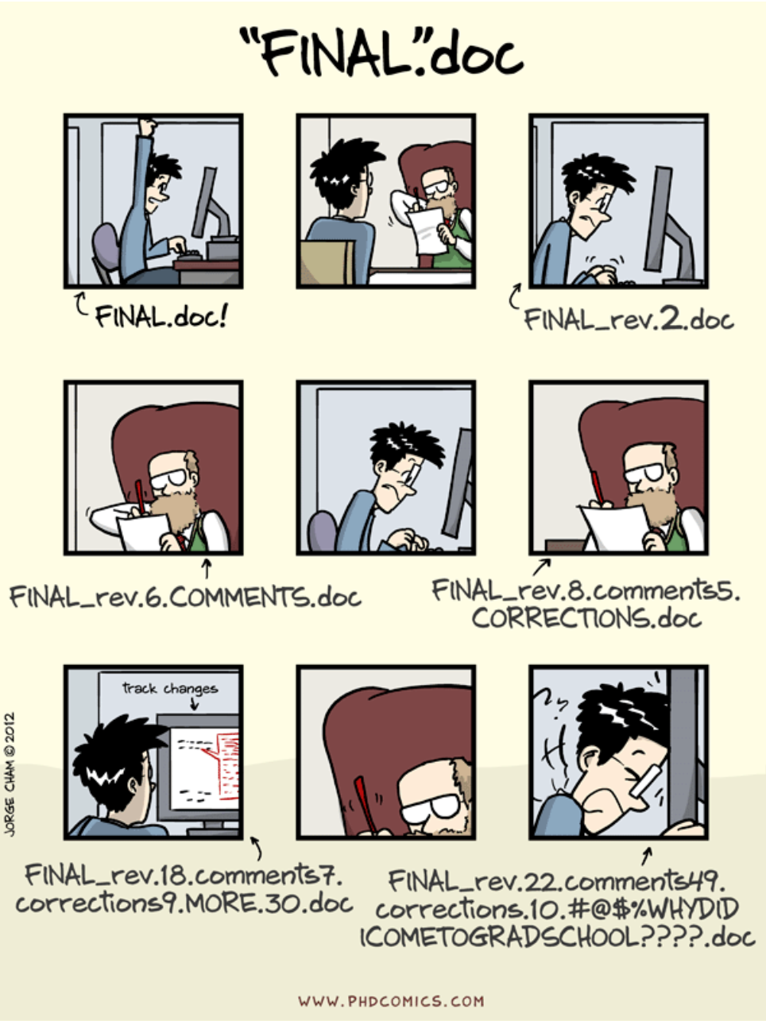
Version Control
A better way to do this

Slide 4

Version Control
From Git website

Slide 5
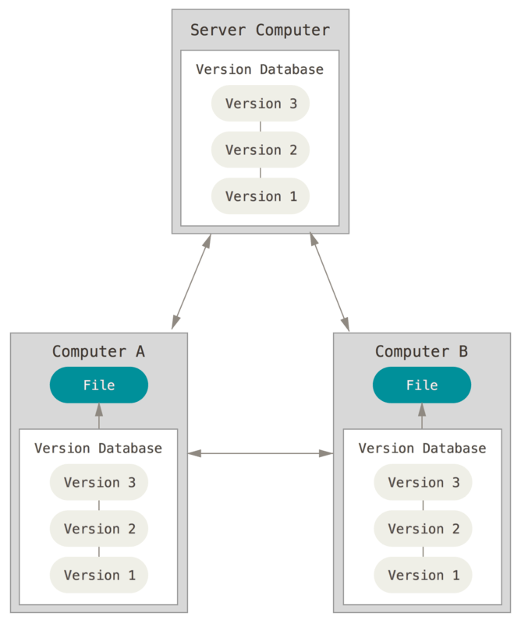
Distributed Version control
From Git’s website

Slide 6
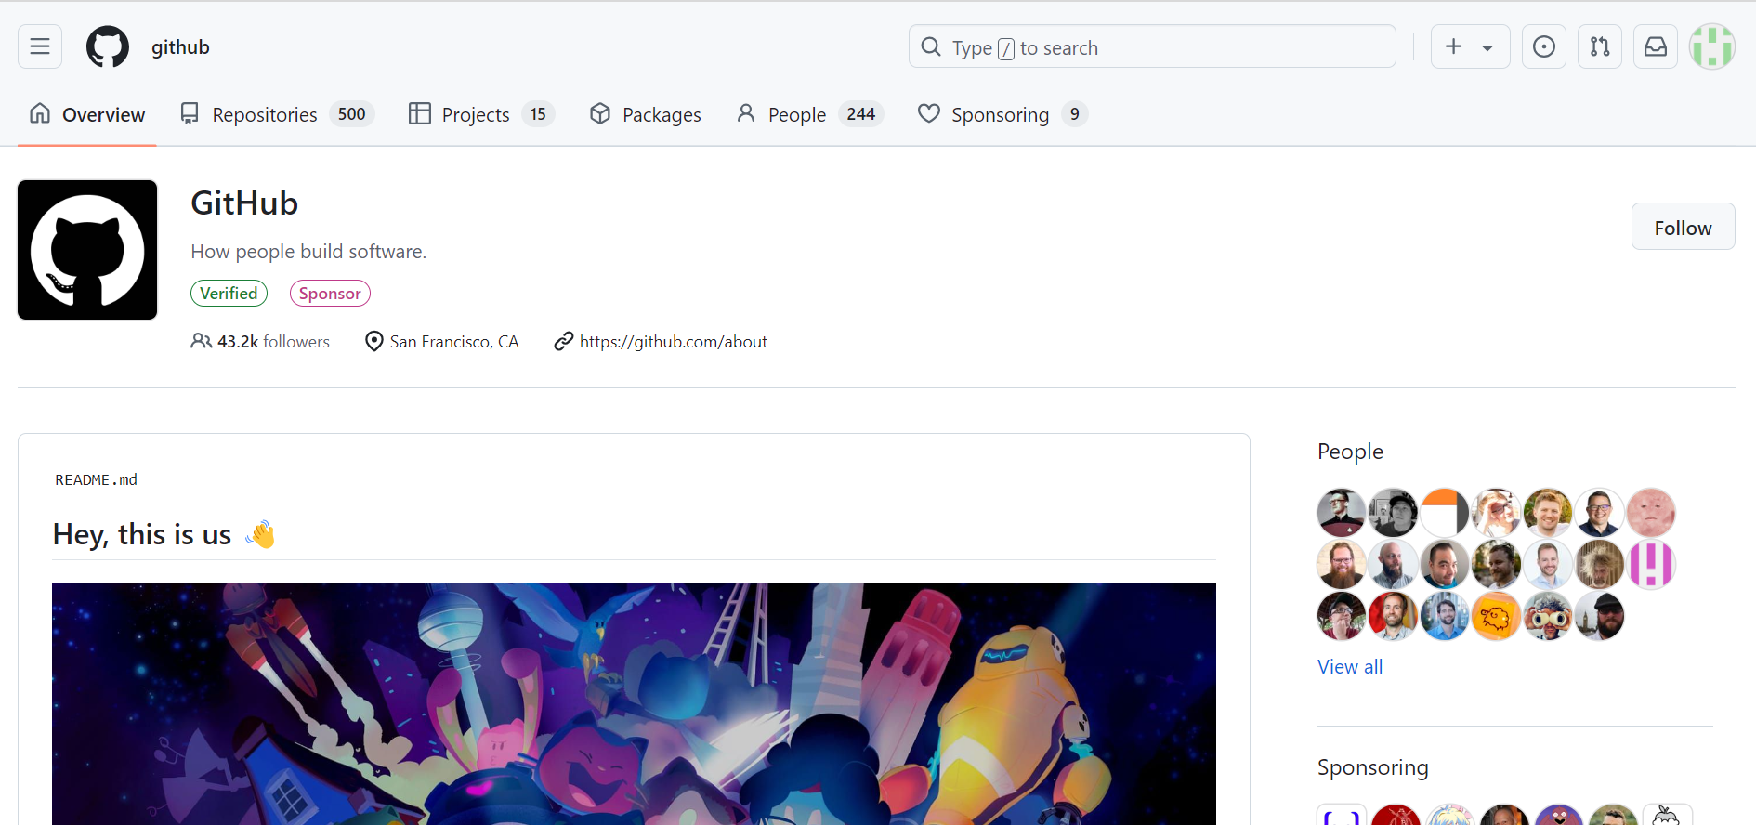
GitHub
A place to host Git repositories online

Slide 7
Some Git commands
Clone
Make a copy of a repository on your computer
Commit
Save a copy of the changes on your repository. You can go back to a committed version in the future.
Push
Update a remote repository with changes on your copy of the repository.

Slide 8
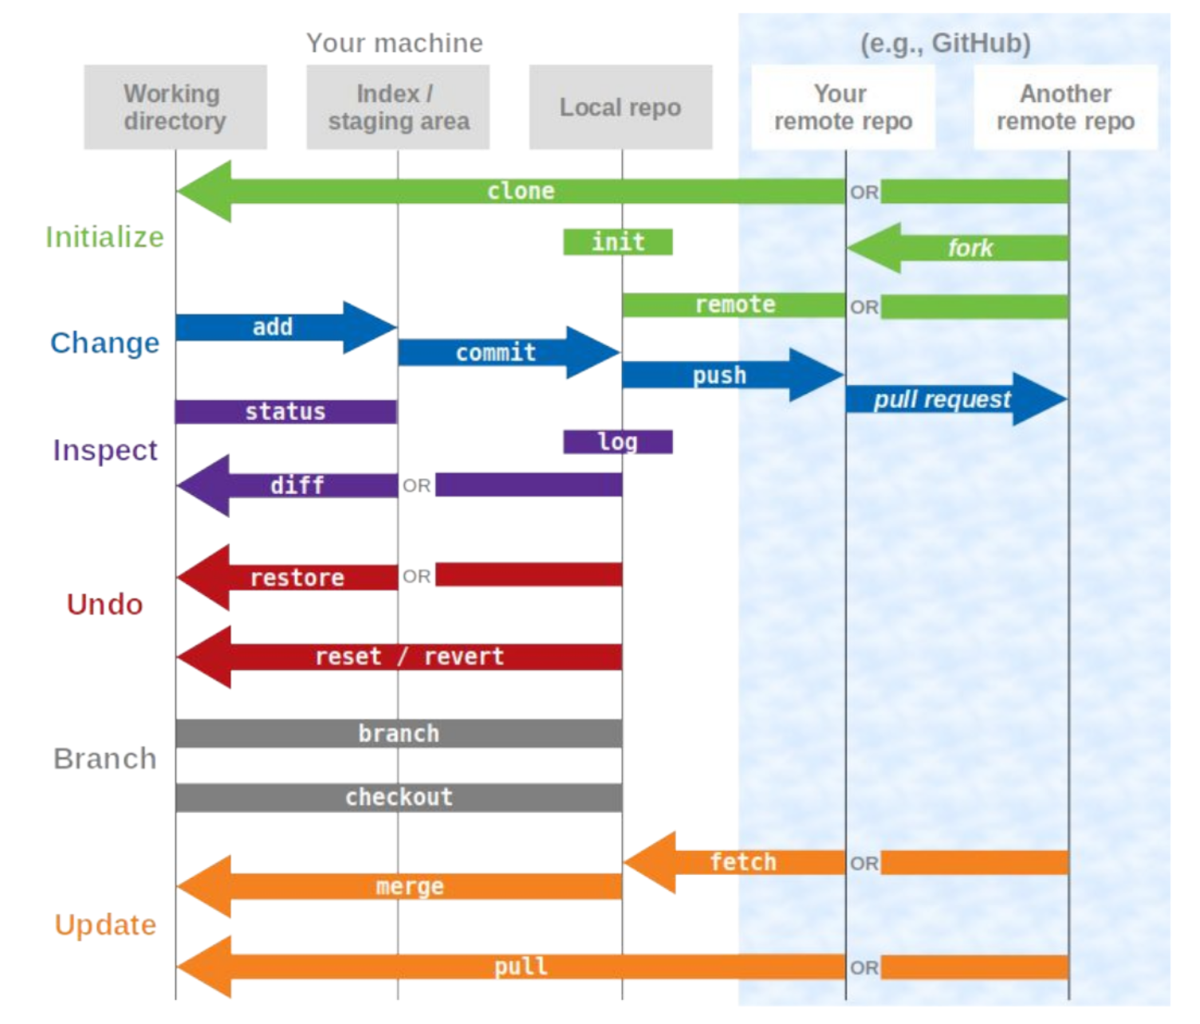
And there is more…
From Kendra Oudyk’s Git workshop

Slide 9
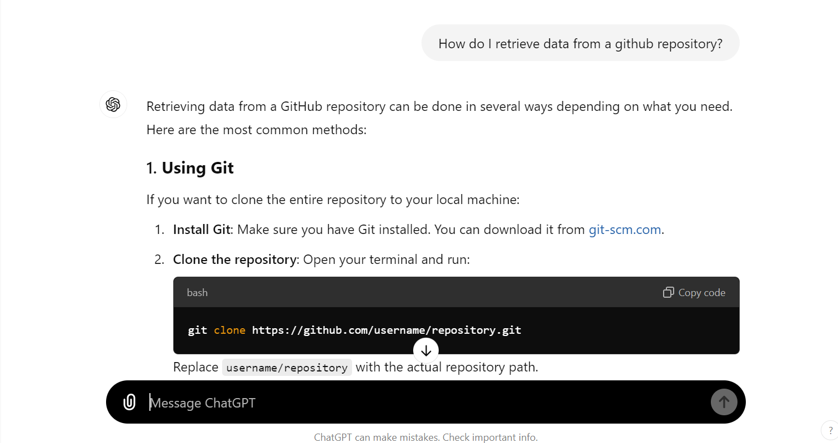
Don’t panic!
You most likely won’t use all of these.
Google and ChatGPT are your friends

Slide 10
Multiple ways to use Git
The terminal (Git Bash)
More freedom but harder to use if you don’t have experience with terminals.
Code editor integrations
Vs code for example or google colab. This might be useful if you are already using a given editor.
Graphical User Interface
GitHub Desktop for example. Easier to use. Probably sufficient to retrieve and publish data on GitHub.

Slide 11
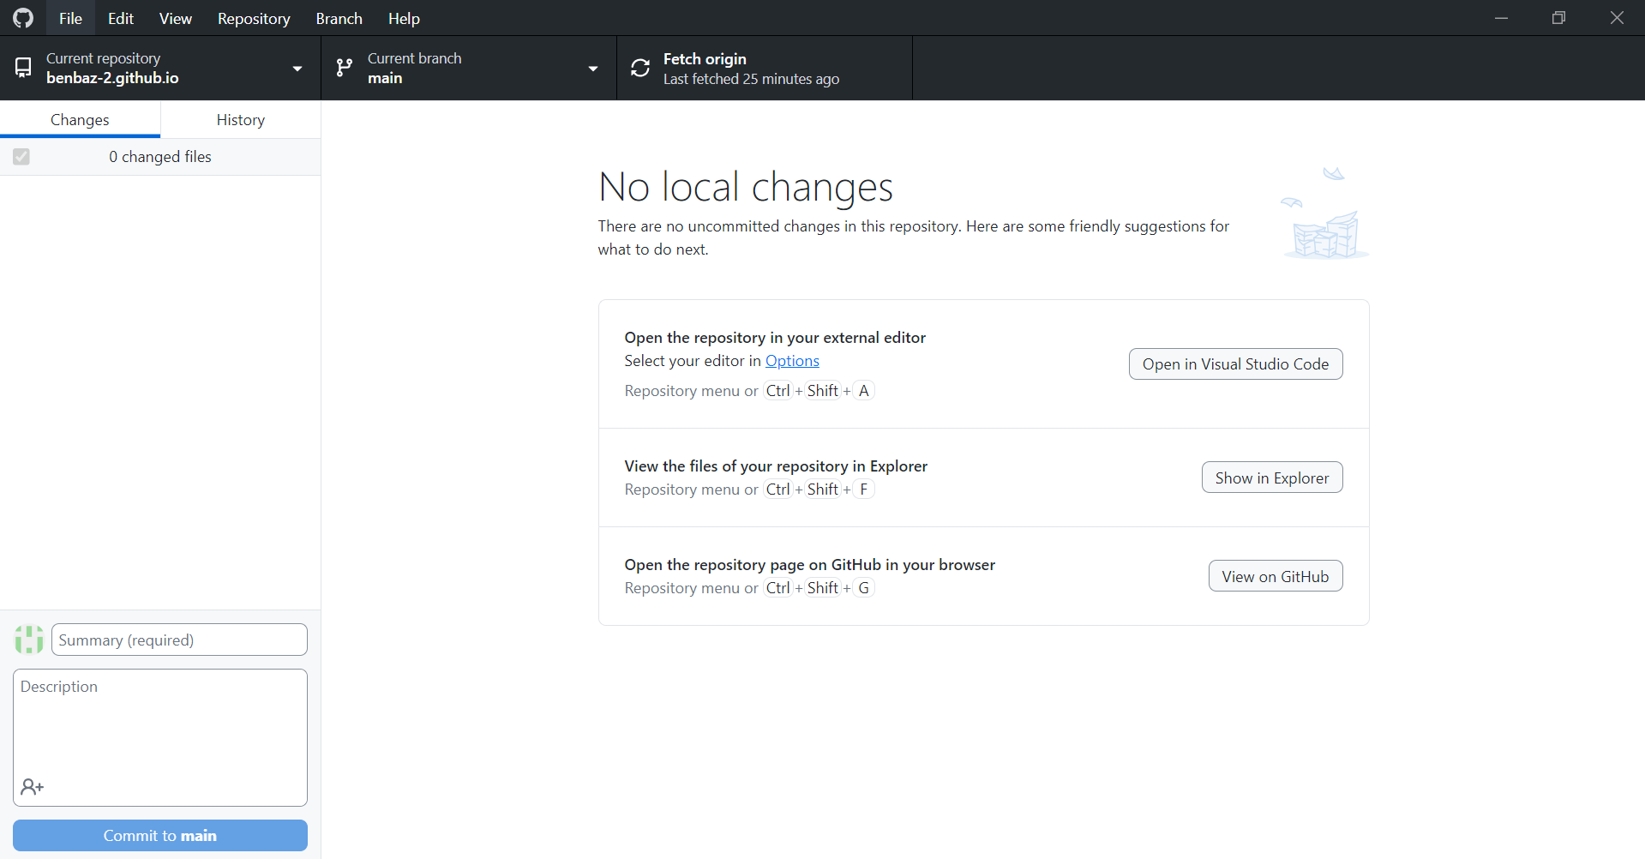
GitHub desktop

