Slide 1
introducing Google Charts
Ben Beadle
CSCE 489 - Practicum
3/20/2013
Notes:
This presentation demonstrates the new capabilities of PowerPoint and it is best viewed in Slide Show. These slides are designed to give you great ideas for the presentations you’ll create in PowerPoint 2010!
For more sample templates, click the File tab, and then on the New tab, click Sample Templates.

Slide 2
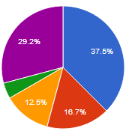
A visualization tool for website developers
What is Google Charts?

Slide 3




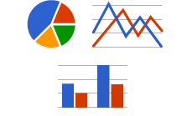
What is Google Charts?
Aggregate data from:
Arrays or literals
Chart Tools Datasource protocol
Your database
Must be in a DataTable or DataView format
Choose from over 15 customizable charts to display your data

Slide 4
Pros and Cons to Google Charts
Pros
Best option for web
Very customizable
Gorgeous Charts
Interactive for your users
Written in JavaScript
No styling required
Cons
A lot to take in
Can require specify
Some charts aren’t available
Doesn’t manipulate

Slide 5
Five Easy Steps
Optional
1
2
3
4
5
6
Choose your chart
Load the libraries
Prepare the data
Customize your chart
Display your chart
Make it interacive
Display gorgeous charts on your website in five easy steps.

Slide 6
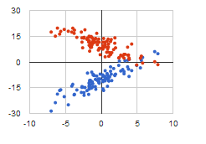
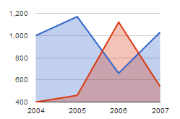
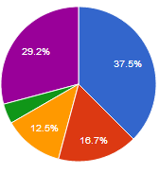
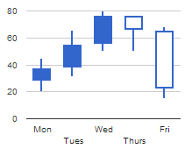
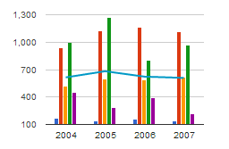
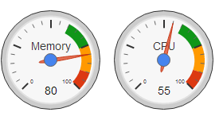
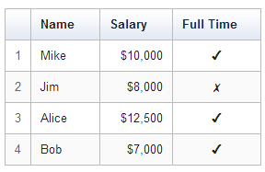
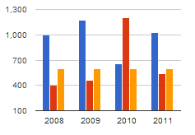
Choose your chart
1

Slide 7
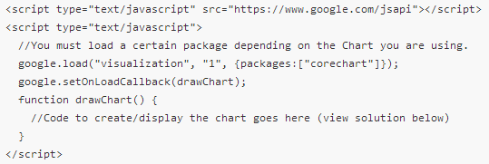
Load the libraries
2
The “package” depends on your chart.

Slide 8
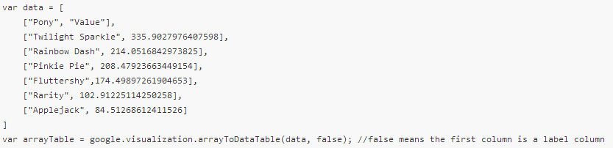
Prepare your data
3
Three ways:
Create a DataTable or DataView object
2. Populate server-side
3. Query a data source

Slide 9
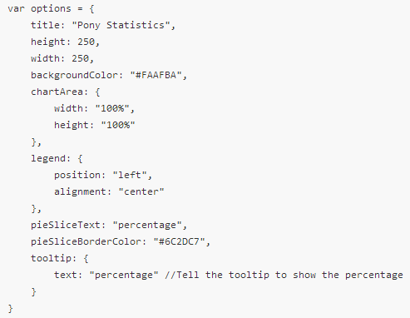
Customize your chart
4
Tons of options
Chart-specific options

Slide 10
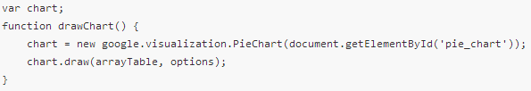
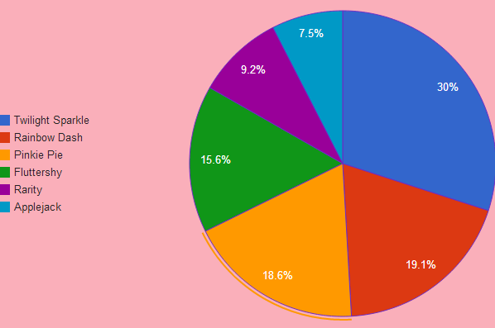

Display your chart
5

Slide 11
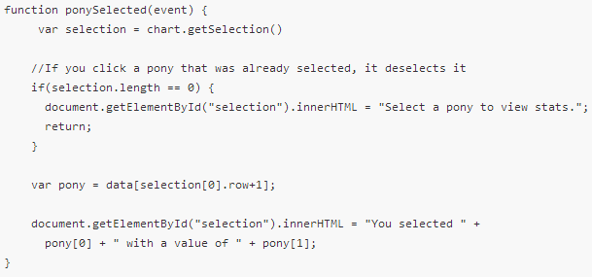
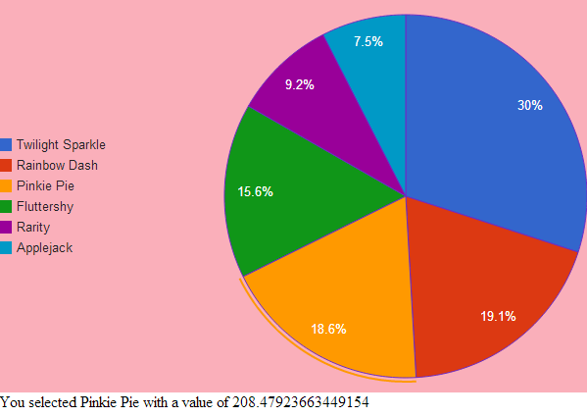
Optional: Make your chart interactive
6

Slide 12



Demo

Slide 13

Questions?
?
Thanks and Gig ‘Em

