Slide 1
Nuclear Fuel Performance
NE-533
Spring 2022

Slide 2
Last Time
There are a variety of limiting phenomena in LWR fuel systems that provide the boundaries of operation and lifetime
These limits include phenomena in the fuel, gap, cladding, corrosion, and assembly levels
Primary system water chemistry affects fuel performance through the deposition of corrosion products on fuel pin surfaces
Beginning of mechanistic modeling

Slide 3
MOOSE Project Part 3
0.5 cm
1-D problem, set up in 2D-RZ
Given a uniform heat generation rate of LHR = 175 W/cm, what are the stresses due to thermal expansion in the fuel?
Will need tensor mechanics and heat conduction
1) Assume a constant fuel surface temperature and constant thermal conductivity
2) Assume a constant fuel surface temperature but temperature dependent thermal conductivity
1 cm
Fuel

Slide 4
Mixed oxide (MOX) fuels

Slide 5
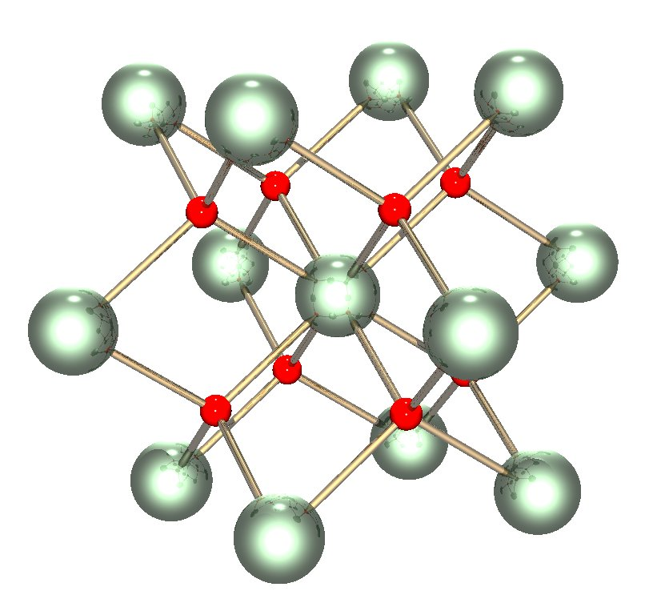
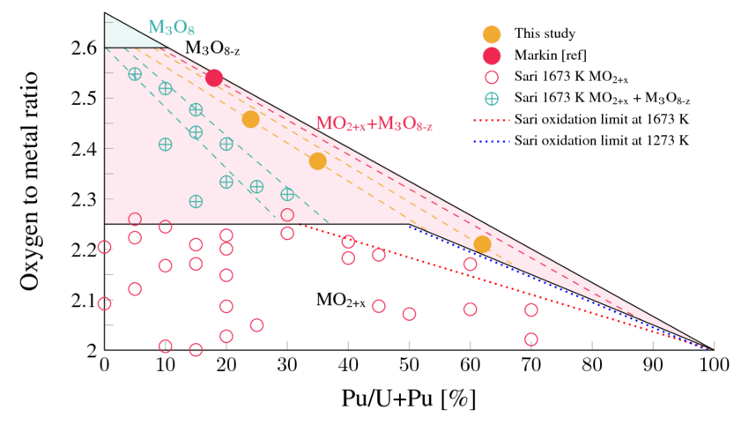
Why MOX?
The first fast breeder reactors built in the 1950s used metallic fuel (plutonium and uranium), as metals offer the highest heavy metal density and therefore the highest breeding ratio
Because of dimensional instability due to swelling and growth, metal fuels could hardly achieve high burnup
By the 1960s, mixed uranium and plutonium oxide (U,Pu)O2 was known to be highly radiation tolerant and began to be considered as a reference fuel for fast reactors

Slide 6
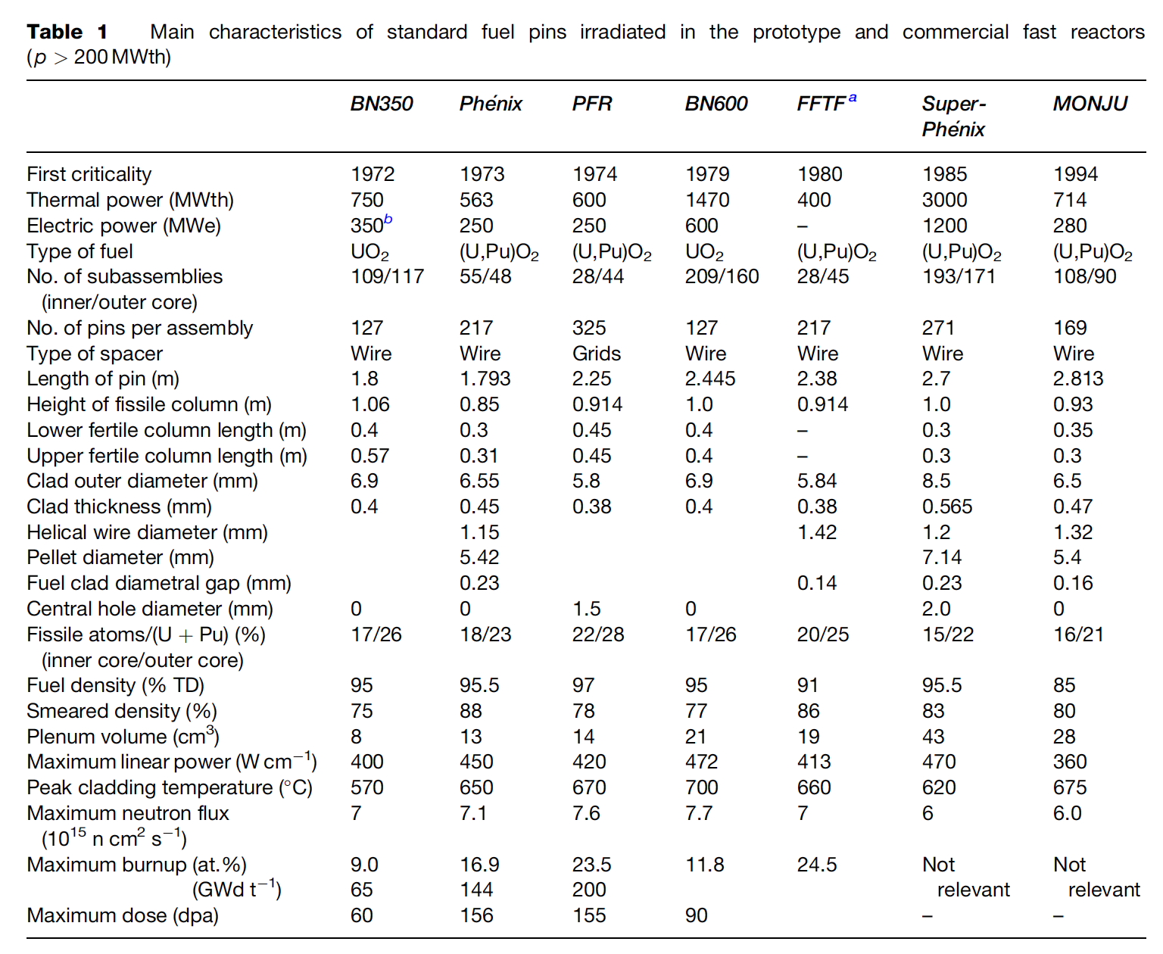
Mixed Oxides
UO2 can be combined with PuO2 for a mixed oxide (MOX) fuel for use in fast reactors
Allows to burn excess weapons grade plutonium
About 30 reactors in Europe currently utilize a partial MOX core
Similar behavior to UO2, but different neutronics, fission gas release, thermal conductivity, etc.
Less common is inclusion of minor actinides in MOX to burn waste

Slide 7
MOX Designs
The fuel pin is a long cylinder (2–3m long, 5–10mm diameter), clad in a steel tube (0.4–0.6mm thick) closed in both ends by welded plugs, preventing direct contact between the radioactive material and the sodium coolant
The oxide fissile column (~1 m long) consists of a stack of conventionally pressed and sintered pellets with an outer diameter slightly smaller than the inner diameter of the clad, providing a gap ~100 micron gap
Both full pellets and annular pellets have been used
A He gap with a pressure ~1 atm is used
Fuel pins of fast reactors are designed to operate at a high linear heat generation rate: between 400 and 500 W/cm, about twice higher than standard linear power in light water reactors (LWRs)

Slide 8
MOX Fuel
As the fast reactor fuel pin diameters are generally smaller than classical rod diameters of LWRs, the power density and heat fluxes are much higher in fast reactors than in LWRs
For example, in a Phenix fuel pin at 450W/cm, the power density in the pellet reaches almost 2000 W/cc
Sodium enters the bottom part of the core at about 400 C and the average coolant temperature above the core is typically about 550 C
The neutron flux is very intense (~7x10¹⁵ n/cm²/s in the core center) and the assembly materials suffer high damage, more than 100 dpa, at high burnup
Qualifying metallic materials able to withstand such high damage while keeping their shape and mechanical properties was/is one of the key challenges for fast reactors
In order to reduce fuel cycle costs, the main objective of oxide fuels R&D for fast reactors has been to reach high burnup, typically around 150 GWd/ton, about twice the burnup achieved in LWRs

Slide 9
MOX Fuel
The main requirements and design criteria are the following:
Guaranteeing the absence of fuel melting, both in nominal conditions and during off-normal events
Keeping cladding integrity and fuel pin tightness
Cooling of the fuel pin bundle must be ensured up to high burnup in all operating conditions
Loading and unloading of subassemblies have to be guaranteed, which induces a limitation on the deformation of the hexagonal wrapper tubes

Slide 10
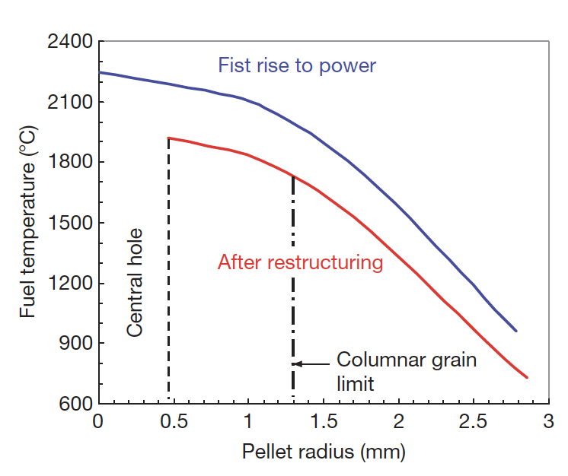
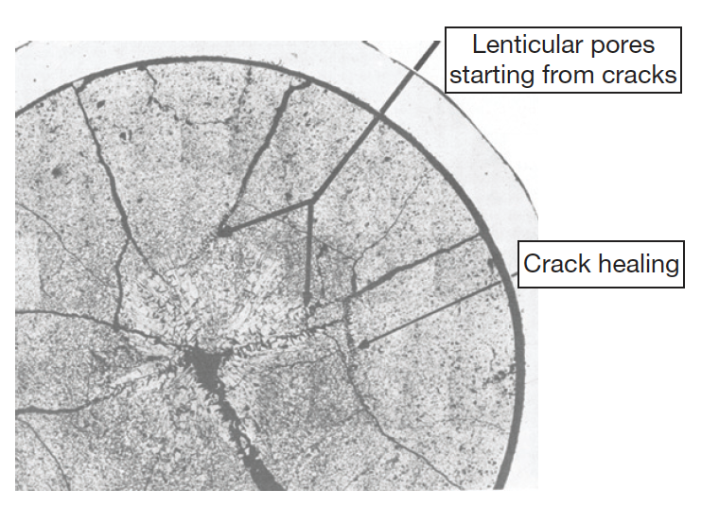
MOX Fuels
Most phenomena occurring inside oxide fuel pellets are thermally activated, and a good knowledge of the thermal field inside the fuel stack is key
Centerline temperatures can reach above 2000C, significantly higher than thermal LWRs
Thermal conductivity is low and degrades with irradiation
Due to the steep thermal gradient, thermal stress cracks form
Restructuring takes place due to the high temperatures, leading to distinct regions in the fuel

Slide 11
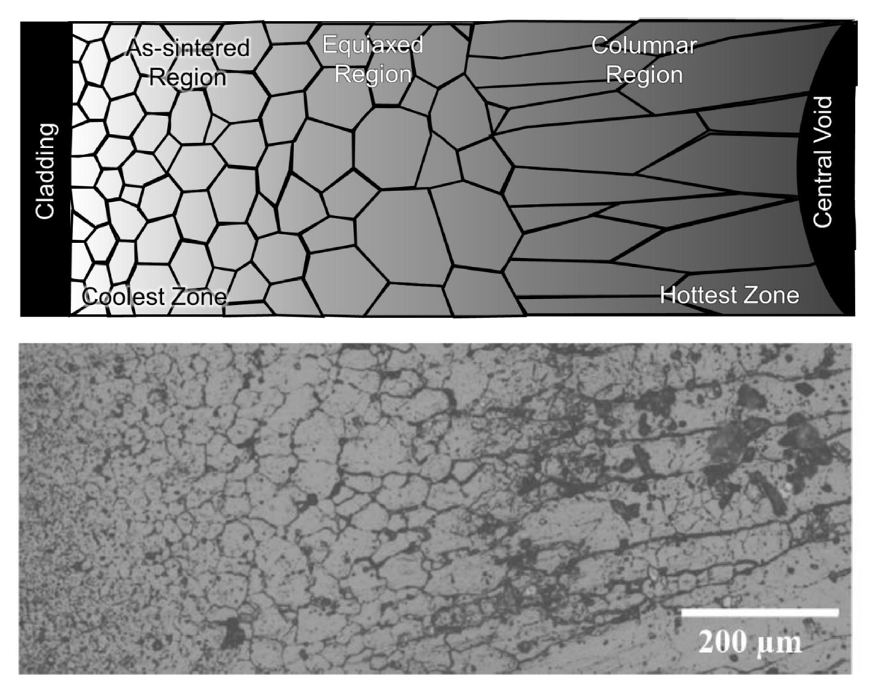
MOX Restructuring
Pu bearing fast reactor oxide fuels display four defining regions of a restructured pellet:
the central void, the columnar grain growth region, the equiaxed grain growth region, and the as-sintered region
The higher temperatures and heating rates form coarse, elongated grains that grow radially toward the outer rim of the fuel
The equiaxed region consists of grains that have undergone significant growth when compared to the un-irradiated samples
The central void forms from the accumulation of voids and pores present in the fuel along a thermal gradient

Slide 12
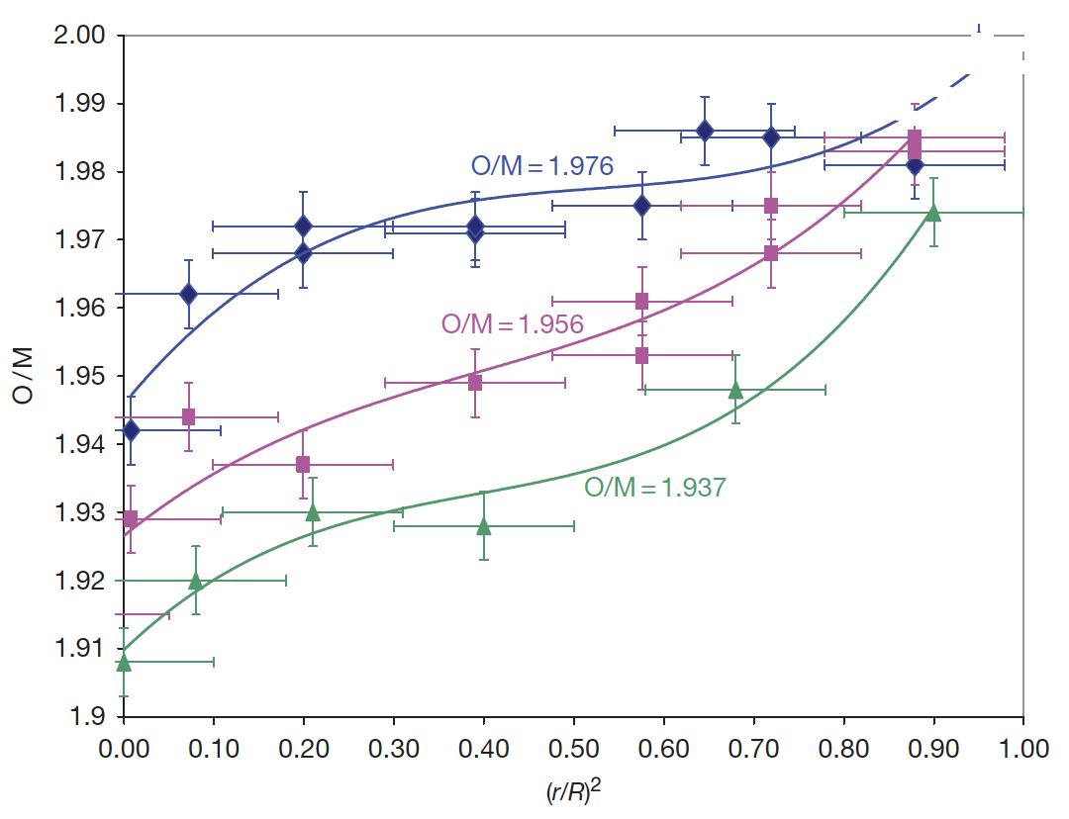
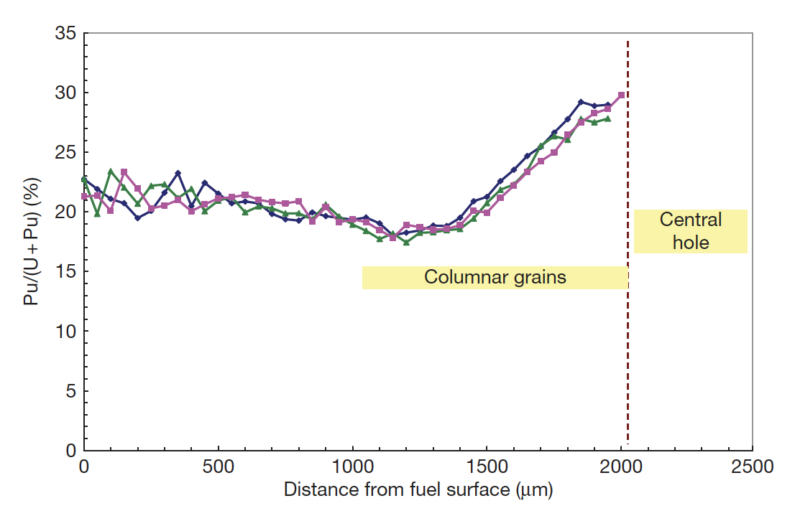
Constituent Redistribution
The as-fabricated oxide pellets to be used as fuel in fast reactors are always hypostoichiometric with an initial O/M typically in the range 1.93–2.00
Oxygen is redistributed radially, migrating down the thermal gradient, thus bringing the composition close to stoichiometry near the periphery, whereas the O/M ratio becomes very low in the hottest area
Irradiated oxide pellets generally exhibit a plutonium enrichment in the central area near the central hole, and a slight plutonium depletion in a ring located near the periphery of columnar grains

Slide 13
Gap Closure
Although the thermal expansion coefficient is lower in oxide fuel than in austenitic stainless steel cladding the temperatures in the fuel pellets are much higher than in the cladding and induce a higher thermal expansion in the fuel pellet
At high linear powers gap closure is completed after a burnup of about 1% or even less
Fuel pellets are broken into several fragments at the end of first rise to power, resulting in a small average displacement of matter toward the cladding
The force exerted on the fuel column by the spring located in the upper part of causes an axial compression creep
The main cause of gap closure is probably the gaseous swelling of the fuel

Slide 14
Fission Products
The main objective of oxide fuels in fast reactors is to achieve very high burnup; 15 at.% or even more is typically considered as a reference target
This means that at the end of irradiation, 15% of the initial actinide atoms (U and Pu) have disappeared and 30% new atoms are present in the fuel
All physical and chemical properties of oxide fuel will continuously evolve during its lifetime in the reactor; in particular, fission products will induce a decrease of thermal conductivity as well as a decrease of melting point, thus reducing the margin to fuel melting
Most phenomena occurring in the fuel pins will be a direct consequence of these fission products
This large amount of fission products is one of the specificities of fast oxide fuel
The fission products effects depend upon the chemical state of the fission product, which is influenced by the oxygen potential of the fuel

Slide 15
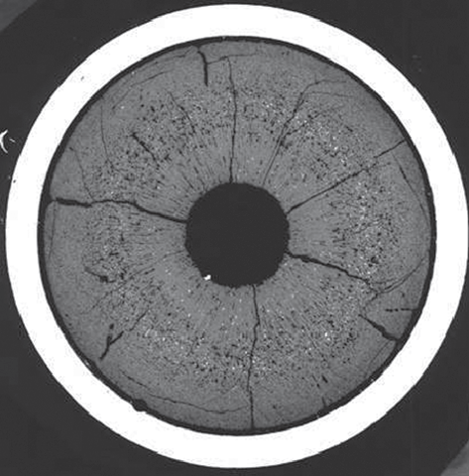
Fission Products
Fission products lie in the main five families:
solid solution, oxide precipitates, metallic precipitates, volatile gases, noble gases
On the metallographs of fuel irradiated at high burnup, white inclusions are systematically observed
The higher the burnup and the temperature, the larger these precipitates
In most cases, EPMA on these precipitates shows essentially five elements: Mo, Ru, Tc, Rh, and Pd.
They are the five ‘noble metal’ fission products with the highest yield

Slide 16
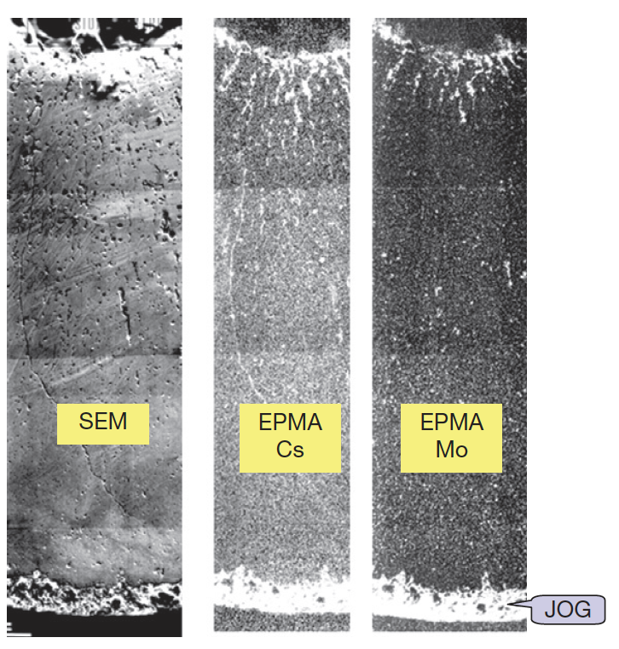
Joint Oxide Gain (JOG)
Even after gap closure, there remains a residual gap a couple of micrometers wide due to surface roughness
At high burnup, radial micrographs show a reopening of the gap, however, this gap is no longer filled with gas, but with fission product compounds
All the fission products migrating toward the cold region of the pellet accumulate first in the oxide fuel, and then escape the fuel and accumulate between the fuel and the cladding where they form a bonding layer
At high burnup, this JOG reaches a diameter width of about 150 μm
Serves as mechanical buffer; has low thermal cond.

Slide 17
FCCI
FCCI appears as one of the potential life-limiting factors for high burnup fuel elements
Fission products in the JOG play a predominant role on FCCI and on the resulting strong corrosion
The (U,Pu)O2 fuel itself does not directly react with the cladding, but it provides the oxygen needed for some of the reactions
Volatile fission products, tellurium and cesium, are the corrosive species able to overcome the passivation of stainless steel and therefore to induce clad corrosion
Several types of corrosion reactions and mechanisms are possible, occurring at different stages of irradiation, sometimes successively in the same pin, and resulting in different attack features
Thus, a qualitative understanding of corrosion mechanisms has been achieved, but it is not yet possible to give a complete physical description of FCCI and to predict corrosion depths

Slide 18
Summary
Oxide fuel for fast reactors has proved to be a mature, quite reliable, and very robust fuel concept
SFRs with MOX operate at much higher power and temperature than LWRs
Despite the low thermal conductivity, fuel loadings to the cladding remain low, and oxide fuel pins have demonstrated an ability to reach extremely high burnup (>15 at%)
O/M ratio is one of the most significant factors in determining the nature of actinide redistribution, fission product precipitate chemistries, and FCCI formation

