Slide 1
Nuclear Fuel Performance
NE-591-010
Spring 2021

Slide 2
Last Time
We derived two analytical solutions for the stress in a pressurized cylinder
Thin walled cylinder
Thick walled cylinder
Increases in temperature cause most materials to expand
We call this thermal expansion, which is a strain that doesn’t inherently cause stress
Thermal expansion can cause stress when
Deformation is constrained
There are gradients in the expansion coefficient
There is a temperature gradient
We have analytical equations for thermal stresses in the cladding and in the fuel

Slide 3
THERMO-Mechanics

Slide 4
The gap changes as a function of time
Both the pellet and the cladding swell
But, as the gap decreases, the temperature changes, which again makes the gap change
The solution using the analytical equations is iterative, due to the dependence of the gap size and temperature.

Slide 5
Calculate the steady state temperature profile in the rod, including thermal expansion
LHR = 200 W/cm, δ⁰_{gap} = 30 μm, R_{f} = 0.5, T_{cool} = 580 K, T_{EXP,0} = 373 K, k_{gap} = 0.0026 W/cm-K, t_{C}= 0.06 cm, α_{f} = 11.0e-6 1/K, α_{C} = 7.1e-6 1/K
ΔT_{cool} = 25.5 K, ΔT_{clad} = 22.5 K, ΔT_{fuel} = 530.5 K
So, T_{IC} = 580 + 25.5 + 22.5 = 628.0 K, T_{s} = 701.5 K, T₀ = 1232.0 K
First, we will deal with expansion in the cladding
Av(R_{c}) = 0.5 + 30e-4 + 0.06/2 = 0.533 cm
Av(T_{C}) = 580 + 25.5 + 22.5/2 = 616.75 K
ΔR_{c} = 0.533*7.1e-6*(616.75 – 373) = 9.22e-4 cm
$$= ΔR_{c}−ΔR_{f}$$

Slide 6
Calculate the steady state temperature profile in the rod, including thermal expansion
Second, we deal with the fuel
Av(Tf) = (1232 + 701.5)/2 = 966.7 K
ΔR_{f} = 0.5*11e-6*(966.7 – 373) = 0.0033 cm
The total change in the gap is 9.22e-4 – 0.0033 = -0.0023
However, that means the gap is smaller and so our temperatures were wrong!

Slide 7
This calculation is repeated until the gap width stops changing significantly
The change in the gap does NOT effect the coolant or cladding temperatures, just the gap and fuel temperatures.
We only need to repeat the calculation of the fuel and cladding temperatures and the change in the gap
Iteration | δ_{gap} (cm) | T_{s} (K) | T₀ (K)
0 | 0.003 | 701 | 1232
1 | 0.00066 | 644 | 1174
2 | 0.00097 | 652 | 1182
3 | 0.00094 | 651 | 1181
4 | 0.00094 | 651 | 1181

Slide 8
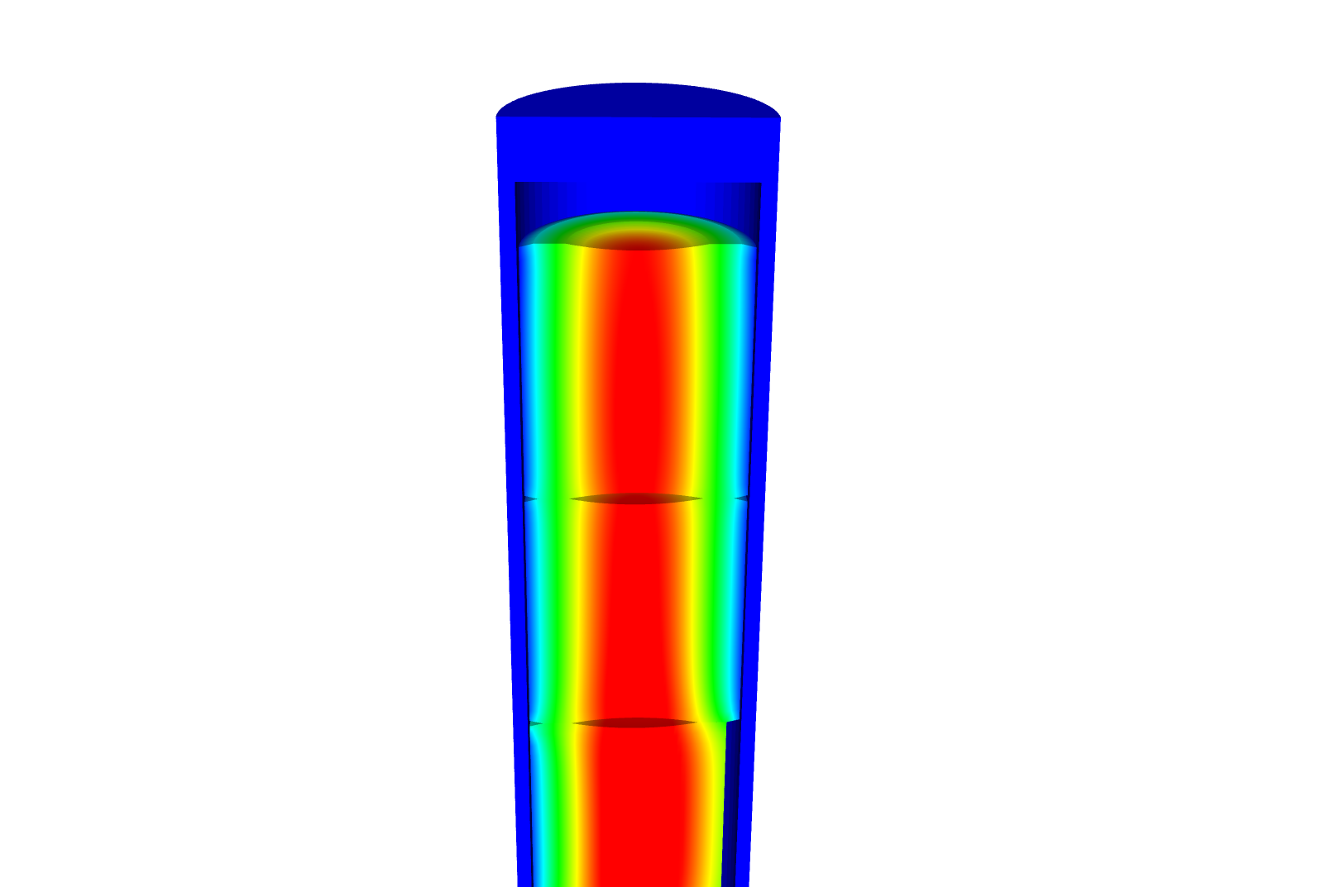
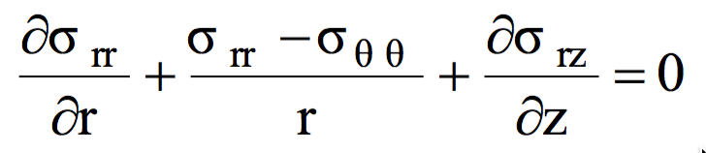
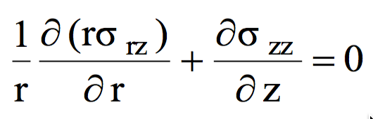
Relating Displacements to Stress
We have been determining the stress due to some internal pressure or strain
Often, the information more readily obtainable are the displacements
Utilizing the previous equations, can develop displacement to stress relationships for our geometry

Slide 9
Assuming problem is axisymmetric

Slide 10
Solve for the stress from the strain
Assume isotropic materials
Can perform matrix multiplication for the calculation of the stress, given the displacements

Slide 11
Further simplify the problem to be 1D (1.5D)
No change in Z:

Slide 12

Determine the strain and stress in the pellet for 1D case
Assume the radial displacement in the fuel pellet is u_{r}(r) = 0.05r cm.
What is the strain tensor? At the outer edge:
We are dealing with UO₂, so E = 200 GPa and ν = 0.345
C₁₁ = E (1 – ν)/((1+ν)( 1–2 ν)) = 200*(1–0.345)/(1.345*(1–2*.345)) = 314.2 Gpa
C₁₂ = E ν/((1+ν)( 1–2 ν)) = 200*0.345/(1.345*(1–2*.345)) = 165.5 Gpa
Now we can calculate the stresses
σ_{rr} = 0.05*314.2 + 0.05*165.5 = 23.98 GPa
σ_{θθ} = 0.05*165.5 + 0.05*314.2 = 23.98 GPa
$$σ=\left[\begin{matrix}23.98 \\ 23.98\end{matrix}\right]$$

Slide 13
Example problem
Compute the stress and strain tensors in the center and at the outer edge (r = 0.5 cm) in 1D axisymmetric coordinates in a fuel pellet with u_{r}(r) = r²/5. C₁₁ = 314.2 Gpa, C₁₂ = 165.5 Gpa.
First, calculate the strain tensor
ε_{rr} = u_{r,r} = 2r/5
ε_{θθ} = u_{r}/r = r/5
At the center there is no strain; at the outer edge
To calculate the stress, convert to a strain vector and multiply by elastic constant matrix
The stress in the center is zero
On the outer edge
σ_{rr} = 0.2*314.2 + 0.1*165.5 = 79.4 GPa
σ_{θθ} = 0.1*314.2 + 0.2*165.5 = 64.52 GPa

