Slide 1
Cladding Oxidation
NE 591

Slide 2
Last time
Growth and creep are the major mechanisms for dimensional instability in zirconium alloy cladding
Growth results from the clustering of interstitials on prismatic planes
Creep occurs in three stages: (1)creep down from water pressure; (2)creep out from fuel column; (3)fuel column axial stress
Under irradiation, zirconium experiences irradiation induced hardening due to interstitial loops on the prismatic planes
Channels form that don’t have loops, resulting in localized deformation
Other phenomena:
Fatigue; SCC; PCMI; PCCI

Slide 3
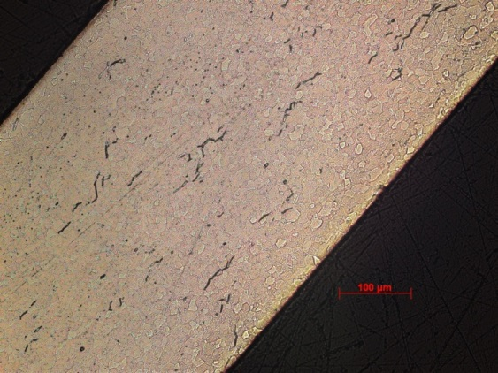
Zirconium Oxidation
Corrosion of zirconium is one of the largest concerns for LWR fuel operation
Zirconium interacts with water to make zirconia and hydrogen
Both the oxide layer and the hydrogen adversely impact cladding performance
ZrO₂
Zr metal

Slide 4
Corrosion
Corrosion is the degradation of a material and its properties under the action of the surrounding environment by chemical and/or electrochemical reaction
Corrosion reactions require the following:
Oxidant
Electric current
A corrosion reaction is composed of an oxidation reaction and a reduction reaction
During corrosion at a particular spot on the surface of the object made of iron, oxidation takes place and that spot behaves as an anode
The electrons released at this anodic spot move through the metal and go to another spot on the metal and reduce oxygen at that spot in presence of H⁺, which behaves as a cathode

Slide 5
Corrosion
Corrosion reaction rates are determined by thermodynamics and kinetics
Thermodynamics tell us whether a material may corrode
Measure voltage difference between anodic and cathodic sites
Kinetics tell us how quickly a material will corrode
Measure net current between anodic and cathodic sites

Slide 6

Formation of Oxide Layer After Oxide Formation
H₂0
Zr
H₂0
ZrO₂
Zr
O⁻²
e⁻
Oxidation reaction:
Dissociation of water at oxide/water interface
Absorption of oxygen into oxide layer
Diffusion of oxygen through oxide layer
Reaction of oxygen with zirconium
Diffusion of electrons through oxide layer
Reduction of hydrogen
Reduction reaction:

Slide 7
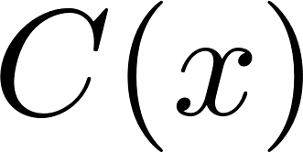
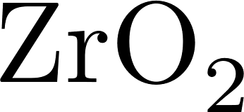

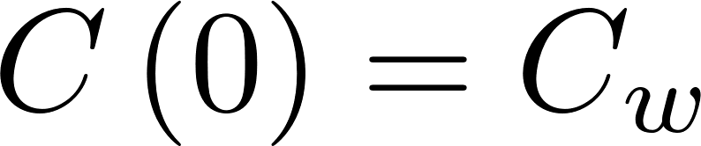
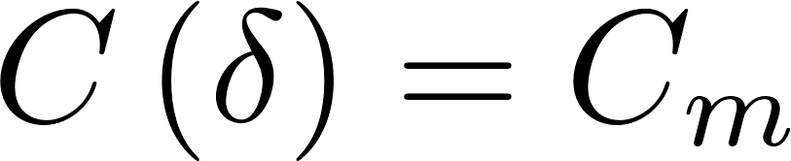


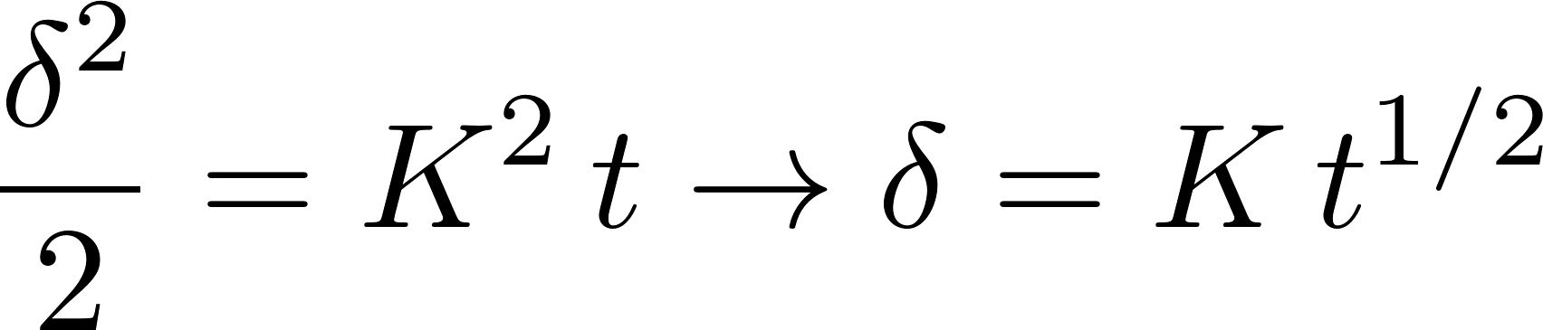
Corrosion rate limited by diffusion
Because the rate limiting steps are diffusion, we can model the oxidation rate using diffusion
Assumptions:
Transport of O species is rate-limiting
Transport of charged species by diffusion only
Homogeneous oxide layer
No sources/sinks of ions in oxide
All oxygen is used to create oxide
No loss of oxide

Slide 8
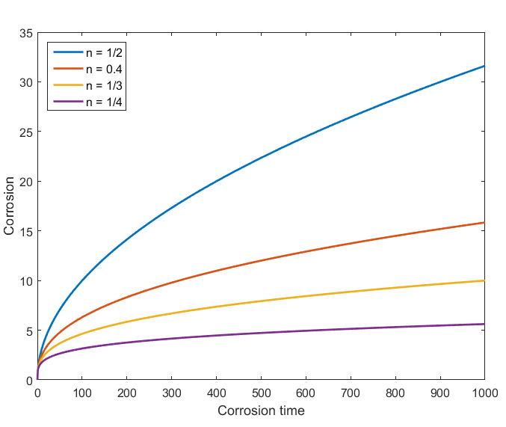
Observed kinetics are slower than parabolic
Parabolic kinetics
Diffusion of species across the oxide
Sub-parabolic kinetics
Development of cracks in oxide
Additional ions in oxide
Non-uniform electric field in oxide layer
Once a nonhomogeneous electric field arises, the corrosion rate decreases to the sub-parabolic rate due to inhibition of transport of charged species.

