Slide 1
Nuclear Fuel Performance
NE-533
Spring 2026

Slide 2
UO2 Radiation effects

Slide 3
Radiation Damage
The macroscopic and observable results of exposure of solids to energetic particles are collectively known as radiation effects
Heat production from the nuclear fuel to generate electricity ensues mostly from the slow down of the fission products by nuclear or electronic interactions
As a direct consequence, there are also defects created along the path of the fission fragments leading to modification of the physical properties of the fuel
Most Frenkel defects (interstitial-vacancy pair) are produced by secondary collision cascades
The dominant defect type is anion Frenkel pairs
Local charge neutrality prevents/inhibits the formation of interstitials and vacancies as independent processes, as the cations and anions are charged species

Slide 4
To balance charge, how many oxygen vacancies need to be created for every uranium vacancy?
Two
U+4, O-2
This forms a Schottky trio defect

Slide 5
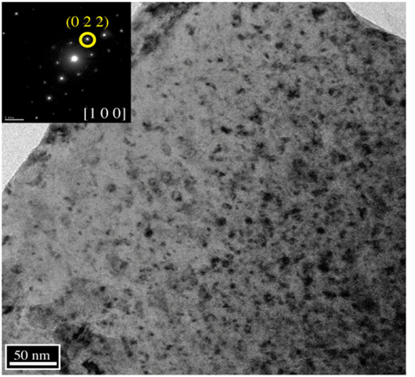
Loop Formation
Dislocations are generally a mixture of screw and edge components in the shape of a loop
The most important slip system in UO2 is the one which minimizes the electrostatic energy, the easy slip along {100}<110> tends to minimize the repulsive force between cations
Prismatic loops are of interstitial type and consist of a disc-shaped layer of defects in a cluster
This defect cluster is more energetically favorable than dispersed defects in the bulk
Vacancies will cluster and form into voids
Prismatic loops in UO2 from alpha particle irradiation

Slide 6
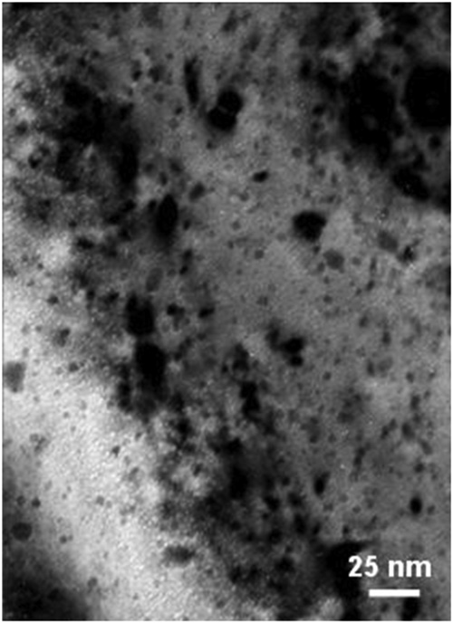
Voids
Due to preferential absorption of interstitials at dislocations, we are left with a slight excess of vacancies in the bulk to nucleate and grow voids
Void nucleation can occur homogeneously by the collection of vacancies in the matrix, or heterogeneously at structural features (precipitates, grain boundaries, etc.)
The vacancy-rich radiation damage core is considered to be an important void nucleation mechanism in UO2
Vacancy diffusion then allows void growth
Gas atoms can often serve to stabilize small voids
Voids (bright spots) from alpha irradiation in UO2

Slide 7
UO2 Radiation Effects
Chemistry changes
two fission products are generated from each fission, resulting up to about 3% of the chemical species present at the end of life for commercial fuel
the amount of fission products change both chemical and physical properties
Physical property changes
The physical effects caused by atomic displacements are rather complex and depend on the relative sink strengths of a given material for interstitials and vacancies and on the temperature
lattice parameter, thermal conductivity, elasticity, formation of the high burnup structure

Slide 8
Thermal Conductivity Degradation
One of the major effects of defect formation is the degradation of thermal diffusivity, due to phonon scattering
Results obtained on irradiated UO2 show that the thermal conductivity is decreasing with increasing burn-up, and that at equal burn-up, samples with higher irradiation temperatures have higher thermal conductivity
There are mesoscopic and atomistic features that affect the thermal conductivity
The porosity existing in fresh fuels evolves during irradiation and has a strong impact on heat transport, because voids/bubbles have significantly lower kth than the lattice
Precipitates are formed by fission products that are insoluble in the UO2 lattice, forming oxide or metallic inclusions: can use composite theory to get effective thermal conductivities; typically, these precipitates INCREASE the thermal conductivity of the fuel

Slide 9
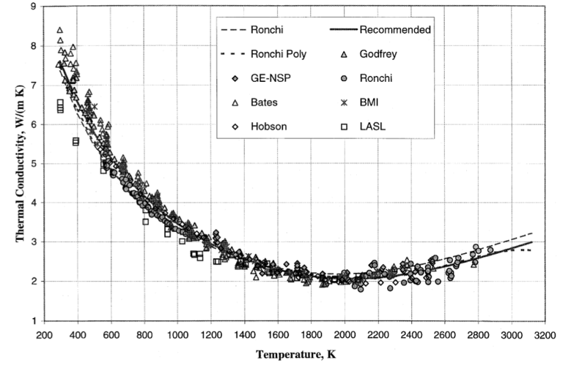
Thermal Conductivity Degradation
Actinides, rare earths, and transition metals can form mixed oxides with UO2 (soluble fission products): these atoms act as phonon scattering centers as a result of the differences in bonding, radii, or mass, and thus decrease kth
Volatile fission products/gases are partially in solution and partially in bubbles, where they act as phonon scatterers or as low kth composite fractions
Point defects and extended defects contribute to the degradation of the thermal conductivity by scattering or limiting the mean free path of the phonons

Slide 10
UO2 Thermal Conductivity
We have established correlations for thermal conductivity of fresh UO2 fuel as a function of temperature
Where t = T/1000
The first part of the equation describes the phonon interactions
The second part describes electronic transport which becomes significant at high temperature

Slide 11
UO2 Thermal Conductivity
UO₂ thermal conductivity is low and decreases more during reactor operation
The thermal conductivity has been collected after various amounts of burnup to make empirical fits

