Slide 1
Ceramic nuclear fuel fracture modeling with the extended finite element method
Wen Jiang, Benjamin W. Spencer, John E. Dolbow
Ana Antunes
Deparment of Nuclear Engineering

Slide 2
Introduction: Motivation
Fracture happens early in the fuel due to thermal stresses and is not a direct safety concern.
However, there is an important role on fuel performance:
Increase fuel pellet diameter,
Radial relocation,
PCMI – cladding failure.
X-FEM (eXtended Finite Element Method):
Allows for arbitrary spatial discontinuities to be represented within the context of FEM;
Strengths of the standard FEM (continuous behavior) while addressing shortcomings (discontinuous behavior).

Slide 3
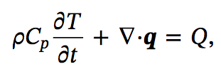
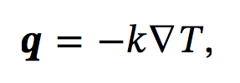


Governing equations
(1)
Energy balance:
Heat flux:
Momentum conservation:
(2)
(3)
E: elasticity tensor
ε: total strain
ε_{th}: thermally-induced strain
(4)

Slide 4
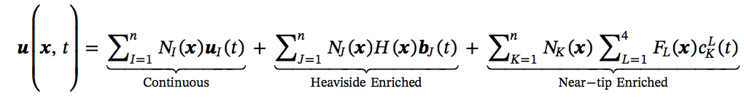
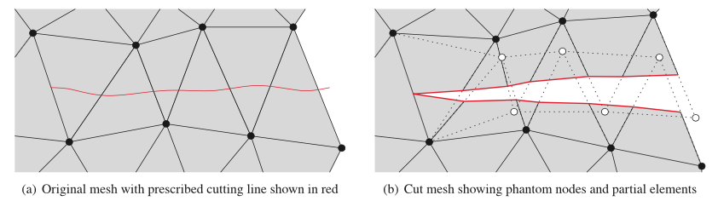
Phantom-node-based X-FEM
(5)
Crack tips coincide with element edges

Slide 5
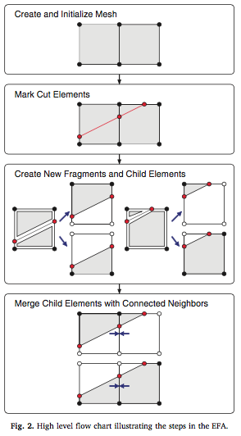
EFA – Element Fragment Algorithm
Complexity in implementing the phantom node method: solving connectivity of the partial elements created when there is a crack
EFA: relies on the use of data structures known as “fragments”
Can be applied to 3D structures

Slide 6

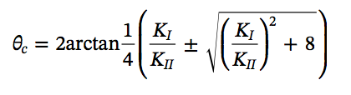
X-FEM crack initiation and propagation
The method does not define the locations of the discontinuities. Problems with: pre-defined stationary cracks, propagation from initially-prescribed cracks, and problems where cracks initiate and propagate
Crack propagation: direction is determined using maximum hoop stress
(6)
K_{I}: Mode-I stress factor
K_{II}: Mode-II stress factor
(7)

Slide 7



X-FEM crack initiation and propagation
Crack propagation: stress intensity factors
(8)
(9)
With K_{I}^{aux} = 1.0 and K_{II}^{aux} = K_{III}^{aux} = 0
(10)
Critical stress intensity factor

Slide 8
X-FEM crack initiation and propagation
Crack initiation: most common approach is to place a crack at the location of maximum stress when a stress criterion is exceeded
In a cylindrical fuel pellet, the highest stresses in an uncracked pellet occur in the outside surface of the fuel; in this work, this was used to simplify crack initiation which are only permitted to initiate on the outer surface of the fuel.
Critical maximum hoop stress value; hoop stress is uniform in an ideal pellet, while in an actual pellet cracks initiate in local defects – random distribution of the local fracture strength
Specimen size: larger specimen presents more flaws; larger finite elements = larger volumes = higher probability of failure

Slide 9
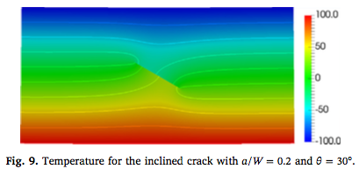
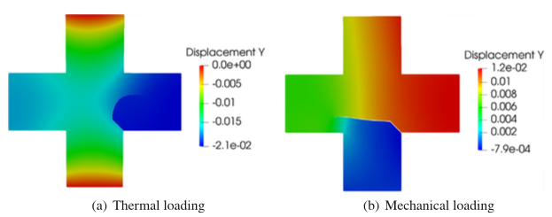
Benchmarks
Rectangular plate with an inclined crack (temperature gradient)
Crack propagation in a cruciform plate (thermal and mechanical loading)

Slide 10
LWR fuel pellet cracking – stationary cracks
Problem designed to simulate conditions in fresh fuel subject to a ramp full power
Only fuel pellet is modeled (no cladding)
Full Bison simulation previously performed (pellet+clad) to obtain outer fuel temperature history, used as B.C. for this problem
Power is ramped up from zero to 25 kW/m over 10000 s, and then held at that level
Materials property values were obtained from the literature

Slide 11
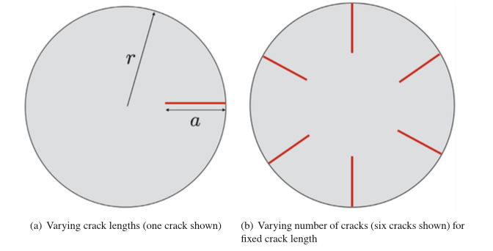
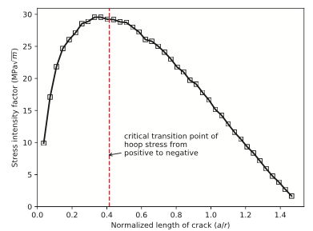
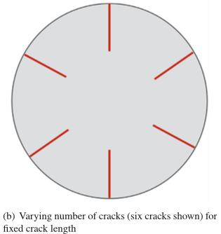
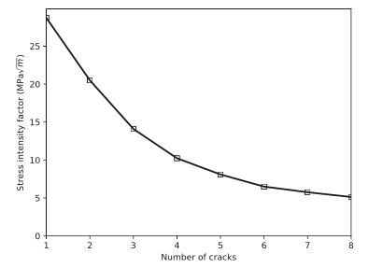
LWR fuel pellet cracking – stationary cracks
single crack and effect of varying its length
crack length fixed at a/r=0.5 and number of cracks varying

Slide 12
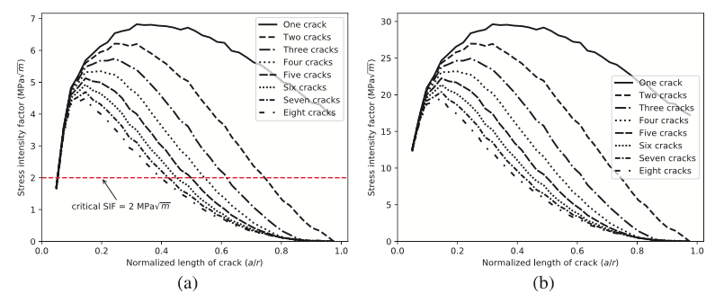
LWR fuel pellet cracking – stationary cracks
iii. variation on both crack length and number of cracks
(a) time = 2300 s, power = 5 kW/M (b) time = 10000 s, power = 25 kW/M

Slide 13
LWR fuel pellet – propagating cracks
No initial cracks defined;
Condition: cracks initiate if the maximum principal tensile stress exceeds the tensile strength of the material (130 MPa);
Cracks initiate with a 0.4mm length and are allowed to grow if the SIF exceeds a critical value; incremented by Δa = 0.2 mm ;
Repeated as many times as needed until the fracture criteria are no longer exceeded ;
Two separate simulations made: K_{c} of 2 and 4 MPa√m to demonstrate sensitivity to the parameter
Sensitivity study: initial crack length and crack extension length
Due to limited experimental data, reasonable ceramic materials properties values were chosen

Slide 14
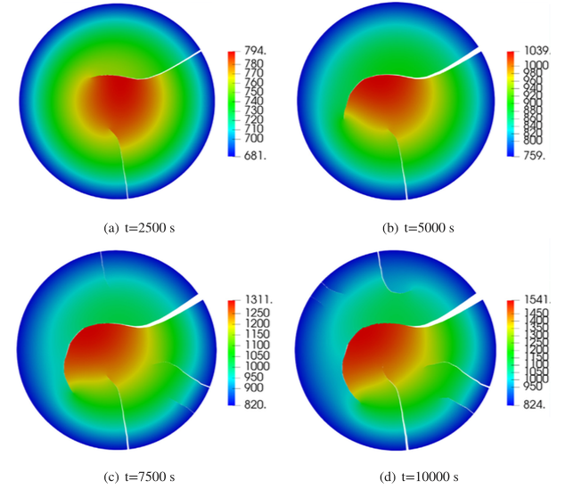
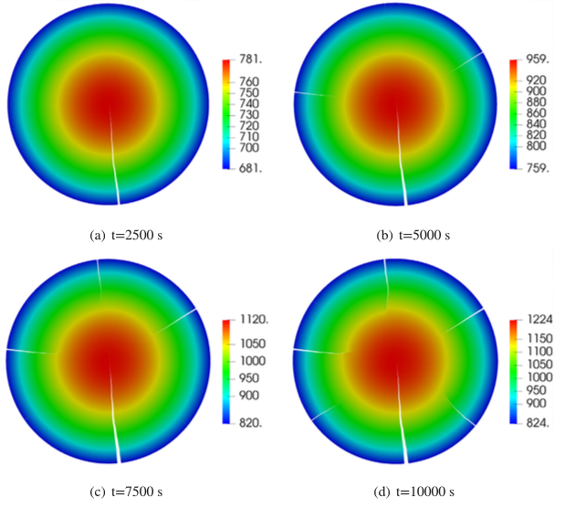
Propagating cracks: K_{c} sensitivity
K_{c} = 2 MPa√m
K_{c} = 4 MPa√m

Slide 15
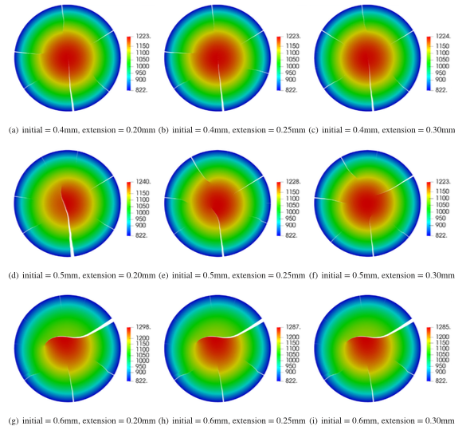
Propagating cracks: crack length sensitivity
initial
extension

Slide 16
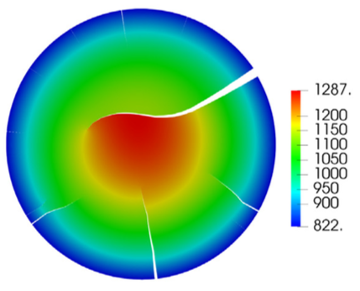
Conclusion
Paper shows implementation of phantom-based X-FEM with demonstrated viability through benchmarking;
Very reasonable results for both prescribed stationary cracks and propagating cracks in nuclear fuel;
Drawback: only defines the behavior of model in presence of discontinuities defined by external means.
Major concern: heat transfer through the cracks

Slide 17
Questions?

