Slide 1
Review: Neutronics and Fuel Performance Evolution of Accident Tolerant FeCrAl Cladding Under Normal Operation Conditions
Quentin Faure
NE 591 – 010: Nuclear Fuel Performance
March 9th, 2021

Slide 2
Outline
Introduction
Neutronics Model and Fuel Performance Model
Fuel Performance Results
Discussion

Slide 3
Introduction
General topic: new cladding (FeCrAl) for Accident Tolerant Fuel (ATF). Comparison of neutronics and fuel performance behaviors of fuel with FeCrAl cladding compared to Zircaloy fuel during normal operation.
Property of FeCrAl compared to Zircaloy:
Similar thermal conductivity
Increased creep resistance at high temperature
Oxidation rate two to three orders of magnitude lower
Smaller thermal and irradiation creeps (not known)
Slower hydrogen generation
Thermal neutron absorption cross-section is 12 – 16 times higher
Higher specific heat capacity
Increased time margin during accident (from one hour to a few hours)
Problem: FeCrAl properties have not been fully implemented in neutronics and fuel performance software (for example: thermal conductivity as a function of neutron irradiation and burnup)
Fuel design based on another paper. This design gives satisfying fuel cycle length and allows small modifications the fuel conception for a 15% cost increase in fuel production (different enrichment but same cladding outer diameter so no need to change fuel assembly design and reactor core design)

Slide 4
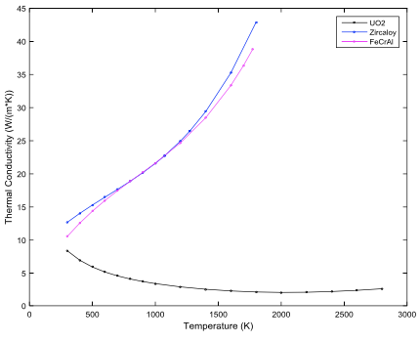
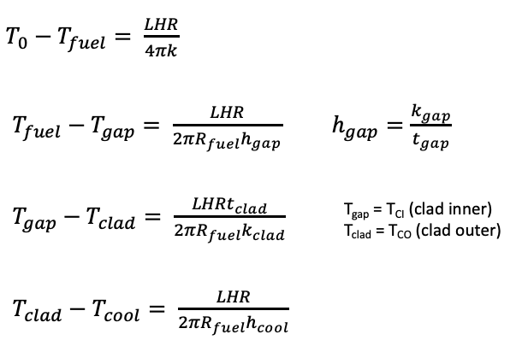
Serpent Neutronics Simulations Parameters
Coolant temperature: 580 K
Fuel Temperature: 900 K
Cladding and gap temperature: 600 K
Problem:
Fuel centerline or fuel surface temperature?
Why is the cladding and gap temperature the same? No spatial variation?
FeCrAl cladding is only 61 % of the thickness of Zircaloy
Fuel radius is 5 % bigger for FeCrAl cladding fuel
Gap thicknesses are the same
Thermal conductivity are very close
Fuel temperature should be different:
T_{gap} – T_{clad} should varied by approximately 60 %
for FeCrAl compared to Zircaloy in steady-state

Slide 5
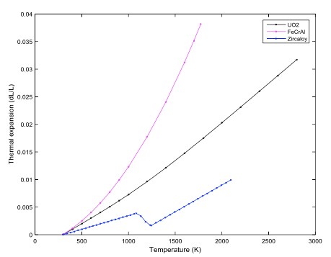
Serpent Neutronics Simulations Parameters
Thermal expansion:
Much higher thermal expansion than Zircaloy cladding
It would have been interesting to plot the thermal expansion as a function of temperature in mm rather than % since the cladding is thinner with FeCrAl. It would allow to compared the variation in thickness of the cladding.
Melting point of FeCrAl not specified (not relevant to the paper but a good information to provide)

Slide 6
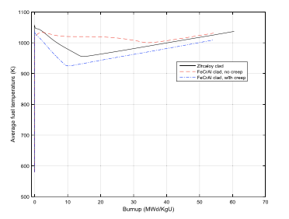
BISON Fuel Performance Simulations Parameters
Creep model:
Creep model for FeCrAl is not available in BISON
Creep is lower for FeCrAl than for Zircaloy
2 models: FeCrAl with Zircaloy creep model and without creep
Creep model is not presented in the paper but plays very important role in the model
Finite element model choice not explained

Slide 7
Results Fuel Performance
Fuel temperature evolution explanation:
It is specified in the paper that the explanation is for a “nominal PWR core modeled by BISON”. Therefore, the time scale is not the same as in the figure. Why not giving an explanation directly of the simulations results?
Wrong explanation on the gap size evolutions phenomenon's:
“At the beginning of simulation (power ramp over 3 h), gap width rapidly decreased from 0.08 mm to 0.03–0.04 mm due to fuel densification.” Correct explanation: gap decreases due to thermal expansion
“Gap will continue to decrease as a combination of fuel densifi- cation, fuel swelling, fuel thermal expansion and clad creep. But within the first 50 days of depletion, FeCrAl case with no creep undergo a slight gap increase because there is no cladding creep inward to counteract the decrease in gap size.” Correct explanation: cladding creep does not counteract the decrease in gap size. The gap increase is likely to be due densification and no creep
“FeCrAl clad with no creep shows that gap closure can be delayed greatly, by more than 400 days. This means Pellet-Cladding Mechanical Interaction (PCMI) is significantly delayed.” It would have been wise to plot the closure difference in days between both fuels as a function of the axial positions rather than presenting at only 2 axial points showing that no general conclusion can be made.

Slide 8
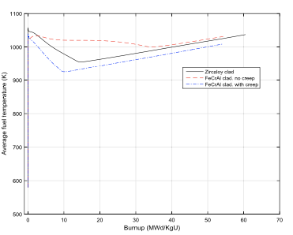
Results Fuel Performance
Explanation on the average fuel temperature difference between both model:
“When we look at Zircaloy and FeCrAl with creep cases, FeCrAl has a similar thermal conductivity but a much higher specific heat capacity compared with zircaloy. This explains the lower average fuel temperature for FeCrAl cladding with creep.” Heat capacity impacts temporal variation. Higher specific heat capacity makes the evolution smoothers. More explanation are needed here.
No satisfactory explanation for the model without creep average temperature evolution (need an explanation of the creep model used to better understand the results):
Thermal expansion is happening at the beginning so smaller gap, leading to lower temperature (explanation from the paper), not really seen here
Then fission gas is released leading to a decrease of the thermal conductivity of the gap, meaning temperature increases (explanation from the paper). Seems to happen at much later stage for the model without creep. Why?

Slide 9
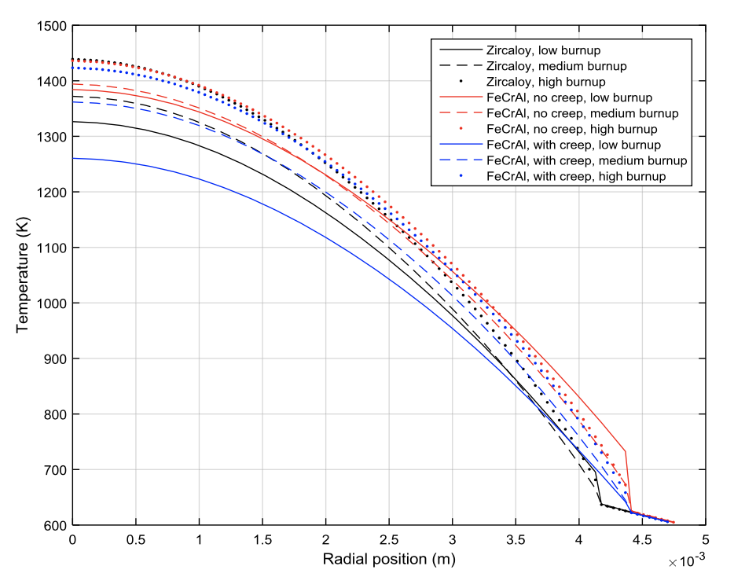
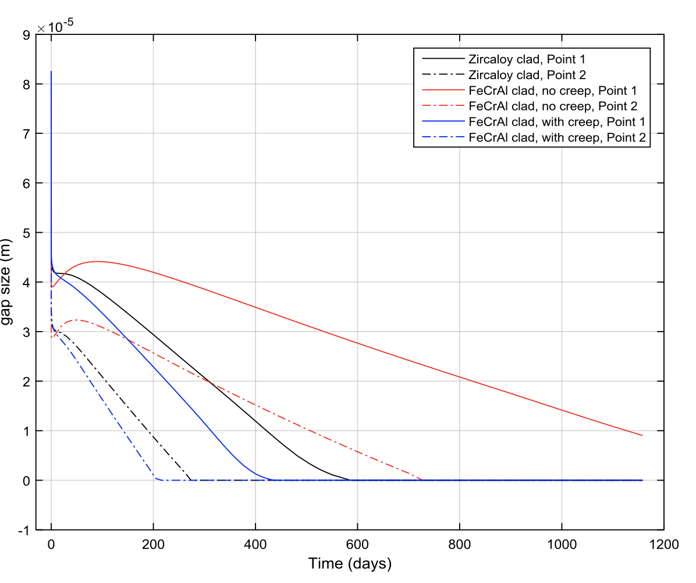
Results Fuel Performance
Personal hypothesis for Temperature vs Radial Position:
Difference in gap thickness at the BOC (bigger gap for the model without creep) leads to higher temperature change in the gap compared to the Zircaloy cladding model, it can explain part of it.
There is almost no change in temperature in the gap at BOC for the model with creep and FeCrAl cladding but there is a much bigger change for the Zircaloy model while the gap size is approximatively the same. No explanation given here.

Slide 10
Discussion
Some assumptions made in the paper seems or are wrong.
Some models are not presented and can be very useful to understand the results found.
Some results are not explained correctly or are missing an explanation.
Little correlation between each graphics made (a lot of them can be made).
Try to fill the gap regarding the normal operation for FeCrAl cladding fuel but does not really do it
Ideas:
Model an entire core and analyze the impact of the new fuel on the peak powers, poison generations, ...
Varied the cladding thickness and maybe enrichment to see what can be achieved
Developed a model for FeCrAl creep (or use one if that exist) and add it as a third model (guess model)
Provide another transient analysis with a different software than what has been done alrealdy

Slide 11
Reference
X. Wu et al., Neutronics And Fuel Performance Evaluation Of Accident Tolerant FeCrAl Cladding Under Normal Operation Conditions, Annals of Nuclear Energy, Vol. 85 (2015), pp. 763 - 775

Slide 12
Thank you!

