Slide 1
“Modeling and Simulation of Oxygen Transport in High Burnup LWR Fuel”
Simunovic, S., Besmann, T. M., Moore, E., Poschmann, M., Piro, M. H.A., et al., J. Nucl. Mat. 538 (2020) 152194.
Presented by: Cole Takasugi

Slide 2
Outline
Outline
Background
Model Development
Demonstration Problems
Discussion and Conclusions

Slide 3
Background
Oxidation state and composition of Light Water Reactor (LWR) nuclear fuel has a strong influence on performance and safety.
Oxygen chemical potential may affect the oxygen to uranium (O/M) ratio, phase of fuel materials and fission products, whether as metals, oxides, new phases, etc.; these in turn determine the thermal and mechanical properties of the fuel.
Oxygen transport in fuel is driven by a gradient in oxygen chemical potential gradients resulting from two competing factors – temperature and burnup.
Temperature is parabolic with a maximum in the center of fuel
Burnup is exponential with a minimum from the center of fuel

Slide 4
Background
Coupled Code
In this study, a Finite Element Method (FEM) was utilized to develop a computational model for oxygen transport in LWR fuel.
Elemental composition of the fuel as a function of burnup (time and space dependent) was calculated with ORIGEN-S.
These compositions were implemented in an oxygen transport model for the BISON fuel performance code.
Supporting thermochemical simulations were performed by Thermochimica, coupled to BISON.
ORIGEN-S
Composition (r,t)
BISON
Fuel Performance
Thermochimica
Thermochemistry

Slide 5
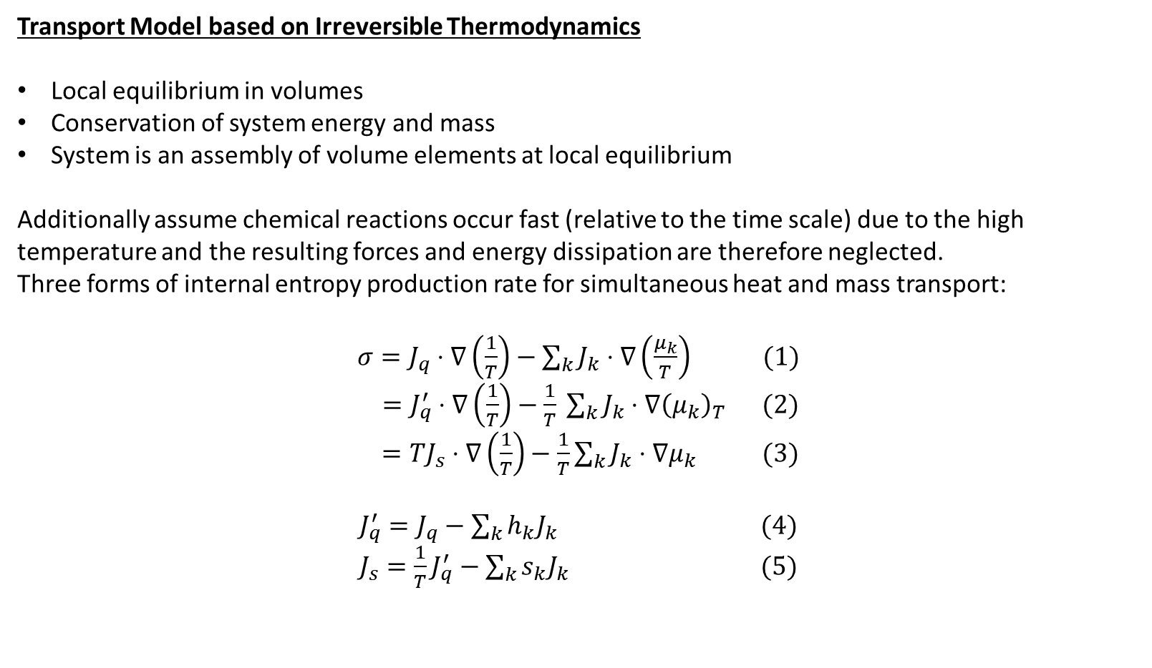
Model Development
Transport Model based on Irreversible Thermodynamics
Local equilibrium in volumes
Conservation of system energy and mass
System is an assembly of volume elements at local equilibrium
Additionally assume chemical reactions occur fast (relative to the time scale) due to the high temperature and the resulting forces and energy dissipation are therefore neglected.
Three forms of internal entropy production rate for simultaneous heat and mass transport:
$σ=J_{q}⋅∇\left(\frac{1}{T}\right)−\sum_{k}{J_{k}⋅∇\left(\frac{μ_{k}}{T}\right)}$ (1) $=J_{q}^{′}⋅∇\left(\frac{1}{T}\right)−\frac{1}{T} \sum_{k}{J_{k}⋅∇{\left(μ_{k}\right)}_{T}}$ (2) $=TJ_{s}⋅∇\left(\frac{1}{T}\right)−\frac{1}{T}\sum_{k}{J_{k}⋅∇μ_{k}}$ (3)
$J_{q}^{′}=J_{q}−\sum_{k}{h_{k}J_{k}}$ (4)
$J_{s}={\frac{1}{T}J}_{q}^{′}−\sum_{k}{s_{k}J_{k}}$ (5)
$T$ - Temperature $P$ - Pressure $μ$ - Chemical Potential $k$ - Component Index $s$ - Entropy $h$ - Enthalpy
$n$ - Number Density $J_{q}$ - Heat Flux (total) $J_{q}^{′}$ - Heat Conduction $J_{s}$ - Entropy Flux $J_{k}$ - Flux of Component k

Slide 6
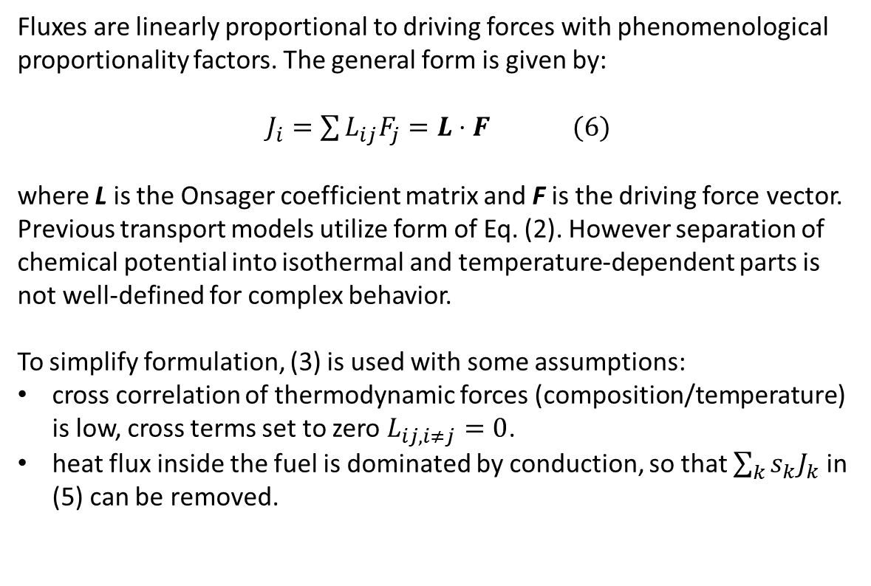
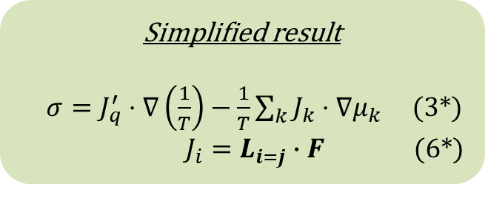
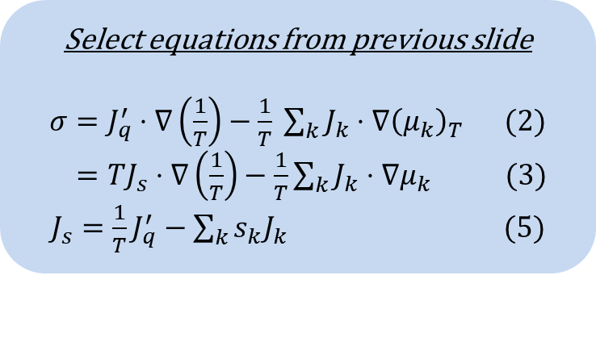
Model Development
Transport Model based on Irreversible Thermodynamics (cont.)
Fluxes are linearly proportional to driving forces with phenomenological proportionality factors. The general form is given by:
$J_{i}=\sum{L_{ij}F_{j}}=L⋅F$ (6)
where L is the Onsager coefficient matrix and F is the driving force vector.
Previous transport models utilize form of Eq. (2). However separation of chemical potential into isothermal and temperature-dependent parts is not well-defined for complex behavior.
To simplify formulation, (3) is used with some assumptions:
cross correlation of thermodynamic forces (composition/temperature) is low, cross terms set to zero $L_{ij, i≠j}=0$.
heat flux inside the fuel is dominated by conduction, so that $\sum_{k}{s_{k}J_{k}}$ in (5) can be removed.
Select equations from previous slide
$σ=J_{q}^{′}⋅∇\left(\frac{1}{T}\right)−\frac{1}{T} \sum_{k}{J_{k}⋅∇{\left(μ_{k}\right)}_{T}}$ (2) $=TJ_{s}⋅∇\left(\frac{1}{T}\right)−\frac{1}{T}\sum_{k}{J_{k}⋅∇μ_{k}}$ (3)
$J_{s}={\frac{1}{T}J}_{q}^{′}−\sum_{k}{s_{k}J_{k}}$ (5)
Simplified result
$σ=J_{q}^{′}⋅∇\left(\frac{1}{T}\right)−\frac{1}{T}\sum_{k}{J_{k}⋅∇μ_{k}}$ (3*)
$J_{i}=L_{i=j}∙F$ (6*)
$T$ - Temperature $P$ - Pressure $μ$ - Chemical Potential $k$ - Component Index $s$ - Entropy $h$ - Enthalpy
$n$ - Number Density $J_{q}$ - Heat Flux (total) $J_{q}^{′}$ - Heat Conduction $J_{s}$ - Entropy Flux $J_{k}$ - Flux of Component k

Slide 7
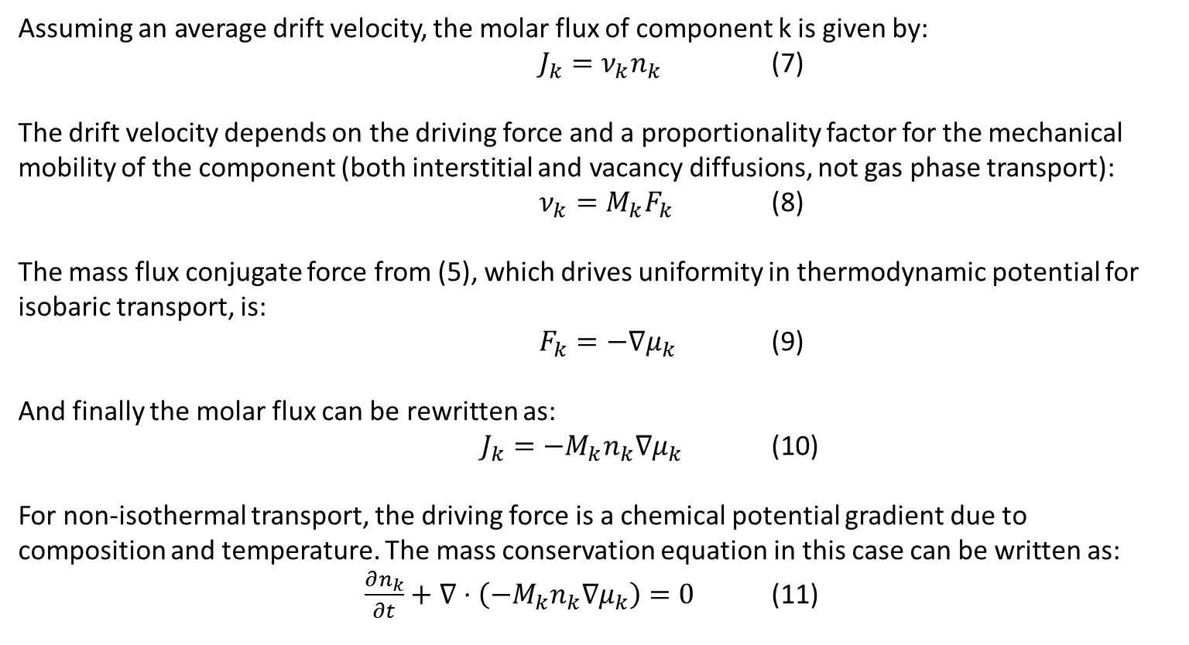
Model Development
Transport Model for Component Diffusion
Assuming an average drift velocity, the molar flux of component k is given by:
$J_{k}=ν_{k}n_{k}$ (7)
The drift velocity depends on the driving force and a proportionality factor for the mechanical mobility of the component (both interstitial and vacancy diffusions, not gas phase transport):
$ν_{k}=M_{k}F_{k}$ (8)
The mass flux conjugate force from (5), which drives uniformity in thermodynamic potential for isobaric transport, is:
$F_{k}=−∇μ_{k}$ (9)
And finally the molar flux can be rewritten as:
$J_{k}=−M_{k}n_{k}∇μ_{k}$ (10)
For non-isothermal transport, the driving force is a chemical potential gradient due to composition and temperature. The mass conservation equation in this case can be written as:
$\frac{∂n_{k}}{∂t}+∇⋅\left(−M_{k}n_{k}∇μ_{k}\right)=0$ (11)
7
$μ$ - Chemical Potential $k$ - Component Index $n$ - Number Density $J_{k}$ - Flux of Component k $ν$ - Average Drift Velocity

Slide 8
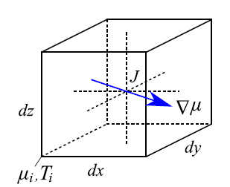
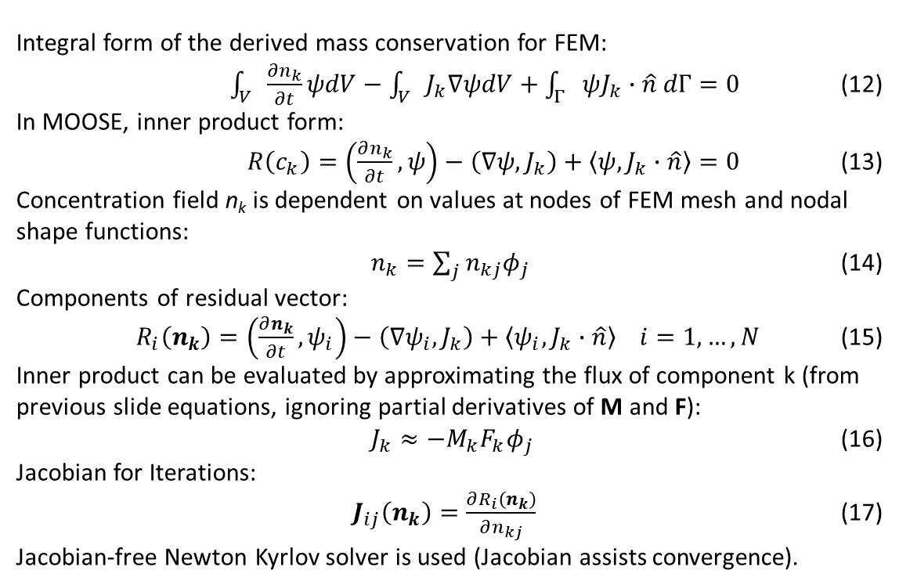
Model Development
Finite Element Method (FEM) Implementation of Transport Equations
The derived equation for mass conservation assumes infinitesimal volumes of uniform properties. A finite element method implementation allows for computation of chemical potential within the element to obtain mass flux. A continuum representation is used which evaluates at node centers and interpolates across the volume (makes gradients accessible).
Integral form of the derived mass conservation for FEM:
$\int_{V}{\frac{∂n_{k}}{∂t}ψdV}−\int_{V}{J_{k}∇ψdV}+\int_{Γ}{ψJ_{k}∙\hat{n} dΓ}=0$ (12)
In MOOSE, inner product form:
$R\left(c_{k}\right)=\left(\frac{∂n_{k}}{∂t},ψ\right)−\left(∇ψ,J_{k}\right)+\left\langle ψ, J_{k}∙\hat{n}\right\rangle =0$ (13)
Concentration field n_{k} is dependent on values at nodes of FEM mesh and nodal shape functions:
$n_{k}=\sum_{j}{n_{kj}φ_{j}}$ (14)
Components of residual vector:
$R_{i}\left(n_{k}\right)=\left(\frac{∂n_{k}}{∂t},ψ_{i}\right)−\left(∇ψ_{i},J_{k}\right)+\left\langle ψ_{i}, J_{k}∙\hat{n}\right\rangle i=1,…,N$ (15)
Inner product can be evaluated by approximating the flux of component k (from previous slide equations, ignoring partial derivatives of M and F):
$J_{k}≈−M_{k}F_{k}φ_{j}$ (16)
Jacobian for Iterations:
$J_{ij}\left(n_{k}\right)=\frac{∂R_{i}\left(n_{k}\right)}{∂n_{kj}}$ (17)
Jacobian-free Newton Kyrlov solver is used (Jacobian assists convergence).
Continuum representation FEM.
$k$ - Component Index $n$ - Number Density $J_{k}$ - Flux of Component k $ψ$ - Test Function $φ$ – Nodal Shape Function
$V$ - Element Volume $Γ$ - Element Surface $N$ – Number of FEM Nodes
8

Slide 9
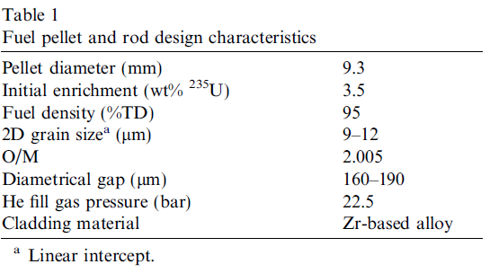
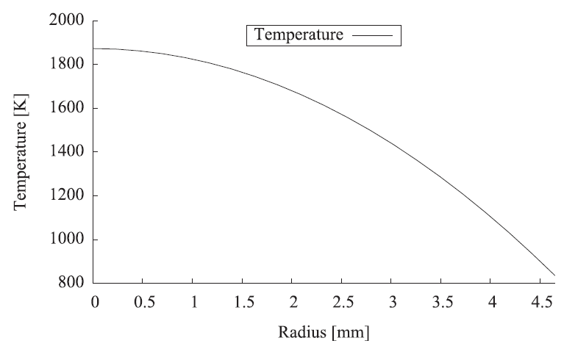
Demonstration Problems
Demonstration Problems
Two demonstration problems were constructed to simulate oxygen transport in UO_{2±x} fuel for a given parabolic temperature field over a 1-year period. The initial fuel composition of uniform UO_{2.005} was used. For the first demonstration, the total composition was not modified and all changes are due to temperature effects on oxygen diffusion. In the second demonstration fuel composition evolves over time due to burnup.
Walker, C.T., et al., “On the oxidation state of UO₂ nuclear fuel at a burn-up of around 100 MWd/kgHM”, J. Nucl. Mat. 345 (2005) 192, 205.
Local Fuel Composition with Burnup
The elemental composition of fuel as a function of radius and time was evaluated in the ORIGEN-S depletion code.
For simplicity, only oxygen is allowed to transport as the focus is on the demonstration of the formulation and coupling.
9

Slide 10
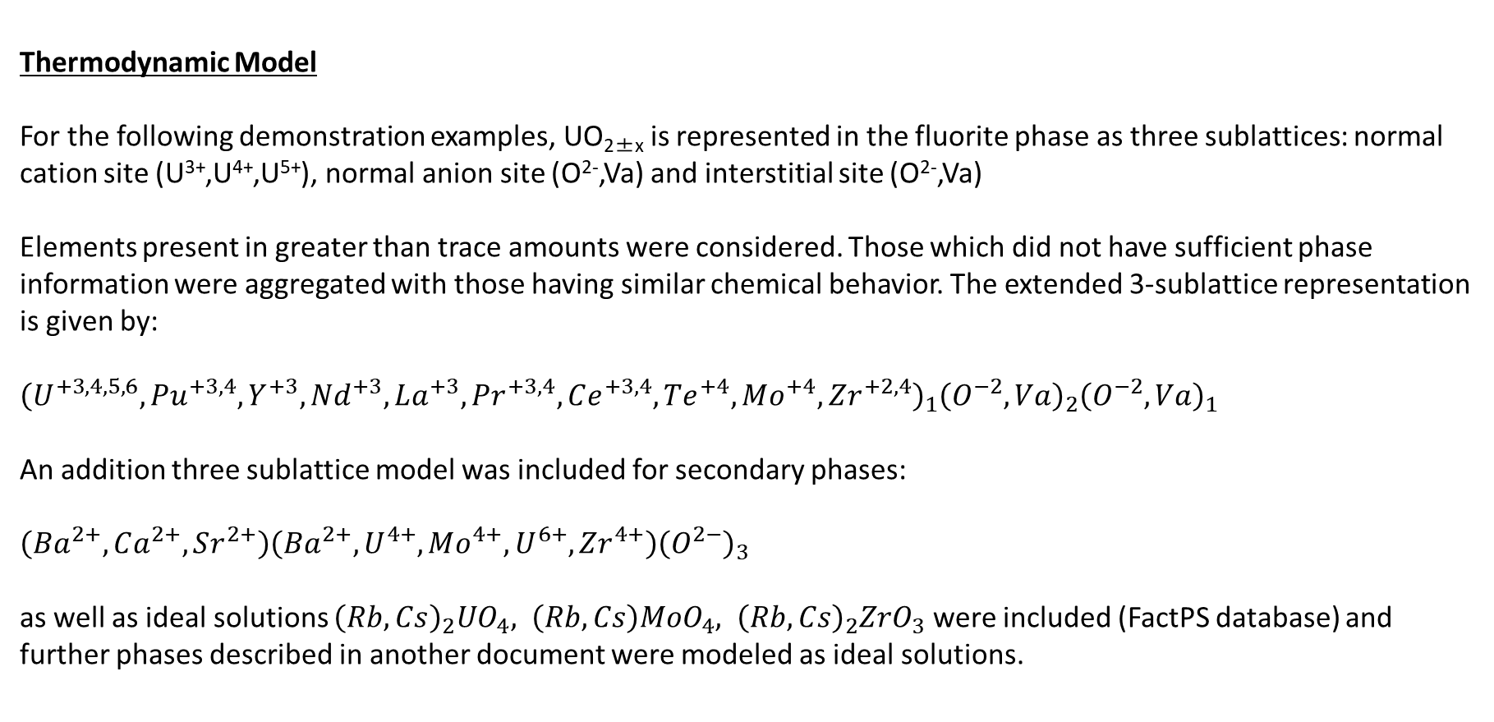
Demonstration Problems
Thermodynamic Model
For the following demonstration examples, UO_{2±x} is represented in the fluorite phase as three sublattices: normal cation site (U³⁺,U⁴⁺,U⁵⁺), normal anion site (O²⁻,Va) and interstitial site (O²⁻,Va)
Elements present in greater than trace amounts were considered. Those which did not have sufficient phase information were aggregated with those having similar chemical behavior. The extended 3-sublattice representation is given by:
${\left(U^{+3,4,5,6},Pu^{+3,4},Y^{+3},Nd^{+3},La^{+3},Pr^{+3,4},Ce^{+3,4},Te^{+4},Mo^{+4},Zr^{+2,4}\right)}_{1}{\left(O^{−2},Va\right)}_{2}{\left(O^{−2},Va\right)}_{1}$
An addition three sublattice model was included for secondary phases:
$\left(Ba^{2+},Ca^{2+},Sr^{2+}\right)\left(Ba^{2+},U^{4+},Mo^{4+},U^{6+},Zr^{4+}\right){\left(O^{2−}\right)}_{3}$
as well as ideal solutions ${\left(Rb,Cs\right)}_{2}UO_{4}, \left(Rb,Cs\right)MoO_{4}, {\left(Rb,Cs\right)}_{2}ZrO_{3}$ were included (FactPS database) and further phases described in another document were modeled as ideal solutions.
10

Slide 11
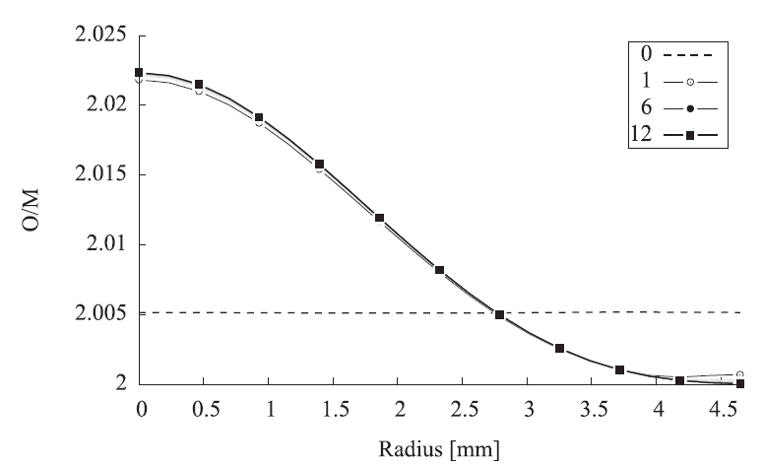
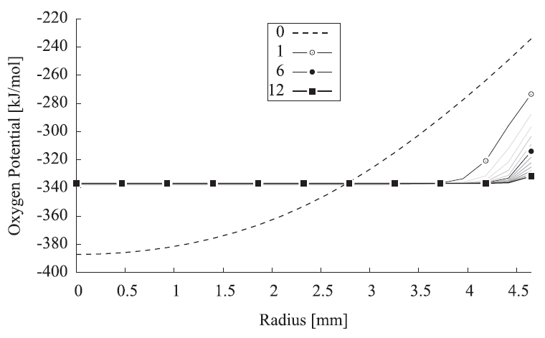
Demonstration Problems
Demonstration Problem 1: Oxygen Diffusion Only
The temperature profile is responsible for oxygen diffusion in this case, and oxygen slightly migrates down the chemical potential gradient. The O/M ratio and oxygen potentials both approach near-equilibrium values, except at the rod edge where the lower temperature causes low mobility.

Slide 12
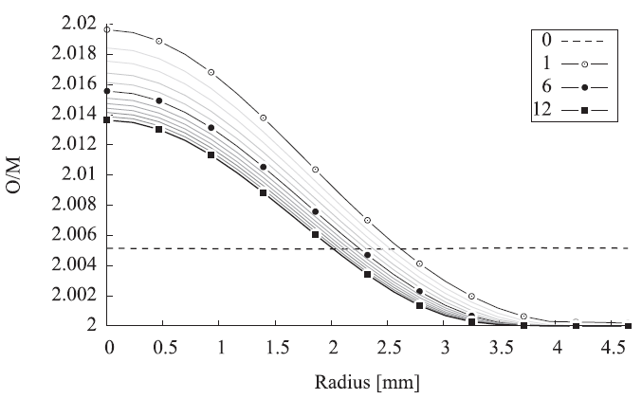
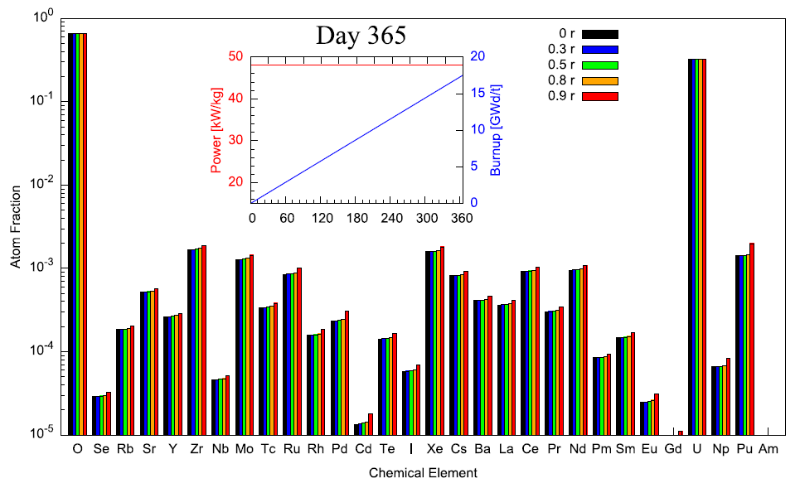
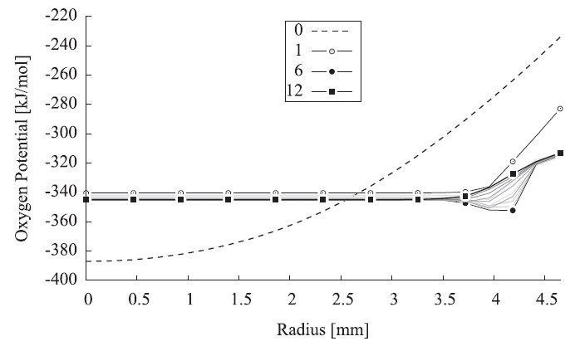
Demonstration Problems
Demonstration Problem 2: Oxygen Diffusion with Burnup
Fission product compositions are provided to BISON as a function of time and position, which sends composition information to Thermochimica for coupled fuel performance/thermochemical calculations.
A downward trend in oxygen-uranium ratio is observed (net effect of fission product oxidation states and uranium losses). Similar to the previous case, oxygen potential is driving toward uniformity.

Slide 13
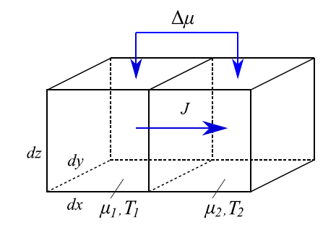
Discussion and Conclusions
General Critiques
The paper included extensive details on methods/formulations which were not used. E.g., other irreversible thermodynamics entropy production rate densities, discontinuous volumes in equilibrium FEM implementation (as opposed to continuum).
Complex behavior of oxygen potential in demonstration 2 could be further explained (change in direction). Month lines in this plot are also disordered due to this behavior and cannot be understood.
Some important information is left as references to other papers, such as the demonstration problem specifications, but could be condensed and reproduced in this paper (keeping references) for problem completeness.
Walker, C.T., et al., “On the oxidation state of UO₂ nuclear fuel at a burn-up of around 100 MWd/kgHM”, J. Nucl. Mat. 345 (2005) 192, 205.

Slide 14
Discussion and Conclusions
Conclusions
The demonstration cases presented the use of Thermochimica coupling to BISON to perform oxygen diffusion calculations. By supplying compositions of irradiated fuel as evaluated by ORIGEN-S, effects of burnup on oxygen diffusion were also observed.
Differences between the two cases demonstrate the importance of performing detailed thermochemical calculations in determining the oxidation state of fuel.
For this study, a fixed temperature distribution was applied with a focus on thermochemistry and diffusion coupling as development of a capability for coupled BISON-Thermochimica. Time-dependent temperature profiles and other steps toward more complete modelling capabilities are clear next steps.
Applications of work such as this could include further development of the coupled code to study fuel design failure susceptibility, for example to simulate irradiated fuel chemistry and better understand the impact of oxygen transport on stress corrosion cracking or other failure mechanisms.

