Slide 1
Nuclear Fuel Performance
NE-591-010
Spring 2021

Slide 2
Last Time
Growth and creep are the major mechanisms for dimensional instability in zirconium alloy cladding
Growth results from the clustering of interstitials on prismatic planes
Creep occurs in three stages: (1) creep down from water pressure; (2) creep out from fuel column; (3) fuel column axial stress
Under irradiation, zirconium experiences irradiation induced hardening due to interstitial loops
Dislocation channels form that don’t have loops, resulting in localized deformation
Other phenomena:
Fatigue; SCC; PCMI; PCCI

Slide 3
cladding oxidation

Slide 4
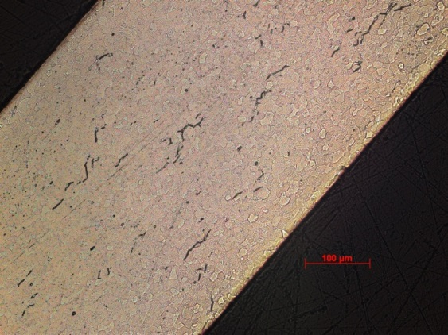
Zirconium Oxidation
Corrosion of zirconium is one of the largest concerns for LWR fuel operation
Zirconium interacts with water to make zirconia and hydrogen
Both the oxide layer and the hydrogen adversely impact cladding performance
ZrO₂
Zr metal

Slide 5
Corrosion
Corrosion is the degradation of a material and its properties under the action of the surrounding environment by chemical and/or electrochemical reaction
Corrosion reactions require the following:
Oxidant
Electric current
A corrosion reaction is composed of an oxidation reaction and a reduction reaction
During corrosion at a particular spot on the surface of the object, oxidation takes place and that spot behaves as an anode
The electrons released at this anodic spot move through the metal and go to another spot and reduce H, which behaves as a cathode

Slide 6
Corrosion
Corrosion reaction rates are determined by thermodynamics and kinetics
Thermodynamics tell us whether a material may corrode
Measure voltage difference between anodic and cathodic sites
Kinetics tell us how quickly a material will corrode
Measure net current between anodic and cathodic sites

Slide 7

Formation of Oxide Layer After Oxide Formation
H₂0
Zr
H₂0
ZrO₂
Zr
O⁻²
e⁻
Oxidation reaction:
Dissociation of water at oxide/water interface
Absorption of oxygen into oxide layer
Diffusion of oxygen through oxide layer
Reaction of oxygen with zirconium
Diffusion of electrons through oxide layer
Reduction of hydrogen
Reduction reaction:

Slide 8
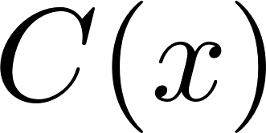
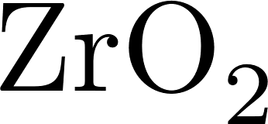

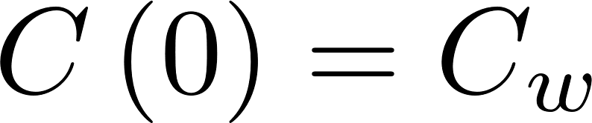
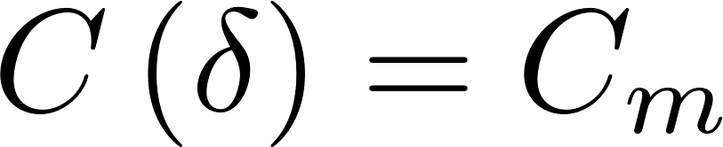


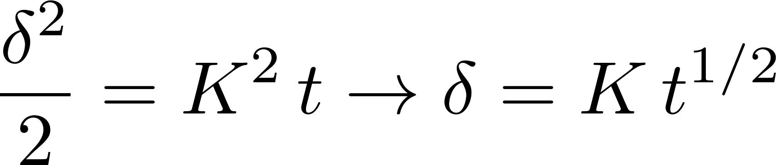
Corrosion rate limited by diffusion
Because the rate limiting steps are diffusion, we can model the oxidation rate using diffusion
Assumptions:
Transport of O species is rate-limiting
Transport of charged species by diffusion only
Homogeneous oxide layer
No sources/sinks of ions in oxide
All oxygen is used to create oxide
No loss of oxide

Slide 9
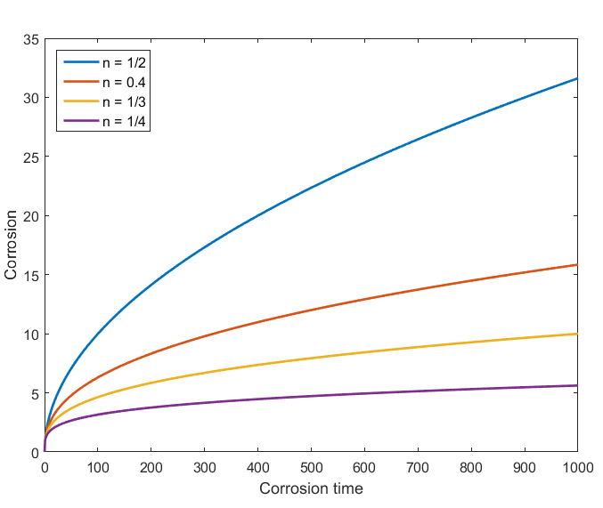
Observed kinetics are slower than parabolic
Parabolic kinetics
Diffusion of species across the oxide
Sub-parabolic kinetics
Additional ions in oxide
Non-uniform electric field in oxide layer
Once a nonhomogeneous electric field arises, the corrosion rate decreases to the sub-parabolic rate due to inhibition of transport of charged species

Slide 10
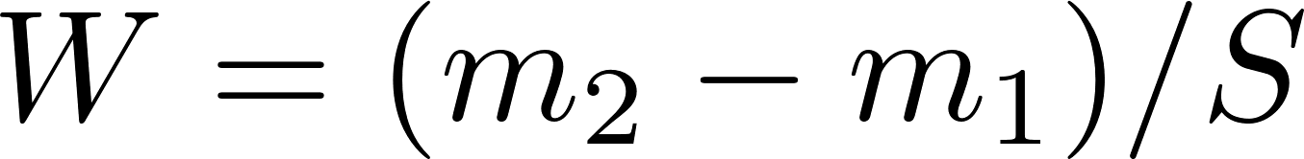
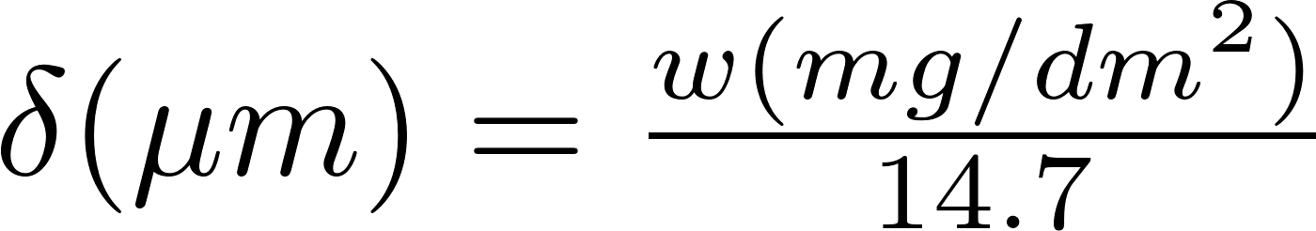
Corrosion Quantified
Corrosion is measured by sample weight gain
Oxidation of alloys is measured experimentally using the weight gain in mg/dm²
Oxide forms by incorporating oxygen in the metal structure causing an increase in weight
Approximation weight gain – oxide thickness for Zr:
Dividing by the surface enables comparison between samples

Slide 11
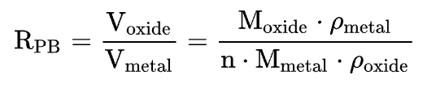
Pilling-Bedworth ratio : PBR
The ratio of the volume per unit of the metal oxide to the volume per unit of the corresponding metal is called the Pilling-Bedworth ratio (PBR)
PBR < 1: the oxide coating layer is thin, likely broken and provides no protective effect (for example magnesium)
PBR > 2: the oxide coating chips off and provides no protective effect (example iron)
1 < PBR < 2: the oxide coating is passivating and provides a protecting effect against further surface oxidation
Passivation refers to a material becoming "passive," that is, less affected or corroded by the environment of future use
ZrO₂
Zr metal

Slide 12
Example
A corrosion coupon of ZIRLO measures 2.8 cm x 2.8 cm x 600 µm and has an initial mass of 3 g. After corrosion for 200 days, its final mass is 3.0721 g. What is the estimated oxide thickness?
First, we need to convert the units (10 cm = 1 dm)
Find area
S = 0.28*0.28 = 0.0784 dm²
Find mass change
dM = 307.21 - 300 mg = 7.21 mg
Then we calculate the weight gain per area
W = dM/S = (7.21)/0.0784= 91.96 mg/dm²
Last estimate the thickness
d = W/14.7 = 91.96/14.7 = 6.3 microns thick after 200 days

Slide 13
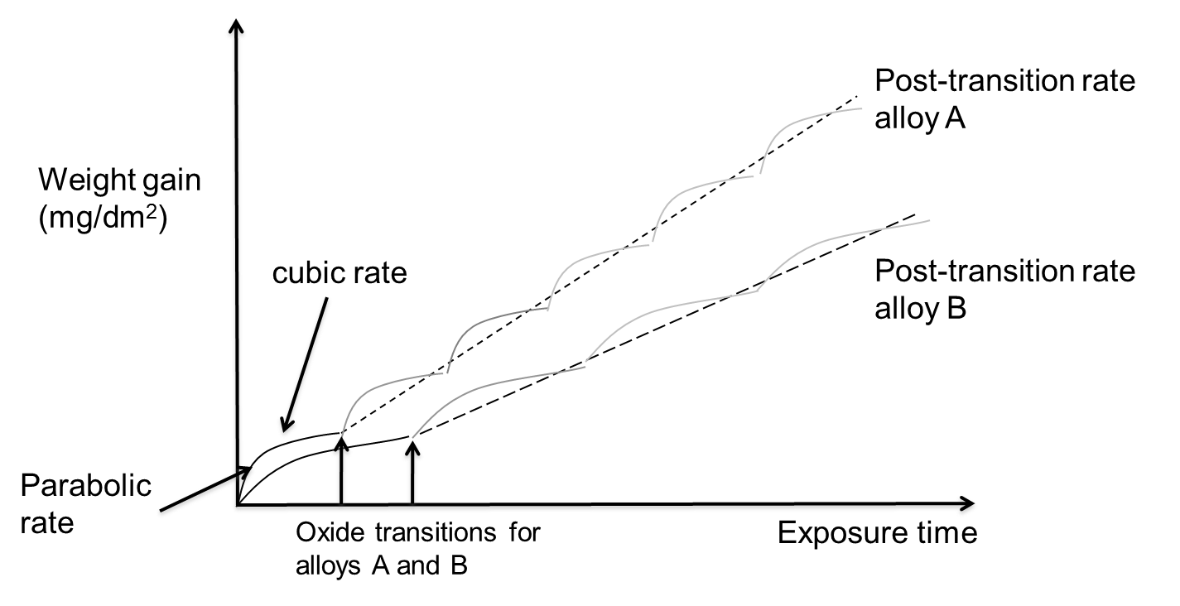
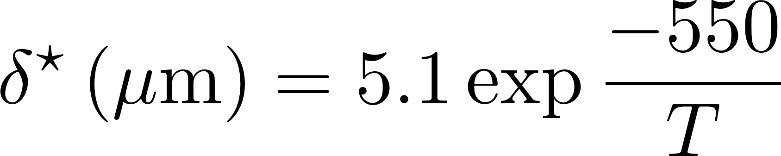
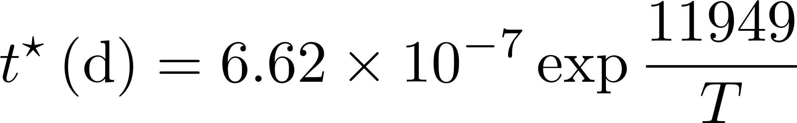
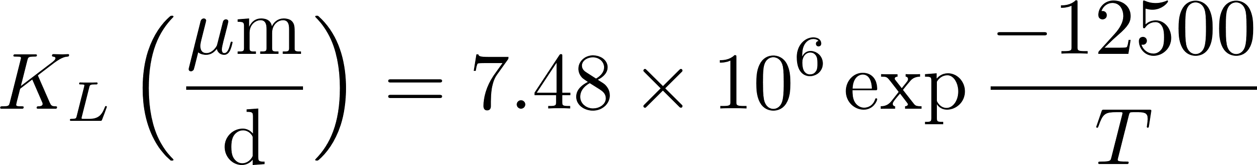
Corrosion Rate
Average weight gain of a sample follows linear kinetics
The oxide reaches transition at different times in different points, but the average is linear
Critical oxide thickness for transition is defined as
Critical time for transition is defined as
After transition, oxide thickness is

Slide 14
Example
Estimate the oxide thickness on a ZIRLO sample at 650 K after 200 days exposed to water.
First, we have to determine if the oxide has gone through transition
t* = 6.62e-7*exp(11949/650 k) = 63.76 days
So, the sample is past transition, so we need to use the linear fit
Next, we calculate the oxide thickness at transition
δ* = 5.1*exp(-550/650) = 2.19 microns
Now, we can compute the final oxide thickness
K_{L} = 7.48e6*exp(-12500/650) = 0.0333
δ = 2.19 + 0.0333*(200 – 63.76) = 6.73 microns

Slide 15
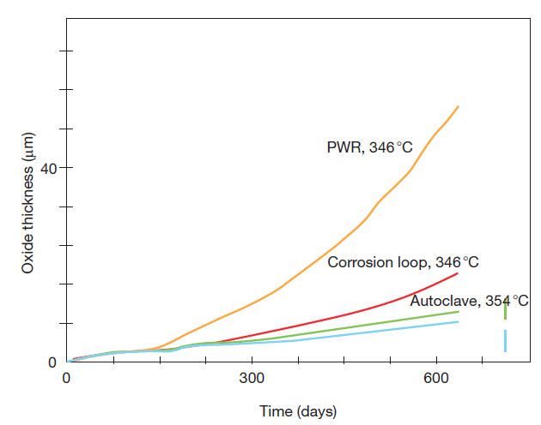
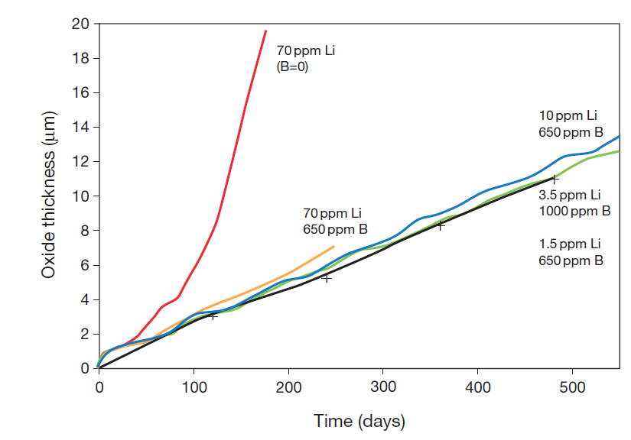
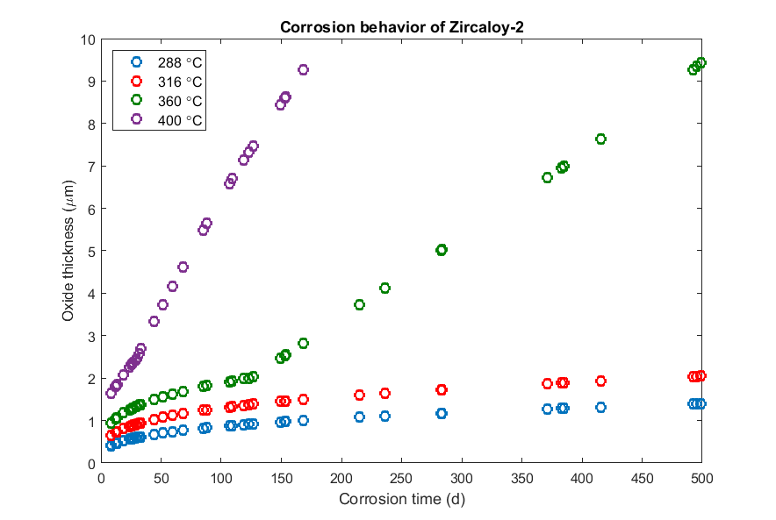
Other factors affecting corrosion
Irradiation: Radiation damage to the metal; Radiation damage to oxide
Water chemistry: Coolant additions are added to control neutronics, corrosion, and hydrogen pick-up
Temperature:
Corrosion rate increases
with temperature

Slide 16
Impact of Corrosion
The oxide layer has a low thermal conductivity, restricting heat transport
For Zircaloy, k = 22 W/(mK)
For ZrO₂, k = 1.7 – 2.7 W/(mK)
The oxide layer is much more brittle than the zircaloy
Zircaloy metal is removed as brittle oxide is added to the material
Oxidation produces hydrogen that can enter the cladding and form brittle hydrides

Slide 17
Corrosion Summary
Corrosion is the environmental degradation of materials
Cladding oxidizes, forming ZrO₂
The limiting step for oxidation is the oxygen transport through the oxide layer
It begins being controlled by diffusion
Then, a protective layer forms that slows oxidation
Once transition occurs, it loses its protectiveness and speeds up again
Oxidation hurts cladding performance by
Restricting heat transport
Converting zircaloy into a brittle oxide

Slide 18
Hydride Formation
Corrosion reaction:
Corrosion of zirconium so damaging in large part due to hydride formation
Some of the hydrogen atoms produced by oxidation enter the cladding and form a hydride phase
The fraction of the produced hydrogen that enters the cladding is defined by the pickup fraction:
Hydrogen is produced twice as fast as oxygen
J_{H} = 2 f J_{O}
ZrO₂
Zr metal
Hydrogen pick-up

Slide 19
Given a thickness of oxide, how can we predict the hydrogen pickup?
A cladding with an initial thickness of 600 microns that initially has 40 wt. ppm H undergoes corrosion to a total oxide thickness of 80 microns. What is the overall hydrogen content in wt. ppm if the hydrogen pickup fraction is 15%?
First, we must determine the weight of H that has entered the cladding
ρ_{ZrO2} is 5.68 g/cm³, of which 32/(91+32)= 0.26 = 26% is O, thus 1.47 g/cm³ of O
A 1 micron oxide layer corresponds to a weight gain of 14.7 mg/dm² and thus with an 80 micron layer, weight gain = 14.7*80 = 1176 mg/dm²
This mass corresponds to 1.176 N_{A}/16 atoms of oxygen = 4.42 x 10²² atoms/dm²
f = 15%, so the ingress of hydrogen will be 0.15*2*4.42e22 = 1.33e22 atoms of hydrogen/dm², or 0.022 g of H.
Now, we determine the fraction in wt. ppm in a 10 cm square cross section w/ PBR = 1.56
The uncorroded thickness is 600 – 80/PBR = 600 – 80/1.56=549 microns
The volume of zirconium is 549 x 10⁻⁴ (cm)*10*10 =5.49 cm³
ρ_{Zr} = 6.5 g/cm³, so the total mass of Zr is 6.5*5.49 =35.7 g.
Thus the hydrogen concentration is 0.022/35.7 =6.18e-4= 618 wt. ppm, which, added to the original 40 wt. ppm, is 658 wt. ppm

Slide 20
We can estimate the hydrogen content in the cladding from the oxide thickness δ and the pickup fraction f

Slide 21
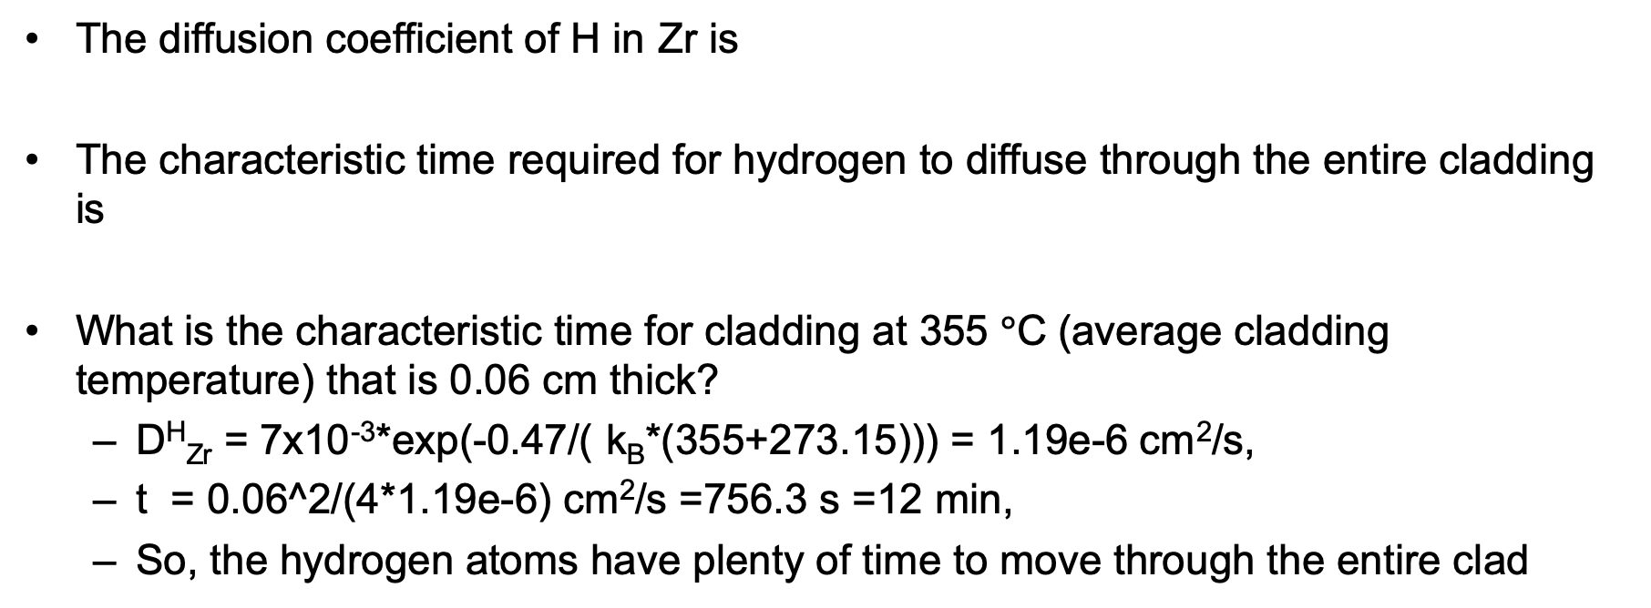
Hydrogen Diffusion
The diffusion coefficient of H in Zr is
The characteristic time required for hydrogen to diffuse through the entire cladding is
What is the characteristic time for cladding at 355 $°$C (average cladding temperature) that is 0.06 cm thick?
D^{H}_{Zr} = 7x10⁻³*exp(-0.47/( k_{B}*(355+273.15))) = 1.19e-6 cm²/s,
t = 0.06^2/(4*1.19e-6) cm²/s =756.3 s =12 min,
So, the hydrogen atoms have plenty of time to move through the entire clad

Slide 22
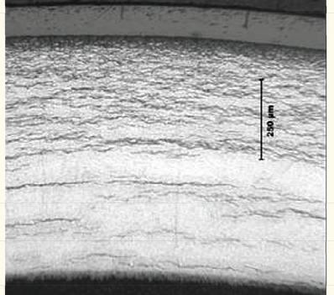
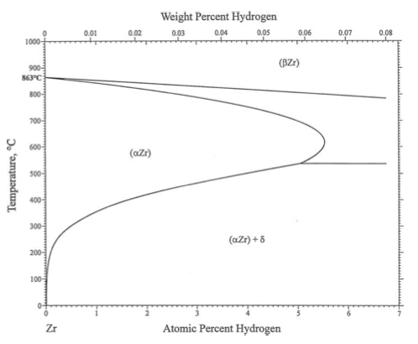
Hydriding
Hydride concentrations are not uniform, because they respond to temperature and stress gradients
Hydrogen tends to move toward lower temperature (Soret effect)
It also moves to areas with tensile stress
Hydrogen has a low solubility in zirconium, so even small hydrogen concentrations result in hydrides

Slide 23
Effect of Hydrides
The hydride rim is caused by the Soret effect and the temperature dependence of the solubility
The hydride rim and blisters can cause a loss of ductility, leading to earlier failure
Hydride rims are layers of uniform depth, that can reach 50–60 microns, and cover a wide area on the tube azimuthal and axial directions
Blisters have an elliptic shape, are more localized on the tube external surface and are deeper, usually covering half of the cladding thickness

Slide 24
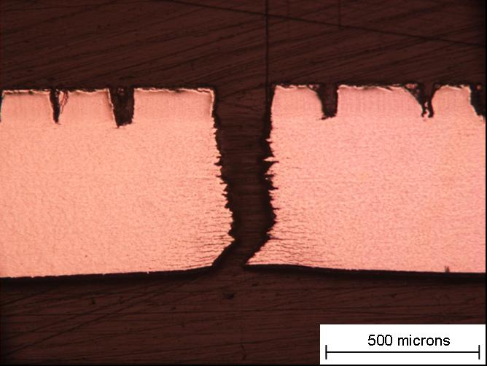
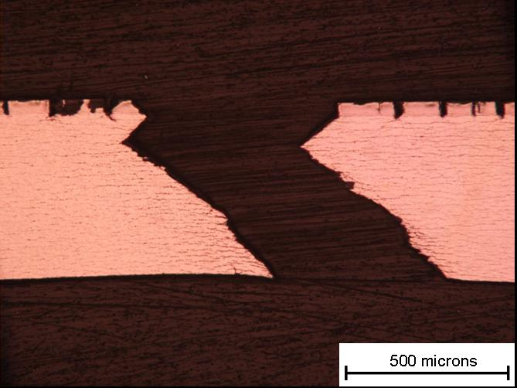
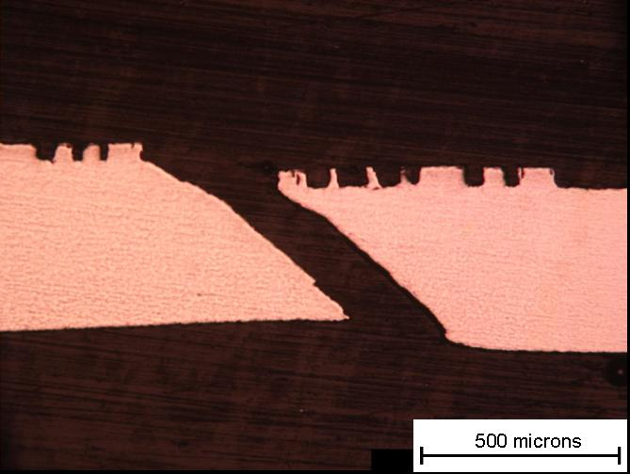
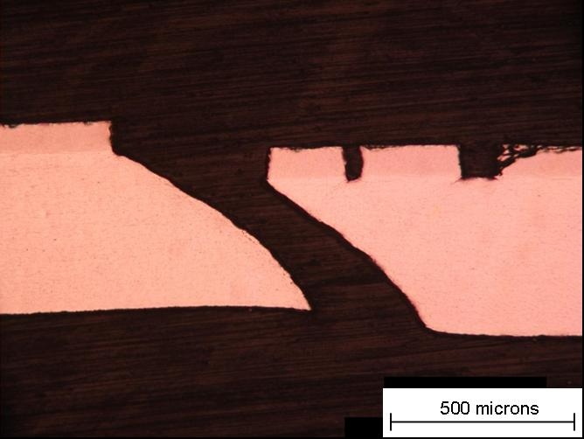
Blister failure examples
But in small blisters => shear instability
90 degree failure at RT
40 μm Blister Broken at 25 °C
M014
93 μm Blister Broken at 25 °C
M020
53 μm Blister Broken at 300 °C M025
83 μm Blister Broken at 300 °C M023
At 300 C, 45 degree shear
24

Slide 25
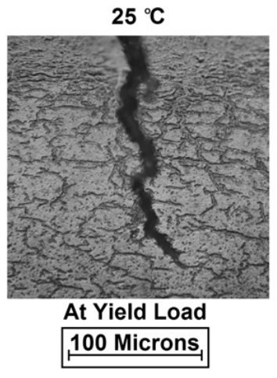
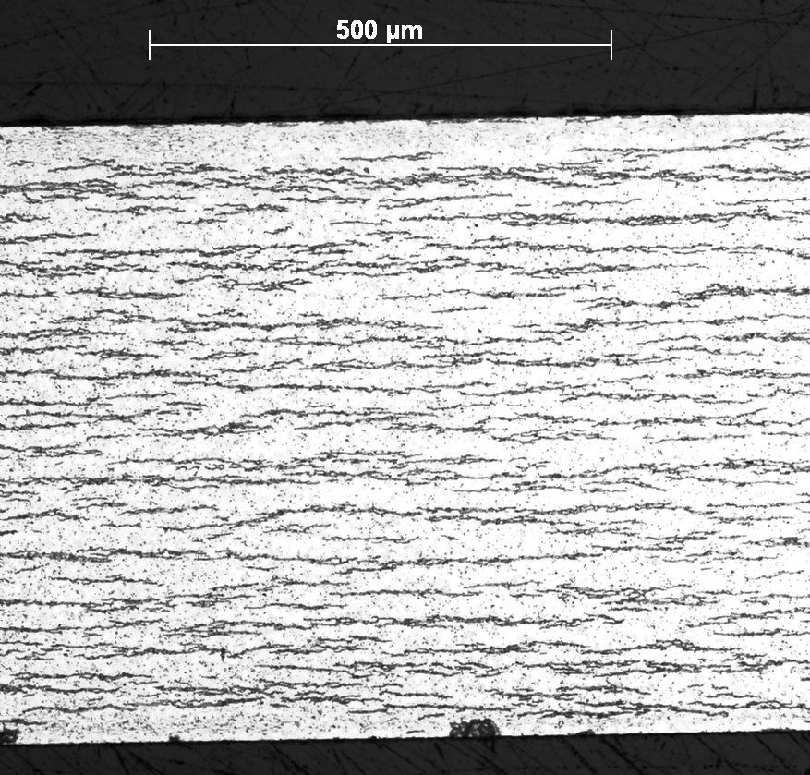
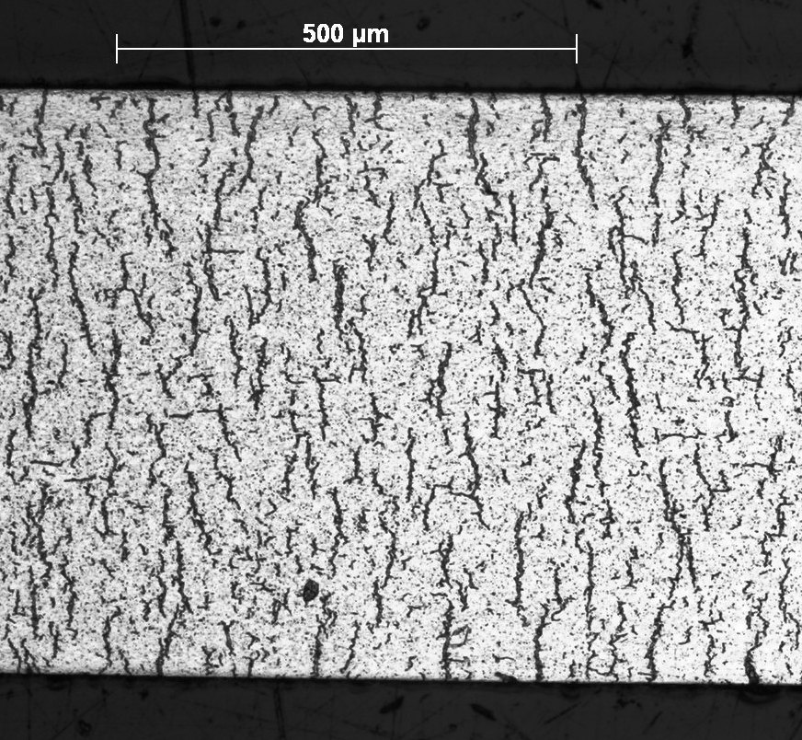
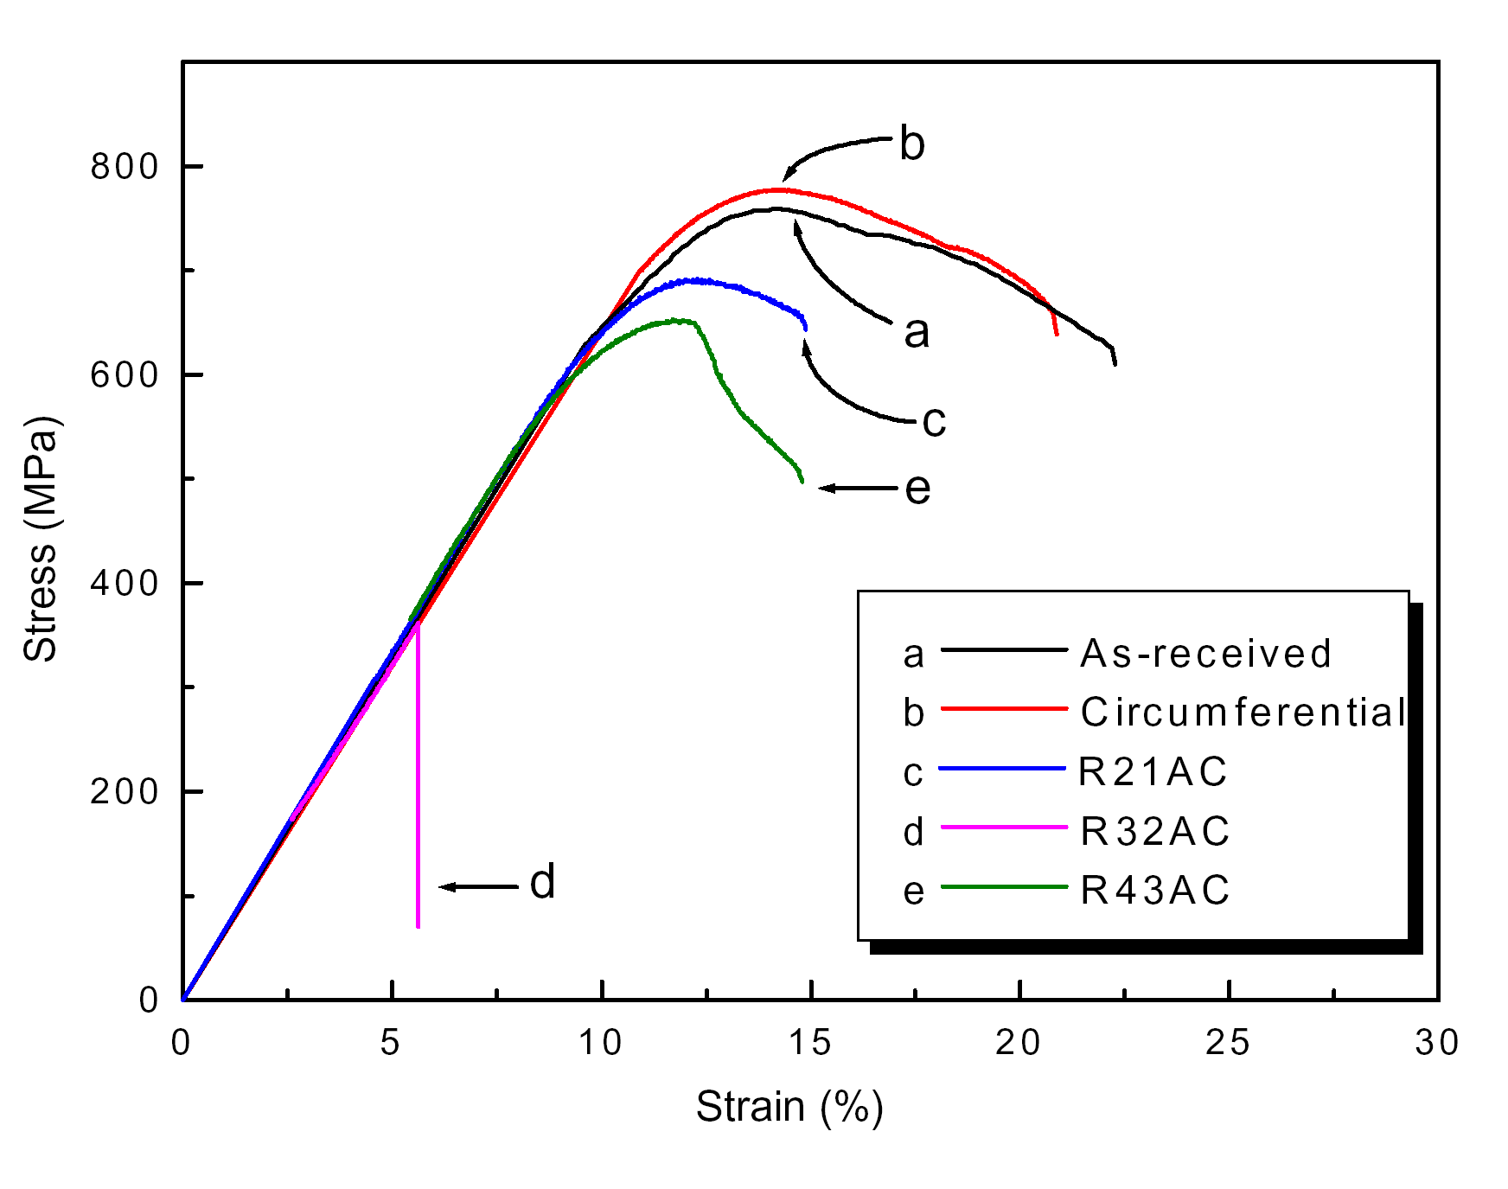
Circumferential vs Radial Hydrides
Under reactor conditions, hydride platelets precipitate circumferentially
In used fuel after drying, the hydrides can reprecipitate with a radial orientation
The hydrides reform in a radial direction due to the tensile hoop stress
Radial hydrides provide easy crack paths and significantly decrease the ductility of the cladding

Slide 26
Hydrides Summary
Hydrogen released by oxidation enters the cladding
It quickly diffuses throughout the cladding, but prefers low temperature
Due to low solubility (that is a function of temperature), hydrides form
Hydrides are brittle, and so reduce the ductility of the cladding
Radial hydrides can form in used fuel after drying, and reduce the ductility much more than circumferential hydrides

