Slide 1
Nuclear Fuel Performance
NE-533
Spring 2025

Slide 2
Housekeeping
Exam Thursday
Problem session after lecture
MOOSE project due 2/28
Snowstorm coming…
Assuming that class is cancelled on Thursday, we will do the exam via zoom
Cameras on, I will be a virtual proctor
Will submit your scanned or photographed exam and cheat sheet and email them to me

Slide 3
Last Time
The crystal lattice is never perfect; it has defects
Point defects, dislocations, grain boundaries, voids and precipitates
Microstructure can be tailored through processing, during fabrication or post-fabrication
Started UO2 radiation effects
interstitial loops and voids
changes in thermal conductivity due to irradiation and chemistry changes
have various empirical models which take into account phonon and electron kth, as well as burnup

Slide 4
mechanistic modeling

Slide 5
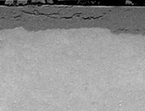
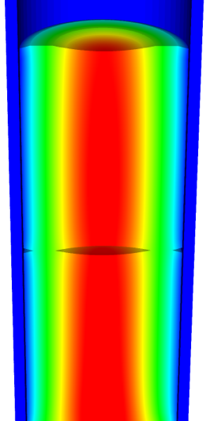
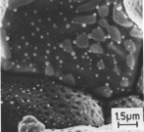
Microstructure-based fuel performance modeling
Structure/property relationships connect the microstructure variables to the property values
Operating Conditions
Neutron flux
Coolant T&P
Variables
Temperature
Displacement
Stoichiometry
Cladding
Property values
Microstructure evolution models
Microstructure evolution models
Fuel Property values
Elasticity tensor
Elasticity tensor
Grain growth
Grain growth
Cladding
Microstructure variables
Average grain size
Dislocation density
H concentration
Hydride fraction
Point defect concentrations
Loop density
2nd phase particle fraction
Fuel
Microstructure variables
Average grain size
Dislocation density
U defect concentrations
Pu concentration
Fission product precipitate fractions
Dissolved fission products
Fission gas bubble fraction
Grain boundary fission gas bubble coverage
Crack parameter
Plasticity
Plasticity
Thermal conductivity
Yield stress
Defect prod. & transport
Defect prod. & transport
Fracture stress
Thermal conductivity
Hydrogen transport
Fission gas behavior
Melting temperature
Failure criteria
Loop evolution
Densification
Diffusion constants
Dimensional change
Gap variable
Gap fission gas concentration
Fracture
Dimensional change

Slide 6

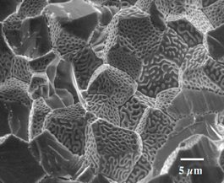
Example: fission gas behavior in the fuel
Take into account a finite set of variables to describe the state of the material
Utilize a mechanistic model of fission gas behavior to predict the evolution of the microstructure
Utilize this updated microstructure to inform a number of structure/property relationships
Variables
Temperature
Displacement
Stoichiometry
Elasticity tensor
Thermal conductivity
Model of fission gas behavior
Structure/property relationships
Fracture stress
Dissolved fission products
Fission gas bubble fraction
Grain boundary fission gas bubble coverage
Gap fission gas concentration
Dimensional change
Gap conductance
Gap pressure

Slide 7
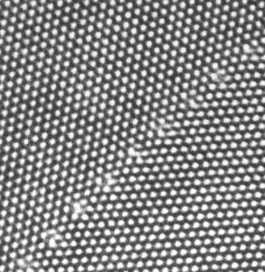
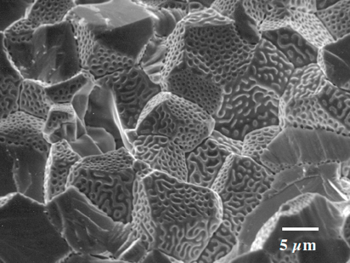
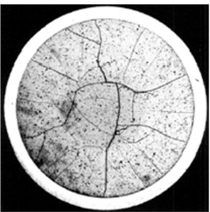
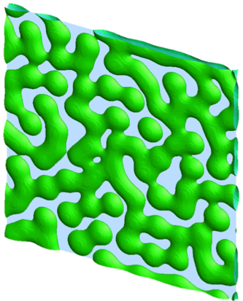
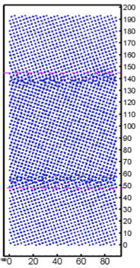
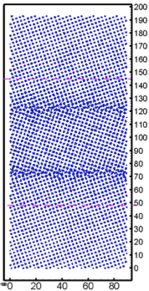
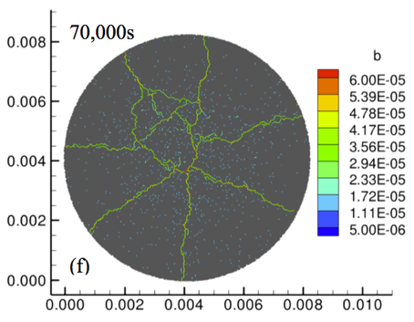
Multiscale separate effects experiments and simulations inform the development of the models
nm
μm
mm

Slide 8
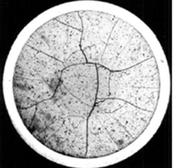
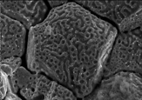
Microstructure-based models
Can provide a structure/property relationship to replace the existing burnup dependent model
For example, thermal conductivity, taking into account microstructural features and their evolution
Grain boundary and bubbles
Intragranular porosity
Precipitated fission products
κ_{pr}
Bulk conductivity
Vacancies and interstitials
Fission gas

Slide 9
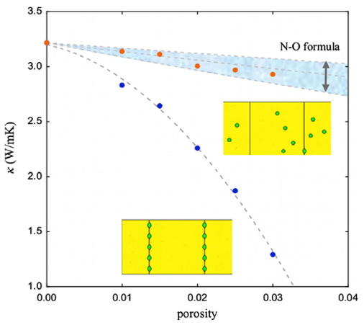
Parametrizing the mechanistic model
We employ multiscale modeling and simulation to determine the various parameters for the model
MD simulations conducted at LANL have been used to determine the coefficients for various point defects
MD simulations have shown that phonon scattering must be accounted for to accurately represent small bubbles
Mesoscale simulations have shown that GrB bubbles have a larger impact on the thermal conductivity
Maxwell-Eucken (no phonon scattering)

Slide 10
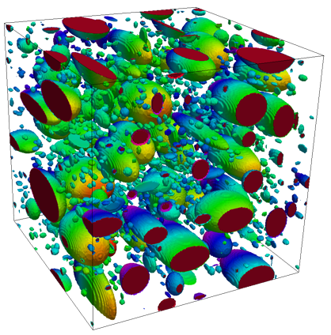
Parametrizing the mechanistic model
A thermal resistor model is created to describe the impact of GrB bubbles on the thermal conductivity
MARMOT simulations are currently being used to inform the development of the precipitate multiplier

Slide 11
Parametrizing the mechanistic model
Each term in the expression must be coupled to a corresponding state variable
The full model calculates the thermal conductivity as a function of:
Temperature
Point defect concentrations
Intragranular bubble density and average radius
Fractional coverage of bubbles on GBs and average radius
Precipitate volume fractions and average sizes
Currently effects of precipitate fission products and individual point defects are neglected in the model, as they are not tracked or predicted in BISON

Slide 12
Comparing with experiments…
The model under-predicts the temperature in most cases, but not all
Thus, the model is neglecting some resistive effects from the microstructure
Generally performs as well, and in some cases better, than the burnup based model
RISO-3 AN3
RISO-3 AN4
RISO II-3
US PWR TSQ0002

Slide 13
UZr Fuel Performance Modeling
Development of a quantitative phase-field model of macroscale constituent redistribution in the U-Zr system, where model parameters were optimized, and the model validated against an independent data set
Calculation of surface tension based on molecular dynamics, which is used in the BISON gaseous metallic fuel swelling model

Slide 14
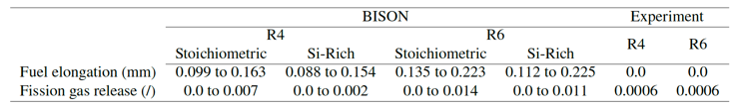
U3Si2 Fuel Performance Modeling
Point Defect Diffusion, Fission gas swelling, thermal and irradiation creep

Slide 15
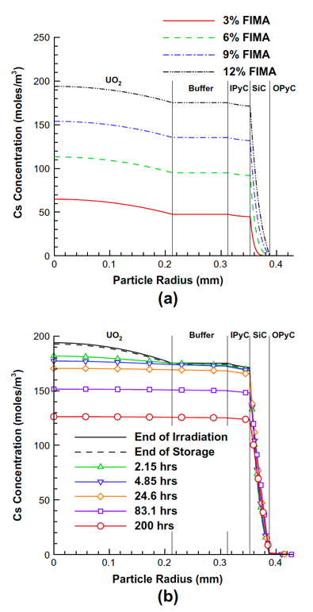
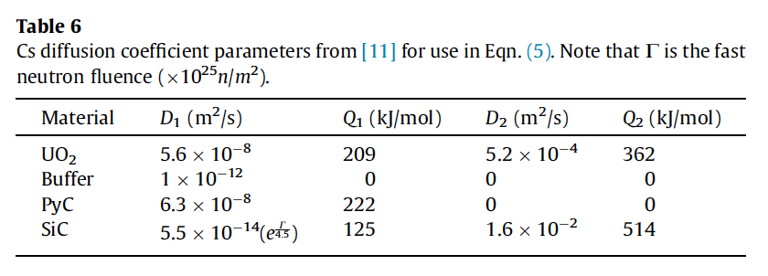


TRISO Particle Fuel Performance Modeling
TRISO particle modeling is still under development from a mechanistic model standpoint
Imperfect data for many critical fission products through different layers
Data typically for UO2 only, not for UC or UCO fuel kernels

Slide 16
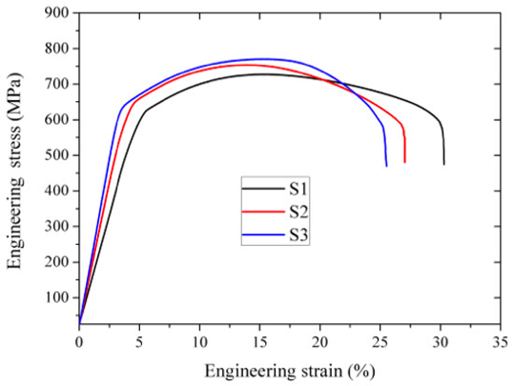
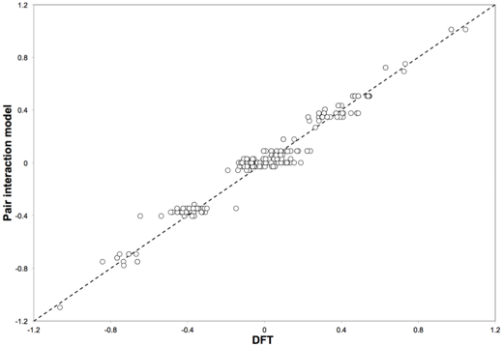
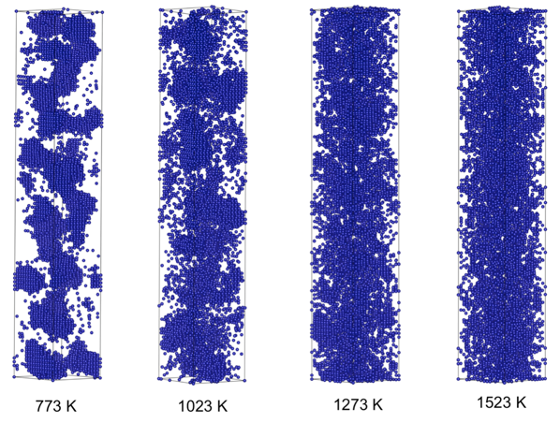
FeCrAl
Evolution of compositional randomness (precipitation) will affect the mechanical properties of FeCrAl
Kinetic Monte Carlo simulations modeled the precipitation of alpha’ phase from bcc Fe-Cr alloys under thermal aging at various temperatures
Fe-Al alloys do not show any phase separation
Can determine critical temperatures for precipitation and the resulting microstructures to investigate potential hardening

Slide 17
Summary
Researchers are working to develop materials models for the fuel and cladding that are mechanistic rather than empirical and that are based on the evolution of the microstructure rather than the burnup

