Slide 1
Nuclear Fuel Performance
NE-533
Spring 2026

Slide 2
MOOSE Notes
When you login: enter “groups” in the command line
Verify that ne533s26 is listed – this should be fixed… but I want you to verify
Ensure that you have set conda up!
(base) [bwbeeler@login01 ~]$
conda activate /usr/local/usrapps/ne533s26/bwbeeler/moose
cd /share/ne533s26/$USER
#Make your 'input.file'
mpirun -np 2 /usr/local/usrapps/ne533s26/beeler_moose/beeler_moose-opt -i input.file

Slide 3
MOOSE Project
Three-part project
Will upload input and output files to Moodle
Will upload a written Part 1 report, max of 10 pages (including figures)
This is an individual project, but some collaboration is encouraged
Write up with deliverables from Part 1, choice of materials, mesh, details therein, etc.
Part 1 is due March 3

Slide 4
MOOSE Project Part 1
0.5 cm
0.005 cm
0.1 cm
Fuel pellet dimensions listed
This is a 1-D problem, but I want your geometry to be set up in 2-D RZ
Assume reasonable values for material properties
Outer cladding temperature is constant: 600 K
Solve temperature profile for:
Steady-state: Q = 350 W/cm^3
Compare against analytical solution
Use both a constant k and a temperature-dependent k
Perform a mesh convergence study
Use transient solver
Explore two mesh options:
explicitly meshing the gap
without meshing the gap
1 cm
Fuel
Cladding
Gap

Slide 5
Last Time
Defined strain as a matrix of deformations
Tensile test stress/strain curves
Youngs modulus, yield strength, ultimate tensile strength, fracture strength
Matrix of elastic constants relating strains to stresses
only two unique constants for isotropic materials
Strain hardening
permanent deformation, leading to increased yield strength
dislocation pileup, increase in number of barriers
We developed analytical solutions for the stress in a pressurized cylinder with a thin wall

Slide 6
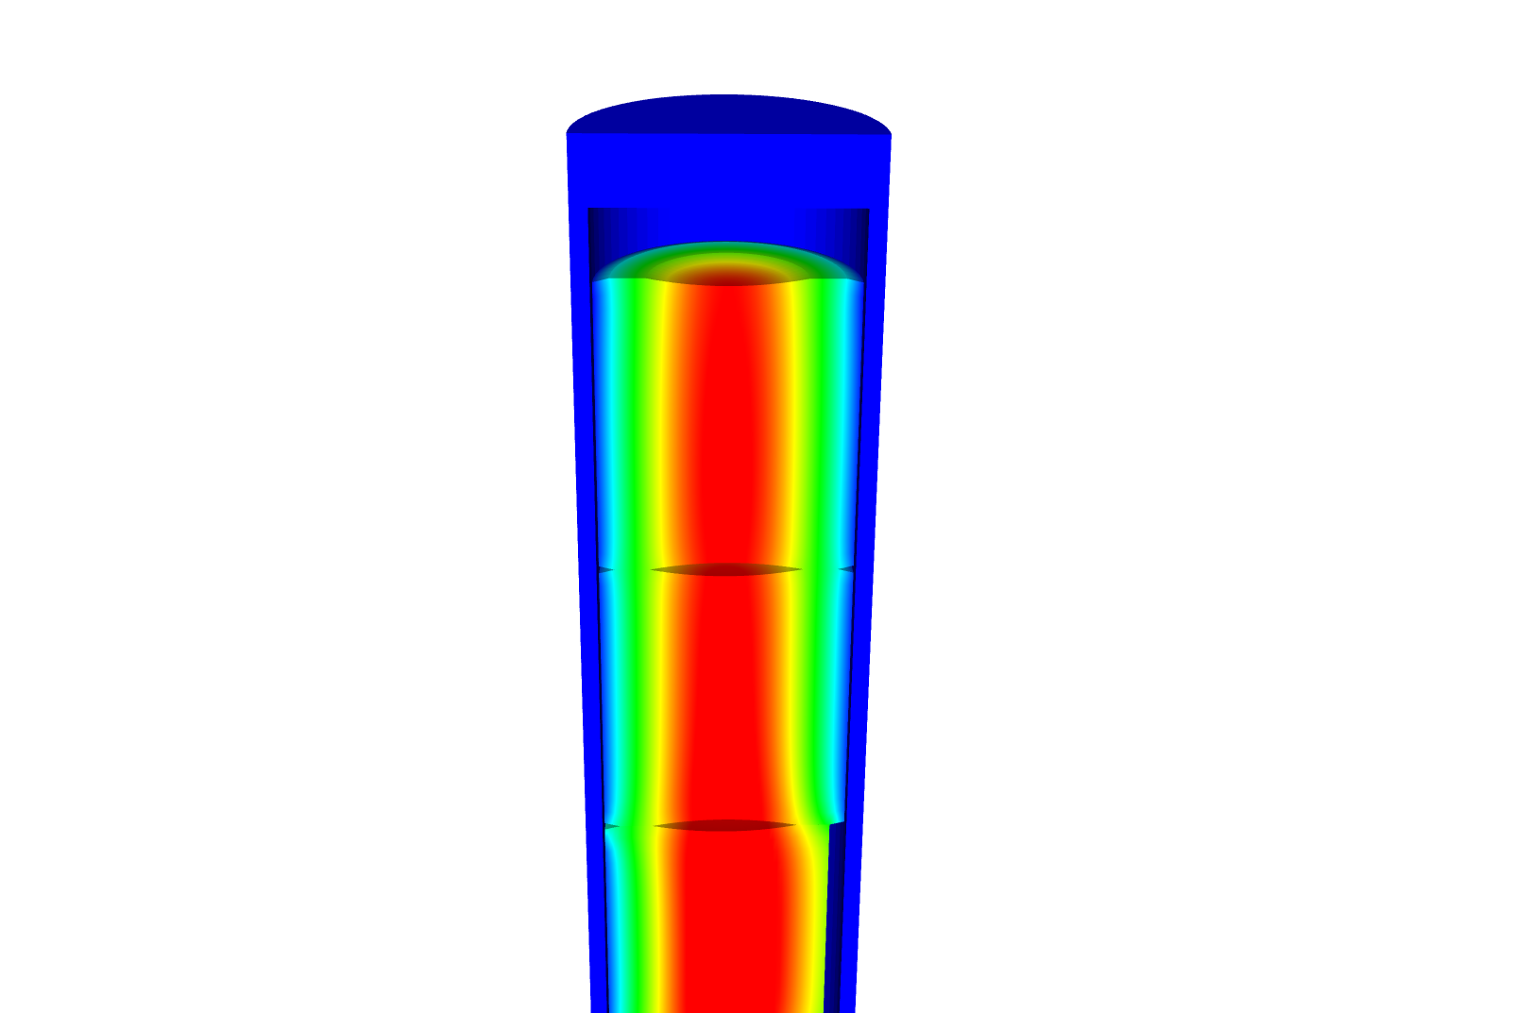
Develop constitutive relations for thick-walled
We assume small strains, so the strain is defined with respect to displacement: u
We assume isotropic material response:

Slide 7
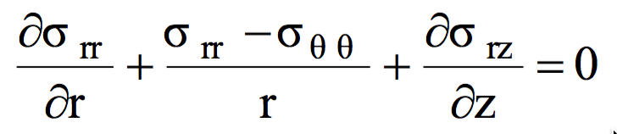
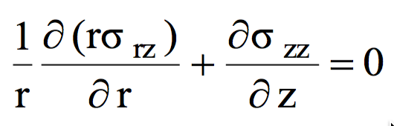
Stress within a pressurized cylinder that has thick walls (radius/thickness<20)
The cylinder as an inner radius R_{i} and an outer Radius R_{o}
We assume there is no shear stress, so σ_{rz} = 0
We will begin with the r equation
Now we need our constitutive law
We combine these equations to get

Slide 8
Develop equations for the stress within a pressurized cylinder with thick walls
We need one more relationship from the definition of the strain
From the previous slide, we have
If we combine these, we get
Again, from the previous slide
We end up with

Slide 9
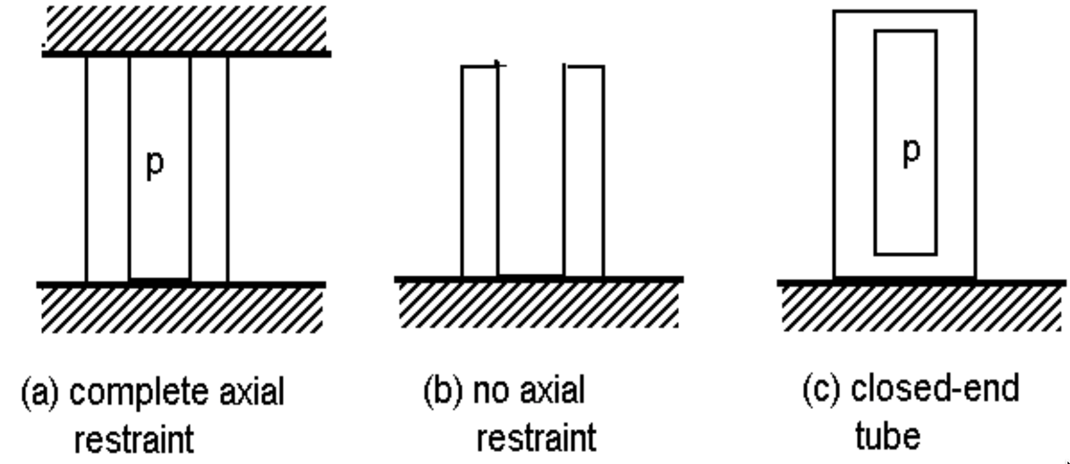
We now have an ODE so we can solve to get the stress
Our boundary conditions are σ_{rr}(R_{i}) = -p and σ_{rr}(R_{o}) = 0
After integrating twice, we get
From σ_{rr}, we can get σ_{θθ} from
From the end condition, we determine σ_{zz}
(a)
(b)
(c)

Slide 10
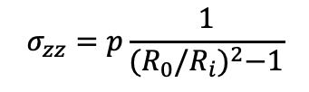
Determine if a fuel rod will exceed its yield stress
A fuel rod has an initial pressure of 5 MPa that increases to 9 MPa during operation. Will it exceed its yield stress?
R_{i} = 0.52, R_{o} = 0.58 cm, σ_{y} = 381 MPa
$$σ_{zz}=p\frac{1}{{(R_{0}/R_{i})}^{2}−1}$$
Which stress is the largest?
σ_{θθ}
At what position r will the hoop stress be the largest?
r = R_{i} = 0.52 cm
What is the stress at p = 5 MPa?
σ_{θθ} = 5*((0.58/0.52)^2 + 1)/((0.58/0.52)^2 – 1) = 46.0 MPa
What is the stress at p = 9 Mpa?
σ_{θθ} = 9*((0.58/0.52)^2 + 1)/((0.58/0.52)^2 – 1) = 82.7 Mpa
Again, we don’t even get close to yielding

Slide 11
We’ve now solved this same problem assuming thin and thick-walled cylinders

Slide 12
THERMO-Mechanics

Slide 13
Thermal Expansion
As the temperature increases, atoms have larger vibrations, causing the material to expand
This expansion doesn’t raise the energy of the material when unrestrained
This expansion can be treated as a strain, but as one that doesn’t cause stress

Slide 14
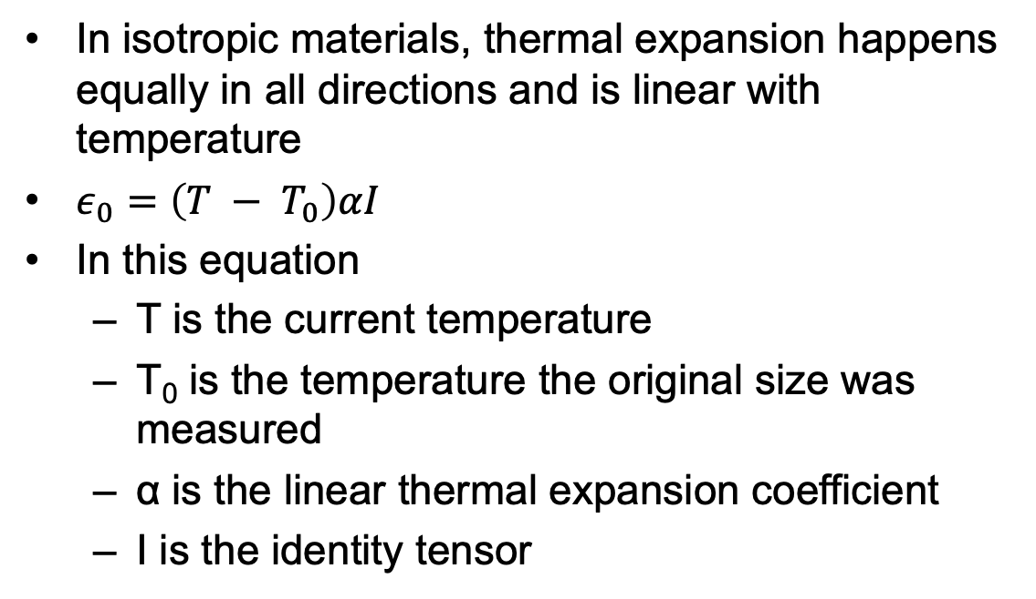
Thermal Expansion
In isotropic materials, thermal expansion happens equally in all directions and is linear with temperature
$ε_{0}=\left(T − T_{0}\right)αI$
In this equation
T is the current temperature
T₀ is the temperature the original size was measured
α is the linear thermal expansion coefficient
I is the identity tensor

Slide 15
Thermal Expansion
Though thermal expansion doesn’t directly cause stress, it can still lead to thermal stress

Slide 16


What is the stress in a thin constrained rod of length L when it is heated to ΔT?
The rod has a Young’s modulus of E and an expansion coefficient of α
$$ε_{T}=\left(T − T_{0}\right)αI$$
$σ=C (ε − ε_{T})$
$$ε_{0}=\left(T − T_{0}\right)α$$
$σ=E (0 − ΔTα)$
$σ=−EΔTα$

Slide 17
The large temperature gradient within a fuel pellet results in large thermal stresses

Slide 18
Consider the constitutive relations plus T
We assume small strains, so the strain is defined as
We assume isotropic material response, so

Slide 19

Consider a cylinder with thermal expansion but not pressure
$σ_{rr}\left(R_{i}\right)=σ_{rr}\left(R_{0}\right)=0$
Similar to the equations we worked through before
$\frac{1}{r^{3}}\frac{d}{dr}\left(r^{3}\frac{dσ_{rr}}{dr}\right)=−\left(\frac{αE}{1−ν}\right)\frac{1}{r}\frac{dT}{dr}$
Solving this ODE:

Slide 20
What is the hoop stress in the cladding?

Slide 21
Where is hoop stress equal to zero?
$$σ_{θθ}\left(r\right)=\frac{1}{2}ΔT\frac{αE}{1−ν}\left(1−2\frac{R_{i}}{δ}\left(\frac{r}{R_{i}}−1\right)\right)=0$$
$$\left(1−2\frac{R_{i}}{δ}\left(\frac{r}{R_{i}}−1\right)\right)=0$$
$$\left.2\frac{R_{i}}{δ}\left(\frac{r}{R_{i}}−1\right)\right.=1$$
$$\left.\left(\frac{r}{R_{i}}−1\right)\right.=\frac{δ}{{2R}_{i}}$$
$$\left. r\right.=\frac{δ}{2}+R_{i}$$

Slide 22
The linear temperature gradient across the cladding causes axial thermal stresses

Slide 23
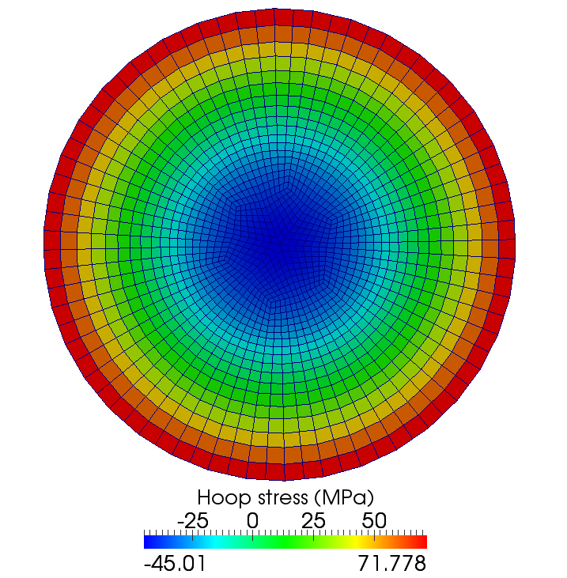
Same approach to the thermal stress in a fuel pellet
The thermal stress is due to the temperature gradient

Slide 24
Solve this stress ODE
The boundary conditions are:
Once we solve it, we obtain
Then we can solve the hoop stress
The axial stress is more complicated to obtain, but you end up with

Slide 25
The fuel temperature gradient causes large thermal stresses

Slide 26
Example

Slide 27
How far do fuel cracks extend?
E = 200 GPa, ν = 0.345, α = 11.0e-6 1/K, σ_{fr} = 130 MPa, ΔT = 550 K
Solve for η
– σ_{fr} / σ* = 1 – 3 η²
3 η² = 1 + σ_{fr} / σ*
η = ( (1 + σ_{fr} / σ*)/3 )^{½}
σ* = 11.0e-6*200*550/(4*(1 – 0.345) ) = 461.8 MPa
η = sqrt( (1 + 130/461.8)/3 ) = 0.65

Slide 28
thermal expansion

Slide 29
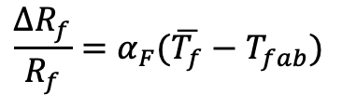
The gap changes as a function of time
Both the pellet and the cladding swell
But, as the gap decreases, the temperature changes, which again makes the gap change
The solution using the analytical equations is iterative, due to the dependence of the gap size and temperature
$$\frac{∆R_{f}}{R_{f}}=α_{F}(\overline{T_{f}}−T_{fab})$$

Slide 30
Example

Slide 31
This calculation is repeated until the gap width stops changing significantly
The change in the gap does NOT affect the coolant or outer cladding temperatures, just the gap and fuel temperatures
Does fuel centerline temp go up or down with correction?
Iteration | δ_{gap} (cm) | T_{s} (K) | T₀ (K)
0 | 0.003 | 701 | 1232
1 | 0.00066 | 644 | 1174
2 | 0.00097 | 652 | 1182
3 | 0.00094 | 651 | 1181
4 | 0.00094 | 651 | 1181

