Slide 1
Nuclear Fuel Performance
NE-533
Spring 2024

Slide 2
Last time
RIA is often caused in PWR/BWR by control rod ejection/drop
Shorter pulses have greater impact than longer pulses (given same energy deposition)
Effects of RIA depend on burnup includefission gas, FCMI, oxide layer, hydrides, cladding pressure, etc
LOCA, pipe break resulting in loss of coolant/flow
Increase in temperature, decrease in coolant pressure
High temperatures lead to increased oxidation, producing additional hydrogen, this can lead to embrittlement, ballooning, and burst of the cladding
ATF concepts
increase mitigation time
improve steam oxidation, improve cladding properties, improve fuel properties, enhance FP retention

Slide 3
Accident Safety Limits
Fuel cladding temperature cannot exceed 1204 C
Local cladding oxidation cannot exceed 17% of wall thickness
H generated must be less than 1% of the total amount that could be generated if all Zr were oxidized
Limits on radiation dose to staff
The response to steam oxidation, specifically on oxide growth and H generation is critical to evaluate safe performance (and potentially qualify new materials)

Slide 4
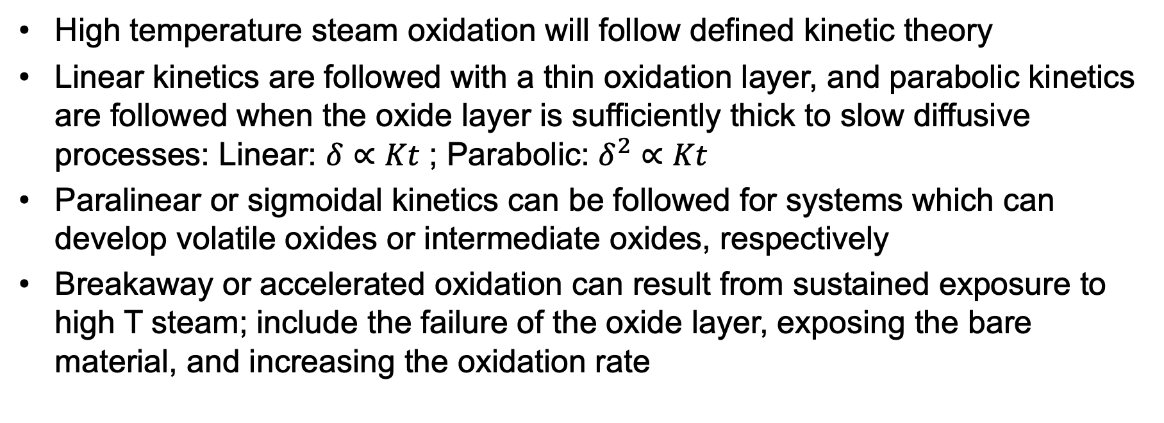
Steam Oxidation
High temperature steam oxidation will follow defined kinetic theory
Linear kinetics are followed with a thin oxidation layer, and parabolic kinetics are followed when the oxide layer is sufficiently thick to slow diffusive processes: Linear: $δ∝Kt$ ; Parabolic: $δ^{2}∝Kt$
Paralinear or sigmoidal kinetics can be followed for systems which can develop volatile oxides or intermediate oxides, respectively
Breakaway or accelerated oxidation can result from sustained exposure to high T steam; include the failure of the oxide layer, exposing the bare material, and increasing the oxidation rate

Slide 5

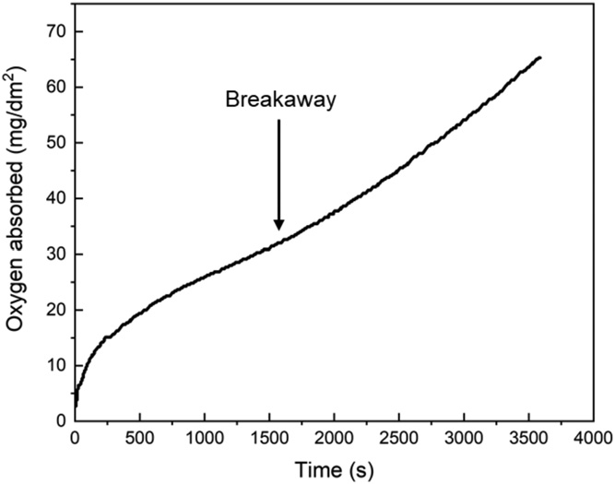
Steam Oxidation
Zr oxidizes with an exothermic reaction
Below 600C, the reaction follow a parabolic or cubic rate law resulting in a uniform and passivating oxide layer
At higher T, the oxide layer can crack due to surface stresses, resulting in breakaway oxidation
At loss of passivation, the oxidation rate can become linear and localized
Zirlo at 1000C in steam

Slide 6
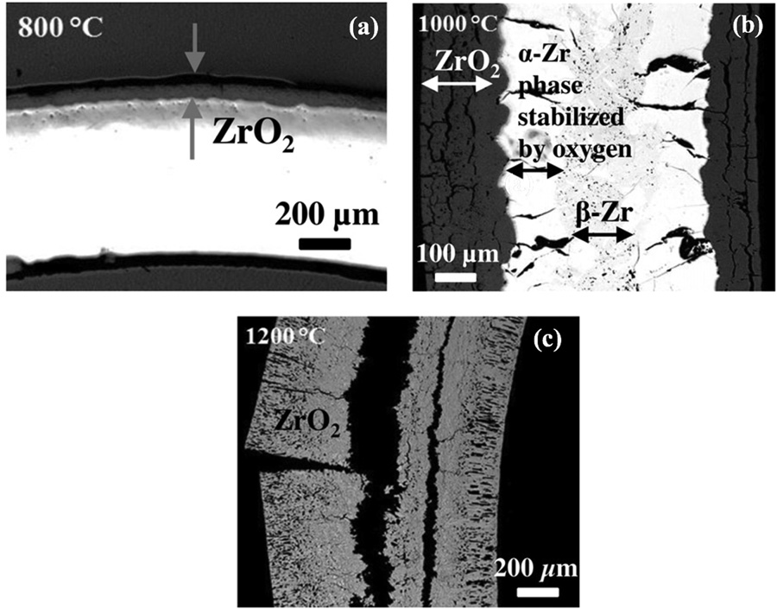
Steam Oxidation
Right is an image of Zircaloy-2 after steam oxidation for 8 hours at a) 800 C, b) 1000 C, c) 1200 C
At 800C, the oxide layer is intact and passivating
At higher temperatures, the oxide layer is thicker and cracked
At 1200C, everything has been oxidized

Slide 7
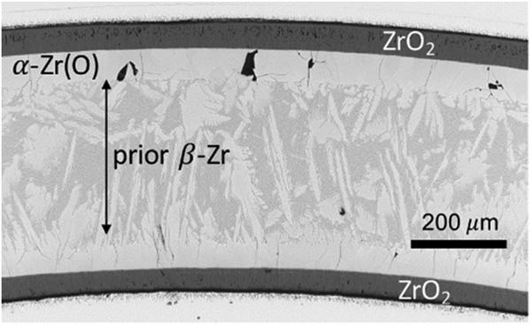
High T Phase Transition
alpha Zr can phase transform to beta Zr at 863 C
With high O content, this leads to a beta phase matrix with oxygen-stabilized alpha Zr closest to the oxide/metal interface
This stabilized alpha phase contributes to the brittle failure behavior

Slide 8
Hydride Embrittlement
We have already covered this
Hydrogen produced in oxidation and radiolysis can be picked up by the cladding, producing hydrides which can embrittle the cladding
More oxidation = more hydrogen = more embrittlement

Slide 9
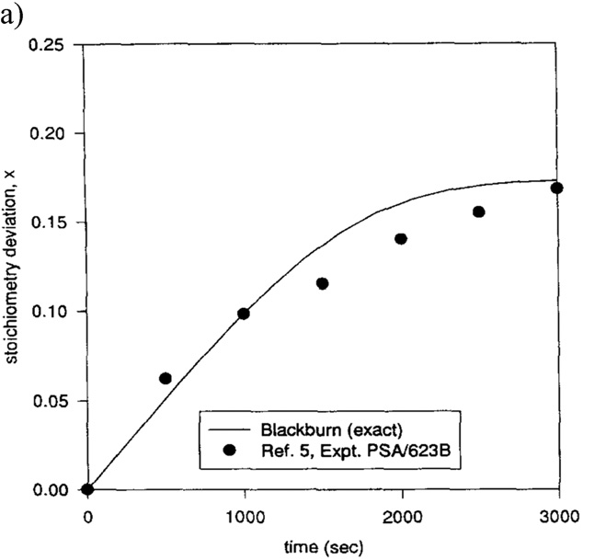
Fuel oxidation
UO2 is chemically inert to water, with a positive Gibbs free energy to form U3O8 or U4O9 compounds
The oxidation of UO2 is a dissolution reaction of water on the surface, freeing O to diffuse into UO2, making UO2+x, and producing H in the coolant

Slide 10
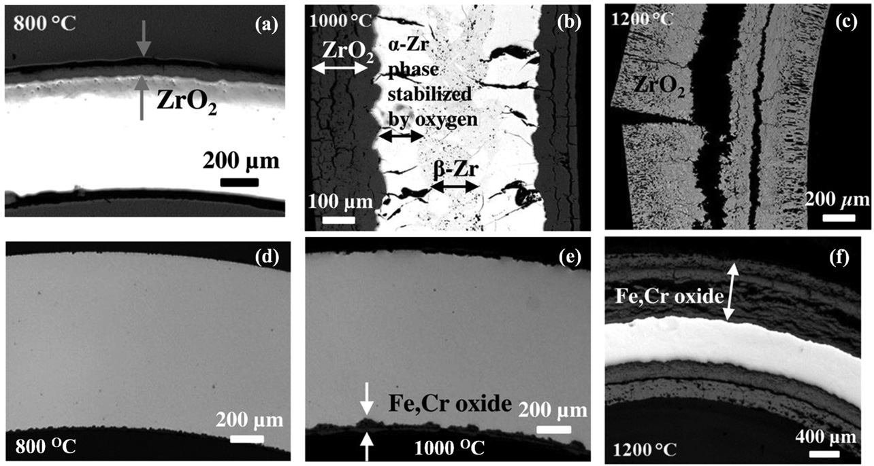
Advanced Cladding Materials
Fe-Cr or Fe-Cr-Al alloys display significantly improved oxidation resistance compared to Zr alloys
Fe-Cr can still form oxides which are not protective at 1200 C
Fe-Cr-Al alloys form an Al2O3 layer with enhanced stability compared to ZrO2, FeO2, or Cr2O3
SiC cladding can display even better oxidation resistance

Slide 11
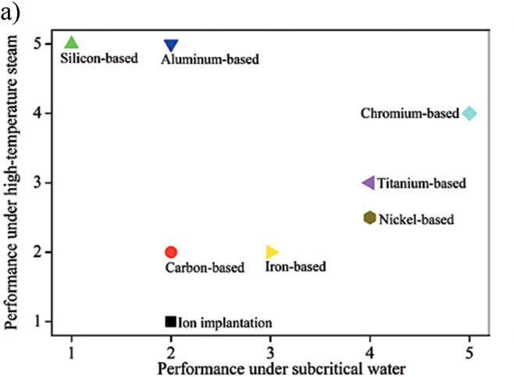
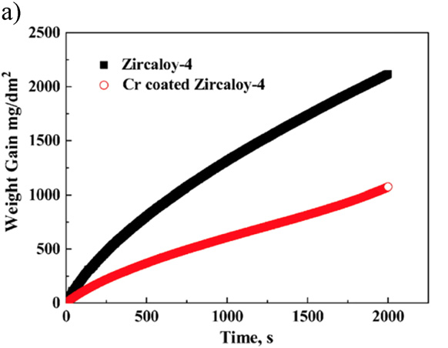
Coatings
The development of advanced coatings to enhance the accident tolerance by providing a barrier to steam attack of the underlying Zr
Different coatings with different fabrication methods have been explored
Cr coating has shown success in improving Zr cladding performance up to 1000 C
Behavior under 1200 C steam has shown little improvement

Slide 12
Summary
Steam oxidation behavior is critical for safe operation during an accident
Breakaway oxidation can occur, leading to thick, cracked oxides and high H generation
Zr phase transformations are indicative of high temperatures, and lead to further embrittlement of the cladding
Fuel oxidation of UO2 is largely not a concern, but can have deviations in stoichiometry, affecting fuel properties
Advanced cladding materials and coatings are being explored to improve accident tolerance

Slide 13
Limiting phenomena

Slide 14
Limiting Phenomena
Concerning limiting phenomena, some criteria have been established for the UO2 and MOX fuel designs
Engineering must demonstrate that all relevant parameters fulfill those criteria at any time from the loading of the fuel to reprocessing, or during long-term storage
The key performance limiting phenomena are Pellet-clad mechanical interaction; Cladding elongation and assembly bow; Cladding oxidation and hydrogen pickup; Cladding wear; Power to melt; Fuel rod internal pressure; Departure from nucleate boiling; Normal operation limits

Slide 15
Limiting Phenomena
PCMI
PCMI is a complex process with a maximum risk for failure when the fuel pellet to cladding gap closes firmly and the reactivity of the fuel is still high
The risk is enhanced by pellet fragments inducing a local shear strain on the cladding, and by the chemical interaction kinetics at the interface
In order to prevent SCC, the cladding hoop stress calculated for normal operation and transients is limited
The extent of the total permanent hoop strain is limited during the whole lifetime of the fuel rods, typically to 1%

Slide 16
Limiting Phenomena
Cladding elongation and assembly bow
During irradiation, the anisotropic character of the cladding material and the preferential migration of vacancies and interstitials in specific lattice planes drive an overall cladding axial growth, activated by the fast neutron flux
When contact is established between the pellet and the cladding, pellet axial elongation causes an additional axial cladding strain
This can lead to fuel rod bow with pitch reduction between the rods, reducing thermal margins
Differential elongation of guide tubes in a PWR assembly can lead to an overall assembly bow

Slide 17
Limiting Phenomena
Cladding oxidation and hydrogen pickup
For the ZrO2 formation at the cladding waterside surface, a typical criterion is related to the ASTM criterion of a maximum cladding wall thickness reduction of 10%, which corresponds to an oxide thickness of the order of 100 microns
When the hydrogen concentration in the cladding exceeds the solubility limit, 70–100 ppm by weight at operating temperatures, zirconium hydrides will form
The impact of hydrides on key mechanical properties depends strongly on hydride distribution and orientation
Oxidation and hydrogen pickup are increasingly important at higher exposures, as the dependence on burnup is nonlinear

Slide 18
Limiting Phenomena
Cladding wear
The criterion for cladding wear at the contact points between grid spring/dimples and the fuel rod is often also related to the ASTM criterion of a maximum cladding wall thickness reduction of 10%
More wear is technically acceptable, as evidenced from operational experience

Slide 19
Limiting Phenomena
Power to melt
The use of uranium dioxide or MOX provides a comfortable power to melt margin
The melting temperature decreases slightly with burnup, but remains above 2750C
At high burnup, above 50 MWd/kgM, considering the fuel thermal conductivity decrease, the power to melt was estimated to be around 600 W/cm, which is an unrealistic high LHR

Slide 20
Limiting Phenomena
Fuel rod internal pressure
Significant reopening of the radial gap between the fuel stack and the cladding must be avoided to ensure the heat transfer to the coolant
If a gap opens, fuel overheating and excessive fission gas release can occur, ultimately leading to fuel failure
The original criterion required that the rod inner pressure must never exceed the outer coolant pressure
This criterion was over-conservative and has been replaced by a ‘nonlift-off’ criterion, where the radial creep-out of the cladding (driven by gas pressure in excess of the system pressure) must never exceed the expansion rate of the pellet
Experiments have shown that a large overpressure of the gas (considerably more than 5.0 MPa) is needed to initiate the reopening

Slide 21
Limiting Phenomena
Departure from nucleate boiling
With increasing heat flux there comes a point at which the heat transfer from a fuel rod rapidly decreases due to the insulating effect of a steam blanket that forms on the rod surface, resulting in a severe increase of cladding temperature and possibly cladding failure
The ratio of the heat flux needed to cause departure from nucleate boiling (DNB) at given local coolant properties (pressure, enthalpy, mass flow rate) to the actual local heat flux of a fuel rod is defined as the DNBR
This phenomenon may limit the maximum allowed thermal power of a given PWR

Slide 22
Limiting Phenomena
Normal operation limits
Constraints on the axial LHR distribution are typically applied at the core design level and during normal operation to guarantee that the conditions are never worse than those assumed in scenarios considered in the accident analyses
The maximum allowed LHR may depend on the axial position and on burnup, and can be reactor- and even cycle-specific
The fulfilment of the constraint is verified during the reload safety evaluation process as well as during plant operation

Slide 23
Summary
There are a variety of limiting phenomena in LWR fuel systems that provide the boundaries of operation and lifetime
These limits include phenomena in the fuel, gap, cladding, corrosion, and assembly levels
The performance of uranium dioxide and MOX fuels in LWR nuclear reactors is well established
These fuels have demonstrated a very good behavior during irradiation, favored by their high melting temperature, providing large operating temperature margins

Slide 24
water chemistry

Slide 25
Water Chemistry
Excellent water quality is essential if material degradation is to be controlled
Primary system water chemistry affects fuel performance through the deposition of corrosion products on fuel pin surfaces
In the early days of nuclear power plant operation, impurities in the coolant water were a major factor in causing excessive corrosion
Chlorides and sulfates are particularly aggressive in increasing intergranular stress corrosion cracking (IGSCC) and other corrosion processes
Initial efforts to improve water quality brought about a slow but steady reduction in impurities through improved design and operation of purification systems

Slide 26
Water Chemistry
Excellent water chemistry alone is not sufficient to control corrosion, thus programs to modify water chemistry, including minimizing oxygen to reduce the electrochemical corrosion potential (ECP) in BWRs, and oxygen and pH control in PWRs, have been implemented
Additives to further inhibit the corrosion process have been developed and are now in widespread use
Water chemistry advances are now an important part of the overall operating strategy to control material degradation

Slide 27
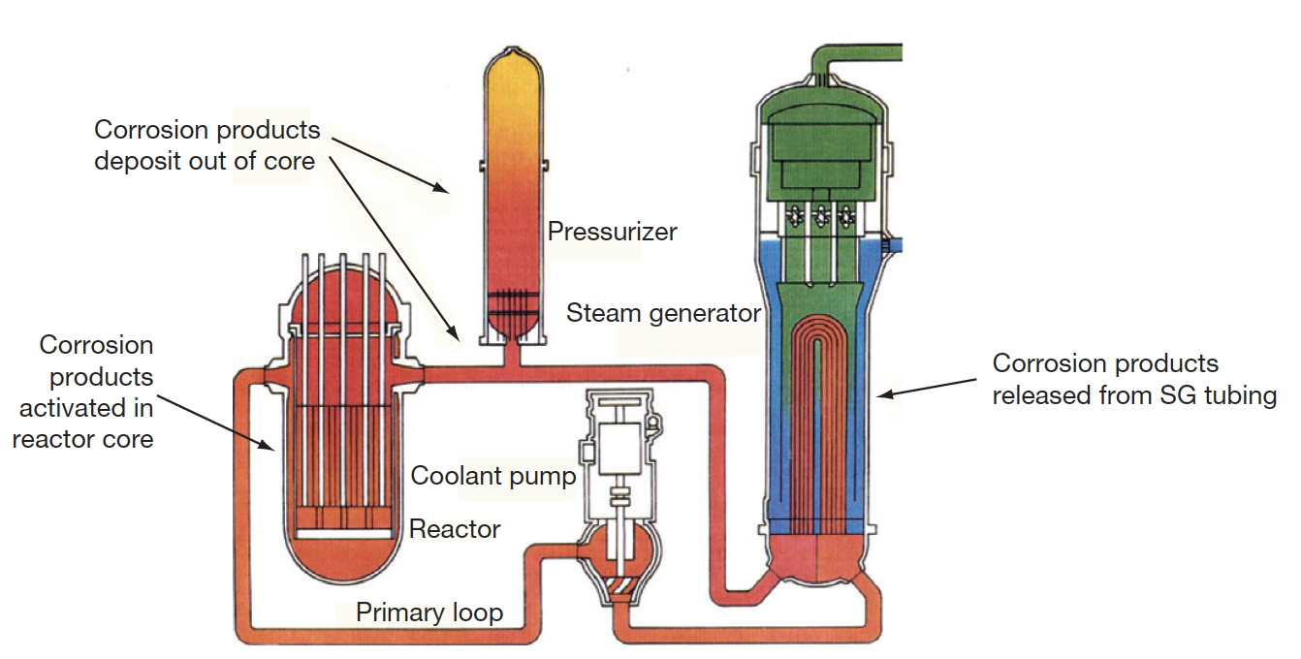
PWR Water Chemistry
In the very early days of PWR operation, heavy crud buildup on fuel cladding surfaces was caused by the transport of corrosion products from the steam generators into the reactor core
Activated corrosion products caused high-radiation fields on out-of-core surfaces fuel performance was compromised, and even coolant flow issues were observed

Slide 28
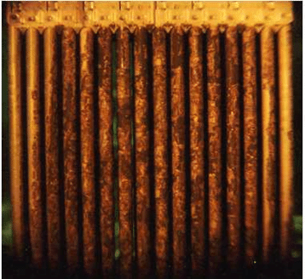
CRUD
A corrosion product called Chalk River unidentified deposit (CRUD) accumulates on the Ni alloy and stainless-steel surfaces
CRUD is an accumulation of materials and corrosion products that is composed of either dissolved ions or solid particles such as Ni, Fe, and Co on fuel rod cladding surfaces in NPPs
CRUD degrades heat production by nuclear fuel because it is slowly eroded by the circulation of the hot pressurized water and later deposited on the cladding or outer housing of fuel rods
The chemical composition of CRUD varies depending on the types of refueling cycles and the constituents of the basic metal material
Irradiation can produce radionuclides in the CRUD, such as 60Co and 63Ni

Slide 29
PWR Water Chemistry
PWR problems were initially mitigated by imposing a hydrogen overpressure on the primary system, reducing the corrosion potential, and raising the primary chemistry pH
Commercial PWR power plants use a steadily decreasing concentration of boric acid as a chemical shim for reactivity control throughout the fuel cycle, which results in the use of lithium hydroxide to control pH
The concept of ‘coordinated boron and lithium’ was developed, whereby the concentration of LiOH was gradually reduced in line with the boric acid reduction to maintain a constant pH
It was determined that heavy fuel crud buildup was avoided if a constant pH of > 6.9 was maintained, as the solubility of Ni and Fe is dependent on pH
Zinc injection is utilized to reduce radiation fields, and also inhibits SCC

Slide 30
Radiation Control
Corrosion products deposited on the fuel become activated, are released back into the coolant, and may be deposited on out-of-core surfaces
During shutdowns, the major radiation source for personnel exposure is activated corrosion products, deposited on primary system surfaces
The mechanism of the zinc ion effect is complex, as release of ⁶⁰Co from fuel crud is reduced, and deposition out-core is also reduced
Aqueous zinc ion promotes the formation of a more protective spinel-structured corrosion film on stainless steel, especially when reducing conditions are present
Both cobalt and zinc favor tetrahedral sites in the spinel structure, but the site preference energy favors zinc incorporation
The ⁶⁰Co remains longer in the water and is eventually removed by the cleanup system

Slide 31
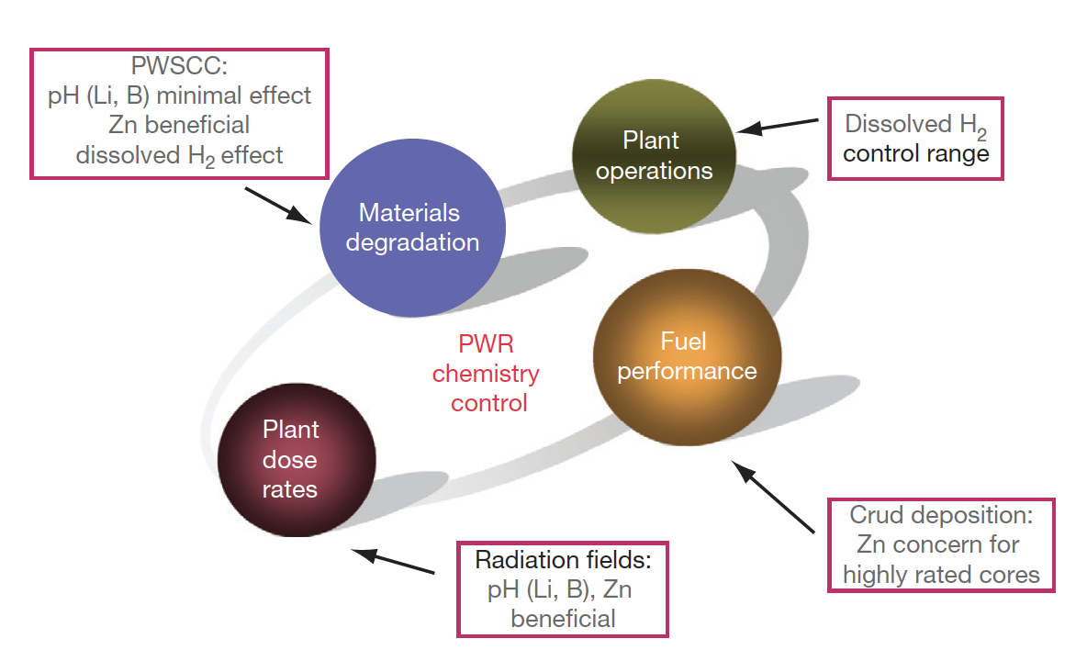
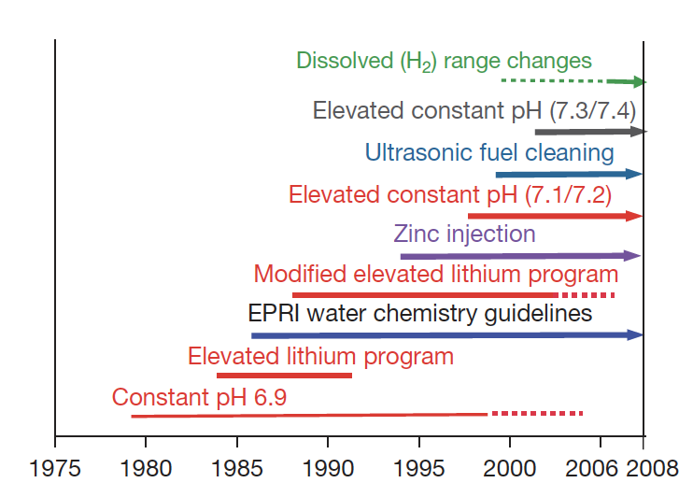
PWR Water Chemistry

Slide 32
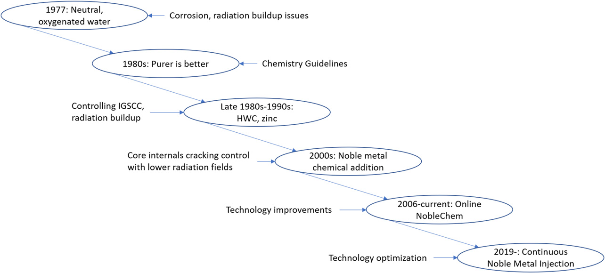
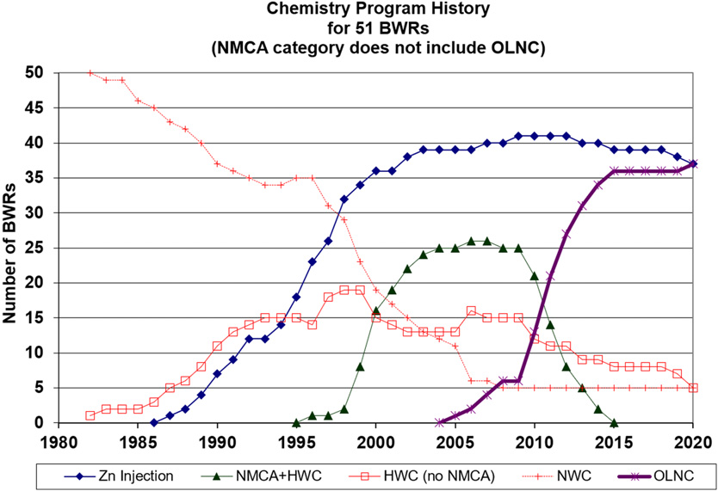
BWR Water Chemistry
Similarly, BWR water chemistry has to be optimized to meet requirements on material degradation, fuel performance, and control of radiation fields
BWR chemistry strategies have changed over time, focusing on purity, limiting SCC, and control of radiation fields

Slide 33
IGSCC Mitigation
Intergranular SCC (IGSCC) of 304 stainless steel core internals (and other materials) is one of the key chemistry control issues in BWRs
The control of the electrochemical potential (Redox potential) by hydrogen injection was effective at reducing IGSCC
Move from normal water chemistry (NWC) to hydrogen water chemistry (HWC) limits crack growth
Added noble metals (such as Pt) as coating on surfaces, or injection into water to increase efficiency of HWC

Slide 34
IGSCC Mitigation
Noble metal addition had previously only been conducted during outages, but changed to online addition to prevent ‘crack flanking’
Areas in the core are protected by different mitigation strategies, based on temperatures and two-phase flow
Radiation control: Zn injection also used in BWRs

Slide 35
Fuel Performance Concerns
CRUD deposition on the cladding surface can reduce heat transfer, increasing fuel temperatures, which also increases oxidation rates
Addition of Zn and noble metals can increase the adherence of CRUD deposits on the cladding
Zn/noble metals also can cause a failure/cracking of the oxide layer, promoting further corrosion
There are concentration limits on Zn and noble metals to limit CRUD formation
In PWRs, CRUD-induced power shifts (CRIPs) can occur by trapping boron in the CRUD, changing the power distribution
CRUD-related failures have been eliminated since about 2005

Slide 36
Summary
Brief overview of water chemistry concerns
Primary system water chemistry affects fuel performance through the deposition of corrosion products on fuel pin surfaces
Control measures such as dissolved H2 and balancing LiOH to boron content are utilized to control the pH
Zinc injection is utilized to control radiation fields
CRUD can cause failures or CRIPs, affecting the performance of the fuel
Water chemistry is an evolving balancing act between corrosion of the core internals, radiation fields, CRUD development, pH, and reactivity

