Slide 1
Nuclear Fuel Performance
NE-533
Spring 2026

Slide 2
Last time
RIA
control rod ejection/drop
fast rise in temperature/power
causes pellet expansion and gas bubble expansion
can lead to either PCMI-based failure of DNB-based failure
LOCA
pipe burst
rise in temperature from decay heat without cooling
much slower than RIA
leads to high oxidation, high T, high hydriding, ballooning and burst
Started on accident safety limits, talking through steam oxidation

Slide 3
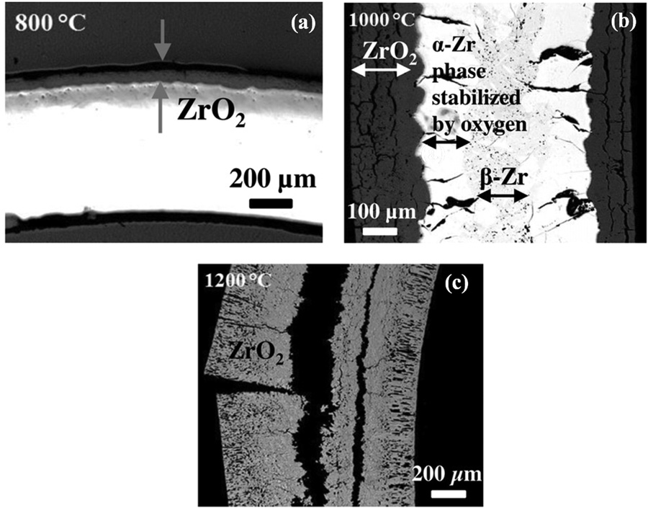
Steam Oxidation
Right is an image of Zircaloy-2 after steam oxidation for 8 hours at a) 800 C, b) 1000 C, c) 1200 C
At 800C, the oxide layer is intact and passivating
At higher temperatures, the oxide layer is thicker and cracked
At 1200C, everything has been oxidized

Slide 4
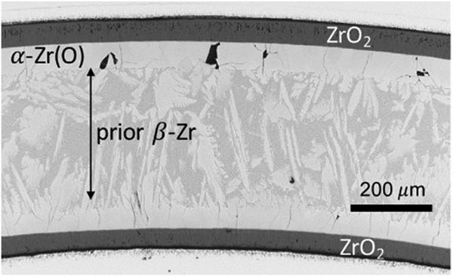
High T Phase Transition
alpha Zr can phase transform to beta Zr at 863 C
With high O content, this leads to a beta phase matrix with oxygen-stabilized alpha Zr closest to the oxide/metal interface
This stabilized alpha phase contributes to the brittle failure behavior

Slide 5
Hydride Embrittlement
We have already covered this
Hydrogen produced in oxidation and radiolysis can be picked up by the cladding, producing hydrides which can embrittle the cladding
More oxidation = more hydrogen = more embrittlement

Slide 6
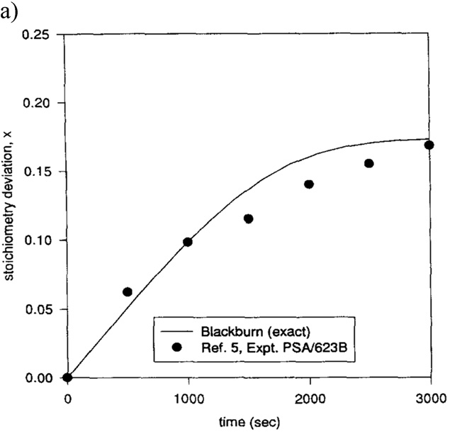
Fuel oxidation
UO2 is chemically inert in water, with a positive Gibbs free energy to form U3O8 or U4O9 compounds
The oxidation of UO2 is a dissolution reaction of water on the surface, freeing O to diffuse into UO2, making UO2+x, and producing H in the coolant

Slide 7
Summary
Steam oxidation behavior is critical for safe operation during an accident
Breakaway oxidation can occur, leading to thick, cracked oxides and high H generation
Zr phase transformations are indicative of high temperatures, and lead to further embrittlement of the cladding
Fuel oxidation of UO2 is largely not a concern, but can have deviations in stoichiometry, affecting fuel properties

Slide 8
Accident tolerant fuels

Slide 9
Mitigation through design
Accident tolerant fuels aim to provide additional coping time
The time required for the water to boil away
The time required for the fuel to melt
The time required for the molten fuel to breach the primary pressure boundary
Fuels with enhanced tolerance can tolerate loss of active cooling for a considerably longer period, while maintaining or improving performance during normal operation
Can also widen the existing safety margin for nuclear plants and improve nuclear plant performance with fuel that lasts longer

Slide 10
Accident Tolerant Criteria
﻿The safety margin is increased by reducing the fuel’s centerline temperature relative to its melting temperature or another relevant failure temperature
﻿The release of fission products from the fuel matrix is mitigated
﻿Uranium density is maximized enabling increased operational flexibility by increasing cycle length, reducing enrichment, etc.
﻿The chemical response of the fuel is limited during exposure to the reactor coolant
﻿The volumetric heat capacity is minimized so that the fuel tends to transfer energy out of the pellet and into the coolant
﻿The potential for fuel, cladding, and coolant interaction – both chemical and mechanical – is minimized
T﻿he impact of non-fissile fuel constituents on neutronics, fuel cycle, reactor performance, and safety characteristics is minimized

Slide 11
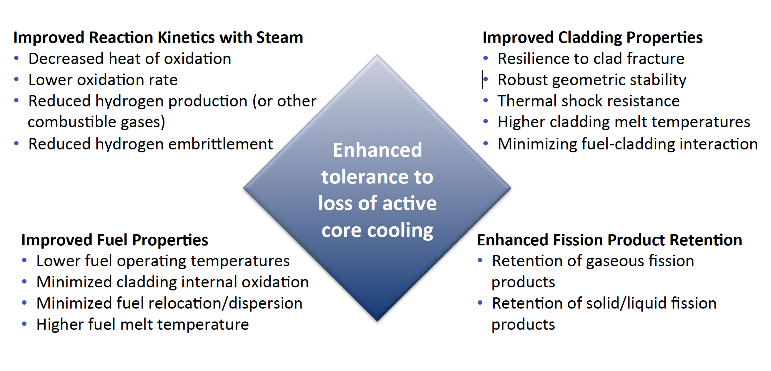
Accident Tolerance

Slide 12
Categories of ATF Concepts
ATF can be divided into three main categories
near-term ATF improvements
novel fuel and cladding materials
transformational fuel and cladding concepts
Near-term ATF improvements
Improved Zr alloy cladding
Enhanced UO2
These changes are mean to be drop-in replacements that are compatible with existing systems

Slide 13
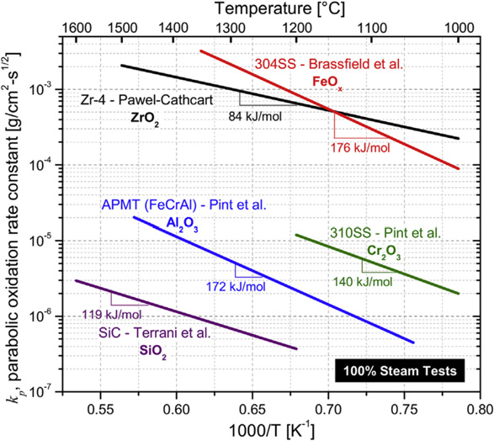
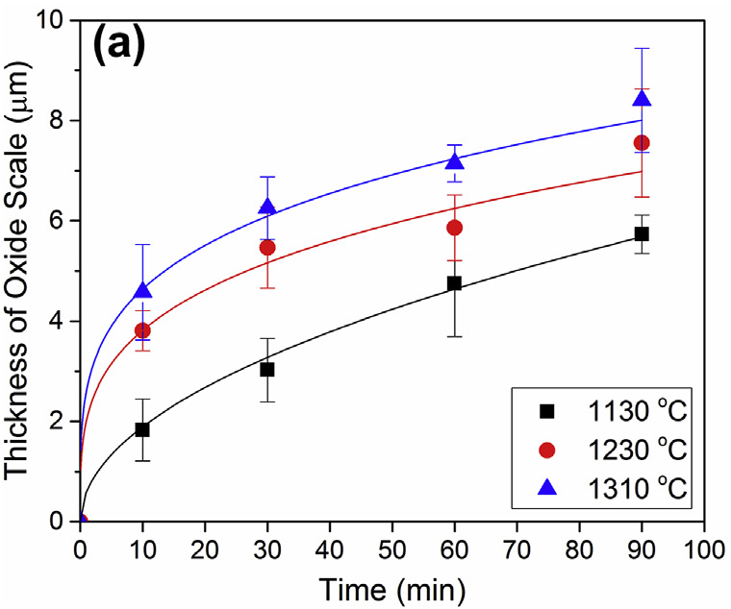
Near-term ATF Coatings
Improved zirconium-based cladding
coatings to improve corrosion resistance, especially under high T steam
metallic coatings or ceramics nitride or MAX coatings (M=transition metal, A=group 13-16 elements, e.g., Al or Si, X=C/N)
typically contain either Cr, Al, or Si, to ensure a protective oxide coating
Mose widely explored are ﻿Cr metal, CrAl, and CrN coatings
﻿Cr coatings of 2-10 μm on Zr-4 resulted in a ~50X reduction in oxidation rate over Zr-4 in a steam environment
Less oxidation also yields less H, and thus less embrittlement

Slide 14
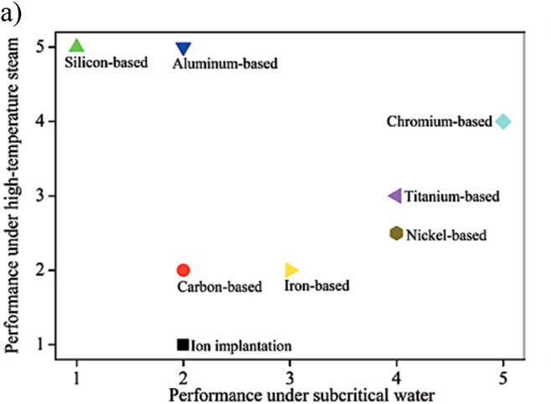
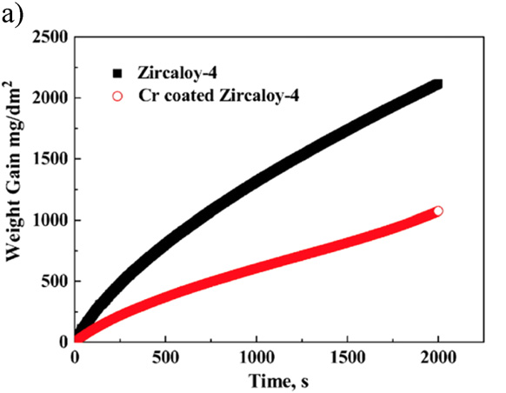
Near-term ATF Coatings
Ceramic coatings can display excellent oxidation resistance, but can be brittle and displace CTE mismatch
Variety of fabrication methods explored for metallic coatings
cold spray, CVD, PVD, sputtering, etc.
Mechanical integrity of the coating and adherence to Zr is key
Also have the issue of Cr-Zr eutectic reaction at 1332 C deteriorates cladding
But, very promising and still being pursued

Slide 15
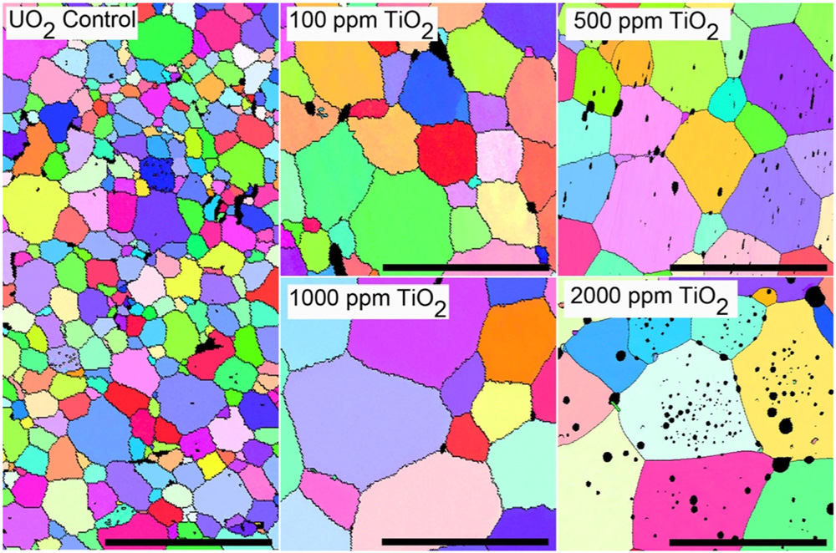
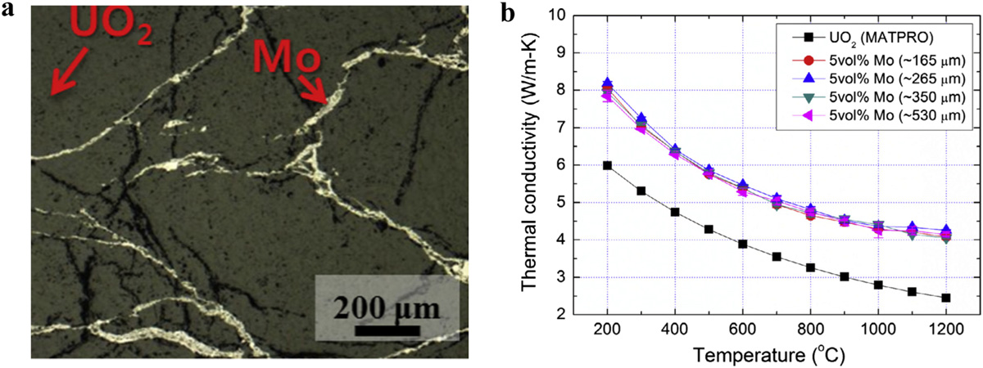
Near-term ATF Fuel
Enhanced UO2
minor additives to improve UO2 properties
Doped UO2 typically includes a transition metal oxide (e.g., Cr2O3, TiO2), that modifies the oxygen potential, subsequently modifying the oxygen kinetics, changing the grain size during sintering
Larger grain sizes mean slower/delayed fission gas release (think of the Booth model)
Inert secondary inclusions (e.g., Mo, SiC, diamond, BeO) involve higher levels of additives targeted to increase the thermal conductivity
Natural development in UO2 fuel, will happen to some degree to gain margins in safety, fuel performance, and economics

Slide 16
Categories of ATF Concepts
Novel fuel and cladding materials
U3Si2 or UN fuels
FeCrAl alloys for cladding
Requires additional licensing
Minimal changes needed for LWR designs, could be deployed in 10ish years
Transformational fuel and cladding concepts
fully ceramic micro-encapsulated (FCM) fuels, e.g., TRISO
SiC/SiC composite cladding
drastically differ from traditional LWR fuel systems
may require significant modifications to reactor design and operation, but offer potentially large benefits to performance and/or safety

Slide 17
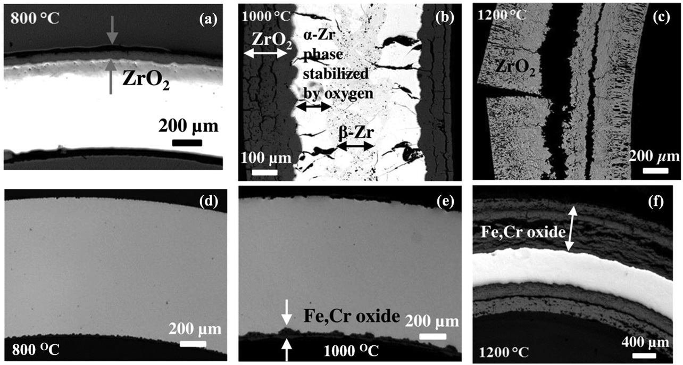
Advanced Cladding Materials
Fe-Cr or Fe-Cr-Al alloys display significantly improved oxidation resistance compared to Zr alloys
Fe-Cr can still form oxides which are not protective at 1200 C
Fe-Cr-Al alloys form an Al2O3 layer with enhanced stability compared to ZrO2, FeO2, or Cr2O3
SiC cladding can display even better oxidation resistance

Slide 18
Summary
Accident tolerant fuel includes different fuel and cladding materials to increase time before catastrophic behavior during an accident
Aim to add coping time, increase safety margin, improve behaviors
Four key areas:
improve reaction kinetics with steam, improved cladding properties, improved fuel properties, enhanced fission product retention
Near term concepts
cladding coatings (Cr, CrAl, etc.)
enhanced UO2 (dopants, inert additives)
Novel fuel and cladding concepts
Transformational concepts

Slide 19
Limiting phenomena

Slide 20
Limiting Phenomena
Concerning limiting phenomena, some criteria have been established for the UO2 and MOX fuel designs
Engineering must demonstrate that all relevant parameters fulfill those criteria at any time from the loading of the fuel to reprocessing, or during long-term storage
The key performance limiting phenomena are Pellet-clad mechanical interaction; Cladding elongation and assembly bow; Cladding oxidation and hydrogen pickup; Cladding wear; Power to melt; Fuel rod internal pressure; Departure from nucleate boiling; Normal operation limits

Slide 21
Limiting Phenomena
PCMI
PCMI is a complex process with a maximum risk for failure when the fuel pellet to cladding gap closes firmly and the reactivity of the fuel is still high
The risk is enhanced by pellet fragments inducing a local shear strain on the cladding, and by the chemical interaction kinetics at the interface
In order to prevent SCC, the cladding hoop stress calculated for normal operation and transients is limited
The extent of the total permanent hoop strain is limited during the whole lifetime of the fuel rods, typically to 1%

Slide 22
Limiting Phenomena
Cladding elongation and assembly bow
During irradiation, the anisotropic character of the cladding material and the preferential migration of vacancies and interstitials in specific lattice planes drive an overall cladding axial growth, activated by the fast neutron flux
When contact is established between the pellet and the cladding, pellet axial elongation causes an additional axial cladding strain
This can lead to fuel rod bow with pitch reduction between the rods, reducing thermal margins
Differential elongation of guide tubes in a PWR assembly can lead to an overall assembly bow

Slide 23
Limiting Phenomena
Cladding oxidation and hydrogen pickup
For the ZrO2 formation at the cladding waterside surface, a typical criterion is related to the ASTM criterion of a maximum cladding wall thickness reduction of 10%, which corresponds to an oxide thickness of the order of 100 microns
When the hydrogen concentration in the cladding exceeds the solubility limit, 70–100 ppm by weight at operating temperatures, zirconium hydrides will form
The impact of hydrides on key mechanical properties depends strongly on hydride distribution and orientation
Oxidation and hydrogen pickup are increasingly important at higher exposures, as the dependence on burnup is nonlinear

Slide 24
Limiting Phenomena
Cladding wear
The criterion for cladding wear at the contact points between grid spring/dimples and the fuel rod is often also related to the ASTM criterion of a maximum cladding wall thickness reduction of 10%
More wear is technically acceptable, as evidenced from operational experience

Slide 25
Limiting Phenomena
Power to melt
The use of uranium dioxide or MOX provides a comfortable power to melt margin
The melting temperature decreases slightly with burnup, but remains above 2750C
At high burnup, above 50 MWd/kgU, considering the fuel thermal conductivity decrease, the power to melt is estimated to be around 600 W/cm, which is an unrealistic high LHR

Slide 26
Limiting Phenomena
Fuel rod internal pressure
Significant reopening of the radial gap between the fuel stack and the cladding must be avoided to ensure the heat transfer to the coolant
If a gap opens, fuel overheating and excessive fission gas release can occur, ultimately leading to fuel failure
The original criterion required that the rod inner pressure must never exceed the outer coolant pressure
This criterion was over-conservative and has been replaced by a ‘nonlift-off’ criterion, where the radial creep-out of the cladding (driven by gas pressure in excess of the system pressure) must never exceed the expansion rate of the pellet
Experiments have shown that a large overpressure of the gas (considerably more than 5.0 MPa) is needed to initiate the reopening

Slide 27
Limiting Phenomena
Departure from nucleate boiling
With increasing heat flux there comes a point at which the heat transfer from a fuel rod rapidly decreases due to the insulating effect of a steam blanket that forms on the rod surface, resulting in a severe increase of cladding temperature and possibly cladding failure
The ratio of the heat flux needed to cause departure from nucleate boiling (DNB) at given local coolant properties (pressure, enthalpy, mass flow rate) to the actual local heat flux of a fuel rod is defined as the DNBR
This phenomenon may limit the maximum allowed thermal power of a given PWR

Slide 28
Limiting Phenomena
Normal operation limits
Constraints on the axial LHR distribution are typically applied at the core design level and during normal operation to guarantee that the conditions are never worse than those assumed in scenarios considered in the accident analyses
The maximum allowed LHR may depend on the axial position and on burnup, and can be reactor- and even cycle-specific
The fulfilment of the constraint is verified during the reload safety evaluation process as well as during plant operation

Slide 29
Summary
There are a variety of limiting phenomena in LWR fuel systems that provide the boundaries of operation and lifetime
These limits include phenomena in the fuel, gap, cladding, corrosion, and assembly levels
The performance of uranium dioxide and MOX fuels in LWR nuclear reactors is well established
These fuels have demonstrated a very good behavior during irradiation, favored by their high melting temperature, providing large operating temperature margins

