Slide 1
Nuclear Fuel Performance
NE-533
Spring 2026

Slide 2
Housekeeping
Exam 3 stats:
Avg: 84
Curve of 6 points applied
Presentation and MOOSE part 2 grades out this week
Plan is for the last exam to be on April 23 (week from today)
Last partial lecture and problem session next Tuesday
Reminder MOOSE part 3 is due April 28
ClassEval is active, please everyone fill this out
Send me the confirmation that you completed this, and you get +3 onto exam 4
Will also send out a link to my own personal survey (this is also anonymous), send me the confirmation you completed this, get another +3 onto exam 4

Slide 3
Last Time
Steam kinetics
Beyond 800 C oxidation is too rapid, above 1200 C, entire cladding gets consumed
Zr phase transformation at 863 C, leads to beta and O-stabilized alpha (which is more brittle)
ATF
improved cladding properties, improved steam corrosion, improved fuel properties, improved fission product retention
Near term improvements: coatings, fuel additives
Novel fuel/cladding: U3Si2/UN fuels, FeCrAl cladding
Transformative fuel/cladding: FCM, SiC/SiC, etc.
Limiting phenomena: Pellet-clad mechanical interaction; Cladding elongation and assembly bow; Cladding oxidation and hydrogen pickup; Cladding wear; Power to melt; Fuel rod internal pressure; Departure from nucleate boiling; Normal operation limits

Slide 4
water chemistry

Slide 5
Water Chemistry
Excellent water quality is essential if material degradation is to be controlled
Primary system water chemistry affects fuel performance through the deposition of corrosion products on fuel pin surfaces
In the early days of nuclear power plant operation, impurities in the coolant water were a major factor in causing excessive corrosion
Chlorides and sulfates are particularly aggressive in increasing intergranular stress corrosion cracking (IGSCC) and other corrosion processes
Initial efforts to improve water quality brought about a slow but steady reduction in impurities through improved design and operation of purification systems

Slide 6
Water Chemistry
Excellent water chemistry alone is not sufficient to control corrosion, thus programs to modify water chemistry, including minimizing oxygen to reduce the electrochemical corrosion potential (ECP) in BWRs, and oxygen and pH control in PWRs, have been implemented
Additives to further inhibit the corrosion process have been developed and are now in widespread use
Water chemistry advances are now an important part of the overall operating strategy to control material degradation

Slide 7
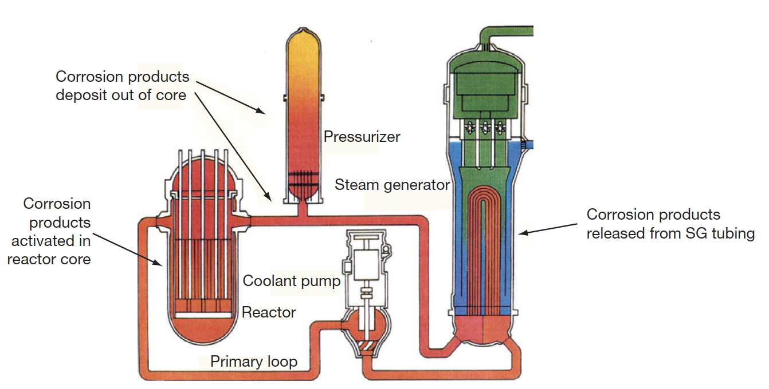
PWR Water Chemistry
In the very early days of PWR operation, heavy crud buildup on fuel cladding surfaces was caused by the transport of corrosion products from the steam generators into the reactor core
Activated corrosion products caused high-radiation fields on out-of-core surfaces
Fuel performance was compromised, and even coolant flow issues were observed

Slide 8
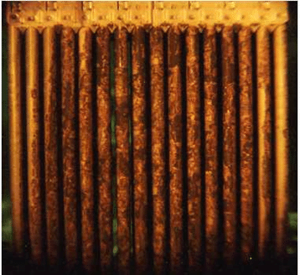
CRUD
A corrosion product called Chalk River unidentified deposit (CRUD) accumulates on the Ni alloy and stainless-steel surfaces
CRUD is an accumulation of materials and corrosion products that is composed of either dissolved ions or solid particles such as Ni, Fe, and Co on fuel rod cladding surfaces
CRUD degrades heat production by nuclear fuel because the constituents are slowly eroded by the circulation of the hot pressurized water and later deposited on the cladding
The chemical composition of CRUD varies depending on the types of refueling cycles and the constituents of the basic metal material

Slide 9
CRUD Cycle
First, metallic constituents from core internals or heat exchangers are dissolved in the high T water
Those constituents get deposited on the surface of the cladding, often in a spinel-type structure (AB2O4), with Fe, Ni, and Co some of the primary species
Proximity to the fuel leads to activation of these species, producing radionuclides in the CRUD, such as 60Co and 63Ni
CRUD can flake off, chip, or species can dissolve into the water and then collect on the out-of-core surfaces

Slide 10
PWR Water Chemistry
PWR problems were initially mitigated by imposing a hydrogen overpressure on the primary system, reducing the corrosion/oxygen potential, and raising the primary chemistry pH
Commercial PWR power plants use a steadily decreasing concentration of boric acid as a chemical shim for reactivity control throughout the fuel cycle, which results in the use of lithium hydroxide to control pH
The concept of ‘coordinated boron and lithium’ was developed, whereby the concentration of LiOH was gradually reduced in line with the boric acid reduction to maintain a constant pH
It was determined that heavy fuel crud buildup was avoided if a constant pH of > 6.9 was maintained, as the solubility of Ni and Fe is dependent on pH
Zinc injection is utilized to reduce radiation fields, and also inhibits SCC

Slide 11
Radiation Control
Corrosion products deposited on the fuel become activated, are released back into the coolant, and may be deposited on out-of-core surfaces
During shutdowns, the major radiation source for personnel exposure is activated corrosion products, deposited on primary system surfaces
The mechanism of the zinc ion effect is complex, as release of ⁶⁰Co from fuel crud is reduced, and deposition out-core is also reduced
Aqueous zinc ion promotes the formation of a more protective spinel-structured corrosion film on stainless steel, especially when reducing conditions are present
Both cobalt and zinc favor tetrahedral sites in the spinel structure, but the site preference energy favors zinc incorporation
The ⁶⁰Co remains longer in the water and is eventually removed by the cleanup system

Slide 12
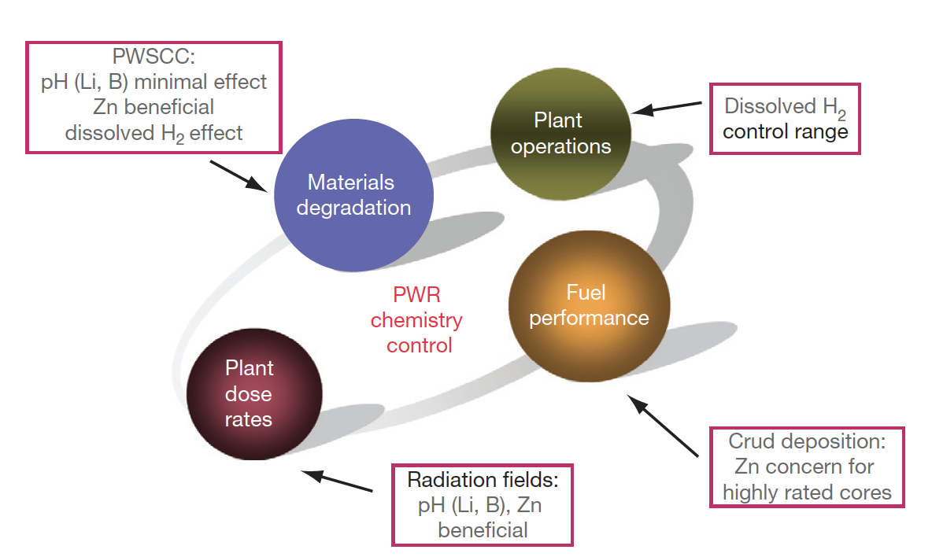
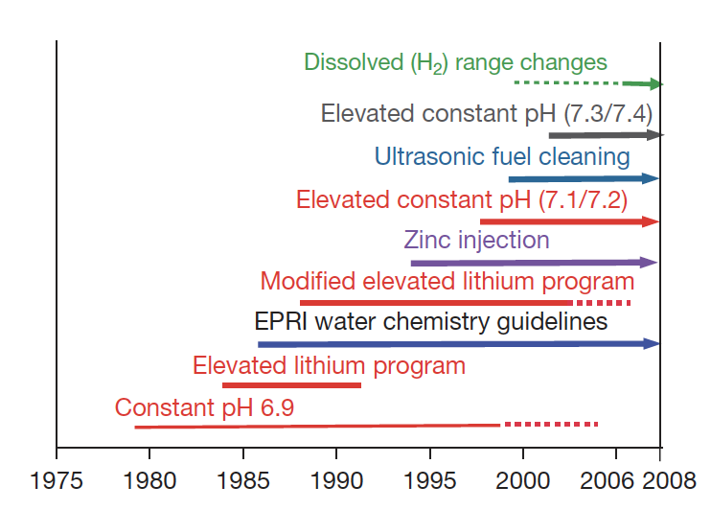
PWR Water Chemistry

Slide 13
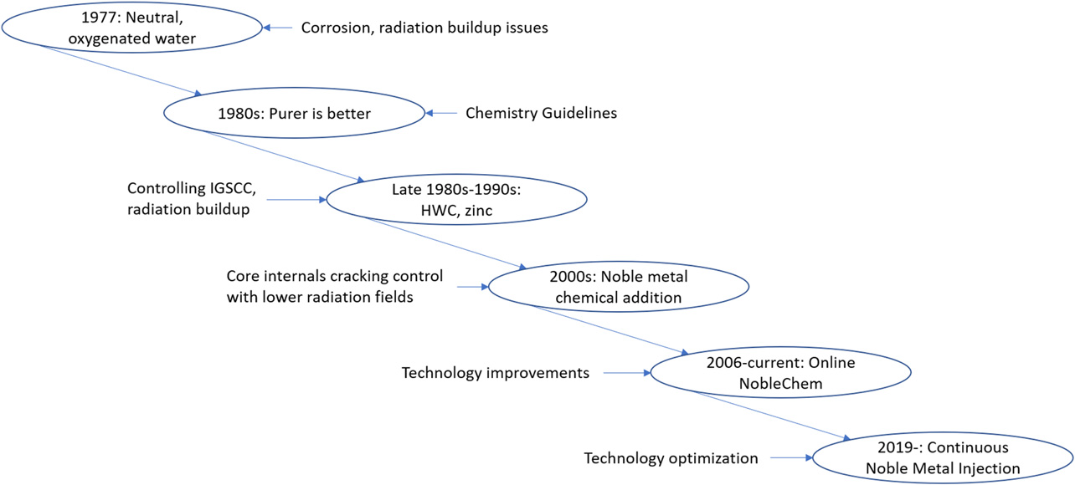
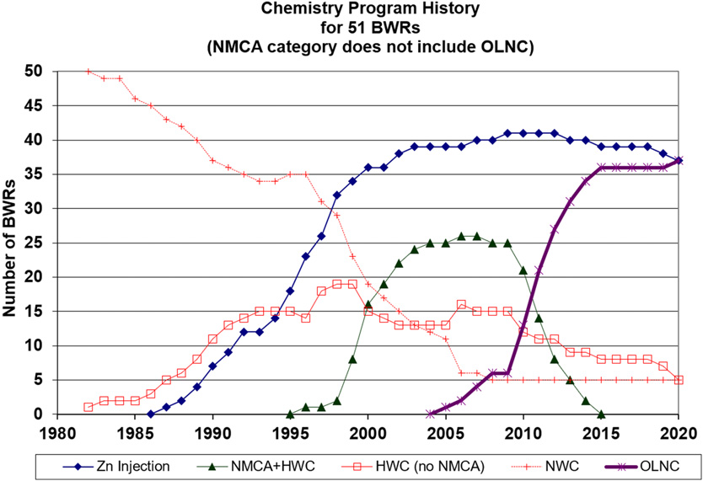
BWR Water Chemistry
Similarly, BWR water chemistry has to be optimized to meet requirements on material degradation, fuel performance, and control of radiation fields
BWR chemistry strategies have changed over time, focusing on purity, limiting SCC, and control of radiation fields

Slide 14
IGSCC Mitigation
Intergranular SCC (IGSCC) of 304 stainless steel core internals (and other materials) is one of the key chemistry control issues in BWRs
The control of the electrochemical potential (Redox potential) by hydrogen injection was effective at reducing IGSCC
Move from normal water chemistry (NWC) to hydrogen water chemistry (HWC) limits crack growth
Added noble metals (such as Pt) as coating on surfaces, or injection into water to increase efficiency of HWC

Slide 15
IGSCC Mitigation
Noble metal addition had previously only been conducted during outages, but changed to online addition to prevent ‘crack flanking’
Areas in the core are protected by different mitigation strategies, based on temperatures and two-phase flow
Radiation control: Zn injection also used in BWRs

Slide 16
Fuel Performance Concerns
CRUD deposition on the cladding surface can reduce heat transfer, increasing fuel temperatures, which also increases oxidation rates
Addition of Zn and noble metals can increase the adherence of CRUD deposits on the cladding
Zn/noble metals also can cause a failure/cracking of the oxide layer, promoting further corrosion
There are concentration limits on Zn and noble metals to limit CRUD formation
In PWRs, CRUD-induced power shifts (CRIPs/CIPS) can occur by trapping boron in the CRUD, changing the power distribution
CRUD-related failures have been eliminated since about 2005

Slide 17
Key Themes Over Time
Increasing Chemical Precision
From simple purity control to tightly optimized ppm/ppb-level adjustments
Shift from Reactive to Predictive
Early chemistry responded to problems; modern chemistry anticipates them via modeling
Tradeoff Management
Every chemistry choice affects multiple outcomes:
Higher pH leads to less corrosion, but possible fuel issues
Hydrogen injection → less SCC, but higher dose rates (BWRs)
Materials–Chemistry Coupling
Water chemistry evolution closely tracks:
Alloy development (e.g., Inconel, stainless steels, Zircaloy)
Fuel design changes (higher burnup, different claddings)

Slide 18
Summary
Primary system water chemistry affects fuel performance through the deposition of corrosion products on fuel pin surfaces
Control measures such as dissolved H2 and balancing LiOH to boron content are utilized to control the pH
Zinc injection is utilized to control radiation fields
CRUD can cause failures or CRIPs, affecting the performance of the fuel
Water chemistry is an evolving balancing act between corrosion of the core internals, radiation fields, CRUD development, pH, and reactivity

Slide 19
Mixed oxide (MOX) fuels

Slide 20
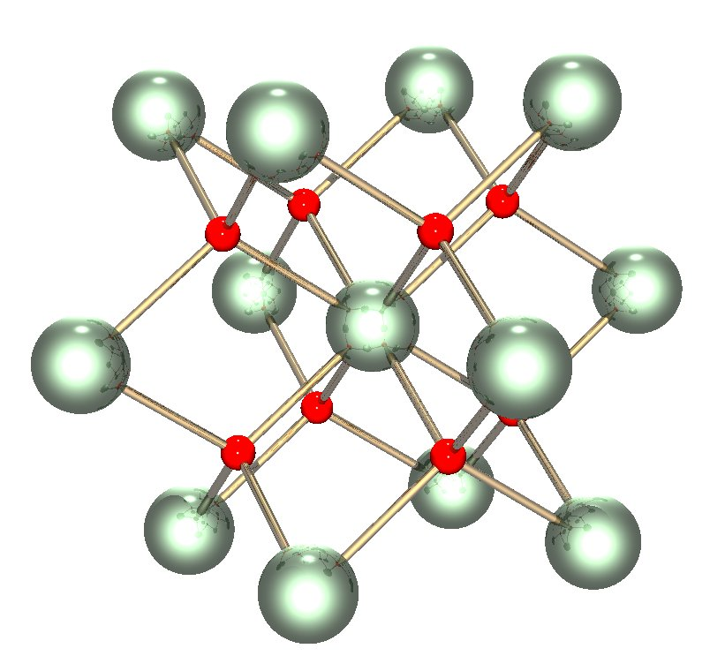
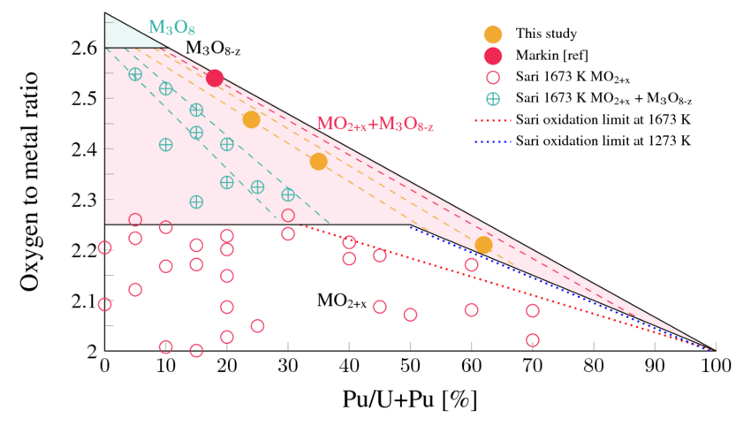
Why MOX?
The first fast breeder reactors built in the 1950s used metallic fuel (plutonium and uranium), as metals offer the highest heavy metal density and therefore the highest breeding ratio
Because of dimensional instability due to swelling and growth, metal fuels couldn’t achieve high burnup
By the 1960s, mixed uranium and plutonium oxide (U,Pu)O2=MOX was known to be highly radiation tolerant and began to be considered as a reference fuel for fast reactors

Slide 21
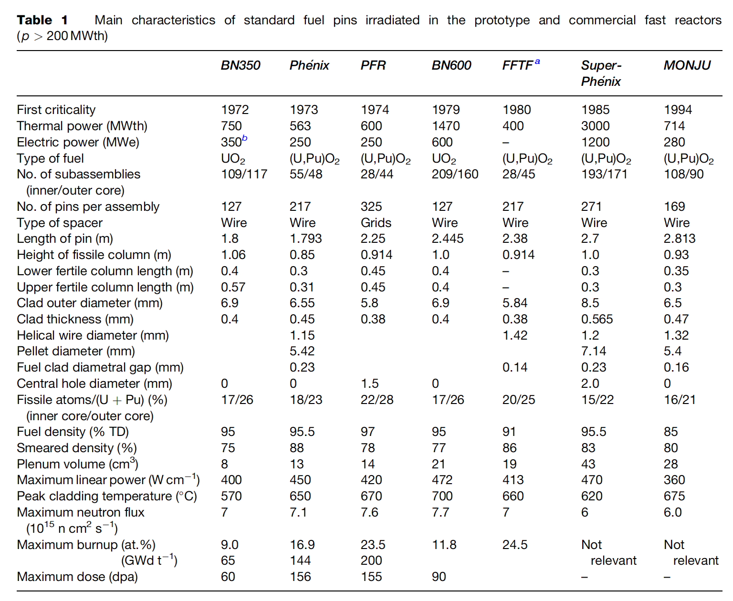
Mixed Oxides
MOX fuel allows to burn excess weapons grade plutonium
About 30 LWRs in Europe currently utilize a partial MOX core
Similar behavior to UO2, but different neutronics, fission gas release, thermal conductivity, etc.
Less common is inclusion of minor actinides in MOX to burn waste
Can also serve as a breeder
Also a fuel concept for SFRs

Slide 22
MOX Designs
The fuel pin is a long cylinder (2–3m long, 5–10mm diameter), clad in a steel tube (0.4–0.6mm thick) closed in both ends by welded plugs, preventing direct contact between the radioactive material and the sodium coolant (or water coolant, in LWR concepts)
The oxide fissile column (~1 m long) consists of a stack of conventionally pressed and sintered pellets with an outer diameter slightly smaller than the inner diameter of the clad, providing a gap ~100 micron gap
Both full pellets and annular pellets have been used
A He gap with a pressure ~1 atm is used
Fuel pins of fast reactors are designed to operate at a high linear heat generation rate: between 400 and 500 W/cm, about 2x-3x higher than standard linear power in light water reactors (LWRs)

Slide 23
MOX Fuel
As the fast reactor fuel pin diameters are generally smaller than classical rod diameters of LWRs, the power density and heat fluxes are much higher in SFRs than in LWRs
For example, in a Phenix fuel pin at 450 W/cm, the power density in the pellet reaches almost 2000 W/cc
Sodium enters the bottom part of the core at about 400 C and the average coolant temperature above the core is typically about 550 C
The neutron flux is very intense (~7x10¹⁵ n/cm²/s in the core center) and the assembly materials suffer high damage, more than 100 dpa, at high burnup
Qualifying metallic materials able to withstand such high damage while keeping their shape and mechanical properties was/is one of the key challenges for fast reactors
In order to reduce fuel cycle costs, the main objective of oxide fuels R&D for fast reactors has been to reach high burnup, typically around 150 GWd/ton, about twice the burnup achieved in LWRs

Slide 24
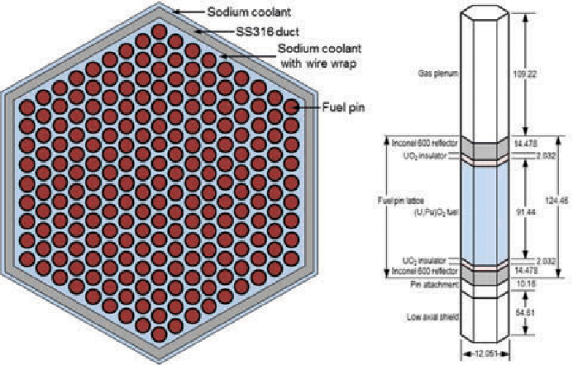
UO2 to MOX Design Differences
Shorter fuel column/rod in MOX
Smaller fuel diameter in MOX
Steel cladding vs. zircaloy cladding
Much higher heating rates in MOX
Larger gas plenum
Sodium coolant in SFRs
Extended burnup for MOX
Hexagonal packing of fuel pins
FFTF Assembly

Slide 25
MOX Fuel
The main requirements and design criteria are the following:
Guaranteeing the absence of fuel melting, both in nominal conditions and during off-normal events
Keeping cladding integrity and fuel pin tightness
Cooling of the fuel pin bundle must be ensured up to high burnup in all operating conditions
Loading and unloading of subassemblies have to be guaranteed, which induces a limitation on the deformation of the hexagonal wrapper tubes

Slide 26
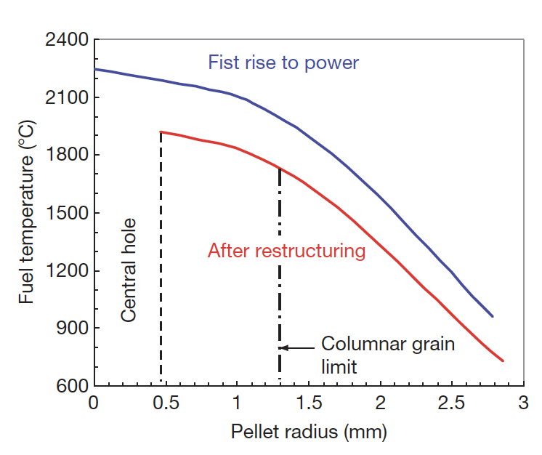
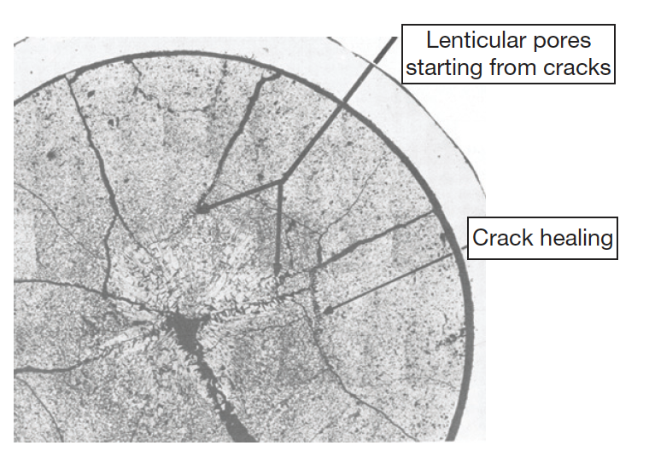
MOX Fuels
Most phenomena occurring inside oxide fuel pellets are thermally activated, and a good knowledge of the thermal field inside the fuel stack is key
Centerline temperatures can reach above 2000C, significantly higher than thermal LWRs
Thermal conductivity is low and degrades with irradiation
Due to the steep thermal gradient, thermal stress cracks form
Restructuring takes place due to the high temperatures, leading to distinct regions in the fuel

Slide 27
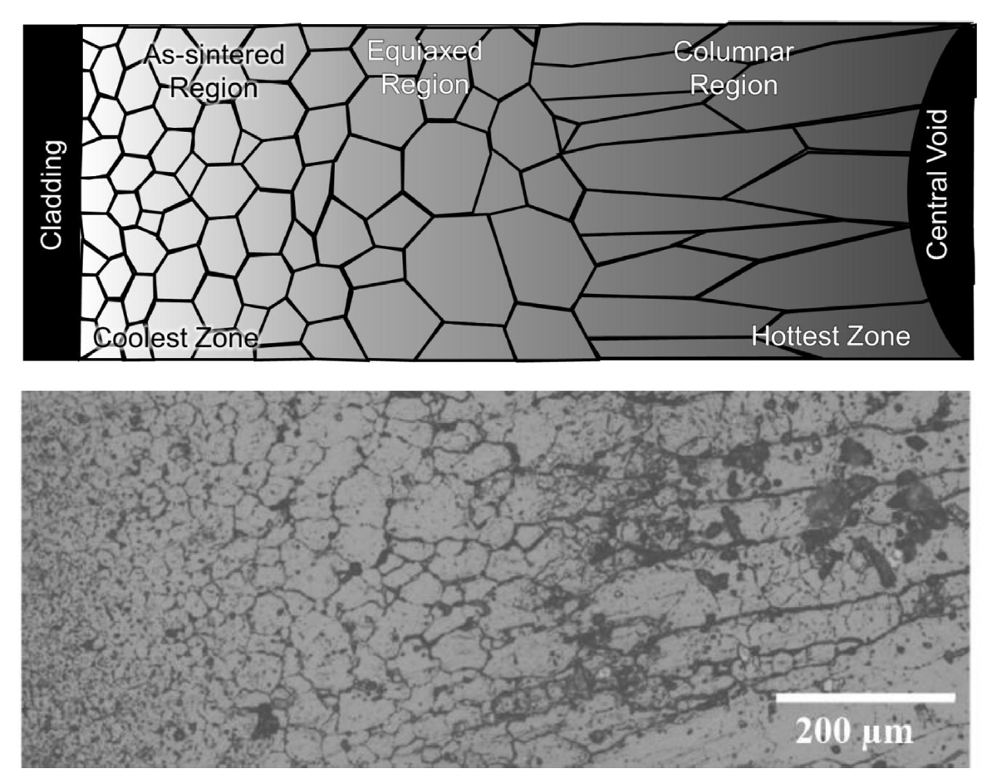
MOX Restructuring
Pu bearing fast reactor oxide fuels display four defining regions of a restructured pellet:
the central void, the columnar grain growth region, the equiaxed grain growth region, and the as-sintered region

