Slide 1
Nuclear Fuel Performance
NE-533
Spring 2022

Slide 2
Last time
Fission gas release models are used to understand fission gas experiments and to predict gas release for fuel performance codes
Spherical grain models predict a fraction of gas release for post-irradiation annealing or for in-pile gas release
Booth model takes Stage 1 into account; Forsberg-Massih model takes Stage 1 and 2 into account
Fission gas diffusivity behavior changes with temperature and fission rate

Slide 3
MOOSE Project
Three-part project
Will upload input and output files to Moodle
Will upload a final written report, 5-10 pages (including figures), times new roman, 12pt, 1.5 space, pdf
Due April 26 – Tuesday before Finals week
This is an individual project, but some collaboration is encouraged

Slide 4
MOOSE Project Part 1
0.5 cm
0.002 cm
0.1 cm
Fuel pin dimensions listed
This is a 1-D problem, but I want your geometry to be set up in 2-D RZ
Assume reasonable values for thermal conductivities, can assume constant k
Outer cladding temperature: 500 K
Mesh: something sufficiently converged
Solve temperature profile for:
Steady-state: LHR = 150 W/cm²
Compare against analytical solution
Solve for centerline temperature vs time
Transient: LHR = 150*(1-EXP(-0.05*time))+150 for up to t=100
1 cm
Fuel
Cladding
Gap

Slide 5
Fission products

Slide 6
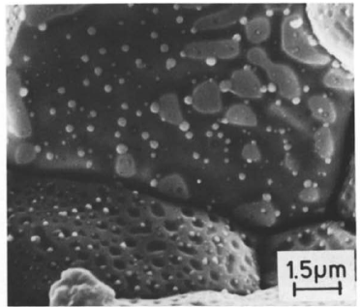
There are various types of fission products that form in the fuel
Soluble oxides (Y, La and the rare earths)
Dissolved in the cation sublattice
Insoluble oxides (Zr, Ba and Sr)
Form insoluble oxides in the fluorite lattice
Metals (Mo, Ru, Pd, and Tc)
Form metallic precipitates
Volatiles (Br, Rb, Te, I and Cs)
Exist as gases at high temperatures of the pellet interior
Also exist as solids at the cooler pellet exterior
Noble gases (Xe, Kr)
Essentially insoluble in the fuel matrix
Form either intragranular (within grain) voids or bubbles or intergranular (grain boundary) bubbles

Slide 7
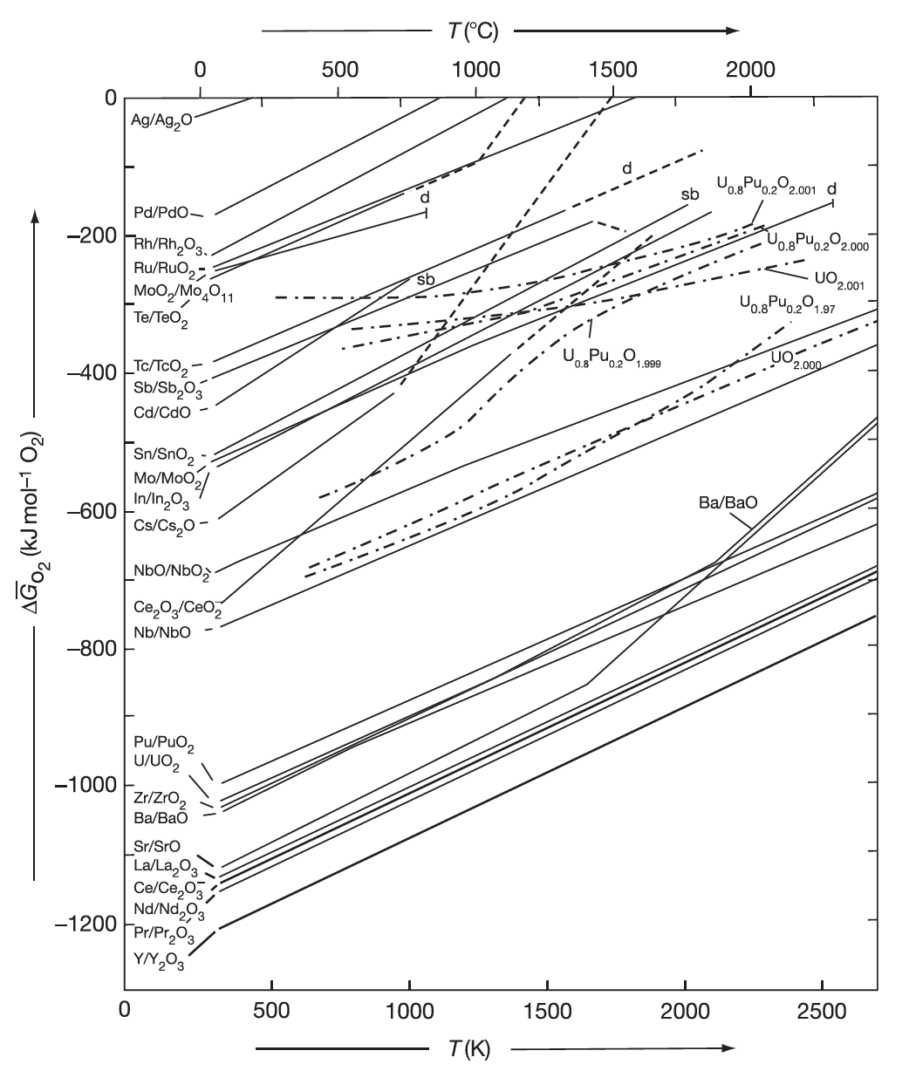
Oxide Formation
With burnup, the liberated oxygen will associate with U, Pu, and La but may not be in sufficient supply to combine with Pd and other less oxidizing elements
If the Gibbs energy of formation of the given fission product lies below the fuel oxygen potential, the element will be capable of forming an oxide
If the fission product point is above the chemical potential in the fuel, the fission product will exist as an element in the fuel (in a separate metallic phase)

Slide 8
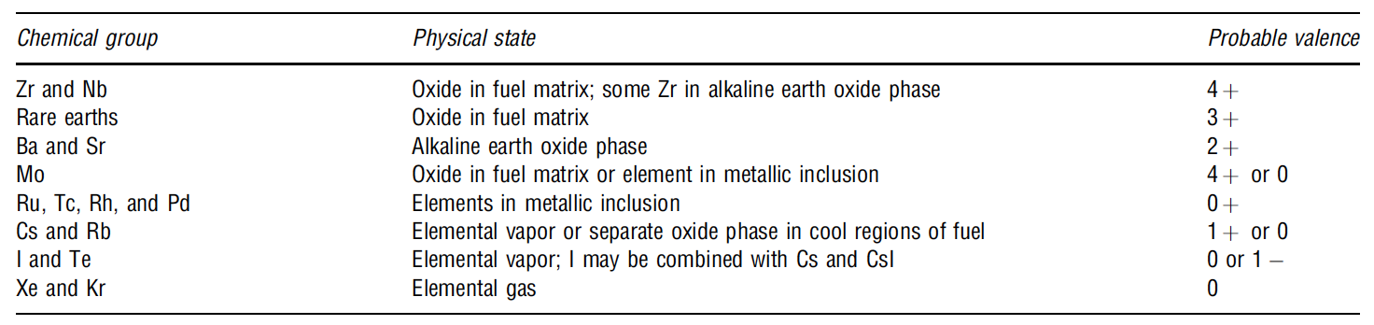
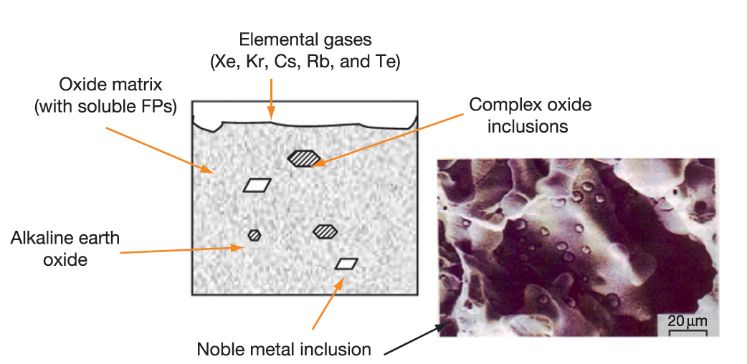
Fission Products
When a 4+ valence fission product (e.g.,Zr4+) enters the lattice, there is no change in the electrical neutrality
If the charge of the fission-product cation is lower than U+4, the site occupancy of the lattice is altered to achieve electrical neutrality
The alkaline earth cations Ba+ and Sr2+ have large ionic radii and form a separate oxide phase
Fission products that have limited solubility in UO2 will segregate to the grain boundaries and voids

Slide 9
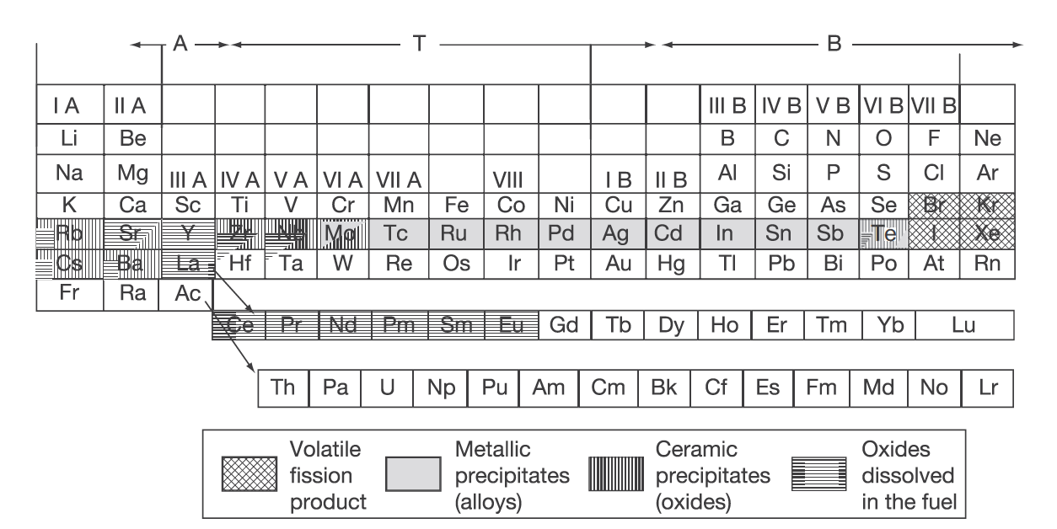
Volatile Fission Products
Xe release occurs at the central region of the pellet where the highest temperatures were achieved during irradiation
Volatile FPs are released from the fuel matrix similar to that of the noble gases
Volatile fission products in the gap can react among themselves, resulting in a changing chemical speciation
The kinetics of formation/decomposition of CsI and Zr iodides are possible factors in the mechanism of SCC

Slide 10
Fission Product Segregation
Fission products can be segregated because of their migration to specific locations such as intragranular segregations, grain boundaries, or pellet surfaces
Metallic inclusions are commonly observed in ceramographs from irradiated samples
They are formed by isotopes of Mo, Tc, Ru, Rh, Pd, Ag, Cd, In, Sn, Sb, and Te
These inclusions are found at the surface of the grain boundaries and are associated, in general, with grain boundary and intragranular bubbles
Some of the components of these precipitates can be oxidized or reduced forming other compounds of high volatility that can be released from the fuel matrix
Cs, Ru, Te, and Ba have been consistently found at the cracks in the pellet and on the clad inner surface
The white inclusions are metallic precipitates, which are composed of Mo, Tc, Rh, Ru, and Pd, form a quinary alloy in an hcp structure
A “gray oxide phase” perovskite structure containing different combinations of Ba, Cs, Zr, Mo, and U can also form

Slide 11
FP Interaction with Zr Cladding
Fission fragments will deposit on the inner surface of the cladding
Some of these species can diffuse into the clad, while others can attack the clad thereby initiating cracks that can later progress with the formation of through-wall cracks
Oxygen will diffuse into the cladding and contribute to its oxidation state
Measurements have shown deposits of Sr, Cs, Pu, and Am
The corrosion behavior of zirconium by Te has been reported
The chemical reaction between some corrosive fission products and the cladding can lead to PCI
Fission products such as Cs, Cd, or I can attack the cladding inducing crack initiation, which then progress through the cladding by intragranular and transgranular cracking modes

Slide 12
Fuel Swelling/Dimensional Change

Slide 13
Fuel changes size and shape under reactor operation

Slide 14
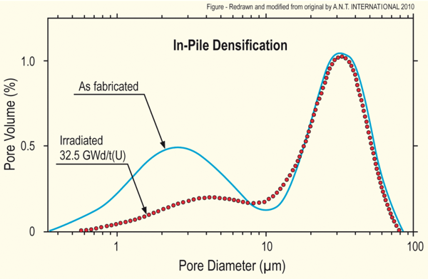
Densification
Densification takes place during initial 5 - 10 MWd/kgU
Small, as-built pores close due to effects of fission spikes and vacancy diffusion
Large pores stable (in absence of large hydrostatic stress)
Empirical correlation for densification is a function of
β - Burnup (in FIMA)
Δρ₀ – Total densification that can occur (a common value is 0.01)
β_{D} – Burnup at which densification stops ( a common value is 5 MWD/kgU)
C_{D} = 7.235 − 0.0086 (T(°C) − 25) for T < 750°C and CD = 1 for T ≥ 750 °C
[Maier et al, 1988]

Slide 15
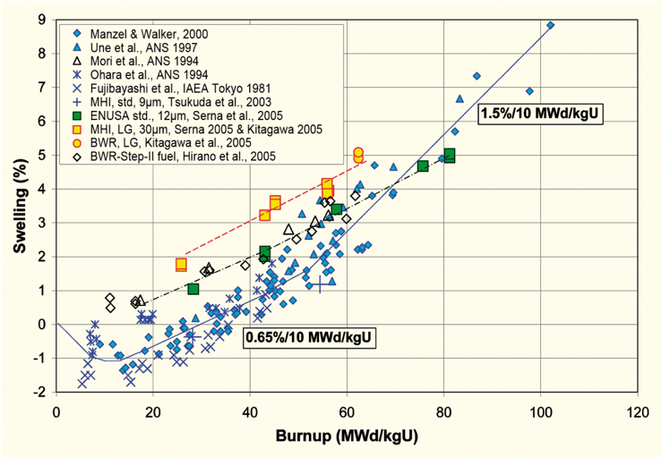
Fission product induced swelling
Fission product swelling results from three changes in the fuel microstructure
Solid swelling: Accumulation of soluble and insoluble fission products in fuel matrix
Gaseous swelling: Accumulation of gaseous and volatile fission products in intragranular and intergranular pores
High burnup swelling: Restructuring of pellet rim with the accumulation of fission gas in a large number of small pores
after Garzarolli in [Rudling et al, 2007]

Slide 16
Solid fission product swelling
The solid fission product swelling model is a function of:
Β – Burnup (in FIMA)
ρ – Initial UO₂ density (g/cm³)

Slide 17
Gaseous fission product swelling
Gaseous swelling varies strongly with temperature, fission rate and stress
T < 1000K
Fission gas atoms remain in fuel matrix or collect in small, isolated, intragranular pores (<1 nm)
Intragranular pore size limited by fission spikes that drive gas back into fuel matrix
Gaseous swelling constrained by fission gas release
T = 1000 to 1700 K
Swelling takes place at hot interior of pellet
Gas atoms in fuel matrix diffuse to grain boundaries and collect in pores
Gas pressure causes bubbles to increase in size and to coalesce into larger pores
Gaseous swelling opposed by applied stress
Gaseous swelling also constrained by fission gas release

Slide 18
Total change in volume
The total change in volume is found by adding all components of dimensional change
ε_{tot} = ε_{th} + ε_{D} + ε_{sfp} + ε_{gfp}
Example:
fission rate = 2.5e13 f/(cm³ s)
T(fuel) = 1400 K
T_{ref} = 300 K
For densification: Δρ₀ = 0.01 and β_{D} = 5 MWD/kgU
Total time: 2 weeks

Slide 19
Change in Volume Example
First, we need to calculate the burnup, enrich 5%,
M_{UO2}=16*2+238*0.95+235*0.05=269.9 g/mol
N_{U} = N_{a} ρ_{U}/M_{U} = 6.022e23*10.97/269.9 = 2.45e22 atoms of U/cm³
β = 2.5e13*3600*24*7*2/2.45e22 = 0.0012 FIMA
Next, we need to determine the strain from thermal expansion
ε_{th} = αΔT = 11e-6*(1400 – 300) = 0.0121
Then, we consider densification,
We need to calculate C_{D}, but because we are higher than 750C, C_{D} = 1
We need to convert the burnup to FIMA, β_{D} = 5 MWD/kgU/950 = 0.0053 FIMA
ε_{D} = 0.01*(exp(0.0012*log(0.01)/(1*0.0053)) – 1) = -0.0065

Slide 20
Change in Volume Example
For solid fission product swelling,
For the density of UO₂, ρ = 10.97 g/cm³
ε_{sfp} = 5.577e-2*10.97*0.0012 = 7.34e-4
Finally, gaseous fission product swelling
ε_{gfp} = 1.96e-28*10.97*0.0012*(2800 – 1400)^11.73* exp(-0.0162*(2800 – 1400))*exp(-17.8*10.97*0.0012) = 0.0023
Total:
ε_{tot} = ε_{th} + ε_{D} + ε_{sfp} + ε_{gfp} = 0.0121 – 0.0065 + 7.34e-4 + 0.0023 = 0.0086

Slide 21
The overall swelling behavior depends on temperature

Slide 22
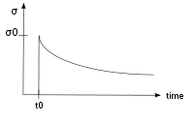
Creep
Creep is a general mechanism for plastic deformation that occurs over time when σ < σ_{y}
Consider a heated metal beam so it expands some distance dx
We then fix it between two walls and let it cool down
Because σ < σ_{y}, that stress remains constant
In creep, defect diffusion is induced by the stress to cause permanent deformation and reduce the stress
Therefore, creep
Occurs over time
Increases with increasing number of diffusing defects
High temperature (thermal creep)
Irradiation (irradiation creep)
x
x+dx
σ = E ε

Slide 23
Creep
General creep equation:
Creep can be caused by various microstructural mechanisms
Bulk Diffusion (Nabarro-Herring creep)
Atoms diffuse (high T), causing grains to elongate along the stress axis
Q = Q(self diffusion), m = 1, and b = 2
Grain boundary diffusion (Coble creep)
Atoms diffuse along grain boundaries to elongate the grains along the stress axis
Q = Q(grain boundary diffusion), m = 1, and b = 3
Dislocation creep
Dislocations glide under a high stress
Dislocations climb due to defects to avoid obstacles
Q = Q(self diffusion), m = 4–6, and b = 0

Slide 24
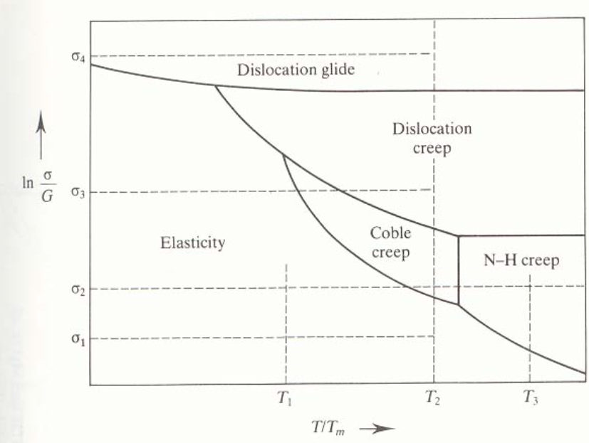
Different creep mechanisms are active for different combinations of stress and temperature

Slide 25
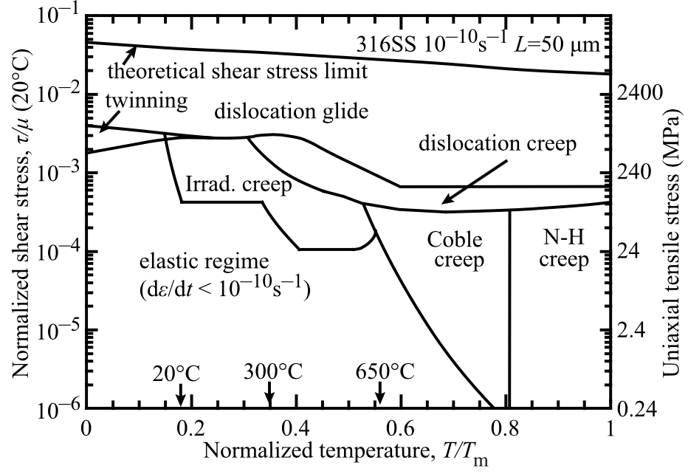
The behavior of creep changes in irradiated materials

Slide 26

Irradiation and Creep
Irradiation accelerates creep, causing it to be significant at lower temperatures
Irradiation has little effect on diffusional creep, but it accelerates dislocation creep in cubic materials
The dislocation creep rate can be written as
ρ_{d}^{m} is the density of mobile dislocations
b is the burgers vector
v_{d} is the dislocation velocity
Gliding dislocations quickly get pinned by obstacles
As the dislocations absorb defects created by irradiation, they climb to different slip planes to avoid the obstacles
More interstitials are absorbed than vacancies due to the higher sink strength for interstitials

Slide 27
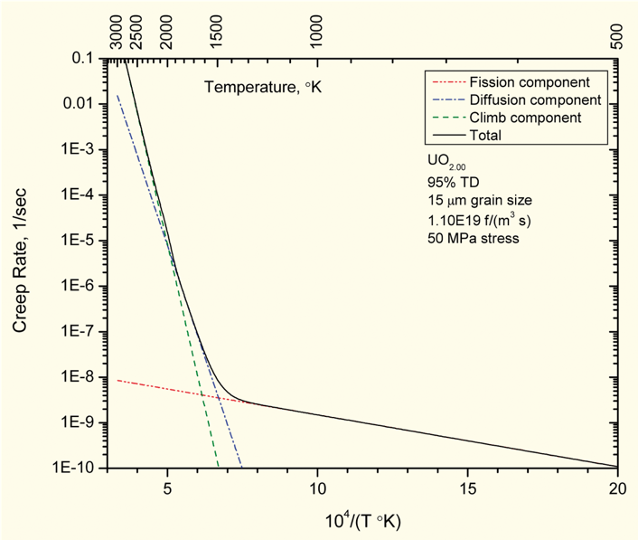
Fuel Creep
Like other materials, the fuel also undergoes creep
The fuel creep (In UO2) is a combination of diffusion creep and irradiation creep
It is expected that fuel creep plays a major role in dimensional change in metallic fuels, largely via N-H and Coble creep, but still unproven experimentally and no good creep models exist for metallic fuels

Slide 28
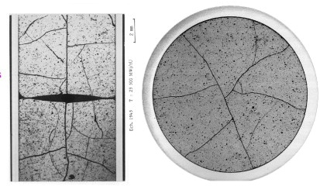
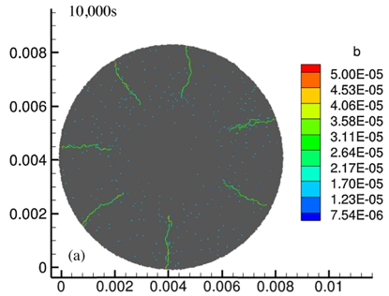
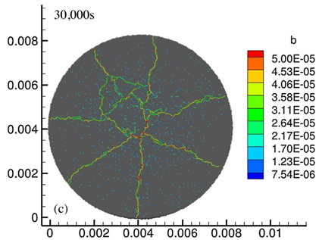
Fracture
UO₂ pellets fracture during changes in temperature due to large thermal stresses
Fracture results in:
Increased gap reduction
Reduced thermal conductivity
Increased avenues for fission gas release
Fracture has been typically modeled in two ways:
Empirical relocation model that is a function of burnup
Semi-empirical smeared cracking model
Modern methods provide means of modeling discrete cracks
Radial cracks partially penetrate the pellet during temperature increase
Full cracking occurs when the temperature decreases

Slide 29
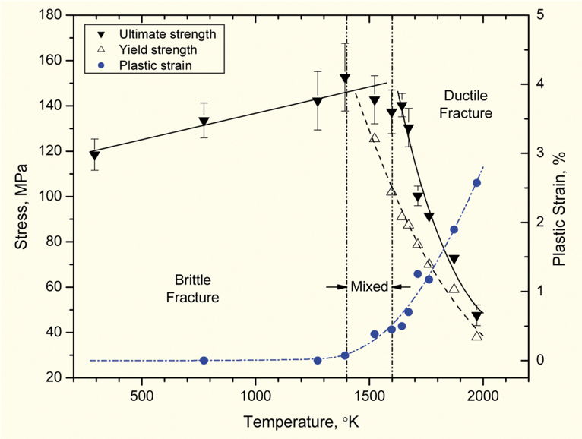
Fracture
The fracture behavior of the fuel is fairly complicated
Fracture strength varies with grain size (G)
σ_{frac} = G^{-m}σ_{frac, ref}, m = 0.04 – 0.05 (vs. m ~ 0.5 for metal)
Increasing grain size from 10 μm to 100 μm reduces σ_{frac} by ~10%
Ductility transition temperature is lower in-reactor than in thermal tests
Fracture strength is ~10× higher in compression than in tension
Load-deformation behavior strongly affected by creep under in-reactor conditions

Slide 30
Summary
Many materials models for fuel are empirical and correlated to burnup
Fuel pellets change shape due to
Thermal expansion (increase in volume)
Densification (decrease in volume)
Swelling (increase in volume)
Creep (volume stays the same)
Fracture also decreases the gap, as fractures pieces shift outward

Slide 31
Summary
The fuel thermal conductivity decreases with burnup
Empirical models take into account both phonon and electron based thermal transport
BISON primarily utilizes the NFIR model to describe thermal conductivity
The NFIR model is a fairly accurate empirical model of the fuel thermal conductivity

