Slide 1
Nuclear Fuel Performance
NE-533
Spring 2026

Slide 2
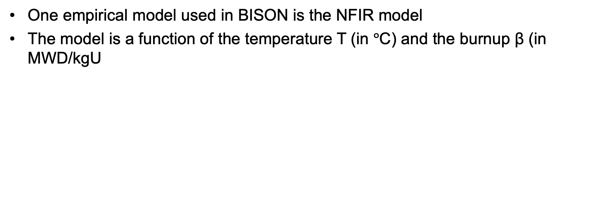
UO2 Thermal Conductivity
One empirical model used in BISON is the NFIR model
The model is a function of the temperature T (in $°$C) and the burnup β (in MWD/kgU

Slide 3
UO2 Thermal Conductivity
The R_{f} function switches between two k_{ph} functions, accounting for thermal recovery

Slide 4
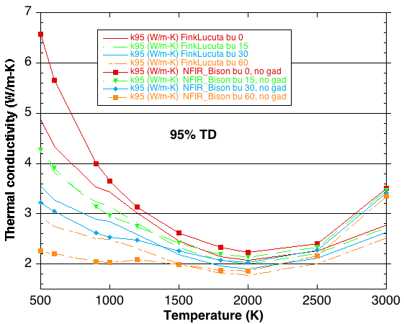
MOOSE/BISON Models
https://mooseframework.inl.gov/bison/source/materials/UO2Thermal.html
Fink-Lucuta
Halden
NFIR
NFI
Ronchi-Staicu
Toptan (NCSU alum)

Slide 5
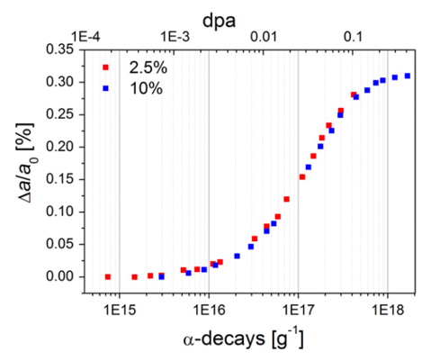
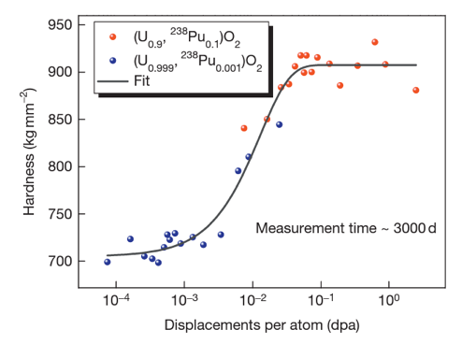
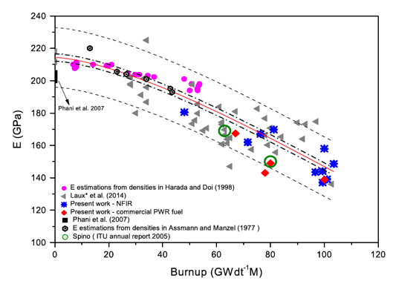
Other Physical Changes
An important effect of radiation damage is the volume increase of the crystal lattice, leading to macroscopic swelling of the fuel material
Alpha particle damage alone can cause approximately 0.4% swelling
Mechanical properties also vary with damage
Hardness increases as a function of dpa
Young’s modulus decreases with dpa

Slide 6
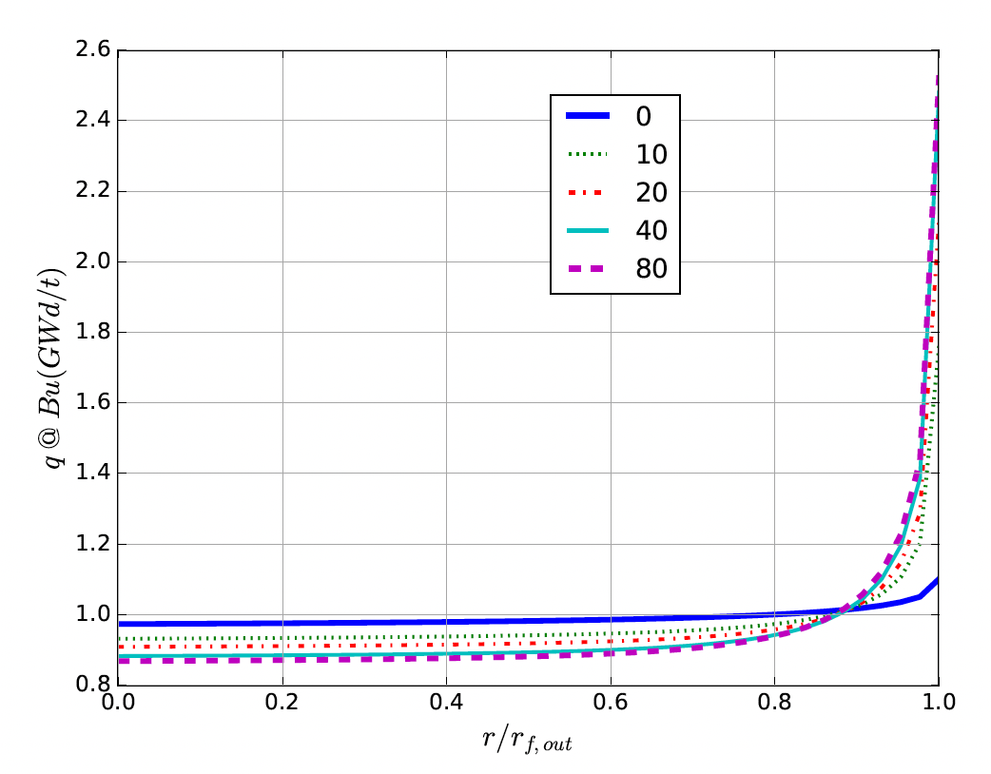
High Burnup Structure (HBS)
At the beginning of the irradiation, the local power is ~10% higher on the pellet periphery, due to self-shielding effect in 235U fissions driven by neutrons entering the rods after interactions in the water
With increasing burnup, a strong capture of neutrons by U-238 in the resonance range occurs at the periphery of the fuel
This leads to the production of Pu-239, and leads to a higher fissile density and thus a further increase in the local power/burnup
This high local burnup area is on the outer ring of the fuel and is about 200 microns thick, which represents about 8% of the fuel

Slide 7
High Burnup Structure (HBS)
When thermal recovery is not sufficiently efficient (at lower temperatures), the accumulation of defects at high burnup can lead to the instability of the crystalline structure, initiating a restructuring driven by the energy stored in the material
This can be amorphization (not observed in UO2) or recrystallization/polygonization
Polygonization is the rearrangement of dislocations into sub-domain walls with slightly misaligned grains
In UO2, grains subdivide from 10 microns in size to 100-200 nm size, and a densely porous structure is formed (~20% porosity)

Slide 8
High Burnup Structure (HBS)
The increase of the relative porosity volume degrades the material conductivity and reduces the mean grain size
On the other hand, the intragranular irradiation defect-cleaning improves the fuel intrinsic thermal conductivity
Fission gas in HBS bubble is retained, not released
Exact mechanism of HBS formation is not fully understood, believe to be polygonization, interacting with fission gas bubbles, dislocation growth, and high levels of energy deposition

Slide 9
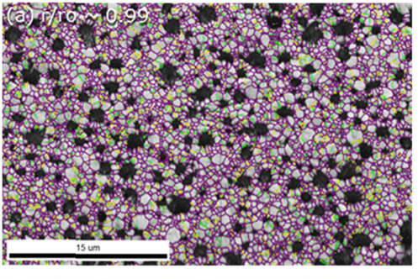
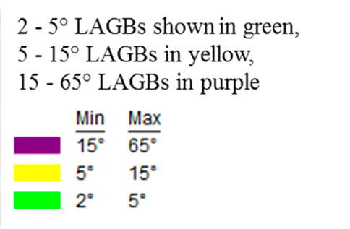
High Burnup Structure (HBS)
HBS has a high fission gas retention capacity, and does not evolve toward an open system of interconnected channels, even when porosity reaches very high values
Thus, the HBS is a relatively stable structure, limiting pressure increase in the plenum
While burnup is higher in the rim region, the HBS polygonization removes/sweeps defects to new grain boundaries, removing some phonon scatterers
Despite high porosity, thermal conductivity increases, slightly decreasing centerline temperatures in high burnup fuel

Slide 10
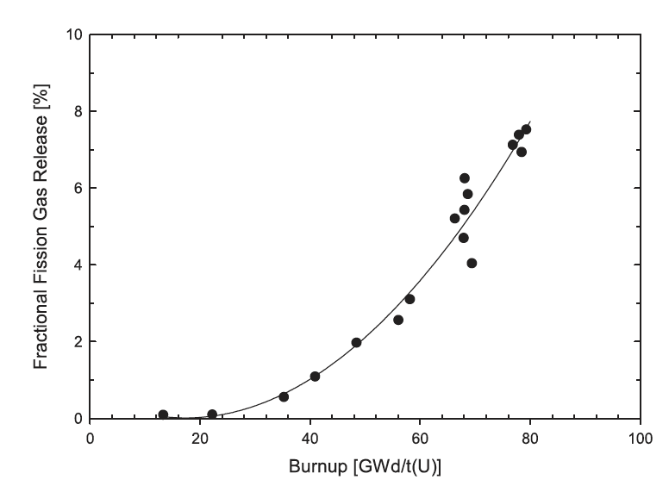
HBS and Fission Gas Release
The large increase in porosity within the HBS in high burnup fuel also affects fission gas release, providing local intergranular accommodation for retaining fission gases
Although the formation of the HBS promotes local fission gas retention, the absolute amount of fission gases that are released to the gap increases with burnup

Slide 11
Radiation Effects Summary
Formation of loops of voids as primary defect clusters
Radiation effects include both chemistry and physical property changes
One of the key physical properties modified is the thermal conductivity
have several empirical (and mechanistic) models to account for burnup and temperature
HBS forms towards the end of life, generating a fine-grained structure with high porosity
HBS retains fission gas and slightly increases thermal conductivity

Slide 12
Fuel chemistry

Slide 13
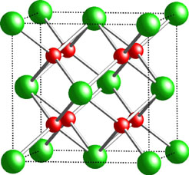
Fuel Chemistry
UO₂ is an ionic compound that must have balanced charges
What is the charge of a typical oxygen ion?
O²⁻
Uranium valance states
Possible: U³⁺, U⁴⁺, U⁵⁺, U⁶⁺
Most stable: U⁴⁺, U⁵⁺, U⁶⁺
Beyond UO2, can have U4O9, U3O8, UO3
The UO2 structure is very stable all the way up to the melting temperature and down to extremely low temperatures, even with irradiation damage
There is space in the uranium lattice that can accommodate fission products

Slide 14
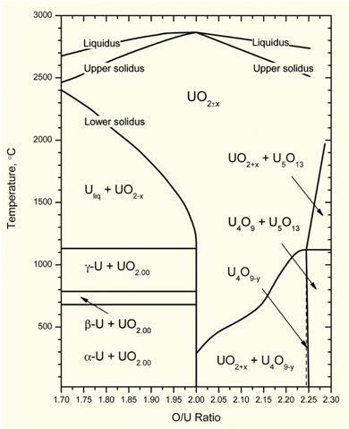
O/M ratio
The ratio of oxygen to uranium metal (O/M ratio) can vary
This is the stoichiometry
The homogeneity range of uranium dioxide extends to both hypo-(UO_{2-x}) and hyper(UO_{2+x})-stoichiometric compositions in oxygen
The minimum and maximum oxygen contents in the dioxide correspond to the compounds with the formula of respectively UO_{1.67} at 2720 K and UO_{2.25} at approximately 2030 K
Will the O/M ratio go up or down during reactor operation?
It is complicated, because of the formation of fission products that also react with the oxygen, and O interaction with Zr cladding

Slide 15
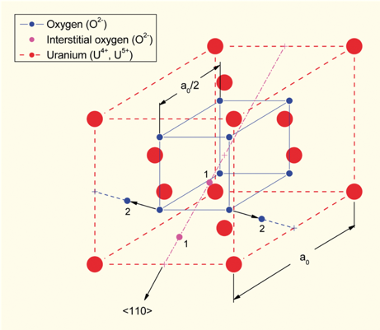
Excess O
The crystal structure of UO₂ can accommodate extra oxygen
Excess oxygen resides at interstitial locations
Oxygen in neighboring sites is displaced
Cation valence increases to maintain electrical neutrality
Fuel fabricated to be nearly stoichiometric; i.e., UO2.00± because:
It is the most stable
It has the highest melting temperature
[after Olander, 1976]

Slide 16
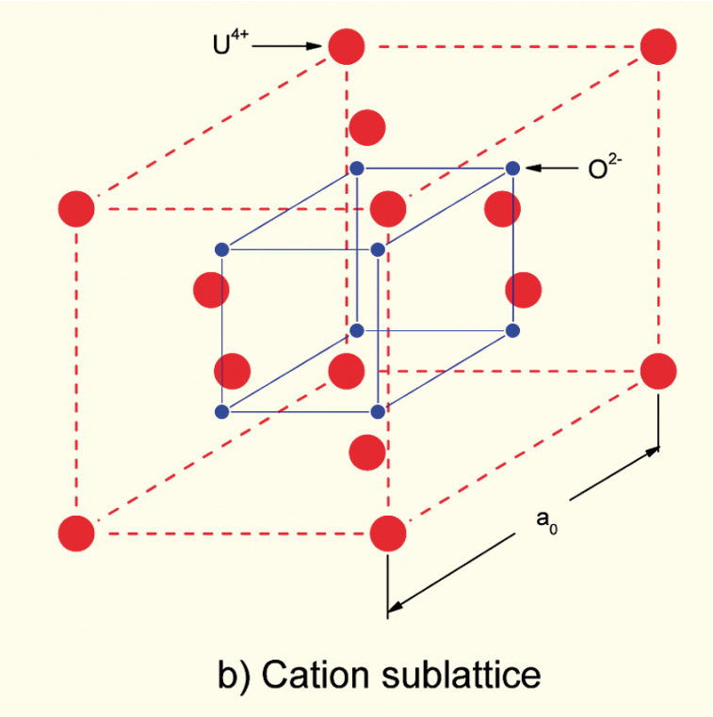
Incorporation of Fission Products
As fission products form, the valence state of the uranium can change
Typical valence of soluble fission products is M³⁺
The uranium valence state changes to compensate
Oxygen liberated by fission
Fission products produced with M³⁺ valance state incorporated in fuel lattice
Uranium oxidizes from U⁴⁺ to U⁵⁺ or U⁶⁺ to maintain local electrical neutrality

Slide 17
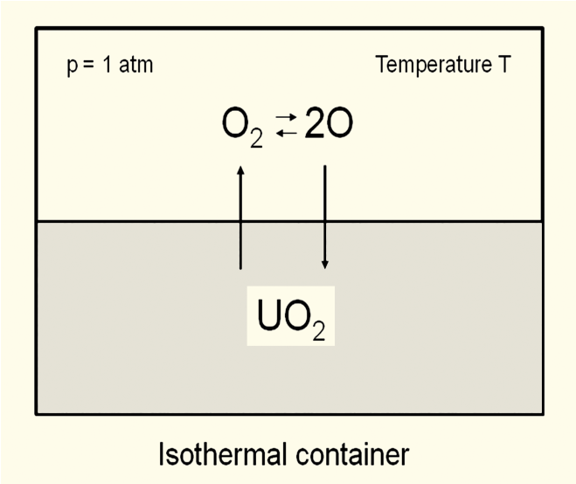
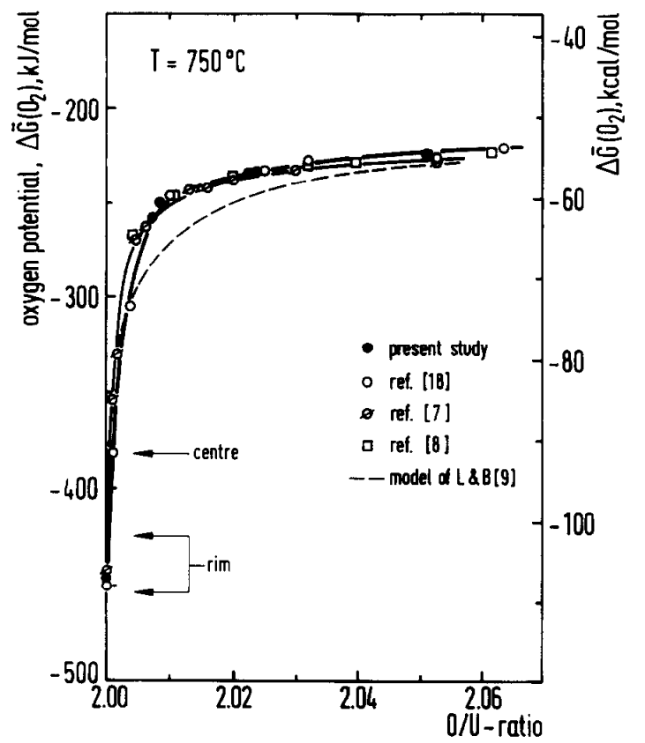
Oxygen potential
The oxygen potential is a measure of how free the oxygen is to escape/move around
Oxygen potential is defined as:
or, equivalently:
With = Chemical potential of oxygen in solution
= Gibbs free energy of gaseous oxygen at temperature T and a standard pressure (1 atm)
It is possible to determine the stoichiometry from the oxygen potential

Slide 18
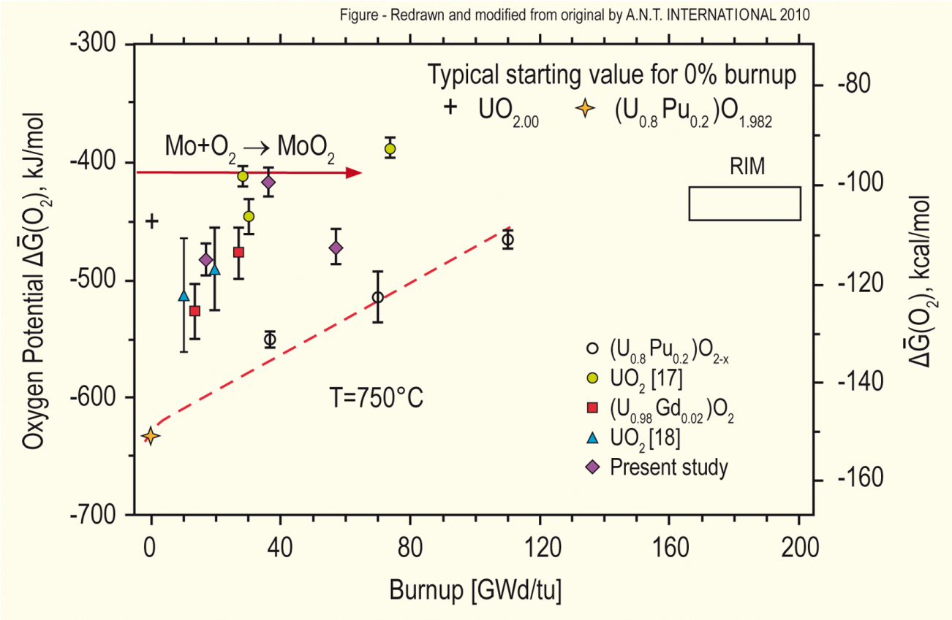
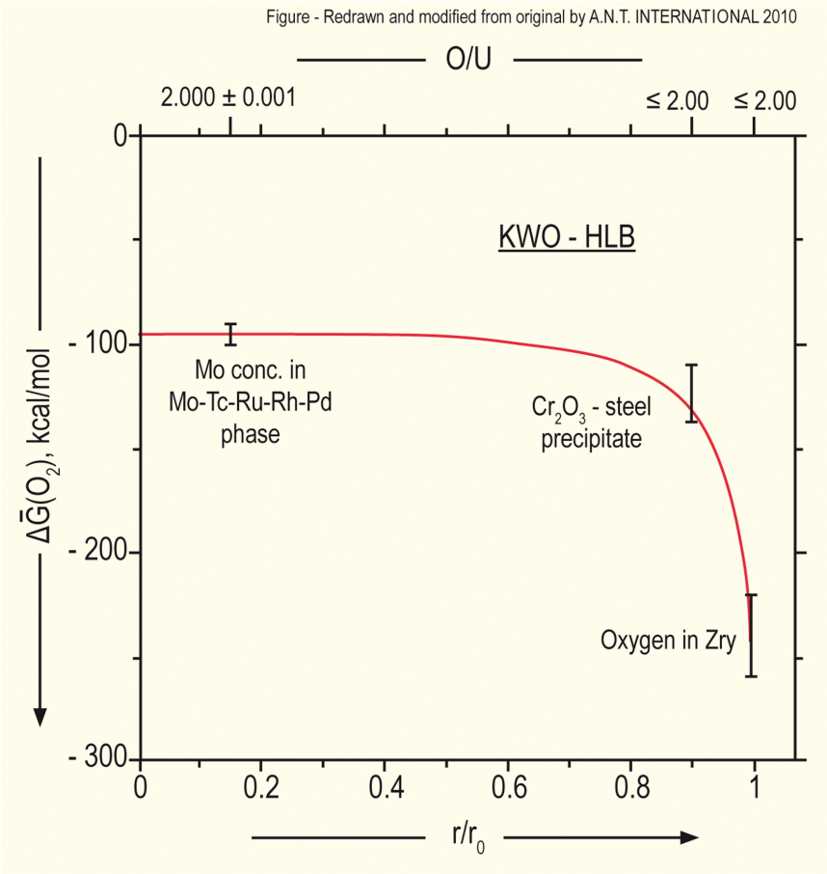
Oxygen potential
The oxygen potential changes during irradiation, indicating change in the O/M ratio
Oxygen potential changes during irradiation due to
Liberation of oxygen by fission; Generation of fission products; Conversion of uranium to plutonium; Reaction of oxygen with U, Pu, fission products, and cladding
Oxygen potential across pellet radius observed to be constant at the approximate value of Mo/MoO₂ reaction (from calculations)
Mo serves as a buffer to the O potential, or a means of inferring what the oxygen potential may have been in the fuel from PIE
Oxygen potential is low near the cladding, because the oxygen enters the cladding

Slide 19
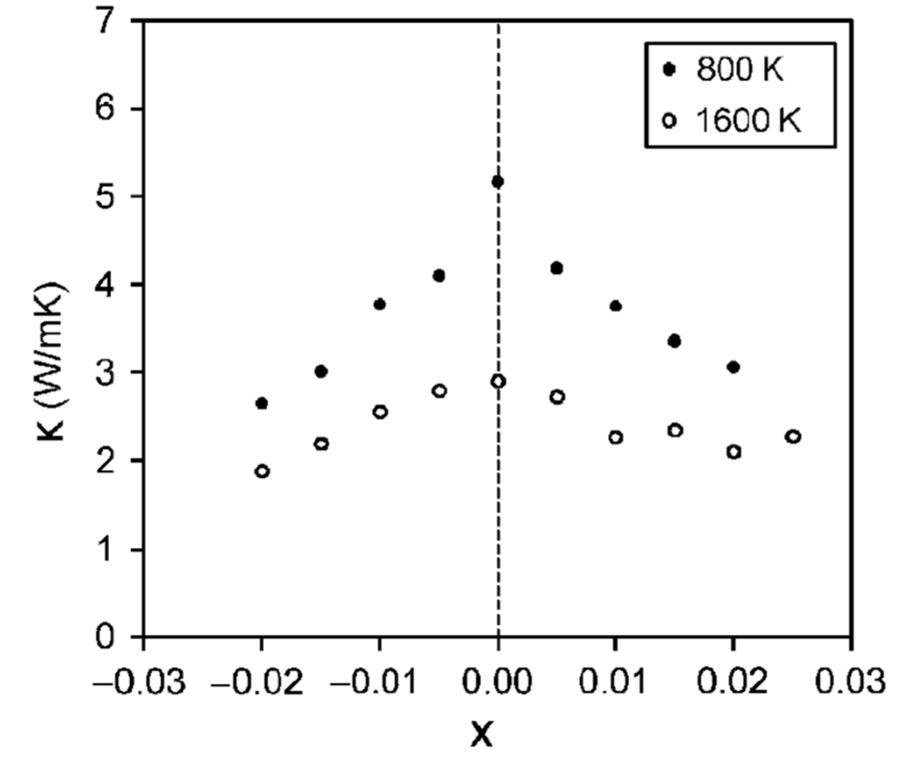
Fuel Stoichiometry/Properties
The stoichiometry of the fuel directly impacts the fuel performance
Stoichiometry impacts
Melting temperature
Thermal conductivity
Processes dependent on diffusion
Grain growth
Fission gas release
Creep
Chemical state and behavior of fission products
Chemical reactions at inner cladding surface
Thermal conductivity is highest for stoichiometric UO2

Slide 20
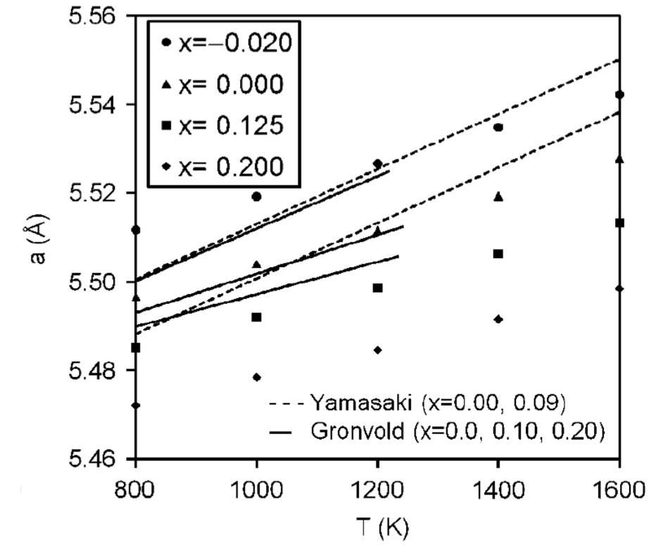
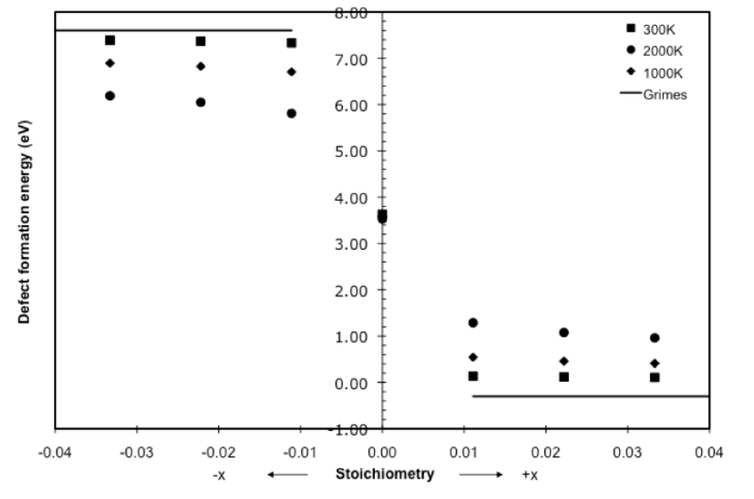
Fuel Stoichiometry/Properties
The lattice constant of the material decreases with increasing stoichiometry
The vacancy formation energy also changes with stoichiometry

Slide 21
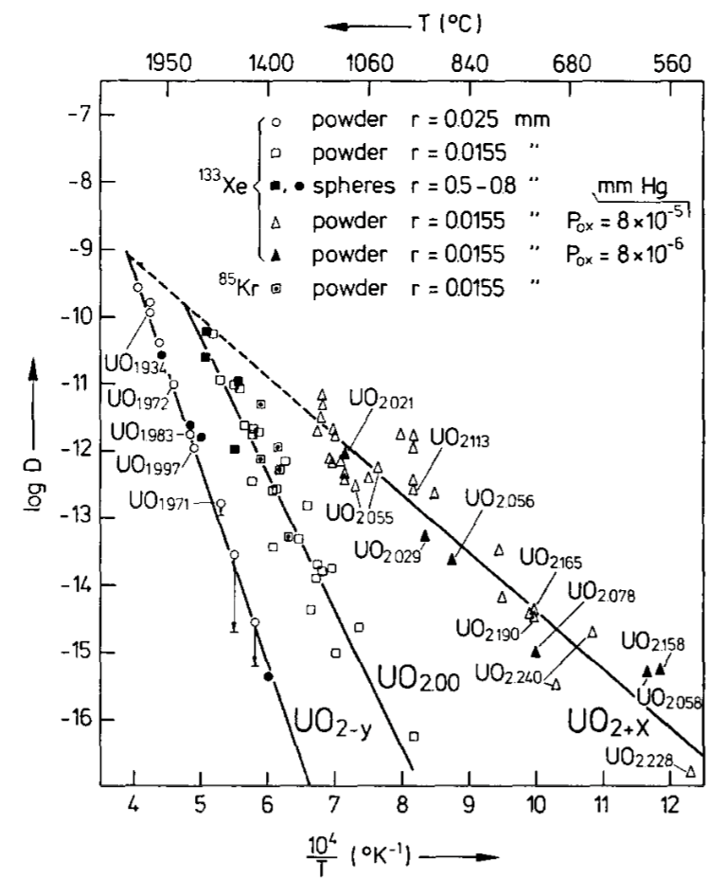
Fuel Stoichiometry/Properties
Fission product | UO_{1.97} | UO₂ | UO_{2.03}
Xe | 3.88 eV | 3.88 ev | 2.61 eV
Cs | 1.7 eV | -0.04 eV | -3.29 eV
Sr | -3.71 eV | -6.03 eV | -9.55 eV
The solution energy of Xe, Cs, and Sr in UO₂ depends on stoichiometry as well
The coefficient defining Xe diffusion also changes with stoichiometry
Though stoichiometry matters, most fuel performance codes ignore it

Slide 22
Fuel Chemistry Summary
UO₂ has a cubic fluorite structure that is very stable
The charges are balanced with a U⁴⁺ valence state
However, the ratio of oxygen to uranium can change. We call this the stoichiometry and abbreviate it as O/M ratio
The O/M ratio changes during reactor operation, but it is complicated
The O/M ratio impacts many properties of the fuel

Slide 23
Fission products

Slide 24
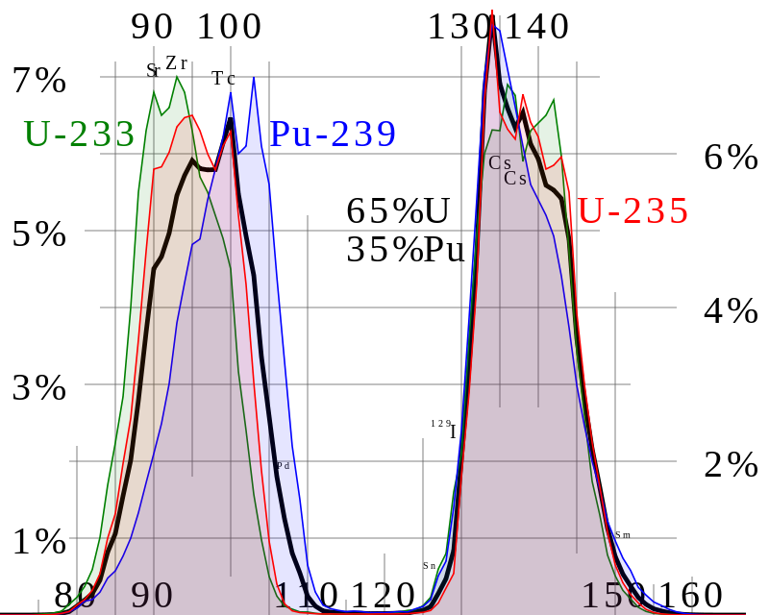
Fission Product Generation
Fission releases around 200 MeV
The fission fragments have 169 MeV of kinetic energy
2 to 3 neutrons with an average energy of 2 MeV
7 MeV of prompt gamma ray photons
The remaining energy is released by beta decay
Every fission product that is produced is now in the crystal lattice of the fuel, changing the chemistry/microstructure

Slide 25
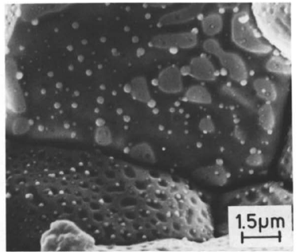
There are various types of fission products that form
Soluble oxides (Y, La and the rare earths)
Dissolved in the cation sublattice
Insoluble oxides (Zr, Ba and Sr)
Form insoluble oxides in the fluorite lattice
Metals (Mo, Ru, Pd, and Tc)
Form metallic precipitates
Volatiles (Br, Rb, Te, I and Cs)
Exist as gases at high temperatures of the pellet interior
Also exist as solids at the cooler pellet exterior
Noble gases (Xe, Kr)
Essentially insoluble in the fuel matrix
Form either intragranular (within grain) voids or bubbles or intergranular (grain boundary) bubbles

Slide 26
All fission products impact the behavior of the fuel

Slide 27
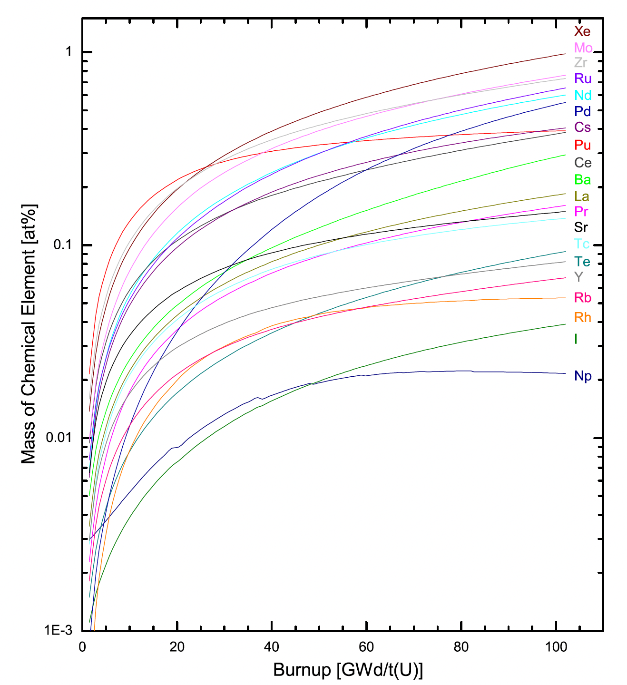
Fission Product Evolution
Not only are the absolute proportion of fission products accumulating with time, but the relative proportions are changing with respect to one another
There are continuous transitions between the groups as the critical concentration conditions for new phase development are surpassed because of increased burnup
Since fission releases two oxygen but only one metal atom, and not all metal atoms will react to bond the oxygen, the O/M ratio of the fuel slowly increases during burnup

Slide 28
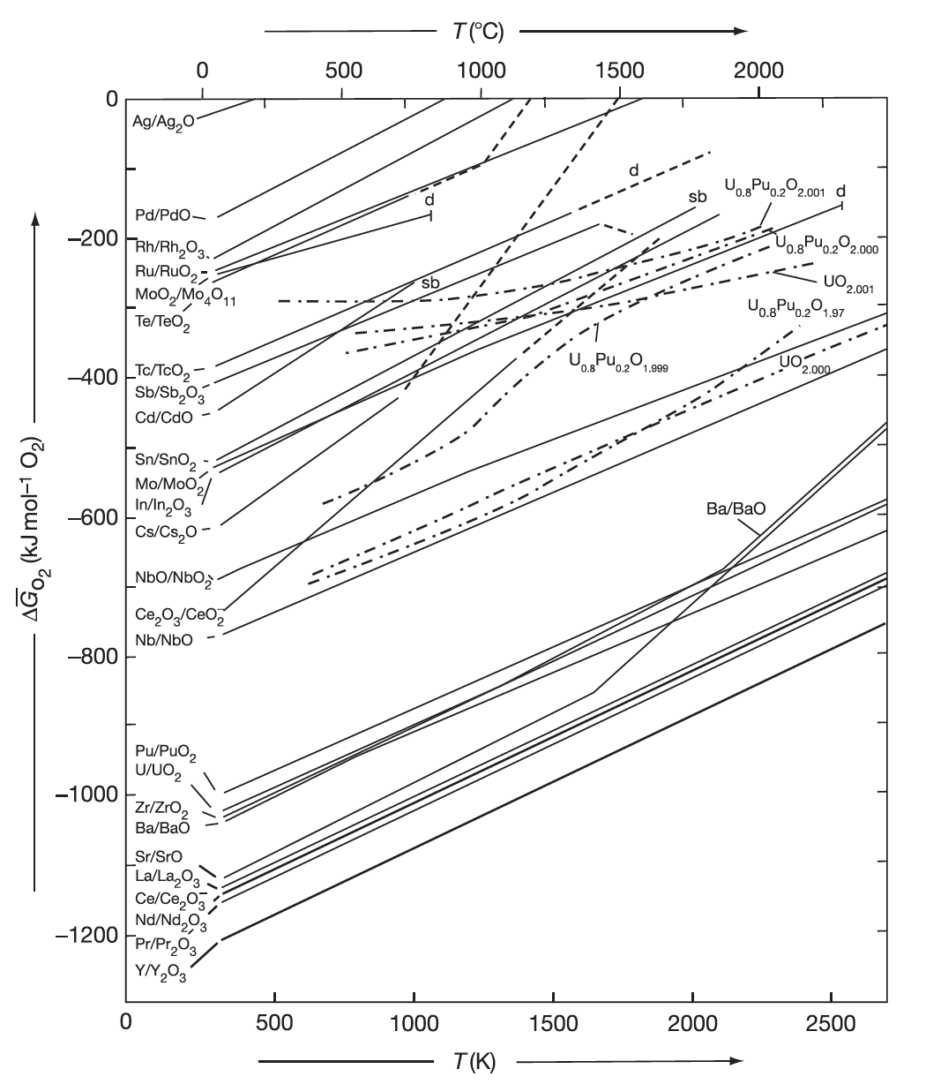
Oxide Formation
With burnup, the liberated oxygen will associate with U, Pu, and La but may not be in sufficient supply to combine with Pd and other less oxidizing elements
If the Gibbs energy of formation of the given fission product lies below the fuel oxygen potential, the element will be capable of forming an oxide (Ce, Sr, Ba)
If the reaction line is above the oxygen potential in the fuel, the fission product will exist as an element in the fuel (in a separate metallic phase) (Ru, Pd, Tc)

Slide 29
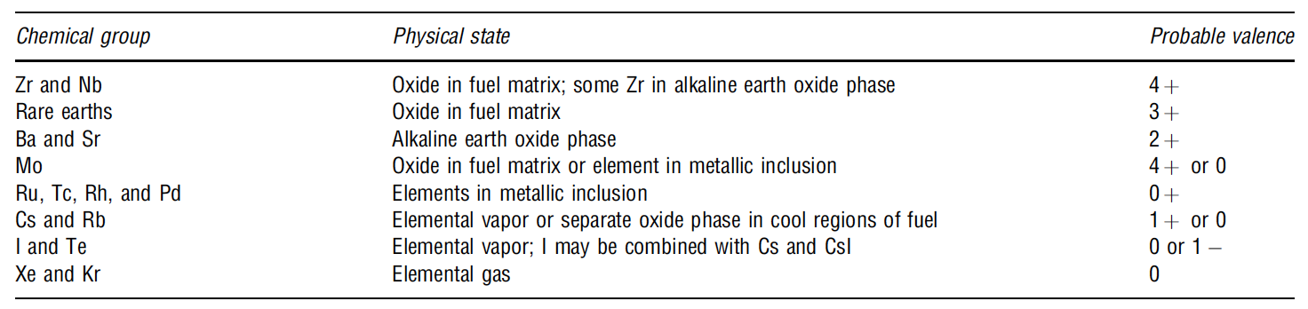
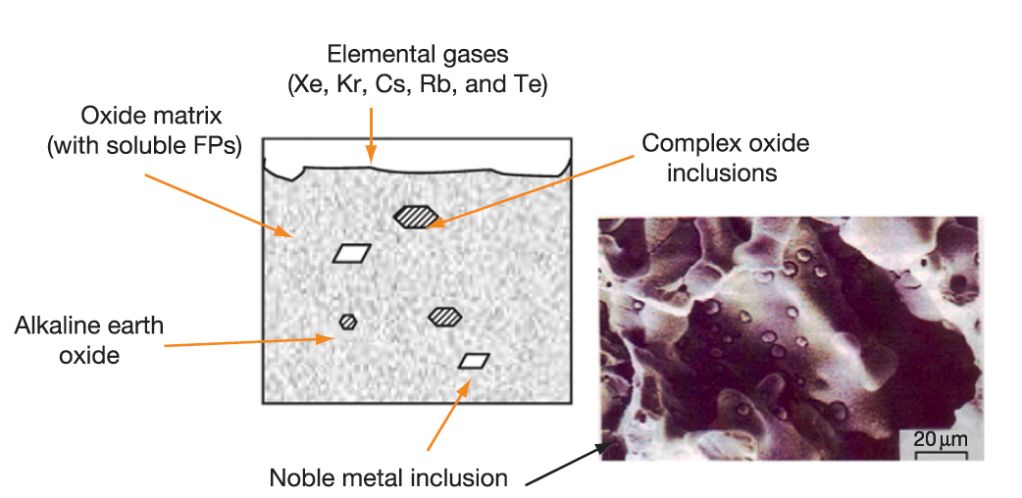
Soluble/Insoluble Fission Products
When a 4+ valence fission product (e.g.,Zr4+) enters the lattice, there is no change in the electrical neutrality
If the charge of the fission-product cation is lower than U+4, the site occupancy of the lattice is altered to achieve electrical neutrality
The alkaline earth cations Ba+ and Sr2+ have large ionic radii and form a separate oxide phase
Fission products that have limited solubility in UO2 will segregate to the grain boundaries and voids

Slide 30
Fission Product Segregation/Precipitation
Fission products can be segregated because of their migration to specific locations such as intragranular segregations, grain boundaries, or pellet surfaces
Metallic inclusions are commonly observed in ceramographs from irradiated samples
They are formed by isotopes of Mo, Tc, Ru, Rh, Pd, Ag, Cd, In, Sn, Sb, and Te
These inclusions are found at the surface of the grain boundaries and are associated, in general, with grain boundaries and intragranular bubbles
Some of the components of these precipitates can be oxidized or reduced forming other compounds that can be released from the fuel matrix
Cs, Ru, Te, and Ba have been consistently found at the cracks in the pellet and on the clad inner surface
The white inclusions are metallic precipitates, which are composed of Mo, Tc, Rh, Ru, and Pd, form a quinary alloy in an hcp structure
A “gray oxide phase” perovskite structure containing different combinations of Ba, Cs, Zr, Mo, and U can also form

Slide 31
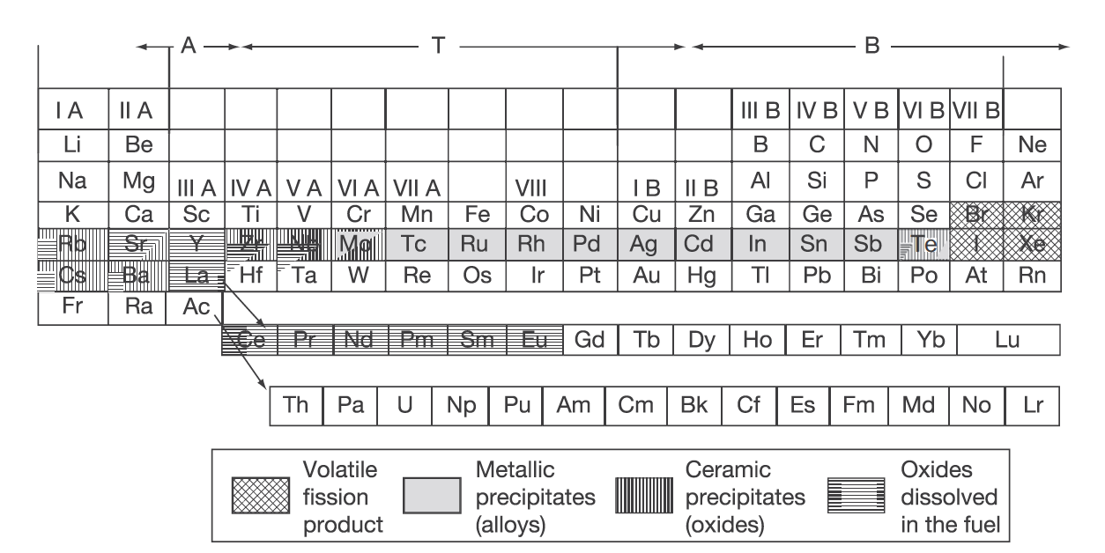
Volatile/Gaseous Fission Products
Xe release occurs at the central region of the pellet where the highest temperatures were achieved during irradiation
Volatile FPs are released from the fuel matrix similar to that of the noble gases
Volatile fission products in the gap can react among themselves, resulting in a changing chemical speciation
The kinetics of formation/decomposition of CsI and Zr iodides are possible factors in the mechanism of SCC

Slide 32
FP Interaction with Zr Cladding
Fission fragments will deposit on the inner surface of the cladding
Some of these species can diffuse into the cladding, while others can attack the cladding thereby initiating cracks that can later progress with the formation of through-wall cracks
Oxygen will diffuse into the cladding and contribute to its oxidation state
Measurements have shown deposits of Sr, Cs, Pu, and Am
The corrosion behavior of zirconium by Te has been reported
The chemical reaction between some corrosive fission products and the cladding can lead to PCI
Fission products such as Cs, Cd, or I can attack the cladding inducing crack initiation, which then progress through the cladding by intragranular and transgranular cracking modes

