Slide 1
Nuclear Fuel Performance
NE-533
Spring 2026

Slide 2
Reminders/Notes
This is lecture 15
Will have lecture 16 on 3/24, exam expected on 3/31
Paper presentation assigned
Will also post MOOSE part 2 before Tuesday (3/24)

Slide 3
Last Time
Concept of creep
plastic deformation over time when σ < σ_{y}
Three main kinds of creep:
Nabarro-Herring, Coble, Dislocation
Fracture can change the dimensions of the fuel
Zirconium cladding
good: low cross section, good kth, resistant to void swelling, cheap, etc.
bad: high T steam corrosion, hydrides, anisotropic
Zirconium fabrication/processing affects microstructure
Irradiation growth of Zr
interstitials and vacancies preferentially align causing expansion in a and contraction in c

Slide 4
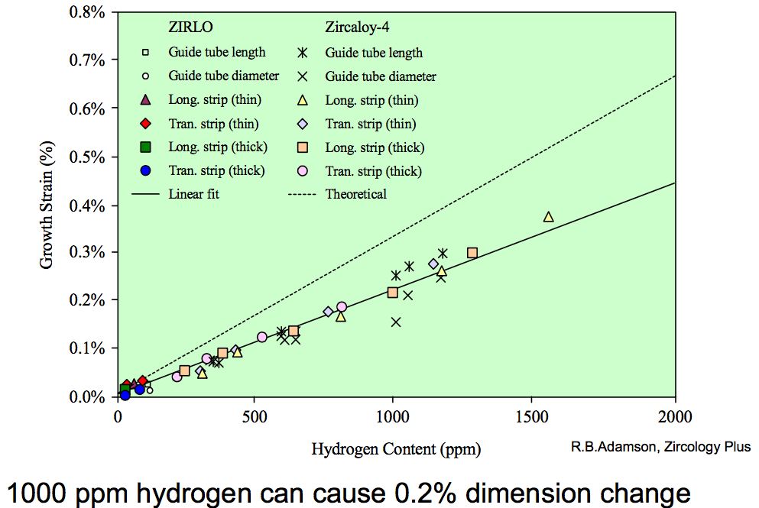
Zirconium Hydrides
Hydrides cause size change because the hydride lattice is larger than the zirconium lattice
There are a number of different Zr-H phases and morphologies that can present
0.1% H can cause 0.2% growth

Slide 5
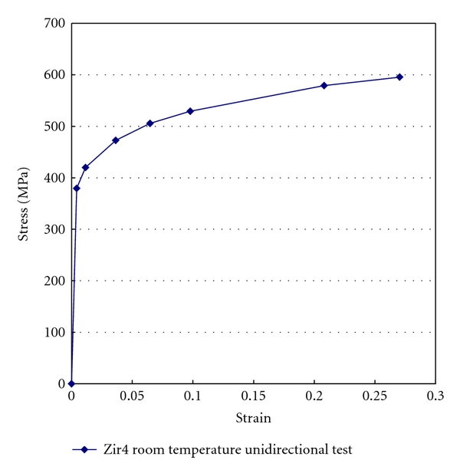
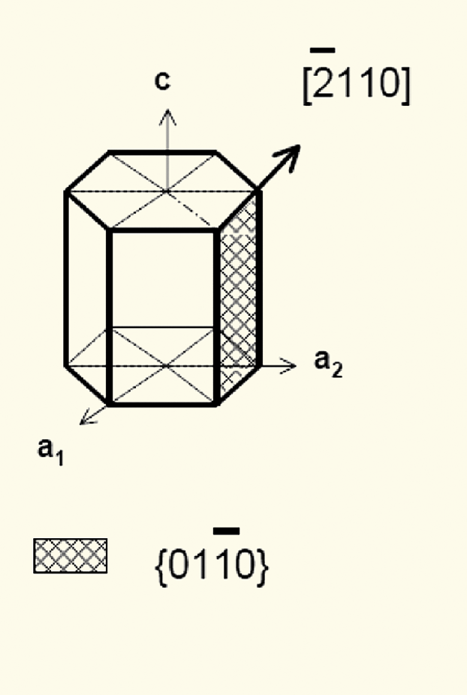
Mechanical Behavior of Zr Cladding
Zirconium alloys plastically deform primarily due to dislocation motion on prismatic planes

Slide 6
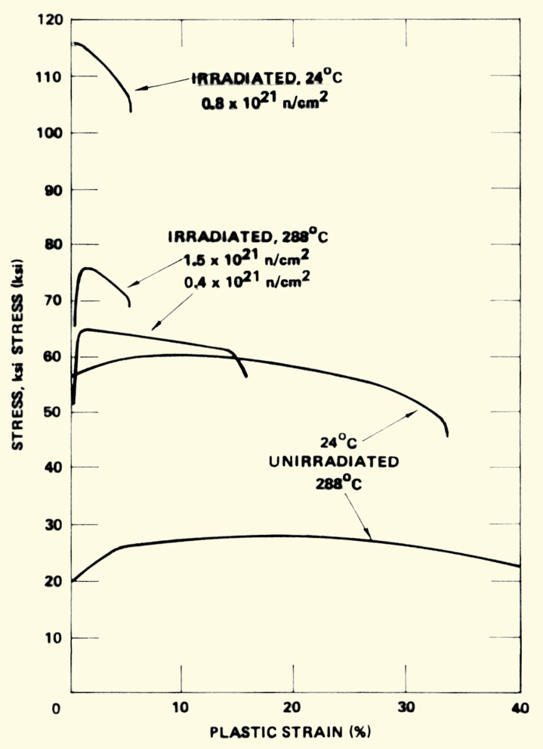
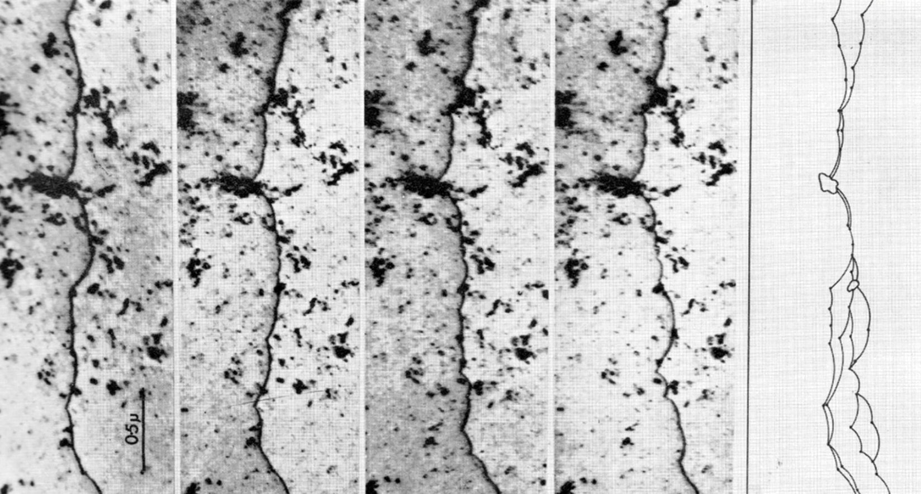
Irradiation Hardening
Under irradiation, the interstitial loops that buildup on the prismatic planes cause hardening
The UTS goes up with fluence, while the total elongation goes down
dislocation is moving

Slide 7
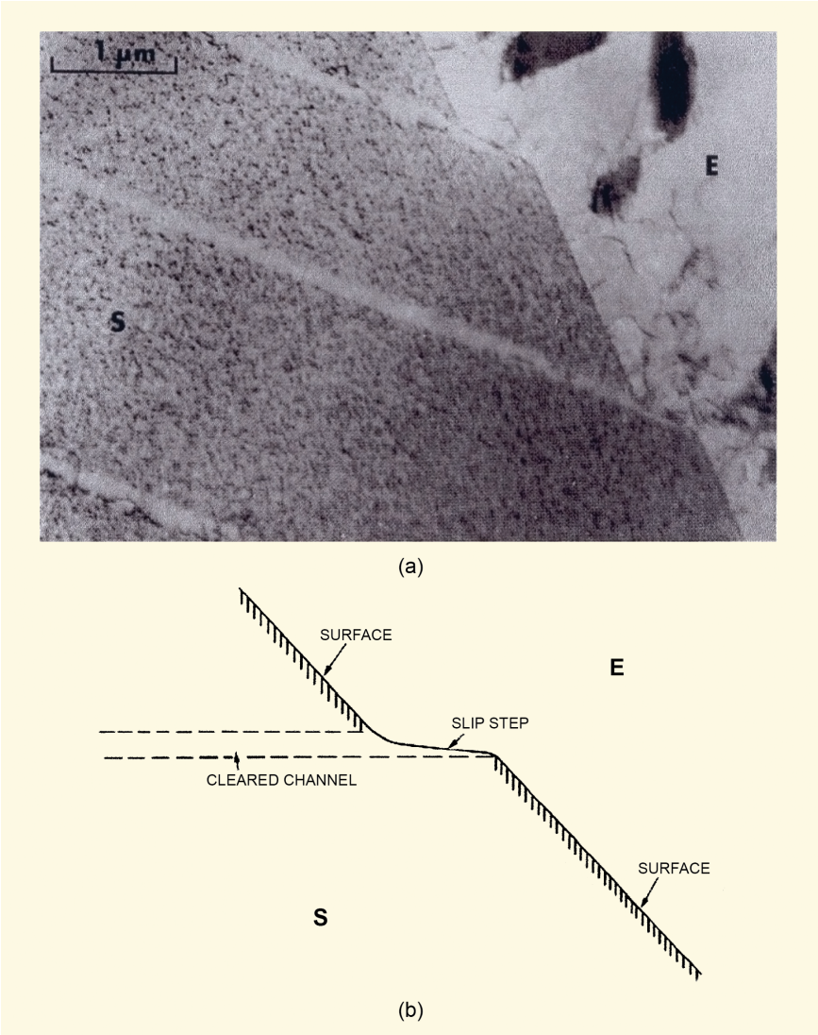
Dislocation Channels
When stress is high enough, loops are “swept away”, forming a clean channel
Once a channel is cleaned out, dislocations continue to move along it
This results in lots of deformation in that one area, creating slip steps
In HCP zircaloy, channels form on basal planes or prismatic planes depending on
Load direction
Temperature
Oxygen content in the alloy
Fluence

Slide 8
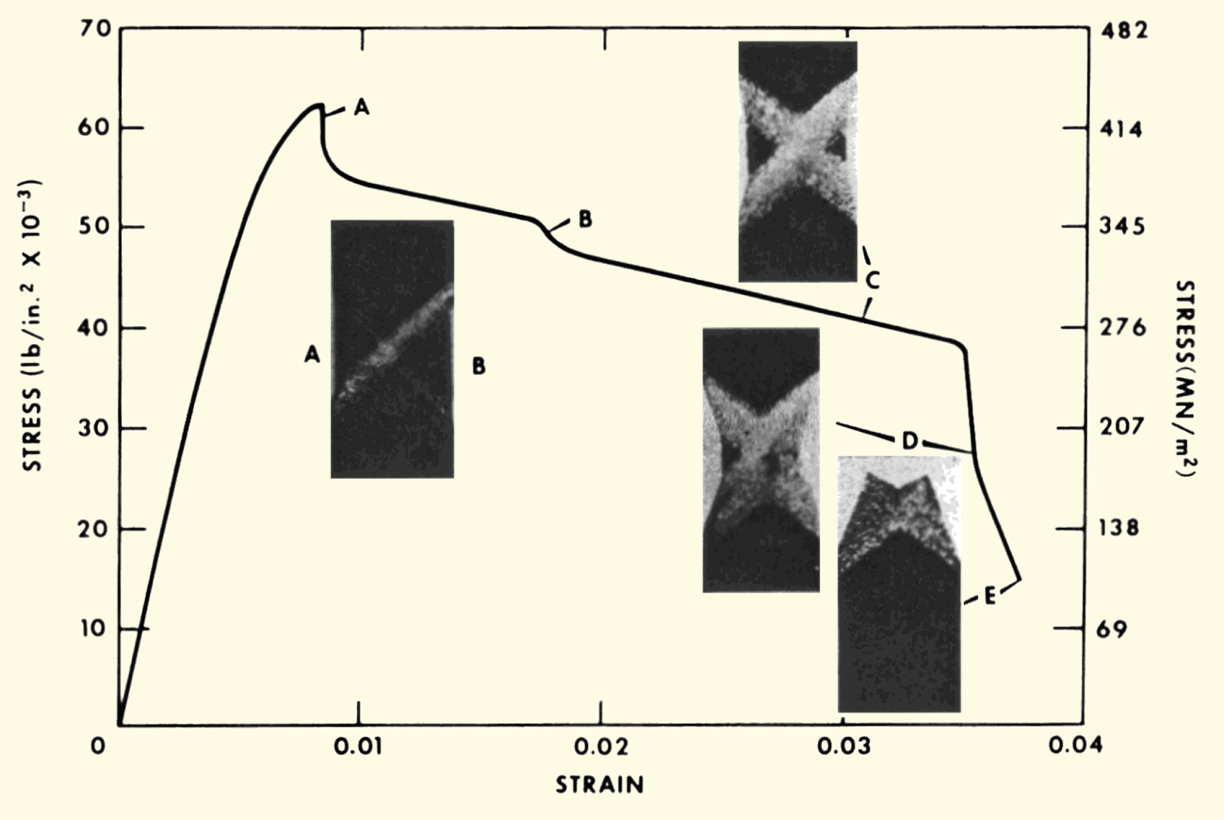
Dislocation Channels
Channel formation is an important behavior in irradiated zircaloy
Increases the effective ductility in high irradiated material
Dislocation channel deformation occurs at high load or high fluence

Slide 9
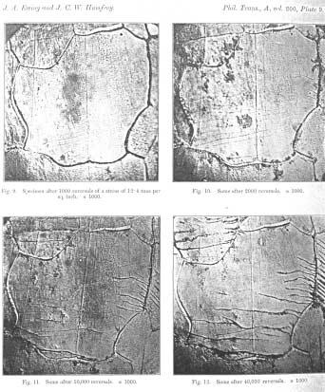
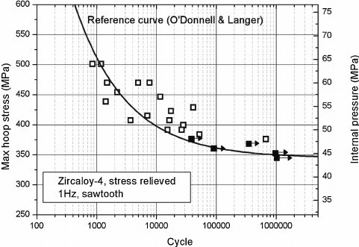
Fatigue
Material fatigue is the weakening of a material caused by repeated applied loads
Materials under cyclic loading can experience brittle-like fracture at stresses significantly below their UTS
It is caused by the slow propagation of microstructure damage
The engineering tool for investigating fatigue is the S-N curve
An S-N curve is a graph of the magnitude of the cyclic stress (S) against the logarithmic scale of cycles to failure (N)

Slide 10
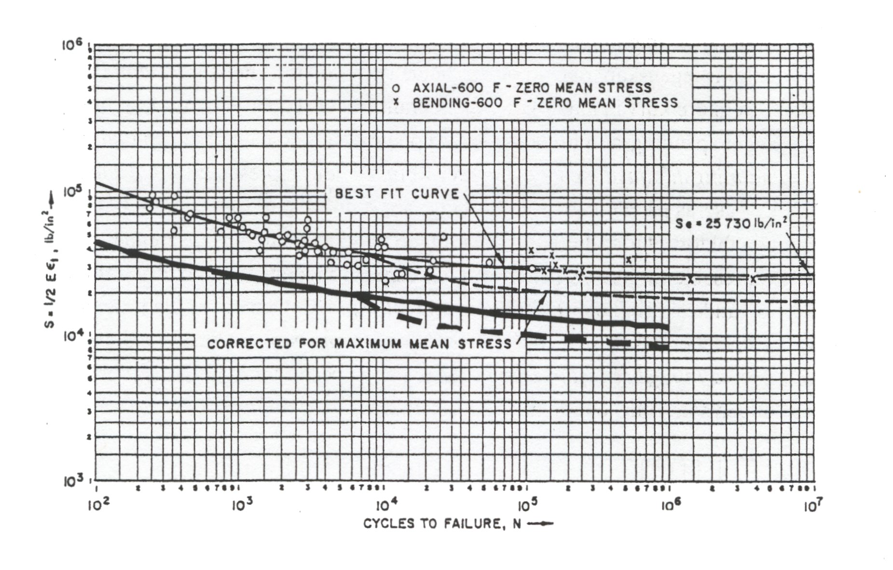
Zr Fatigue
Zircaloy experiences fatigue like other metals
Zircaloy has a fatigue limit at about 10⁵ cycles at 180 MPa (The UTS is >500 MPa)
Irradiation slightly lowers the fatigue life in the low cycle range, to less than about 10⁴ cycles
Irradiation has no effect on the fatigue life on the high cycle (lower stress) range, greater than about 10⁵ cycles
Design must demonstrate a factor of safety of 2 on stress and 20 on cycles

Slide 11
Summary
Zirconium has a number of favorable properties that make it suitable for a cladding material
Fabrication processes tailor the microstructure, relieving damage from forming
Growth and creep are the major mechanisms for dimensional changes in zirconium alloy cladding
Zr can fail via fatigue cracking and safety limits are imposed to not exceed stress or cycles

Slide 12
Pellet Cladding Interaction (PCI)
PCI includes both mechanical (PCMI) and chemical interaction (PCCI), often seen in a more general sense FCMI and FCCI
The process of PCI involves the combination of high internal mechanical stress in the cladding and a corrosive environment resulting from the accumulation of volatile fission products in the fuel-clad gap
These conditions may lead to the initiation and propagation of radial cracks, which can penetrate through the cladding
Frequent PCI failures were observed in the 1960s and 1970s, leading to extensive research efforts
Altering operational procedures, modifying the manufacturing process of the cladding, adding a composite layer and/or applying a protective coating to the inner cladding surface can help mitigate these failures

Slide 13
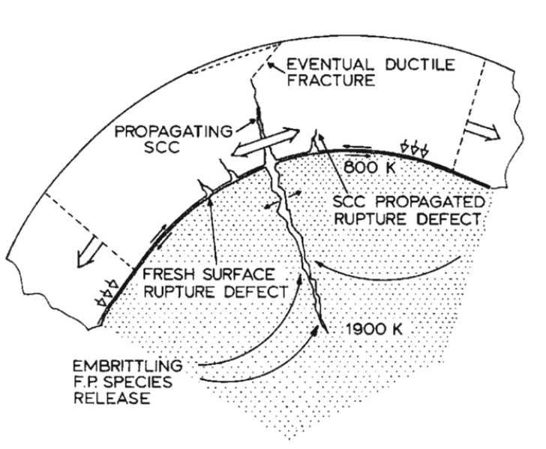
Physical Phenomena in PCI
The fuel thermally expands and swells
The cladding undergoes thermal and irradiation-induced creep
Mechanical interaction between the fuel pellet and cladding generates radial compressive stresses in addition to tensile hoop stresses
Volatile fission product gases are released into the gap
The cracking of the fuel pellet together with non-uniform thermal expansion resulting in preferential contact at the pellet interfaces increases local mechanical stresses in the cladding

Slide 14
Stress Corrosion Cracking (SCC)
Alloys that are in a corrosive environment may develop cracks that would not otherwise develop in the absence of either stress or the corrosive environment – stress corrosion cracking (SCC)
Stress corrosion cracks may propagate along intergranular (IG) and/or transgranular (TG) paths
The propagation modes of these cracks may depend on the localized mechanical and chemical conditions that lead to SCC
In order for SCC to initiate and propagate in any material, four conditions are simultaneously required:
A corrosive environment, a susceptible material, sufficient stress, and sufficient time

Slide 15
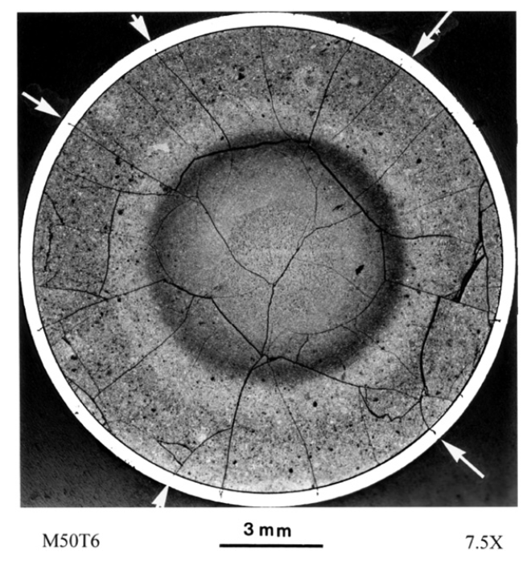
Corrosive Environment
Chemically aggressive fission products accumulating in the fuel-clad gap form an important component of the corrosive environment
Primary corrosive species are the volatile fission products, such as iodine (I), cadmium (Cd) and cesium (Cs)
Corrosive species can diffuse down the temperature gradient through fuel cracks
A higher local concentration of fission gases exists near the fuel crack and SCC is more likely to occur in the adjacent cladding region

Slide 16
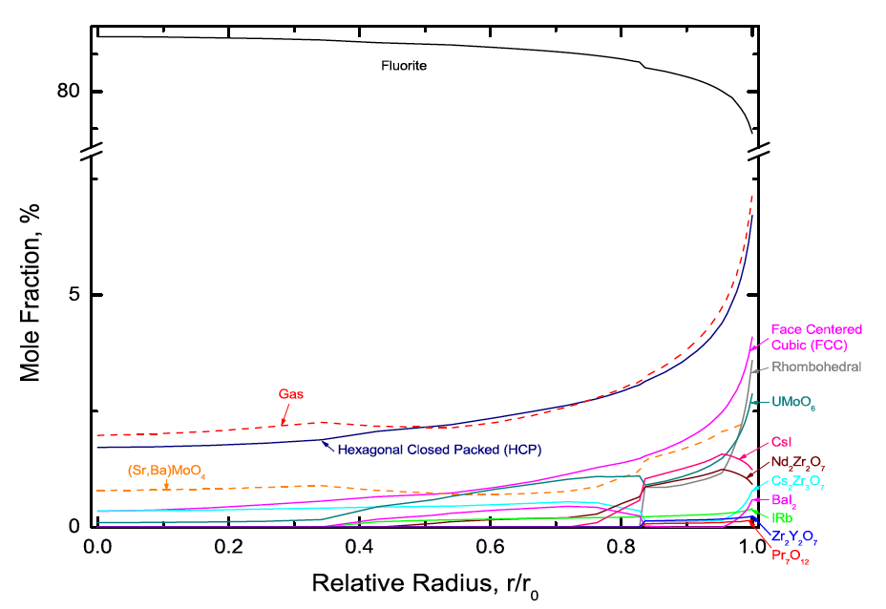
Corrosive Environment
The ability of fission product atoms to be transported through the fuel to the fuel-clad gap depends on several factors, including its physical state
The mobility of fission gases is markedly different than solid state diffusion
The relative amounts of I and other chemical elements in the gaseous phase depend on the local fuel chemistry, which varies spatially
The figure illustrates the predicted effects of fuel chemistry, in particular the predicted spatial distribution of phases in highly irradiated PWR UO2 fuel, whereby the chemical behavior on the fuel surface is of particular interest

Slide 17
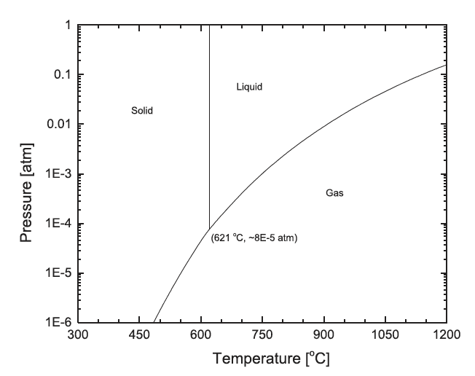
Corrosive Environment
The dominant I containing solid phase that is predicted to be thermodynamically stable on the fuel surface is CsI
Since typical fuel surface temperatures during normal operating conditions are of the order of 350–450 C and the hydrostatic pressure is greater than 1 atm, one would expect that solid CsI would be stable in the fuel-clad gap
The radiolytic decomposition of CsI increases the iodine partial pressure in the gap by many orders of magnitude
CsI

Slide 18
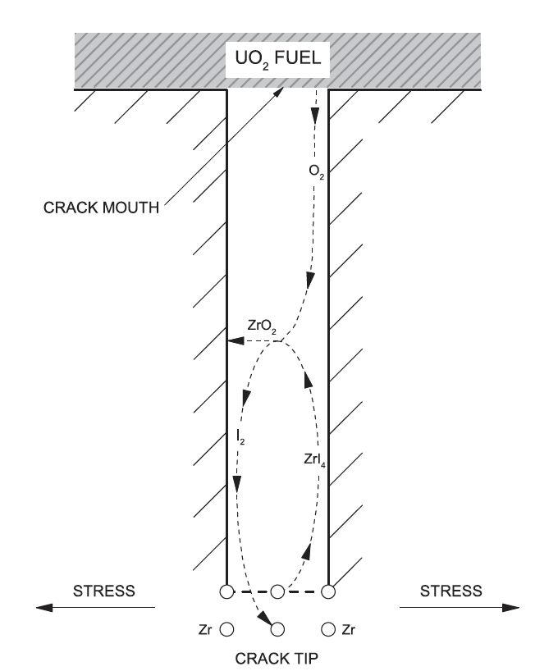
Corrosive Environment
The chemical interaction of liberated I (and possibly other elements) with the cladding is of great importance in crack initiation
A zirconium iodide gaseous species migrates up the temperature gradient towards the crack mouth, whereby the high affinity of Zr for O may result in ZrO2 formation, and decomposition may once again liberate I2 gas
The deposition of ZrO2 on the crack walls is believed to create a passivation layer, which further localizes I encroachment at the crack tip

Slide 19
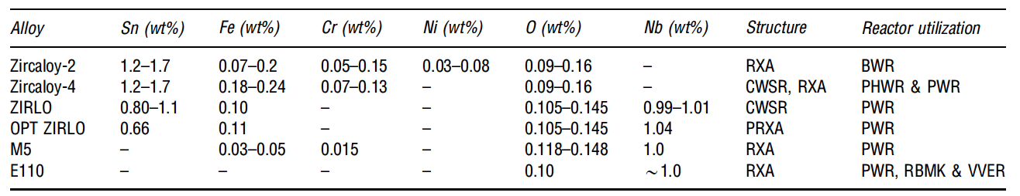
Susceptible Material
The susceptibility of the cladding to SCC can be influenced by many factors, including the composition, microstructure, texture, and irradiation damage of the cladding, and the presence of an oxide passivation layer, which protects the metal from chemical attack
All zirconium alloy cladding materials used in commercial power reactors are prone to PCI failure
Minor compositional changes have been shown to offer slightly different performance characteristics

Slide 20
Susceptible Material
The initial motivation of alloying zirconium with small amounts of tin was to offset the loss of corrosion resistance resulting from the introduction of nitrogen impurities during fabrication
The control of impurities during manufacturing have significantly improved since the introduction of these alloys, making the addition of unnecessary
The addition of niobium to these zirconium alloys increases the strength of the cladding while providing higher irradiation creep resistance and has exhibited elevated corrosion resistance, which is desirable for higher burnup fuel
All Zr alloys are somewhat equally susceptible to SCC cracking following prolonged irradiation

Slide 21
Sufficient Stress
The stress on the cladding depends on the external coolant pressure and creep, in addition to the stress imposed internally by the fuel
The fuel pellet structurally deforms as a result of the following mechanisms: thermal expansion, solid and gaseous fission product swelling, thermal and irradiation-induced creep, irradiation-induced densification and cracking
The fuel thermally expands almost immediately in response to an increase in temperature, whereas the contributions of creep and fission product swelling are longer term and depend on burnup
UO2 fuel is typically fabricated with an initial porosity of 3%–5% to accommodate fission products
The benefits of this with respect to minimizing SCC are twofold: first, the effect of swelling is diminished by solid fission products filling internal voids; second, initial pores provide sinks for fission gases, thus impeding their release to the fuel-clad gap

Slide 22
Reducing Internal Pressure
The initial grain size of the fuel, which evolves with burnup, affects fission gas release, among other factors
Since intragranular fission gas diffusion occurs at a much slower rate than intergranular diffusion, larger grain sizes impede the overall release of fission gases to the fuel surface
Reducing fission gas release with large grained fuel is less effective with increasing linear powers from 50-65 kW/m
As an undesired consequence to improved fission gas retention with large grained fuel, fission product swelling can be more pronounced

Slide 23
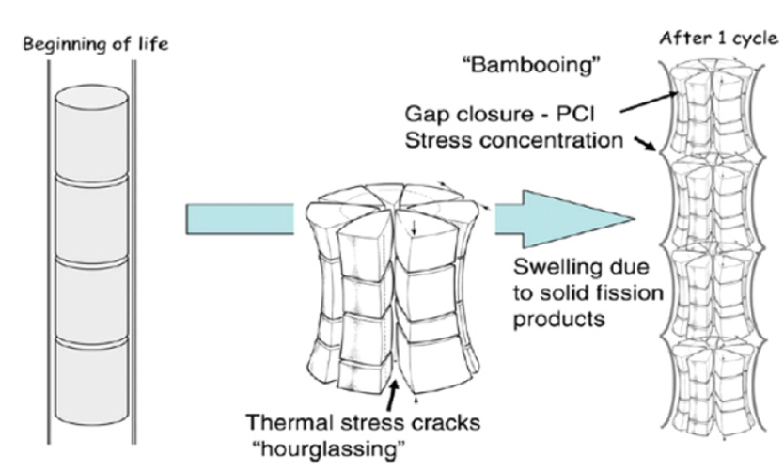
Pellet Deformation
The large thermal gradients in the radial direction, and a lesser extent in the axial direction, contribute to non-uniform thermal expansion, which results in a shape that resembles an hourglass
Pellet cracking due to thermal stresses further contributes to the hourglassing effect
The edges of cylindrical pellets induce large local stress concentrations in the cladding when the pellet-clad gap closes with the enhanced risk of perforation

Slide 24
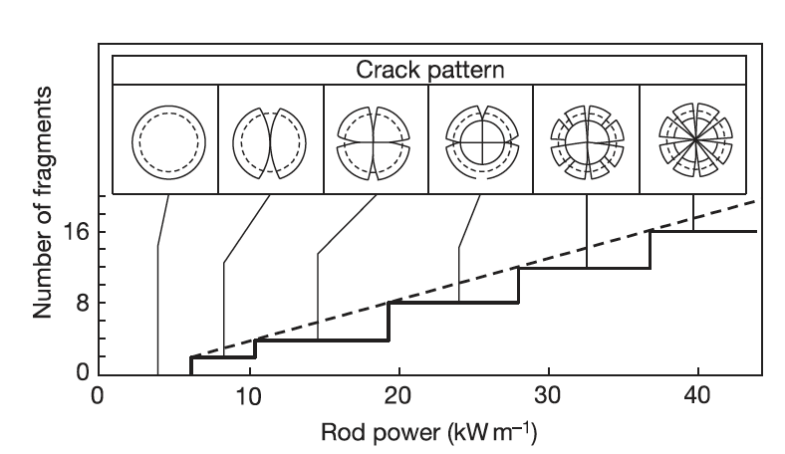
Fuel Cracking
Fuel pellets experience varying degrees of fracture due to large internal stresses induced by thermal expansion that exceed the fracture strength of UO2
The fracture strength varies from 80 to 150 MPa and is strongly influenced by pellet microstructure, which decreases with respect to porosity, pore size, and grain size
The number of fuel cracks generally increases with larger thermal gradients, thus the number of cracks in the fuel increases with respect to linear power

Slide 25
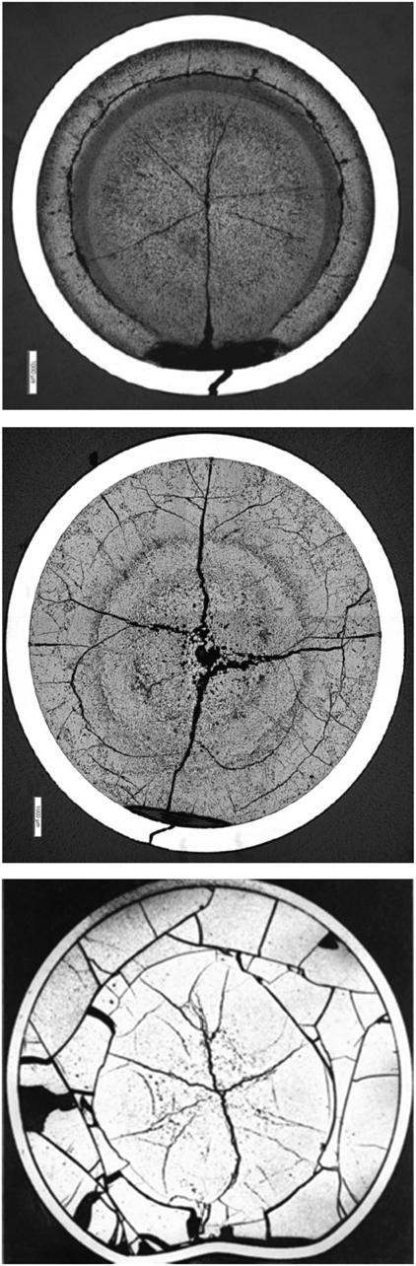
Missing Pellet Surface
Several failures have been experienced in LWRs in the early 2000s due to physical defects in the fuel, often due to chipping, which is often referred to as a Missing Pellet Surface (MPS)
The cladding eventually creeps down onto the fuel, except in the vicinity of the MPS
A local stress concentration is experienced in the cladding adjacent to the MPS as a result of the bending moment that is induced by non-uniform contact coupled with an expanding pellet
The increased local concentration of corrosive fission product species together with enhanced local stresses elevates the risk for SCC failure
PWR
BWR
PHWR

Slide 26
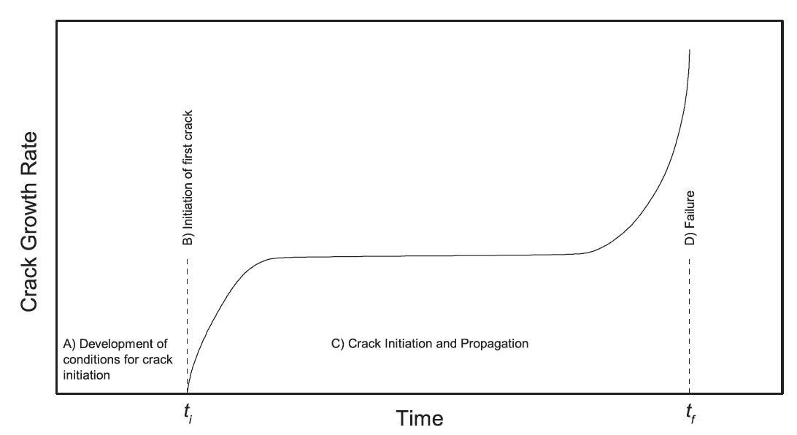
Sufficient Time
A sufficient duration of time is required for SCC to develop in the cladding
The SCC process can be divided into four stages:
Development of the corrosive environment and the surface conditions required for SCC to initiate,
Initiation of SCC,
Propagation of SCC, and
Failure
The SCC-induced crack will typically propagate through the majority of the cladding wall, and then the remaining ligament typically fails by ductile shear

Slide 27
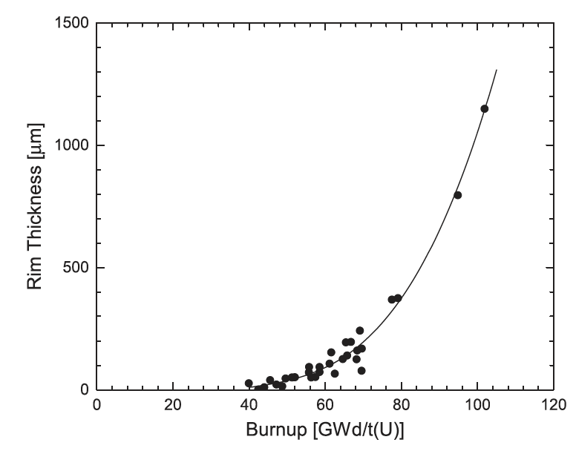
Effect of Burnup
The period of time to establish the conditions for SCC is related to burnup, and is complicated by the numerous mechanisms associated with changes in both the fuel and cladding during the course of irradiation
The mechanisms with relevance to SCC that become more pronounced with burnup include irradiation damage to the cladding, fission product swelling, fission gas release, and formation of a High Burnup Structure
The local burnup in the rim region can be 2–3 times greater than the integral burnup in highly irradiated fuel, which means that the local concentrations of fission and activation products in the rim region are considerably higher, which have a direct influence on the fuel surface chemistry

Slide 28
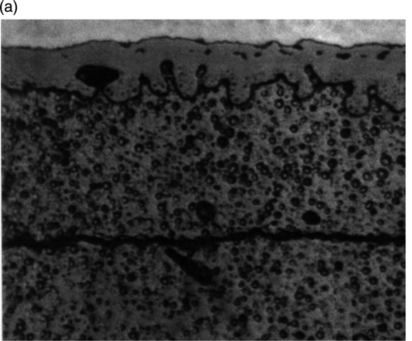
Rim/HBS Region
In medium burnup fuels, an internal zirconia layer 6–12 mm thick forms on the clad inner wall as soon as pellet-clad contact occurs
The coverage of the clad internal surface by zirconia tends to extend progressively with further irradiation and gap closing
High burnup fuel shows the development of a very effective pellet-clad bonding characterized by an intimate mixing of U and of the internal zirconia layer
Pellet-clad bonding, has been observed and seems to be controlled by the irradiation duration at closed pellet-clad gap

Slide 29
Summary
Pellet-clad interaction (PCI) takes two forms
Pellet-clad chemical interaction, PCCI (bonding occurs)
Pellet-clad mechanical interaction, PCMI (pellet pushes and drags cladding)
In order for SCC to initiate and propagate in any material, four conditions are simultaneously required:
A corrosive environment, a susceptible material, sufficient stress, and sufficient time
BWRs more likely to have PCI failures than PWRs
Two types of mitigation strategies to limit PCI failures

