Slide 1
Nuclear Fuel Performance
NE-533
Spring 2026

Slide 2
Housekeeping
Exam 2 graded
average: 85.5
stdev: 18
5-point curve
MOOSE feedback will be out by the end of the week

Slide 3
MOOSE Project Part 2
0.5 cm
0.1 cm
0.005 cm
Fuel pin dimensions listed – 2D RZ
Assume reasonable values for thermal conductivities, T dependent
Utilize axial T_{cool}, with T_{cool}^{in}= 500 K, reasonable flow rate, heat capacity, etc.
Utilize axial LHR, with LHR⁰=350 W/cm
Solve temperature profile for cladding surface, fuel surface, fuel centerline
Find axial location of peak temperatures
Make sure you are instituting an appropriate mesh!
2 m
Fuel
Gap
Cladding

Slide 4
MOOSE Part 2 Writeup
Will upload input and output files to Moodle
Write up with deliverables from Part 1 & 2, choice of materials, mesh, details therein, etc.
Expected to have fixed any issues with Part 1
If any major changes to Part 1 files, include them in submission
Part 2 writeup max of 10 pages
Due April 7

Slide 5
Last Time
Wrapped up Zr cladding overview
Zr hydrides can form and lead to dimensional change; Zr alloys undergo substantial irradiation hardening; Dislocation channels can extend the ductility of the cladding; Discussed Zr fatigue
Pellet cladding interaction (PCI)
Mechanical, chemical, and combined effects
Stress corrosion cracking: cracks only develop with both stress and the corrosive environment
corrosive environment, a susceptible material, sufficient stress, and sufficient time
Corrosive environment
iodine liberated from CsI interacts with Zr metal, forms ZrI4, then interacts with O2, forms ZrO2, releases I2 for more corrosion
Susceptible materials
all Zr alloys are susceptible, alloying can modify this slightly
Sufficient Stress
creep down, fuel expansion+swelling, cracks and defects, etc.

Slide 6
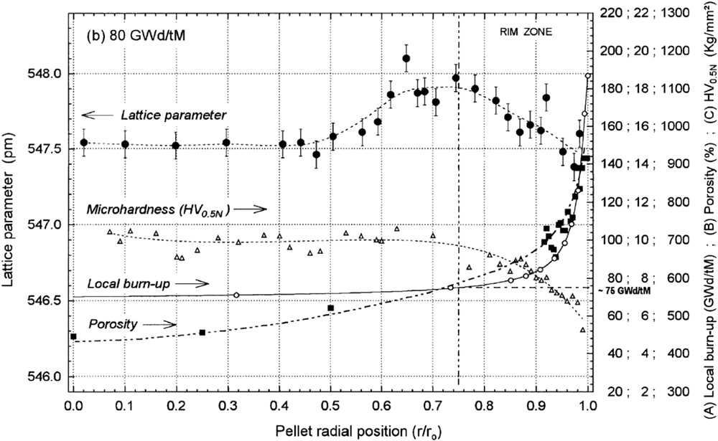
Rim/HBS Region
The HBS region has a much higher porosity (up to 30% locally) than the bulk of the fuel, which affects the mechanical properties
Microhardness measurements show a reciprocal trend of the strength with porosity
The softening of the fuel surface might be beneficial in reducing mechanical stresses imposed by the fuel on the cladding at the point of contact

Slide 7
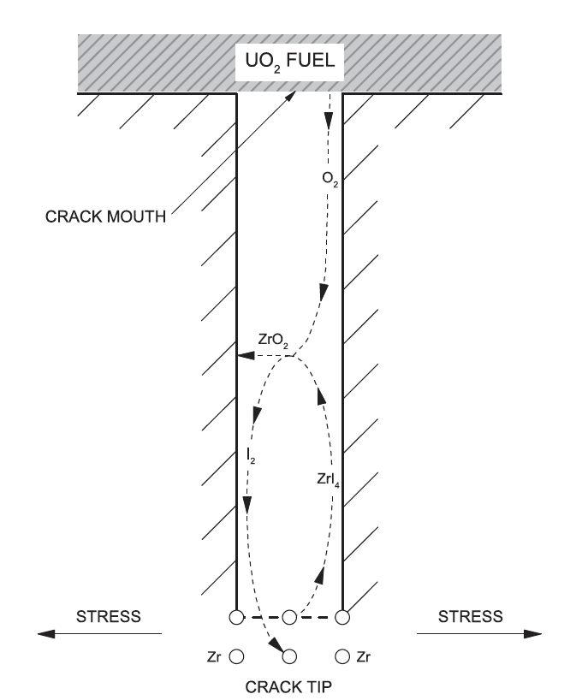
Incubation Time
The corrosive environment, represented by a sufficient inventory of chemically active fission gases in the gap, not only depends on burnup, but the ability of these gases to chemically attack the cladding
This environment requires that the normally protective oxide coating on the inner surface of the cladding is breached, thus permitting corrosive species to chemically react with the bare cladding
The incubation time reflects the time required for a flaw in the protective oxide to be developed and for sufficient ZrI4 to form in the cladding, resulting in the development of cracks

Slide 8
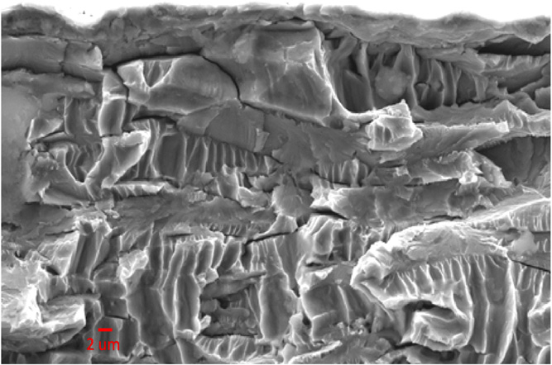
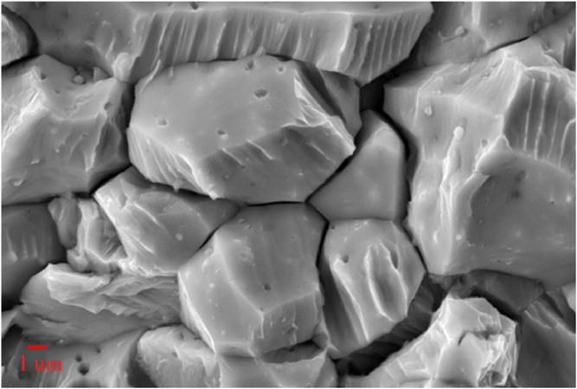
Crack Propagation
Transgranular
Once a crack has initiated, it can propagate through the cladding wall with a sufficiently high applied load
Both intergranular and transgranular propagation modes are possible
The propagation rate is a linear function of the stress intensity factor, K_{SCC}, and is independent on the propagation mode for sufficiently high K_{SCC}
The increase in iodine content generally increases the crack propagation rate
Increasing temperature results in decreasing the susceptibility to PCI failure, while neutron irradiation has been found to increase susceptibility
Intergranular

Slide 9
Through-Cracks
Following the formation of a through-wall crack and the ingress of water into the fuel-clad gap, the cracking process is arrested since the corrosive species (notably I, Cs, and Cd) have been discharged
The ingress of water in the fuel-clad gap may result in clad hydriding on the inner surface
The initial SCC crack can oxidize, and volume expansion may lead to resealing the primary failure
All PCI cracks are pin-hole defects, whereas observable cracks are secondary due to clad hydriding or ductile tearing
The time to failure depends on many parameters, but is generally determined by the local linear power, the change in linear power, and the local burnup

Slide 10
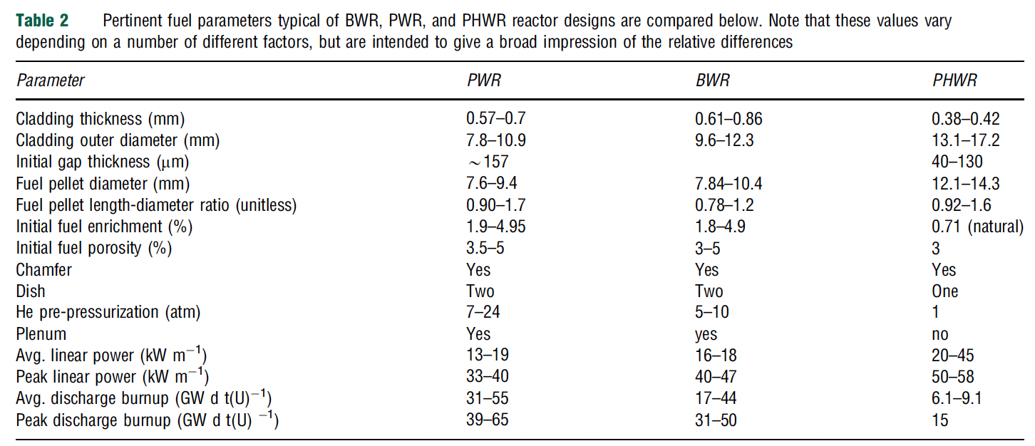
Reactor Susceptibility
All current PWR, BWR and CANDU reactors utilize UO2 fuel, zirconium alloy cladding, and are water cooled
The degree of susceptibility of each reactor and fuel design to PCI rests on numerous design specifications
PWRs have smaller fuel diameters, BWRs have the thickest cladding
The geometric design has an influence on the stresses in the fuel and cladding
Linear power affects the temperature, which impacts a variety of other phenomena
Discharge burnup influences the inventory of fission products in the fuel/cladding interface

Slide 11
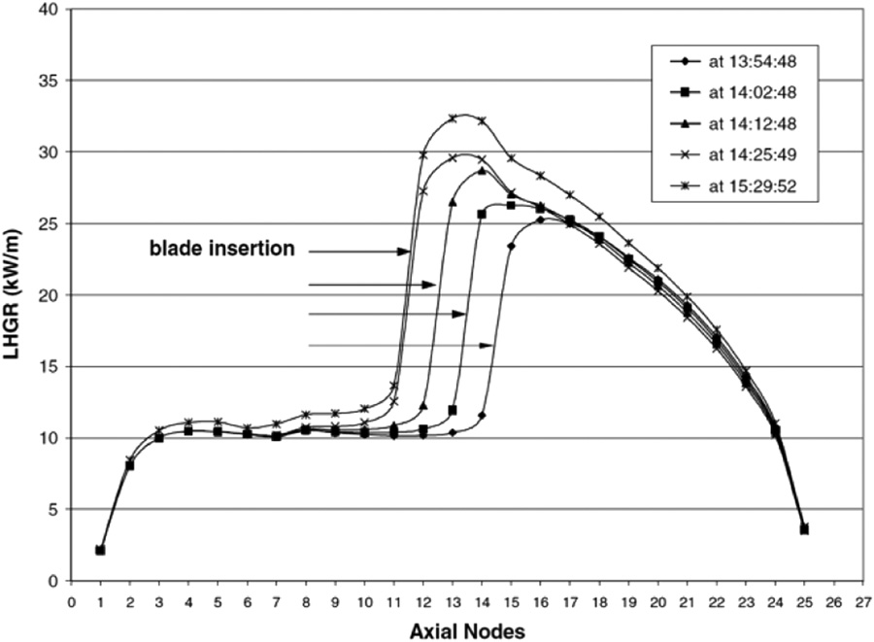
Reactor Susceptibility
In general, PCI failures are typically experienced (by any reactor) during a large change in power; thus, the manner in which power changes dictates to a large degree the likelihood of PCI failure
Unlike BWRs, the neutron flux in a PWR is not primarily controlled by the insertion and extraction of control rods during operation
Due to smoother control of reactivity and a lower linear power, PCI failures are significantly less frequent in PWRs than other major commercial power reactor designs
PCI failures are more of a concern in BWRs
Control blade maneuvers in BWRs create local power transients that often lead to PCI failures in fuel rods adjacent to these blades
The change in LHR resulting from the successive removal of three control rod blades

Slide 12
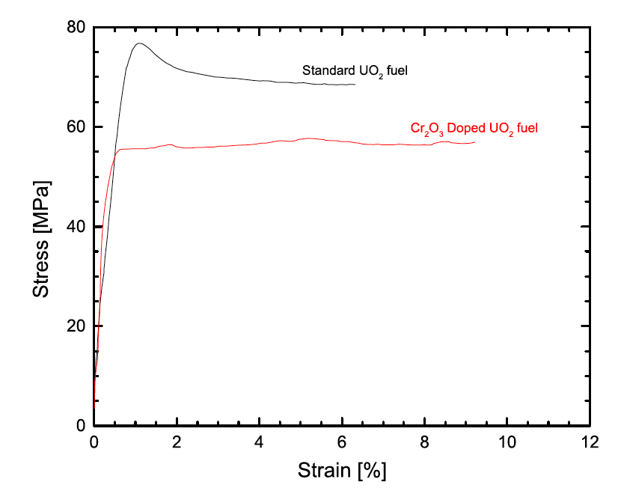
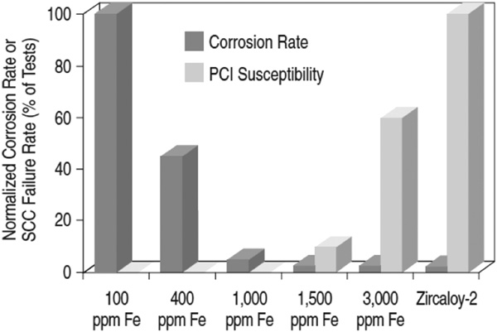
PCI Mitigation
There are two primary approaches to mitigate PCI failures: 1) changes in the design of various components – notably, the fuel pellet, fuel cladding, and fuel assembly; 2) the manner in which the reactor is operated can be altered to minimize PCI failures
The design of fuel has changed to better optimize performance and reliability, including modifying the fuel pellet geometry, microstructure (i.e., grain size and porosity), and composition (i.e., initial O/M, minor additives)
Many design changes of the cladding have been investigated, including the development of small grain sizes and texture control, alloy composition, inclusion of an inner liner and the application of a pellet-clad interlayer

Slide 13
PCI Mitigation
Fuel assembly designs for all reactor types are constantly evolving as assemblies/bundles are improved to increase operational economics
A continuing trend in design evolution is sub-division of the fuel into smaller diameter elements/rods to increase the total number of elements/rods, which increases assembly/bundle power without a corresponding increase in UO2 temperature, thus mitigating thermally driven fuel failure mechanisms
Other changes in general fuel assembly/bundle design include variations on fill gas pressure, presence and design of plenums to collect fission gases, changes to appendage design to improve CHF, general optimization of rod end regions in the reactor to mitigate end-flux-peaking
Operational mitigation: The three variables that are controlled from an operational point of view are the linear power, change in linear power, ramp rate and discharge burnup

Slide 14
End of Module 3

Slide 15
Module Review
Radiation damage effects in UO2
thermal conductivity degradation, high burnup structure formation, etc.
Chemistry of the fuel
charge state, O/M ratio, impact on properties, etc.
Fission products
five groups, impact fuel properties, impacted by chemistry
Fission gas release
three stages, Booth model, Forsberg-Massih, etc.

Slide 16
Module Review
Fuel swelling and dimensional change
thermal expansion, fission product swelling, creep, densification
Zirconium cladding
processing, irradiation growth, creep, hydrides, hardening, etc.
Pellet/Cladding Interaction
SCC

Slide 17
Problem Session

