Slide 1
Nuclear Fuel Performance
NE-533
Spring 2026

Slide 2
Housekeeping
Last module!
Planned last exam on April 23
Will cover what we can until then

Slide 3
MOOSE Submission
bsub < submission.script
#!/bin/bash
#BSUB -n 12
#BSUB -J moose_test
#BSUB -W 02:00
#BSUB -o out.%J
#BSUB -e err.%J
export OMP_NUM_THREADS=1
source ~/.bashrc
conda activate /usr/local/usrapps/ne533s26/bwbeeler/moose
mpirun -np 12 /usr/local/usrapps/ne533s26/beeler_moose/beeler_moose-opt -i test.i
conda deactivate

Slide 4
cladding oxidation

Slide 5
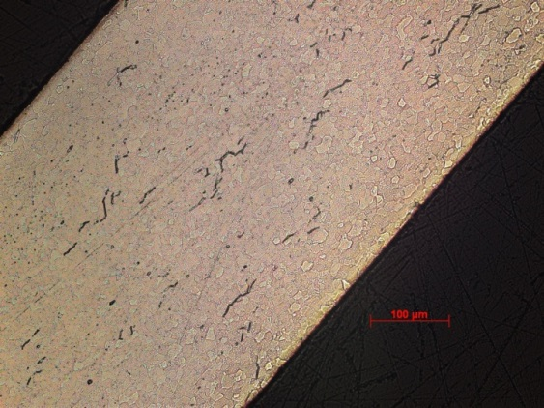
Zirconium Oxidation
Corrosion of zirconium due to the water coolant is one of the largest concerns for LWR fuel operation
Corrosion of zirconium alloys in an aqueous environment is principally related to the oxidation of the zirconium by the oxygen in the coolant, dissolved or produced by radiolysis of water
Zirconium interacts with water to make zirconia and hydrogen
Both the oxide layer and the hydrogen adversely impact cladding performance
ZrO₂
Zr metal

Slide 6
Corrosion
Corrosion is the degradation of a material and its properties under the action of the surrounding environment by chemical and/or electrochemical reaction
Corrosion reactions require the following:
Oxidant
Electric current
A corrosion reaction is composed of an oxidation reaction and a reduction reaction
During corrosion at a particular spot on the surface of the object, oxidation takes place, and that spot behaves as an anode
The electrons released at this anodic spot move through the metal and go to another spot and reduce H, which behaves as a cathode

Slide 7
Corrosion
Corrosion reaction rates are determined by thermodynamics and kinetics
Thermodynamics tell us whether a material may corrode
Measure voltage difference between anodic and cathodic sites
Kinetics tell us how quickly a material will corrode
Measure net current between anodic and cathodic sites

Slide 8
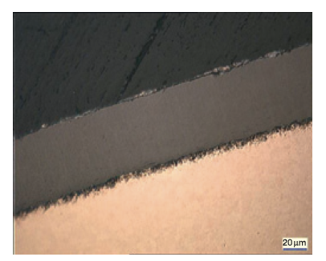
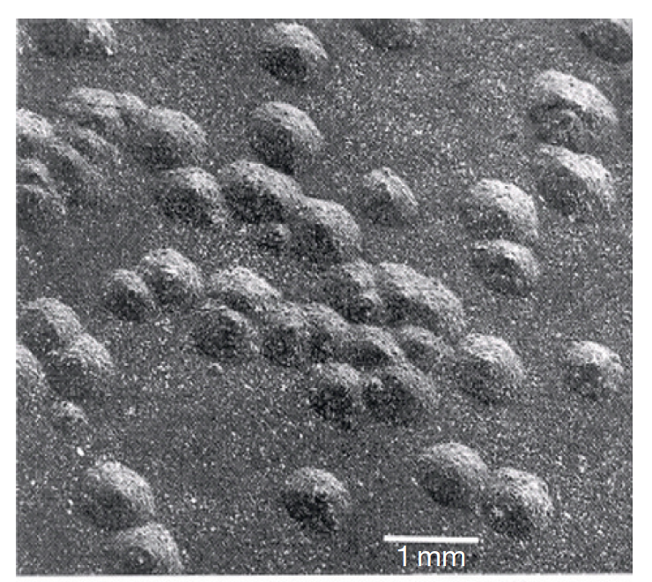
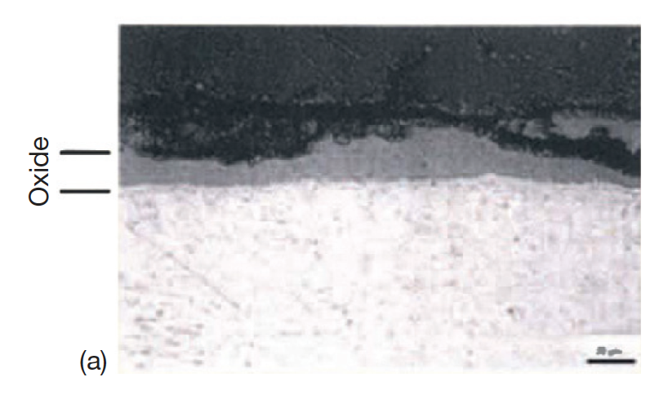
Corrosion Types in LWRs
Several types of corrosion morphologies have been observed in nuclear reactors and in autoclave experiments, of which the most important are: 1) uniform, 2) nodular, and 3) shadow
Uniform: The formation of a thin uniform layer of zirconium dioxide on the surface of a zirconium alloy component
Nodular : The formation of local, small, circular zirconium oxide blisters
Shadow: The formation of local corrosion regions that mirror the shape (suggestive of a shadow) of other nearby noble reactor core components

Slide 9

Formation of Oxide Layer After Oxide Formation
H₂0
Zr
H₂0
ZrO₂
Zr
O⁻²
e⁻
Oxidation reaction:
Dissociation of water at oxide/water interface
Absorption of oxygen into oxide layer
Diffusion of oxygen through oxide layer
Reaction of oxygen with zirconium
Diffusion of electrons through oxide layer
Reduction of hydrogen
Reduction reaction:

Slide 10
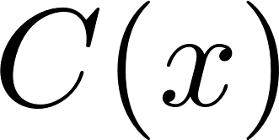
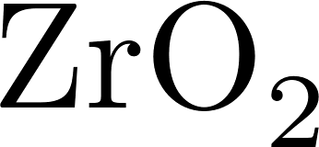

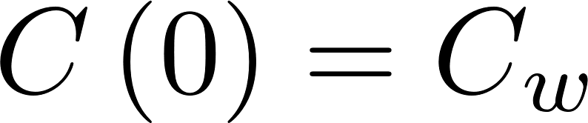
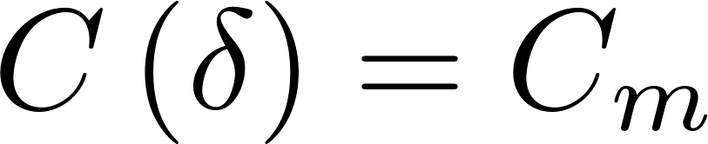

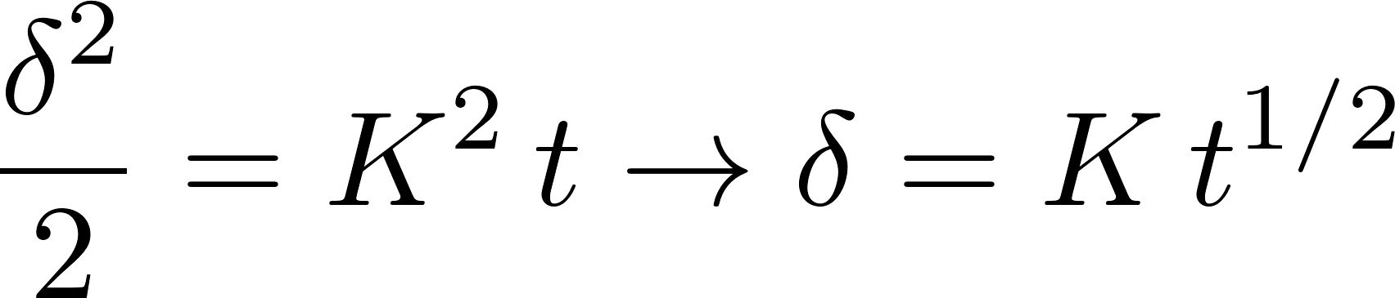

Corrosion rate limited by diffusion
Because the rate limiting steps are diffusion, we can model the oxidation rate using diffusion
Assumptions:
Transport of O species is rate-limiting
Transport of charged species by diffusion only
Homogeneous oxide layer
No sources/sinks of ions in oxide
All oxygen is used to create oxide
No loss of oxide

Slide 11
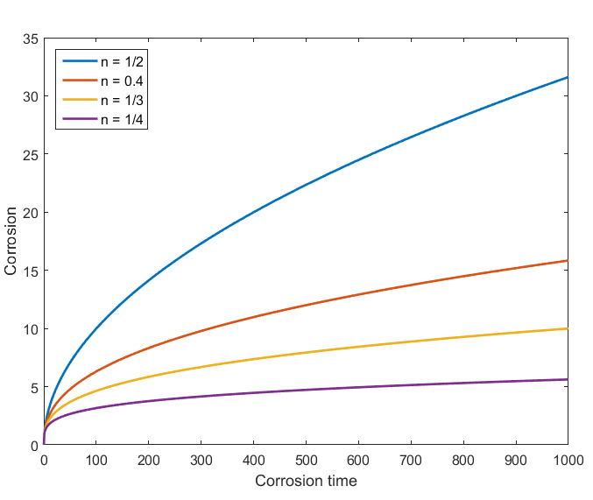
Observed kinetics are slower than parabolic
Parabolic kinetics
Diffusion of species across the oxide
Sub-parabolic kinetics
Additional ions, dopants, or defects in oxide
Non-uniform electric field in oxide layer
Once a nonhomogeneous electric field arises, the corrosion rate decreases to the sub-parabolic rate due to inhibition of transport of charged species
Ideally, corrosion slows as oxide layer gets thicker

Slide 12
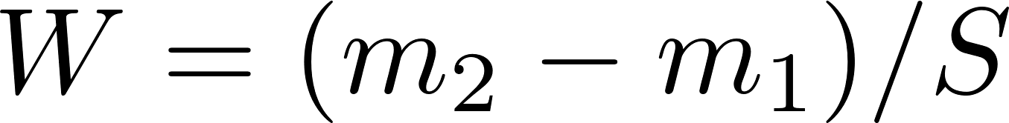
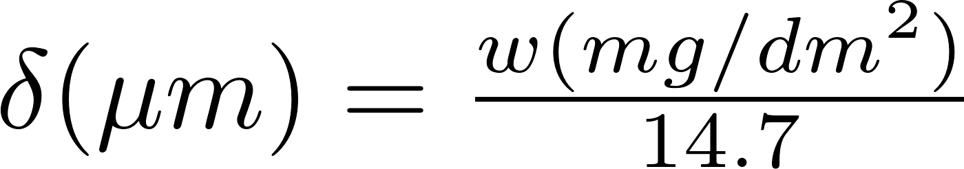
Corrosion Quantified
This example is for static corrosion testing
Corrosion is measured by sample weight gain
Oxidation of alloys is measured experimentally using the weight gain in mg/dm²
Oxide forms by incorporating oxygen in the metal structure causing an increase in weight
14.7 comes from density of O in ZrO2
Approximation weight gain – oxide thickness for Zr:
Dividing by the surface enables comparison between samples

Slide 13
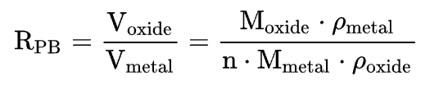
Pilling-Bedworth ratio : PBR
The ratio of the volume per unit of the metal oxide to the volume per unit of the corresponding metal is called the Pilling-Bedworth ratio (PBR)
PBR < 1: the oxide coating layer is thin, likely broken and provides no protective effect (for example magnesium)
PBR > 2: the oxide coating chips off and provides no protective effect (example iron)
1 < PBR < 2: the oxide coating is passivating and provides a protecting effect against further surface oxidation
Passivation refers to a material becoming "passive," that is, less affected or corroded by the environment
ZrO₂
Zr metal

Slide 14
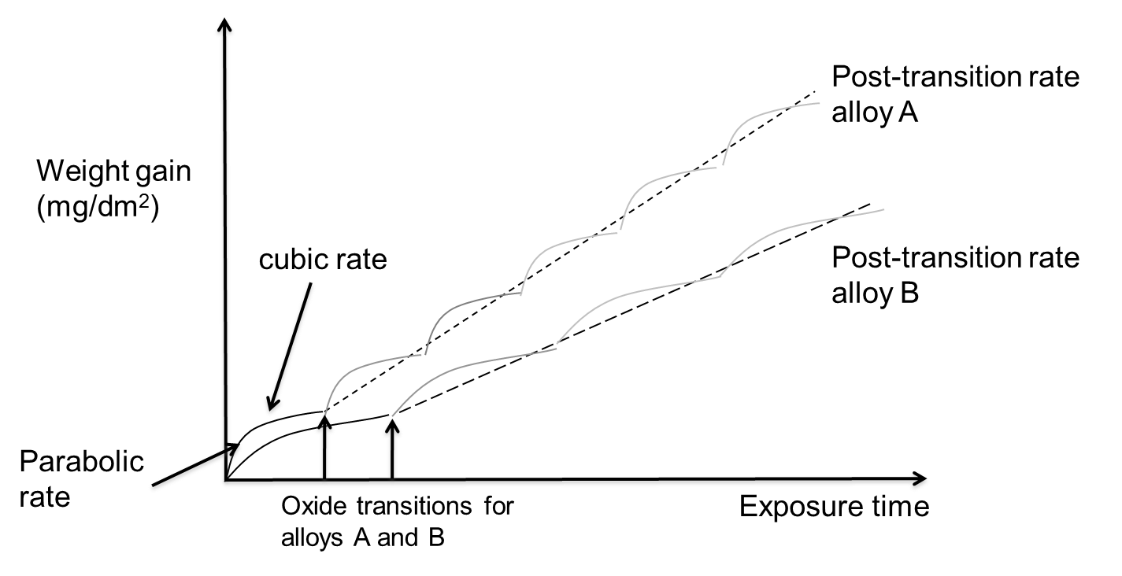
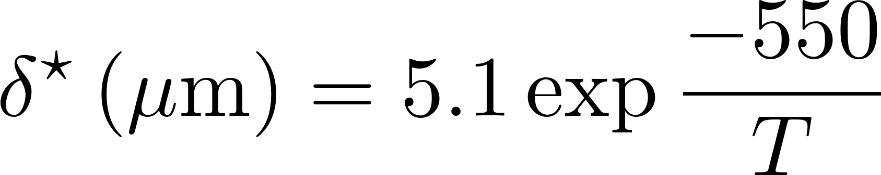
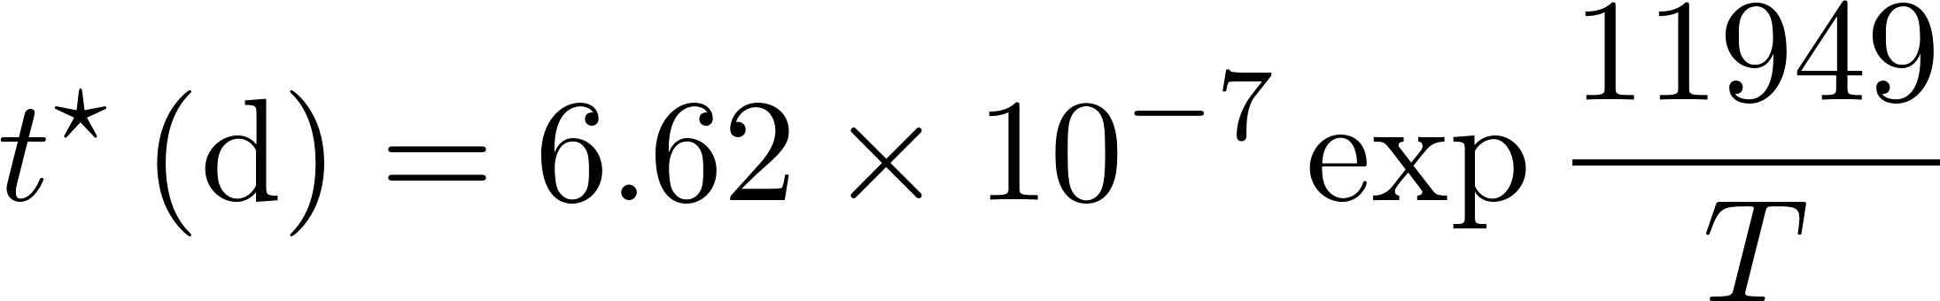
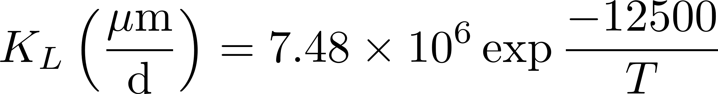
Corrosion Rate
Average weight gain of a sample post-transition follows linear kinetics
The oxide reaches transition at different times in different points, but the average is linear
This stepped kinetics relates to the oxide layer losing its passivating properties
Somewhat unique to Zr alloys
Critical oxide thickness for transition is defined as
Critical time for transition is defined as
After transition, oxide thickness is

Slide 15
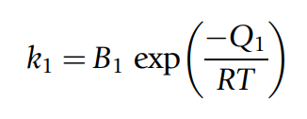
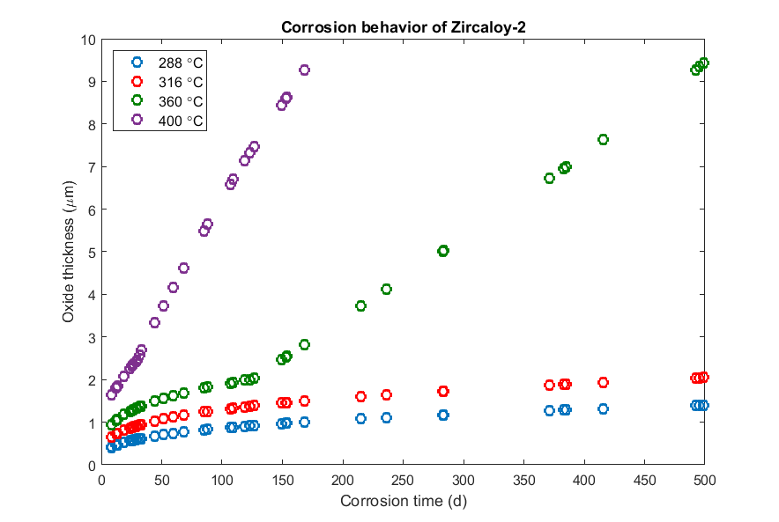
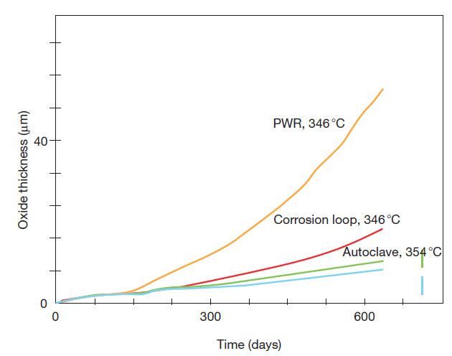
Other factors affecting corrosion
Temperature:
Corrosion rate increases with temperature
Irradiation: Radiation damage to the metal; Radiation damage to oxide
Increases corrosion rates

Slide 16
Impact of Corrosion
The oxide layer has a low thermal conductivity, restricting heat transport
For Zircaloy, k = 22 W/(mK)
For ZrO₂, k = 1.7 – 2.7 W/(mK)
The oxide layer is much more brittle than the zircaloy
Zircaloy metal is removed as brittle oxide is added to the material
Oxidation produces hydrogen that can enter the cladding and form brittle hydrides

Slide 17
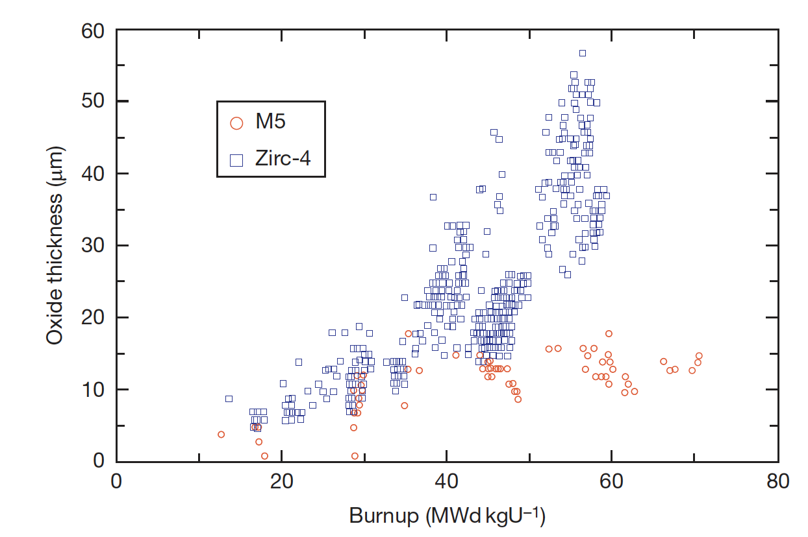
Corrosion Control
The oxidation and hydrogen uptake of Zircaloy is of course determined by many factors
The chemical and physical state of the material: composition, metallurgical condition, and surface condition
Two different zirconium alloys employed in French PWRs, Zircaloy and Zr1% Nb (M5), display distinct corrosion behaviors
The peak oxide layer thickness of Zircaloy-4 increases significantly with burnup, whereas that of Zr1%Nb shows a moderate increase

Slide 18
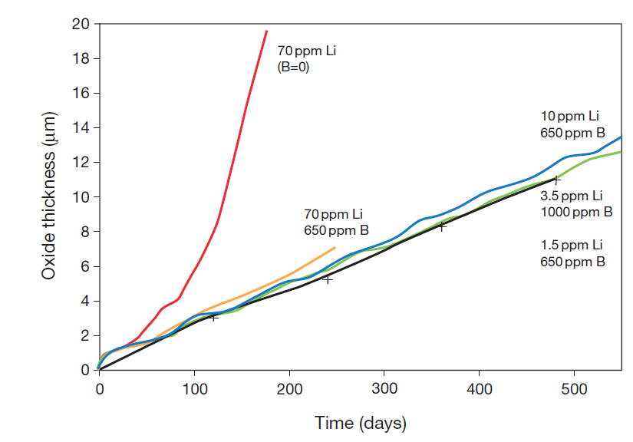
Corrosion Control
Water Chemistry
The dissolved oxygen and hydrogen play a major role in the corrosion process, but other dissolved species must also be taken into account
To control the pH of the coolant at slightly alkaline conditions, LiOH is added and H3BO3 (boric acid) is added for reactivity control in PWRs
Impurities (Cl, F) and coolant-borne species (Cu, Ni, etc.) must be considered
Temperature and irradiation also have an effect on the corrosion behavior, but are governed by engineering constraints
CRUD (Chalk River Unidentified Deposit) can accelerate corrosion

Slide 19
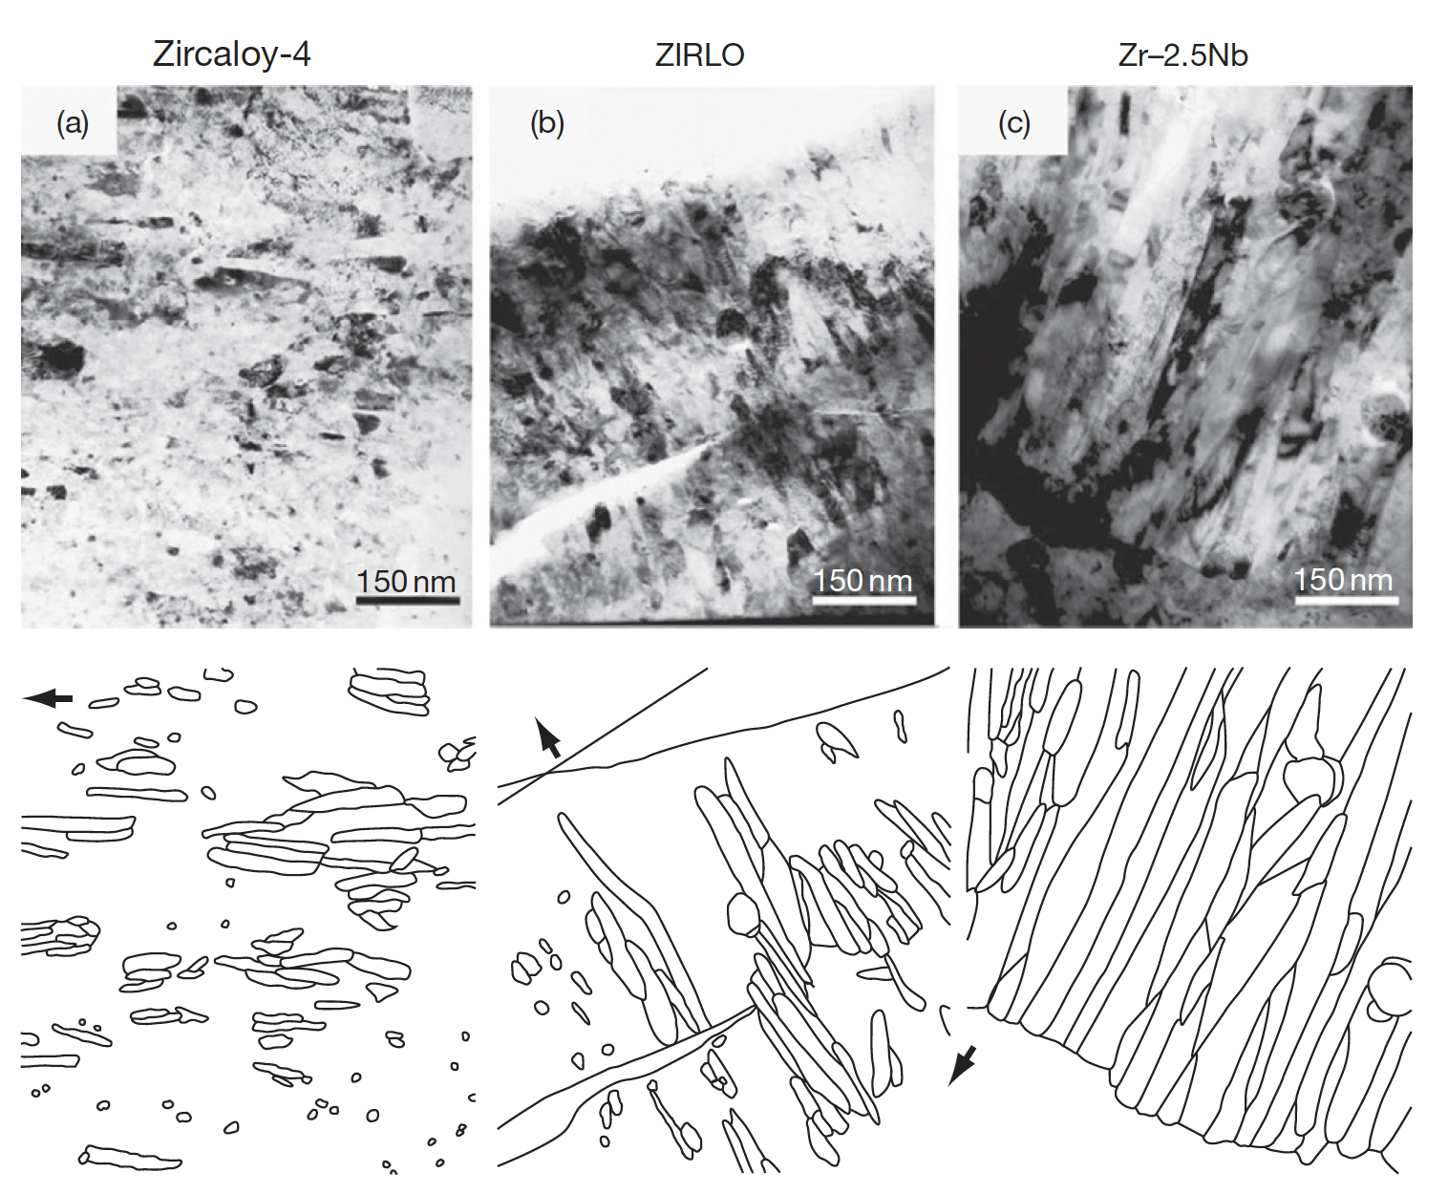
Corrosion Layer
Uniform corrosion is a passivating event since a protective layer of zirconium oxide is formed as a result of the reaction with the O2 ions or the OH radicals
The oxide layer is microcrystalline, initially equiaxed, later growing into columnar grains that are formed in a dense packing, of which the mean crystallite size increases as the oxide thickens

Slide 20
Corrosion Summary
Corrosion is the environmental degradation of materials
Cladding oxidizes, forming ZrO₂
The limiting step for oxidation is the oxygen transport through the oxide layer
It begins being controlled by diffusion
Then, a protective layer forms that slows oxidation
Once transition occurs, it loses its protectiveness and speeds up again
Oxidation hurts cladding performance by
Restricting heat transport
Converting zircaloy into a brittle oxide

Slide 21
Hydride Formation
Corrosion reaction:
Corrosion of zirconium is so damaging in large part due to hydride formation
Some of the hydrogen atoms produced by oxidation enter the cladding and form a hydride phase
Other sources of H can increase the amount available to form hydrides, but this is minor
Hydrogen pickup causes hydrogen embrittlement, loss of fracture toughness, delayed hydride cracking, accelerated corrosion, and accelerated irradiation growth
ZrO₂
Zr metal
Hydrogen pick-up

Slide 22
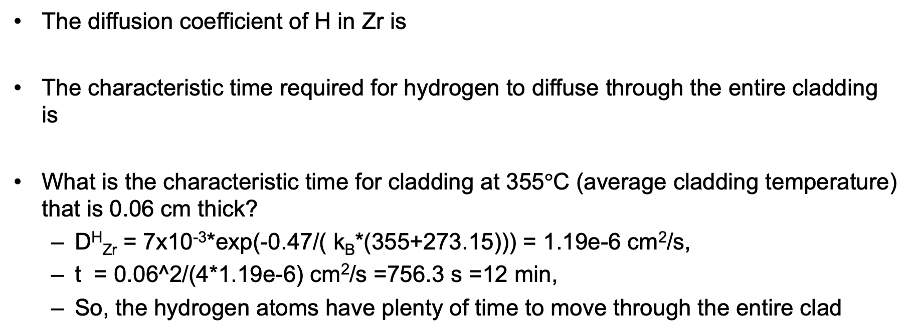
Hydrogen Diffusion
The diffusion coefficient of H in Zr is
The characteristic time required for hydrogen to diffuse through the entire cladding is
What is the characteristic time for cladding at 355$°$C (average cladding temperature) that is 0.06 cm thick?
D^{H}_{Zr} = 7x10⁻³*exp(-0.47/( k_{B}*(355+273.15))) = 1.19e-6 cm²/s,
t = 0.06^2/(4*1.19e-6) cm²/s =756.3 s =12 min,
So, the hydrogen atoms have plenty of time to move through the entire clad

Slide 23
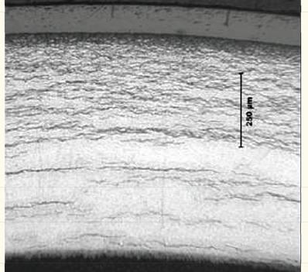
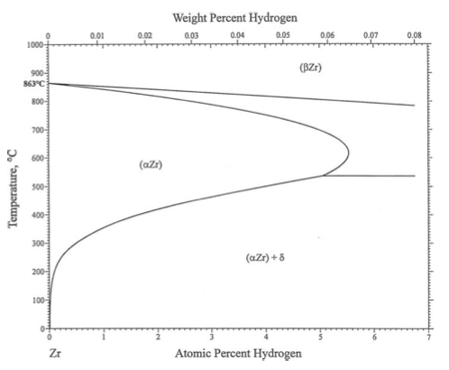
Hydriding
Hydride concentrations are not uniform, because they respond to temperature and stress gradients
Plate-type hydrides lead to stress concentrations, prefer matrix tensile stresses
Hydrogen tends to move toward lower temperature (Soret effect)
It also moves to areas with tensile stress
Hydrogen has a low solubility in zirconium, so even small hydrogen concentrations result in hydrides

Slide 24
Effect of Hydrides
The hydride rim is caused by the Soret effect and the temperature dependence of the solubility
The hydride rim and blisters can cause a loss of ductility, leading to earlier failure
Hydride rims are layers of uniform depth, that can reach 50–60 microns, and cover a wide area on the tube azimuthal and axial directions
If hydride is localized, can form blisters
Blisters have an elliptic shape, are more localized on the tube external surface and are deeper, usually covering half of the cladding thickness

Slide 25
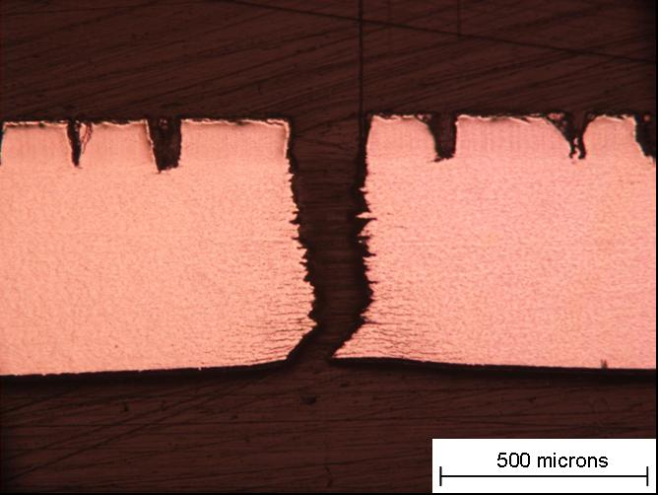
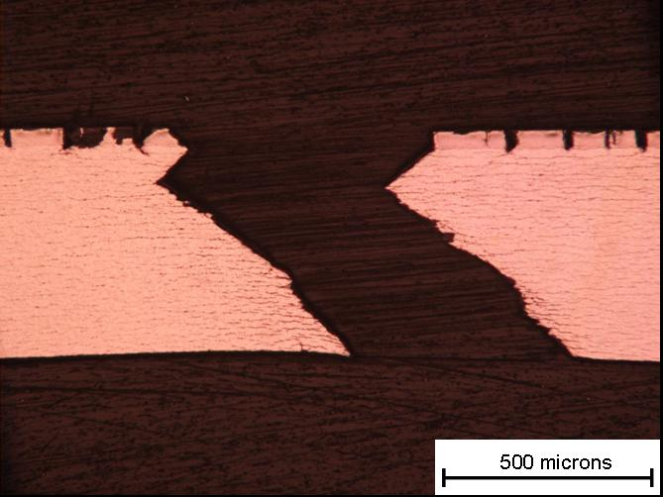
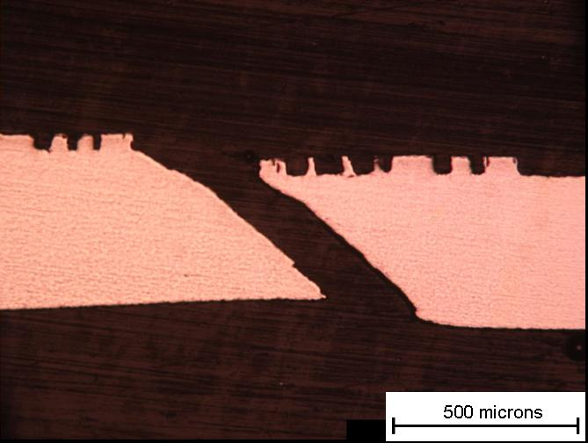
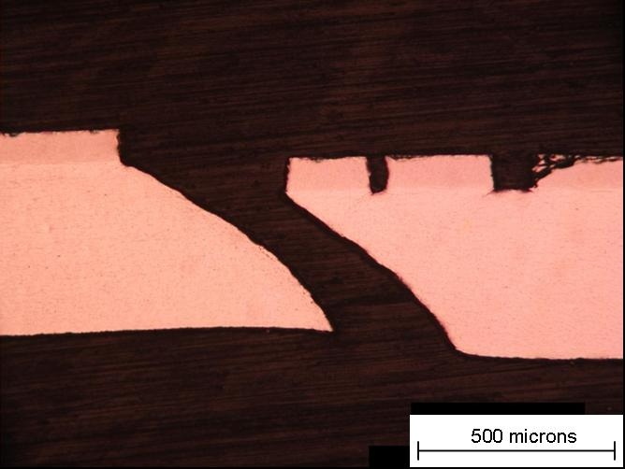
Blister failure examples
But in small blisters => shear instability
90 degree failure at RT
40 μm Blister Broken at 25 °C
M014
93 μm Blister Broken at 25 °C
M020
53 μm Blister Broken at 300 °C M025
83 μm Blister Broken at 300 °C M023
At 300 C, 45 degree shear
25

Slide 26
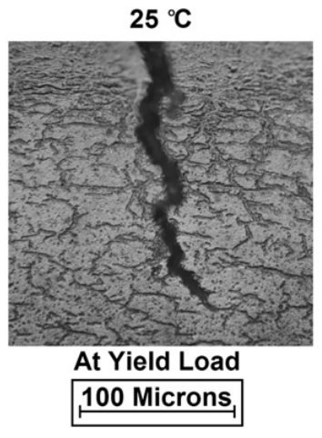
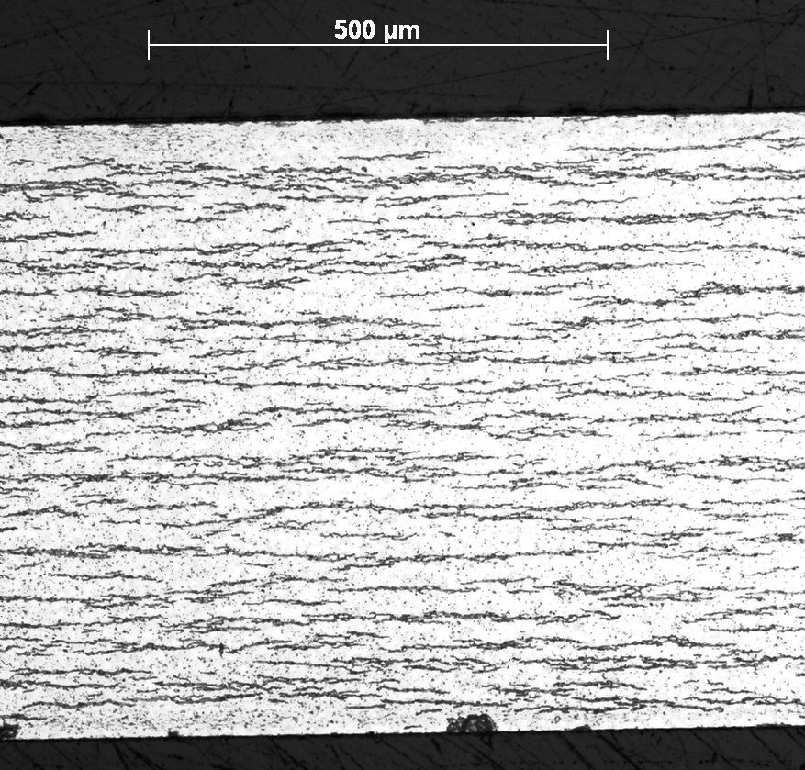
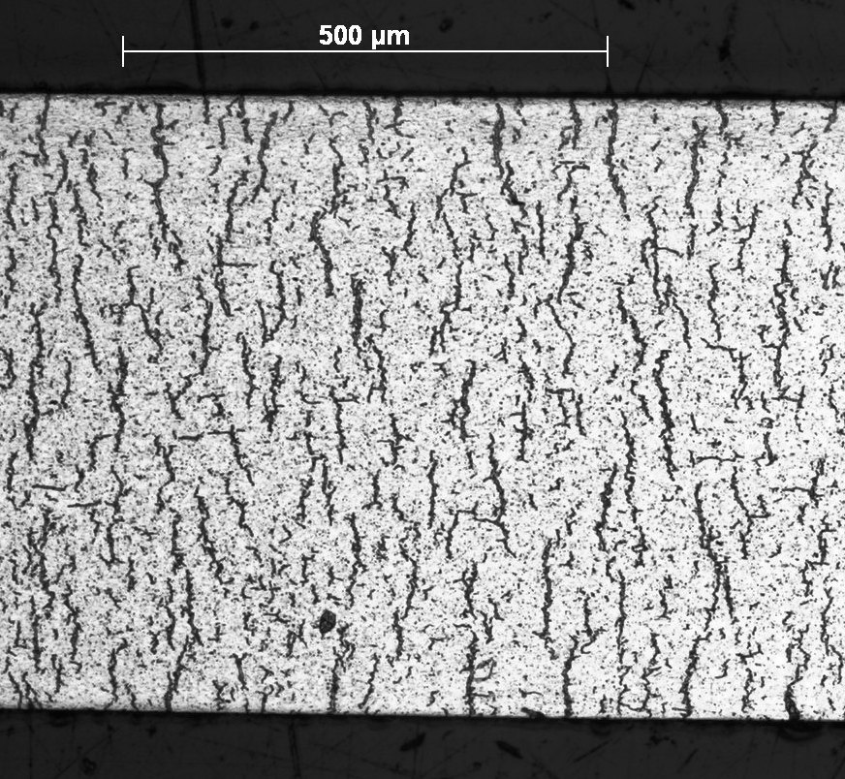
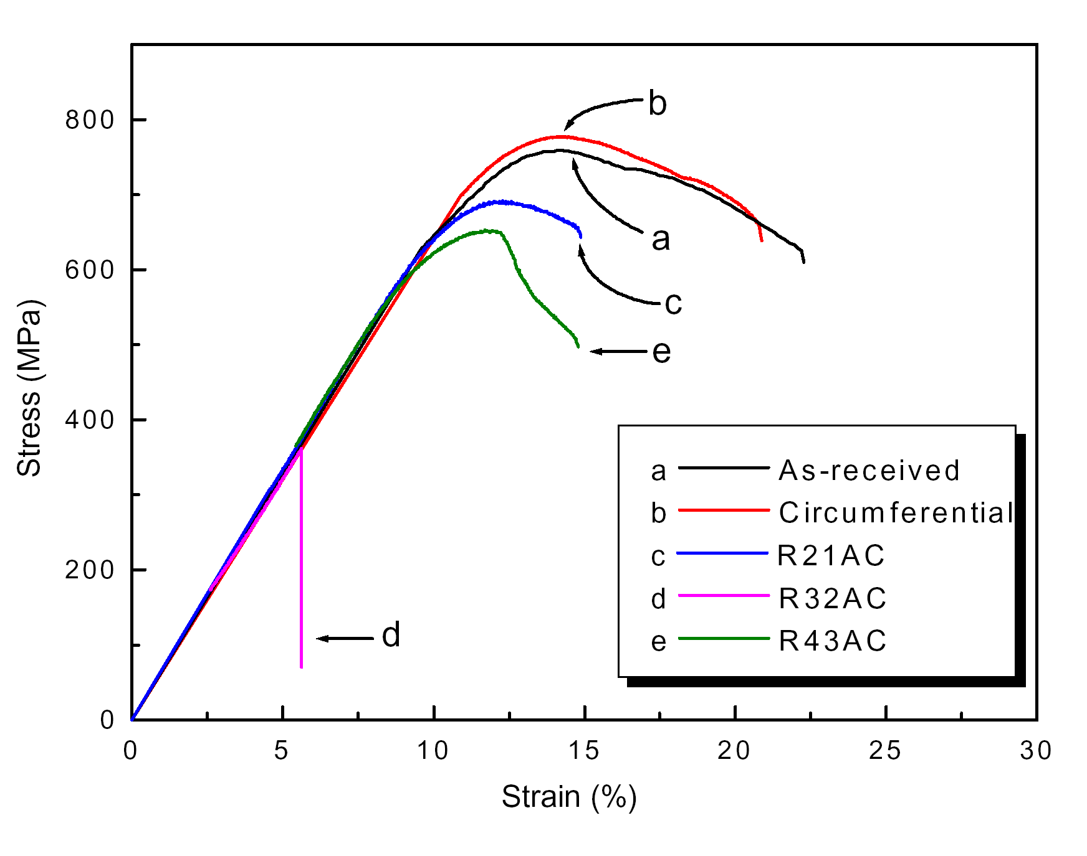
Circumferential vs Radial Hydrides
Under reactor conditions, hydride platelets precipitate circumferentially
In used fuel after drying, the hydrides can reprecipitate with a radial orientation
The hydrides reform in a radial direction due to the tensile radial stress
Radial hydrides provide easy crack paths and significantly decrease the ductility of the cladding

Slide 27
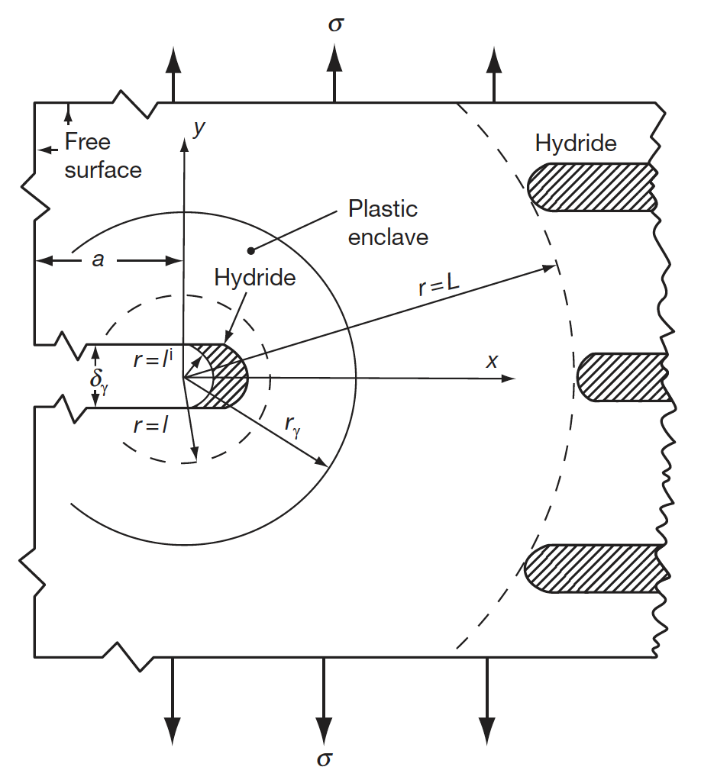
Delayed Hydride Cracking
The theory of DHS is that the crack tip hydride grows as hydrogen migrates from hydrides in the bulk of the material to the crack tip
The driving force for the diffusion of the hydrogen is the difference in the chemical potential of hydrogen between the bulk material and the crack tip hydride in response to stress
An increasing hydrostatic tensile stress reduces the chemical potential of hydrogen in the hydride relative to the bulk
This chemical potential difference causes hydrogen in solution to diffuse to the crack tip where it precipitates

Slide 28
Hydrogen Pickup
The fraction of the produced hydrogen that enters the cladding is defined by the pickup fraction:
Hydrogen is produced twice as fast as oxygen
J_{H} = 2 f J_{O}
We can estimate the hydrogen content in the cladding from the oxide thickness δ and the pickup fraction f

Slide 29
Given a thickness of oxide, how can we predict the hydrogen pickup?
A cladding with an initial thickness of 600 microns that initially has 40 wt. ppm H undergoes corrosion to a total oxide thickness of 80 microns. What is the overall hydrogen content in wt. ppm if the hydrogen pickup fraction is 15%?
First, we must determine the weight of H that has entered the cladding
ρ_{ZrO2} is 5.68 g/cm³, of which 32/(91+32)= 0.26 = 26% is O, thus 1.47 g/cm³ of O
A 1 micron oxide layer corresponds to a weight gain of 14.7 mg/dm² and thus with an 80 micron layer, weight gain = 14.7*80 = 1176 mg/dm²
This mass corresponds to 1.176 N_{A}/16 atoms of oxygen = 4.42 x 10²² atoms/dm²
f = 15%, so the ingress of hydrogen will be 0.15*2*4.42e22 = 1.33e22 atoms of hydrogen/dm², or 0.022 g of H.
Now, we determine the fraction in wt. ppm in a 10 cm square cross section w/ PBR = 1.56
The uncorroded thickness is 600 – 80/PBR = 600 – 80/1.56=549 microns
The volume of zirconium is 549 x 10⁻⁴ (cm)*10*10 =5.49 cm³
ρ_{Zr} = 6.5 g/cm³, so the total mass of Zr is 6.5*5.49 =35.7 g.
Thus the hydrogen concentration is 0.022/35.7 =6.18e-4= 618 wt. ppm, which, added to the original 40 wt. ppm, is 658 wt. ppm

Slide 30
Hydrides Summary
Hydrogen released by oxidation enters the cladding and quickly diffuses throughout the cladding
Due to low solubility (that is a function of temperature), hydrides form
Hydrides are brittle, and so reduce the ductility of the cladding
Hydrides form circumferentially under operating conditions due to the tensile hoop stress in the cladding
Radial hydrides can form in used fuel after drying, and reduce ductility much more than circumferential hydrides
DHC is a phenomenon based upon increased solubility of hydrogen in the high tensile stress around a crack tip
Have the ability to predict hydrogen pickup in oxidized Zr cladding

