Slide 1
Nuclear Fuel Performance
NE-533
Spring 2025

Slide 2
Housekeeping
Exam Thursday
Problem session after lecture
MOOSE project due 2/28
Snowstorm coming…
Assuming that class is cancelled on Thursday, we will do the exam via zoom
Cameras on, I will be a virtual proctor
Will submit your scanned or photographed exam and cheat sheet and email them to me

Slide 3
Last Time
The crystal lattice is never perfect; it has defects
Point defects, dislocations, grain boundaries, voids and precipitates
Microstructure can be tailored through processing, during fabrication or post-fabrication
Started UO2 radiation effects
interstitial loops and voids
changes in thermal conductivity due to irradiation and chemistry changes
have various empirical models which take into account phonon and electron kth, as well as burnup

Slide 4
UO2 Radiation effects Continued

Slide 5
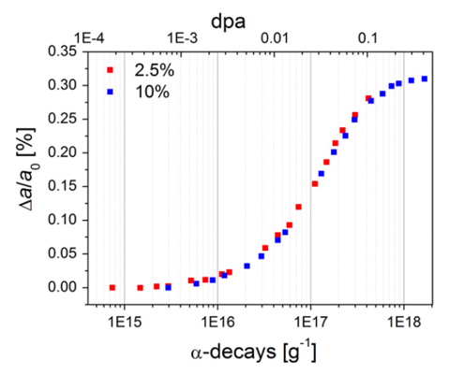
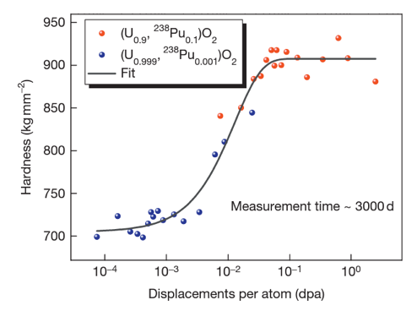
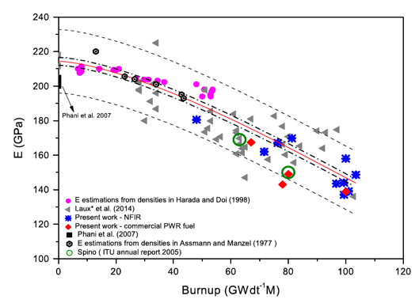
Other Physical Changes
An important effect of radiation damage is the volume increase of the crystal lattice, leading to macroscopic swelling of the fuel material
Alpha particle damage alone can cause approximately 0.4% swelling
Mechanical properties also vary with damage
Hardness increases as a function of dpa
Young’s modulus decreases with dpa

Slide 6
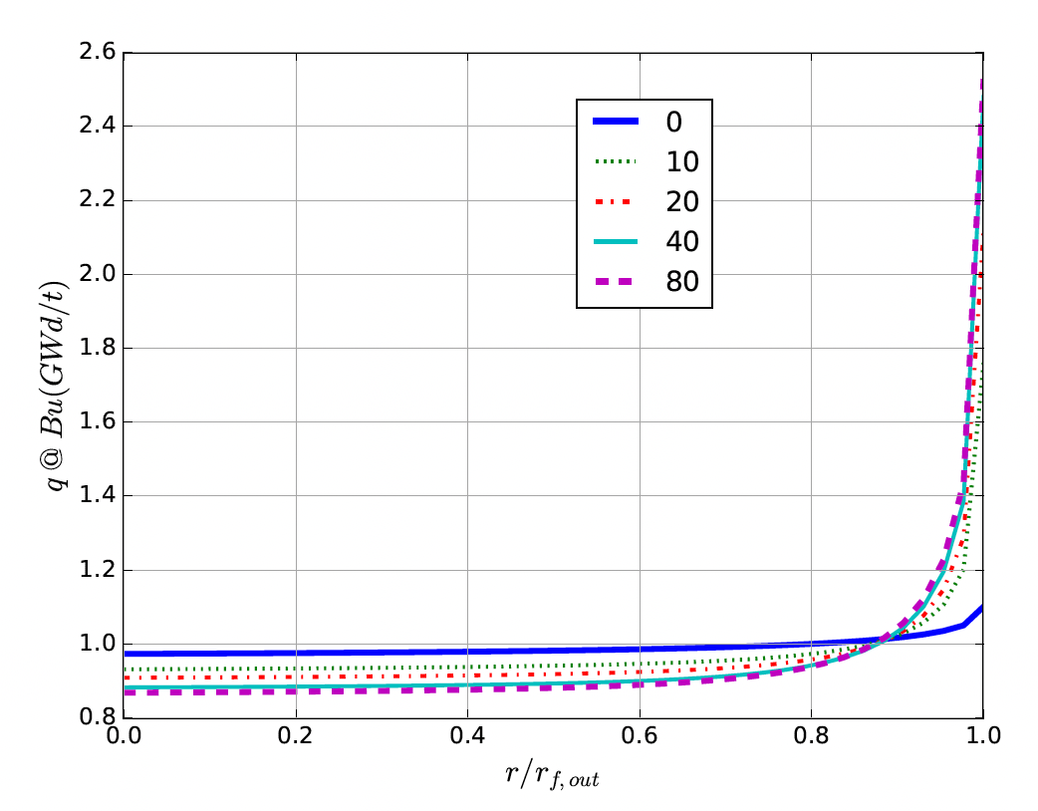
High Burnup Structure (HBS)
At the beginning of the irradiation, the local power is ~10% higher on the pellet periphery, due to self-shielding effect in 235U fissions driven by neutrons entering the rods after interactions in the water
With increasing burnup, a strong capture of neutrons by U-238 in the resonance range occurs at the periphery of the fuel
This leads to the production of Pu-239, and leads to a higher fissile density and thus a further increase in the local power/burnup
This high local burnup area is on the outer ring of the fuel and is about 200 microns thick, which represents about 8% of the fuel

Slide 7
High Burnup Structure (HBS)
When thermal recovery is not sufficiently efficient (at lower temperatures), the accumulation of defects at high burnup can lead to the instability of the crystalline structure, initiating a restructuring driven by the energy stored in the material
This can be amorphization (not observed in UO2) or recrystallization/polygonization
Polygonization is the rearrangement of dislocations into sub-domain walls with slightly misaligned grains
In UO2, grains subdivide from 10 microns in size to 100-200 nm size, and a densely porous structure is formed (~20% porosity)

Slide 8
High Burnup Structure (HBS)
The increase of the relative porosity volume degrades the material conductivity and reduces the mean grain size
On the other hand, the intragranular irradiation defect-cleaning improves the fuel intrinsic thermal conductivity
Fission gas in HBS bubble is retained, not released
Exact mechanism of HBS formation is not fully understood, believe to be polygonization, interacting with fission gas bubbles, dislocation growth, and high levels of energy deposition

Slide 9
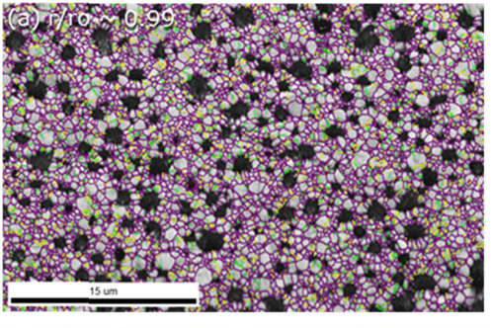
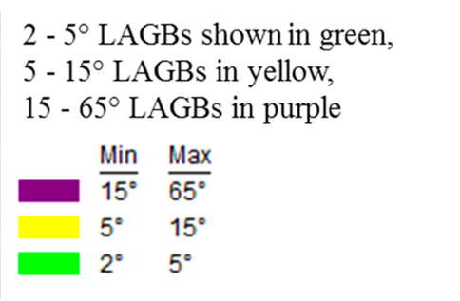
High Burnup Structure (HBS)
HBS has a high fission gas retention capacity, and does not evolve toward an open system of interconnected channels, even when porosity reaches very high values
Thus, the HBS is a relatively stable structure, limiting pressure increase in the plenum
While burnup is higher in the rim region, the HBS polygonization removes/sweeps defects to new grain boundaries, removing some phonon scatterers
Despite high porosity, thermal conductivity increases, slightly decreasing centerline temperatures in high burnup fuel

Slide 10
Radiation Effects Summary
Formation of loops of voids as primary defect clusters
Radiation effects include both chemistry and physical property changes
One of the key physical properties modified is the thermal conductivity
have several empirical (and mechanistic) models to account for burnup and temperature
HBS forms towards the end of life, generating a fine-grained structure with high porosity
HBS retains fission gas and slightly increases thermal conductivity

Slide 11
mechanistic modeling

Slide 12
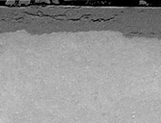
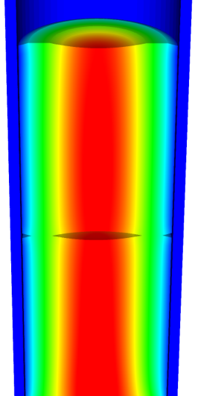
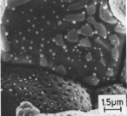
Microstructure-based fuel performance modeling
Structure/property relationships connect the microstructure variables to the property values
Operating Conditions
Neutron flux
Coolant T&P
Variables
Temperature
Displacement
Stoichiometry
Cladding
Property values
Microstructure evolution models
Microstructure evolution models
Fuel Property values
Elasticity tensor
Elasticity tensor
Grain growth
Grain growth
Cladding
Microstructure variables
Average grain size
Dislocation density
H concentration
Hydride fraction
Point defect concentrations
Loop density
2nd phase particle fraction
Fuel
Microstructure variables
Average grain size
Dislocation density
U defect concentrations
Pu concentration
Fission product precipitate fractions
Dissolved fission products
Fission gas bubble fraction
Grain boundary fission gas bubble coverage
Crack parameter
Plasticity
Plasticity
Thermal conductivity
Yield stress
Defect prod. & transport
Defect prod. & transport
Fracture stress
Thermal conductivity
Hydrogen transport
Fission gas behavior
Melting temperature
Failure criteria
Loop evolution
Densification
Diffusion constants
Dimensional change
Gap variable
Gap fission gas concentration
Fracture
Dimensional change

Slide 13

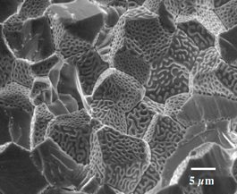
Example: fission gas behavior in the fuel
Take into account a finite set of variables to describe the state of the material
Utilize a mechanistic model of fission gas behavior to predict the evolution of the microstructure
Utilize this updated microstructure to inform a number of structure/property relationships
Variables
Temperature
Displacement
Stoichiometry
Elasticity tensor
Thermal conductivity
Model of fission gas behavior
Structure/property relationships
Fracture stress
Dissolved fission products
Fission gas bubble fraction
Grain boundary fission gas bubble coverage
Gap fission gas concentration
Dimensional change
Gap conductance
Gap pressure

Slide 14
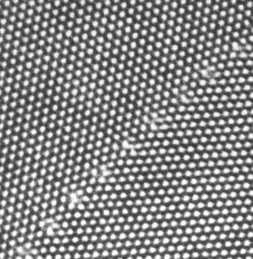
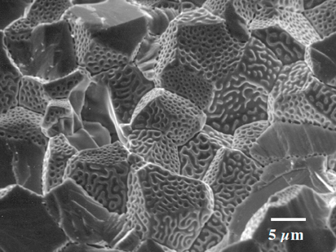
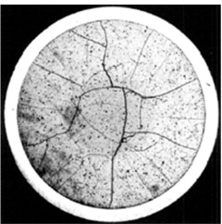
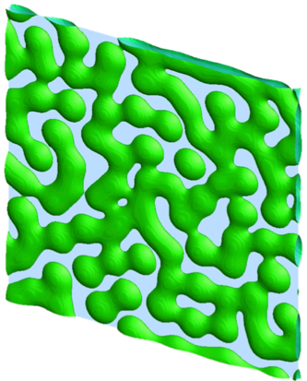
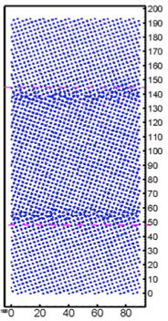
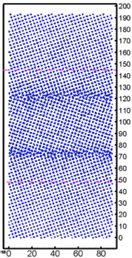
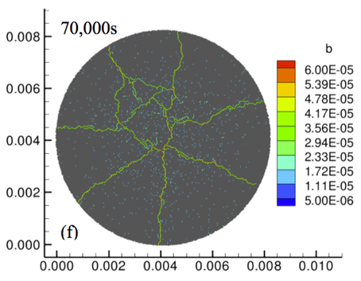
Multiscale separate effects experiments and simulations inform the development of the models
nm
μm
mm

Slide 15
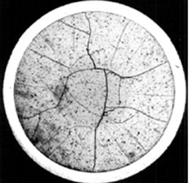
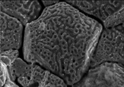
Microstructure-based models
Can provide a structure/property relationship to replace the existing burnup dependent model
For example, thermal conductivity, taking into account microstructural features and their evolution
Grain boundary and bubbles
Intragranular porosity
Precipitated fission products
κ_{pr}
Bulk conductivity
Vacancies and interstitials
Fission gas

Slide 16
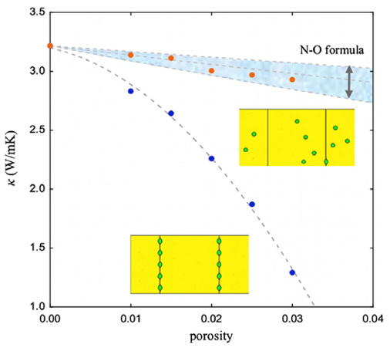
Parametrizing the mechanistic model
We employ multiscale modeling and simulation to determine the various parameters for the model
MD simulations conducted at LANL have been used to determine the coefficients for various point defects
MD simulations have shown that phonon scattering must be accounted for to accurately represent small bubbles
Mesoscale simulations have shown that GrB bubbles have a larger impact on the thermal conductivity
Maxwell-Eucken (no phonon scattering)

Slide 17
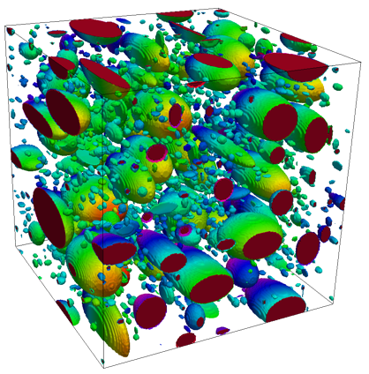
Parametrizing the mechanistic model
A thermal resistor model is created to describe the impact of GrB bubbles on the thermal conductivity
MARMOT simulations are currently being used to inform the development of the precipitate multiplier

Slide 18
Parametrizing the mechanistic model
Each term in the expression must be coupled to a corresponding state variable
The full model calculates the thermal conductivity as a function of:
Temperature
Point defect concentrations
Intragranular bubble density and average radius
Fractional coverage of bubbles on GBs and average radius
Precipitate volume fractions and average sizes
Currently effects of precipitate fission products and individual point defects are neglected in the model, as they are not tracked or predicted in BISON

Slide 19
Comparing with experiments…
The model under-predicts the temperature in most cases, but not all
Thus, the model is neglecting some resistive effects from the microstructure
Generally performs as well, and in some cases better, than the burnup based model
RISO-3 AN3
RISO-3 AN4
RISO II-3
US PWR TSQ0002

Slide 20
UZr Fuel Performance Modeling
Development of a quantitative phase-field model of macroscale constituent redistribution in the U-Zr system, where model parameters were optimized, and the model validated against an independent data set
Calculation of surface tension based on molecular dynamics, which is used in the BISON gaseous metallic fuel swelling model

Slide 21
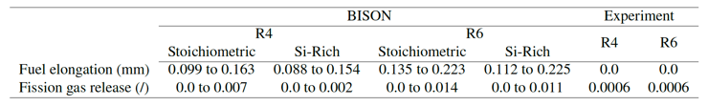
U3Si2 Fuel Performance Modeling
Point Defect Diffusion, Fission gas swelling, thermal and irradiation creep

Slide 22
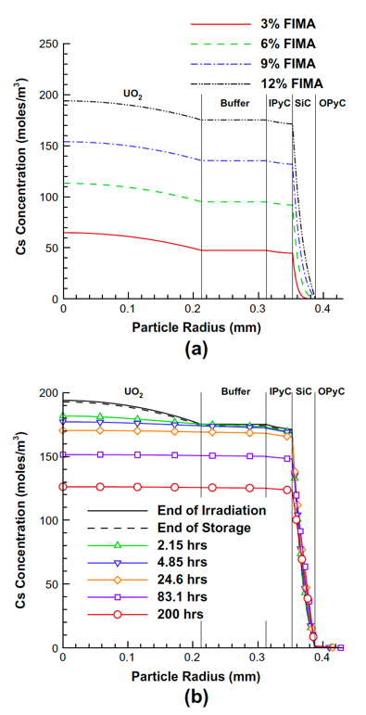
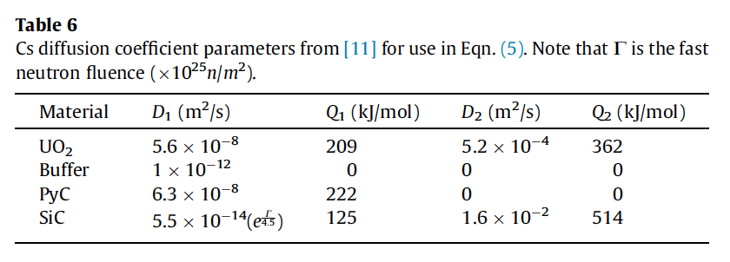


TRISO Particle Fuel Performance Modeling
TRISO particle modeling is still under development from a mechanistic model standpoint
Imperfect data for many critical fission products through different layers
Data typically for UO2 only, not for UC or UCO fuel kernels

Slide 23
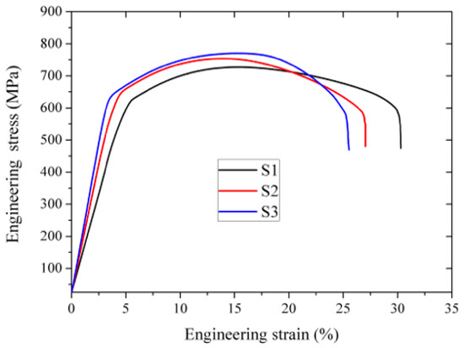
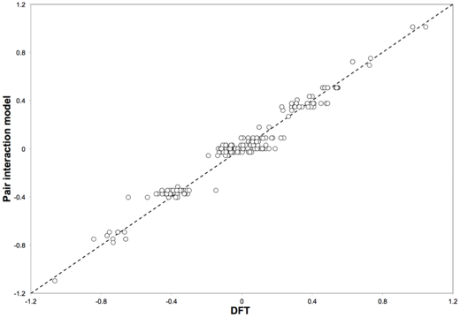
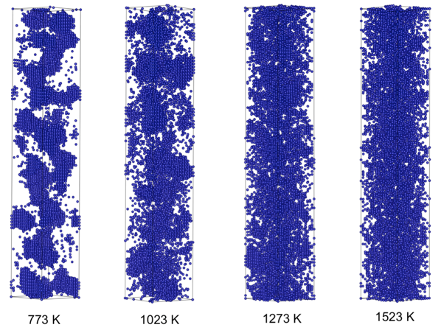
FeCrAl
Evolution of compositional randomness (precipitation) will affect the mechanical properties of FeCrAl
Kinetic Monte Carlo simulations modeled the precipitation of alpha’ phase from bcc Fe-Cr alloys under thermal aging at various temperatures
Fe-Al alloys do not show any phase separation
Can determine critical temperatures for precipitation and the resulting microstructures to investigate potential hardening

Slide 24
Summary
Researchers are working to develop materials models for the fuel and cladding that are mechanistic rather than empirical and that are based on the evolution of the microstructure rather than the burnup

