Slide 1
Nuclear Fuel Performance
NE-533
Spring 2025

Slide 2
Exam 2
Grading catchup:
Exam 2 avg: 86.4; Curve of 5 pts.
MOOSE grading:
sent out today
Paper grading:
sent out today
Let me know of any comments or questions on any of this

Slide 3
MOOSE Project Notes
Two ways of doing the meshes, both work
Single mesh, divide into subdomains
Three separate meshes, stitch meshes together, define subdomains
First way, need to be careful in subdividing, as you can specify multiple blocks at same point
Second way can give you more mesh flexibility and defines points on the block transitions; may help with convergence
can try, but not needed
Can try adaptive timestepping; can check for steady-state with transient
Overall, everyone did very good on the MOOSE project

Slide 4
Last Time
Grain growth, grain boundaries, densification
Started on fuel chemistry

Slide 5
Fuel chemistry CONT.

Slide 6
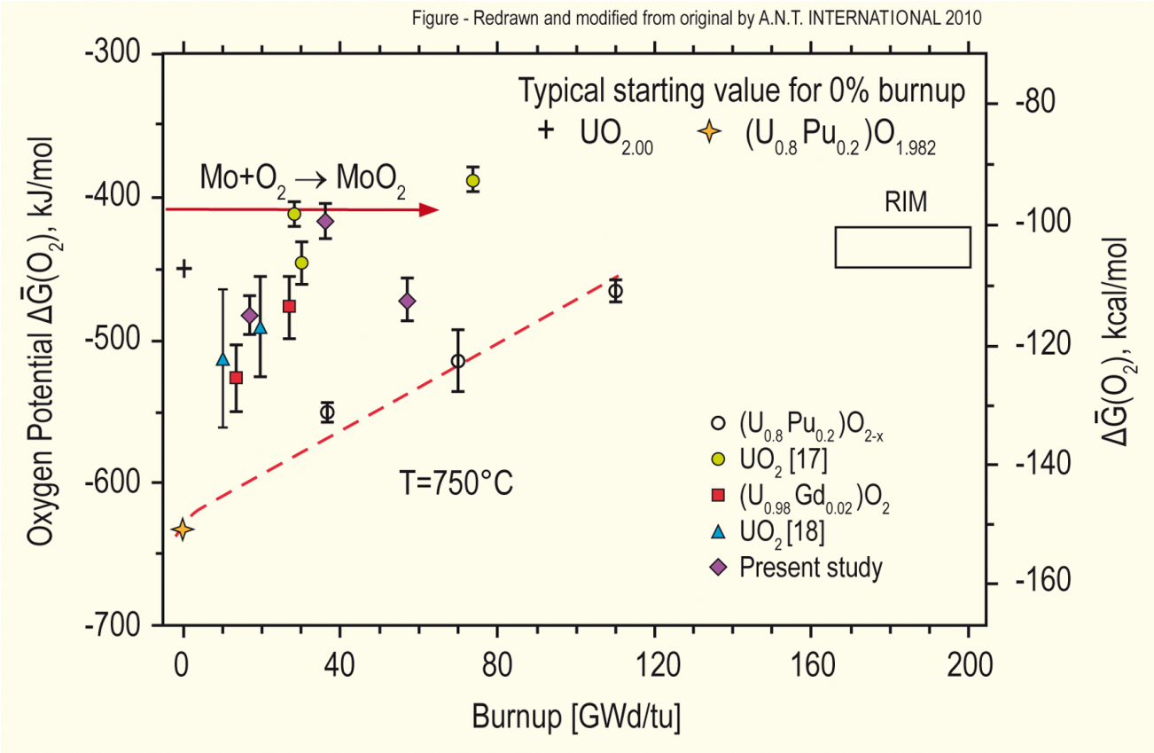
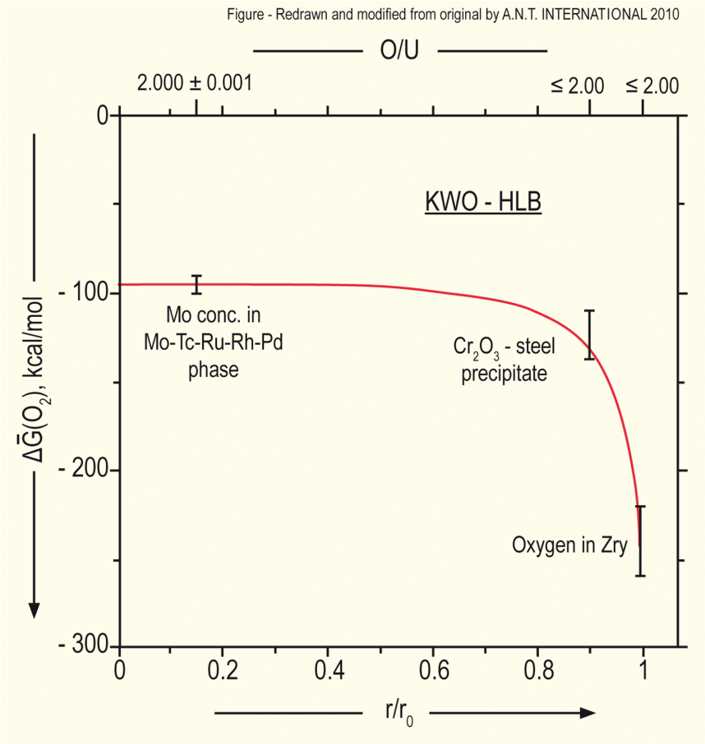
Oxygen potential
The oxygen potential changes during irradiation, indicating change in the O/M ratio
Oxygen potential changes during irradiation due to
Liberation of oxygen by fission; Generation of fission products; Conversion of uranium to plutonium; Reaction of oxygen with U, Pu, fission products, and cladding
Oxygen potential across pellet radius observed to be constant at the approximate value of Mo/MoO₂ reaction (from calculations)
Mo serves as a buffer to the O potential, or a means of inferring what the oxygen potential may have been in the fuel from PIE
Oxygen potential is low near the cladding, because the oxygen enters the cladding

Slide 7
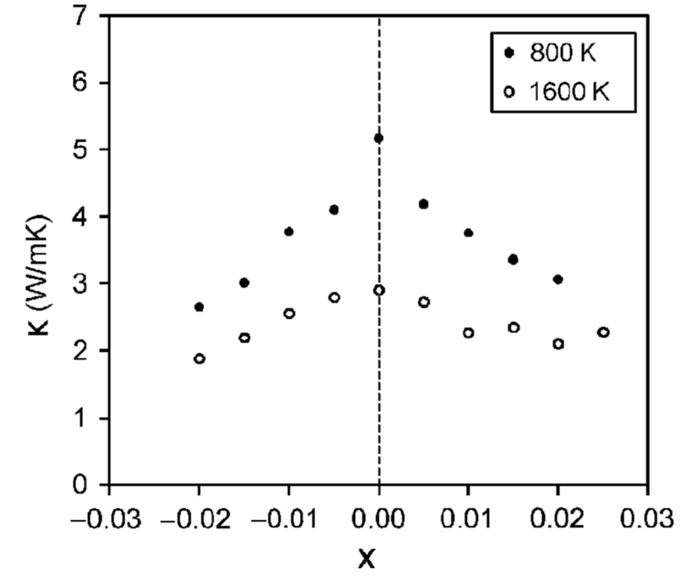
Fuel Stoichiometry/Properties
The stoichiometry of the fuel directly impacts the fuel performance
Stoichiometry impacts
Melting temperature
Thermal conductivity
Processes dependent on diffusion
Grain growth
Fission gas release
Creep
Chemical state and behavior of fission products
Chemical reactions at inner cladding surface
Thermal conductivity is highest for stoichiometric UO2

Slide 8
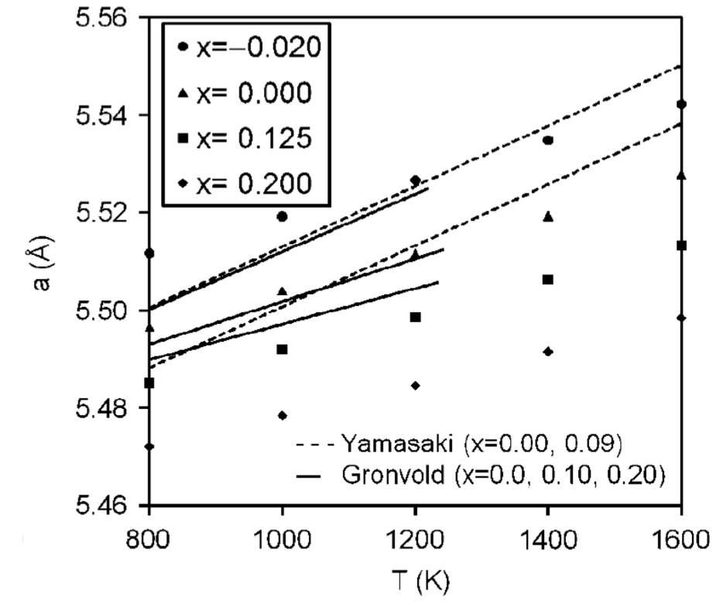
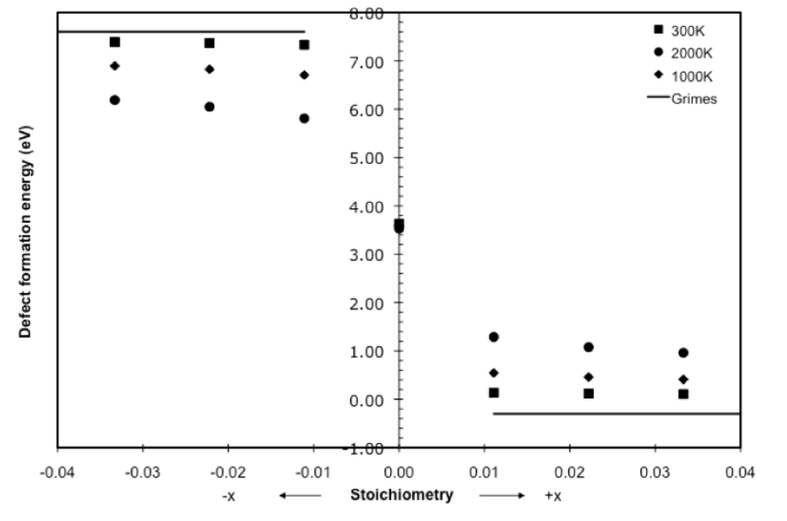
Fuel Stoichiometry/Properties
The lattice constant of the material decreases with increasing stoichiometry
The vacancy formation energy also changes with stoichiometry

Slide 9
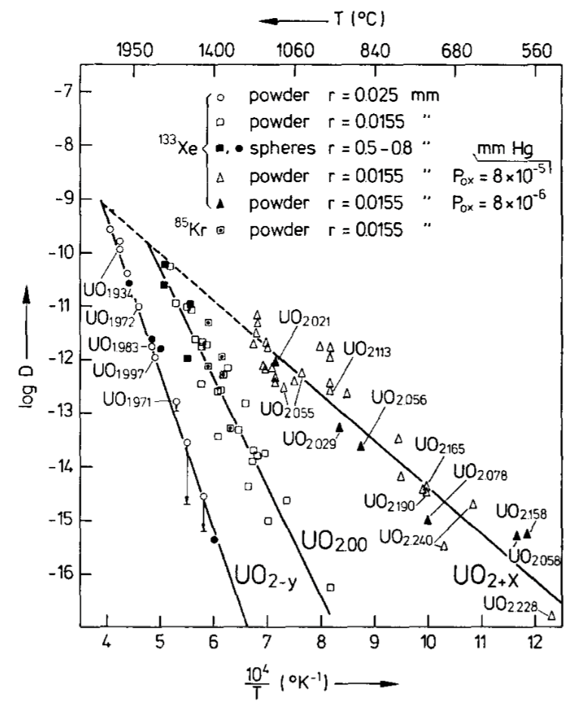
Fuel Stoichiometry/Properties
Fission product | UO_{1.97} | UO₂ | UO_{2.03}
Xe | 3.88 eV | 3.88 ev | 2.61 eV
Cs | 1.7 eV | -0.04 eV | -3.29 eV
Sr | -3.71 eV | -6.03 eV | -9.55 eV
The solution energy of Xe, Cs, and Sr in UO₂ depends on stoichiometry as well
The coefficient defining Xe diffusion also changes with stoichiometry
Though stoichiometry matters, most fuel performance codes ignore it

Slide 10
Fuel Chemistry Summary
UO₂ has a cubic fluorite structure that is very stable
The charges are balanced with a U⁴⁺ valence state
However, the ratio of oxygen to uranium can change. We call this the stoichiometry and abbreviate it as O/M ratio
The O/M ratio changes during reactor operation, but it is complicated
The O/M ratio impacts many properties of the fuel

Slide 11
Fission products

Slide 12
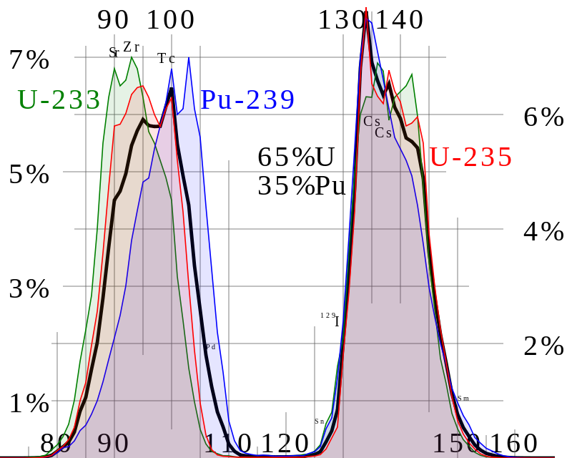
Fission Product Generation
Fission releases around 200 MeV
The fission fragments have 169 MeV of kinetic energy
2 to 3 neutrons with an average energy of 2 MeV
7 MeV of prompt gamma ray photons
The remaining energy is released by beta decay
Every fission product that is produced is now in the crystal lattice of the fuel, changing the chemistry/microstructure

Slide 13
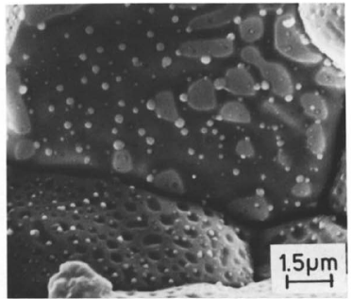
There are various types of fission products that form
Soluble oxides (Y, La and the rare earths)
Dissolved in the cation sublattice
Insoluble oxides (Zr, Ba and Sr)
Form insoluble oxides in the fluorite lattice
Metals (Mo, Ru, Pd, and Tc)
Form metallic precipitates
Volatiles (Br, Rb, Te, I and Cs)
Exist as gases at high temperatures of the pellet interior
Also exist as solids at the cooler pellet exterior
Noble gases (Xe, Kr)
Essentially insoluble in the fuel matrix
Form either intragranular (within grain) voids or bubbles or intergranular (grain boundary) bubbles

Slide 14
All fission products impact the behavior of the fuel

Slide 15
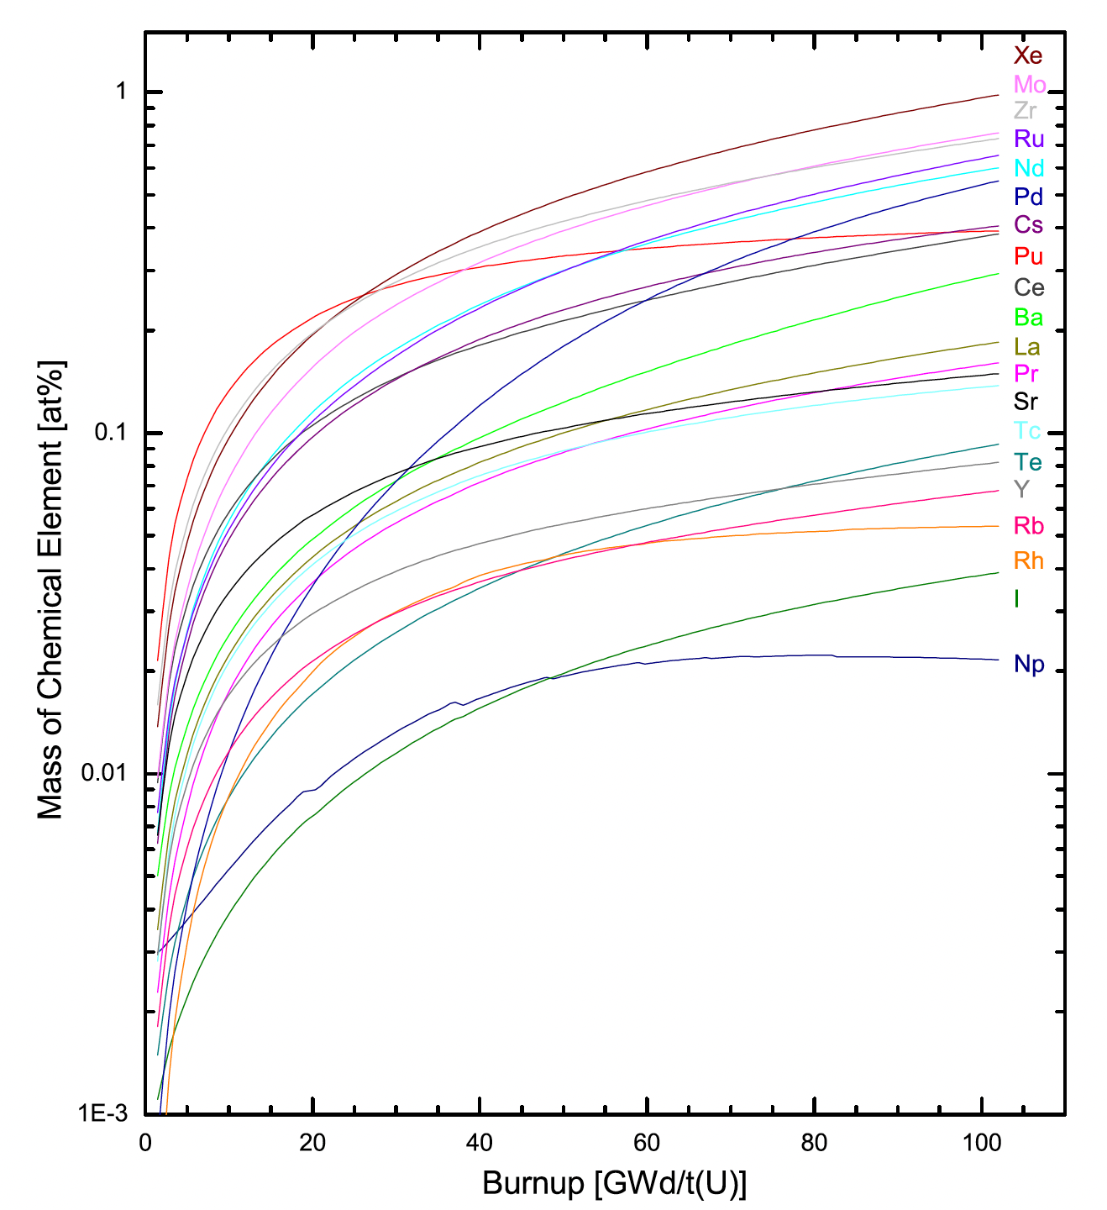
Fission Product Evolution
Not only are the absolute proportion of fission products accumulating with time, but the relative proportions are changing with respect to one another
There are continuous transitions between the groups as the critical concentration conditions for new phase development are surpassed because of increased burnup
Since fission releases two oxygen but only one metal atom, and not all metal atoms will react to bond the oxygen, the O/M ratio of the fuel slowly increases during burnup

Slide 16
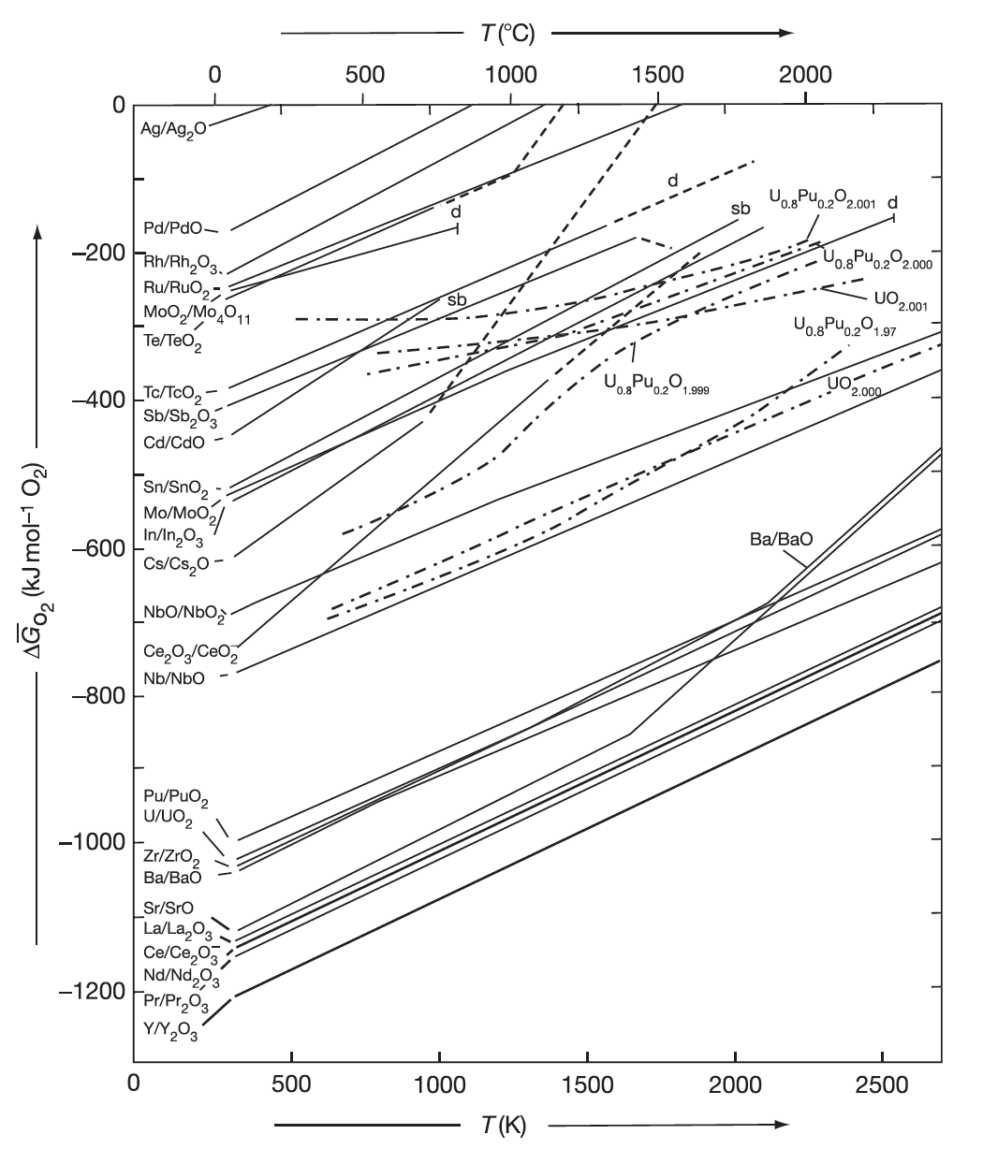
Oxide Formation
With burnup, the liberated oxygen will associate with U, Pu, and La but may not be in sufficient supply to combine with Pd and other less oxidizing elements
If the Gibbs energy of formation of the given fission product lies below the fuel oxygen potential, the element will be capable of forming an oxide (Ce, Sr, Ba)
If the reaction line is above the oxygen potential in the fuel, the fission product will exist as an element in the fuel (in a separate metallic phase) (Ru, Pd, Tc)

Slide 17
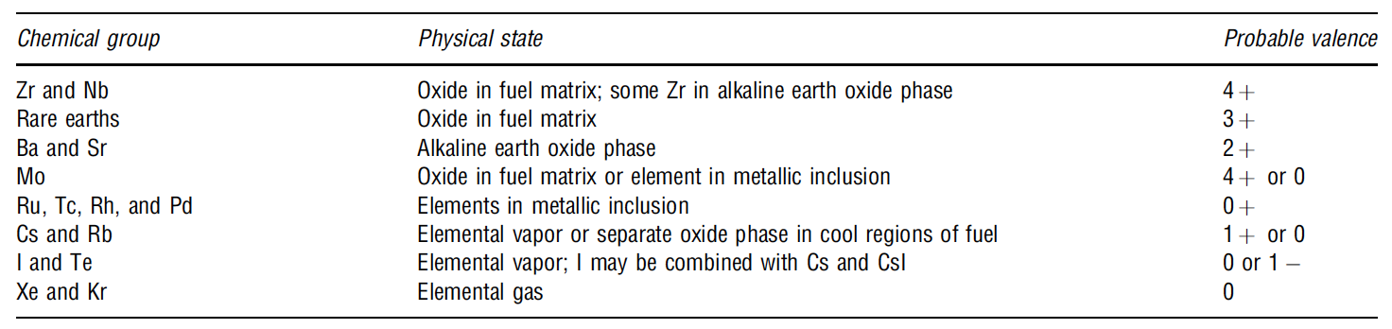
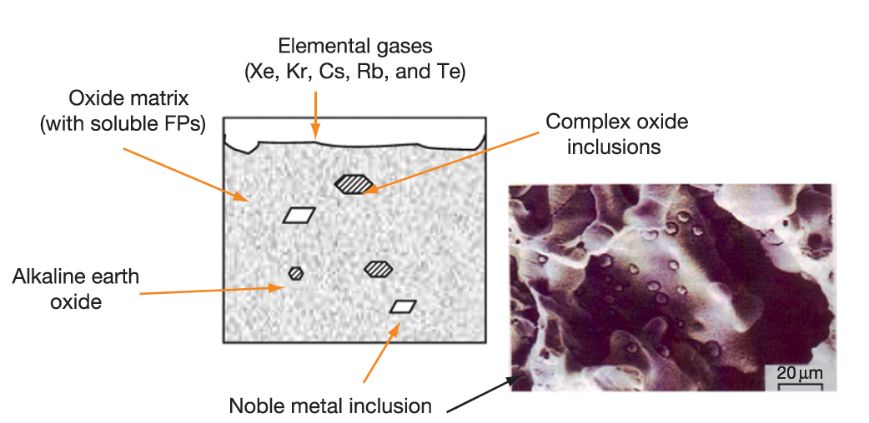
Soluble/Insoluble Fission Products
When a 4+ valence fission product (e.g.,Zr4+) enters the lattice, there is no change in the electrical neutrality
If the charge of the fission-product cation is lower than U+4, the site occupancy of the lattice is altered to achieve electrical neutrality
The alkaline earth cations Ba+ and Sr2+ have large ionic radii and form a separate oxide phase
Fission products that have limited solubility in UO2 will segregate to the grain boundaries and voids

Slide 18
Fission Product Segregation/Precipitation
Fission products can be segregated because of their migration to specific locations such as intragranular segregations, grain boundaries, or pellet surfaces
Metallic inclusions are commonly observed in ceramographs from irradiated samples
They are formed by isotopes of Mo, Tc, Ru, Rh, Pd, Ag, Cd, In, Sn, Sb, and Te
These inclusions are found at the surface of the grain boundaries and are associated, in general, with grain boundaries and intragranular bubbles
Some of the components of these precipitates can be oxidized or reduced forming other compounds that can be released from the fuel matrix
Cs, Ru, Te, and Ba have been consistently found at the cracks in the pellet and on the clad inner surface
The white inclusions are metallic precipitates, which are composed of Mo, Tc, Rh, Ru, and Pd, form a quinary alloy in an hcp structure
A “gray oxide phase” perovskite structure containing different combinations of Ba, Cs, Zr, Mo, and U can also form

Slide 19
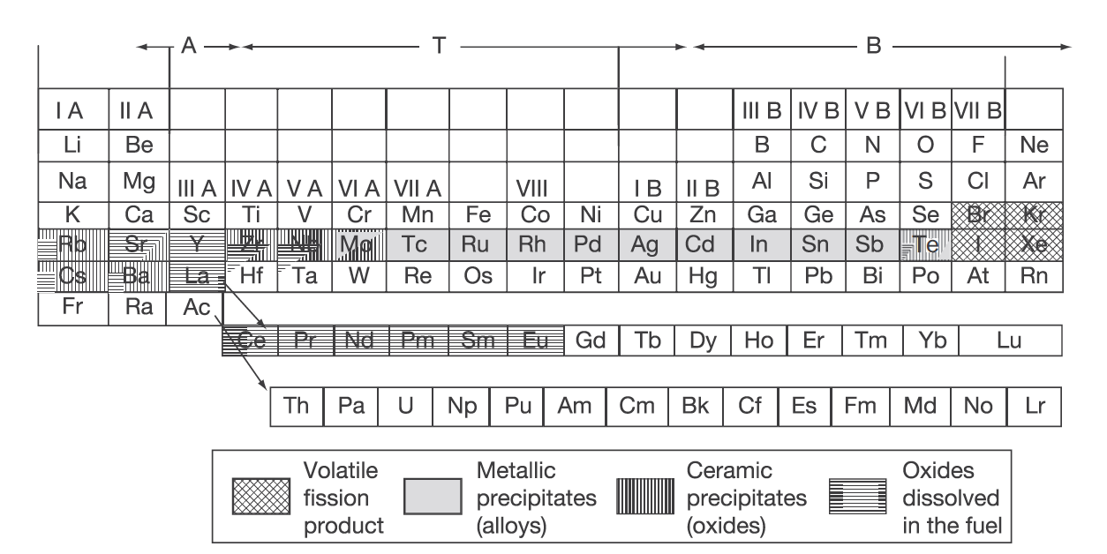
Volatile/Gaseous Fission Products
Xe release occurs at the central region of the pellet where the highest temperatures were achieved during irradiation
Volatile FPs are released from the fuel matrix similar to that of the noble gases
Volatile fission products in the gap can react among themselves, resulting in a changing chemical speciation
The kinetics of formation/decomposition of CsI and Zr iodides are possible factors in the mechanism of SCC

Slide 20
FP Interaction with Zr Cladding
Fission fragments will deposit on the inner surface of the cladding
Some of these species can diffuse into the cladding, while others can attack the cladding thereby initiating cracks that can later progress with the formation of through-wall cracks
Oxygen will diffuse into the cladding and contribute to its oxidation state
Measurements have shown deposits of Sr, Cs, Pu, and Am
The corrosion behavior of zirconium by Te has been reported
The chemical reaction between some corrosive fission products and the cladding can lead to PCI
Fission products such as Cs, Cd, or I can attack the cladding inducing crack initiation, which then progress through the cladding by intragranular and transgranular cracking modes

Slide 21
Fission Gas Release

Slide 22

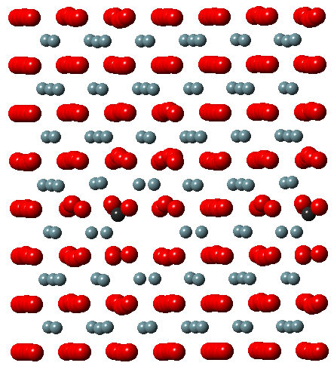
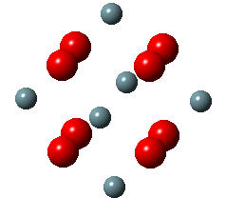
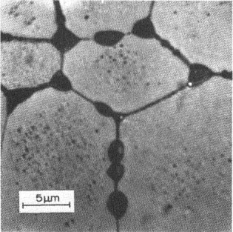
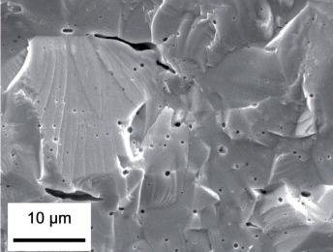
Fission Gas Release
Fission gases (Xe, Kr) are released in a process composed of three stages in UO2
Stage 1: Gas atoms are produced throughout the fuel due to fission and diffuse towards grain boundaries
Small intragranular bubbles form within the grains, but never get larger than a few nm radius due to resolution from energized particles
Gas atoms that don’t get trapped within the intragranular bubbles migrate to grain boundaries
Atoms forming a vacancy cluster

Slide 23
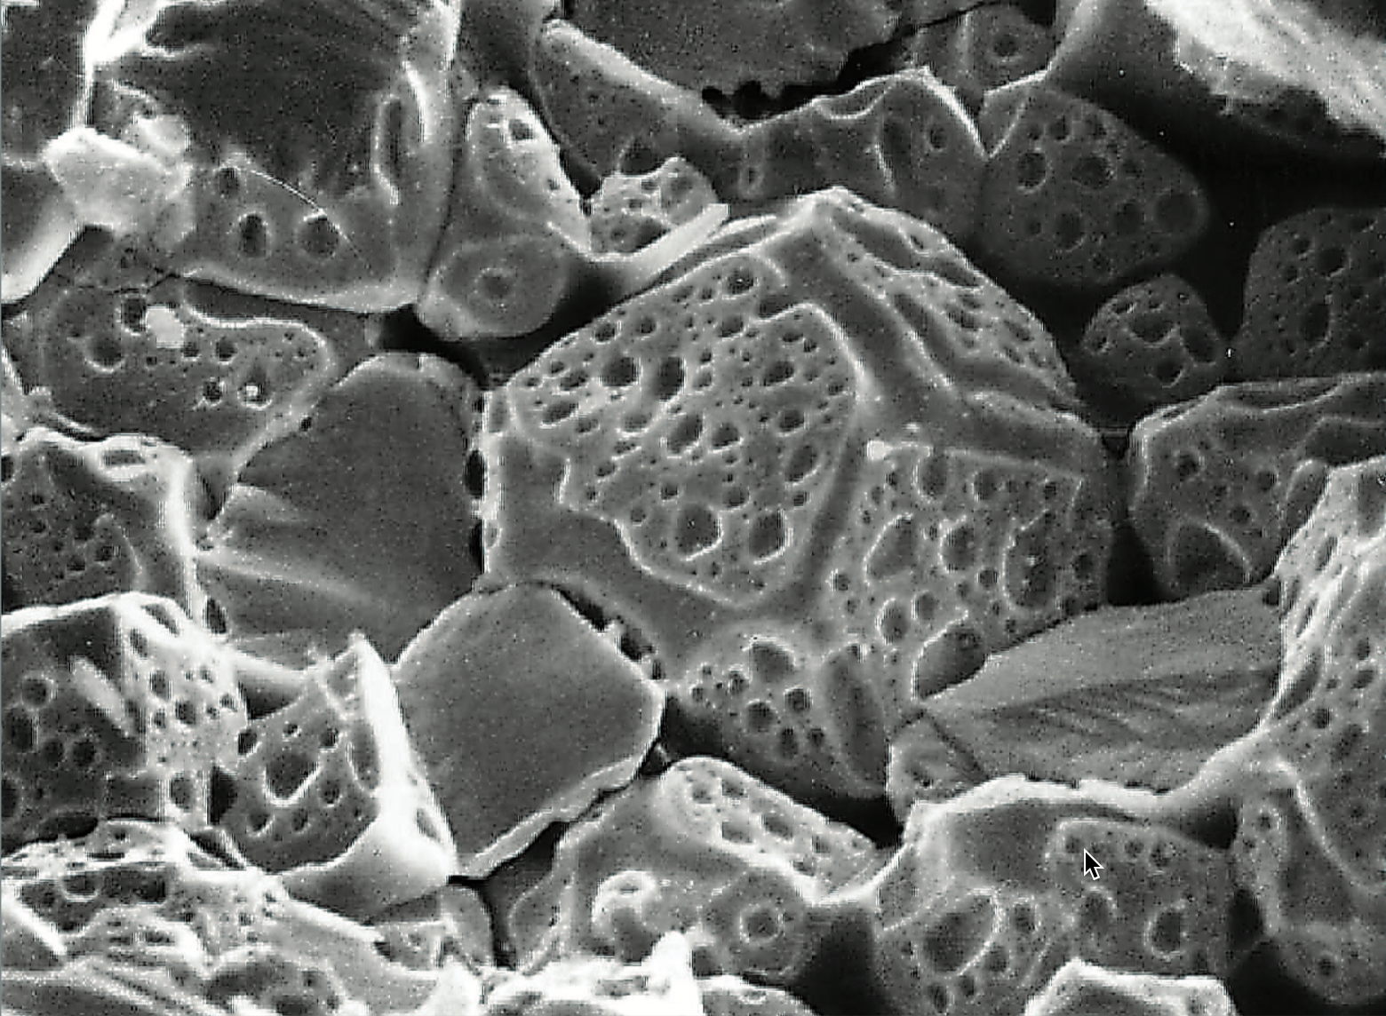
Fission Gas Release
Stage 2: Gas bubbles nucleate on grain boundaries, growing and interconnecting
Stage 3: Gas travels through interconnected bubbles to a free surface

Slide 24
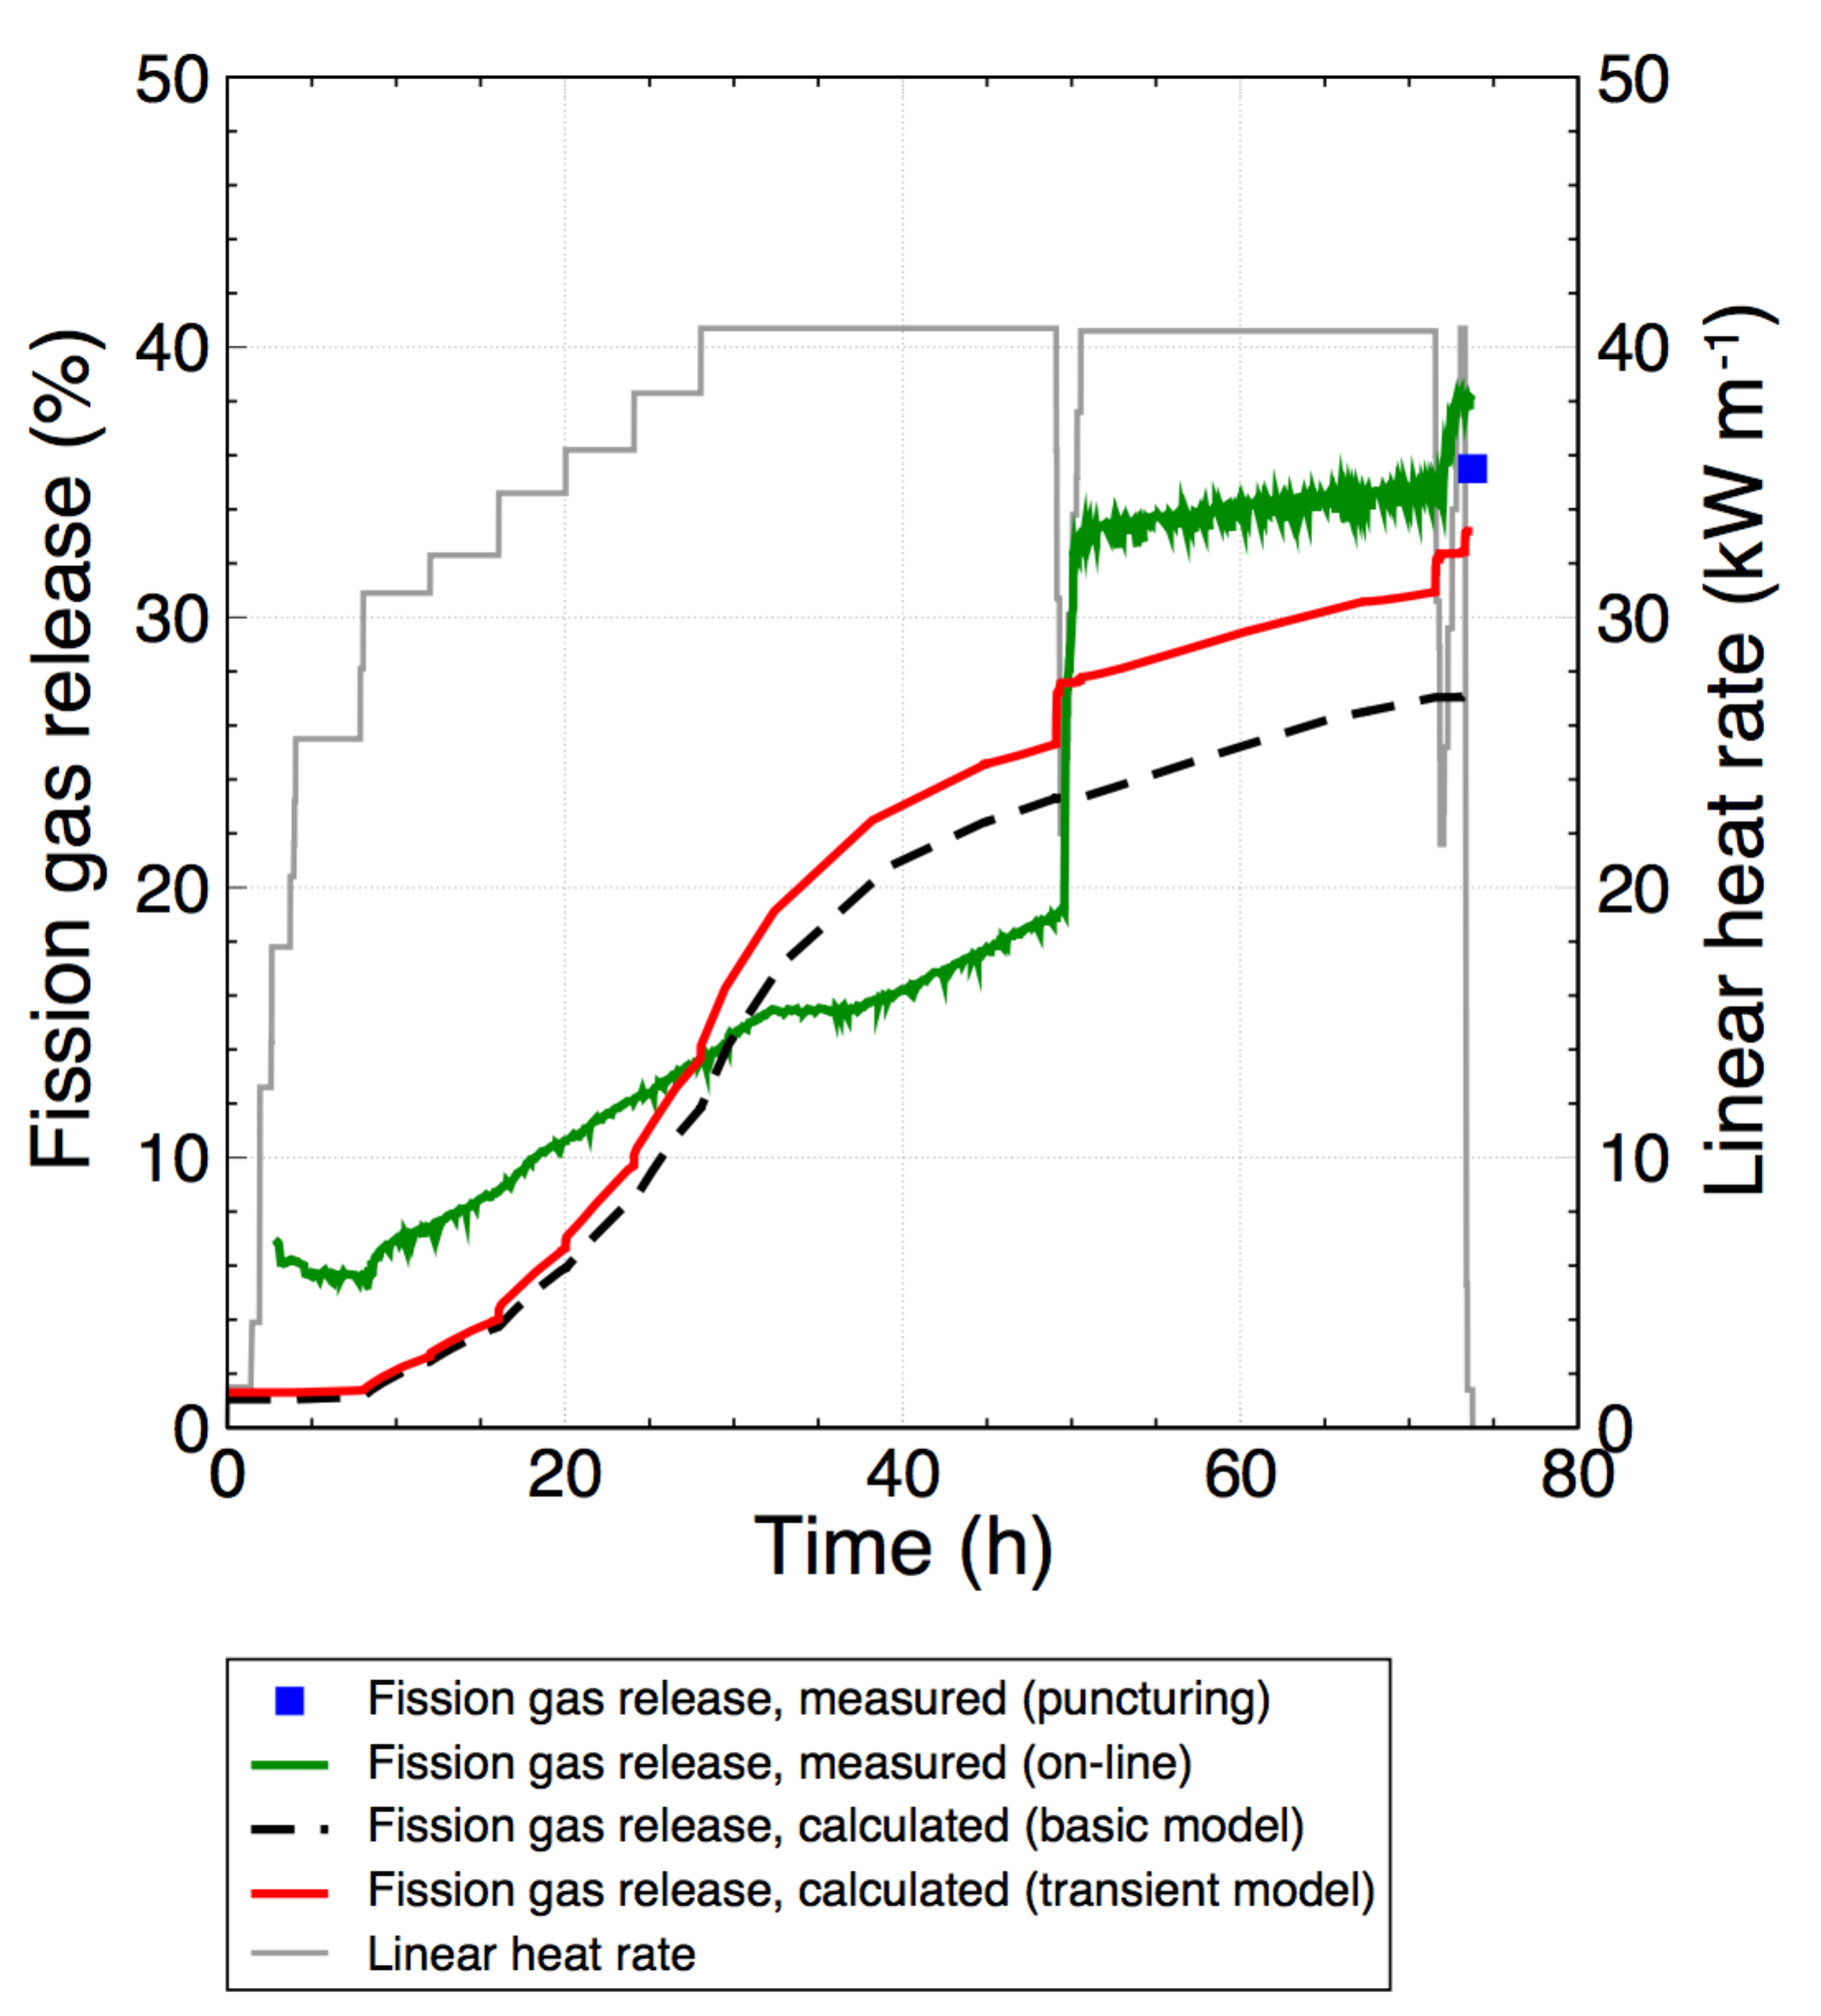
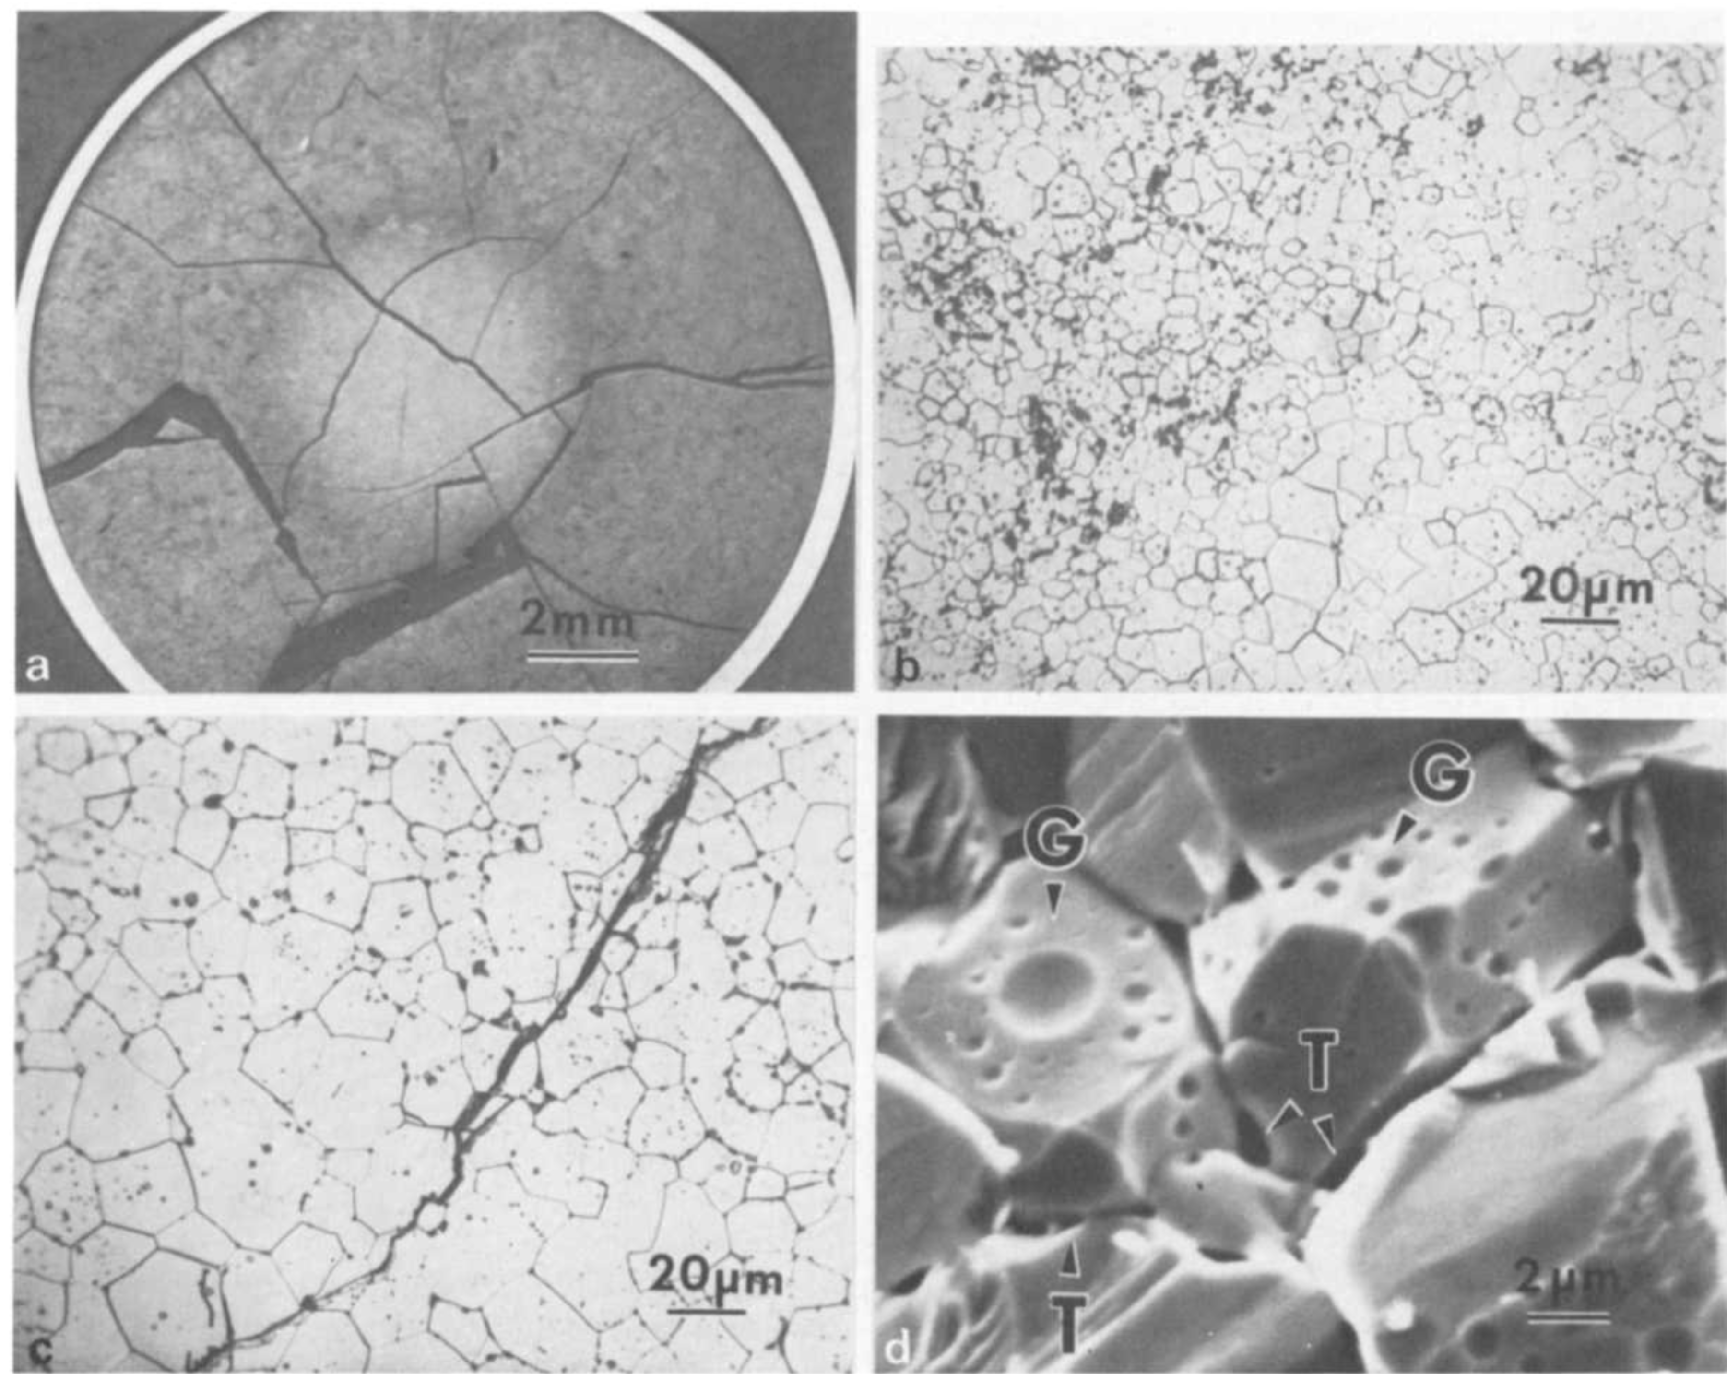
Fission Gas Release
Fission gas release also occurs due to mechanisms that don’t depend on diffusion
Release can occur to particle recoil and knockout at low temperature
It can occur due to fracture during rapid transients

