Slide 1
Nuclear Fuel Performance
NE-533
Spring 2025

Slide 2
Last Time
Fission gas release
experiments fall into post-irradiation annealing, or in-pile
Showed Booth model equations for post-irradiation annealing and in-pile release
Forsberg-Massih 2-stage FGR model
Three components of diffusion
intrinsic, RED, RDD
Swelling/dimensional change
densification, thermal expansion, solid/gas fission product swelling, creep

Slide 3
Fuel Swelling/Dimensional Change Cont…

Slide 4
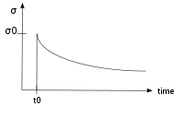
Creep
Creep is a general mechanism for plastic deformation that occurs over time when σ < σ_{y}
Consider a heated metal beam so it expands some distance dx
We then fix it between two walls and let it cool down
Because σ < σ_{y}, that stress remains constant
In creep, defect diffusion is induced by the stress to cause permanent deformation and reduce the stress
Therefore, creep
Occurs over time
Increases with increasing number of diffusing defects
High temperature (thermal creep)
Irradiation (irradiation enhanced thermal creep)
x
x+dx
σ = E ε

Slide 5
Creep
General creep equation:
Creep can be caused by various microstructural mechanisms
Bulk Diffusion (Nabarro-Herring creep)
Atoms diffuse (high T), causing grains to elongate along the stress axis
Q = Q(self diffusion), m = 1, and b = 2
Grain boundary diffusion (Coble creep)
Atoms diffuse along grain boundaries to elongate the grains along the stress axis
Q = Q(grain boundary diffusion), m = 1, and b = 3
Dislocation creep (power law creep)
Dislocations glide under a high stress
Dislocations climb due to defects to avoid obstacles
Q = Q(self diffusion), m = 4–6, and b = 0

Slide 6
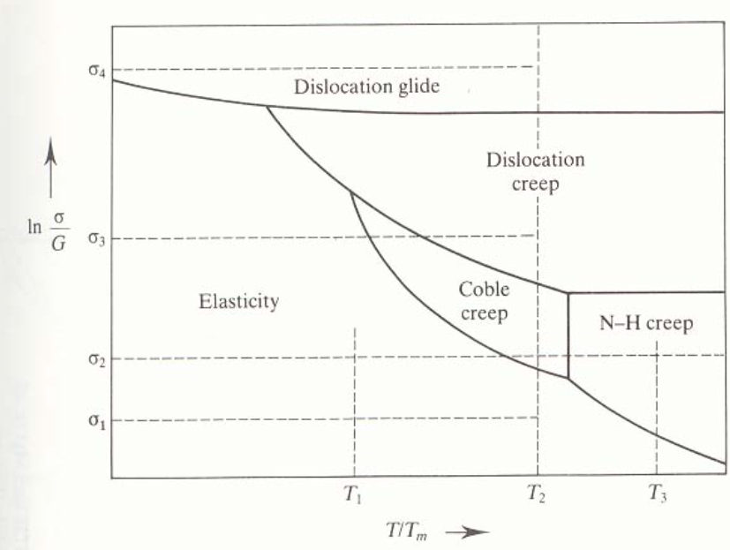
Different creep mechanisms are active for different combinations of stress and temperature

Slide 7
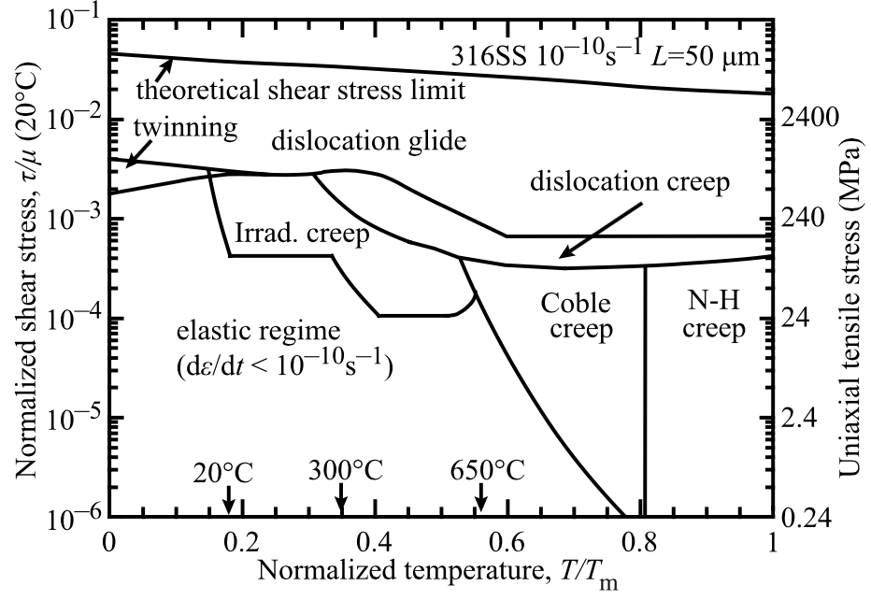
The behavior of creep changes in irradiated materials

Slide 8

Irradiation and Creep
Irradiation accelerates creep, causing it to be significant at lower temperatures
Irradiation typically has little effect on diffusional creep (but can increase defect concentrations)
Primary impact is accelerating dislocation creep in structural/cladding materials
The dislocation creep rate can be written as
ρ_{d}^{m} is the density of mobile dislocations
b is the burgers vector
v_{d} is the dislocation velocity
Gliding dislocations quickly get pinned by obstacles
As the dislocations absorb defects created by irradiation, they climb to different slip planes to avoid the obstacles
More interstitials are absorbed than vacancies due to the higher sink strength for interstitials

Slide 9
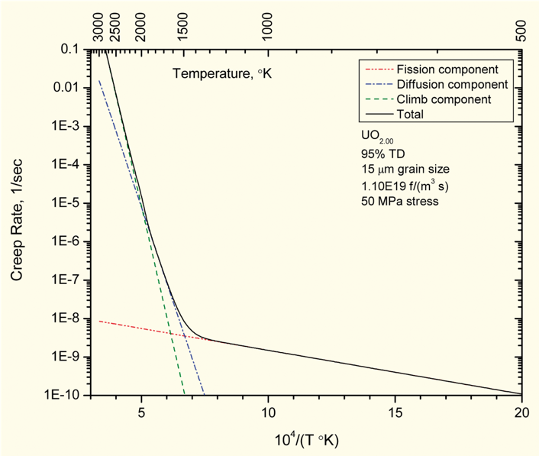
Fuel Creep
Like other materials, the fuel also undergoes creep
The fuel creep (In UO2) is a combination of diffusion creep and irradiation creep
It is expected that fuel creep plays a major role in dimensional change in metallic fuels, largely via N-H and Coble creep, but still unproven experimentally and no good creep models exist for metallic fuels

Slide 10
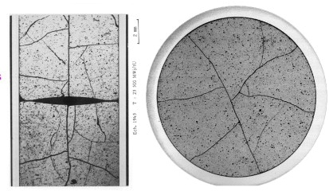
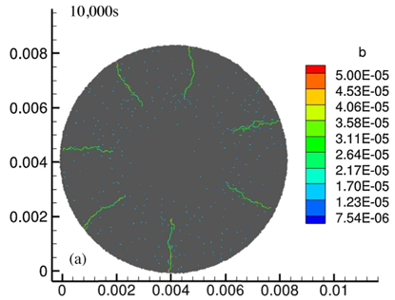
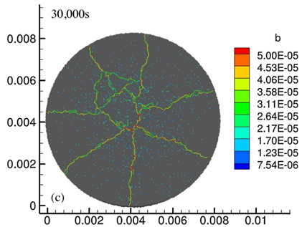
Fracture
UO₂ pellets fracture during changes in temperature due to large thermal stresses
Fracture results in:
Increased gap reduction
Reduced thermal conductivity
Increased avenues for fission gas release
Fracture has been typically modeled in two ways:
Empirical relocation model that is a function of burnup
Semi-empirical smeared cracking model
Modern methods provide means of modeling discrete cracks
Radial cracks partially penetrate the pellet during temperature increase
Full cracking occurs when the temperature decreases

Slide 11
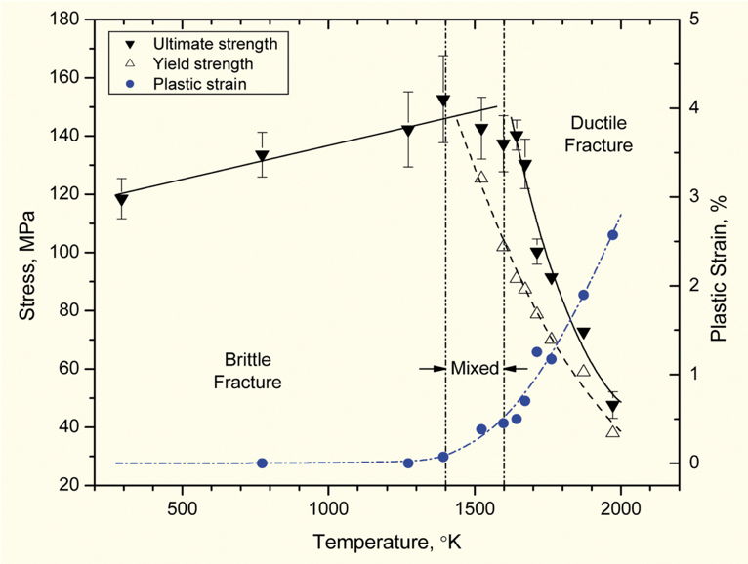
Fracture
The fracture behavior of the fuel is fairly complicated
Fracture strength varies with grain size (G)
σ_{frac} = G^{-m}σ_{frac, ref}, m = 0.04 – 0.05 (vs. m ~ 0.5 for metal)
Increasing grain size from 10 μm to 100 μm reduces σ_{frac} by ~10%
Ductility transition temperature is lower in-reactor than in thermal tests
Fracture strength is ~10× higher in compression than in tension
Load-deformation behavior strongly affected by creep under in-reactor conditions

Slide 12
Summary
Many materials models for fuel are empirical and correlated to burnup
Fuel pellets change shape due to
Thermal expansion (increase in volume)
Densification (decrease in volume)
Swelling (increase in volume)
Creep (volume stays the same)
Fracture also decreases the gap, as fractures pieces shift outward

Slide 13
Zirconium Cladding

Slide 14
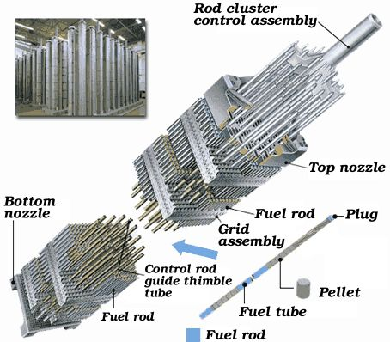
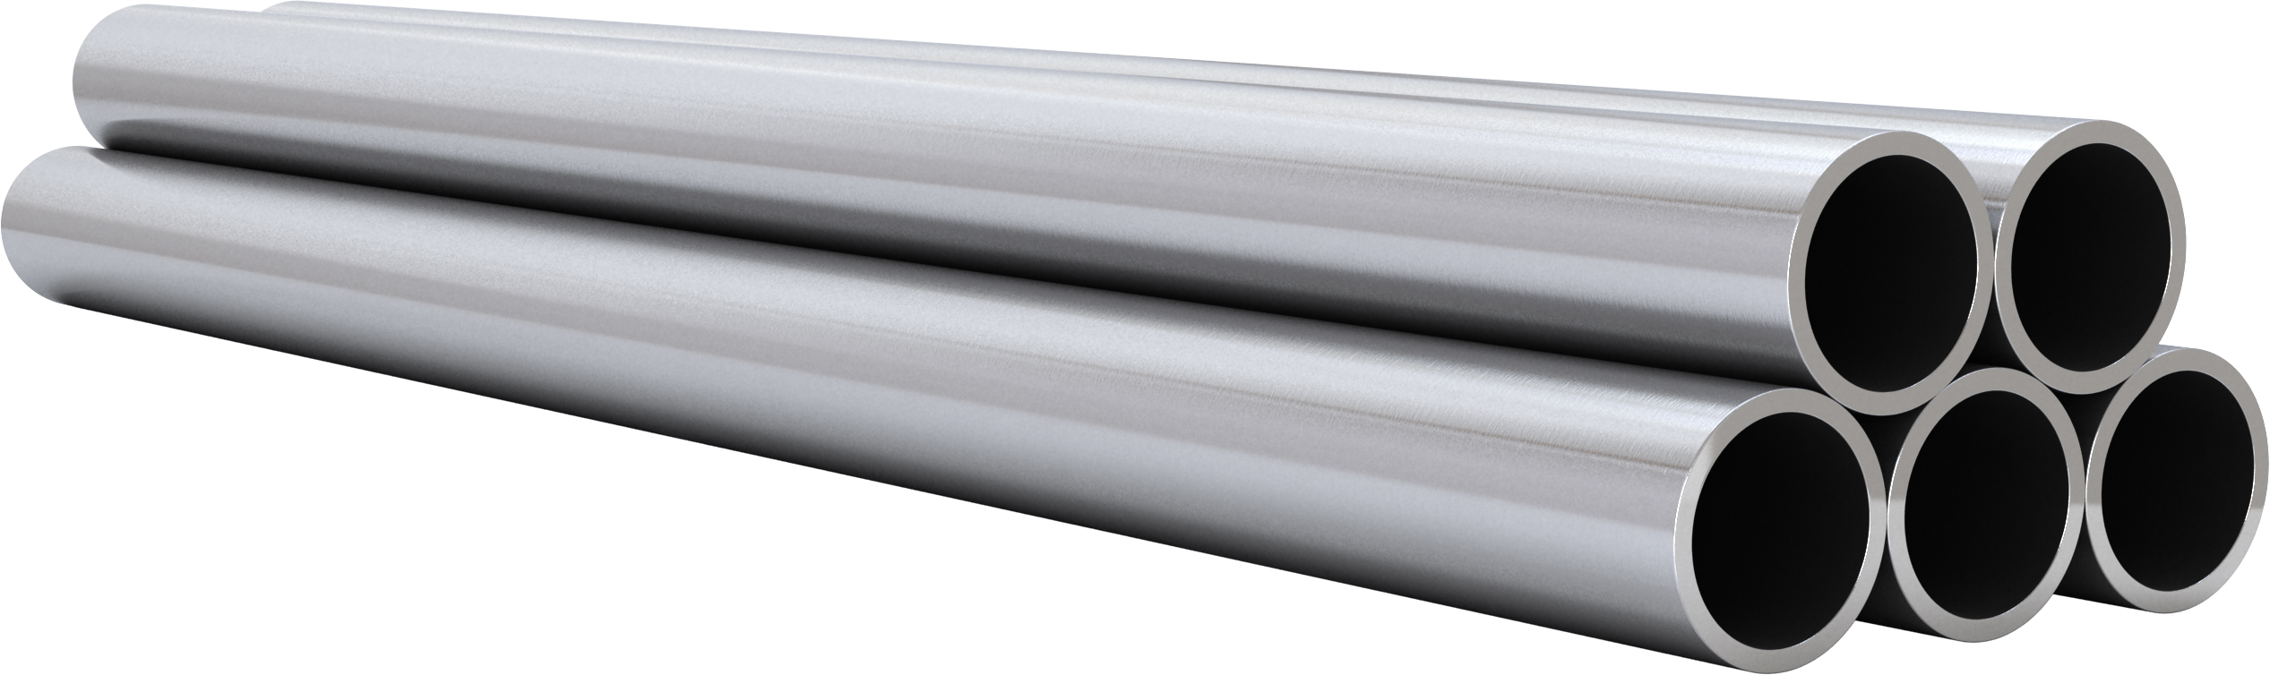
Cladding
The purpose of the cladding is to:
Hold the pellets together so that coolant can freely flow past
Transport heat from fuel to the coolant
Contain fission products
Contain fuel fragments
We would also prefer if the cladding had little to no impact on the neutron transport in the reactor

Slide 15
Why Zirconium alloys?
Benefits
Low neutron cross section
Corrosion resistance in 300˚C water
Resistance to void swelling
Adequate mechanical properties
Good thermal conductivity
Affordable cost
Available in large quantities
Problems
Corrosion under high-temperature steam
Hydride embrittlement
Anisotropic characteristics lead to creep and growth

Slide 16
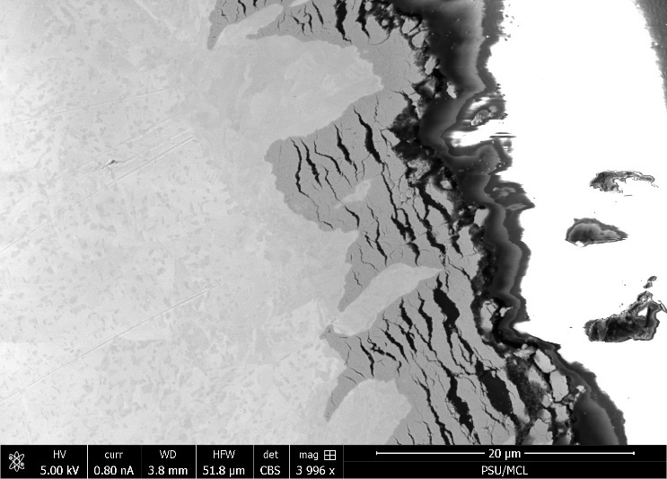
Zirconium
Pure zirconium was not acceptable due to its oxidation behavior
Oxygen with water reacted to form an oxide layer
The oxide layer is brittle and flakes off, allowing more oxidation to occur
Zr alloys were developed to improve corrosion resistance

Slide 17
Commercial Zr Alloys in PWRs
Alloy | Sn % | Nb % | Fe % | Cr % | Ni % | O %
PWRs (structural components and fuel rods)
Zircaloy-4 (SRA) | 1.2-1.7 | - | 0.18-0.24 | 0.07-0.13 | - | 0.1-0.14
ZIRLO (SRA) | 1 | 1 | 0.1 | - | - | 0.12
Optimized ZIRLO (pRXA) | 0.7 | 1 | 0.1 | - | - | 0.12
M5 (RXA) | - | 0.8-1.2 | 0.015-0.06 | - | - | 0.09-0.12
HPA-45 (SRA/RXA) | 0.6 | - | Fe+V | - | - | 0.12
NDA (SRA) | 1 | 0.1 | 0.3 | 0.2 |  | 0.12
MDA (SRA) | 0.8 | 0.5 | 0.2 | 0.1 |  | 0.12
PRXA Partial Recrystallization Anneal
RXA Recrystallization Anneal
SRA Stress-Relief Anneal

Slide 18
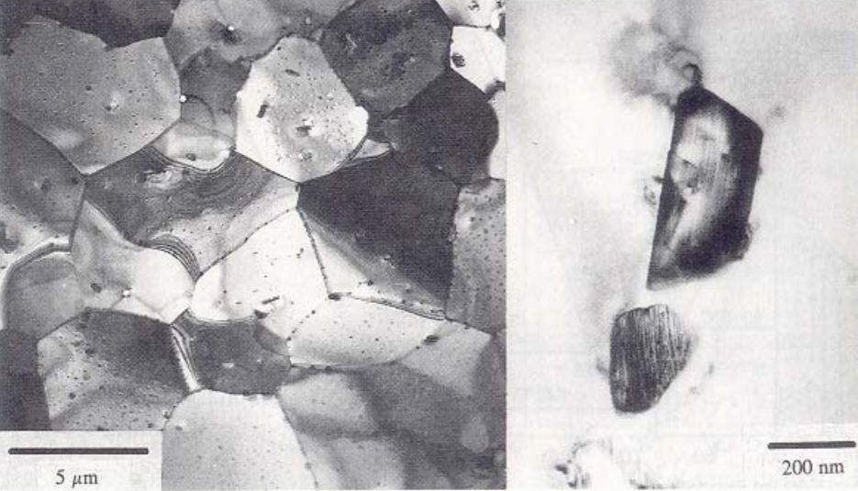
Alloying Elements
The alloying elements impact the microstructure of the material
The intermetallic precipitates significantly improve the oxidation behavior
In Zircaloy 2, the precipitates are
Zr(Cr, Fe)₂
Zr₂(Ni, Fe)
In Zircaloy 4, the precipitates are
Zr(Cr, Fe)₂
Phosphides (Zr₃P) and silicides (Zr₃Si) are also occasionally found
The precipitate distribution, size, morphology, and composition all impact the properties of the material

Slide 19
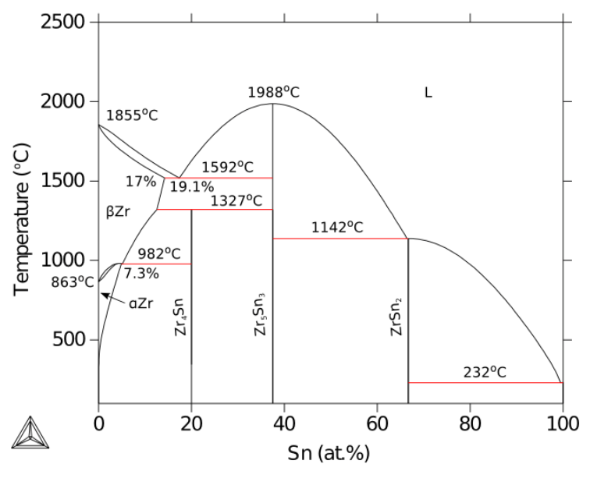
Zirconium Phases
The α-Zr phase has a hexagonal-close-packed (HCP) structure
At temperatures below about 863ºC
Has the most desirable properties
The β-Zr phase has a body-centered cubic (BCC) structure
We try to avoid this phase

Slide 20
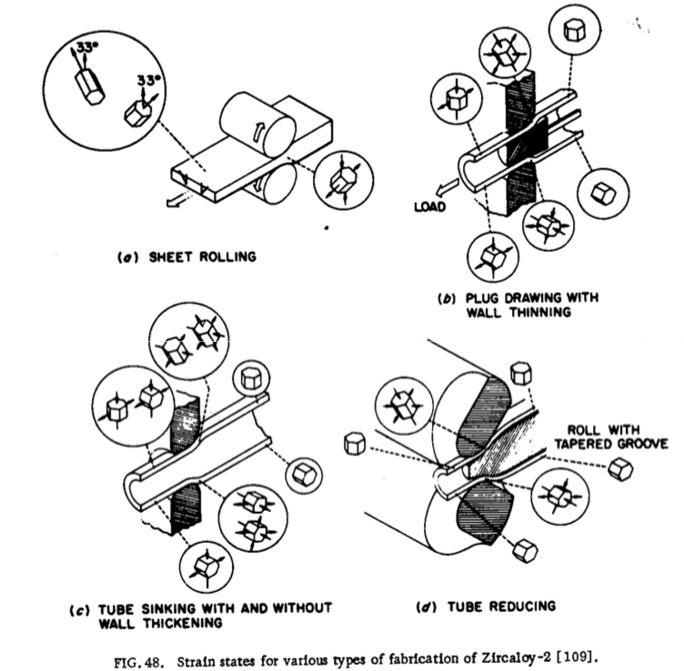
Zr Tube Fabrication
The cladding tubes are fabricated using various processes that severely deform the material
The severe plastic deformation causes significant dislocation hardening, that can make the tube material too brittle
Plastic deformation along slip planes results in reorientation of the grains
The properties of the material are controlled by heat treatment
Raising the temperature, but below 863˚C, anneals the sample to reduce cold work: SRA
Raising the temperature above 863˚C changes to the β phase. They then quench the sample to create a random texture in the α phase: RXA or pRXA

Slide 21
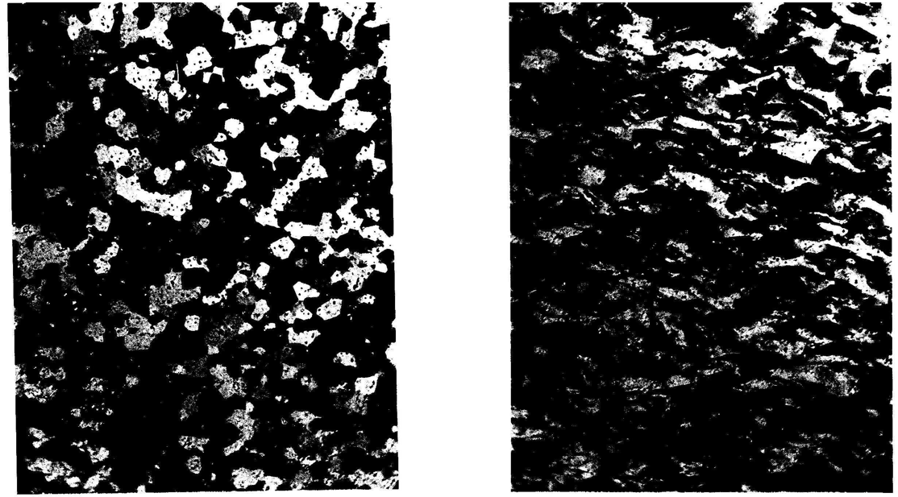
Zr alloy microstructures
Fully recrystallized after quench
Stress-relieved microstructure

Slide 22
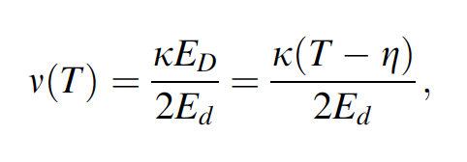
Zirconium Creep and Growth
The cladding undergoes a very large amount of irradiation during its life, the main effects are:
Interstitial loops form on prismatic planes
Later in the reactor exposure, vacancy loops form on the basal plane
The overall number of displacements to the cladding can be calculated with the NRT model to be ~ 8 x 10⁻⁸ dpa/s, which, over 3 years exposure gives a total of ~8 dpa (every atom in the solid is displaced on the average eight times)

Slide 23
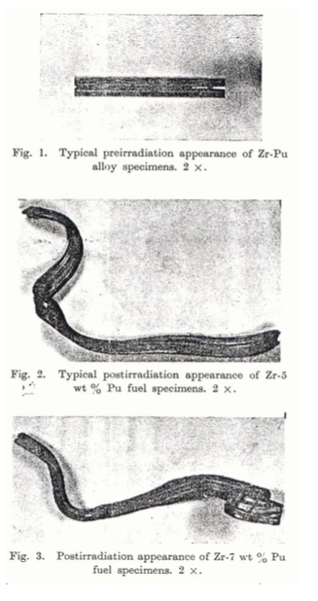
Irradiation Growth
Irradiation growth results from material anisotropy
There is corresponding anisotropy in the defect behavior within the unit cell
There is also a texture formed in the grain orientations
Interstitial loops form on pyramidal planes, causing shrinkage along the center axis
Later, vacancy loops form on basal planes, making it even worse
The result is a change in shape, shrinking in the 0001 direction and expanding in the pyramidal direction

Slide 24
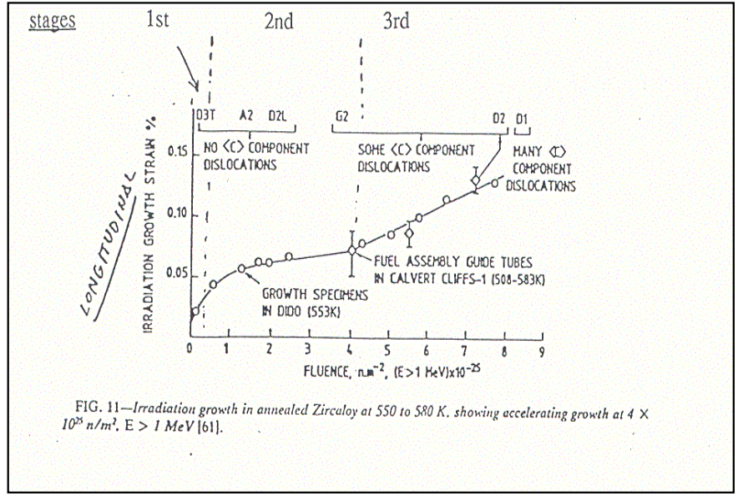
Irradiation Growth
Three stages of irradiation growth
Initial rapid growth to small strains – defect generation
Slow growth – defect accumulation, gets skipped in cold worked material
Accelerated or breakaway growth, caused by formation of vacancy loops on the basal plane
Irradiation growth is affected by:
Fluence, Cold work, Texture, Irradiation temperature, Material chemistry, Hydrogen effects

Slide 25
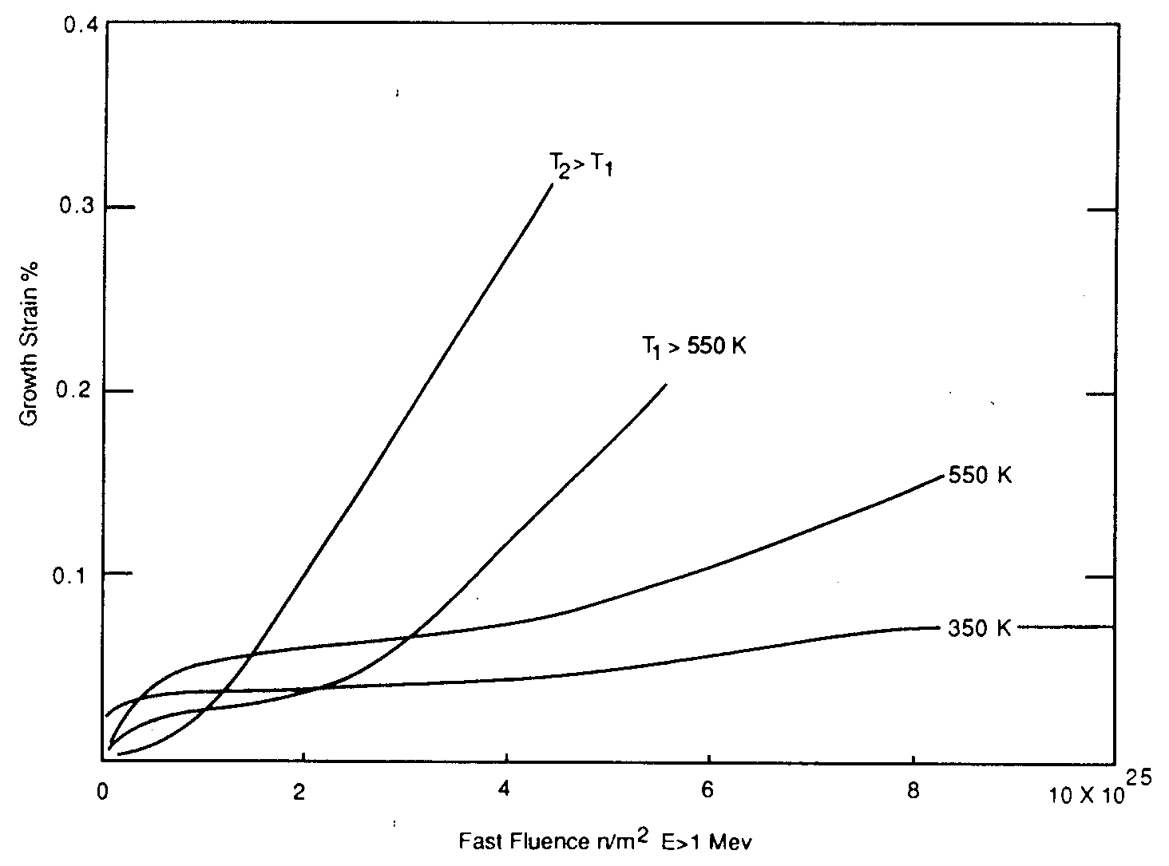
Irradiation Growth
Higher temperature leads to earlier breakaway and higher growth
Higher temperature adds mobility to defects, allowing them to diffuse faster, form clusters, and exacerbate the defect cluster induced anisotropic growth

