Slide 1
Nuclear Fuel Performance
NE-533
Spring 2025

Slide 2
Housekeeping
Last module!
Planned final exam on last day of classes, April 22
Will cover what we can until then

Slide 3
cladding oxidation

Slide 4
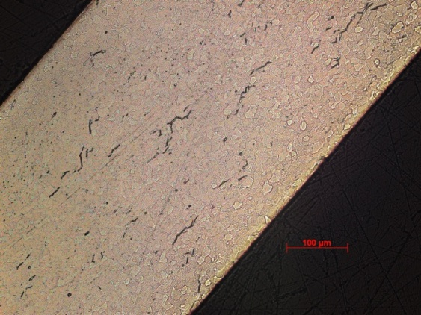
Zirconium Oxidation
Corrosion of zirconium due to the water coolant is one of the largest concerns for LWR fuel operation
Corrosion of zirconium alloys in an aqueous environment is principally related to the oxidation of the zirconium by the oxygen in the coolant, dissolved or produced by radiolysis of water
Zirconium interacts with water to make zirconia and hydrogen
Both the oxide layer and the hydrogen adversely impact cladding performance
ZrO₂
Zr metal

Slide 5
Corrosion
Corrosion is the degradation of a material and its properties under the action of the surrounding environment by chemical and/or electrochemical reaction
Corrosion reactions require the following:
Oxidant
Electric current
A corrosion reaction is composed of an oxidation reaction and a reduction reaction
During corrosion at a particular spot on the surface of the object, oxidation takes place, and that spot behaves as an anode
The electrons released at this anodic spot move through the metal and go to another spot and reduce H, which behaves as a cathode

Slide 6
Corrosion
Corrosion reaction rates are determined by thermodynamics and kinetics
Thermodynamics tell us whether a material may corrode
Measure voltage difference between anodic and cathodic sites
Kinetics tell us how quickly a material will corrode
Measure net current between anodic and cathodic sites

Slide 7
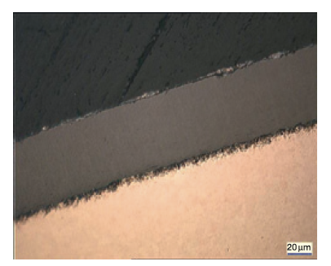
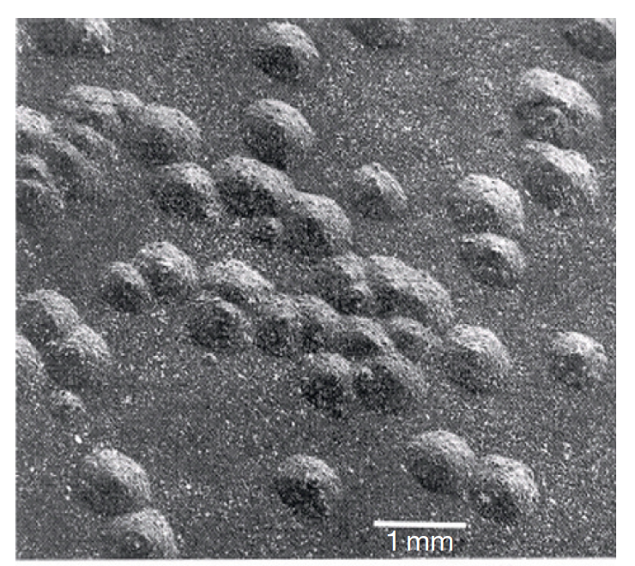
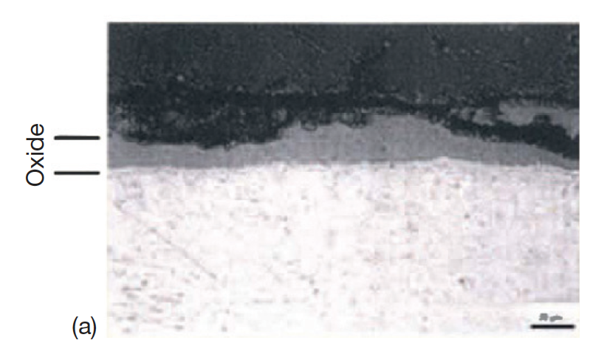
Corrosion Types in LWRs
Several types of corrosion morphologies have been observed in nuclear reactors and in autoclave experiments, of which the most important are: 1) uniform, 2) nodular, and 3) shadow
Uniform: The formation of a thin uniform layer of zirconium dioxide on the surface of a zirconium alloy component
Nodular : The formation of local, small, circular zirconium oxide blisters
Shadow: The formation of local corrosion regions that mirror the shape (suggestive of a shadow) of other nearby noble reactor core components

Slide 8

Formation of Oxide Layer After Oxide Formation
H₂0
Zr
H₂0
ZrO₂
Zr
O⁻²
e⁻
Oxidation reaction:
Dissociation of water at oxide/water interface
Absorption of oxygen into oxide layer
Diffusion of oxygen through oxide layer
Reaction of oxygen with zirconium
Diffusion of electrons through oxide layer
Reduction of hydrogen
Reduction reaction:

Slide 9
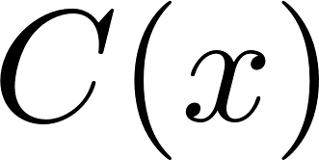
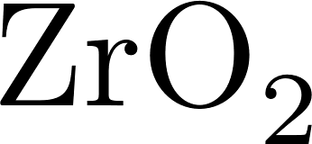

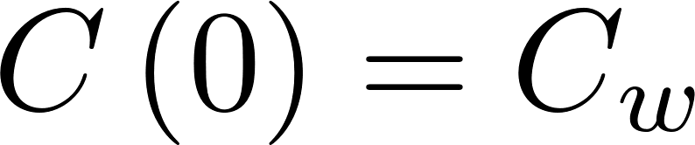
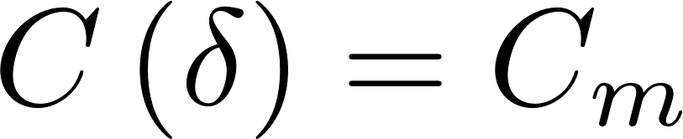

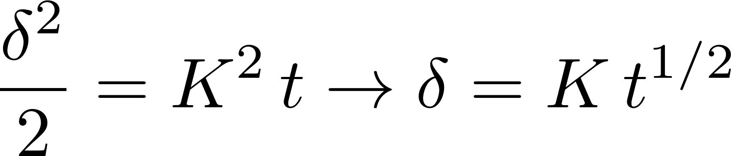

Corrosion rate limited by diffusion
Because the rate limiting steps are diffusion, we can model the oxidation rate using diffusion
Assumptions:
Transport of O species is rate-limiting
Transport of charged species by diffusion only
Homogeneous oxide layer
No sources/sinks of ions in oxide
All oxygen is used to create oxide
No loss of oxide

Slide 10
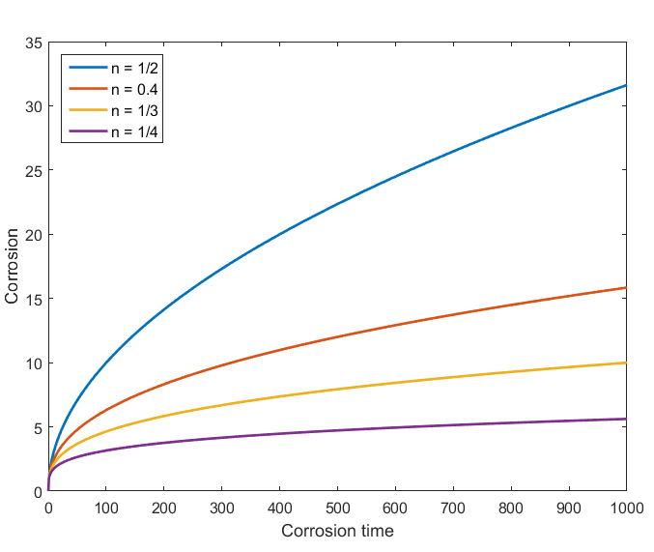
Observed kinetics are slower than parabolic
Parabolic kinetics
Diffusion of species across the oxide
Sub-parabolic kinetics
Additional ions, dopants, or defects in oxide
Non-uniform electric field in oxide layer
Once a nonhomogeneous electric field arises, the corrosion rate decreases to the sub-parabolic rate due to inhibition of transport of charged species

Slide 11
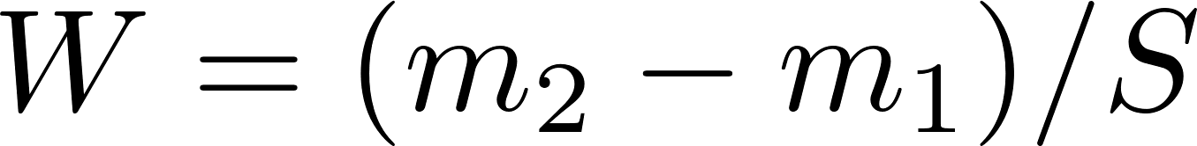
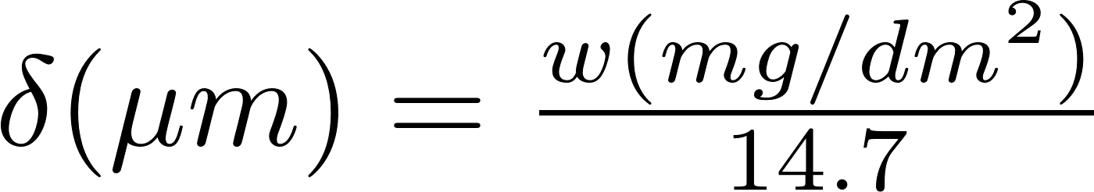
Corrosion Quantified
Corrosion is measured by sample weight gain
Oxidation of alloys is measured experimentally using the weight gain in mg/dm²
Oxide forms by incorporating oxygen in the metal structure causing an increase in weight
14.7 comes from density of O in ZrO2
Approximation weight gain – oxide thickness for Zr:
Dividing by the surface enables comparison between samples

Slide 12
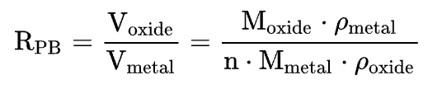
Pilling-Bedworth ratio : PBR
The ratio of the volume per unit of the metal oxide to the volume per unit of the corresponding metal is called the Pilling-Bedworth ratio (PBR)
PBR < 1: the oxide coating layer is thin, likely broken and provides no protective effect (for example magnesium)
PBR > 2: the oxide coating chips off and provides no protective effect (example iron)
1 < PBR < 2: the oxide coating is passivating and provides a protecting effect against further surface oxidation
Passivation refers to a material becoming "passive," that is, less affected or corroded by the environment
ZrO₂
Zr metal

Slide 13
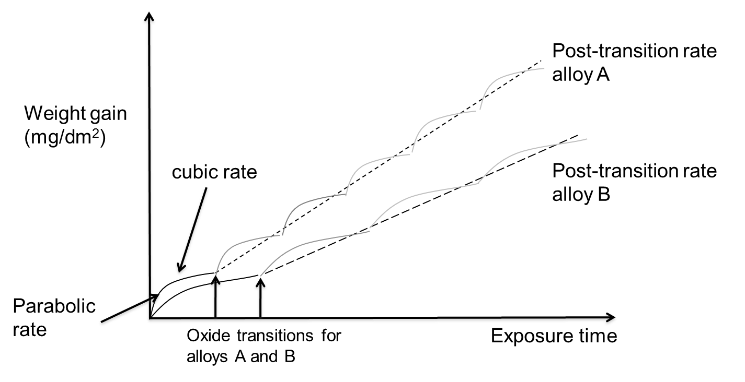
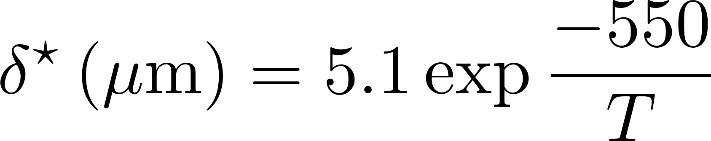
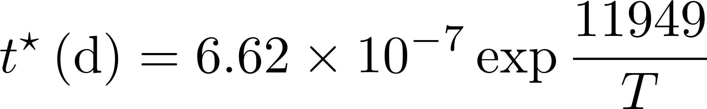
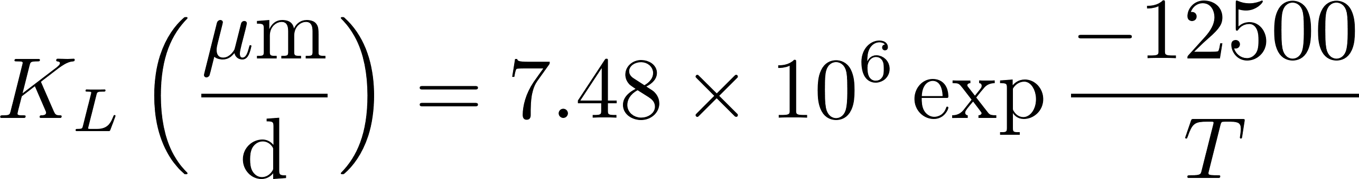
Corrosion Rate
Average weight gain of a sample follows linear kinetics
The oxide reaches transition at different times in different points, but the average is linear
Critical oxide thickness for transition is defined as
Critical time for transition is defined as
After transition, oxide thickness is

Slide 14
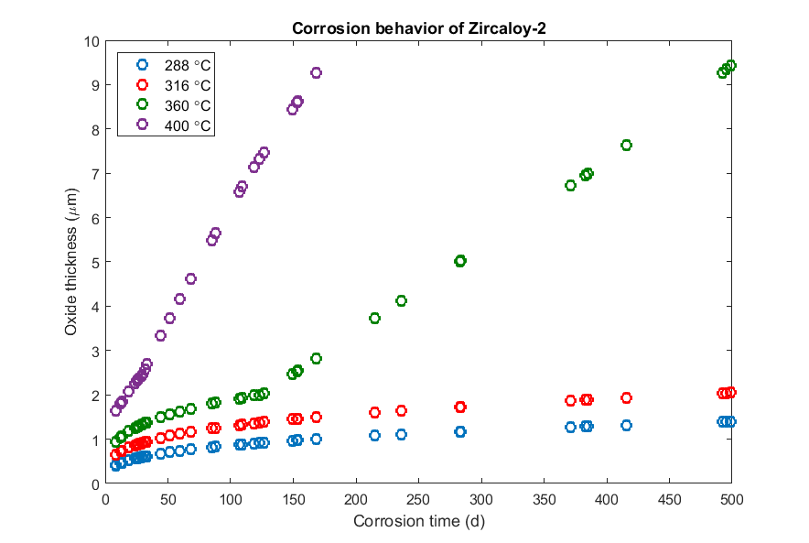
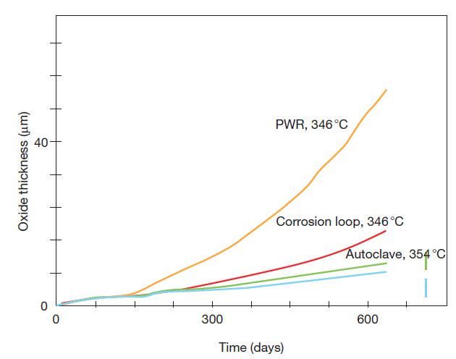
Other factors affecting corrosion
Temperature:
Corrosion rate increases with temperature
Irradiation: Radiation damage to the metal; Radiation damage to oxide

Slide 15
Impact of Corrosion
The oxide layer has a low thermal conductivity, restricting heat transport
For Zircaloy, k = 22 W/(mK)
For ZrO₂, k = 1.7 – 2.7 W/(mK)
The oxide layer is much more brittle than the zircaloy
Zircaloy metal is removed as brittle oxide is added to the material
Oxidation produces hydrogen that can enter the cladding and form brittle hydrides

Slide 16
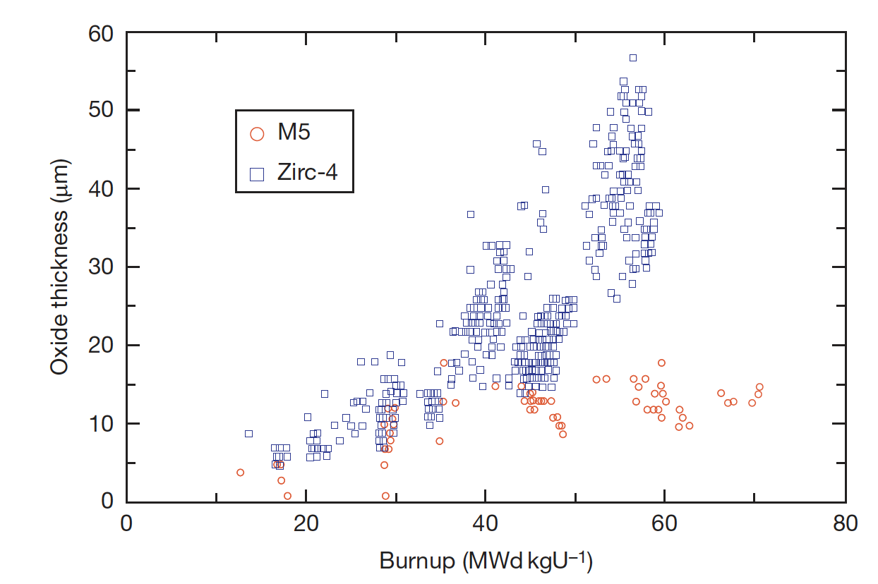
Corrosion Control
The oxidation and hydrogen uptake of Zircaloy is of course determined by many factors
The chemical and physical state of the material: composition, metallurgical condition, and surface condition
Two different zirconium alloys employed in French PWRs, Zircaloy and Zr1% Nb (M5), display distinct corrosion behaviors
The peak oxide layer thickness of Zircaloy-4 increases significantly with burnup, whereas that of Zr1%Nb shows a moderate increase

Slide 17
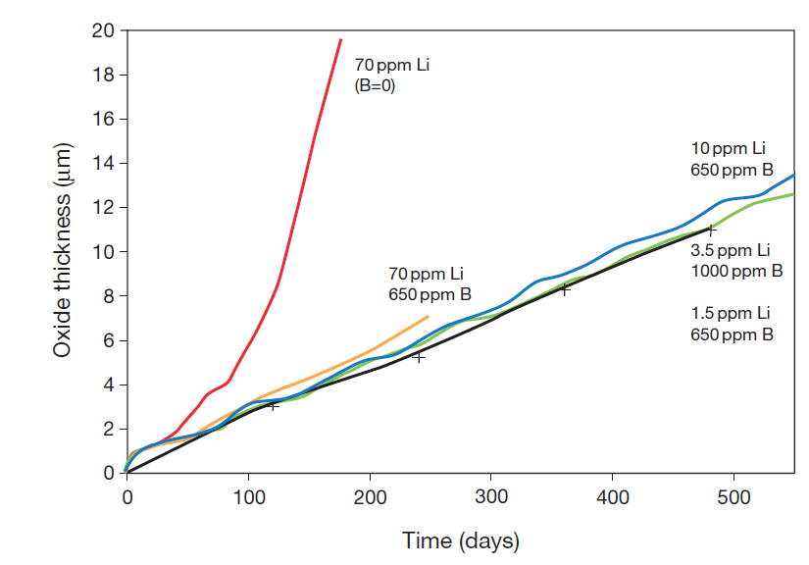
Corrosion Control
Water Chemistry
The dissolved oxygen and hydrogen play a major role in the corrosion process, but other dissolved species must also be taken into account
To control the pH of the coolant at slightly alkaline conditions, LiOH is added and H3BO3 (boric acid) is added for reactivity control in PWRs
Impurities (Cl, F) and coolant-borne species (Cu, Ni, etc.) must be considered
Temperature and irradiation also have an effect on the corrosion behavior, but are governed by engineering constraints
CRUD (Chalk River Unidentified Deposit) can accelerate corrosion

Slide 18
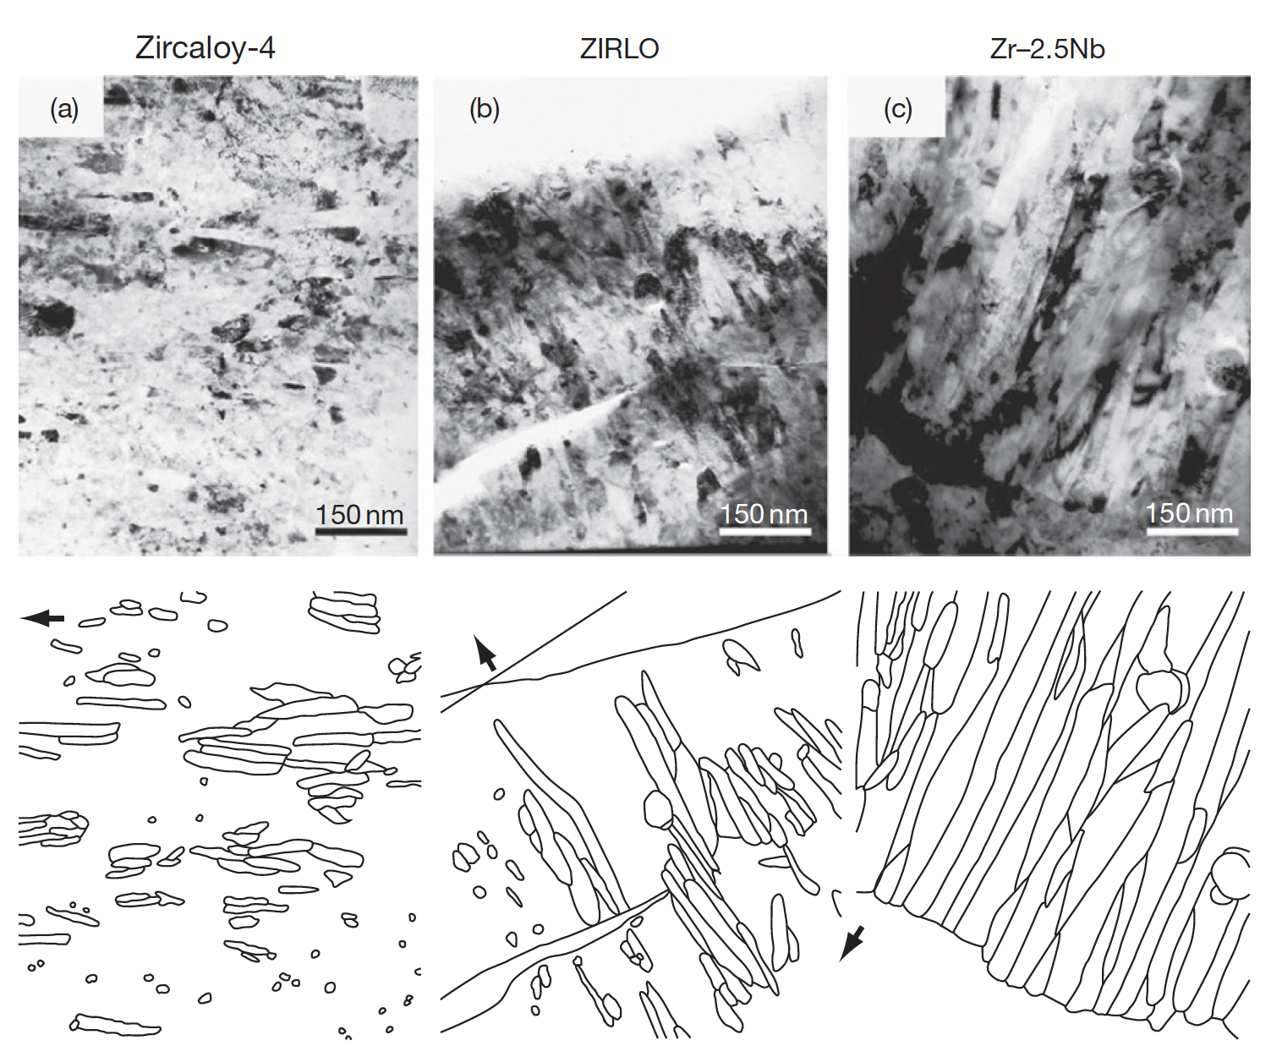
Corrosion Layer
Uniform corrosion is a passivating event since a protective layer of zirconium oxide is formed as a result of the reaction with the O2 ions or the OH radicals
The oxide layer is microcrystalline, initially equiaxed, later growing into columnar grains that are formed in a dense packing, of which the mean crystallite size increases as the oxide thickens

Slide 19
Corrosion Summary
Corrosion is the environmental degradation of materials
Cladding oxidizes, forming ZrO₂
The limiting step for oxidation is the oxygen transport through the oxide layer
It begins being controlled by diffusion
Then, a protective layer forms that slows oxidation
Once transition occurs, it loses its protectiveness and speeds up again
Oxidation hurts cladding performance by
Restricting heat transport
Converting zircaloy into a brittle oxide

Slide 20
Hydride Formation
Corrosion reaction:
Corrosion of zirconium is so damaging in large part due to hydride formation
Some of the hydrogen atoms produced by oxidation enter the cladding and form a hydride phase
Other sources of H can increase the amount available to form hydrides, but this is minor
Hydrogen pickup causes hydrogen embrittlement, loss of fracture toughness, delayed hydride cracking, accelerated corrosion, and accelerated irradiation growth
ZrO₂
Zr metal
Hydrogen pick-up

Slide 21
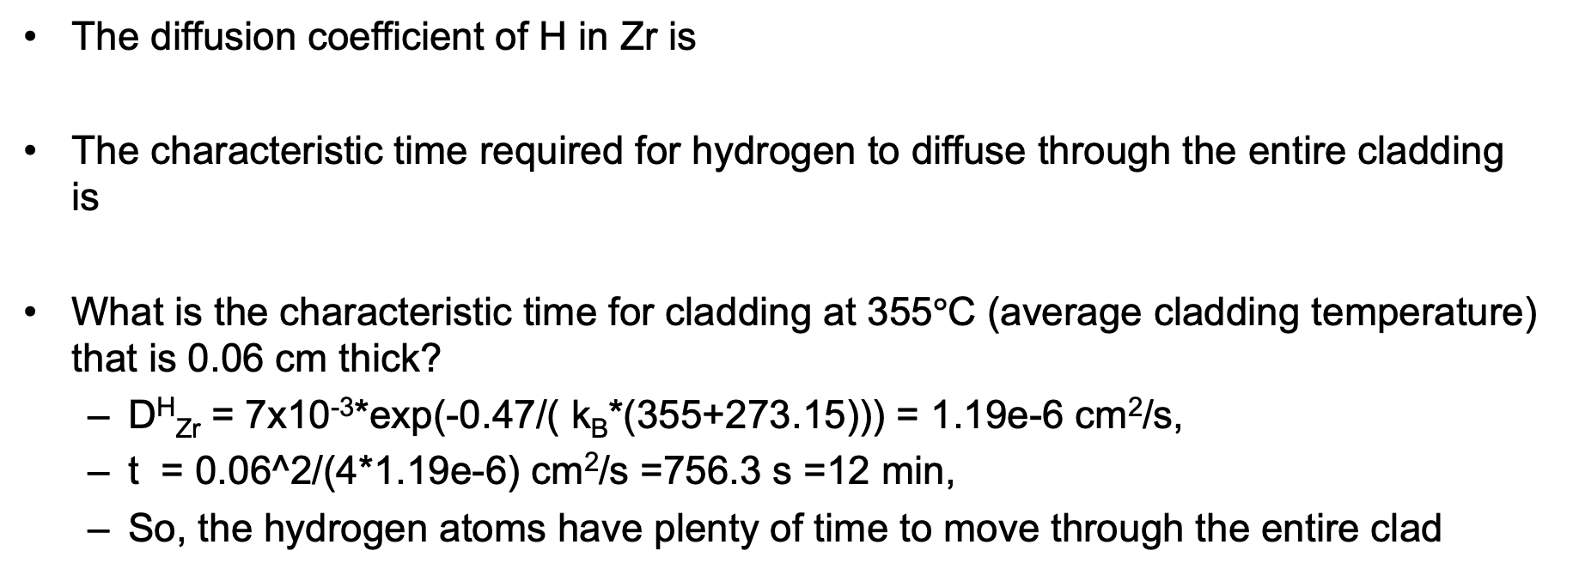
Hydrogen Diffusion
The diffusion coefficient of H in Zr is
The characteristic time required for hydrogen to diffuse through the entire cladding is
What is the characteristic time for cladding at 355$°$C (average cladding temperature) that is 0.06 cm thick?
D^{H}_{Zr} = 7x10⁻³*exp(-0.47/( k_{B}*(355+273.15))) = 1.19e-6 cm²/s,
t = 0.06^2/(4*1.19e-6) cm²/s =756.3 s =12 min,
So, the hydrogen atoms have plenty of time to move through the entire clad

Slide 22
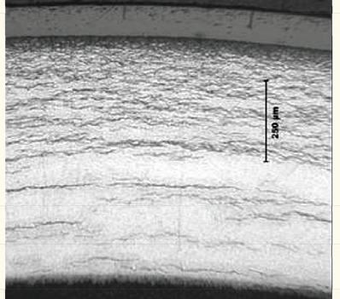
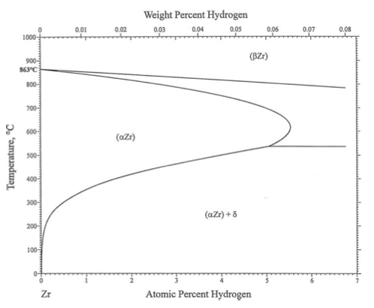
Hydriding
Hydride concentrations are not uniform, because they respond to temperature and stress gradients
Plate-type hydrides lead to stress concentrations, prefer matrix tensile stresses
Hydrogen tends to move toward lower temperature (Soret effect)
It also moves to areas with tensile stress
Hydrogen has a low solubility in zirconium, so even small hydrogen concentrations result in hydrides

Slide 23
Effect of Hydrides
The hydride rim is caused by the Soret effect and the temperature dependence of the solubility
The hydride rim and blisters can cause a loss of ductility, leading to earlier failure
Hydride rims are layers of uniform depth, that can reach 50–60 microns, and cover a wide area on the tube azimuthal and axial directions
If hydride is localized, can form blisters
Blisters have an elliptic shape, are more localized on the tube external surface and are deeper, usually covering half of the cladding thickness

Slide 24
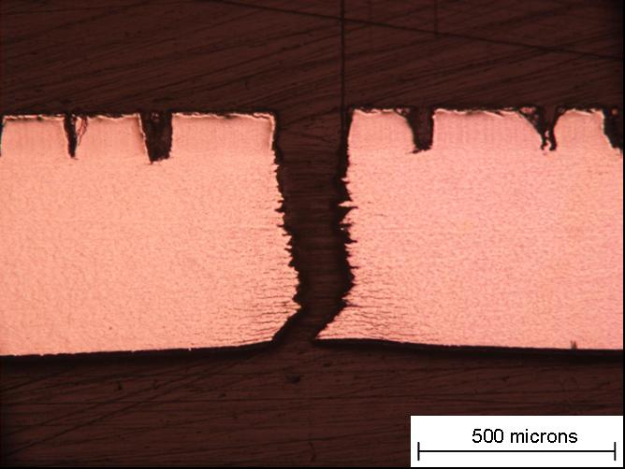
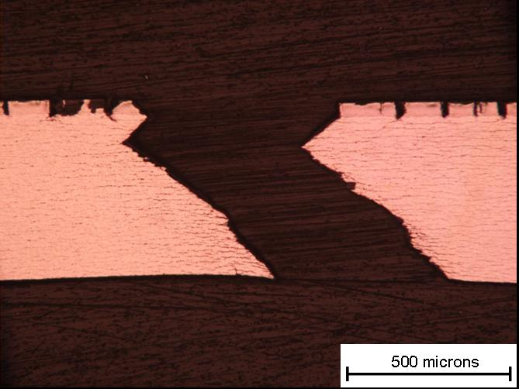
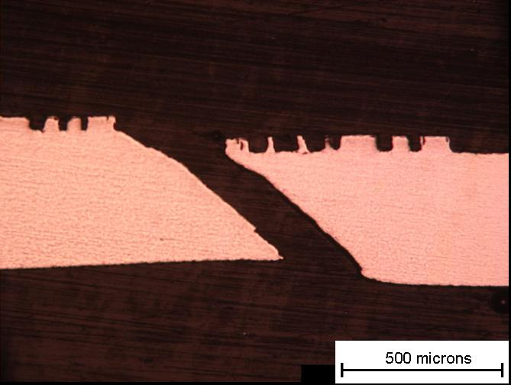
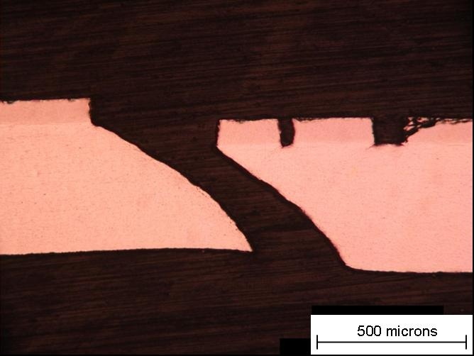
Blister failure examples
But in small blisters => shear instability
90 degree failure at RT
40 μm Blister Broken at 25 °C
M014
93 μm Blister Broken at 25 °C
M020
53 μm Blister Broken at 300 °C M025
83 μm Blister Broken at 300 °C M023
At 300 C, 45 degree shear
24

