Slide 1
Nuclear Fuel Performance
NE-533
Spring 2025

Slide 2
Housekeeping
Class eval is open:
http://go.ncsu.edu/cesurvey
You should have gotten an email requesting that you fill this out
This helps me improve as a professor and provides critical feedback for the course
Have sent out a survey for my personal feedback (also here)
Anonymous, but email me a confirmation of your completion, and you will receive a +5 on the final exam
Exam 3 grades
Avg: 84.7. Curve of 5 points.
Need to pay attention to units! Many simple units mistakes

Slide 3
Last time
Cladding oxidizes, forming ZrO₂
The limiting step for oxidation is
the oxygen transport through the oxide layer
Relationships for oxide thickness based on weight gain and for prediction of oxide layer growth based upon power law kinetics
Hydrogen released by oxidation enters the cladding
Hydrides preferentially form:
in areas of tensile stress and lower temperature (solubility and Soret effect)
Mechanical effect of hydrides:
hydrides are brittle, and so reduce the ductility of the cladding

Slide 4
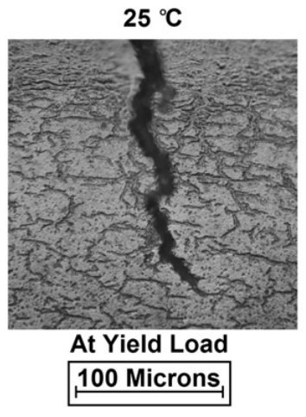
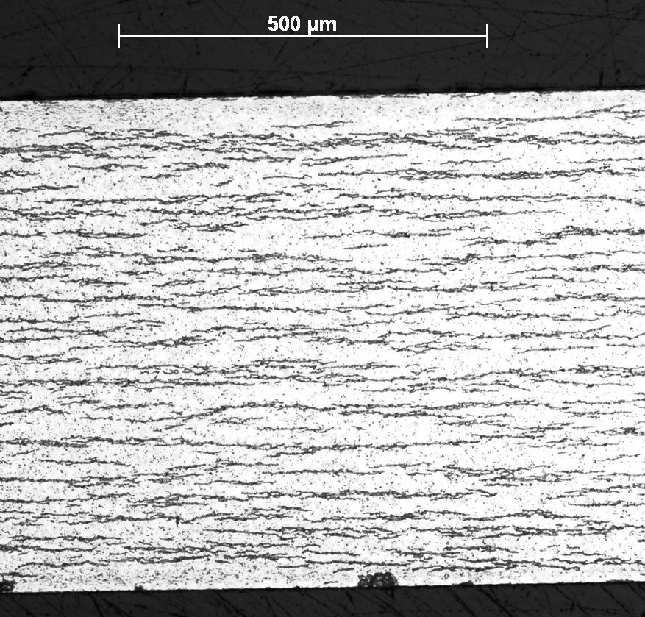
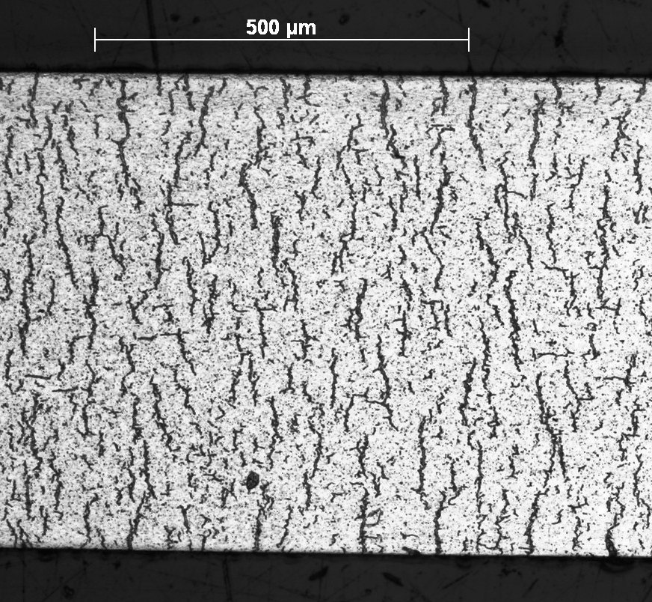
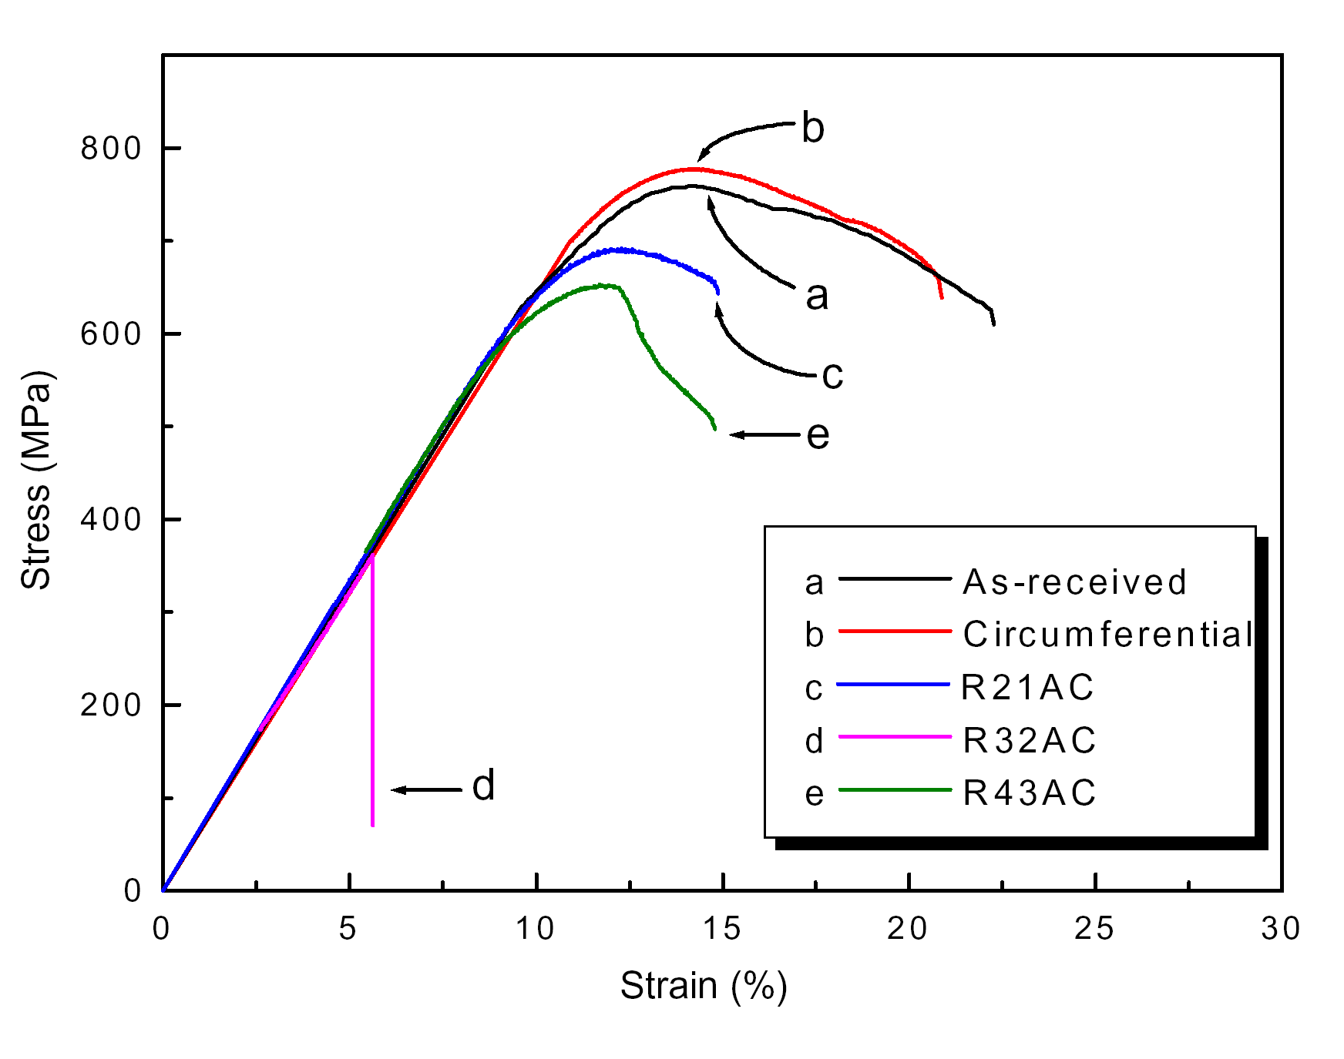
Circumferential vs Radial Hydrides
Under reactor conditions, hydride platelets precipitate circumferentially
In used fuel after drying, the hydrides can reprecipitate with a radial orientation
The hydrides reform in a radial direction due to the tensile radial stress
Radial hydrides provide easy crack paths and significantly decrease the ductility of the cladding

Slide 5
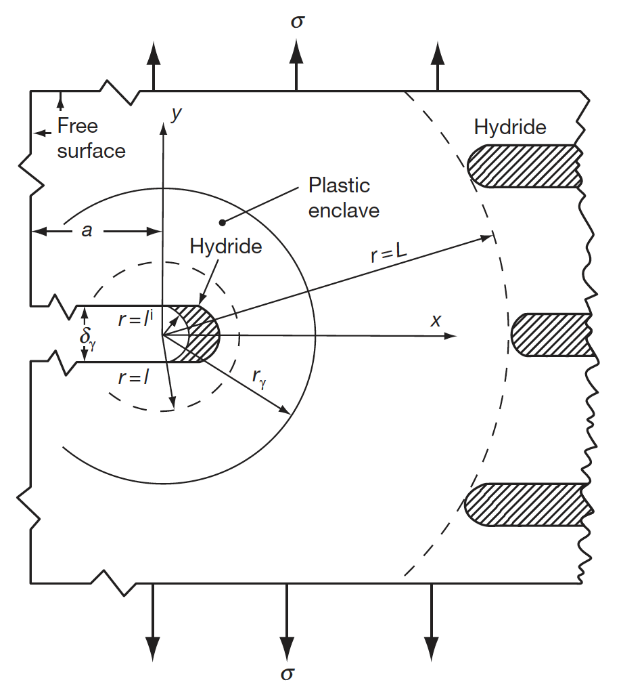
Delayed Hydride Cracking
The theory of DHS is that the crack tip hydride grows as hydrogen migrates from hydrides in the bulk of the material to the crack tip
The driving force for the diffusion of the hydrogen is the difference in the chemical potential of hydrogen between the bulk material and the crack tip hydride in response to stress
An increasing hydrostatic tensile stress reduces the chemical potential of hydrogen in the hydride relative to the bulk
This chemical potential difference causes hydrogen in solution to diffuse to the crack tip where it precipitates

Slide 6
Hydrogen Pickup
The fraction of the produced hydrogen that enters the cladding is defined by the pickup fraction:
Hydrogen is produced twice as fast as oxygen
J_{H} = 2 f J_{O}
We can estimate the hydrogen content in the cladding from the oxide thickness δ and the pickup fraction f

Slide 7
Given a thickness of oxide, how can we predict the hydrogen pickup?
A cladding with an initial thickness of 600 microns that initially has 40 wt. ppm H undergoes corrosion to a total oxide thickness of 80 microns. What is the overall hydrogen content in wt. ppm if the hydrogen pickup fraction is 15%?
First, we must determine the weight of H that has entered the cladding
ρ_{ZrO2} is 5.68 g/cm³, of which 32/(91+32)= 0.26 = 26% is O, thus 1.47 g/cm³ of O
A 1 micron oxide layer corresponds to a weight gain of 14.7 mg/dm² and thus with an 80 micron layer, weight gain = 14.7*80 = 1176 mg/dm²
This mass corresponds to 1.176 N_{A}/16 atoms of oxygen = 4.42 x 10²² atoms/dm²
f = 15%, so the ingress of hydrogen will be 0.15*2*4.42e22 = 1.33e22 atoms of hydrogen/dm², or 0.022 g of H.
Now, we determine the fraction in wt. ppm in a 10 cm square cross section w/ PBR = 1.56
The uncorroded thickness is 600 – 80/PBR = 600 – 80/1.56=549 microns
The volume of zirconium is 549 x 10⁻⁴ (cm)*10*10 =5.49 cm³
ρ_{Zr} = 6.5 g/cm³, so the total mass of Zr is 6.5*5.49 =35.7 g.
Thus the hydrogen concentration is 0.022/35.7 =6.18e-4= 618 wt. ppm, which, added to the original 40 wt. ppm, is 658 wt. ppm

Slide 8
Hydrides Summary
Hydrogen released by oxidation enters the cladding and quickly diffuses throughout the cladding
Due to low solubility (that is a function of temperature), hydrides form
Hydrides are brittle, and so reduce the ductility of the cladding
Hydrides form circumferentially under operating conditions due to the tensile hoop stress in the cladding
Radial hydrides can form in used fuel after drying, and reduce ductility much more than circumferential hydrides
DHC is a phenomenon based upon increased solubility of hydrogen in the high tensile stress around a crack tip
Have the ability to predict hydrogen pickup in oxidized Zr cladding

Slide 9
ACCIDENT SCENARIOS

Slide 10
Kinds of Accidents
Design basis accident: DBA
are postulated, credible accidents with low probability that are used to establish the design basis for the reactor and to define safety limits for its operation
two main kinds are RIA and LOCA
Beyond design basis accident: BDBA
accidents that fall outside of what is designed for, because they are deemed too unlikely to be included in design

Slide 11
Reactivity Initiated Accident (RIA)
Reactivity is the fractional departure from criticality: δk = (k − 1)/k
where k is your effective multiplication factor
k = (Neutrons produced in one generation)/(Neutrons produced in the previous generation)
k = ε L_{f} p L_{th} f η – this is your six-factor formula
ε = fast fission factor
L_{f} = fast non-leakage factor
p = resonance escape probability
L_{th} = thermal non-leakage factor
f = thermal fuel utilization factor
η = reproduction factor

Slide 12
Reactivity
Reactivity = rho = r = δk = (k − 1)/k
At steady state, k=1, rho=0
Reactivity is affected by the temperature and density of coolant, moderator, and fuel
Ideally, nuclear reactors are designed so that a power increase will generate negative reactivity feedback
an increase in the reactivity (higher k) leads to material changes, which in turn force a negative reactivity (lower k)

Slide 13
RIA-PWR
Design Basis Accident: Large and rapid insertion of reactivity caused by inadvertent ejection (PWR) or drop (BWR) of a control rod
A control rod ejection or drop can occur by mechanical failure of the control rod drive mechanism or its housing, and the reactivity of the core can rapidly increase due to decreasing neutron absorption of non-fuel
PWR
Control rod ejection accident (CREA)
Caused by mechanical failure of a control rod mechanism housing, such that the coolant pressure ejects a control rod assembly completely out of the core
Reactivity increase to the core occurs within about 0.1 s in the worst possible scenario
The most severe CREA would occur at normal coolant temperature and pressure, but with nearly zero reactor power

Slide 14
RIA-BWR
BWR
Control rod drop accident (CRDA)
Initiated by the separation of a control rod blade from its drive mechanism
Detached blade remains stuck in position until it suddenly becomes loose and drops out of the core in free fall
Most severe CRDA would occur at with the coolant close to room temperature and atmospheric pressure, and the reactor at nearly zero power
Other RIAs
inadvertent changes in coolant/moderator temperature and/or void fraction may add reactivity to the core

Slide 15
RIA
RIA leads to a fast rise in fuel power and temperature
This power ramp can lead to failure of fuel rods and release of radioactive material (or potentially fuel) into coolant
Release of hot fuel into water can cause rapid steam generation and pressure pulses, damaging other core internals
Coolant pressure pulse could break the reactor coolant pressure boundary or damage the fuel and other core internals so that long-term cooling of the core would be impaired
To prevent such consequences, safety criteria are set up to limit energy injection into the fuel

Slide 16
History of RIA
No RIA with severe consequences has occurred in PWRs or BWRs
The first reactivity-initiated accidents occurred in the 1950s and 1960s and concerned the first generation of research reactors
1952 accident in the NRX reactor at Chalk River
1961 SL-1 accident in Idaho Falls
Both resulted in severe damage and disruption of the reactor, and led to design improvements for later generations of RRs and commercial reactors
Did not eliminate RIAs
K-431 Russian Echo-II nuclear powered submarine in 1985
Chernobyl nuclear power plant, Ukraine, in 1986

Slide 17
Chernobyl RIA
Light water graphite moderated pressure tube design (RBMK)
Severe consequences of the Chernobyl accident were due to the fact that RBMKs lack not only a reactor containment, but also some of the inherent feedback mechanisms
Accident occurred under a reactor test, where normal operating guidelines were ignored and safety systems were shut off
Chernobyl accident prompted new research into reactivity-initiated accidents
focused on high burnup fuel, where previous safety standards had largely been on fresh fuel or low BU

Slide 18
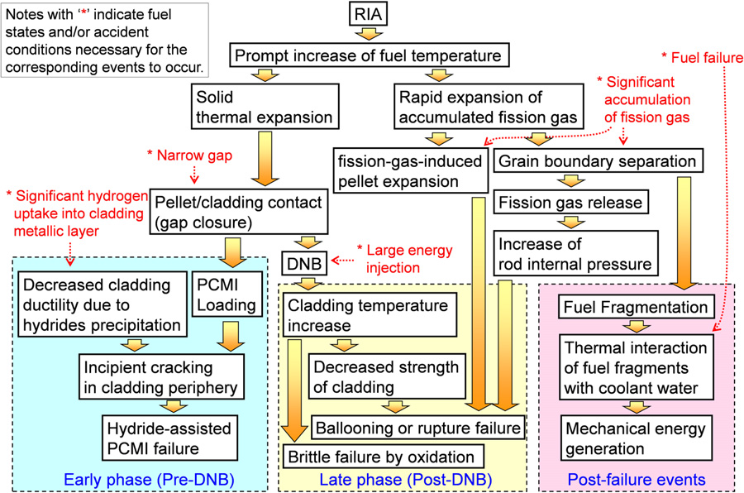
Sequence of RIA

Slide 19
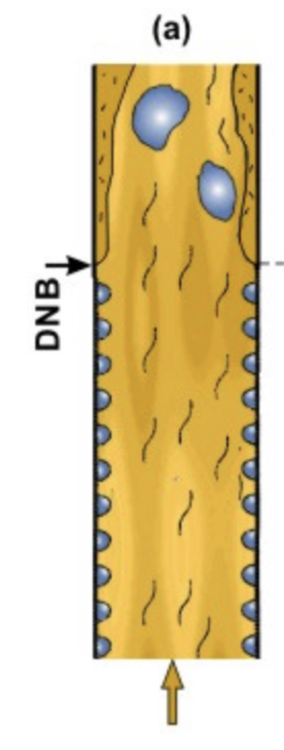
Departure from Nucleate Boiling
If the heat flux of a boiling system is higher than the critical heat flux (CHF) of the system, the bulk fluid may boil, or in some cases, regions of the bulk fluid may boil where the fluid travels in small channels
Large bubbles form, sometimes blocking the passage of the fluid
This results in a departure from nucleate boiling (DNB) in which steam bubbles no longer break away from the solid surface of the channel, bubbles dominate the channel or surface, and the heat flux dramatically decreases
Vapor essentially insulates the bulk liquid from the hot surface, increasing surface temperatures

Slide 20
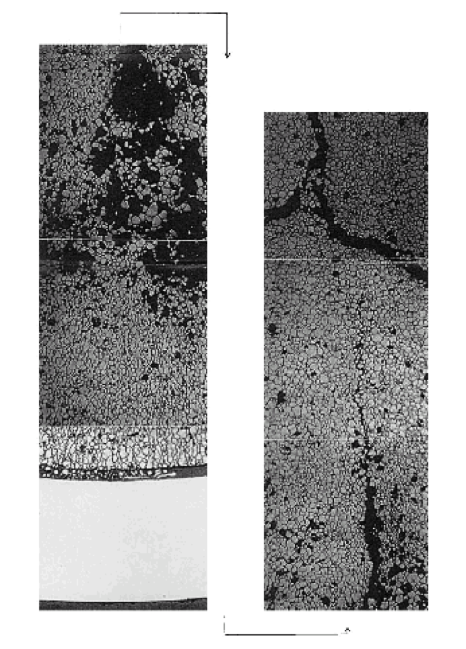
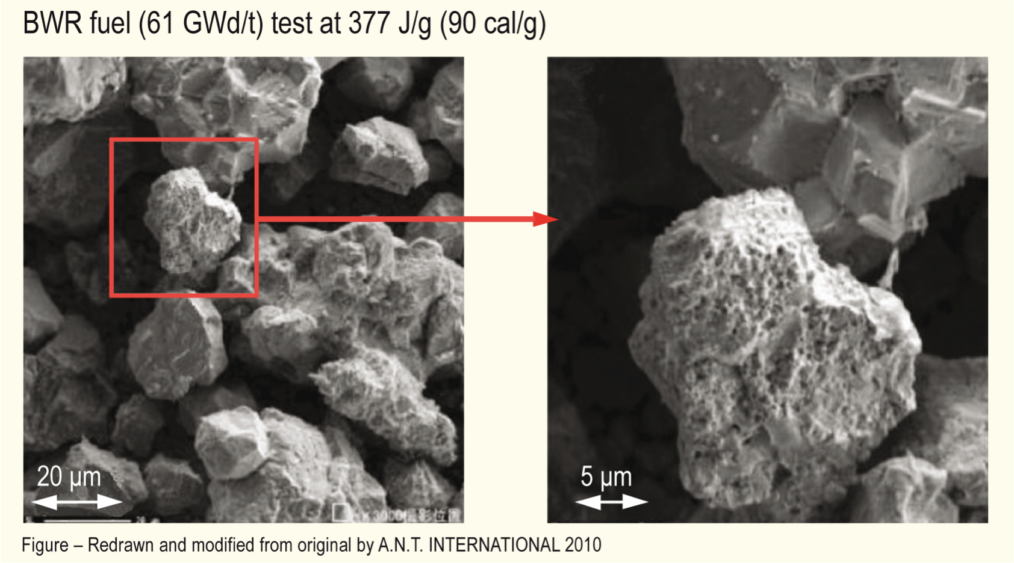
Microstructural Effects
Rapid increase in temperature increases pressure of bubbles
PV = nRT
Rapid pressure increase leads to cracking in fuel

Slide 21
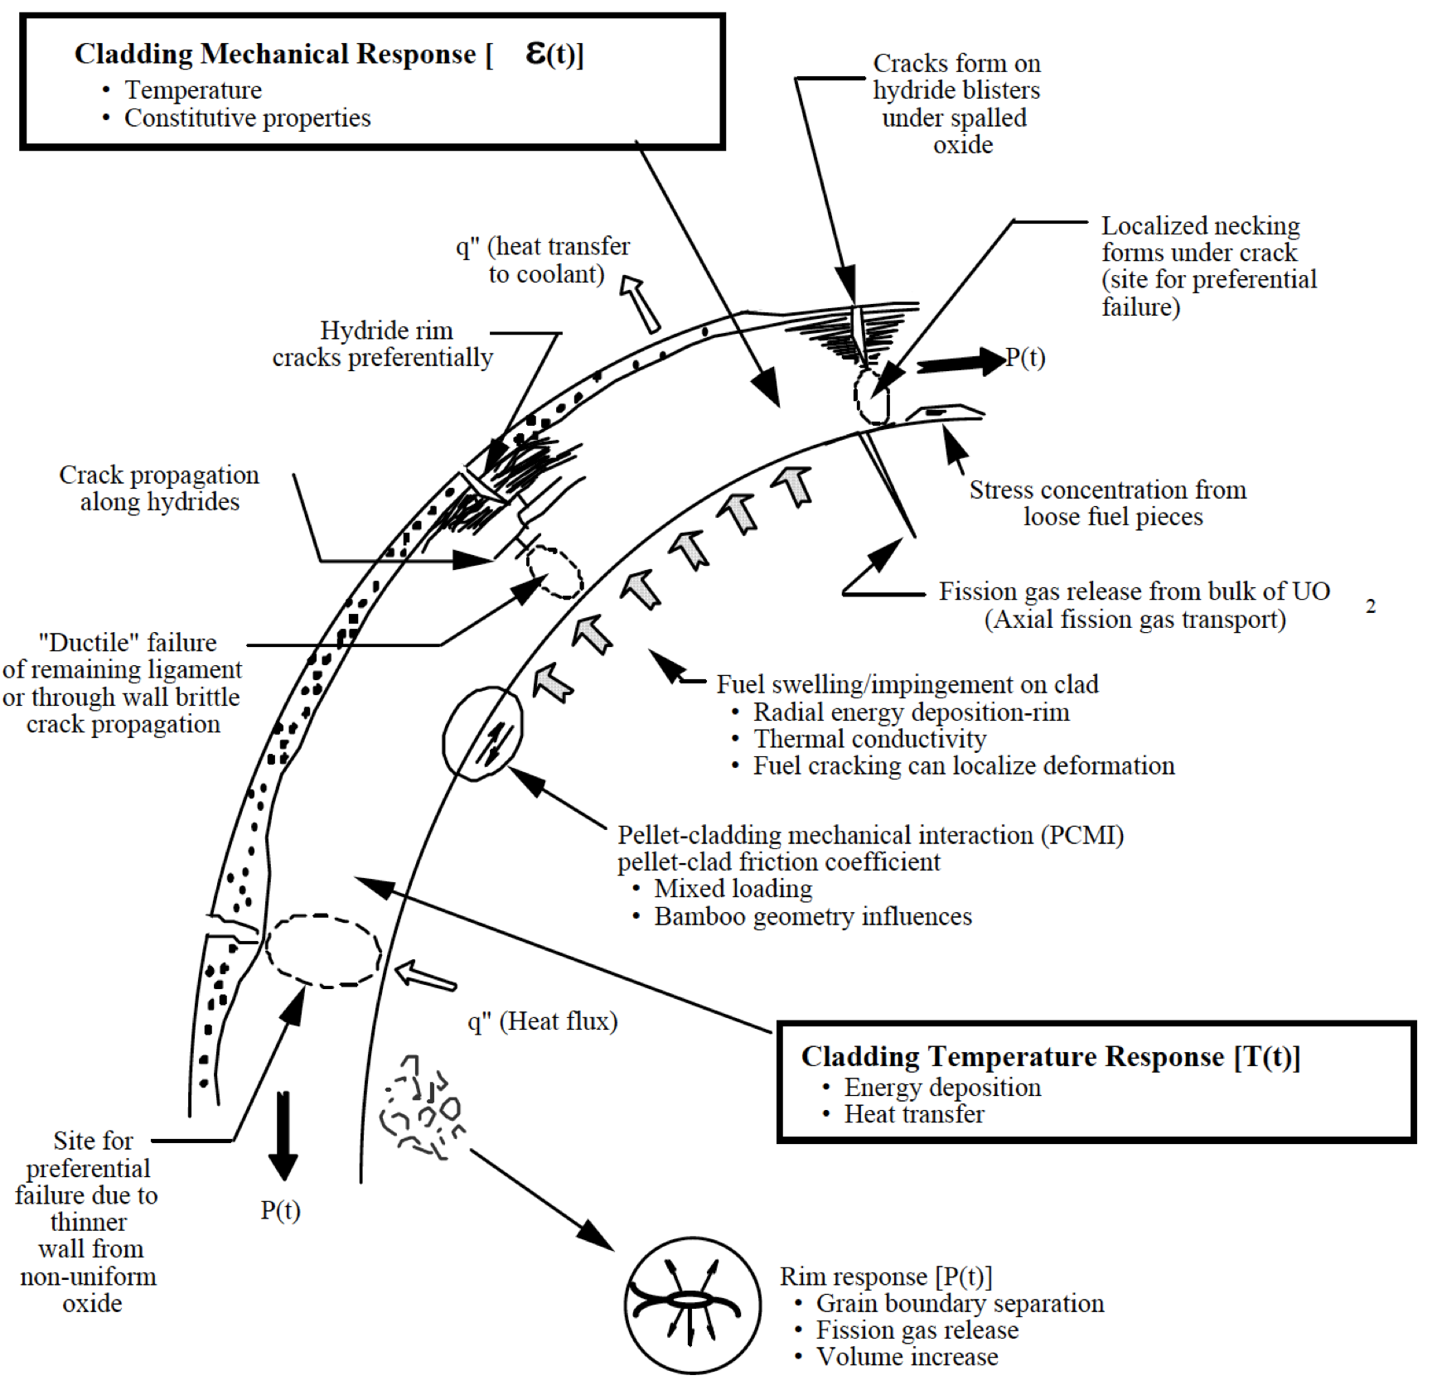
Cladding Response
Take into account burnup, corrosion (oxide layer and hydrides), damage accumulation, PCMI, internal pressure, etc. to properly evaluate strain in cladding
Temperature spike leads to a stress spike, and higher likelihood of cladding failure
Cladding fails either due to PCMI, ballooning/burst, severe oxidation, or partial melting

