Slide 1
Nuclear Fuel Performance
NE-533
Spring 2025

Slide 2
Last Time
Steam oxidation can lead to breakaway oxidation, leading to thick, cracked oxides and high H generation
Advanced cladding materials and coatings are being explored to improve accident tolerance
There are a variety of limiting phenomena in LWR fuel systems that provide the boundaries of operation and lifetime
These limits include phenomena in the fuel, gap, cladding, corrosion, and assembly levels
Primary system water chemistry affects fuel performance through the deposition of corrosion products on fuel pin surfaces, primary control through addition of hydrogen

Slide 3
Mixed oxide (MOX) fuels

Slide 4
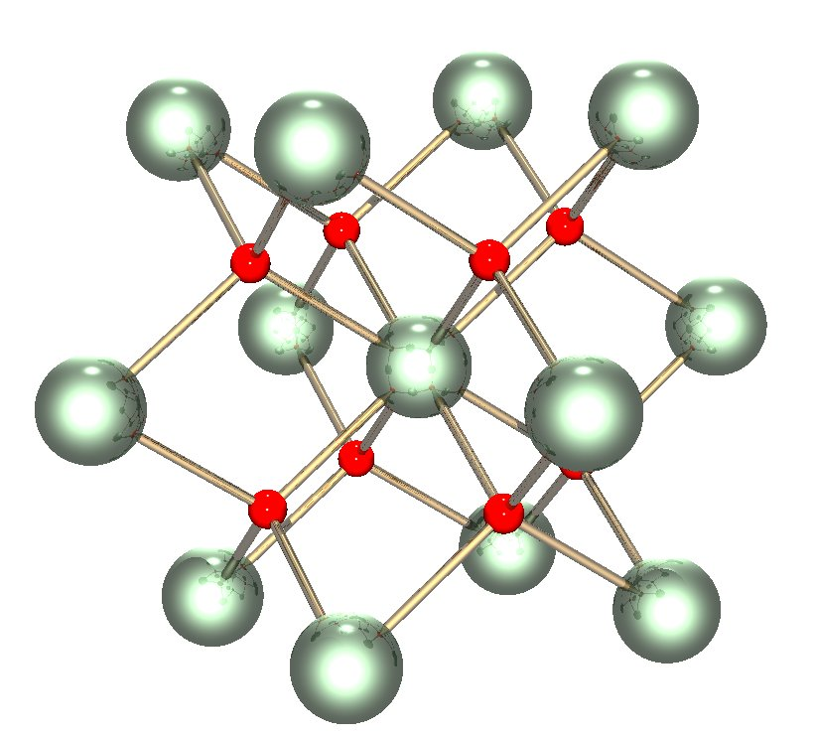
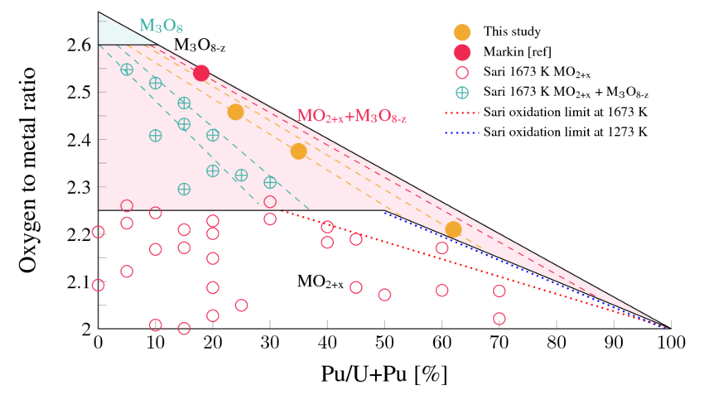
Why MOX?
The first fast breeder reactors built in the 1950s used metallic fuel (plutonium and uranium), as metals offer the highest heavy metal density and therefore the highest breeding ratio
Because of dimensional instability due to swelling and growth, metal fuels couldn’t achieve high burnup
By the 1960s, mixed uranium and plutonium oxide (U,Pu)O2=MOX was known to be highly radiation tolerant and began to be considered as a reference fuel for fast reactors

Slide 5
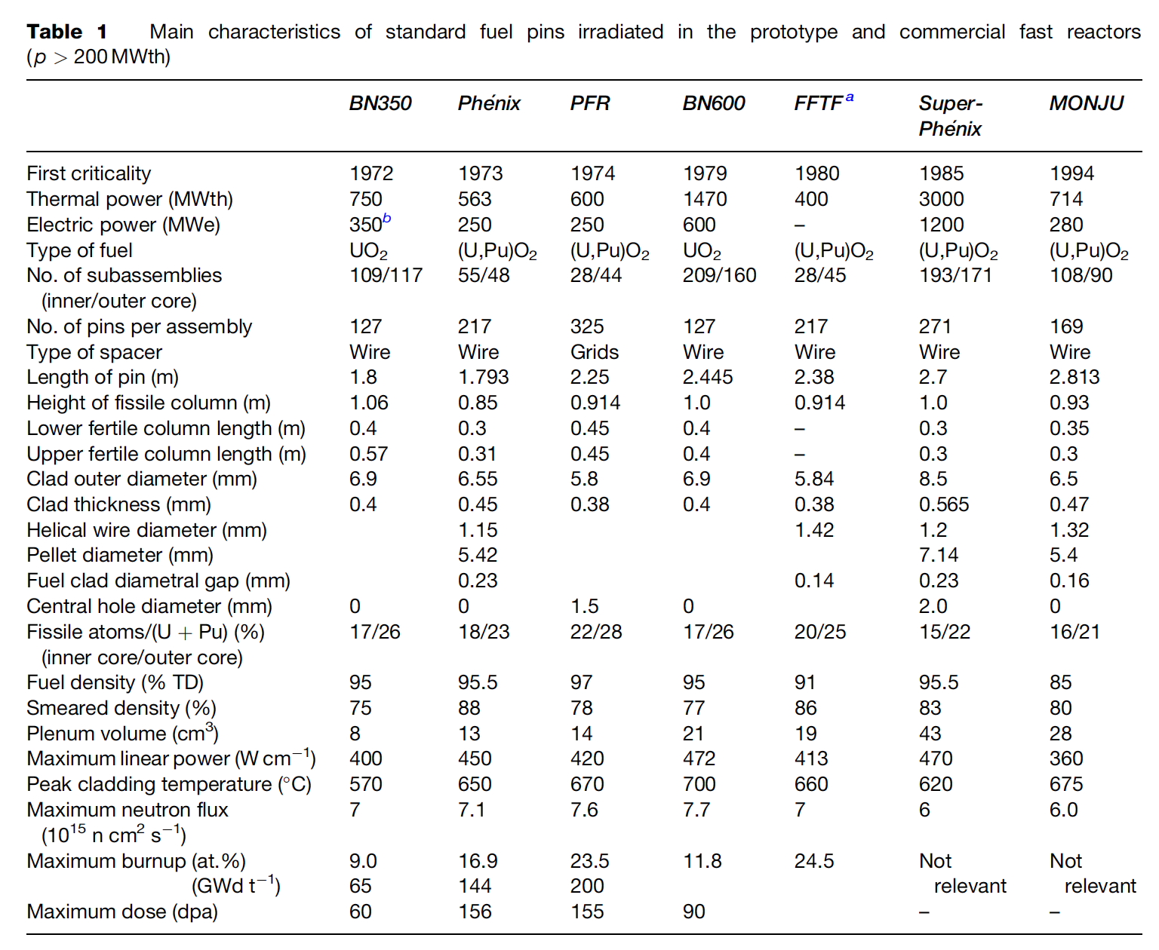
Mixed Oxides
MOX fuel allows to burn excess weapons grade plutonium
About 30 reactors in Europe currently utilize a partial MOX core
Similar behavior to UO2, but different neutronics, fission gas release, thermal conductivity, etc.
Less common is inclusion of minor actinides in MOX to burn waste
Can also serve as a breeder

Slide 6
MOX Designs
The fuel pin is a long cylinder (2–3m long, 5–10mm diameter), clad in a steel tube (0.4–0.6mm thick) closed in both ends by welded plugs, preventing direct contact between the radioactive material and the sodium coolant
The oxide fissile column (~1 m long) consists of a stack of conventionally pressed and sintered pellets with an outer diameter slightly smaller than the inner diameter of the clad, providing a gap ~100 micron gap
Both full pellets and annular pellets have been used
A He gap with a pressure ~1 atm is used
Fuel pins of fast reactors are designed to operate at a high linear heat generation rate: between 400 and 500 W/cm, about 2x-3x higher than standard linear power in light water reactors (LWRs)

Slide 7
MOX Fuel
As the fast reactor fuel pin diameters are generally smaller than classical rod diameters of LWRs, the power density and heat fluxes are much higher in SFRs than in LWRs
For example, in a Phenix fuel pin at 450W/cm, the power density in the pellet reaches almost 2000 W/cc
Sodium enters the bottom part of the core at about 400 C and the average coolant temperature above the core is typically about 550 C
The neutron flux is very intense (~7x10¹⁵ n/cm²/s in the core center) and the assembly materials suffer high damage, more than 100 dpa, at high burnup
Qualifying metallic materials able to withstand such high damage while keeping their shape and mechanical properties was/is one of the key challenges for fast reactors
In order to reduce fuel cycle costs, the main objective of oxide fuels R&D for fast reactors has been to reach high burnup, typically around 150 GWd/ton, about twice the burnup achieved in LWRs

Slide 8
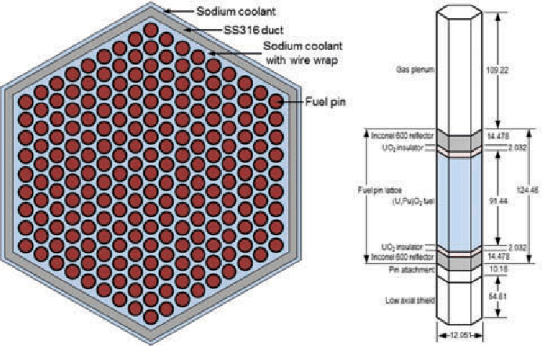
UO2 to MOX Design Differences
Shorter fuel column/rod in MOX
Smaller fuel diameter in MOX
Steel cladding vs. zircaloy cladding
Much higher heating rates in MOX
Larger gas plenum
Sodium coolant in SFRs
Extended burnup for MOX
Hexagonal packing of fuel pins
FFTF Assembly

Slide 9
MOX Fuel
The main requirements and design criteria are the following:
Guaranteeing the absence of fuel melting, both in nominal conditions and during off-normal events
Keeping cladding integrity and fuel pin tightness
Cooling of the fuel pin bundle must be ensured up to high burnup in all operating conditions
Loading and unloading of subassemblies have to be guaranteed, which induces a limitation on the deformation of the hexagonal wrapper tubes

Slide 10
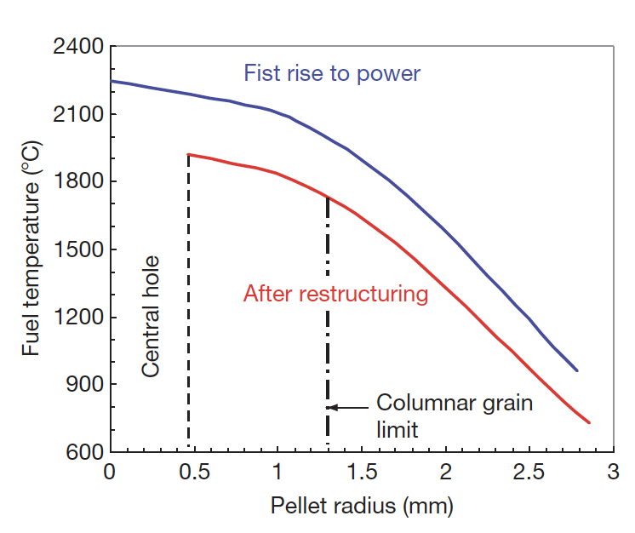
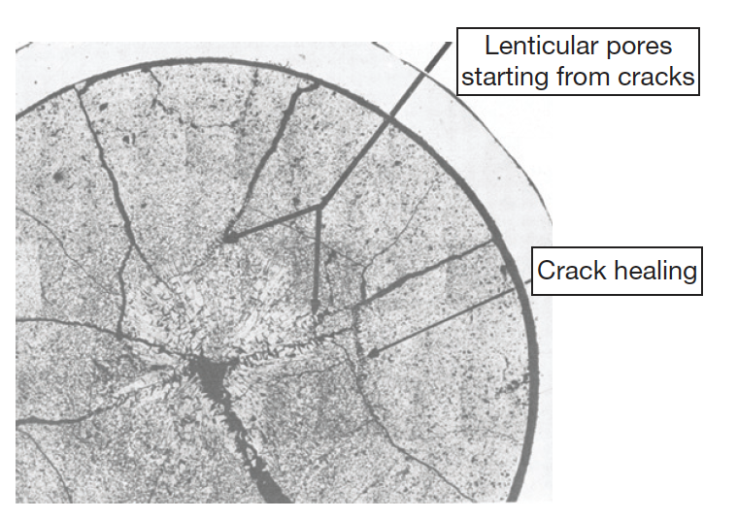
MOX Fuels
Most phenomena occurring inside oxide fuel pellets are thermally activated, and a good knowledge of the thermal field inside the fuel stack is key
Centerline temperatures can reach above 2000C, significantly higher than thermal LWRs
Thermal conductivity is low and degrades with irradiation
Due to the steep thermal gradient, thermal stress cracks form
Restructuring takes place due to the high temperatures, leading to distinct regions in the fuel

Slide 11
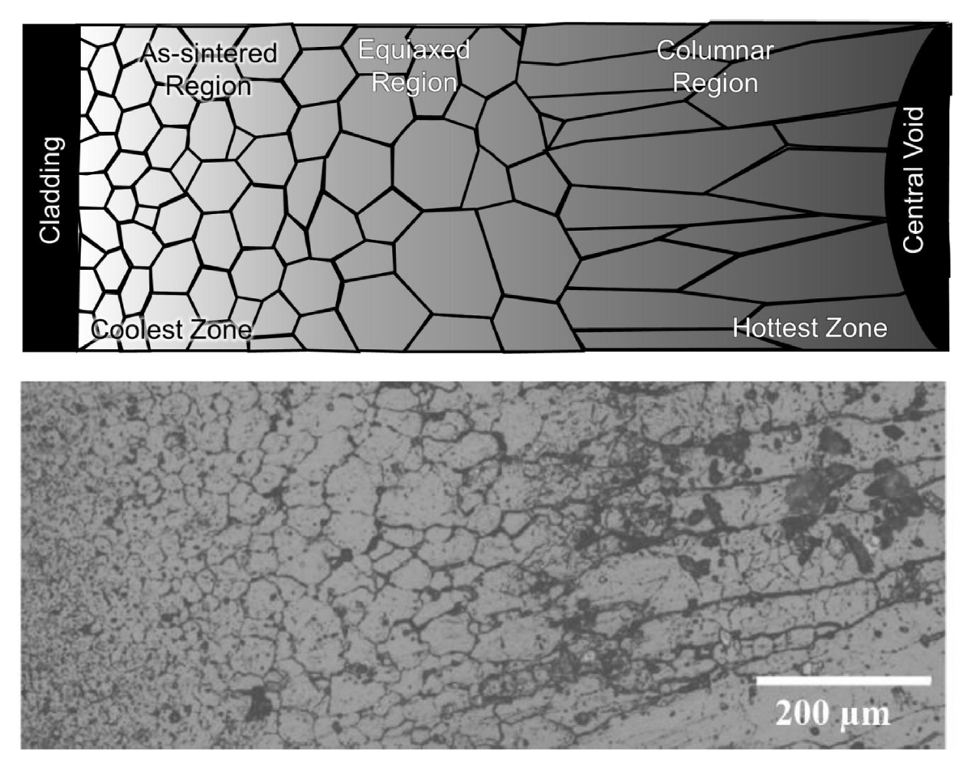
MOX Restructuring
Pu bearing fast reactor oxide fuels display four defining regions of a restructured pellet:
the central void, the columnar grain growth region, the equiaxed grain growth region, and the as-sintered region

Slide 12
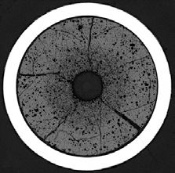
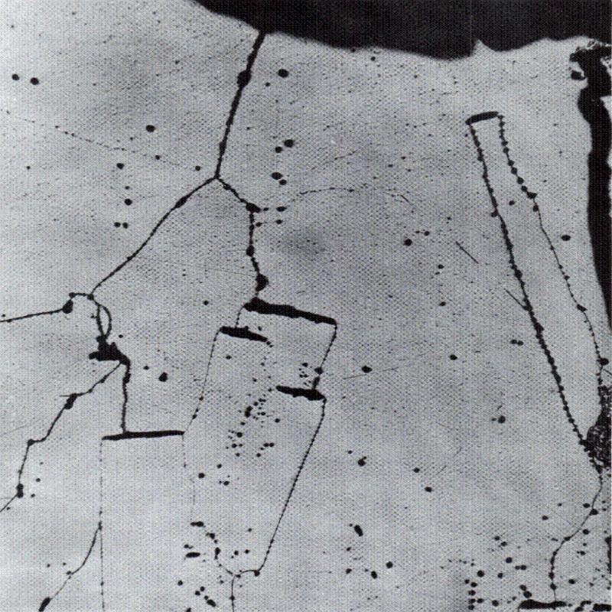
MOX Restructuring
The central void forms from the accumulation of voids and pores present in the fuel along a thermal gradient
The pores orient in a lenticular shape normal to the temperature gradient
The pores are filled with gas, and thus have a higher temperature gradient than that across the fuel
The difference in fuel vapor pressures from hot to cold induces an evaporation–condensation mechanism: fuel evaporating from the hot face and condensing on the cold face travels down the thermal gradient
This induces an inverse displacement of the lenticular pores that climb the thermal gradient toward the center of the pellet
Vapor transport requires T~1800C

Slide 13
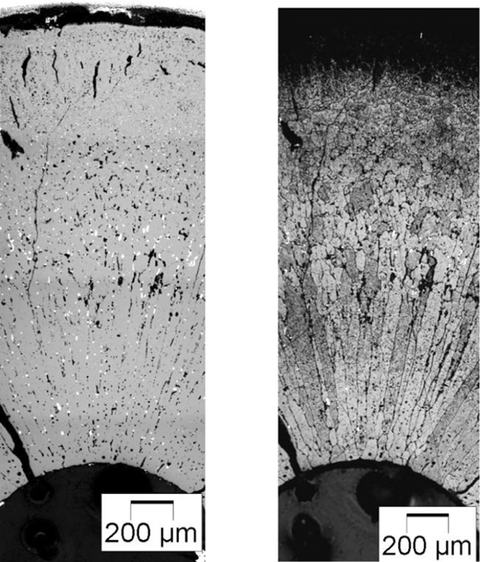
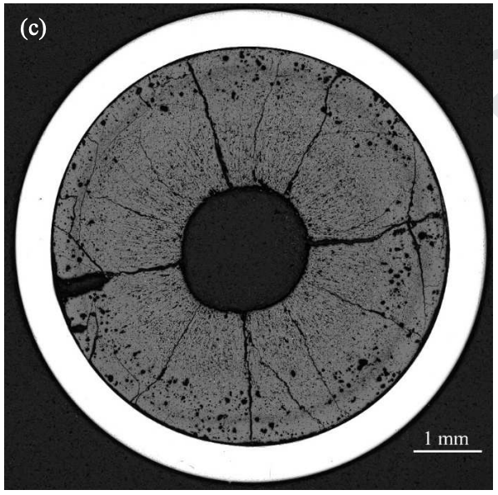
MOX Restructuring
While moving toward the pellet center, the lenticular pores destroy the initial fuel microstructure and leave behind them a dense fuel in elongated ‘columnar grains’ that appear clearly in micrographs
The velocity of the pores varies rapidly with temperature, and the columnar grains only form at temperatures above ~1800C
Below 1800C, an equiaxed region consists of grains that have undergone significant growth when compared to the un-irradiated samples
At the periphery of the fuel pellet, temperatures are sufficiently low to limit grain growth, and thus the microstructure doesn’t undergo rapid changes

Slide 14
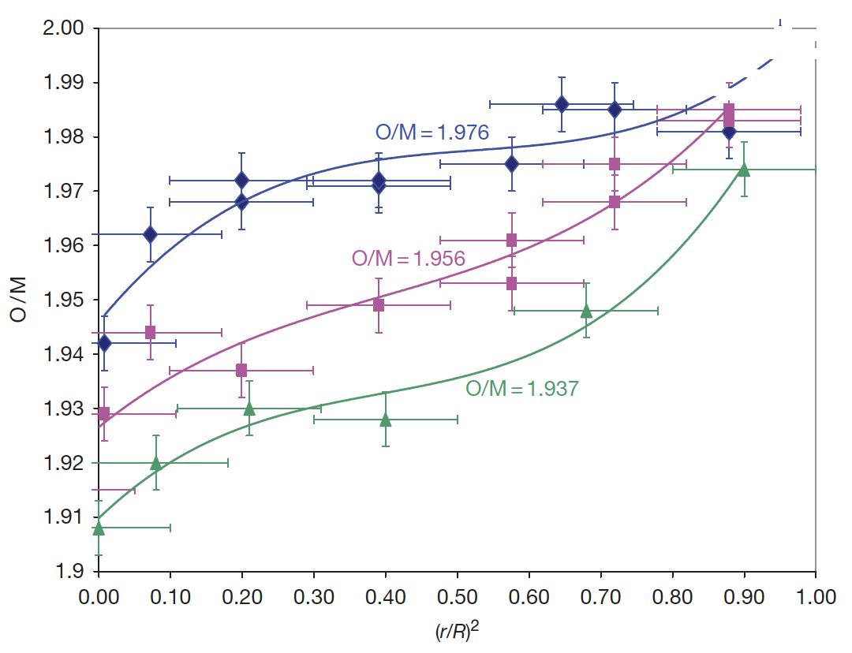
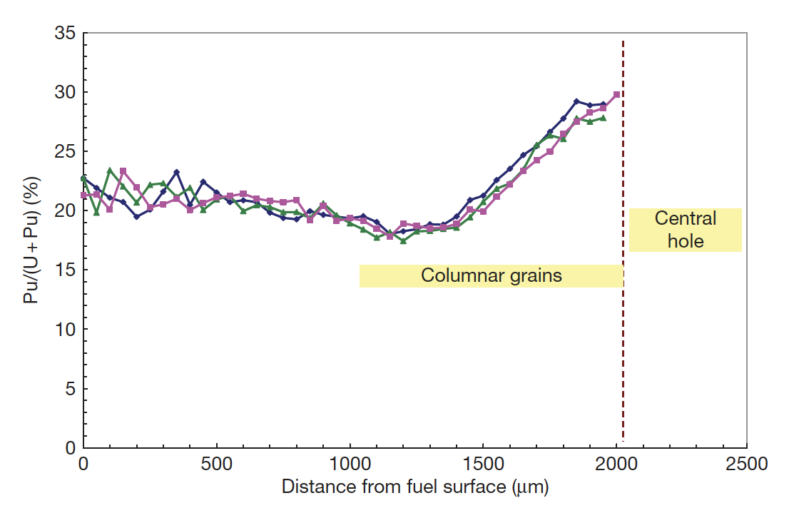
Constituent Redistribution
The as-fabricated oxide pellets used as fuel in fast reactors are always hypostoichiometric with an initial O/M typically in the range 1.93–2.00
Oxygen is redistributed radially, migrating down the thermal gradient, thus bringing the composition close to stoichiometry near the periphery, whereas the O/M ratio becomes very low in the hottest area
Irradiated oxide pellets generally exhibit a plutonium enrichment in the central area near the central hole, and a slight plutonium depletion in a ring located near the periphery of columnar grains
Oxygen and plutonium transport may be either via vapor transport, or Soret diffusion – not known

Slide 15
Gap Closure
Although the thermal expansion coefficient is lower in oxide fuel than in austenitic SS cladding, the temperatures in the fuel pellets are much higher than in the cladding and induce a higher thermal expansion in the fuel pellet
At high linear powers gap closure is completed after a burnup of about 1% or even less
Fuel pellets are broken into several fragments at the end of first rise to power, resulting in a small average displacement of matter toward the cladding
Cladding creep down occurs relatively quickly
The force exerted on the fuel column by the spring located in the upper rod (in addition to the weight of the fuel column) of causes an axial compression creep outwards of the fuel
The main cause of swelling and gap closure is the fission product swelling of the fuel

Slide 16
Fission Products
The main objective of oxide fuels in fast reactors is to achieve very high burnup; 15 at.% or even more is typically considered as a reference target
This means that at the end of irradiation, 15% of the initial actinide atoms (U and Pu) have disappeared and ~26% atoms present in the fuel are FPs
All physical and chemical properties of oxide fuel will continuously evolve during its lifetime in the reactor; in particular, fission products will decrease the thermal conductivity and the melting point, thus reducing the margin to fuel melting
Most phenomena occurring in the fuel pins will be a direct consequence of these fission products
This large amount of fission products is one of the specificities of fast oxide fuel
The fission products effects depend upon the chemical state of the fission product, which is influenced by the oxygen potential of the fuel

Slide 17
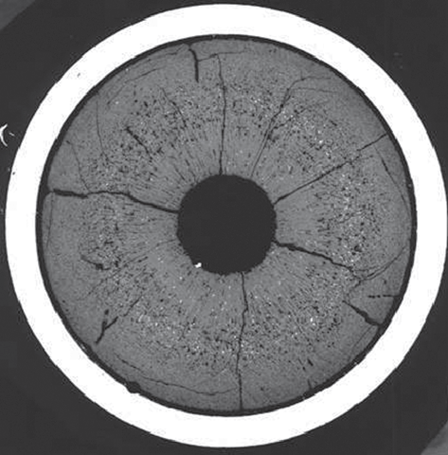
Fission Products
Fission products lie in the main five families:
solid solution, oxide precipitates, metallic precipitates, volatile gases, noble gases
On the metallographs of fuel irradiated at high burnup, white inclusions are systematically observed
The higher the burnup and the temperature, the larger these precipitates
In most cases, EPMA on these precipitates shows essentially five elements: Mo, Ru, Tc, Rh, and Pd.
They are the five ‘noble metal’ fission products with the highest yield

Slide 18
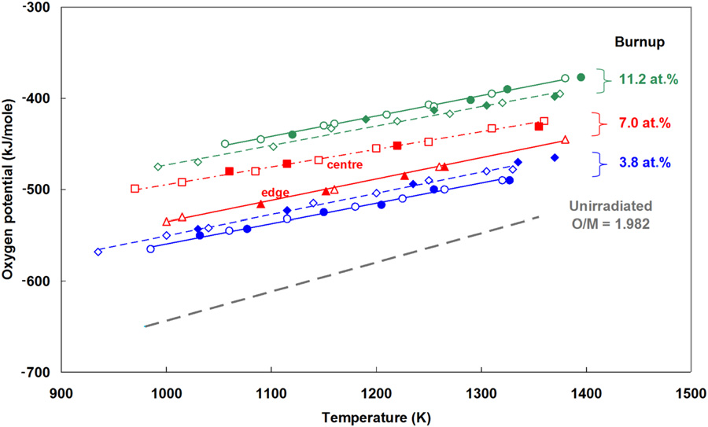
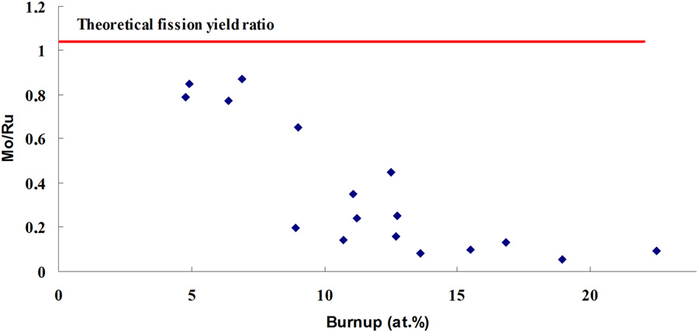
O/M Ratio
Fission releases two oxygen atoms, which cannot be fully bound by the fission products, this increases the O potential in the fuel as dissolved O
The O potential increases until the point where Mo starts to oxidize, leaving the metallic inclusions
The O/M ratio increases until Mo starts to oxidize, then maintains at approximately 2.0 or thereabouts

Slide 19
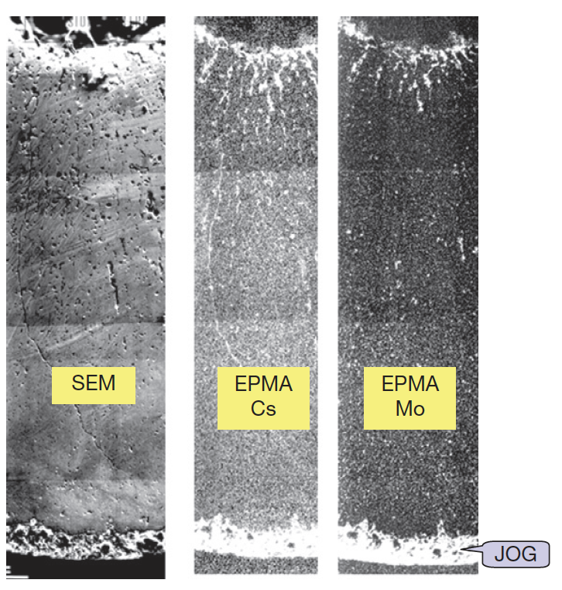
Joint Oxyde Gaine (JOG)
Even after gap closure, there remains a residual gap a couple of micrometers wide due to surface roughness
At high burnup, radial micrographs show a reopening of the gap, however, this gap is no longer filled with gas, but with fission product compounds
JOG is probably Cs2MoO4, but includes lots of other fission product species
All the fission products migrating toward the cold region of the pellet accumulate first in the oxide fuel, and then escape the fuel and accumulate between the fuel and the cladding where they form a bonding layer
At high burnup, this JOG reaches a diameter width of about 150 μm

Slide 20
JOG Effects
The thermal conductivity of Cs2MoO4 is about 10x lower than MOX fuel, but much higher than gases
JOG acts as a mechanical buffer, limiting the amount of PCMI, or stresses in the cladding
JOG reduces fuel swelling, by allowing fission products to leave the fuel into a preferable chemical state
Fission products in the JOG play a predominant role on FCCI and on the resulting strong corrosion

Slide 21
FCCI
FCCI appears as one of the potential life-limiting factors for high burnup fuel elements
The (U,Pu)O2 fuel itself does not directly react with the cladding, but it provides the oxygen needed for some of the reactions
Volatile fission products, tellurium and cesium, are the corrosive species able to overcome the passivation of stainless steel and therefore to induce clad corrosion
Several types of corrosion reactions and mechanisms are possible, occurring at different stages of irradiation, sometimes successively in the same pin, and resulting in different attack features
Thus, a qualitative understanding of corrosion mechanisms has been achieved, but it is not yet possible to give a complete physical description of FCCI and to predict corrosion depths

Slide 22
Accidents/Transients in MOX SFRs
For sodium fast reactors three main types of transient and accident scenarios are considered as references for the study of fuel transient and accident behavior:
the slow power transient representative of one control-rod withdrawal
the loss of cooling due to blockage of a subassembly
the unprotected loss of flow (ULOF) accident that might lead to a core disruptive accident

Slide 23
Control Rod Withdrawal Accident (CRWA)
Slow power transients due to control-rod withdrawal are the most common transients occurring during reactor operation as they are used for regulation of the core power
In case of an inadvertent control-rod withdrawal due to operator action together with a failure of various protection systems, this transient might lead to severe consequences
During such a transient, nominal power can increase by 1-3% per second, and may lead to partial fuel melting inside the pins of the subassemblies surrounding the control rod

Slide 24
Local blockage of a subassembly
Local blockage formation in a fuel assembly due to ingression of some external material into the bundle may lead to pin failure with subassembly degradation and melting
The hypothetical total instantaneous inlet blockage (TIB) of a subassembly at nominal power has been suggested as a potential initiator for a core melt accident
Owing to the rapid and complete loss of flow in the faulted subassembly, the usual detection systems are not operating, so core power can not be shut down in time
The accident is characterized by overheating and melting of the fuel pins, degradation of the subassembly, wall failure, and possible propagation of molten materials into neighboring subassemblies
The main safety issue is the risk of propagation of the accident beyond the neighboring subassemblies that might lead to critical events and generalized core melting
Such an accident caused the Fermi-1 core meltdown in 1966

Slide 25
Unprotected loss of flow accident (ULOF)
The ULOF accident is the result of loss of primary pump flow due to an initiating event such as electrical break-down without reactor scram
The first phase leads to sodium flow reduction and to associated power reduction linked to reactivity feedback
The power to flow ratio increases so that the temperature causes sodium boiling
Due to the positive ‘sodium void effect’ in the central core regions, the ULOF leads to sodium boiling and channel voiding and may result in a core disruptive accident (CDA)
This can lead to generalized core degradation: fuel melting, clad failure and/or melting, fuel ejection into coolant, fuel dispersal and relocation into the channels, and possible mechanical energy release
Although this accident is initiated by a loss of coolant flow, it may rapidly evolve toward a fast reactivity insertion accident

Slide 26
Fuel Behavior Under Slow Power Transients
Despite high fission gas release rate in MOX fuel due to high operation temperature (60-80% release), power increases resulting in higher temperatures also activate fission gas-related phenomena that influence thermal and mechanical pin behavior
Intragranular gas migration toward grain boundary related to the thermal gradient
Gas bubble growth due to coalescence via vacancy diffusion
Fission gas-induced fuel swelling driven by an increase in the bubble pressure
Saturation and interconnection of grain boundary bubbles leading to additional gas release
Under slow power transients, fuel heat generation and heat removal by the sodium coolant are almost in thermal equilibrium, and these ‘quasi’ steady-state conditions allow the evaluation of the power level at which fuel melting occurs, providing operating limits

Slide 27
Fuel Melting
SFRs with MOX are sensitive to any fuel compaction effect that might result from fuel motion (for instance, due to melting) with the potential risk of prompt-critical events and mechanical energy release to the vessel structure
Fuel-melting occurrence depends on pin thermal behavior that is governed by thermal conductivity, heat exchange between fuel and clad through the pellet–clad gap, and melting temperature
Melting temperature and thermal conductivity depend on stoichiometry and burnup
Heat exchange in the fuel system is governed by evolution of gap thickness and composition
High T plastic fuel creep may lead to central hole reduction and to increase of the macroscopic fuel porosity with subsequent reduction of the thermal conductivity and thus higher fuel temperature in the center that results in a lower power at melting onset
High peaking factors (~1.3, compared to ~1.1 in LWRs), can increase the local temperatures in high power regions and increase probability of fuel melting

Slide 28
Summary
Oxide fuel for fast reactors has proved to be a mature, quite reliable, and very robust fuel concept
SFRs with MOX operate at much higher power and temperature than LWRs
Despite the low thermal conductivity, fuel loadings to the cladding remain low, and oxide fuel pins have demonstrated an ability to reach extremely high burnup (>15 at%)
O/M ratio is one of the most significant factors in determining the nature of actinide redistribution, fission product precipitate chemistries, and FCCI formation
Unique features include restructuring, central pore formation, and JOG formation
Three main types of transient of interest in MOX SFRs
slow power transient (CRWA); blockage of a subassembly; unprotected loss of flow accident
Fuel melting is one of the most critical concerns

