Slide 1

Dependence of thermal conductivity on fission-product defects and vacancy concentration in thorium dioxide
M.J. Rahman, B. Szpunar, J.A. Szpunar
NE 591 Class Presentation2
Khadija Mahbuba
Graduate Student
Department of Nuclear Engineering
North Carolina State University

Slide 2
Outline
Introduction
Background
Objective
Methodology
Results
My observations

Slide 3
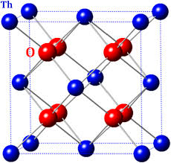
Introduction
The study is about ThO₂ (Thoria).
Thoria has a fluorite crystal structure like UO₂
Th is present in higher concentrations (2-10%) by weight than U (0.1-1%) in their respective ores
Th has longer half life
Thoria has higher thermal conductivity and higher melting point than UO₂
Heat transfer is governed by phonon
Thoria has no magnetic property like UO₂
Behera and Deo (2012)

Slide 4
Background
In nuclear process, the properties and performance of fuel materials are severely deteriorated due to irradiation.
Radiation induced fission products (FPs) and vacancies can affect the thermal properties of nuclear fuel
Thermal conductivity is the most important thermal property of nuclear fuel that controls the heat removal, reactor maximum temperature and eventually the electricity production.
Authors have found thermal and mechanical properties of thoria have been reported in a number of studies, but none of these studies investigates the influence of fission-generated products on thermal transport characteristics.
For thermal transport study in nuclear fuel, atomistic simulations are very effective since thermo-physical and thermo-mechanical properties are strongly controlled by the atomic scale mechanisms. So they performed a molecular dynamics simulation to evaluate thermal properties for a range of temperature and defect concentration.

Slide 5
Objective
Output parameters
Input parameters
Tho2
Defective
Vacancy
(1%, 2%, 5%)
Pure
FPs substitute
(0.34%, 0.68%, 1.02%)
Defective system
Specific heat increment (wrt 300K):f(Temperature, %FP, % Vacancy)
Enthalpy increment (wrt 300K):f(Temperature , %FP, % Vacancy)
Thermal conductivity: f(Temperature, , %FP, % Vacancy, defect distribution)
Lattice parameter :f(Temperature, %FP, % Vacancy)
Temperature range
300K to 1500 K at every 300 K
Xe
Kr
Pure system
Specific heat increment (wrt 300K) :f(Temperature)
Enthalpy increment (wrt 300K) :f(Temperature)
Thermal conductivity: f(Temperature, Supercell length)
S.S. Temperature profile :f(Temperature)
Lattice parameter: f(Temperature, %FP, %Vacancy)
Length of supercell
36, 44, 60,90, 200unit cells
Heat flux at central bin of Supercell
Defect atom cluster size 0, 6, 12, 18, 24

Slide 6
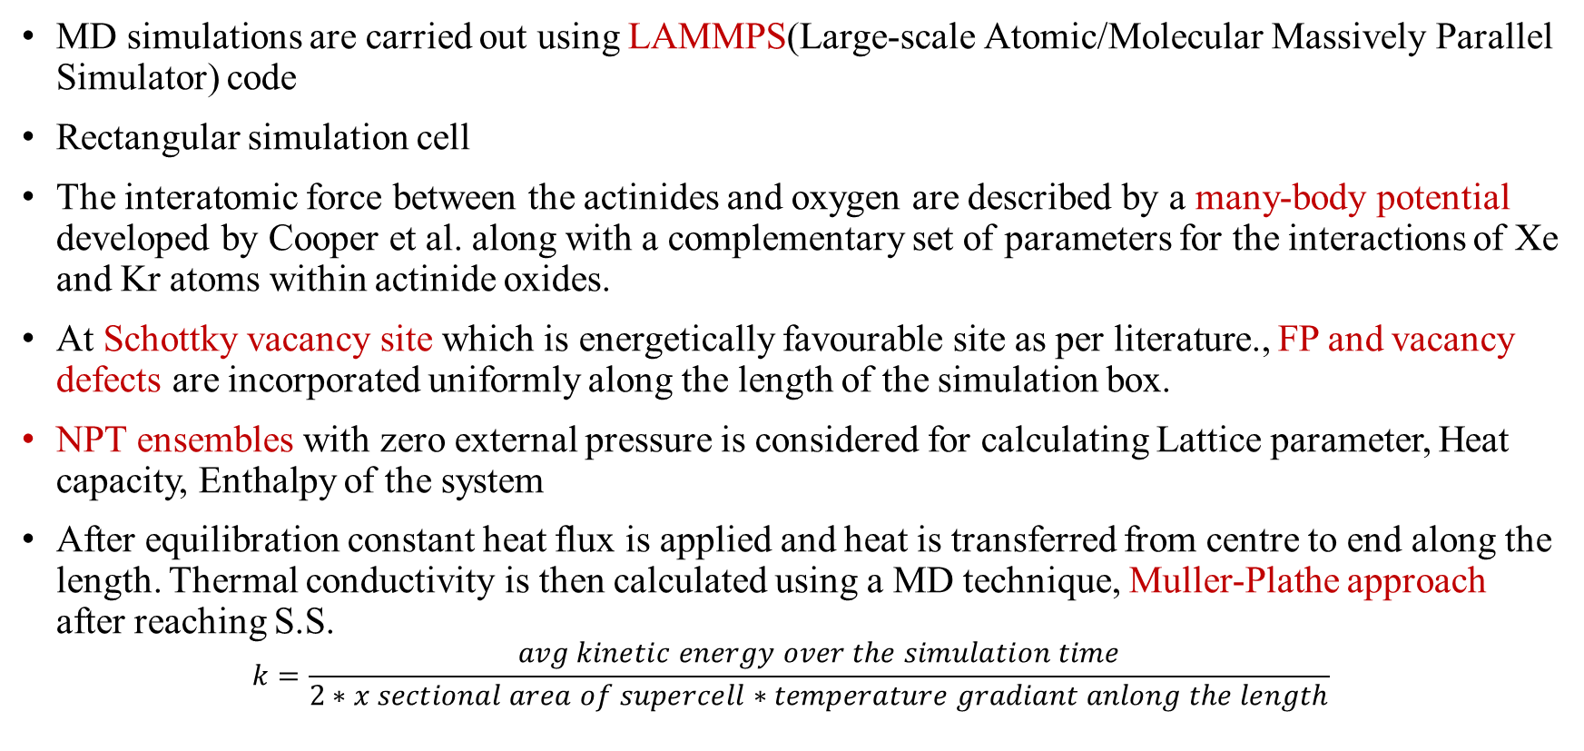
Methodology
MD simulations are carried out using LAMMPS(Large-scale Atomic/Molecular Massively Parallel Simulator) code
Rectangular simulation cell
The interatomic force between the actinides and oxygen are described by a many-body potential developed by Cooper et al. along with a complementary set of parameters for the interactions of Xe and Kr atoms within actinide oxides.
At Schottky vacancy site which is energetically favourable site as per literature., FP and vacancy defects are incorporated uniformly along the length of the simulation box.
NPT ensembles with zero external pressure is considered for calculating Lattice parameter, Heat capacity, Enthalpy of the system
After equilibration constant heat flux is applied and heat is transferred from centre to end along the length. Thermal conductivity is then calculated using a MD technique, Muller-Plathe approach after reaching S.S.
$$k=\frac{avg kinetic energy over the simulation time}{2∗x sectional area of supercell∗temperature gradiant anlong the length}$$

Slide 7
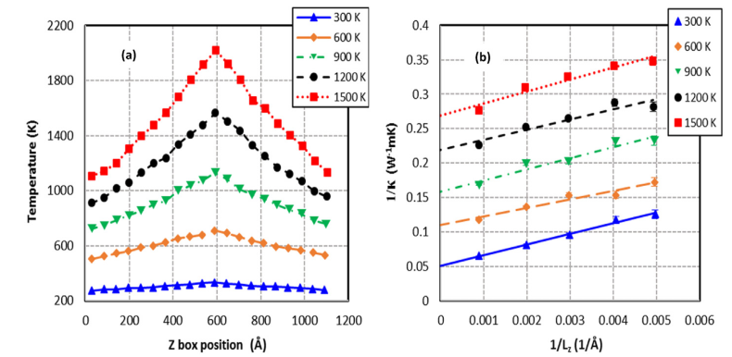
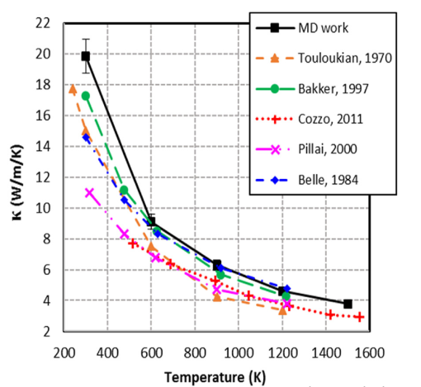
Results
Thermal conductivity for pure thoria
Temperature profile
Comparison of thermal conductivity of pure thoria with literature

Slide 8
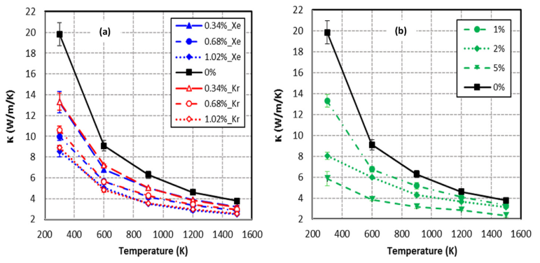
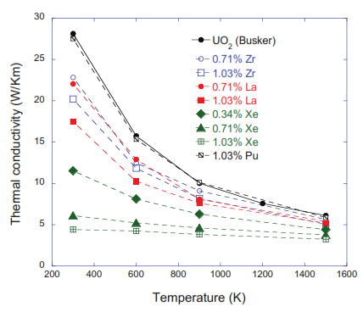
Results
Thermal conductivity for defective thoria
ThO₂ (Rahman et al, 2016)
UO₂ (Lui et al, 2016)

Slide 9
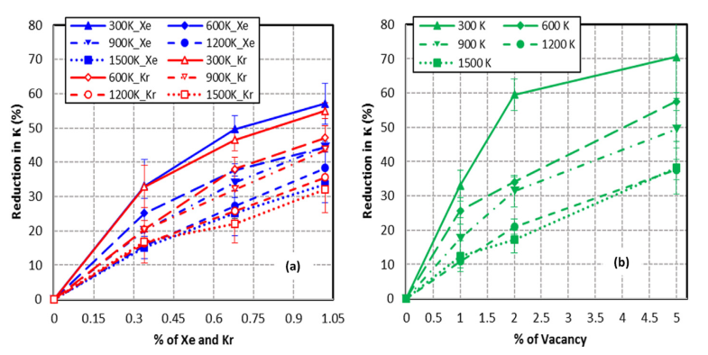
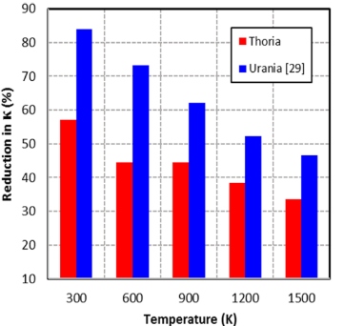
Results
Reduction in Thermal conductivity for defective thoria as per % of defects
ThO₂ (Rahman et al, 2016)
UO₂ (Lui et al, 2016) &ThO₂ (Rahman et al, 2016) thermal conductivity reduction at 1.02% Xe

Slide 10


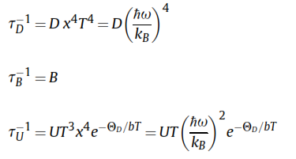

Results
Validation of Thermal conductivity by Analytical and Callaway fit
Analytical model
Callaway model
A, B for const T of pure thoria, C from const % of defective thoria
 | C(mK/W) | D’(s⁻¹K⁻⁴)
ThO₂-Xe | 7.81 | 126475.0
ThO₂-Kr | 7.30 | 112259.3
ThO₂-Vacancy | 2.95 | 42265.04
UO₂-Xe | 33.9 | 235000.0
UO₂-U vacancy |  | 172000.0
UO₂-O Vacancy |  | 79400.0
UO₂ (Lui et al, 2016) &ThO₂ (Rahman et al, 2016)
B, D(pure) , U, b for const T of pure thoria, D’ from const % of defective thoria

Slide 11
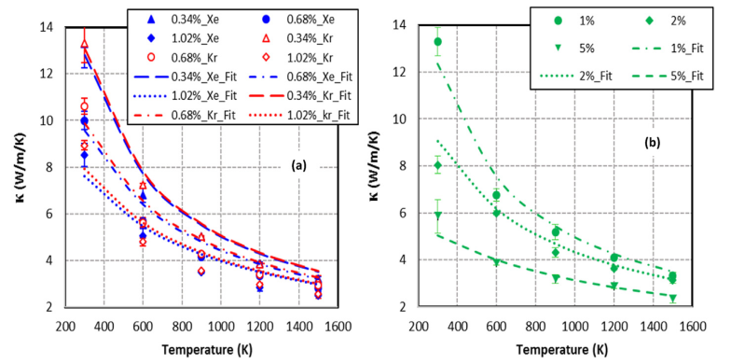
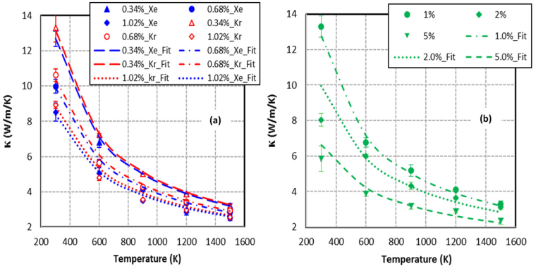
Results
Validation of Thermal conductivity by Analytical and Callaway fit
Analytical fit
Callaway fit

Slide 12
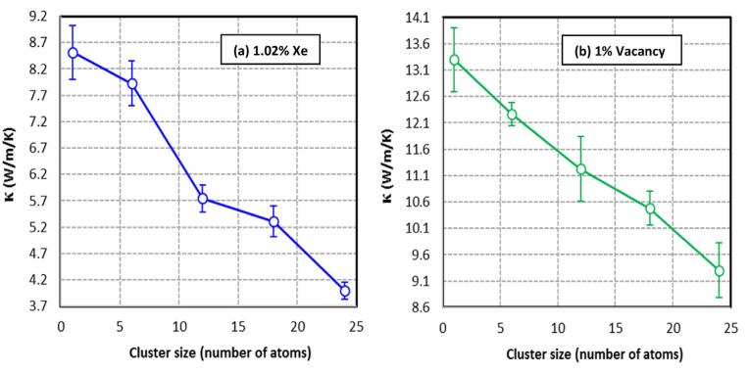
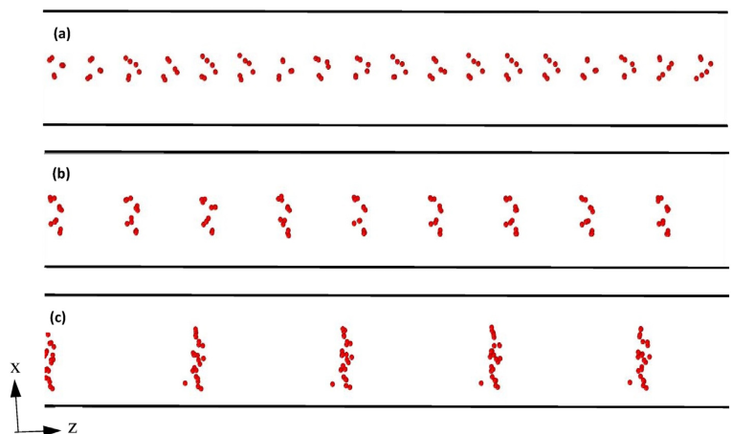
Results
Effect of cluster size Thermal conductivity for defective thoria

Slide 13
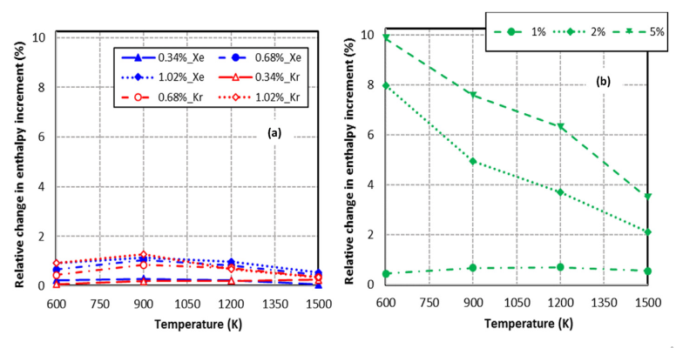
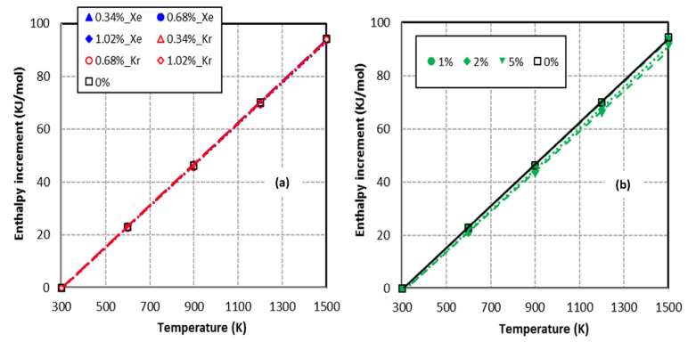
Results
Increment in enthalpy with respect to ThO2 at 300K
Relative increment in Enthalpy vs Temperature
Increment in Enthalpy vs Temperature

Slide 14
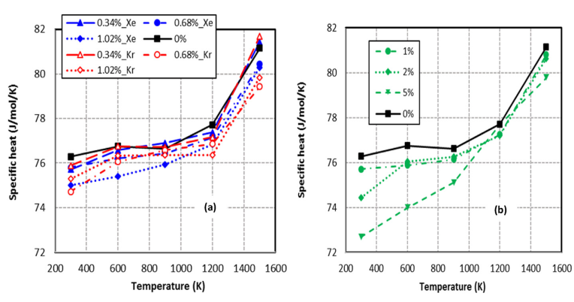
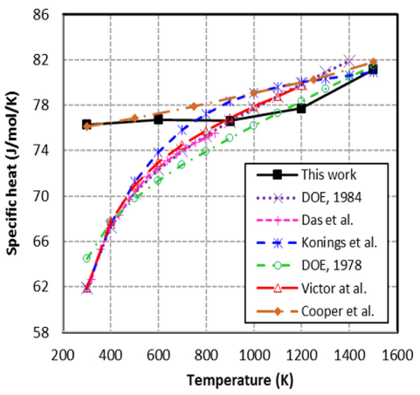
Results
Heat capacity
Slope of enthalpy wrt temperature is heat capacity
Specific heat capacity at constant pressure vs Temperature
Comparing heat capacity of pure thoria with literature

Slide 15
My observations!!
Vacancies in ThO2 structure are created by removing Th and O2 atoms, There should be some scope to calculate the Th vacancy and O vacancy separately.
Some future work can be carried out considering FPs defects as interstitial defect.
If there is few limitations of numerical effort, this simulations can also be performed using ab-initio MD, as in that case a full quantum calculation of the electronic structure is performed at every time step.
1

Slide 16
Thank you!
Questions??

