Slide 1
Nuclear Fuel Performance
NE-533
Spring 2026

Slide 2
Paper Project
Assigned papers uploaded to moodle with your name as a prefix
This will be a critical review of the paper, similar to what we do for QE2, but much shorter
Contextualize, summarize, and analyze
15-minute presentation that summarizes what was done in the paper, provides context on why it was done, and reviews what could or should have been done, or could be done next
All presentations will be submitted via moodle, due by end of the day on Mar. 3
Distance students will submit slides and a recording of their presentation
Presentations will take place in-class on Mar. 4 and Mar. 6

Slide 3
Last Time
Talked through numerical thermomechanics
All fuel performance codes: a) Numerically model the temperature in the fuel, b) Numerically model the stress in the cladding, c) Consider gap pressure, closure, and heat transfer
Some multiphysics fuel performance codes
FRAPCON/FRAPTRAN
BISON
Intro into material property evolution

Slide 4
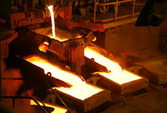
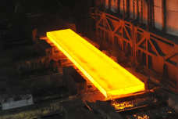
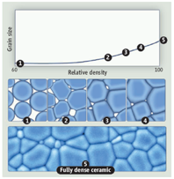
Material processing
The processes we use to make a material have a huge impact on its microstructure and properties
Casting – manufacturing process in which a liquid material is poured into a mold and then allowed to solidify
Can be used to make complex shapes
The solidified microstructure typically has properties that are far from ideal
Sintering – Forming a solid from a powder using heat and/or pressure without melting the material
Applicable to metals and ceramics
Difficult to obtain a material that is fully dense
Used to make fuel pellets
Post-fabrication processing
heat treatment
working

Slide 5
Material processing
Heat treatment: heating or cooling a material to extreme temperatures to get desired microstructure and properties
Used to control the rate of microstructure change, including diffusion, grain growth, or phase change
Annealing
heat and hold the material, which allows for any defects in the material to repair themselves
The metal is then allowed to cool back to room temperature at a slow pace to produce a more ductile crystalline structure
Quenching
heated to a temperature that transforms its internal structure, held at that temperature, then rapidly cooled
The quick cooling process locks in the high T structure, or forces phase transformation without the ability to relax stresses

Slide 6
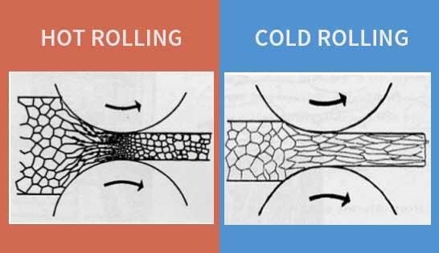
Material processing
Working: metalworking process that plastically deforms the alloy
Cold working occurs below the recrystallization temperature, hot working occurs above
By plastically deforming the material, we are increasing the number of dislocations and dislocation barriers, increasing the yield strength
Main types of working processes:
Squeezing (rolling/extrusion/drawing)
Bending (shaping)
Shearing (slitting)

Slide 7
Summary
Fuel and pellet conditions change with time due to microstructure evolution
Atoms in the fuel and cladding materials are arranged in a crystal lattice
The crystal lattice is never perfect; it has defects
Point defects, dislocations, grain boundaries, voids and precipitates
All materials have defects, radiation damage causes many more defects
Microstructure can be tailored through processing, during fabrication or post-fabrication

Slide 8
UO2 Radiation effects

Slide 9
Radiation Damage
The macroscopic and observable results of exposure of solids to energetic particles are collectively known as radiation effects
Heat production from the nuclear fuel to generate electricity ensues mostly from the slow down of the fission products by nuclear or electronic interactions
As a direct consequence, there are also defects created along the path of the fission fragments leading to modification of the physical properties of the fuel
Most Frenkel defects (interstitial-vacancy pair) are produced by secondary collision cascades
Local charge neutrality prevents the formation of interstitials and vacancies as independent processes, as the cations and anions are charged species
In UO2, two anion vacancies need to be created for each cation vacancy, forming a Schottky trio
The dominant defect type is anion Frenkel pairs

Slide 10
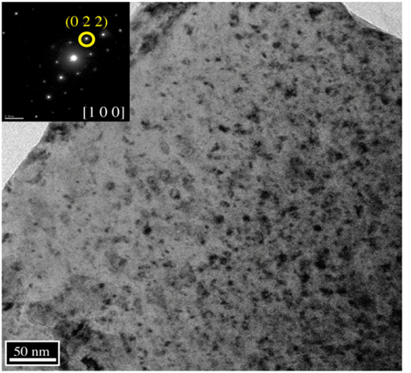
Loop Formation
Dislocations generally a mixture of screw and edge components in the shape of a loop
The most important slip system in UO2 is the one which minimizes the electrostatic energy, the easy slip along {100}<110> tends to minimize the intense repulsive force between cations
Prismatic loops are of interstitial type and consist of a disc-shaped layer of defects in a cluster
This defect cluster is more energetically favorable than dispersed defects in the bulk
Vacancy clusters will form into voids
Prismatic loops in UO2 from alpha particle irradiation

Slide 11
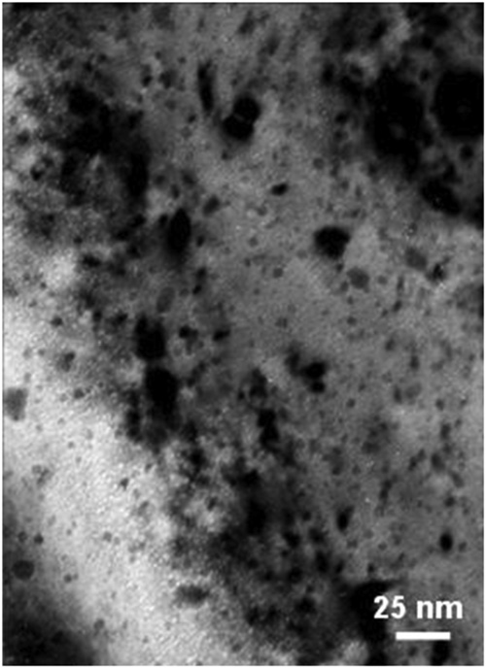
Voids
Due to preferential absorption of interstitials at dislocations, we are left with a slight excess of vacancies in the bulk to nucleate and grow voids
Void nucleation can occur homogeneously by the collection of vacancies in the matrix, or heterogeneously at structural features (precipitates, grain boundaries, etc.)
The vacancy-rich radiation damage core is considered to be an important void nucleation mechanism in UO2
Vacancy diffusion then allows void growth
Gas atoms can often serve to stabilize small voids
Voids (bright spots) from alpha irradiation in UO2

Slide 12
Radiation Effects
Chemistry changes
two fission products are generated from each fission, resulting up to about 3% of the chemical species present at the end of life for commercial fuel
the amount of fission products change both chemical and physical properties
Physical property changes
The physical effects caused by atomic displacements are rather complex and depend on the relative sink strengths of a given material for interstitials and vacancies and on the temperature
lattice parameter, thermal conductivity, elasticity, formation of the high burnup structure

Slide 13
Thermal Conductivity Degradation
One of the major effects of defect formation is the degradation of thermal diffusivity, due to phonon scattering
Results obtained on irradiated UO2 show that the thermal conductivity is decreasing with increasing burn-up, and that at equal burn-up, samples with higher irradiation temperatures have higher thermal conductivity
There are mesoscopic and atomistic features that affect the thermal conductivity
The porosity existing in fresh fuels evolves during irradiation and has a strong impact on heat transport, because voids/bubbles have significantly lower kth than the lattice
Precipitates are formed by fission products that are insoluble in the UO2 lattice, forming oxide or metallic inclusions: can use composite theory to get effective thermal conductivities; typically, these precipitates INCREASE the thermal conductivity of the fuel

Slide 14
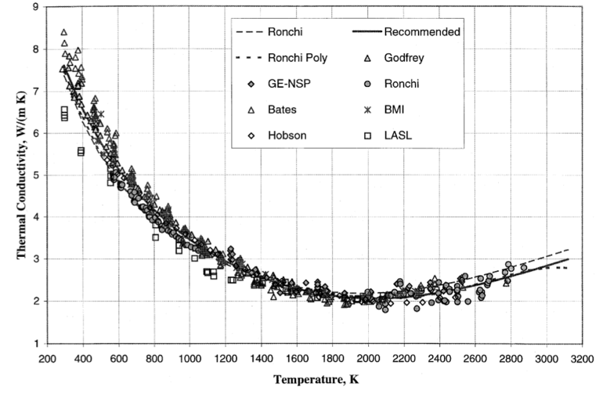
Thermal Conductivity Degradation
Actinides, rare earths, and transition metals can form mixed oxides with UO2 (soluble fission products): these atoms act as phonon scattering centers as a result of the differences in bonding, radii, or mass, and thus decrease kth
Volatile fission products/gases are partially in solution and partially in bubbles, where they act as phonon scatterers or as low kth composite fractions
Point defects and extended defects contribute to the degradation of the thermal conductivity by scattering or limiting the mean free path of the phonons

Slide 15
UO2 Thermal Conductivity
We have established correlations for thermal conductivity of fresh UO2 fuel as a function of temperature
Where t = T/1000
The first part of the equation describes the phonon interactions
The second part describes electronic transport which becomes significant at high temperature

Slide 16
UO2 Thermal Conductivity
UO₂ thermal conductivity is low and decreases more during reactor operation
The thermal conductivity has been collected after various amounts of burnup to make empirical fits

Slide 17

UO2 Thermal Conductivity
One empirical model used in BISON is the NFIR model
The model is a function of the temperature T (in $°$C) and the burnup β (in MWD/kgU

Slide 18
UO2 Thermal Conductivity
The R_{f} function switches between two k_{ph} functions, accounting for thermal recovery

Slide 19
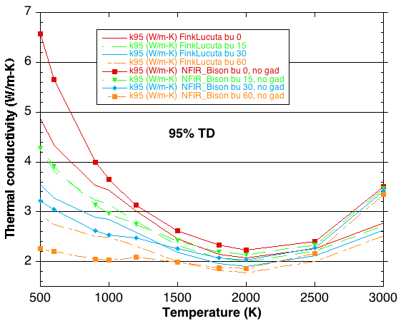
MOOSE/BISON Models
https://mooseframework.inl.gov/bison/source/materials/UO2Thermal.html
Fink-Lucuta
Halden
NFIR
NFI
Ronchi-Staicu
Toptan (NCSU alum)

Slide 20
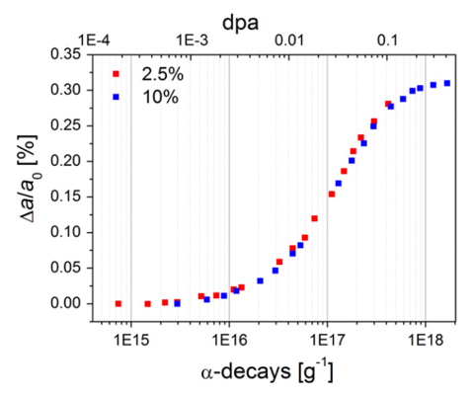
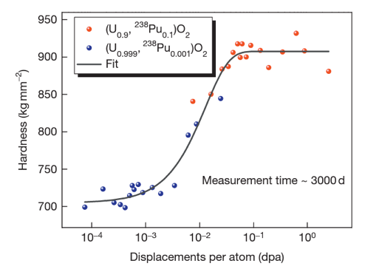
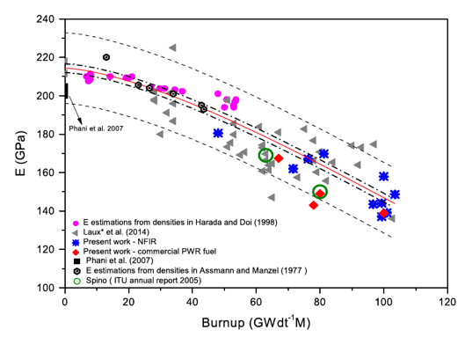
Other Physical Changes
An important effect of radiation damage is the volume increase of the crystal lattice, leading to macroscopic swelling of the fuel material
Alpha particle damage alone can cause approximately 0.4% swelling
Mechanical properties also vary with damage
Hardness increases as a function of dpa
Young’s modulus decreases with dpa

Slide 21
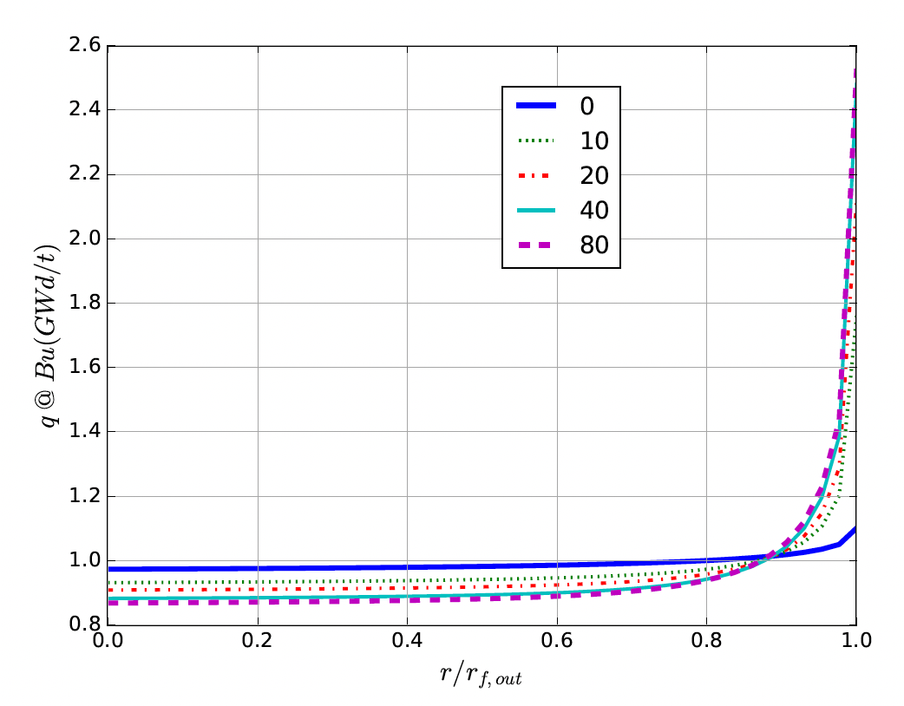
High Burnup Structure (HBS)
At the beginning of the irradiation, the local power is ~10% higher on the pellet periphery, due to self-shielding effect in 235U fissions driven by neutrons entering the rods after interactions in the water
With increasing burnup, a strong capture of neutrons by U-238 in the resonance range occurs at the periphery of the fuel
This leads to the production of Pu-239, and leads to a higher fissile density and thus a further increase in the local power/burnup
This high local burnup area is on the outer ring of the fuel and is about 200 microns thick, which represents about 8% of the fuel

Slide 22
High Burnup Structure (HBS)
When thermal recovery is not sufficiently efficient (at lower temperatures), the accumulation of defects at high burnup can lead to the instability of the crystalline structure, initiating a restructuring driven by the energy stored in the material
This can be amorphization (not observed in UO2) or recrystallization/polygonization
Polygonization is the rearrangement of dislocations into sub-domain walls with slightly misaligned grains
In UO2, grains subdivide from 10 microns in size to 100-200 nm size, and a densely porous structure is formed (~20% porosity)

Slide 23
High Burnup Structure (HBS)
The increase of the relative porosity volume degrades the material conductivity and reduces the mean grain size
On the other hand, the intragranular irradiation defect-cleaning improves the fuel intrinsic thermal conductivity
Fission gas in HBS bubble is retained, not released
Exact mechanism of HBS formation is not fully understood, believe to be polygonization, interacting with fission gas bubbles, dislocation growth, and high levels of energy deposition

Slide 24
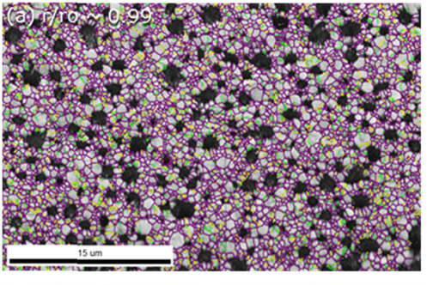
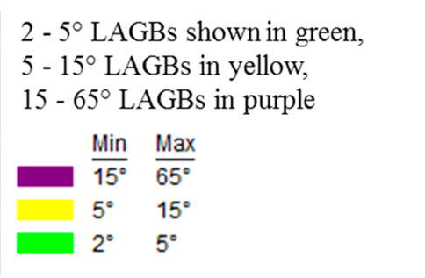
High Burnup Structure (HBS)
HBS has a high fission gas retention capacity, and does not evolve toward an open system of interconnected channels, even when porosity reaches very high values
Thus, the HBS is a relatively stable structure, limiting pressure increase in the plenum
While burnup is higher in the rim region, the HBS polygonization removes/sweeps defects to new grain boundaries, removing some phonon scatterers
Despite high porosity, thermal conductivity increases, slightly decreasing centerline temperatures in high burnup fuel

Slide 25
Radiation Effects Summary
Formation of loops of voids as primary defect clusters
Radiation effects include both chemistry and physical property changes
One of the key physical properties modified is the thermal conductivity
have several empirical (and mechanistic) models to account for burnup and temperature
HBS forms towards the end of life, generating a fine-grained structure with high porosity
HBS retains fission gas and slightly increases thermal conductivity

Slide 26
mechanistic modeling

Slide 27
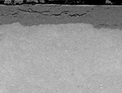
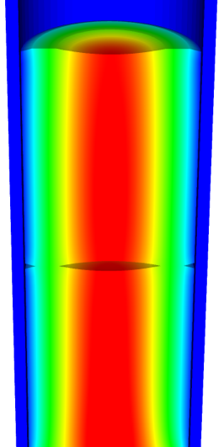
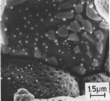
Microstructure-based fuel performance modeling
Structure/property relationships connect the microstructure variables to the property values
Operating Conditions
Neutron flux
Coolant T&P
Variables
Temperature
Displacement
Stoichiometry
Cladding
Property values
Microstructure evolution models
Microstructure evolution models
Fuel Property values
Elasticity tensor
Elasticity tensor
Grain growth
Grain growth
Cladding
Microstructure variables
Average grain size
Dislocation density
H concentration
Hydride fraction
Point defect concentrations
Loop density
2nd phase particle fraction
Fuel
Microstructure variables
Average grain size
Dislocation density
U defect concentrations
Pu concentration
Fission product precipitate fractions
Dissolved fission products
Fission gas bubble fraction
Grain boundary fission gas bubble coverage
Crack parameter
Plasticity
Plasticity
Thermal conductivity
Yield stress
Defect prod. & transport
Defect prod. & transport
Fracture stress
Thermal conductivity
Hydrogen transport
Fission gas behavior
Melting temperature
Failure criteria
Loop evolution
Densification
Diffusion constants
Dimensional change
Gap variable
Gap fission gas concentration
Fracture
Dimensional change

Slide 28

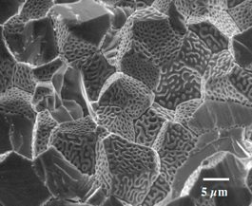
Example: fission gas behavior in the fuel
Take into account a finite set of variables to describe the state of the material
Utilize a mechanistic model of fission gas behavior to predict the evolution of the microstructure
Utilize this updated microstructure to inform a number of structure/property relationships
Variables
Temperature
Displacement
Stoichiometry
Elasticity tensor
Thermal conductivity
Model of fission gas behavior
Structure/property relationships
Fracture stress
Dissolved fission products
Fission gas bubble fraction
Grain boundary fission gas bubble coverage
Gap fission gas concentration
Dimensional change
Gap conductance
Gap pressure

Slide 29
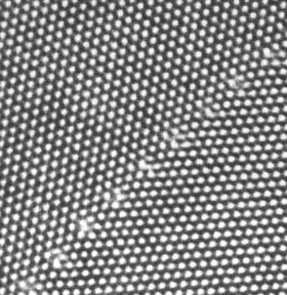
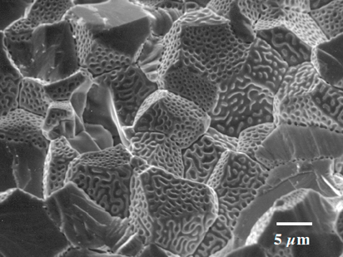
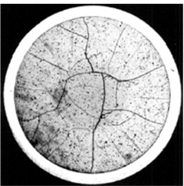
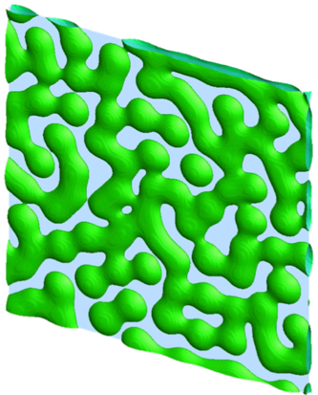
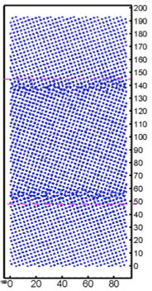
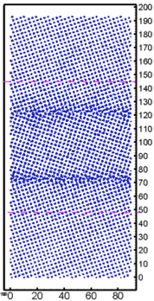
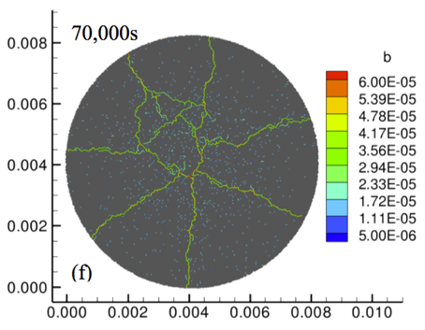
Multiscale separate effects experiments and simulations inform the development of the models
nm
μm
mm

Slide 30
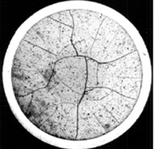
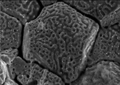
Microstructure-based models
Can provide a structure/property relationship to replace the existing burnup dependent model
For example, thermal conductivity, taking into account microstructural features and their evolution
Grain boundary and bubbles
Intragranular porosity
Precipitated fission products
κ_{pr}
Bulk conductivity
Vacancies and interstitials
Fission gas

Slide 31
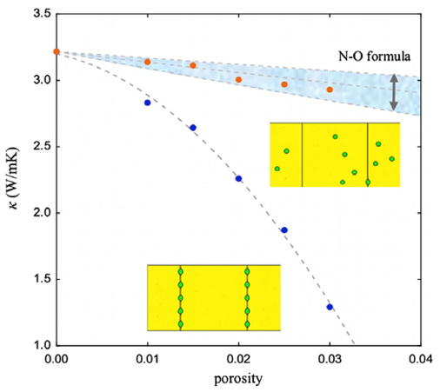
Parametrizing the mechanistic model
We employ multiscale modeling and simulation to determine the various parameters for the model
MD simulations conducted at LANL have been used to determine the coefficients for various point defects
MD simulations have shown that phonon scattering must be accounted for to accurately represent small bubbles
Mesoscale simulations have shown that GrB bubbles have a larger impact on the thermal conductivity
Maxwell-Eucken (no phonon scattering)

Slide 32
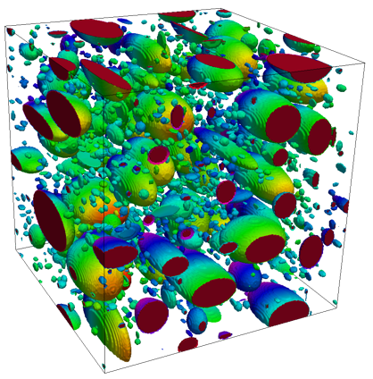
Parametrizing the mechanistic model
A thermal resistor model is created to describe the impact of GrB bubbles on the thermal conductivity
MARMOT simulations are currently being used to inform the development of the precipitate multiplier

Slide 33
Parametrizing the mechanistic model
Each term in the expression must be coupled to a corresponding state variable
The full model calculates the thermal conductivity as a function of:
Temperature
Point defect concentrations
Intragranular bubble density and average radius
Fractional coverage of bubbles on GBs and average radius
Precipitate volume fractions and average sizes
Currently effects of precipitate fission products and individual point defects are neglected in the model, as they are not tracked or predicted in BISON

Slide 34
Comparing with experiments…
The model under-predicts the temperature in most cases, but not all
Thus, the model is neglecting some resistive effects from the microstructure
Generally performs as well, and in some cases better, than the burnup based model
RISO-3 AN3
RISO-3 AN4
RISO II-3
US PWR TSQ0002

Slide 35
Summary
Researchers are working to develop materials models for the fuel and cladding that are mechanistic rather than empirical and that are based on the evolution of the microstructure rather than the burnup

