Slide 1
Nuclear Fuel Performance
NE-533
Spring 2022

Slide 2
Last Time
Fuel and pellet conditions change with time due to microstructure evolution
All materials have defects, radiation damage causes many more defects
Microstructure can be tailored through processing
Thermal conductivity degrades with time
High Burnup Structure can form along the rim
Started on some fuel chemistry

Slide 3
Fuel chemistry

Slide 4
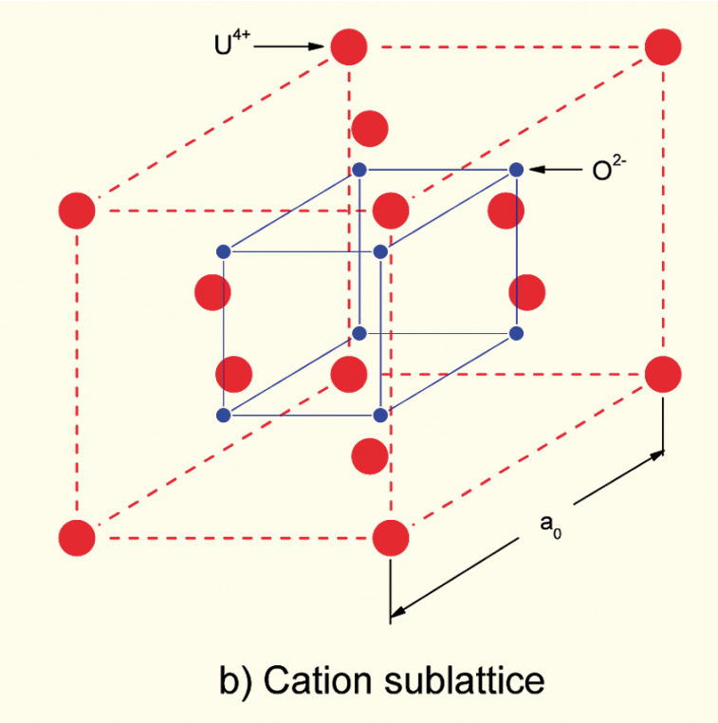
Incorporation of Fission Products
As fission products form, the valence state of the uranium can change
Typical valence of soluble fission products is M³⁺
The uranium valence state changes to compensate
Oxygen liberated by fission
Fission products produced with M³⁺ valance state incorporated in fuel lattice
Uranium oxidizes from U⁴⁺ to U⁵⁺ or U⁶⁺ to maintain local electrical neutrality

Slide 5
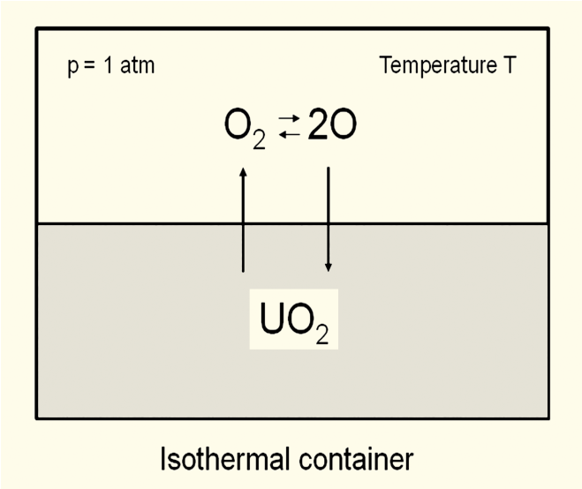
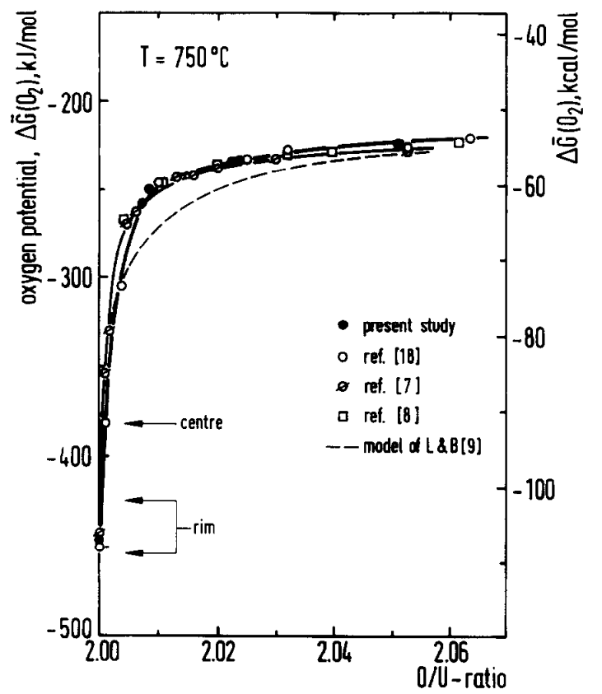
Oxygen potential
The oxygen potential is a measure of how free the oxygen is to escape/move around
Oxygen potential is defined as:
or, equivalently:
With = Chemical potential of oxygen in solution
= Gibbs free energy of gaseous oxygen at temperature T and a standard pressure (1 atm)
It is possible to determine the stoichiometry from the oxygen potential

Slide 6
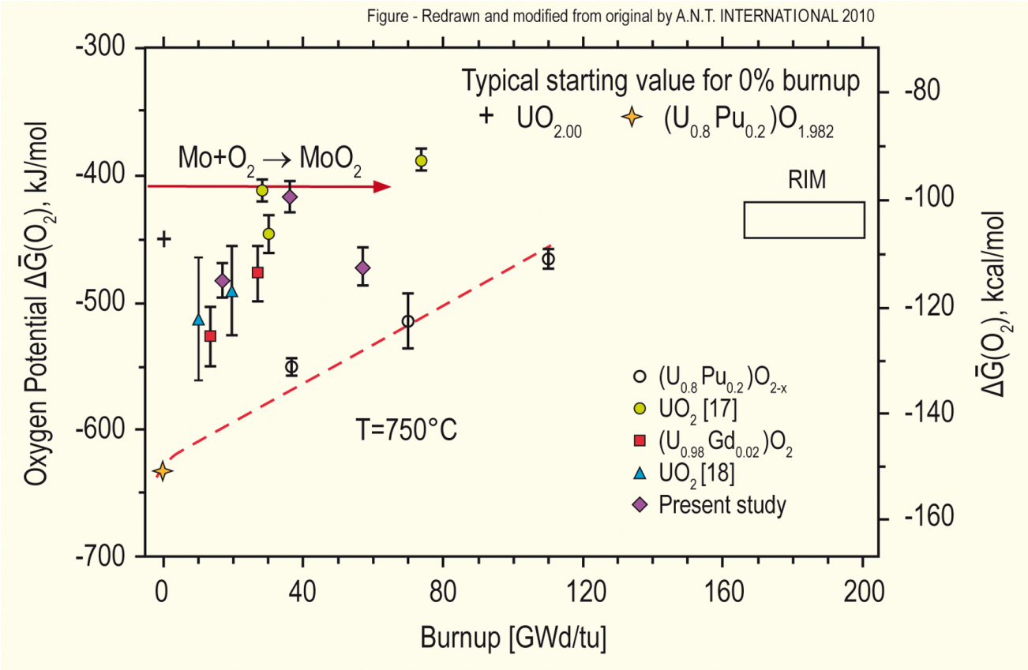
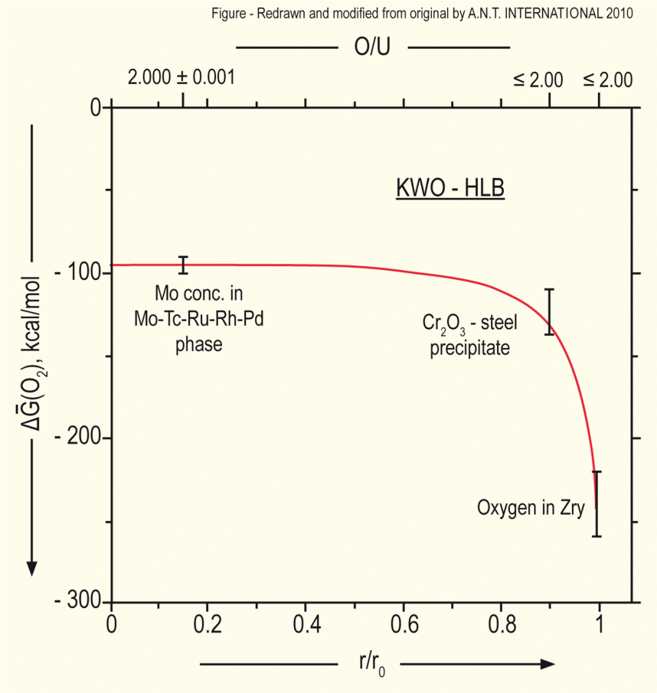
Oxygen potential
The oxygen potential changes during irradiation, indicating change in the O/M ratio
Oxygen potential changes during irradiation due to
Liberation of oxygen by fission; Generation of fission products; Conversion of uranium to plutonium; Reaction of oxygen with U, Pu, fission products, and cladding
Oxygen potential across pellet radius observed to be constant at the approximate value of Mo/MoO₂ reaction (from calculations)
Mo serves as a buffer to the O potential, or a means of inferring what the oxygen potential may have been in the fuel from PIE
Oxygen potential is low near the cladding, because the oxygen enters the cladding

Slide 7
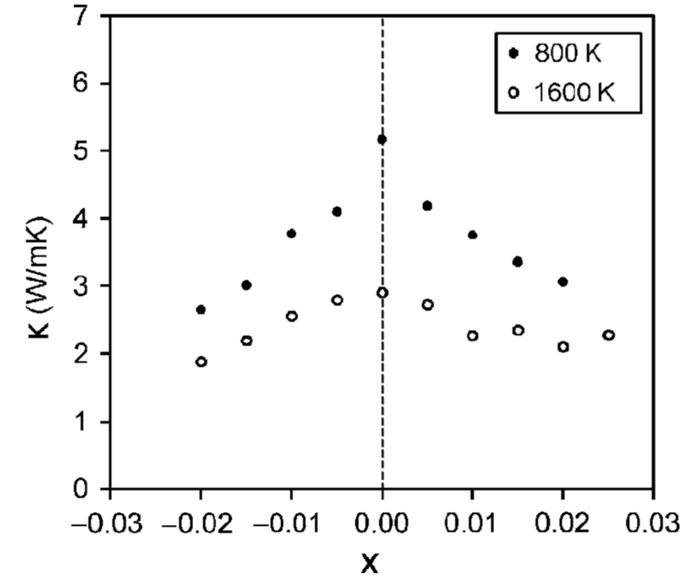
Fuel Stoichiometry/Properties
The stoichiometry of the fuel directly impacts the fuel performance
Stoichiometry impacts
Melting temperature
Thermal conductivity
Processes dependent on diffusion
Grain growth
Fission gas release
Creep
Chemical state and behavior of fission products
Chemical reactions at inner cladding surface
Thermal conductivity is highest for stoichiometric UO2

Slide 8
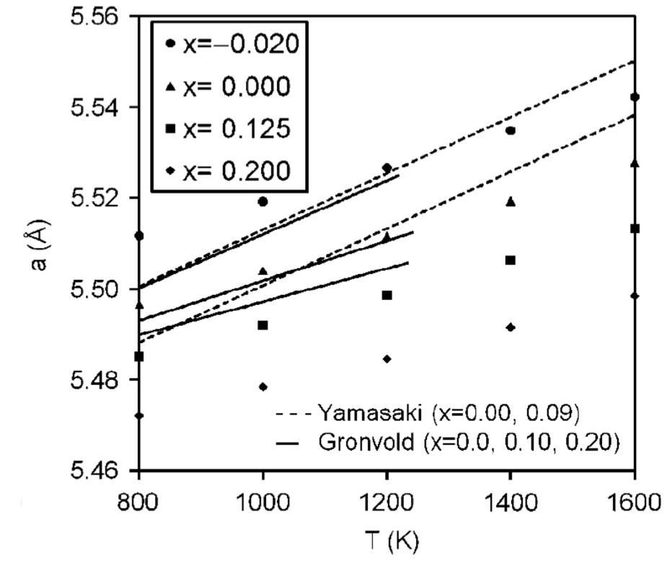
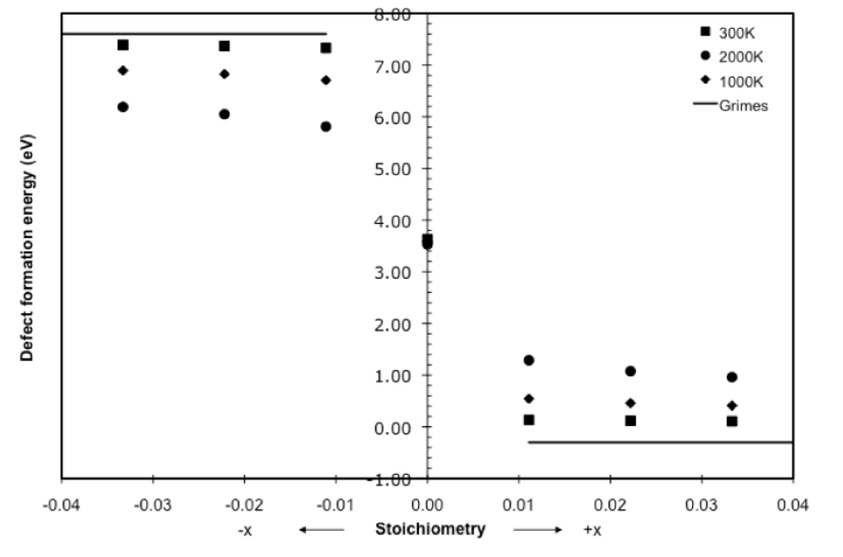
Fuel Stoichiometry/Properties
The lattice constant of the material decreases with increasing stoichiometry
The vacancy formation energy also changes with stoichiometry

Slide 9
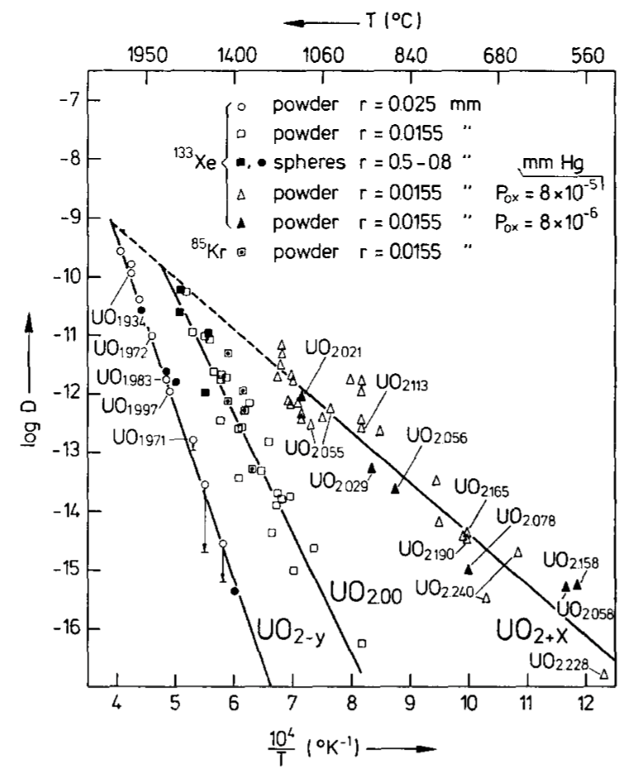
Fuel Stoichiometry/Properties
Fission product | UO_{1.97} | UO₂ | UO_{2.03}
Xe | 3.88 eV | 3.88 ev | 2.61 eV
Cs | 1.7 eV | -0.04 eV | -3.29 eV
Sr | -3.71 eV | -6.03 eV | -9.55 eV
The solution energy of Xe, Cs, and Sr in UO₂ depends on stoichiometry as well
The coefficient defining Xe diffusion also changes with stoichiometry
Though stoichiometry matters, most fuel performance codes ignore it

Slide 10
Fuel Chemistry Summary
UO₂ has a cubic fluorite structure that is very stable
The charges are balanced with a U⁴⁺ valence state
However, the ratio of oxygen to uranium can change. We call this the stoichiometry and abbreviate it as O/M ratio
The O/M ratio changes during reactor operation, but it is complicated
The O/M ratio impacts many properties of the fuel

