Slide 1
Nuclear Fuel Performance
NE-533
Spring 2026

Slide 2
Mechanics

Slide 3
Solid mechanics
When a load is applied to a body, it changes shape and perhaps size
Motions throughout a body are called displacements
u(r, t)
Rigid body displacements do not change the shape and/or size
the rigid body is translated
Changes in shape and/or size are call deformations
The objective of Solid Mechanics is to relate loads (applied force) to deformation

Slide 4
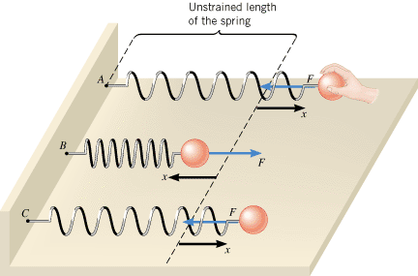
Ideal springs
It can be instructive to view solids as a spring
When we apply some force F, we get some displacement x
F = k x
When the spring is displaced by x, there is force that responds in the opposite direction equal to kx
Due to the displacement, there is a stored energy E = ½ k x²

Slide 5
Observed deformation due to a force
Solid mechanics is similar to the behavior of an ideal spring but throughout a body
An applied load results results in deformation.
The internal strain is like the displacements x
The internal stress is like the internal force F

Slide 6
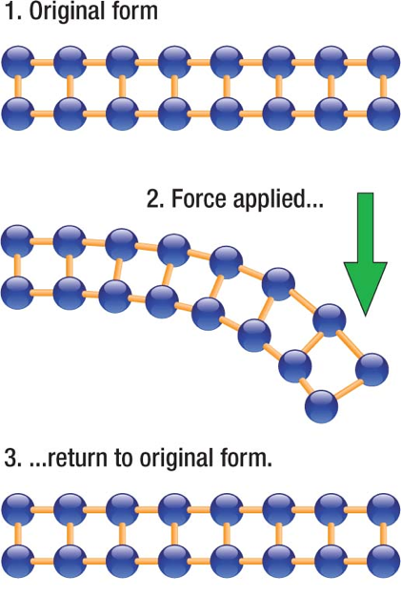
Elasticity
Elasticity is the ability of a body to resist a distorting influence and to return to its original size and shape when that influence or force is removed
In elastic deformation, we are stretching the atomic bonds
The more we stretch the bonds, the more force it takes to stretch
When we release the load, the atoms spring back into their lattice sites

Slide 7
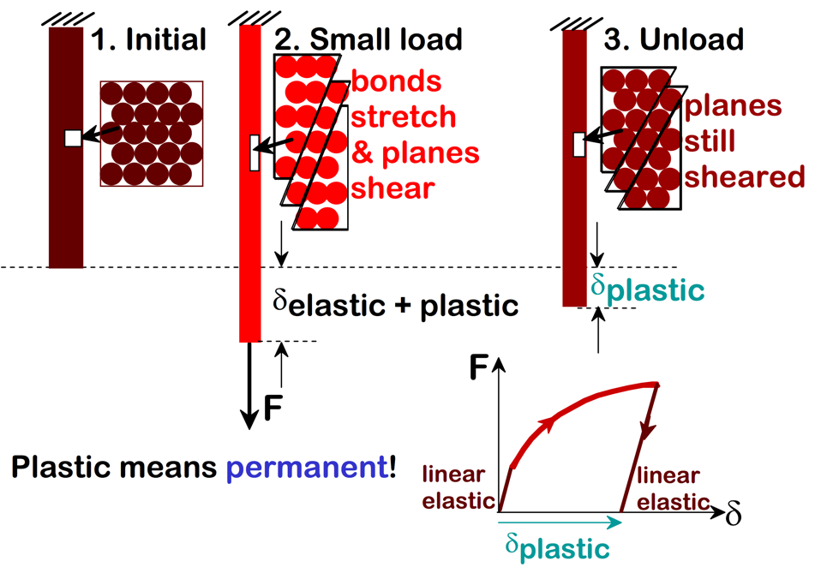
Plasticity
Plasticity is the ability of a solid material to undergo permanent deformation, a non-reversible change of shape in response to applied forces
Plastic deformation is observed in most materials
The transition from elastic behavior to plastic behavior is known as yielding

Slide 8
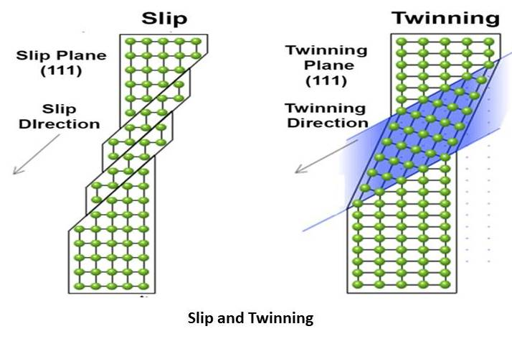
Plasticity
Plasticity is typically caused by two modes of deformation in the crystal lattice: slip and twinning
Slip is a shear deformation which moves the atoms through many interatomic distances relative to their initial positions
Twinning is the plastic deformation which takes place along two planes due to an applied force
Ductility (total elongation), Yield Strength, etc. are dependent upon temperature and composition
Plasticity typically increases at higher temperature

Slide 9
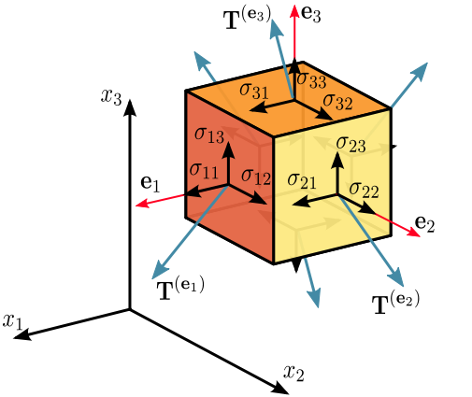

Stress
Stress is a physical quantity that expresses the internal forces that neighboring particles of a continuous material exert on each other
Stress is a force per unit area with SI units of Pa = N/m²
The stress is a 2nd order tensor (a 3 by 3 matrix): Cauchy stress tensor
σ_{ij} = F_{ij}/A_{i}
i is the face the force is applied and j is the direction it is applied
Sigmas are normal stress components, taus are shear stress components

Slide 10
Stress as a response
The stress in a material is the RESPONSE to an applied load (force) or an applied displacement
Uniaxial tension or compression
Only one non-zero stress: σ_{ii} (σ₁₁, σ₂₂, σ₃₃)
Tension means positive stress, compression negative
Examples: Cables, tension tests
Pure shear
Only one non-zero stress: (σ₁₂, σ₁₃, σ₂₃)
Examples: drive shaft
Biaxial tension/compression
Two non-zero stress (e.g. σ₁₁ = 1, σ₂₂ = 2)
Examples: Pressure cylinder or vessel
Hydrostatic compression (pressure)
σ₁₁ = σ₂₂ = σ₃₃ = -p
Anything underwater

