Slide 1
Nuclear Fuel Performance
NE-533
Spring 2026

Slide 2
Housekeeping
Grading of exam 2 and MOOSE project is still ongoing…
Lecture 13 was uploaded last night/this morning
Today is Lecture 14
Lecture 15 will be an online makeup
Then lecture 16 then problem session + Exam 3
Exam 3 should be March 31
Have a good spring break next week!

Slide 3
Paper Project
Will upload papers with names attached today
Will deliver a 15-minute presentation providing a critical review of the paper
This is basically a mini QE Part 1, without the report
If you have a topic that you want the paper to address, reach out to me ASAP
Upload slides to moodle by April 3, will have an assignment generated
Class presentations will be conducted in-person on April 7 and 9
we get through as many as we can, and the remaining students will be tasked with uploading a recording
distance students will upload a recording
Not assigned for NE433 students

Slide 4
Last Time
Fission gas release
experiments fall into post-irradiation annealing, or in-pile
Showed Booth model equations for post-irradiation annealing and in-pile release
Forsberg-Massih 2-stage FGR model
Three components of diffusion
intrinsic, RED, RDD
Swelling/dimensional change
densification, thermal expansion, solid/gas fission product swelling, creep

Slide 5
Fuel Swelling/Dimensional Change Cont…

Slide 6
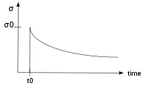
Creep
Creep is a general mechanism for plastic deformation that occurs over time when σ < σ_{y}
Consider a heated metal beam so it expands some distance dx
We then fix it between two walls and let it cool down
Because σ < σ_{y}, that stress remains constant
In creep, defect diffusion is induced by the stress to cause permanent deformation and reduce the stress
Therefore, creep
Occurs over time
Increases with increasing number of diffusing defects
High temperature (thermal creep)
Irradiation (irradiation enhanced thermal creep)
x
x+dx
σ = E ε

Slide 7
Creep
General creep equation:
Creep can be caused by various microstructural mechanisms
Bulk Diffusion (Nabarro-Herring creep)
Atoms diffuse (high T), causing grains to elongate along the stress axis
Q = Q(self diffusion), m = 1, and b = 2
Grain boundary diffusion (Coble creep)
Atoms diffuse along grain boundaries to elongate the grains along the stress axis
Q = Q(grain boundary diffusion), m = 1, and b = 3
Dislocation creep (power law creep)
Dislocations glide under a high stress
Dislocations climb due to defects to avoid obstacles
Q = Q(self diffusion), m = 4–6, and b = 0

Slide 8
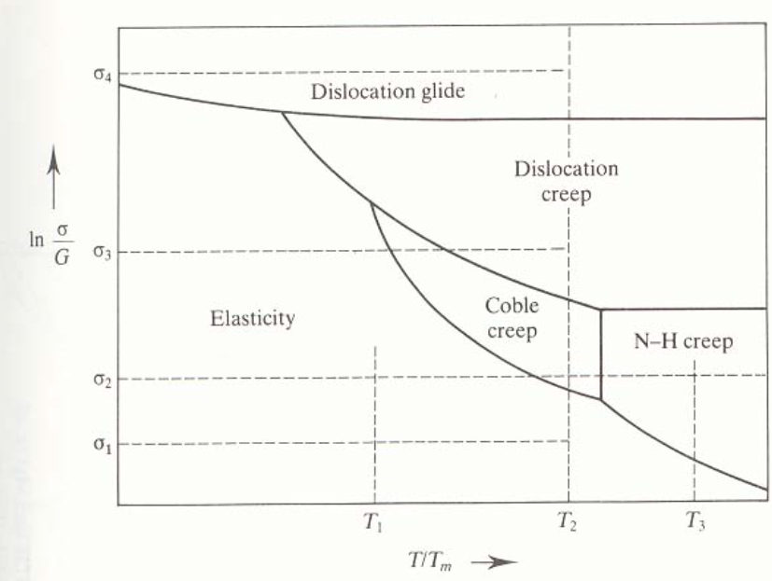
Different creep mechanisms are active for different combinations of stress and temperature

Slide 9
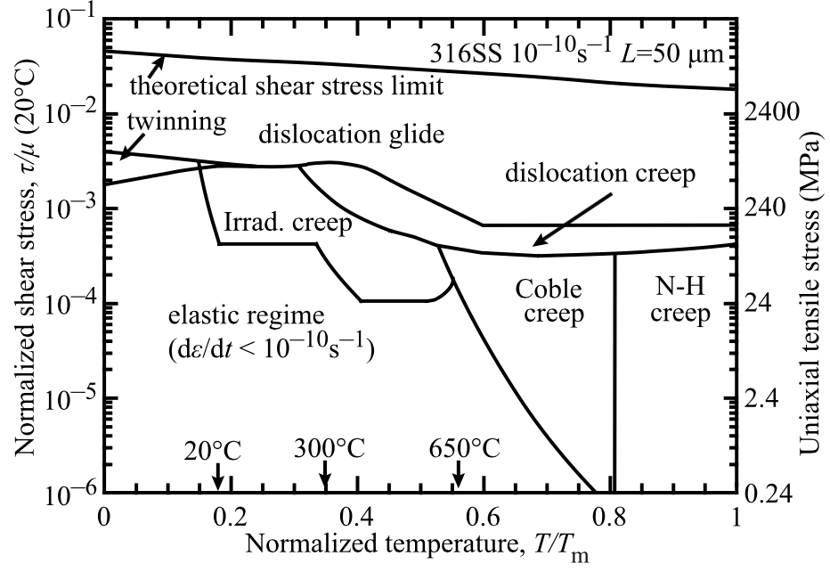
The behavior of creep changes in irradiated materials

Slide 10

Irradiation and Creep
Irradiation accelerates creep, causing it to be significant at lower temperatures
Irradiation typically has little effect on diffusional creep (but can increase defect concentrations)
Primary impact is accelerating dislocation creep in structural/cladding materials
The dislocation creep rate can be written as
ρ_{d}^{m} is the density of mobile dislocations
b is the burgers vector
v_{d} is the dislocation velocity
Gliding dislocations quickly get pinned by obstacles
As the dislocations absorb defects created by irradiation, they climb to different slip planes to avoid the obstacles
More interstitials are absorbed than vacancies due to the higher sink strength for interstitials

Slide 11
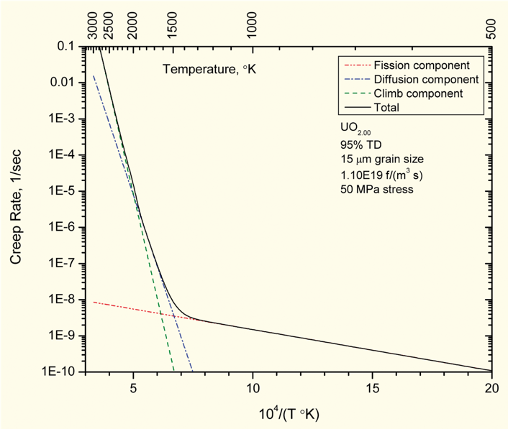
Fuel Creep
Like other materials, the fuel also undergoes creep
The fuel creep (In UO2) is a combination of diffusion creep and irradiation creep
Right shows the combined creep rate
It is expected that fuel creep plays a major role in dimensional change in metallic fuels, largely via N-H and Coble creep, but still unproven experimentally and no good creep models exist for metallic fuels

Slide 12
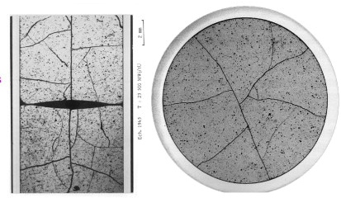
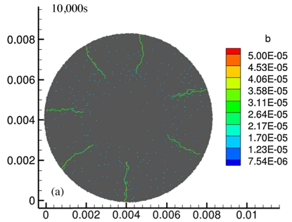
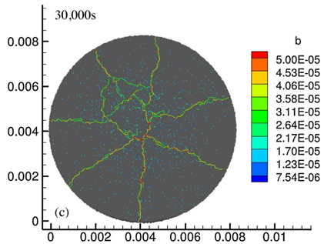
Fracture
UO₂ pellets fracture during changes in temperature due to large thermal stresses
Fracture results in:
Gap reduction
Reduced thermal conductivity
Increased avenues for fission gas release
Fracture has been typically modeled in two ways:
Empirical relocation model that is a function of burnup
Semi-empirical smeared cracking model
Modern methods provide means of modeling discrete cracks
Radial cracks partially penetrate the pellet during temperature increase
Full cracking occurs when the temperature decreases

Slide 13
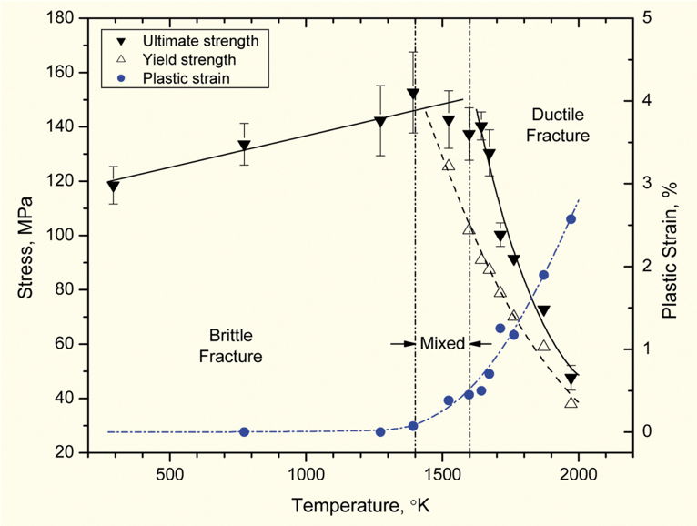
Fracture
The fracture behavior of the fuel is fairly complicated
Fracture strength varies with grain size (G)
σ_{frac} = G^{-m}σ_{frac, ref}, m = 0.04 – 0.05 (vs. m ~ 0.5 for metal)
Increasing grain size from 10 μm to 100 μm reduces σ_{frac} by ~10%
Ductility transition temperature is lower in-reactor than in thermal tests
Fracture strength is ~10× higher in compression than in tension
Load-deformation behavior strongly affected by creep under in-reactor conditions

Slide 14
Summary
Many materials models for fuel are empirical and correlated to burnup
Fuel pellets change shape due to
Thermal expansion (increase in volume)
Densification (decrease in volume)
Swelling (increase in volume)
Creep (volume stays the same)
Fracture also decreases the gap, as fractures pieces shift outward

Slide 15
Zirconium Cladding

Slide 16
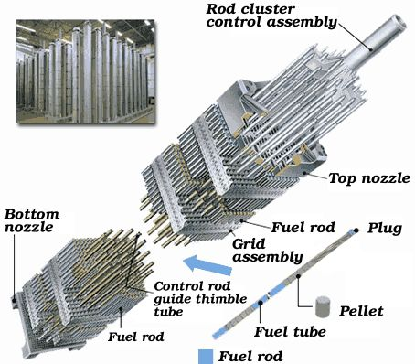
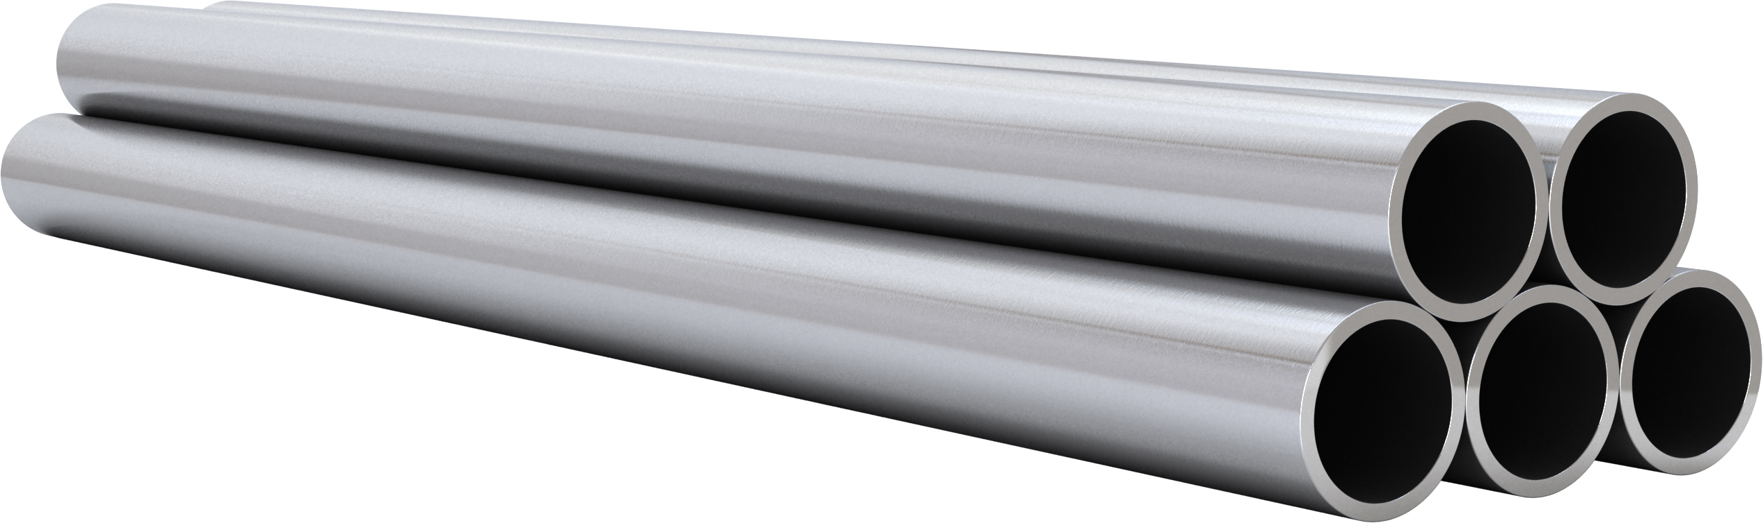
Cladding
The purpose of the cladding is to:
Hold the pellets together so that coolant can freely flow past
Transport heat from fuel to the coolant
Contain fission products
Contain fuel fragments
We would also prefer if the cladding had little to no impact on the neutron transport in the reactor

Slide 17
Why Zirconium alloys?
Benefits
Low neutron cross section
Corrosion resistance in 300˚C water
Resistance to void swelling
Adequate mechanical properties
Good thermal conductivity
Affordable cost
Available in large quantities
Problems
Corrosion under high-temperature steam
Hydride embrittlement
Anisotropic characteristics lead to creep and growth

Slide 18
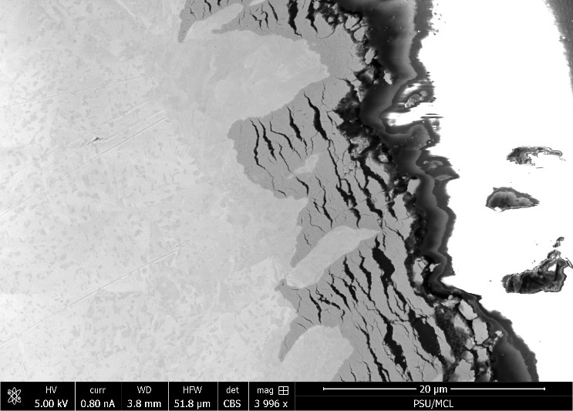
Zirconium
Pure zirconium was not acceptable due to its oxidation behavior
Oxygen with water reacted to form an oxide layer
The oxide layer is brittle and flakes off, allowing more oxidation to occur
Zr alloys were developed to improve corrosion resistance

Slide 19
Commercial Zr Alloys in PWRs
Alloy | Sn % | Nb % | Fe % | Cr % | Ni % | O %
PWRs (structural components and fuel rods)
Zircaloy-4 (SRA) | 1.2-1.7 | - | 0.18-0.24 | 0.07-0.13 | - | 0.1-0.14
ZIRLO (SRA) | 1 | 1 | 0.1 | - | - | 0.12
Optimized ZIRLO (pRXA) | 0.7 | 1 | 0.1 | - | - | 0.12
M5 (RXA) | - | 0.8-1.2 | 0.015-0.06 | - | - | 0.09-0.12
HPA-45 (SRA/RXA) | 0.6 | - | Fe+V | - | - | 0.12
NDA (SRA) | 1 | 0.1 | 0.3 | 0.2 |  | 0.12
MDA (SRA) | 0.8 | 0.5 | 0.2 | 0.1 |  | 0.12
PRXA Partial Recrystallization Anneal
RXA Recrystallization Anneal
SRA Stress-Relief Anneal

Slide 20
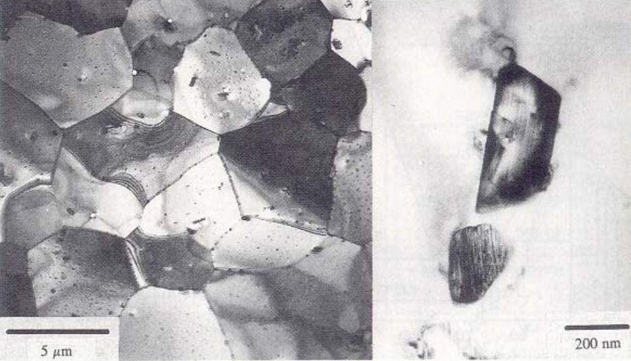
Alloying Elements
The alloying elements impact the microstructure of the material
The intermetallic precipitates significantly improve the oxidation behavior
In Zircaloy 2, the precipitates are
Zr(Cr, Fe)₂
Zr₂(Ni, Fe)
In Zircaloy 4, the precipitates are
Zr(Cr, Fe)₂
Phosphides (Zr₃P) and silicides (Zr₃Si) are also occasionally found
The precipitate distribution, size, morphology, and composition all impact the properties of the material

Slide 21
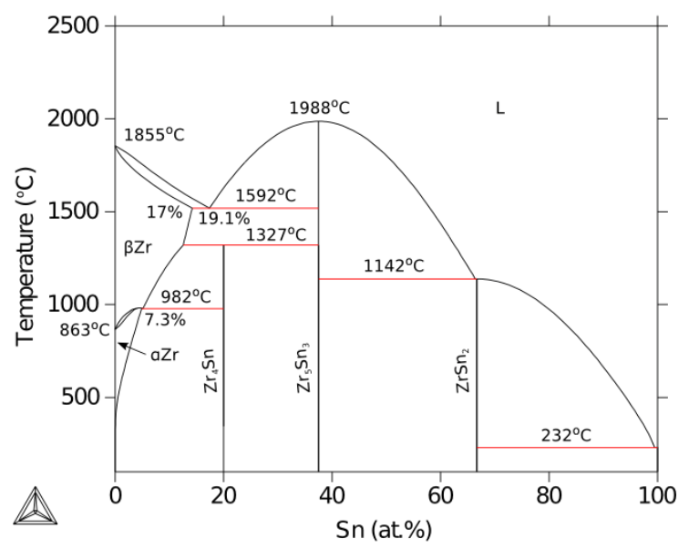
Zirconium Phases
The α-Zr phase has a hexagonal-close-packed (HCP) structure
At temperatures below about 863ºC
Has the most desirable properties
The β-Zr phase has a body-centered cubic (BCC) structure
We try to avoid this phase

Slide 22
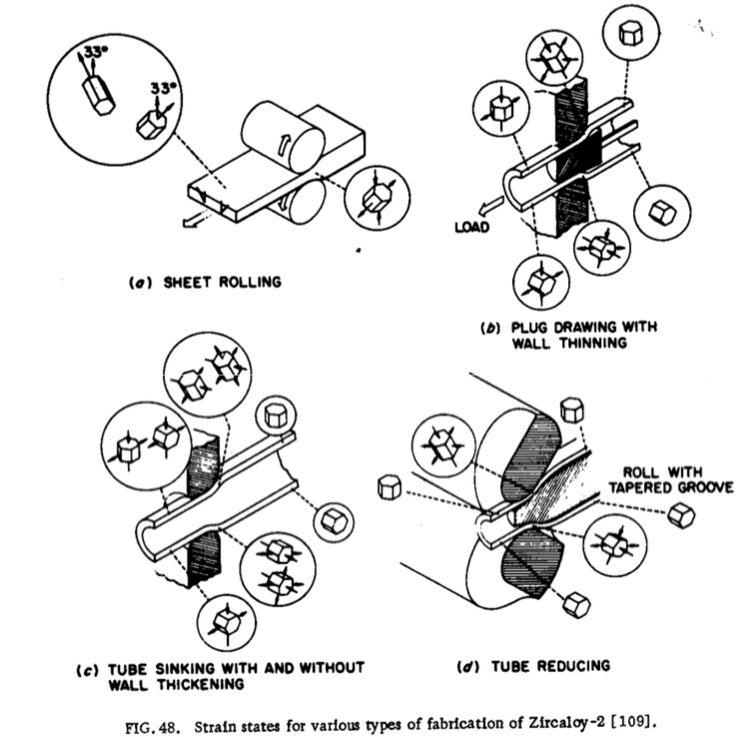
Zr Tube Fabrication
The cladding tubes are fabricated using various processes that severely deform the material
The severe plastic deformation causes significant dislocation hardening, that can make the tube material too brittle
Plastic deformation along slip planes results in reorientation of the grains
The properties of the material are controlled by heat treatment
Raising the temperature, but below 863˚C, anneals the sample to reduce cold work: SRA
Raising the temperature above 863˚C changes to the β phase. They then quench the sample to create a random texture in the α phase: RXA or pRXA

Slide 23
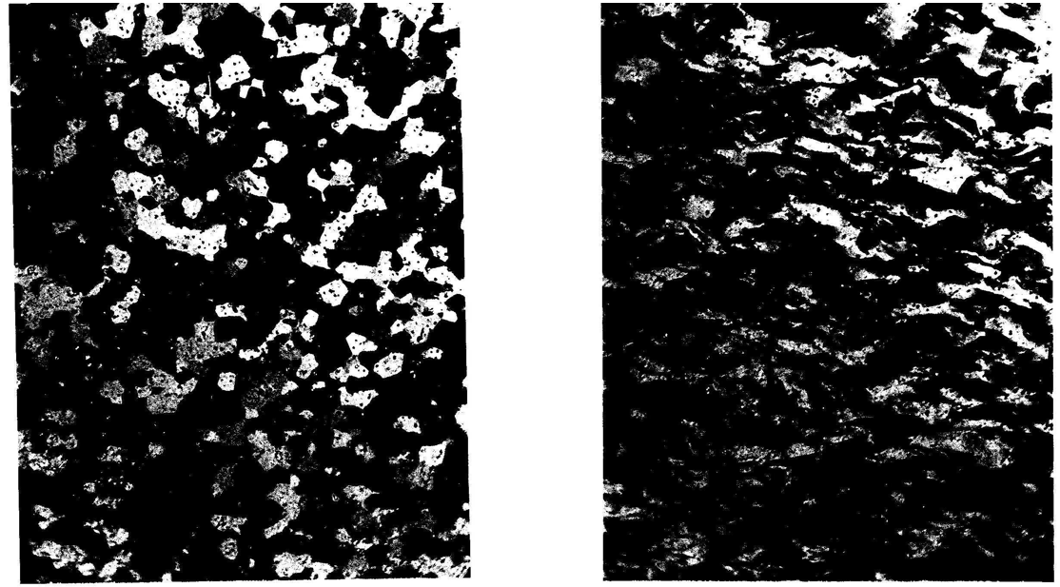
Zr alloy microstructures
Fully recrystallized after quench
Stress-relieved microstructure

Slide 24
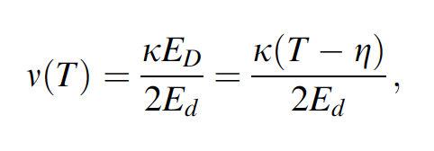
Zirconium Creep and Growth
The cladding undergoes a very large amount of irradiation during its life, the main effects are:
Interstitial loops form on prismatic planes
Later in the reactor exposure, vacancy loops form on the basal plane
The overall number of displacements to the cladding can be calculated with the NRT model to be ~ 8 x 10⁻⁸ dpa/s, which, over 3 years exposure gives a total of ~8 dpa (every atom in the solid is displaced on the average eight times)

Slide 25
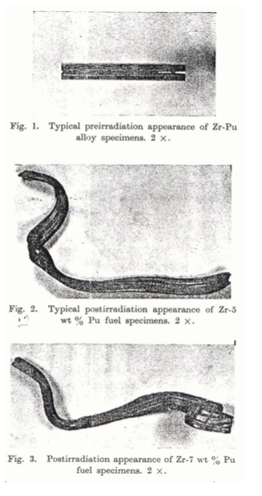
Irradiation Growth
Irradiation growth results from material anisotropy
There is corresponding anisotropy in the defect behavior within the unit cell
There is also a texture formed in the grain orientations
Interstitial loops form on pyramidal planes, causing shrinkage along the center axis
Later, vacancy loops form on basal planes, making it even worse
The result is a change in shape, shrinking in the 0001 direction and expanding in the pyramidal direction

Slide 26
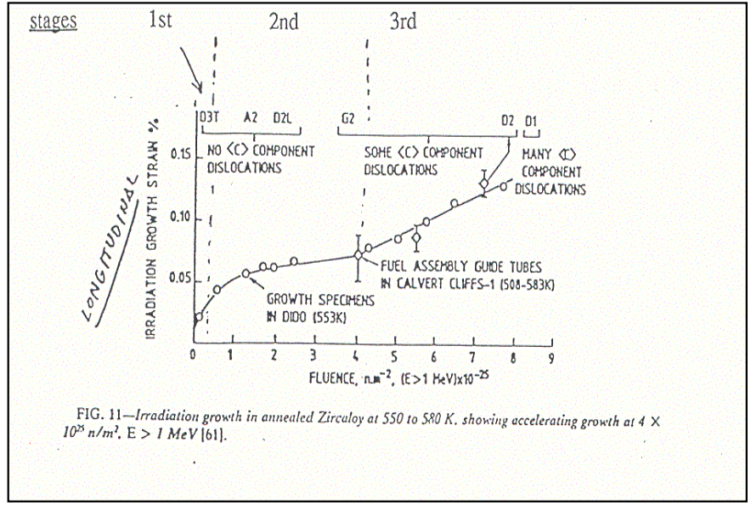
Irradiation Growth
Three stages of irradiation growth
Initial rapid growth to small strains – defect generation
Slow growth – defect accumulation, gets skipped in cold worked material
Accelerated or breakaway growth, caused by formation of vacancy loops on the basal plane
Irradiation growth is affected by:
Fluence, Cold work, Texture, Irradiation temperature, Material chemistry, Hydrogen effects

Slide 27
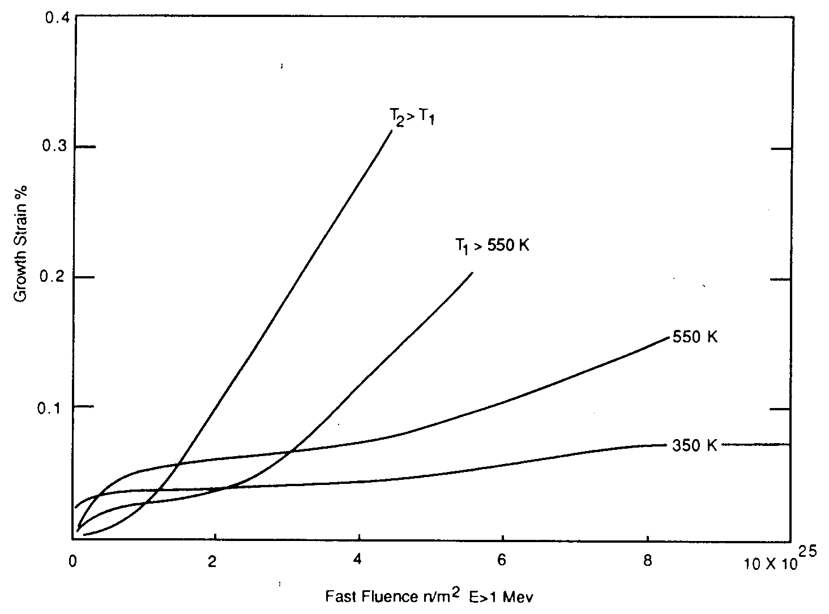
Irradiation Growth
Higher temperature leads to earlier breakaway and higher growth
Higher temperature adds mobility to defects, allowing them to diffuse faster, form clusters, and exacerbate the defect cluster induced anisotropic growth

Slide 28
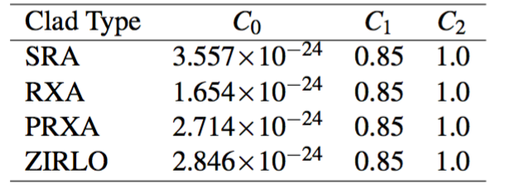
Zircaloy Creep
Empirical models have been developed for thermal and irradiation creep of Zircaloy
Both based on the Von Mises stress
Thermal Creep
With A₀ = 3.14 × 10²⁴ (1/s); shear modulus G = 4.2519 × 10¹⁰ − 2.2185 × 10⁷T Pa; n = 5; Q = 2.7 × 10⁵ J/mol
Irradiation Creep
ϕ is the fast neutron flux n/(cm² s) = 3E11xLHR n/(cm²-s)
Note that SRA stands for stress relief annealed
RXA for recrystallization annealed
PRXA stands for partially recrystallization annealed

Slide 29
Zircaloy Creep Example
Consider an SRA cladding tube at T = 600 K and LHR = 250 W/cm, with a stress σ_{m} = 200 MPa. What is the total creep strain after three years?
First, we will calculate the thermal creep
A₀ = 3.14 × 10²⁴ (1/s)
G = 4.2519 × 10¹⁰ − 2.2185 × 10⁷T Pa = 4.2519e10 − 2.2185e7*600 = 2.92e10 Pa
Q = 2.7 × 10⁵ J/mol, n = 5, R = 8.3144598 J/(K mol)
3.14e24*(200/2.92e4)^5*exp(-2.7e5/(8.3144598*600)) = 1.48e-10 1/s
Now we will calculate the irradiation creep
C₀ = 3.557e-24, C₁ = 0.85, C₂ = 1.0
Φ ≈ 3e11 LHR = 3e11*250 = 7.5e13 n/(cm² s)
3.557e-24*(7.5e13)^0.85*200^1 = 4.43e-10 1/s
The total creep strain rate is 1.48e-10 + 4.43e-10 = 5.91e-10 1/s
The total creep strain after three years is (assuming constant conditions) 5.91e-10*(3600*24*365*3) = 0.056 = 5.6% strain

Slide 30
Creep
Creep impacts fuel performance by shrinking the gap and then conforming to the pellets
a) before “fuel-cladding” interaction: The stress due to coolant pressure exceeds the internal stress from the gap; The diameter decreases due to thermal creep and irradiation creep, where the thermal creep decreases rapidly as irradiation damage builds up; The length increases due to anisotropic creep and irradiation growth

Slide 31
Creep
b) start of “fuel-cladding” interaction: At the contact points the diameter increases, causing some contraction in rod length, and the expanding fuel imparts a local axial tensile stress on the rod, causing an increase in length; Irradiation growth causes an increase in rod length; The net change in length is the sum of the various inputs, but the net is an increase in rod length
c) “fuel-cladding interaction” over most of fuel column: The fuel pellets stress the cladding outward, increasing the diameter of the rod; Anisotropic creep decreases the rod length; Axial pellet-cladding stresses and irradiation growth increase the rod length; The net change in rod length can become negative

