Slide 1
Nuclear Fuel Performance
NE-533
Spring 2026

Slide 2
Housekeeping
Presentations due on Friday (April 3) by midnight
Sent out an email about in-class presentations schedule
MOOSE part 3 has been assigned/uploaded to moodle, due April 28

Slide 3
Last time
Cladding oxidizes, forming ZrO₂
The limiting step for oxidation is
the oxygen transport through the oxide layer
Relationships for oxide thickness based on weight gain and for prediction of oxide layer growth based upon power law kinetics
Hydrogen released by oxidation enters the cladding
Hydrides preferentially form:
in areas of tensile stress and lower temperature (solubility and Soret effect)
Mechanical effect of hydrides:
hydrides are brittle, and so reduce the ductility of the cladding
DHC is a phenomenon based upon increased solubility of hydrogen in the high tensile stress around a crack tip
Have the ability to predict hydrogen pickup in oxidized Zr cladding

Slide 4
ACCIDENT SCENARIOS

Slide 5
Kinds of Accidents
Design basis accident: DBA
are postulated, credible accidents with low probability that are used to establish the design basis for the reactor and to define safety limits for its operation
two main kinds are RIA and LOCA
Beyond design basis accident: BDBA
accidents that fall outside of what is designed for, because they are deemed too unlikely to be included in design

Slide 6
Reactivity Initiated Accident (RIA)
Reactivity is the fractional departure from criticality: δk = (k − 1)/k
where k is your effective multiplication factor
k = (Neutrons produced in one generation)/(Neutrons produced in the previous generation)
k = ε L_{f} p L_{th} f η – this is your six-factor formula
ε = fast fission factor
L_{f} = fast non-leakage factor
p = resonance escape probability
L_{th} = thermal non-leakage factor
f = thermal fuel utilization factor
η = reproduction factor

Slide 7
Reactivity
Reactivity = rho = r = δk = (k − 1)/k
At steady state, k=1, rho=0
Reactivity is affected by the temperature and density of coolant, moderator, and fuel
Ideally, nuclear reactors are designed so that a power increase will generate negative reactivity feedback
an increase in the reactivity (higher k) leads to material changes, which in turn force a negative reactivity (lower k)

Slide 8
RIA-PWR
Design Basis Accident: Large and rapid insertion of reactivity caused by inadvertent ejection (PWR) or drop (BWR) of a control rod
A control rod ejection or drop can occur by mechanical failure of the control rod drive mechanism or its housing, and the reactivity of the core can rapidly increase due to decreasing neutron absorption of non-fuel
PWR
Control rod ejection accident (CREA)
Caused by mechanical failure of a control rod mechanism housing, such that the coolant pressure ejects a control rod assembly completely out of the core
Reactivity increase to the core occurs within about 0.1 s in the worst possible scenario
The most severe CREA would occur at normal coolant temperature and pressure, but with nearly zero reactor power

Slide 9
RIA-BWR
BWR
Control rod drop accident (CRDA)
Initiated by the separation of a control rod blade from its drive mechanism
Detached blade remains stuck in position until it suddenly becomes loose and drops out of the core in free fall
Most severe CRDA would occur at with the coolant close to room temperature and atmospheric pressure, and the reactor at nearly zero power
Other RIAs
inadvertent changes in coolant/moderator temperature and/or void fraction may add reactivity to the core

Slide 10
RIA
RIA leads to a fast rise in fuel power and temperature
This power ramp can lead to failure of fuel rods and release of radioactive material (or potentially fuel) into coolant
Release of hot fuel into water can cause rapid steam generation and pressure pulses, damaging other core internals
Coolant pressure pulse could break the reactor coolant pressure boundary or damage the fuel and other core internals so that long-term cooling of the core would be impaired
To prevent such consequences, safety criteria are set up to limit energy injection into the fuel

Slide 11
History of RIA
No RIA with severe consequences has occurred in PWRs or BWRs
The first reactivity-initiated accidents occurred in the 1950s and 1960s and concerned the first generation of research reactors
1952 accident in the NRX reactor at Chalk River
1961 SL-1 accident in Idaho Falls
Both resulted in severe damage and disruption of the reactor, and led to design improvements for later generations of RRs and commercial reactors
Did not eliminate RIAs
K-431 Russian Echo-II nuclear powered submarine in 1985
Chernobyl nuclear power plant, Ukraine, in 1986

Slide 12
Chernobyl RIA
Light water graphite moderated pressure tube design (RBMK)
Severe consequences of the Chernobyl accident were due to the fact that RBMKs lack not only a reactor containment, but also some of the inherent feedback mechanisms
Accident occurred under a reactor test, where normal operating guidelines were ignored and safety systems were shut off
Chernobyl accident prompted new research into reactivity-initiated accidents
focused on high burnup fuel, where previous safety standards had largely been on fresh fuel or low BU

Slide 13
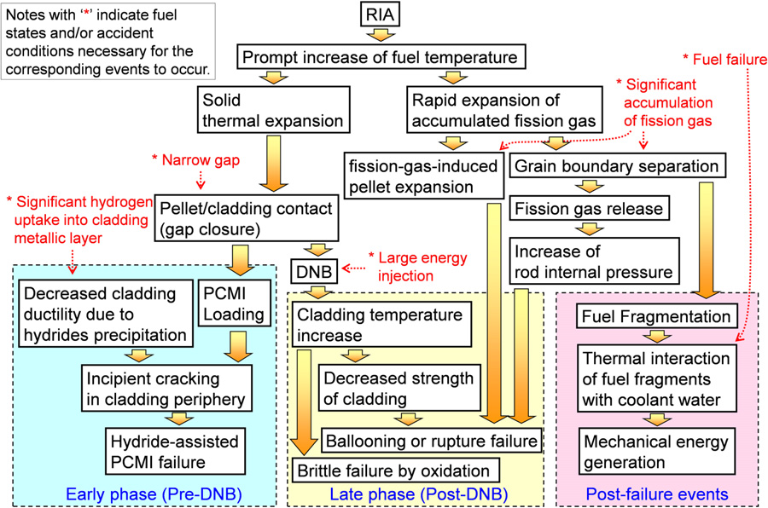
Sequence of RIA

Slide 14
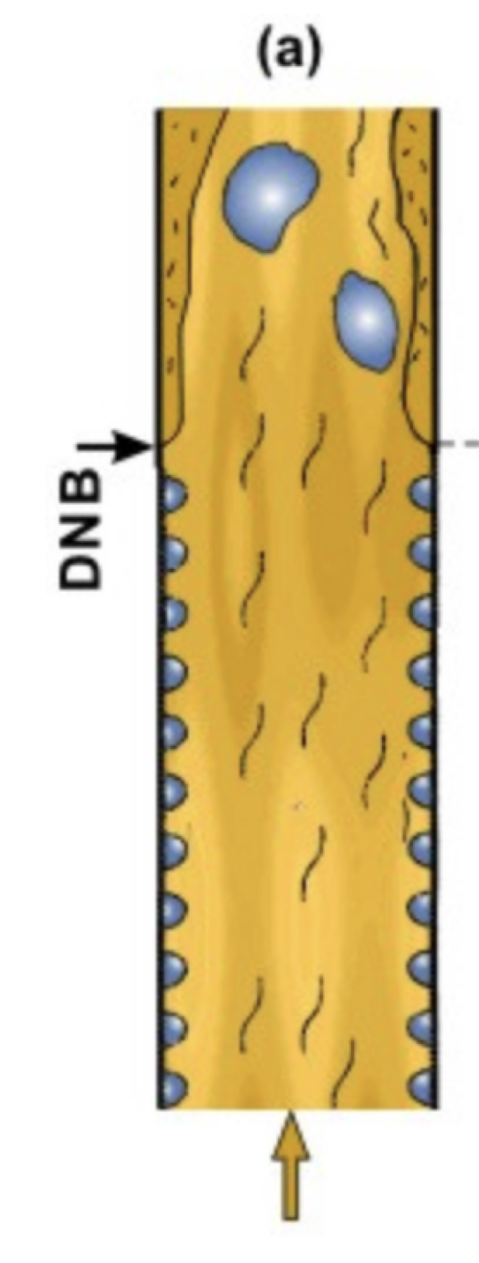
Departure from Nucleate Boiling
If the heat flux of a boiling system is higher than the critical heat flux (CHF) of the system, the bulk fluid may boil, or in some cases, regions of the bulk fluid may boil where the fluid travels in small channels
Large bubbles form, sometimes blocking the passage of the fluid
This results in a departure from nucleate boiling (DNB) in which steam bubbles no longer break away from the solid surface of the channel, bubbles dominate the channel or surface, and the heat flux dramatically decreases
Vapor essentially insulates the bulk liquid from the hot surface, increasing surface temperatures

Slide 15
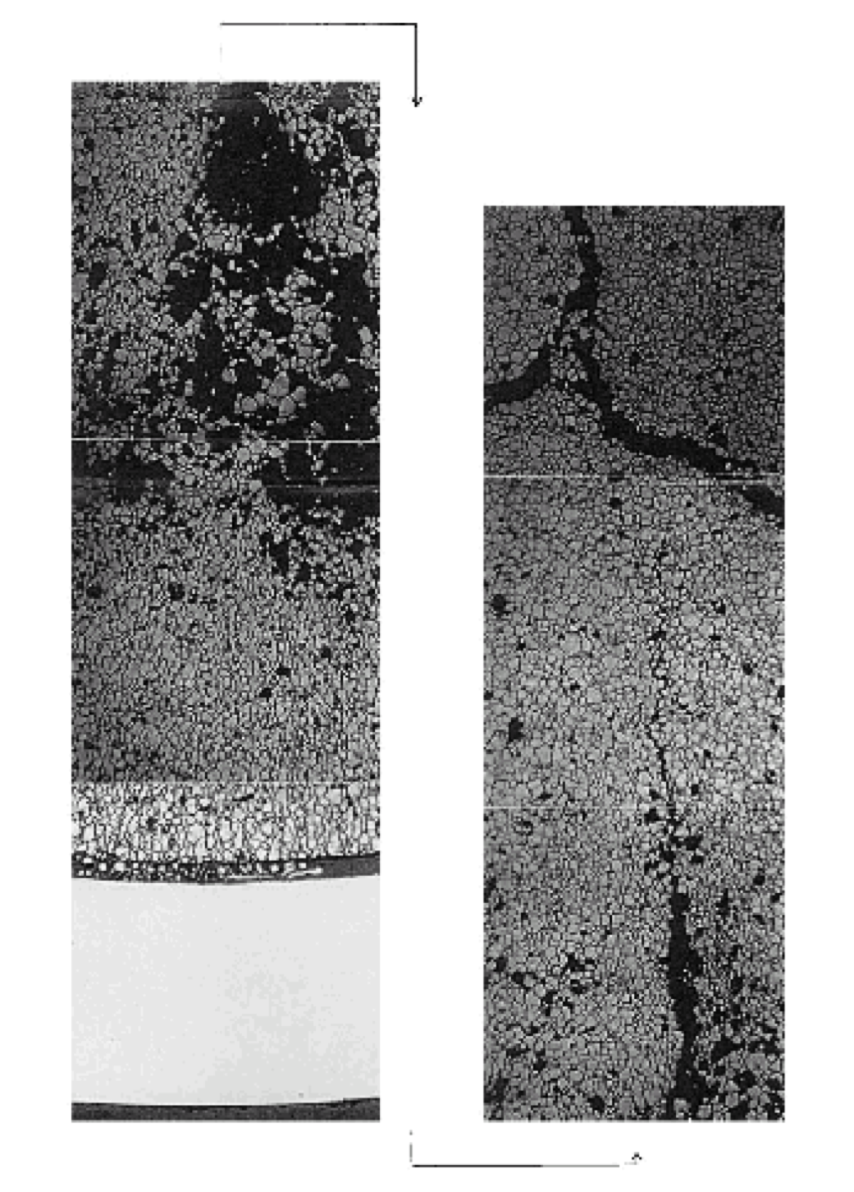
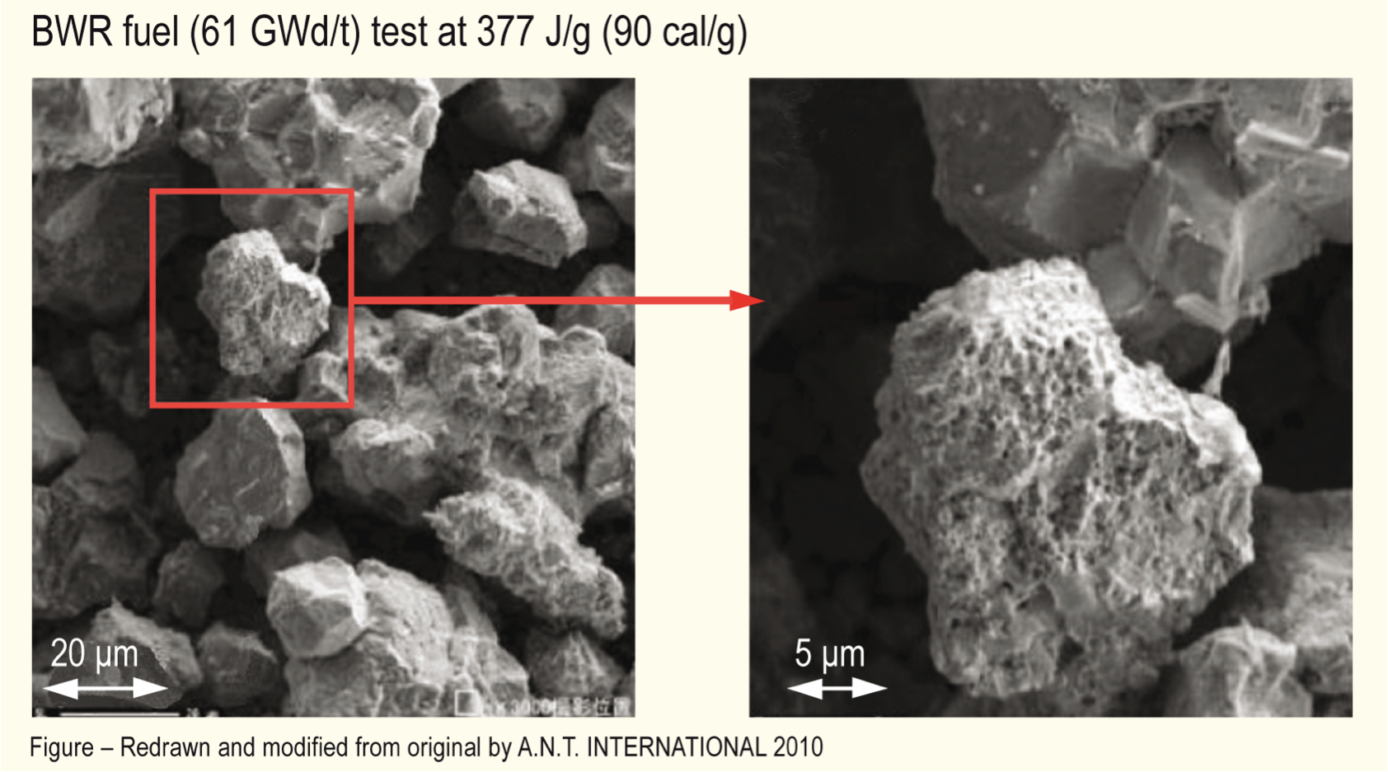
Microstructural Effects
Rapid increase in temperature increases pressure of bubbles
PV = nRT
Rapid pressure increase leads to cracking in fuel

Slide 16
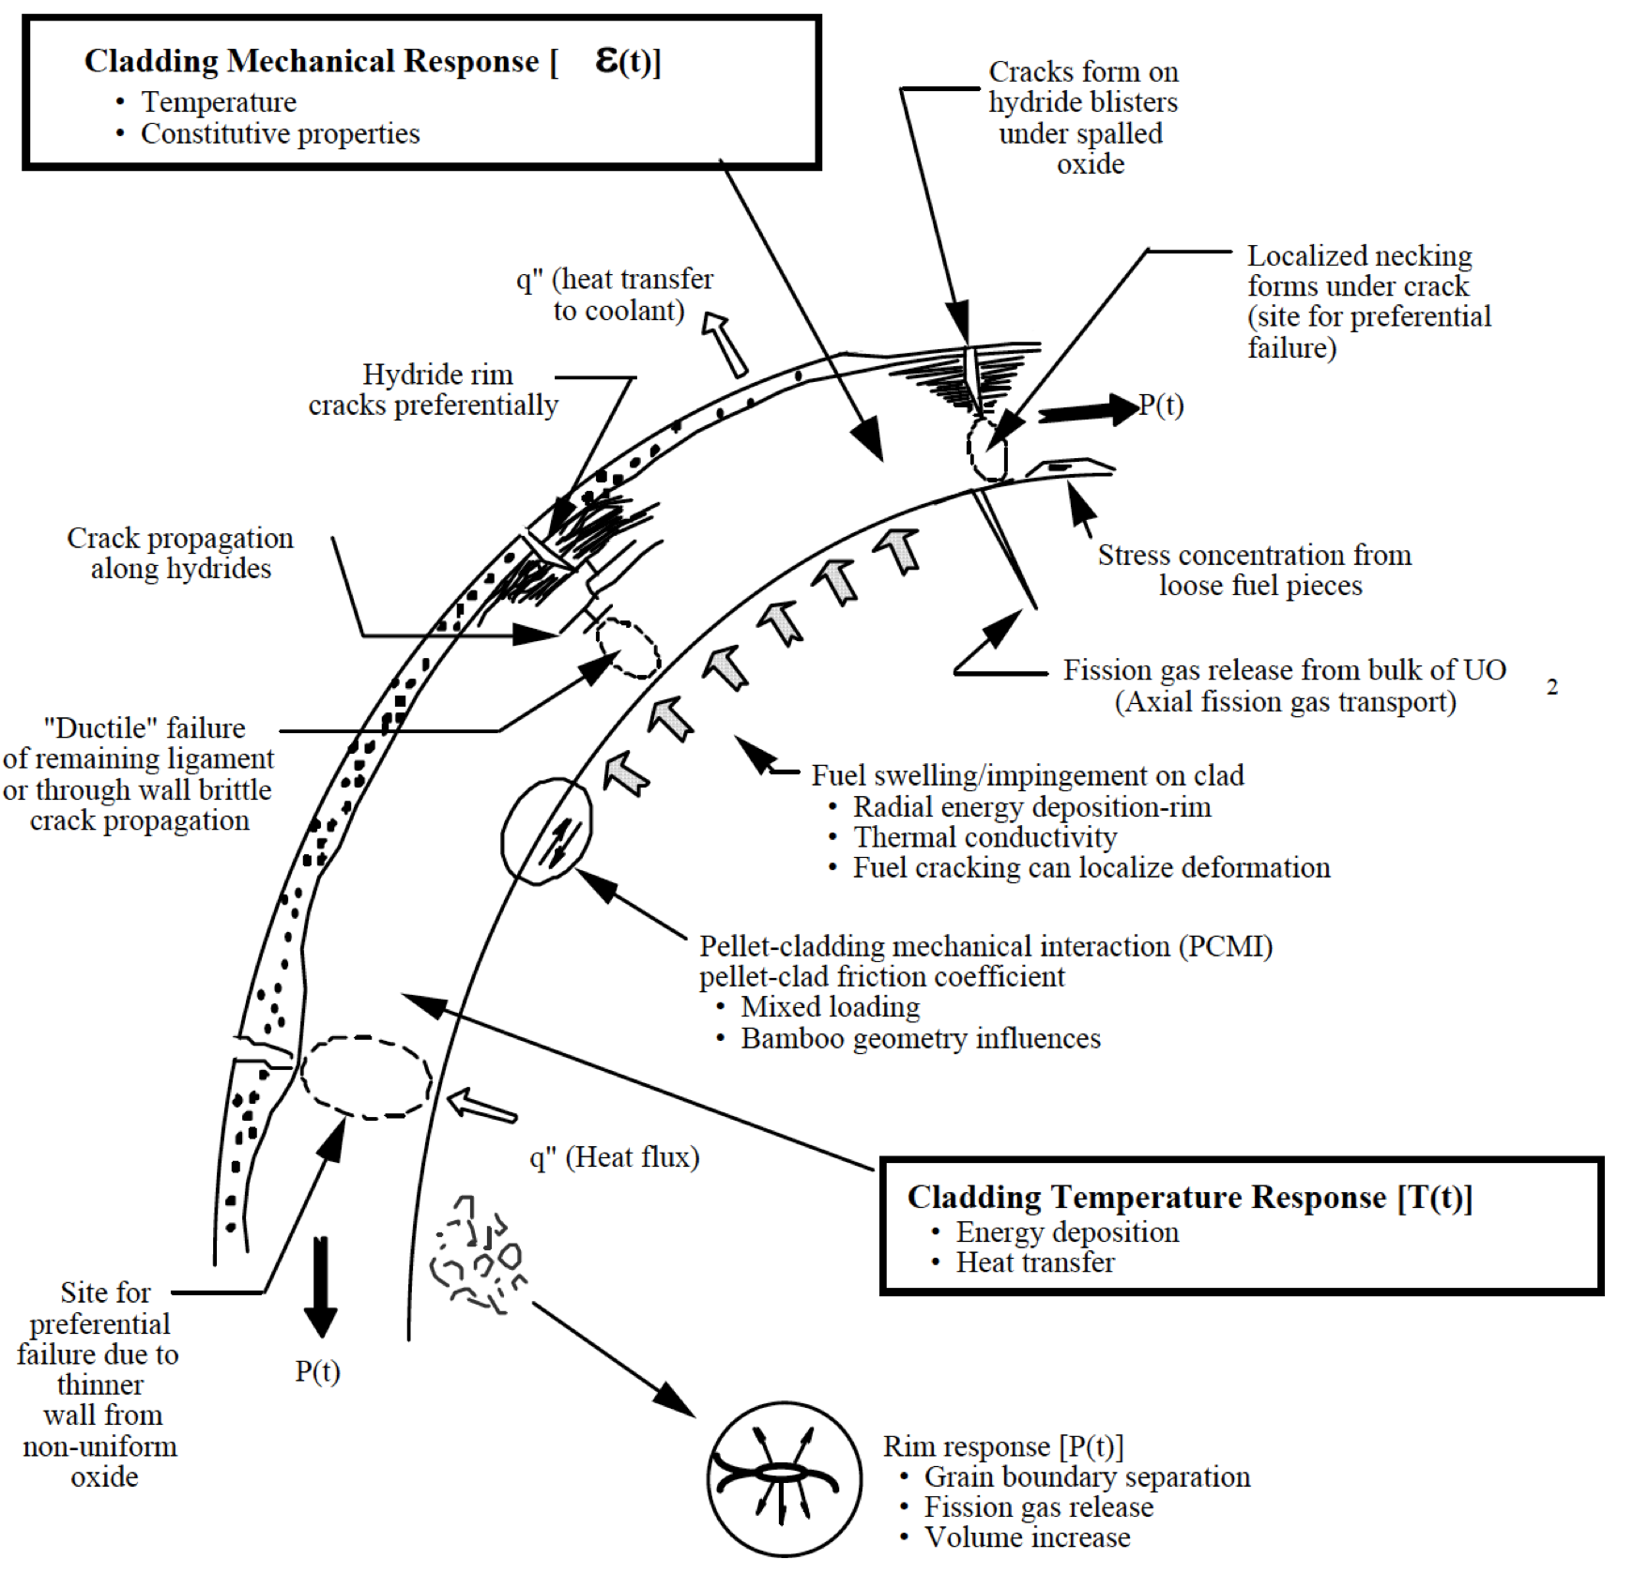
Cladding Response
Take into account burnup, corrosion (oxide layer and hydrides), damage accumulation, PCMI, internal pressure, etc. to properly evaluate strain in cladding
Temperature spike leads to a stress spike, and higher likelihood of cladding failure
Cladding fails either due to PCMI, ballooning/burst, severe oxidation, or partial melting

Slide 17
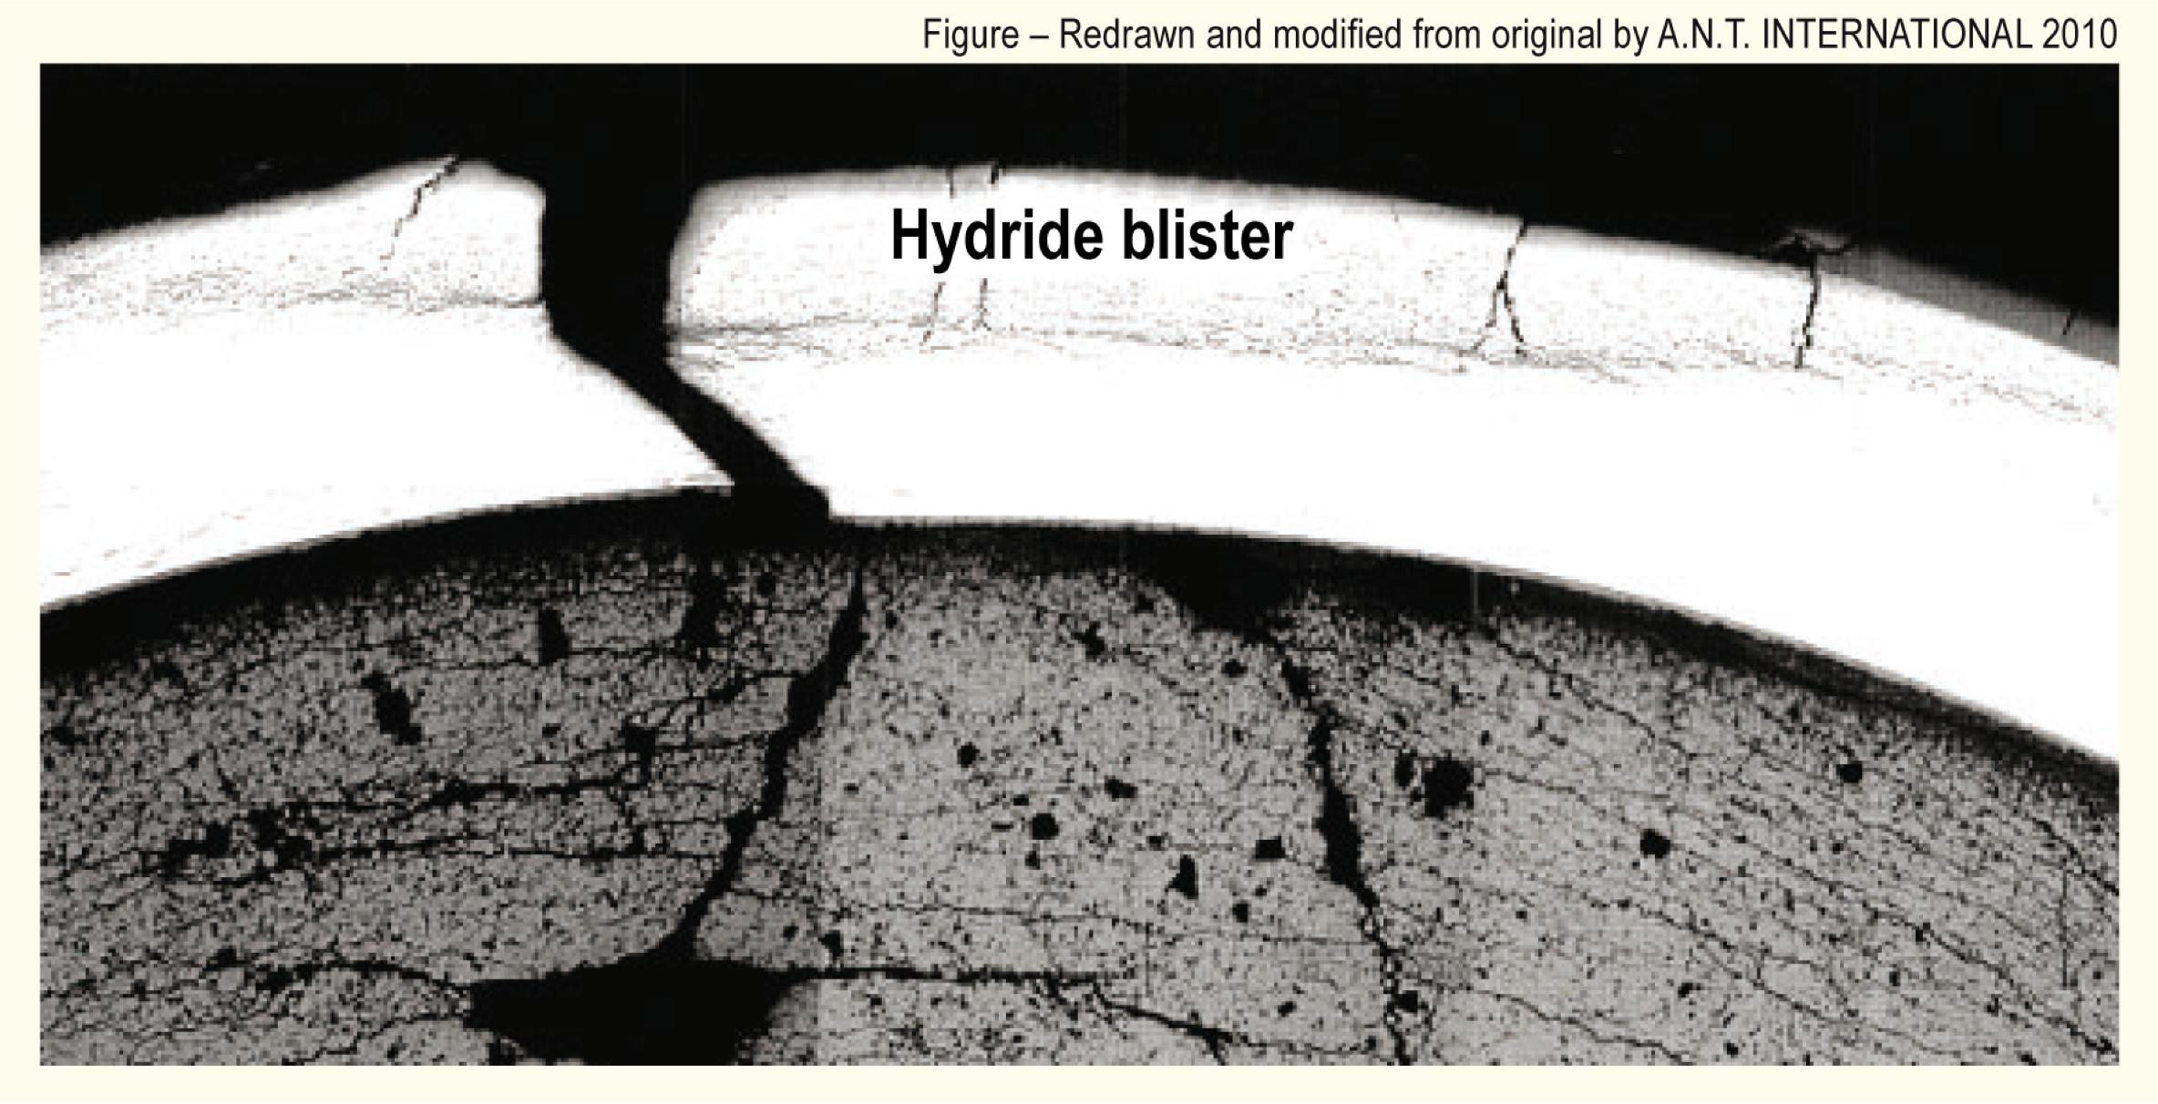
Cladding Response
PCMI failures results from the fuel pushing out on the cladding, causing it to break

Slide 18
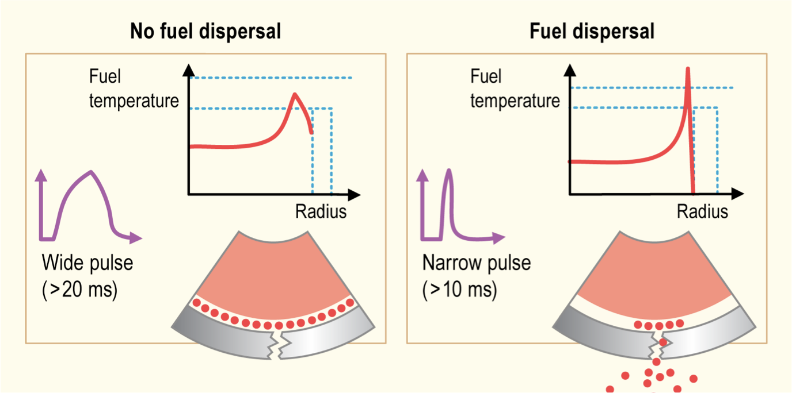
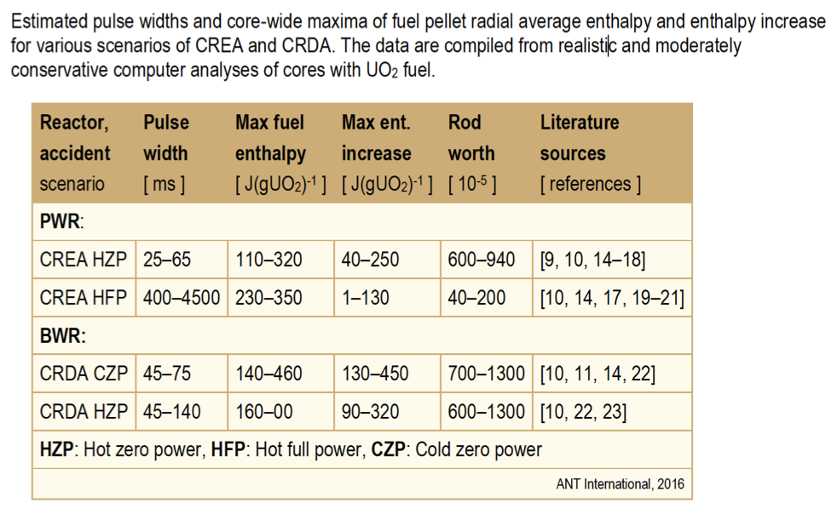
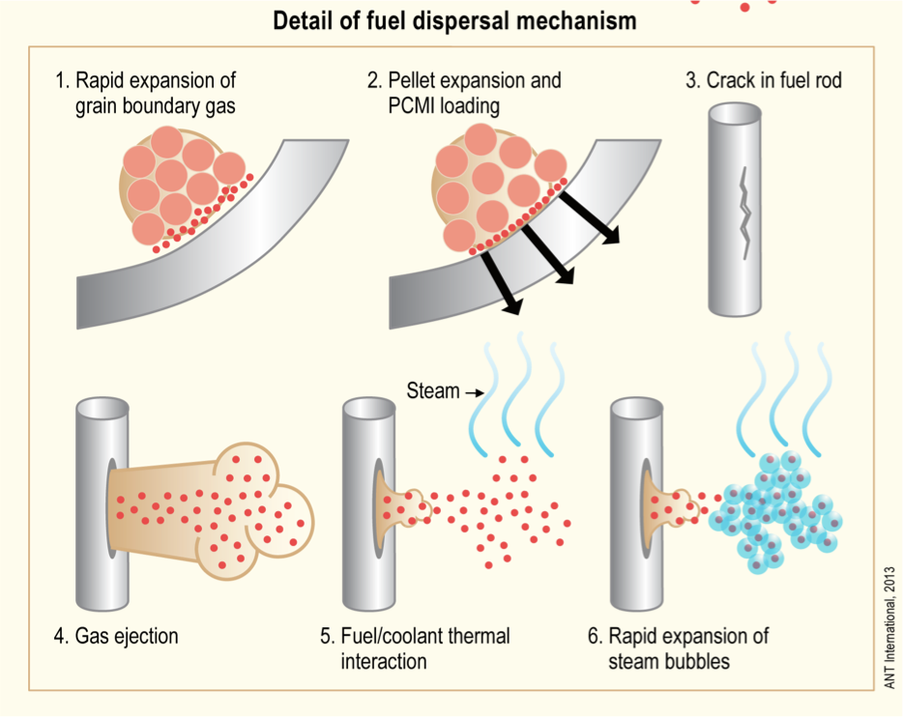
Pulse Width
The amplitude and width of the power pulse can have dramatic impacts on the effects of the RIA
Pulse is typically defined by FWHM, and by total energy deposition (integration of pulse)
More rapid temperature spike is more damaging
Reactor state and type during typical accident scenarios determine pulse width

Slide 19
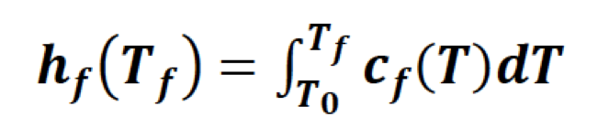
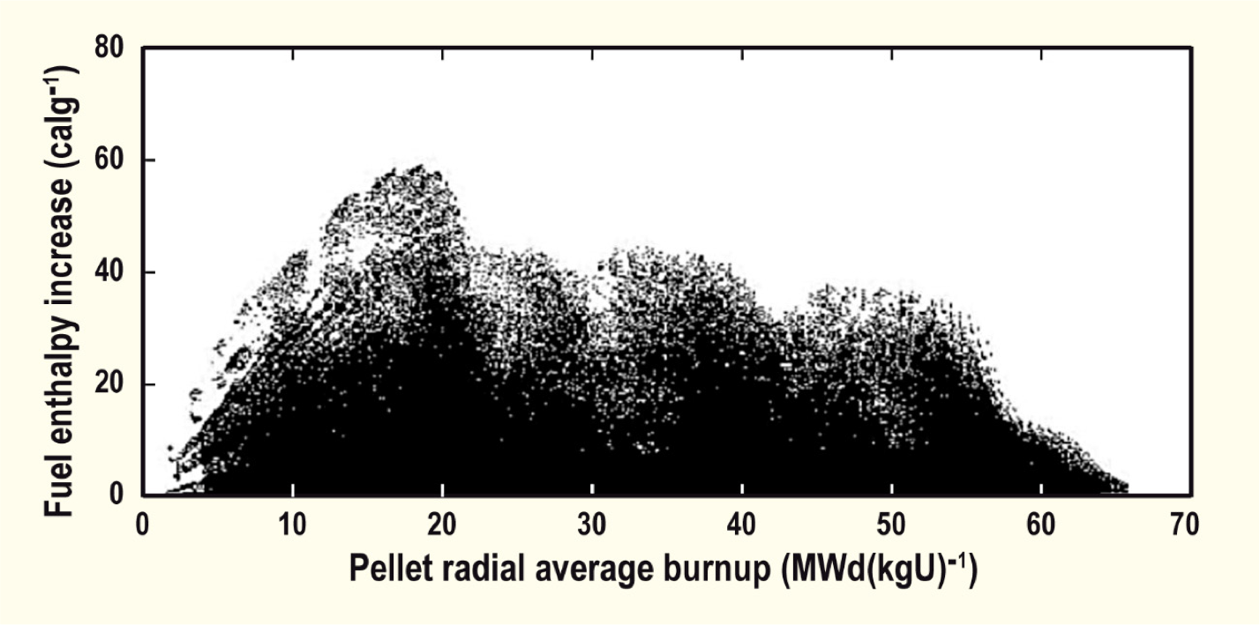
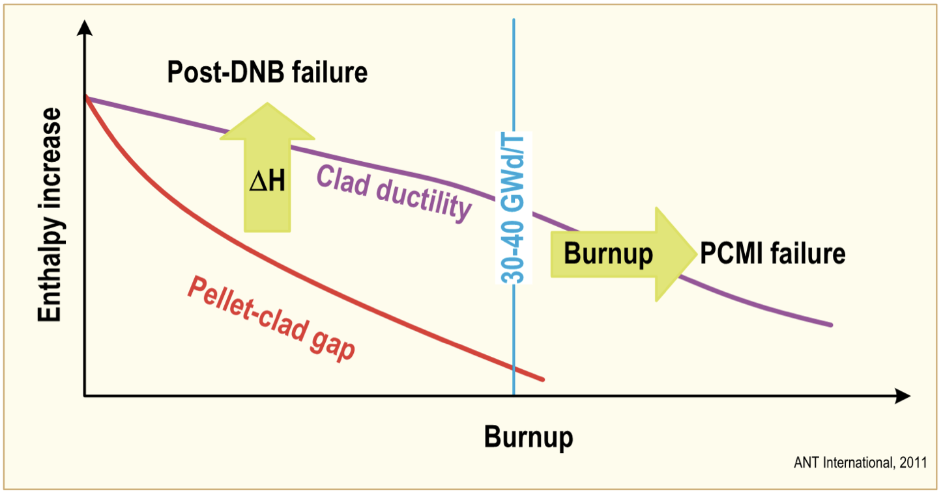
Effect of Burnup
Fuel rod damage correlates with the peak value of fuel pellet specific enthalpy; the higher the enthalpy increase, the more extensive is the damage
Fuel enthalpy increases are higher in fresh fuel
Cladding failure occurs at lower fuel enthalpy increases for irradiated than for fresh fuel rods, thus, the susceptibility to failure increases with increasing fuel burnup
The degree of cladding waterside corrosion is very important for survivability of preirradiated fuel rods
Safety criteria are defined in terms of limits on the radially averaged fuel pellet specific enthalpy, or the increase of this property during the accident

Slide 20
RIA Summary
Reactivity insertion accident
In PWR/BWR often initiated by control rod ejection/drop
Shorter pulses have greater impact than longer pulses (given same energy deposition)
Fast accident, causing temperature spike, pellet expansion, gas expansion
Can lead to PCMI or DNB failure events, and in worst case fuel ejection
Effects of RIA depend on burnup
fission gas, PCMI, oxide layer, hydrides, cladding pressure, etc.

Slide 21
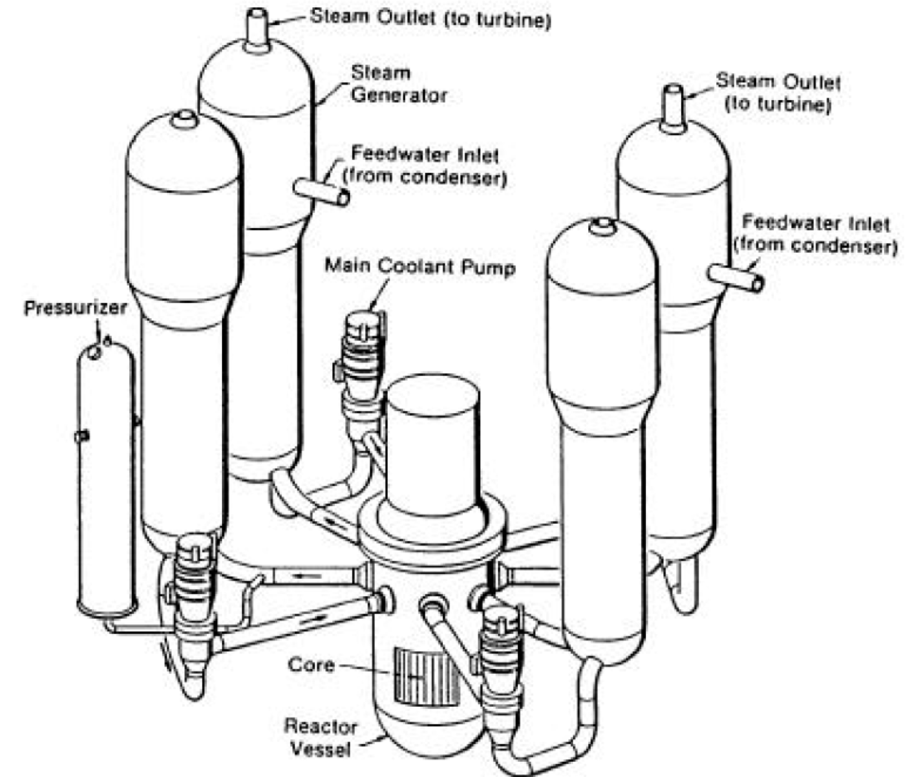
Loss of Coolant Accident (LOCA)
Design basis accident for LWRs
In a LOCA, the coolant flow is reduced or lost altogether (e.g., coolant pipe break)
When this occurs, pressure drops, engaging the emergency shutdown system
SCRAMS the reactor, stopping the fission chain reaction
The reactor water is expelled into the containment
The emergency core cooling system (ECCS) begins to remove heat
Safety requirement is to maintain a coolable geometry

Slide 22
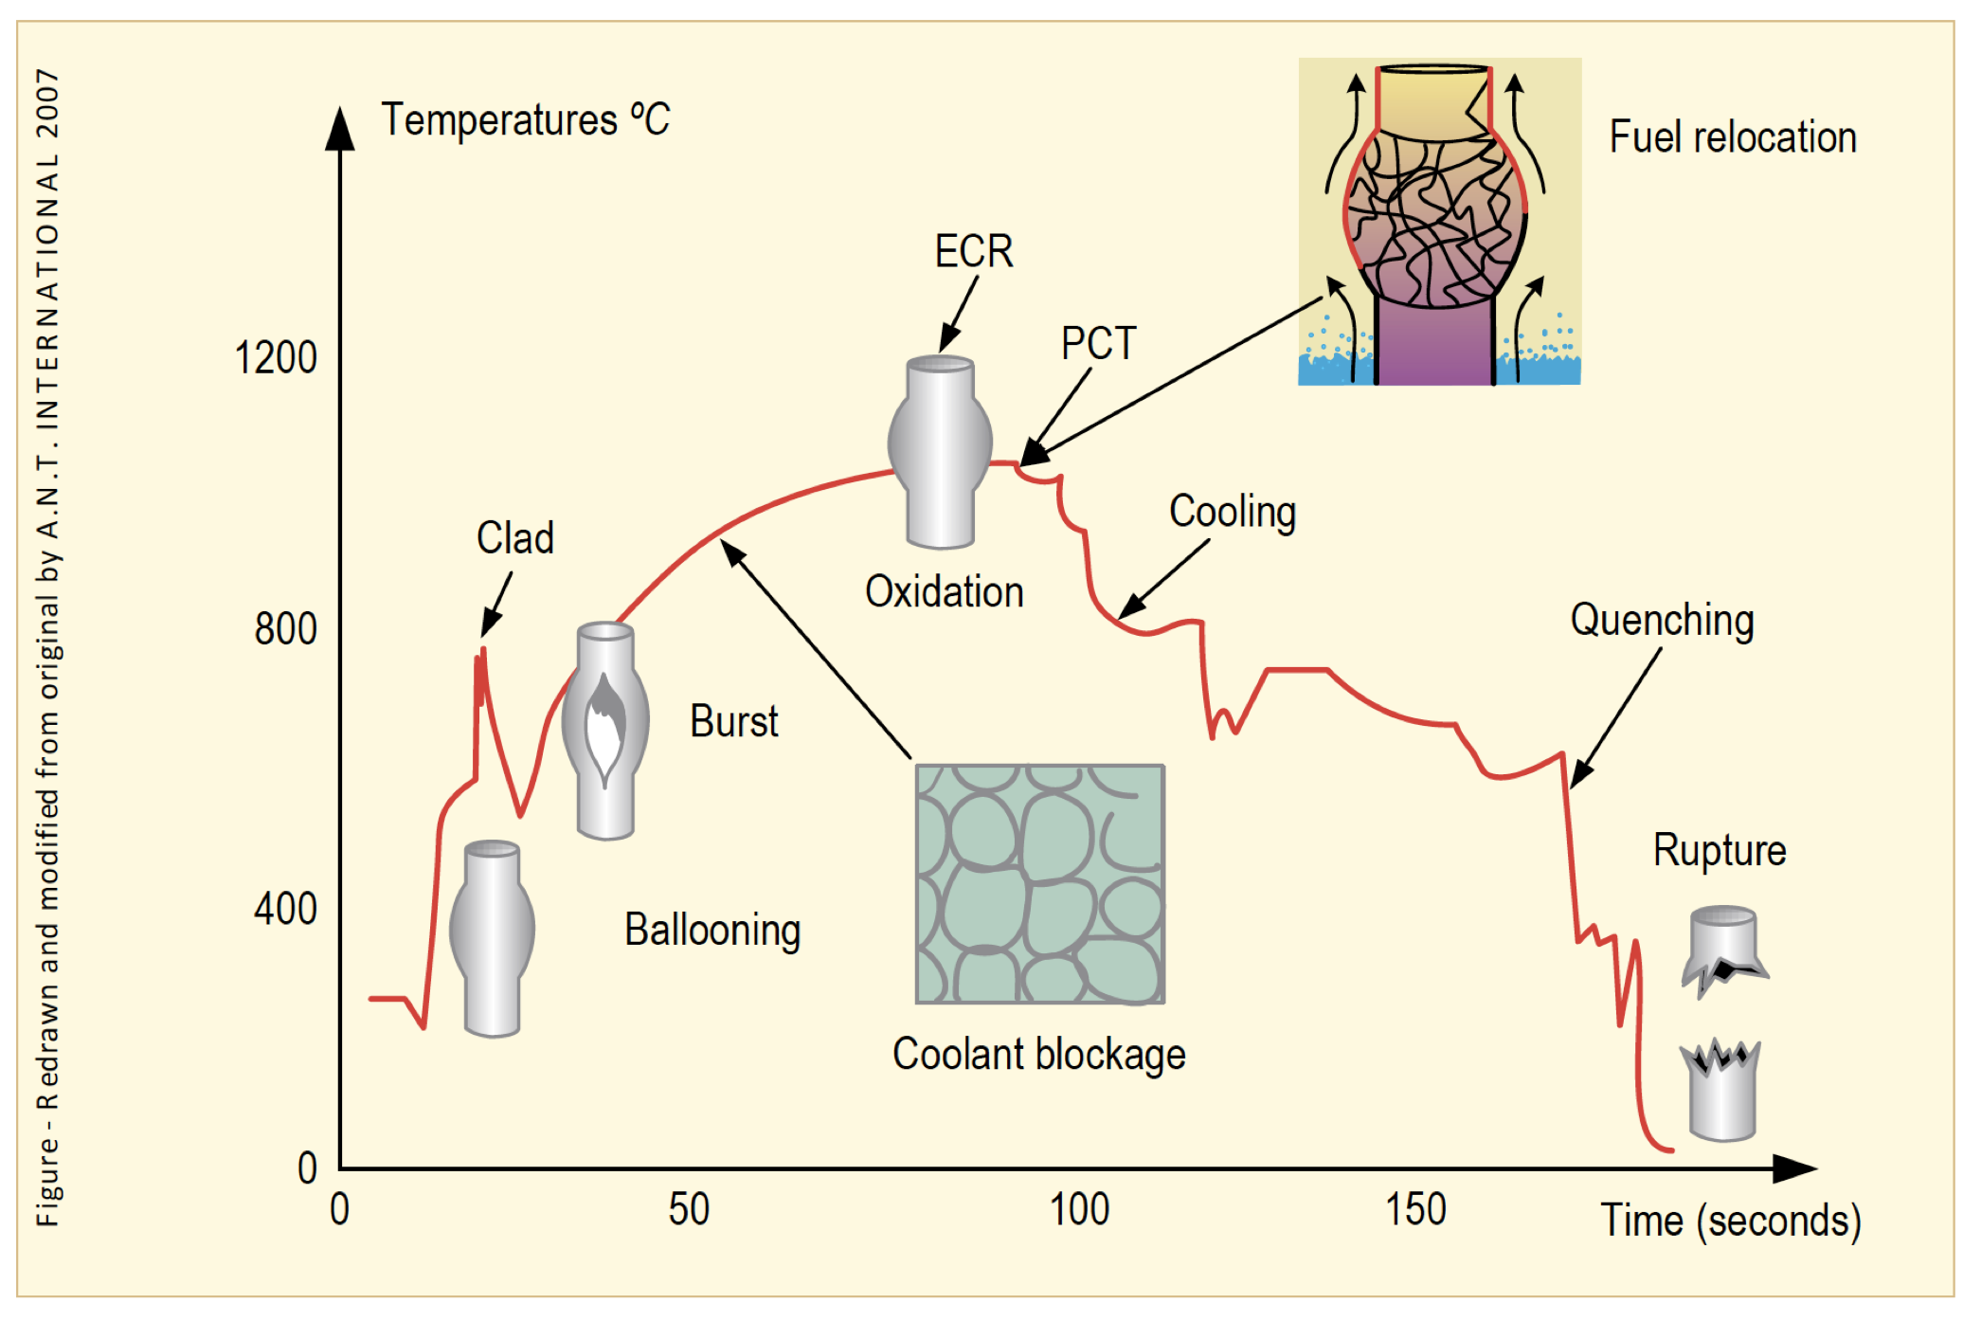
Loss of Coolant Accident (LOCA)
The average temperature of the reactor continues to rise due to radioactive decay in the fuel and the lower cooling
Decrease in coolant pressure and increase in internal pressure causes large plastic deformation
Causes the cladding to balloon out and potentially burst
Ballooning blocks coolant flow
Cladding burst is significantly impacted by oxidation and hydride embrittlement

Slide 23
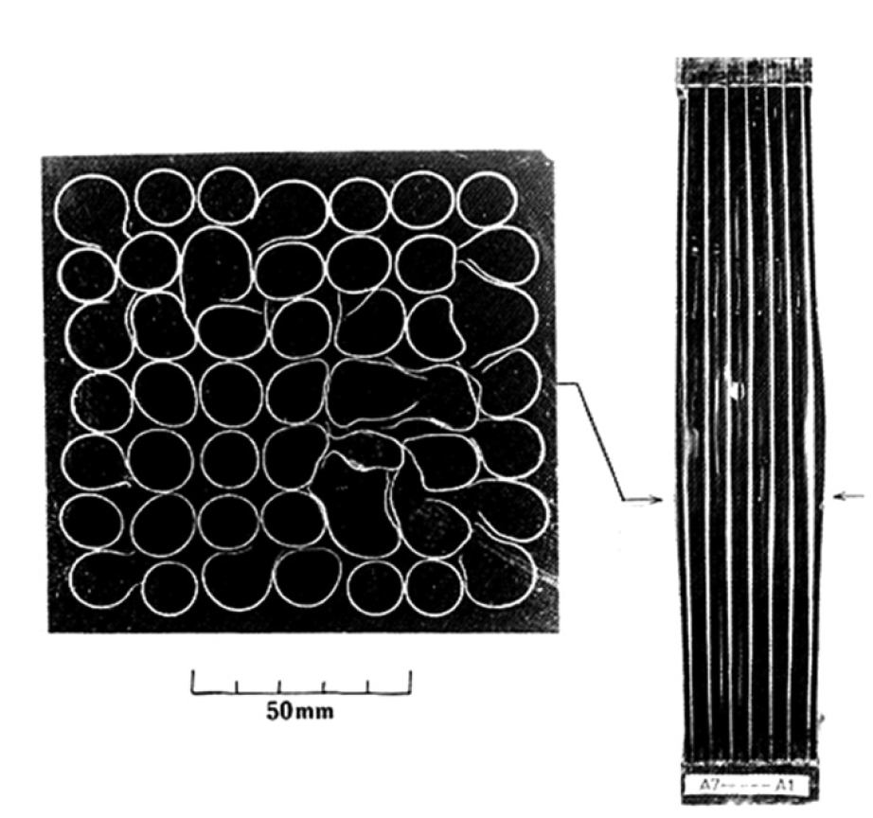
LOCA Blockages
During the heat-up, the cladding plastically deforms (balloon and rupture) due to decrease of the system pressure outside the fuel rod and decrease in cladding strength - rod pressure becomes higher than the system pressure
Creep strength of Zircaloy rapidly falls with the temperature
The beta phase has different creep properties than the alpha phase, and alpha+beta phase can exhibit superplastic behavior
Large plastic deformation of the cladding in the radial direction results in blockage of the coolant channels between fuel rods

Slide 24
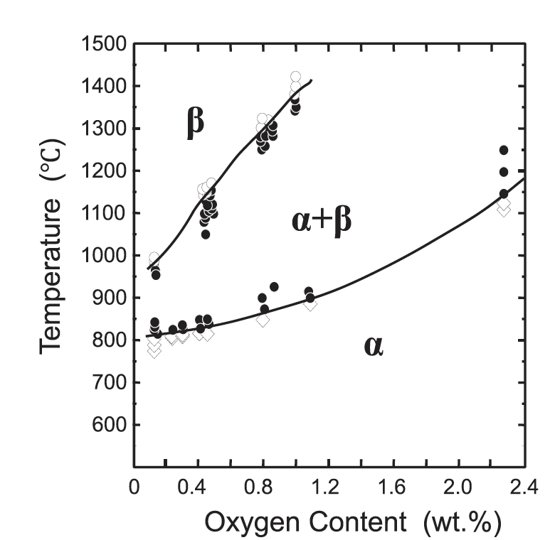
LOCA Phase Transformations
The phase structure of Zircaloy transforms from alpha to alpha+beta above about 800C, and to beta above about 1000C
The cladding reacts with steam or coolant at high temperatures, and an oxide (ZrO2) layer is formed on the surface of the cladding
In addition, absorbed oxygen stabilizes the alpha-phase and a layer of alpha-phase with a high content of oxygen begins to grow on the beta-phase, and the beta-phase becomes less ductile by the oxygen absorption

Slide 25
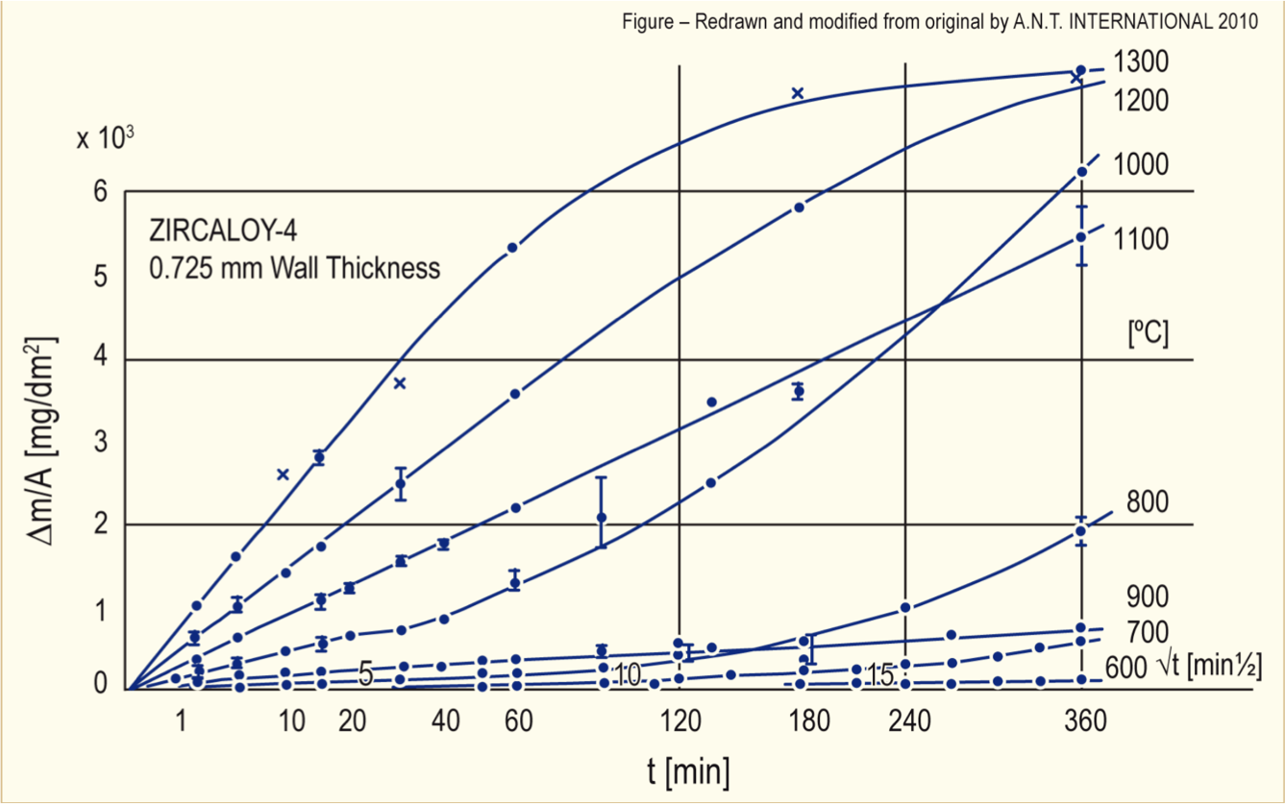
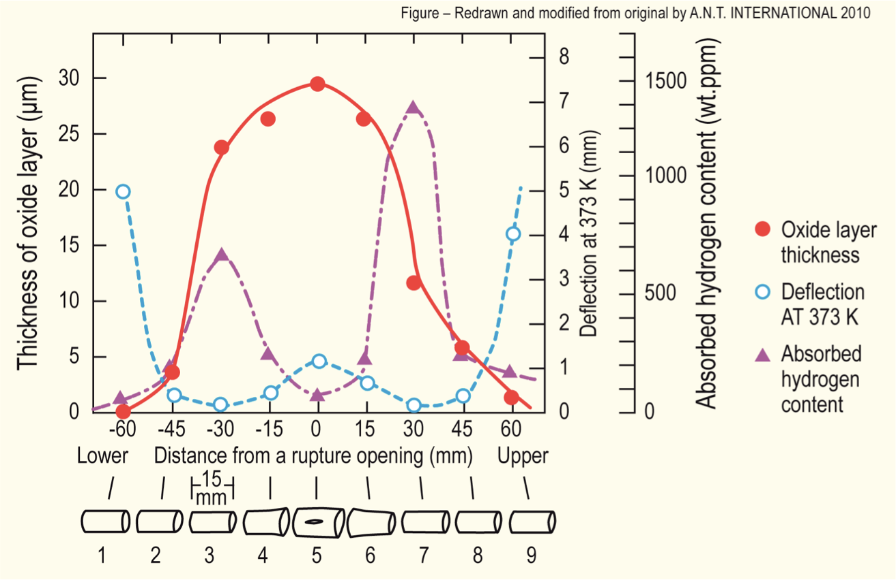
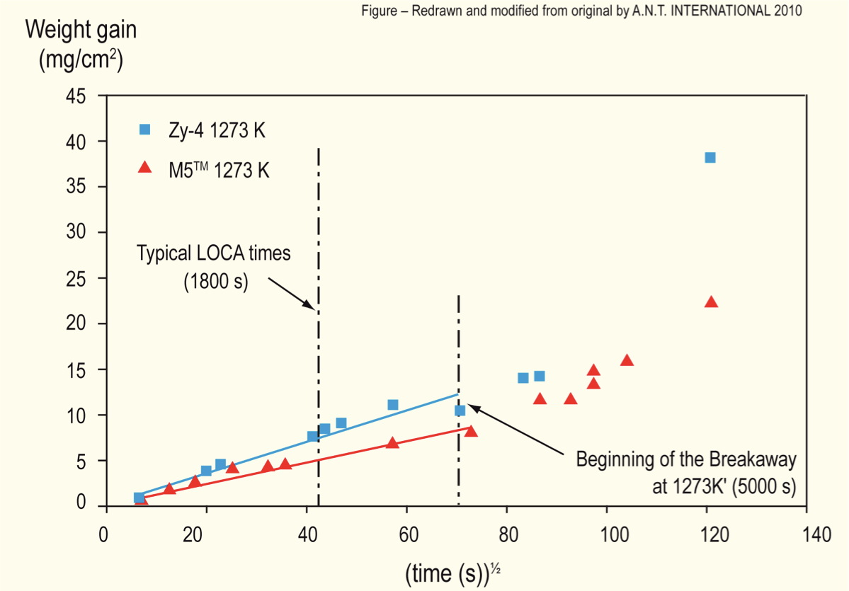
LOCA Oxidation
Oxidation significantly increases at high temperatures
Due to exothermic heat generated during oxidation of the cladding, at high enough temperatures, the rate of oxidation is so high that the heat can no longer be dissipated by cooling, leading to run-away oxidation (Three Mile Island)
Breakaway oxidation results in increased hydrogen pickup, embrittling the cladding
Excess H generation can lead to H2 gas accumulation inside the containment

Slide 26
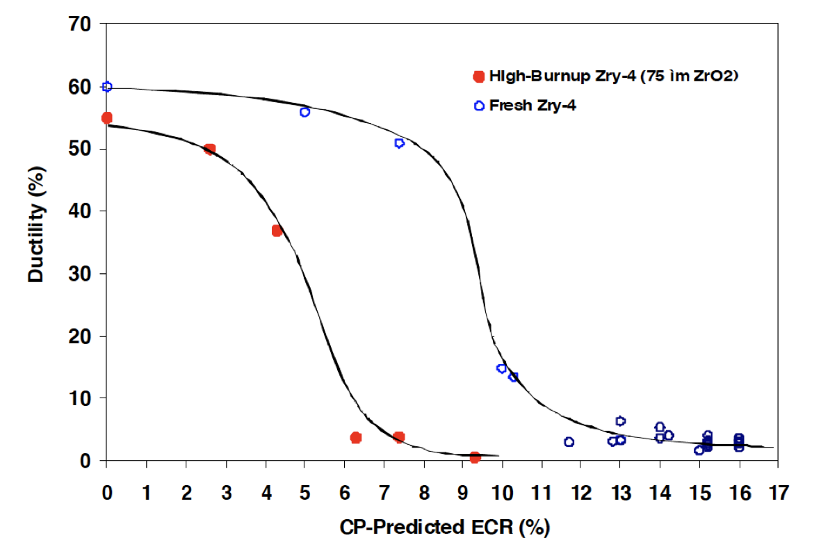
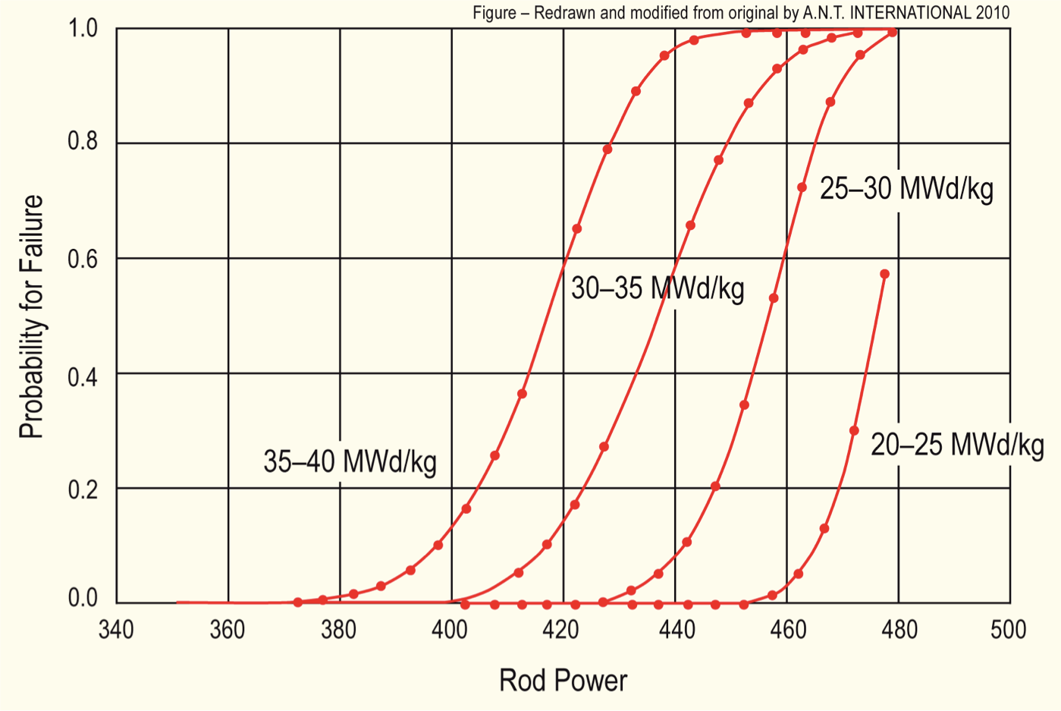
Effect of Burnup
At high burnup, ductility of the cladding is significantly reduced due to existing corrosion, hydrogen embrittlement, and irradiation hardening
This leads to higher likelihood of failure for higher burnup conditions
Alloys with lower corrosion could potentially go to higher burnup, and retain ductility under a LOCA
Similar to RIA (but more slow), temperature increases can lead to gas bubble pressure increases, fuel fragmentation, increased thermal expansion, PCMI, etc.

Slide 27
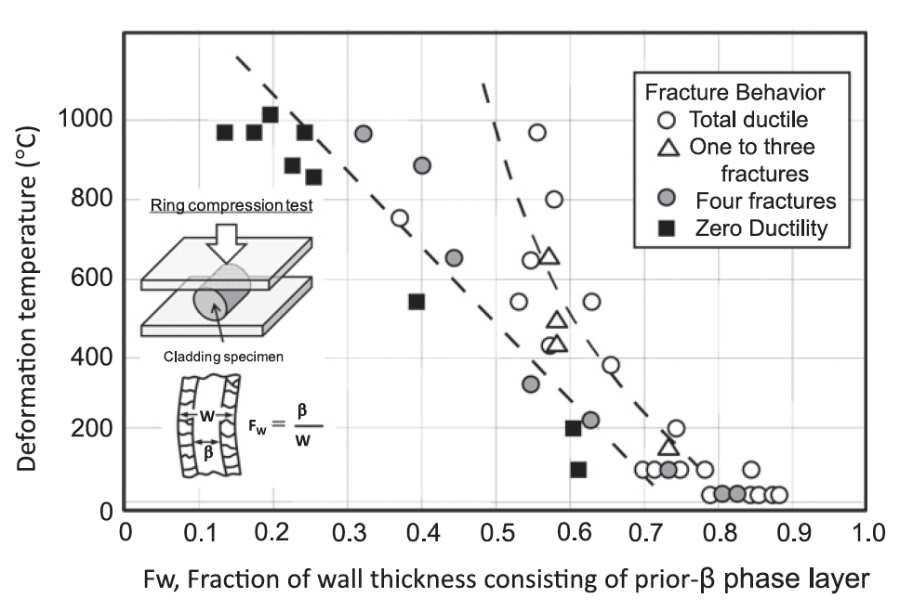
Embrittlement
On rewetting of the cladding by ECCS water, a thermal shock by quenching is induced
If the cladding is severely oxidized at temperatures above 1000C, the embrittled cladding may be fragmented by the quenching
The ductility decreases as the fraction of the unoxidized layer decreases
There are limits imposed on the amount of oxidation to limit brittle failure on ECCS quenching

Slide 28
LOCA Summary
LOCA, pipe break resulting in loss of coolant/flow
Increase in temperature, decrease in coolant pressure
High temperatures lead to increased oxidation, producing additional hydrogen, this can lead to embrittlement, ballooning, and burst of the cladding
LOCA occurs over a timescale of minutes, much longer than a RIA

Slide 29
Accident Safety Limits

Slide 30
Accident Safety Limits
Fuel cladding temperature cannot exceed 1204 C
Local cladding oxidation cannot exceed 17% of wall thickness
H generated must be less than 1% of the total amount that could be generated if all Zr were oxidized
Limits on radiation dose to staff
The response to steam oxidation, specifically on oxide growth and H generation is critical to evaluate safe performance (and potentially qualify new materials)

Slide 31
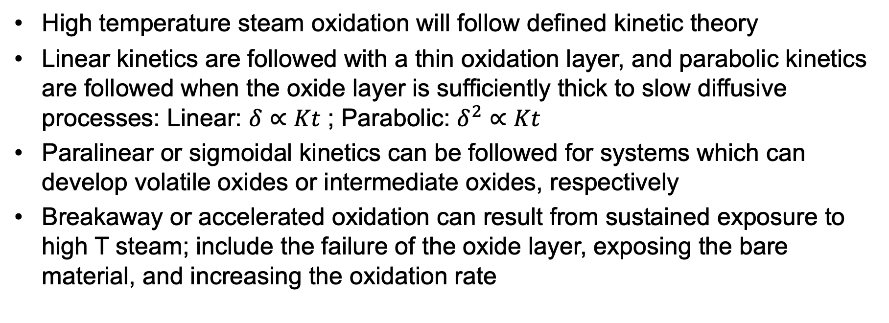
Steam Oxidation
High temperature steam oxidation will follow defined kinetic theory
Linear kinetics are followed with a thin oxidation layer, and parabolic kinetics are followed when the oxide layer is sufficiently thick to slow diffusive processes: Linear: $δ∝Kt$ ; Parabolic: $δ^{2}∝Kt$
Paralinear or sigmoidal kinetics can be followed for systems which can develop volatile oxides or intermediate oxides, respectively
Breakaway or accelerated oxidation can result from sustained exposure to high T steam; include the failure of the oxide layer, exposing the bare material, and increasing the oxidation rate

Slide 32

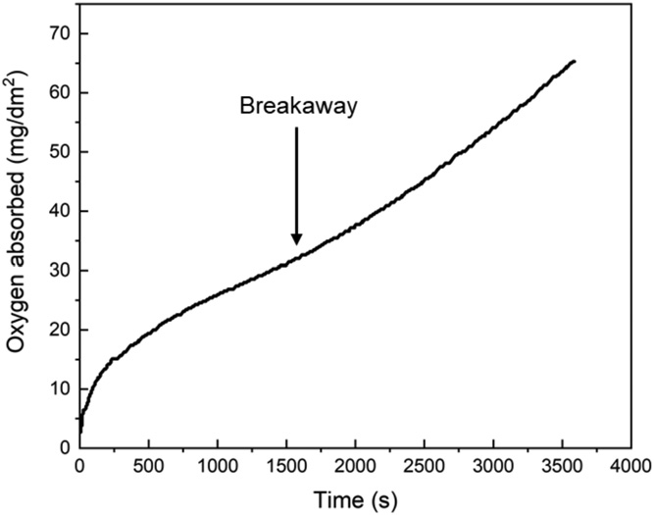
Steam Oxidation
Zr oxidizes with an exothermic reaction
Below 600C, the reaction follow a parabolic or cubic rate law resulting in a uniform and passivating oxide layer
At higher T, the oxide layer can crack due to surface stresses, resulting in breakaway oxidation
At loss of passivation, the oxidation rate can become linear and localized
Zirlo at 1000C in steam

